Slide 1
Infection Control Champions: Made ... Not Born
Ivan W. Gowe, MS, MLS(ASCP)CM, CIC
Pardee Hospital
Hendersonville, NC
Certification is Commitment
www.webbertraining.com
October 11, 2018
Notes:
1

Slide 2
Objectives
Explore how regular and paced education and development can create an Infection Control (IC) champion
Describe resources for the Infection Preventionist’s (IP) development
Understand the central role of IC certification in developing champions
Discuss the certification process
Notes:
2

Slide 3
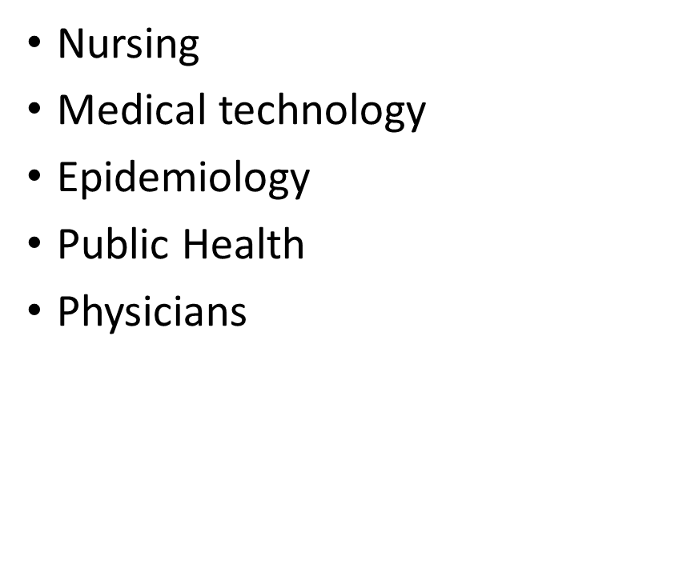
We all start somewhere

Slide 4
Resources
Certification Board of Infection Control and Epidemiology (CBIC) Core competencies
Roadmap for the Novice Infection Preventionist
Association for Professionals in Infection Control and Epidemiology (APIC) Competency Model
Certification in Infection Control (CIC)

Slide 5
Certification Board of Infection Control and Epidemiology (CBIC) Core competencies
Identification of infectious disease processes
Surveillance and epidemiologic investigation
Preventing and controlling the transmission of infectious agents
Employee/occupational health
Management and communication
Education and research
Environment of care
Cleaning, sterilization, disinfection, and asepsis

Slide 6
Roadmap for the Novice IP
APIC resource
Aimed at first time IP
Details necessary tasks and skills for the first two years
Broken down by CBIC core competency
Systematic, exhaustive
A useful assessment tool for the seasoned IP

Slide 7
Roadmap for the Novice IP
Stage 1 verbs (Days 0-60)
Familiarize/Locate/Identify
Assess/Review
Introduce/Subscribe/Meet
Stage 2 verbs (Days 61-120)
Learn/Continue
Understand/Differentiate
Develop/Utilize/Contribute

Slide 8
Roadmap for the Novice IP
Stage 3 verbs (Days 121-365)
Network/Participate/Facilitate
Reassess/Review
Create/Incorporate/Perform/Monitor
Stage 4 verbs (Year 2-CIC)
Volunteer
Prepare
Explore

Slide 9
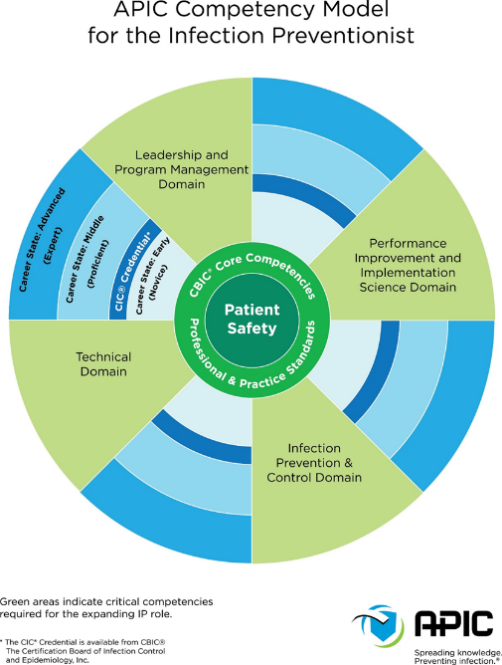

Slide 10
Certification

Slide 11
Why Certify?
Reaffirms that through study and hard work, certificants attain an internationally recognized level of knowledge in the infection prevention and control field
Supports future knowledge and skills
Enhances professional credibility and prestige
Grants personal satisfaction

Slide 12
Objectives of Certification
Provides standardized measure of current knowledge required for persons practicing infection prevention and control
Encourages individual growth and study, thereby promoting professionalism
Formally recognizes professionals in infection prevention and control who fulfill the requirements for certification and recertification

Slide 13
Why The CIC®?
Represents commitment to continual improvement of infection prevention and control functions and their contribution to healthcare and patient safety
Fosters a recognized professional community that helps to reduce infections in healthcare settings
Moves the profession forward

Slide 14
What is CBIC?
Voluntary, independent, multidisciplinary Board
Mission: To protect the public through the development, administration and promotion of an accredited certification in infection prevention & control. CBIC maintains and promotes professional certification of the highest quality through the accomplishment of key objectives.
Notes:
14
14

Slide 15
What is CBIC?
Established by the Association for Professionals in Infection Control and Epidemiology, Inc. (APIC) in 1981; CBIC is an affiliate of APIC
Accredited by the National Commission for Certifying Agencies (NCCA)
Member of the Institute for Credentialing Excellence (ICE), formerly National Organization for Competency Assurance (NOCA)
Notes:
15
15

Slide 16
Board Composition (Minimal Requirements per Bylaws, 2014)
Medical Doctor: (1)
Medical Technologist: (1)
RNs: (3)
Canadian Infection Preventionist (IP): (1)
IP non-hospital setting: (1)
IP long-term care setting: (1)
IP 4 years or less experience as IP: (1)
Public Consumer*: (1)
* All but consumer director & administrator must be CIC®
Notes:
16
16

Slide 17
CBIC Strategic Priorities
Maintain and improve the accredited certification program
Increase recognition/value of certification
Increase the number of certified IP/ICPs
Establish/maintain partnerships with APIC, IPAC Canada and other organizations to accomplish goals
Notes:
17
17

Slide 18
The Application
Certification

Slide 19
Eligibility Requirements
Accountable for infection prevention and control activities in your setting, reflected in your job description
Includes, but is not limited to hospitals, ambulatory surgery centers, long-term care facilities
Have a post-secondary degree
Associate’s degree or higher
Diploma RNs if applying before Dec 31, 2020
Sufficient experience in Core competencies
Recommend at least two years

Slide 20
Eligibility Requirements
Sufficient experience (recommended: two years) in all three (3) of the following core competencies:
Identification of infectious disease processes
Surveillance and epidemiologic investigation
Preventing and controlling the transmission of infectious agents
While there is no specific time requirement that defines “sufficient experience”; the certification examination is geared toward the professional who has had at least two years of full-time experience in infection prevention and control.

Slide 21
Eligibility Requirements
And at least two (2) of the remaining five (5) components:
Employee/occupational health
Management and communication
Education and research
Environment of care
Cleaning, sterilization, disinfection, and asepsis

Slide 22
Eligibility for Certification
Candidates who are self-employed must submit additional documentation (See Candidate Handbook on our website for details)
Individuals who are currently certified are automatically eligible for recertification every 5 years.
Eligibility for Recertification
Notes:
22

Slide 23
Lapsed Certification
If you fail to recertify when you are due and later decide that you would like to, you:
Must meet the criteria for initial certification
May no longer be eligible if you have changed positions to one where infection control is NOT your main area of responsibility
Notes:
23

Slide 24
Applying for the Certification Examination
Ensure eligibility requirements are met
Review the Candidate Handbook for additional information, applications and suggested reference materials
Apply online at www.cbic.org or submit a paper application to the CBIC office
Notes:
24

Slide 25
The Examination
Certification

Slide 26
Developing the Test
Practice Analysis
Content Outline
Question (Item) Development
Test Run Questions (Items)
Establish Cut/Pass Scores
Completed Test
Estimated timeline 18-24 months

Slide 27
Developing The Test
Practice Analysis
Content Outline
Question (Item) Development
Cut (Pass) Scores
Test
Survey
Development
Distribution
Analysis
~ q 5 years
2014 (15.7% response rate)
Based upon findings of practice analysis survey
Revise content specifications
Submission new question (item) with references
Reviewed & edited by Test Committee
Test run for stats
Passing scores calculated to account for question (item) difficulty and differences between examinations
Equated, validated
Checked for similarities & cues
4 Initial Cert Exams
2 Recert Exams
Analysis

Slide 28
Test Questions
Each content area includes test questions that target different cognitive levels:
Recall (simple recall or recognition)
Application (comprehension, interpretation or manipulation of concepts/information)
Analysis (integration of a variety of concepts, problem solving, making judgments)

Slide 29
Sample Question: Recall
In investigating an epidemic, cases should be categorized according to:
A. time, place, and person. B. agent, host, and environment. C. agent, host, and date of onset. D. time, person, and date of onset.
Answer: A

Slide 30
Sample Question: Application
The lengths of stay for patients with nosocomial infections are 12, 12, 12, 13, 15, 15, 16, 20, and 30 days. What is the median length of stay?
A. 12 days B. 15 days C. 16 days D. 25 days
Answer: B

Slide 31
Sample Question: Analysis
The risk of healthcare associated urinary tract infections in spinal cord injury patients is BEST reduced by:
A. prophylactic antibiotics. B. bladder instillation of antiseptic. C. intermittent catheterization. D. placement of all patients with urinary catheters in the same area.
Answer: C

Slide 32
Validity of the Certification Examinations
Exams based on practice analysis to ensure content is current, practice-related and representative of the responsibilities of infection prevention and control professionals
The practice analysis, examination development and examination process adhere to nationally recognized standards for validation, educational, and psychological testing
Notes:
32

Slide 33
Validity of the Certification Examinations
Developed under the guidance of a psychometrician and test development specialist from an independent testing agency
The testing agency oversees scoring of the examination
Each test question undergoes both expert and statistical scrutiny before use
Notes:
33

Slide 34
Validity of the Certification Examinations
Passing scores are determined for each version of the test to ensure equivalency between the different forms at all times
Acknowledged by The Joint Commission as an important element of an effective infection control program
Notes:
34

Slide 35
Confidentiality of Examination Scores
Both CBIC and Prometric (testing company) maintain complete confidentiality of individual test scores
Only summary statistics are provided at open forums and published periodically in the infection prevention and control literature

Slide 36
Methods of Certification & Recertification
Initial certification:
Proctored initial certification examination
Recertification:
Self-paced, open book recertification examination*
*If candidate fails the recertification examination, they must take the proctored certification examination
Certification/recertification is valid for 5 years

Slide 37
Certification Examinations
Comprehensive, job-related, objective tests
150 multiple choice questions; 135 of which are scored
Developed from a practice analysis of Infection Prevention and Control Professionals in the U.S., Canada and other countries
Recognized by APIC and IPAC Canada as the standard for certification in infection control
French-Canadian exam available
Recognized by TJC as a measure of competence

Slide 38
Certification Examinations
Aligned with recognized practice standards for Infection Control and Healthcare Epidemiology
The only standardized measurement of essential knowledge, skills, and abilities expected of infection prevention and control professionals in North America
All content is applicable to multiple healthcare settings
International testing centers
ALL examination questions are the copyrighted property of CBIC

Slide 39
Initial Examination
Proctored examination
Required for initial certification
Administered at assessment centers throughout the United States, Canada and other international sites
90-day window from application approval to exam completion
Notes:
39

Slide 40
Recertification Examination
Self-administered (non-proctored), multiple choice, internet-based from any location
Questions are based on the most current CBIC practice analysis
The purpose of the recertification examination is to demonstrate continued knowledge mastery in the field of infection prevention and control

Slide 41
Recertification Examination
Unlimited access before submission
Must be done alone; do not discuss with colleagues
Deadline to purchase: December 1
Deadline to submit: 11:59pm GMT/6:59pm EST on December 31* (same calendar year)
*CBIC strongly recommends submitting the recertification no later than December 30th to be sure that the exam is submitted successfully in time.
The sooner you purchase the exam, the more time you have to complete it!
Notes:
41

Slide 42
The Preparation
Certification

Slide 43
Preparing for the Examination
Current Content Outline
Content Domain | Items
Identification of Infectious Disease Processes | 22
Surveillance and Epidemiologic Investigation | 24
Preventing/Controlling the Transmission of Infectious Agents | 25
Employee/Occupational Health | 11
Management and Communications | 13
Education and Research | 11
Environment of Care | 14
Cleaning, Sterilization, Disinfection, Asepsis | 15

Slide 44
Preparing for the Examination
Assess Core Competencies for your strengths and weaknesses
Create a study plan
Review reference material (as listed in the candidate handbook), journals and standards, including APIC and IPAC Canada’s Practice Standards
Form/join a study group amongst your peers
Contact your local APIC or IPAC Canada chapter for support.

Slide 45
Preparing for the Examination
Listen to our webinars
“Road to CIC Certification” https://webbertraining.com/recordingslibraryc4.php
"How to Prepare for the CIC exam” http://www.cbic.org/certification/media
Take the practice exam
Review practice questions on CBIC social media

Slide 46
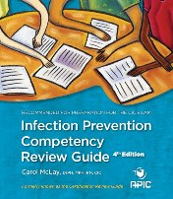
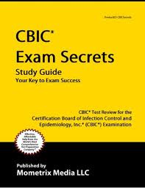
CBIC neither produces nor endorses products or materials related to preparing for the certification examination.
Notes:
46
46

Slide 47
Exam References
Primary References:
APIC Text of Infection Control and Epidemiology, 4th ed., Volume I, Volume II and Volume III, APIC, Washington, DC, 2014.**
Kulich P, Taylor D, eds. The Infection Preventionist’s Guide to the Lab, APIC, Washington, DC, 2012.
Heymann, D., ed. Control of Communicable Diseases Manual, 19th ed., Washington, DC: American Public Health Association; 2008.
Brooks, Kathy. Ready Reference for Microbes, 3rd ed., APIC; 2012.

Slide 48
Exam References
Secondary References:
Current Recommendations of the Advisory Committee on Immunization Practices (ACIP).
Current guidelines, standards, and recommendations from CDC, APIC, SHEA, and Public Health Agency of Canada.
Pickering, Larry K, ed. Red Book, 29th ed., Elk Grove Village, IL: American Academy of Pediatrics; 2012.
**The 2015 recertification examination was written using the 3rd edition of the APIC Text of Infection Control and Epidemiology, Volumes I and II.

Slide 49
Resources
Check CBIC Web site www.cbic.org for:
Online Candidate Handbook (all application and order forms for the examinations are included)
Background information on CBIC and the certification process
Notes:
49

Slide 50
What next?
Certified

Slide 51
Use of the CIC® Credential
Only individuals who have successfully passed the proctored, initial certification examination and have maintained current certification, through the recertification examination* may use the CIC® credential.
The CIC® credential may be used on resumes, business cards, letterhead, and other professional communications.
The CIC® credential may not be used for product or other endorsements.
*CICs may maintain certification through the proctored examination, only if they receive a failing score on the recertification exam.
Notes:
51
51

Slide 52
From Certified to Champion
Volunteer – APIC, IPAC-Canada, CBIC boards, committees
Attend/present at education conferences
Mentor
Network
Research
Review
Notes:
52
52

Slide 53
Resources
Association for Professionals in Infection Control and Epidemiology (APIC)
1275 K St., NW Suite 1000
Washington, DC 20005 (202) 789-1890 www.apic.org
Infection Prevention and Control Canada (IPAC Canada)
PO Box 46125 RPO Westdale Winnipeg, MB R3R 3S3 (866) 999-7111
www.ipac-canada.org

Slide 54
Resources
CBIC Executive Office:
555 East Wells Street
Suite 1100
Milwaukee, WI 53202
Phone: (414) 918-9796
Fax: (414) 276-3349
Web site: www.cbic.org
Testing Company:
Prometric
Phone: (800) 278-6222 (toll free U.S., U.S. Territories, and Canada)
Website: www.prometric.com/cbic
Notes:
54

Slide 55
