Slide 1
Infection Control in Paramedic Services
Jennifer Amyotte Commander of Community Paramedicine & Professional Standards City of Greater Sudbury Paramedic Services
Hosted by Greg Bruce
County of Simcoe Paramedic Services
www.webbertraining.com
October 26, 2017

Slide 2
Disclosure
I disclose, I have no potential or direct conflict of interest.
This presentation contains my observations, knowledge and does not necessarily reflect the opinions of my employer the City of Greater Sudbury Paramedic Services.

Slide 3
Overview
Challenges
Paramedic Knowledge
Research
Point of Care Risk Assessment
Personal Protective Equipment
Moving Forward
Questions
References

Slide 4
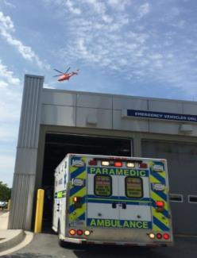
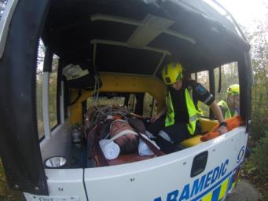
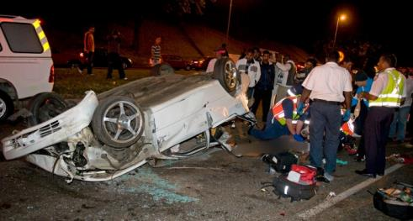
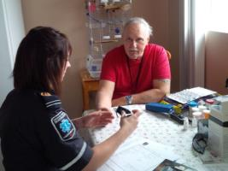
Challenges
Here is a place holder for the text. The coins on this page can be removed. You may delete this text.

Slide 5
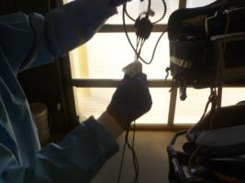
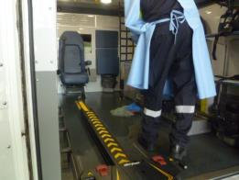
Challenges
Expected rapid “turn around time” to get back into service following transfer of care at ED.

Slide 6
Spaulding Classification System
Studies have determined bacterial pathogens in ambulances on sample collections grew skin and environmental flora.
Paramedics and health care workers may carry staph as part of skin flora in fact a study published in JEMS October 2015 determined Paramedics are 10x higher risk of carrying MRSA if they don’t wash their hands after removing their gloves.
The higher rate of colonization than the normal population can lead to the bacteria being found in ambulances

Slide 7
Cleaning Process
Established process/policy
Checklist, cards for reference
Proper product
Clean to dirty
Use PPE as required
No spray bottles
Ensure wet contact time as per product requirements

Slide 8
Paramedic Knowledge
Canada : formal in College,
In Ontario approx. 4-6 hrs brief education based on National Occupational Competency Profile (NOCP) for Paramedics
Service Providers:
Limited time to provide ongoing training, varied depending on the service, operational demand and current focus ie Ebola, H1N1, SARS
Ontario mandatory: “Designated Officers”
IPAC CANADA
Very few services have “Infection Control Practitioners” or staff members Certified in Infection Control “CIC”

Slide 9
Research
Australian Journal of Paramedicine (2017) Nigel Barr, Mark Holmes, Anne Roiko, William Lord
Stated relatively little research about transmission of pathogens in pre-hospital setting.
Concludes that the mobile paramedic environment presents unique challenges to provide recommended IPC practices, and targeted research into staff compliance is required to identify barriers and enablers to increase the uptake of IPC practices.
Reports suggest paramedics have limited understanding of infectious disease that may demonstrate poor compliance with infection prevention and control protocols when caring for patients.

Slide 10
EMS Provider Compliance with Infection Control Recommendations is Suboptimal
Study done in USA.
Published in Prehospital Emergency Care 2014
Observational study in large ED
423 EMS deliveries observed
899 providers
Use of gloves in 512 (56.9%)
Hand washing observed in 250 (27.8%)
Equipment disinfections 31.6 %
Most commonly disinfected item was the stretcher
Determination IPAC practice suboptimal and strategies
must be developed to improve compliance with
established recognized guidelines

Slide 11
Aseptic procedure always possible in Paramedic Practice?
Aseptic/no touch
Emergency situations
Best practice IV
palpate vein, HH, clean the site, let skin dry 30 seconds, prepare equipment, HH, don gloves, DO NOT REPALPATE VEIN, insert cannula, secure with sterile op site,
situation requiring may prevent all steps being taken.
In the UK medics notify staff so cannula can be replaced ASAP (within 24 hrs)
Emergency Intubation in the field with aspiration prior or during procedure increases risk of VAP. Highest in Trauma patients. American Study 2015

Slide 12
Point of Care Risk Assessment
Purpose: to assess and reduce risk of transmission of microorganisms and determine appropriate actions/precautions possible PPE requires to provide safe interaction with patient and/or environment : WHAT IS MY PURPOSE/TASK?
Done as approaching patient – look for possible risks of exposure to blood, body fluids, excretions, secretions, mucous membranes, non intact skin.
Perform hand hygiene before touching patient or donning gloves if required
Verbal ARI risk tool as required- fever, cough, travel history
Look for rashes, hx diarrhea, vomiting, draining wounds/cellulitis

Slide 13
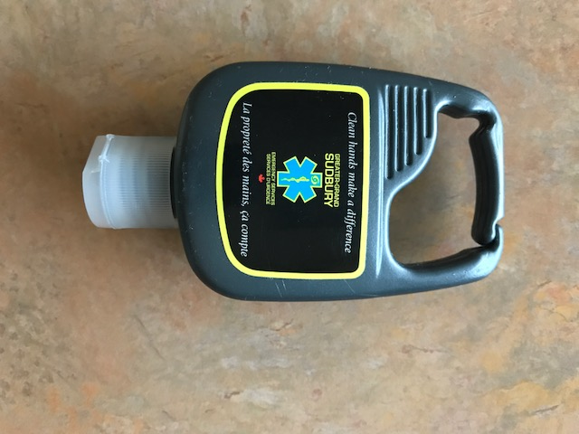
Point of Care Risk Assessment
Determine if require contact and/or droplet precautions - fluid splash, respiratory secretions
Don a gown if uniform is likely to become contaminated during direct patient care or from environment
Ensure to perform hand hygiene
Ensure to pre- notify receiving facility if transporting patient with suspected communicable disease

Slide 14
PPE
Designed to go over scrubs, can present a challenge to medics
Used as a barrier to assist in preventing exposure
Must be readily accessible
Must be appropriate size
Should be put on just before interaction with patient based on point of care risk assessment and/or signage knowledge ( ie. transfer)
Selection of PPE depends on mode of transmission

Slide 15
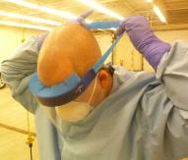
PPE
When interaction with patient is concluded , PPE should be removed and discarded appropriately
Contaminated PPE must NEVER be worn in driver’s cab
Regular education and review of donning and doffing of PPE must be provided
Fit testing of Respirators required, paramedics must be trained in use
Gowns/coveralls – consider fluid resistant
Eye protection- personal issue and/or disposable

Slide 16
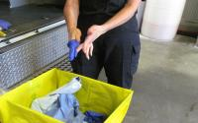
Gloves
Paramedics often wear gloves for a “whole call” only changing if ripped or visibly soiled
DO NOT wear gloves for routine health care activities in which contact is limited to in tact skin of patient
Wear gloves when it is anticipated that the hands will be in contact with mucous membranes, non-intact skin, tissue, blood, body fluids, secretions, excretions, or equipment environmental surfaces contaminated with the above
GLOVES ARE NOT REQUIRED ON EVERY CALL

Slide 17
PPE Enhanced Precautions

Slide 18
Moving Forward
Canadian Paramedic Services Standards Report 2014 – Identified IPAC as one of the top 5 priority areas as a strategic recommendation for the path forward
Review your program with Infection Control Standards – IPAC has one for Canada also an Audit toolkit for Prehospital for members
Immunization Protocols for all first responders starting with Paramedics
Further the education of paramedics and increase number of Infection Control Professionals in services
Increase network of Paramedic ICPs , Canada , USA– potential of Prehosptial Interest Group globally
If you do not have service expertise seek assistance from IPAC Canada, Local Hospital ICPs, Public Health

Slide 19
References
National Occupational Competency Profile for Paramedics Area 3: Health & Safety 3.3 f
Routine Practices & Additional Precautions in all Healthcare Settings Public Health Agency Canada 2013
Routine Practices & Additional Practices in all Healthcare Settings Public Health Ontario 2012
A qualitative exploration of infection prevention and control guidance for Australian paramedics Australian Journal of Paramedicine volume 14/Issue3/Article
EMS Provider Compliance with Infection Control Recommendations is Suboptimal Prehospital Emergency Care Volume 18, 2014 – Issue 2
Prehospital Aspiration is Associated with increased Pulmonary Complications Surgical Infections April 7, 2015
Exposure of Emergency Service Workers to Infectious Diseases Protocol Province of Ontario 2008
Environmental Cleaning and Disinfection for Emergency Vehicles IPAC Canada Practice Recommendations – May 2014

Slide 20
References
9 A Rational Approach to Ambulance Cleaning and Disinfection Practices Mary Ann Miller Jack Wagner April 2014
10. Best Practices for Environmental Cleaning for Prevention and Control of Infections in all Health care Settings -2nd edition Public Health Ontario - PIDAC May 2012
Self-reported behaviors and perceptions of Australian paramedics in relation to hand hygiene and gloving practices in paramedic-led health care AJIC July 2017
IPAC Canada https://ipac-canada.org/about-ipac-canada.php
Canadian Paramedic Services Standards Report : Strategic Planning Report Paramedic Standards Steering Panel March 2014
Infection Prevention and Control Program Standards IPAC Canada

Slide 21
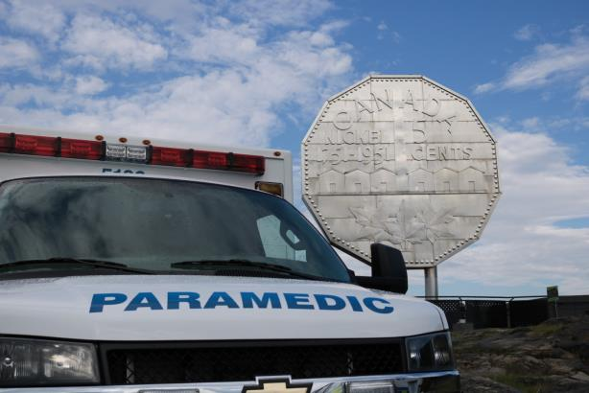
Questions?
Thank you
jennifer.amyotte@greatersudbury.ca

