Slide 1
Control of nosocomial Infection in pediatrics
SH. Armin
Associated professor of Shaheed Beheshtee University
Hosted by Paul Webber
paul@webbertraining.com
www.webbertraining.com
July 16, 2019

Slide 2
Learning objective
What is the nosocomial infection/Health care associated infection(HCAIs)?
What is the Impact of HCAIs on Health system?
what are the risk factors?
How to minimize the risks of contamination?

Slide 3
Definition
Nosocomial infection defined by experts as:
HCAIs are infections that are first appear in 48 hours or more after hospitalization or within 30 days after having received health care in patient who was admitted for a problem likely not related to the microbial pathogen and not in incubation period.

Slide 4
HAIs
device related
surgical site infections (SSIs)
transmissible/infectious diseases or pathogens of concern(viral, bacterial, fungal, and MDRo)
do not discriminate between age, gender, religion, or ethnicity

Slide 5
Rate of Nosocomial
in Europe, incidences vary from 1% for all types of nosocomial infections and up to 23.6% in PICU.
In USA the total rate around 4%.
Study from Southeast Asian countries reported overall prevalence rate of 9.1% .
Overally in high-income countries HCAIs rate is 5%–15% of the hospitalized patients

Slide 6

Impact of HCAIs
mortality
morbidity
cost
Hospital stay
Ab resistance

Slide 7
Impact of HCAIs
CDC calculated approximately 1.7 million nosocomial infections from all types of microorganisms resulting in 99,000 deaths annually in USA.

Slide 8
Impact of HCAIs
Study shows that severely immunocompromised
hospitalized patients are at the highest risk of HAIs.
A mortality rate due to BSI in pediatric population and neonates were 3% and 11% ,respectively especially in very low-birth weights

Slide 9
Impact of HCAIs
specialized programs need to be developed and tailored to meet the needs of the pediatric population based on :
age-related factors that prevent the child from adhering to IP&C standards
Effect of caregivers on prevention and transmission
immature immune systems
Developmental stage

Slide 10
General risk factor
close physical contact with health-care workers
stay in environments where antibiotic-resistant organisms are endemic
Stay in intensive care with indwelling devices
Hyper alimentation
mechanical ventilation
Comorbidities
neutropenic patients
transplantation

Slide 11
Children are not little adult
They refuse to follow isolation percussions
Child life - making isolation feel so lonely
Need t5o ply room in hospital ,which child is infectious in there and cleaned is very important
Child is more expose to hand on than adult
Hand hygiene difficult to reinforce for them
PPE may not fit or available for them

Slide 12

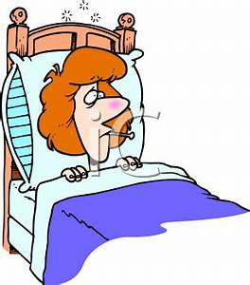
Risk factors for NI
The immunological naivety of young children
congenital /acquired ID
congenital syndromes
Close physical contact between children and visitors and uncontrolled fluids and bodily secretions
Children are susceptible to infections that are prevented in older by vaccination or previous natural exposure
Age make variety in causative organisms
chronic or degenerative organ system disorder

Slide 13
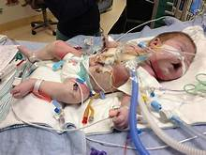
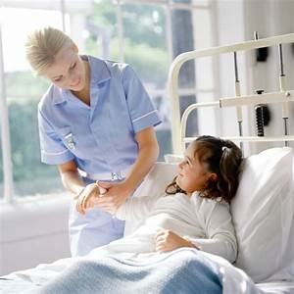
HIGH RISK AREA
Infection rates are the highest in neonatal and PICU (where bloodstream infections are the most frequent), and are usually associated with intravascular devices.
Premature infants may have immature defense mechanisms (including skin, gastrointestinal systems, lungs or be born with severe medical conditions

Slide 14
On general pediatric wards:
respiratory and gastrointestinal infections predominate
reflecting the occurrence in the community.

Slide 15
pathophysiology
For the development of a NI, two pathophysiologic factors must be present:
1-impaired host defenses
2- colonization by pathogenic or non-pathogenic bacteria
Most nosocomial infections arise from the endogenous bacterial flora although many critically ill patients eventually become colonized with resistant bacterial strains.

Slide 16


Chain of infection
Mode of transmission
agent
source
Susceptible host
Port of
entry

Slide 17
Portal of entry into the host
Portal of entry is the way the infectious agent can enter a new host
Common portals of entry include:
• Respiratory tract
• Gastrointestinal tract
• Mucosa (e.g., conjunctiva, nose, mouth)
• Genitourinary tract
• Breach of skin integrity

Slide 18
Three types of infection account for more than 60% of all nosocomial infections:
pneumonia (usually ventilator-associated)
urinary tract infection (usually catheter-associated)
primary bloodstream infection (usually associated with the use of an intravascular device)

Slide 19
Germs acquire ways
  person-person via hands of health-care providers ,patients and visitors
  personal equipment (stethoscopes, personal digital assistants) and clothing
  airborne transmission

Slide 20
Mode of transmission
Direct
transmission
Indirect
transmission
Droplet infection
Vehicle-borne
Unclean hands
and fingers
Contact with soil
Inoculation into skin or mucosa
Air-borne
Fomite-born

Slide 21
Human source of microorganisms
those who already have a disease, or those who are considered to be chronic carriers of an infectious agent.
Patient
Infection control
Visitor
Worker

Slide 22
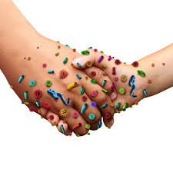
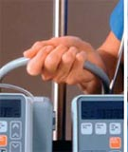
Modes of transmission
Direct contact : consist of direct body surface to body surface contact and physical transfer of bacteria between a susceptible host and an infected or colonized individual.
In direct contact : involves contact of a susceptible host with a contaminated object such as medical instruments, dressings, gloves that are not changed between patients .
hand hygiene

Slide 23
Modes of transmission
Droplet: distance from the source >1 m,
Infectious droplets are generated during coughing, sneezing, talking and through procedures such as bronchoscopy and suctioning.
Transmission occurs when these droplets are propelled a short distance through the air and deposited on a host's mouth, nasal mucosa or conjunctivae.
Wear a surgical mask while in the room

Slide 24
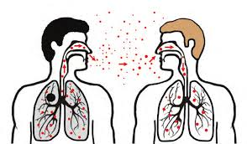
Droplet contact

Slide 25
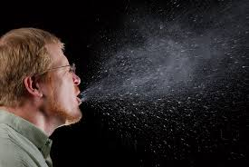
Airborne: consist of dust particles containing bacteria or airborne droplet nuclei of evaporated droplets containing microorganisms that are suspended in the air for longer durations of time.
Microorganisms transmitted in this manner can be inhaled by a susceptible host
ventilation of the space

Slide 26


Slide 27
Strict policies
Education of all caregivers increase the adherence and compliance to policy
Monitoring compliance of hand, personal and environmental hygiene

Slide 28
education and reinforcement required to ensure pediatric safety

Slide 29
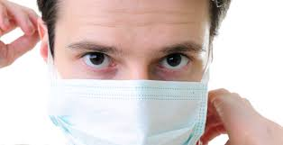
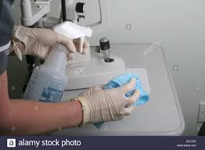
Centers for Disease Control and Prevention. CDC twenty four seven. Saving Lives, Protecting People
Recommendations for Application of Standard Precautions for the Care of All Patients in All Healthcare Settings

Slide 30

HAND HYGIENE
In neonates , ongoing research focuses on :
reducing contaminating periods (eg, less handling of neonates)
sequencing types of infant care (eg, moving from clean to dirty sites during infant handling,
Grouping one type of infant care to one handling period

Slide 31
Encourage others to participate in infection control
students may routinely observe staff who:
  fail to wash hands
  apply inadequate technique in handwashing
  routinely violate correct infection control procedures

Slide 32

barriers to hand hygiene can be overcome when role models promoting the procedure are clearly identified
education of the visitor to ensure that he or she doesn't transmit pathogens to his or her child or to other

Slide 33
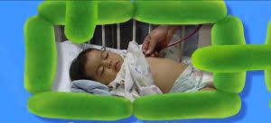
Susceptible host
Severely immunocompromised children require extra protection :
ventilation systems that reduce the risk of exposure to filamentous fungi
Treatment of under laying disease
Immunization
Prophylactic antibiotic therapy

Slide 34
Susceptible host ,health care worker
AAP:
Healthcare workers should receive the influenza vaccine annually
When transporting a contagious patient, facilities should communicate information about the patient's diagnosis and isolation
appropriate management of invasive procedures and devices, sterilization and disinfection of equipment, provision of a clean environment and adequate staffing.

Slide 35
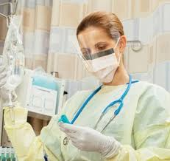
Standard Personal
Protective Equipment (PPE)
IF direct contact with blood & body fluids, secretions,excretions, mucous membranes, non-intact skin
Gloves PLUS gown

Slide 36
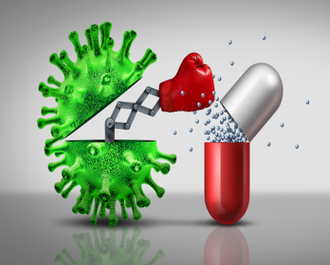
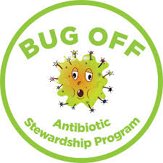
The appropriate use of prophylactic antimicrobials therapy prevents some nosocomial infections, especially in high-risk patients .

Slide 37
The impact of infection control on antimicrobial resistant infections
infection
Antibiotic usage
Sensitive organisms
Morbidity and mortality
Resistance organisms

Slide 38
Supported by higher administration
forceful
Effective IP&C Program
Cover needs of all age group
goals

Slide 39
Continue and Surveillance
Focus on:
staffing numbers and levels of experience
early detection and intervention in outbreak situations
environmental controls ,adequate supplies
programs for education.

Slide 40
Notice to high risk group:
Immuno-deficient patients
Cancers
Transplants
certain lung diseases
immaturity/ VLBW newborn

Slide 41
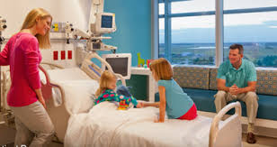
The family is a core component in pediatric ward
it is important to recognize Knowledge and compliance of them as a potential source for infection spread.

Slide 42
goal of infection control programs
decrease the incidence of infections in patients and staff
Considerations relevant to antimicrobial resistant organisms

Slide 43
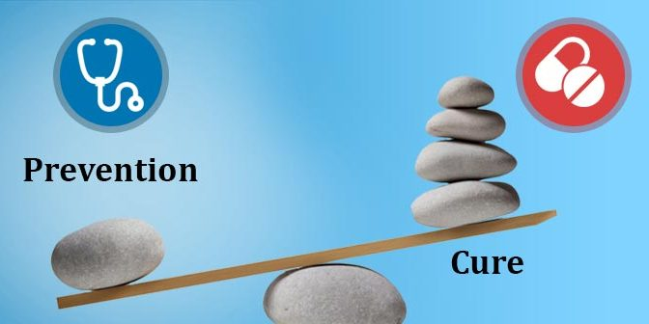

Slide 44

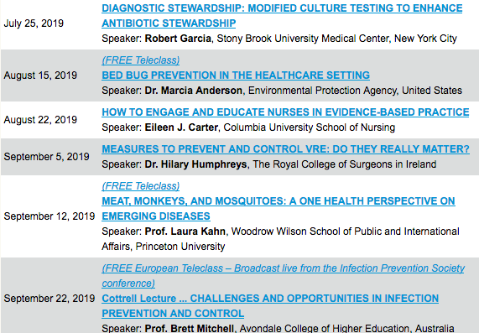

Slide 45


