Slide 1
Infection Control Risk Assessment Issues ... New Construction
Andrew Streifel
Hospital Environment Specialist
strei001@umn.edu
Hosted by Dr. Lynne Sehulster
www.webbertraining.com
October 24, 2019

Slide 2
Levels of Risk
Healthy person
Chronic obstructive pulmonary disease
Diabetes
Steroids
Cancer - solid tumor
HIV infection-end stage of spectrum
Organ transplant
Kidney/heart
Lung/liver
Malignancy - leukemia/lymphoma
• Bone marrow transplant (BMT) allograft
Greatest Risk

Slide 3
New Construction
Hand cleansing
Ventilation pressure management
Bathrooms # of sinks
Water quality temperature/stagnation/conserve
Utility rooms
Construction quality best practice
ICU/OR/NNICU/special vent rooms
Energy and water conserve
Surge capacity
Water damage response
Tie-ins and utility outages

Slide 4
What and Where Risk During Construction AIR & WATER
Patients
Immune suppressed
Convalescent areas
Departments
Surgery
Radiation
Catheterization
Equipment cleaning
Procedures
Bedside or areas
Issues for Environmental Infection Control
Utility planning emergent and routine outages
Ventilation management during projects
Water quality assurance (opportunistic pathogens)

Slide 5
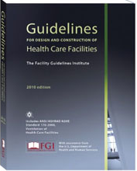
Design Guidelines
Design criteria
Facilities Guidelines Institute
Centers for Disease Control & Prevention
Uniform Building Code
International Building Code
National Fire Protection Association
Plumbing code
Electrical code
Mechanical code
Pharmacy code USP 797
other

Slide 6
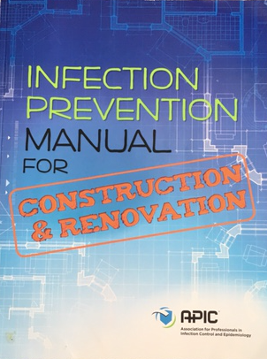
Best Practice Manual from APIC
•Policies
•Construction Documents
•Dust Control
•Water Sampling
•Air Monitoring
•Education and Training
•Equipment Resources
•Architectural and Design
•Floor Recovery and Mold Abatement
•Trends and Issues
•Construction Resources
•Glossary
2015

Slide 8
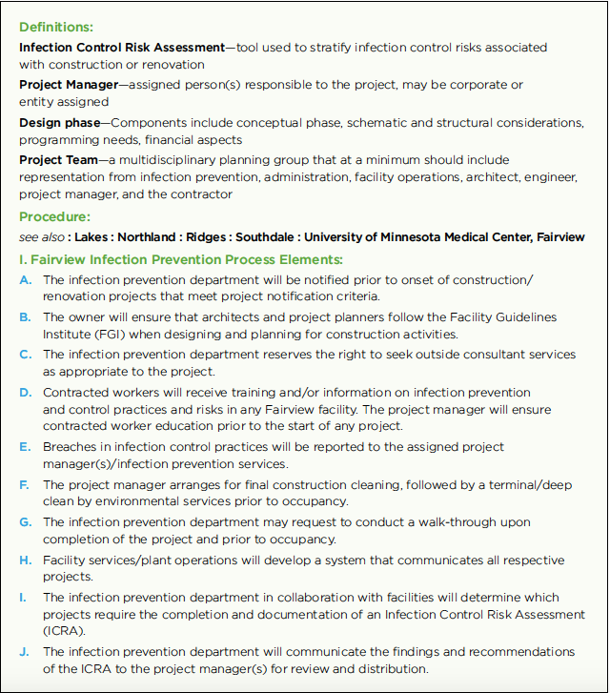
In addition:
ICRA based on FGI
-timing
-team
-design
-surfaces/finishes
-construction
-compliance
-mitigation response
-monitoring
-communication
CODE requirements
Interim Life Safety
-coordination
-fire watch inspection
-IP elements

Slide 9
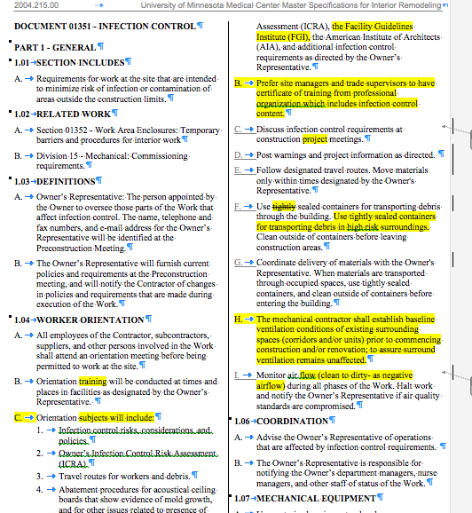
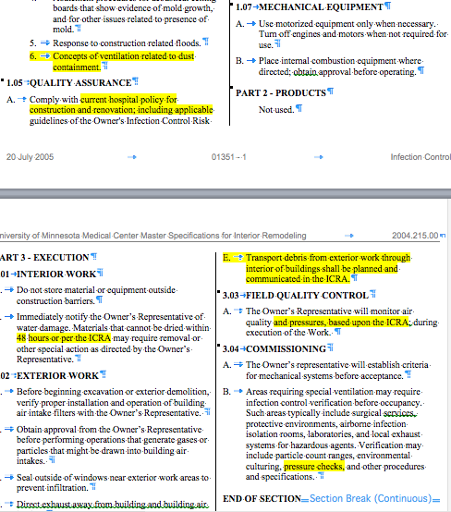
Master Specifications for UMMC

Slide 10
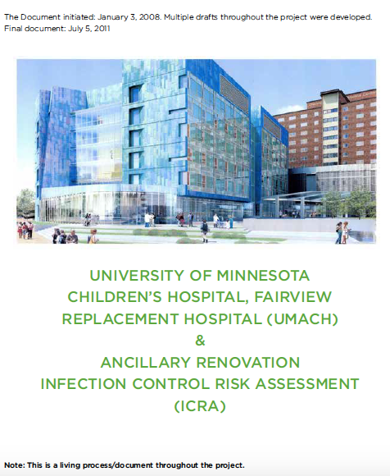
New Construction
ICRA in APIC Infection
Prevention Manual for
Construction and
Renovation 2015
Overview for Planning
Large Projects

Slide 11
Construction Worker Hospital Training
First Day First Hour
TABLE OF CONTENTS
Index
I. The Infection Control Risk Assessment
II. Internal collaboration and consideration
III. Recommendations and Regulatory Resources to be incorporated: External
IV. Recommendations and Regulatory Resources to be incorporated: Internal
V. Operational Issues
VI. Areas Requiring Infection Control Sign off for Design and Specifications
VII. Communication: Technical Review User Group
VIII. Construction
IX. Brief Summary Following-Completion of the South Building & Riverside
X. The UMMC/UMACH Infection Control ICRA Planning and Design Elements for
Consideration and Discussion:
a. Construction
b. Renovation
c. Commissioning
d. Appendix A: Construction/Renovation APIC Matrix
e. Appendix B: Containment and Monitoring

Slide 13
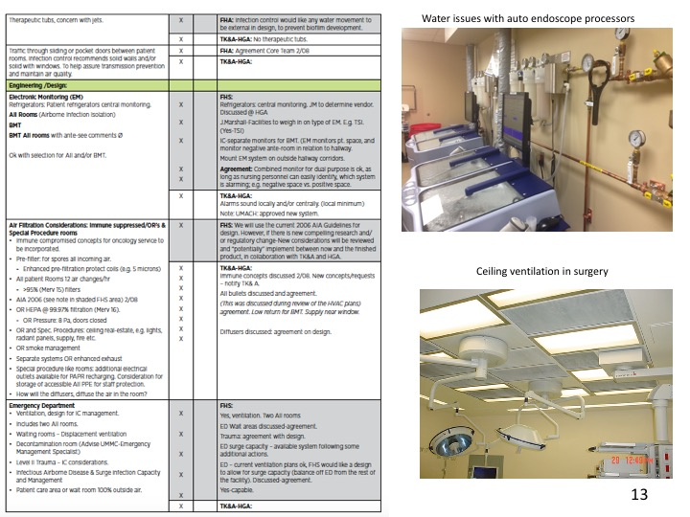

Slide 15
CDC EIC MMWR JUNE 6, 2003
FGI & ASHRAE DESIGN GUIDELINES FOR VENTILATION

Slide 16
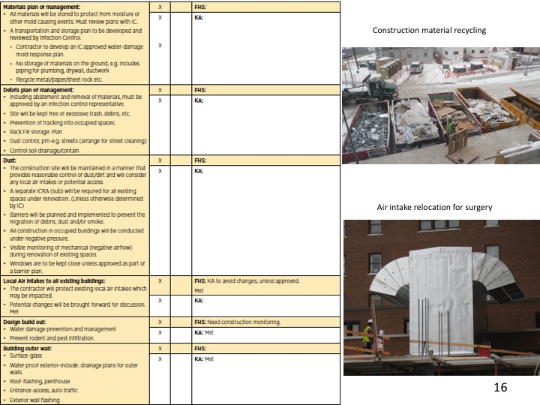

Slide 19
Key Components
Exterior of building
Keeps out water and air infiltration
Ventilation Systems
Provides comfort and infection safety of air
Need evaluation tools
Water Systems
Becoming important for sustainability
Protect for drinking, sanitation and clinical application
Out of control water in healthcare

Slide 20
Notes:
20

Slide 21
Notes:
21

Slide 23
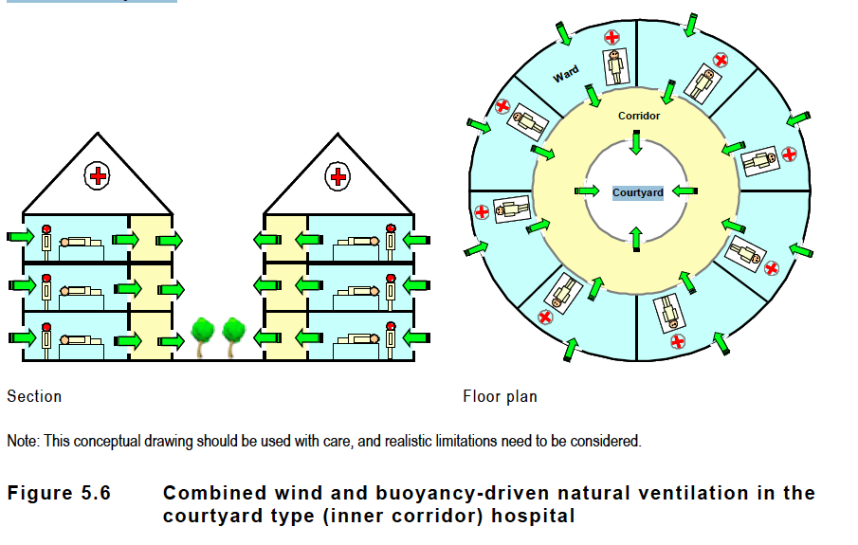
NATURAL VENTILATION

Slide 24
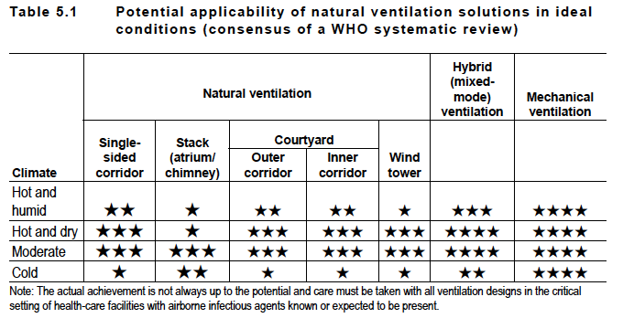
Applicability of natural ventilation systems
Natural ventilation for infection control
in health-care settings.
★ The performance in either thermal comfort or infection control is
unsatisfactory. In terms of infection control, it means the magnitude of
the ventilation rate.
★★ The performance is fair.
★★★ The performance is acceptable, but compromise may be needed in terms
of thermal comfort.
★★★★ The performance is good in terms of both thermal comfort and airborne
infection control.
★★★★★ The performance is very good (satisfactory) in terms of both thermal
comfort and infection control.
WHO Natural Ventilation 2009

Slide 25
Notes:
25

Slide 26
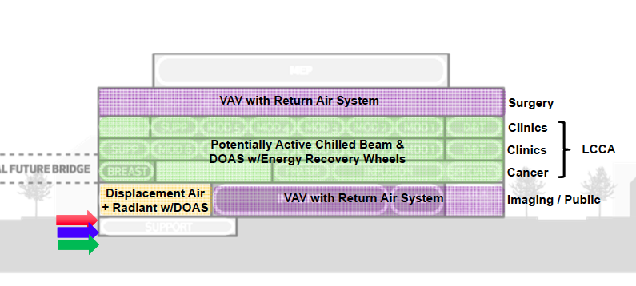
Planning for New Ambulatory Care Center University of Minnesotan Medical Center 2014
Benefits of Active Beams in Healthcare
Reduction in air handling equipment
Minimization and elimination of ductwork
Reduction in reheat
Quiet operation
Improved indoor air quality
Reduced risk of cross contamination

Slide 27
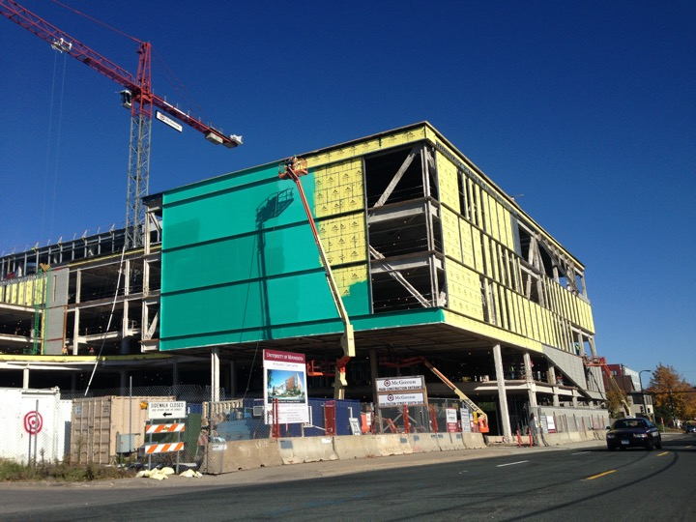

Slide 28
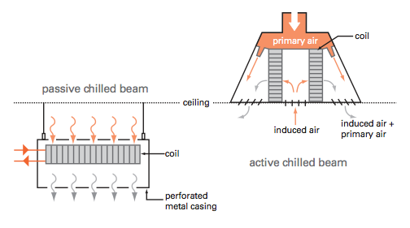
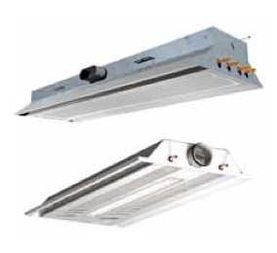
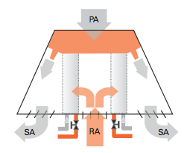
Chill beam advantage is to
separate the cooling component
with the air supply to save energy.

Slide 30
Phases of Construction
* Baseline Preliminary Review & Program Analysis
*Pre-design
*Schematic Design
*Design Development
*Construction Documents
*Construction Implementation
*Facilities Commissioning
*Occupancy
*Certification for Use
•What infection control
principals need to be developed?
-ventilation
-plumbing
-airborne infection isolation
-surgery
-immune suppression
-disaster planning
•Identify locations for need.
-user group collaboration
•Construction methods
-water damage management
-construction methods
-validation process

Slide 31
AIA 2010 Guidelines for Design And Construction of Hospitals & Health Care Facilities
Latest in an over 60-year series of guidelines specific for design and construction of hospital and other health care facilities
Nursing Facilities; Outpatient Facilities
Rehabilitation Facilities; Psychiatric Hospital
Mobile, Transportable, and Relocatable Units
Hospice Care; Assisted Living
Adult Day Care Facilities
Glossary Tables
ASHRAE Std 170 Ventilation for HCF inclusion

Slide 32
Built Environment Projects
Renovation
Program changes
Maintenance & utility upgrade
Preconstruction
Discovery/Utilities, shutoffs, etc.
Recycle equipment
New Construction
Planning Design and Construction
What infection control training is needed for contractor supervisors and workers?

Slide 34
PRECAUTIONS DURING CONSTRUCTION
INDOOR PROJECTS (RENOVATION) OUTDOOR PROJECTS (NEW)
Employee training Employee training
Barrier management Dust control
Water damage Noise and vibration
Demolition precautions Pest control
Dust migration and control Building material storage
Debris and material transport Water damage management
Access routes to work area Sanitation and break areas
Outages (electrical and plumbing) Tie in building issues
Portable filter usage Commissioning-air & water
Noise and vibration Shell spaced-build out
Sanitation and break areas
Commissioning -air & water
Communication Communication
Emergency response Emergency response
Water damage reporting Water damage reporting
Changing work phases Material crane location
ICRA precautions during occupancy Changing ICRA precautions pre occupancy
Water Quality Water Quality
Stagnant water flushing Stagnant water flushing
Testing water requirements Testing water requirements
Punch list Punch list
Critical sinks drinking water Critical sinks drinking water

Slide 35
Awareness Factors by Trade
 | Plumber | HVAC | Electrician | Painter | Laborer | IT Specialist | Riggers | Specialty Trade
Awareness Factors
Water damage | x |  | x | x | x | x |  | x
Mold discovery | x |  | x | x | x | x |  | x
Outages | x | x | x |  |  |  |  | x
ICRA | x | x | x | x | x | x | x | x
Water event response | x |  |  |  | x
Stagnant water | x
Building material storage/stocking | x | x | x | x | x | x | x | x
Noise/vibration | x | x | x |  | x | x | x | x
Track dirt | x | x | x | x | x | x | x | x
Wall/slab penetrations | x | x | x |  | x | x
Material transport | x | x |  |  | x |  | x | x
Biocide application |  |  |  | x | x |  |  | x
Room/wall seal application |  |  |  | x | x

Slide 36
Negative Pressure Room for Airborne Infection Isolation
monitor
Bathroom
Intended Usages:
Procedure/Treatment Rooms
Bronchoscopy
Autopsy
Emergency Rooms
corridor
Positive Pressure Room for Protective Environment
Monitorr
Bathroom
Intended Usages:
Immune Compromised Patient Rooms
Operating Rooms
Corridor
36
Notes:
Environmental Validation Infection Control
Andrew Streifel
36
25

Slide 37
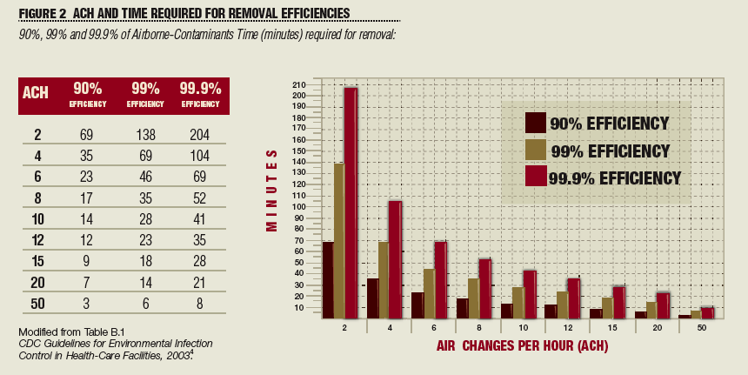
The solution to pollution is dilution…………
Higher room air exchanges purify if filters are working.

Slide 38
Operating Room Ventilation
Comfort control
Temperature and humidity
Cooling capacity for heat gain essential
Anesthetic gas management
Problematic due to no permissible exposure limit
Scavenging and high room air exchange needed
Infectious disease control
Smoke plume management
Airborne microbes? Contact microbes?

Slide 39
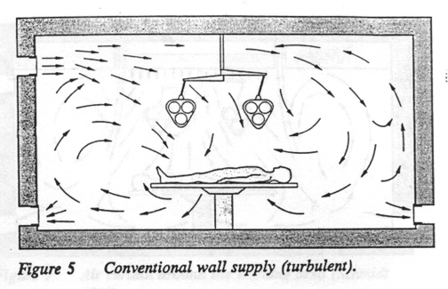
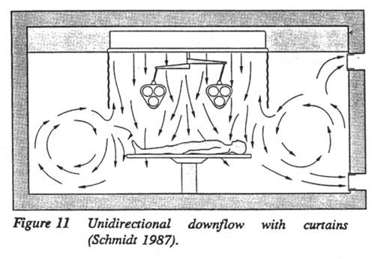
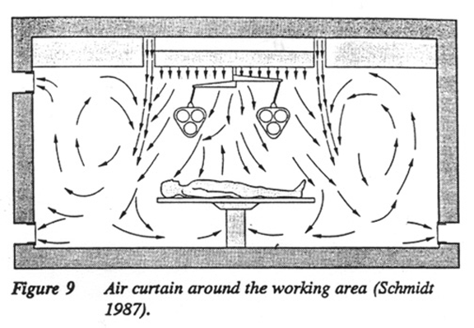
The airflow pattern in OR’s
must overcome thermal
buoyance and maintain a down
ward flow of air

Slide 40
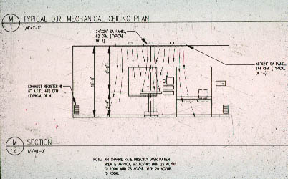
Vertical airflow 30 to 40 lfpm at surgery site

Slide 41
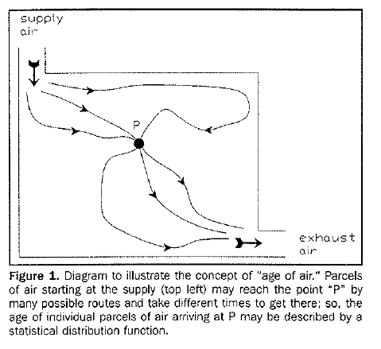
Age of Air Concept for particle movement

Slide 42
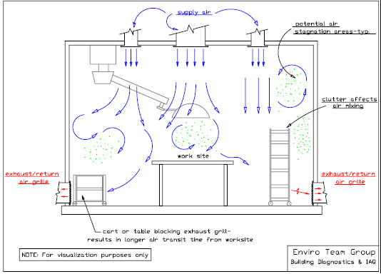
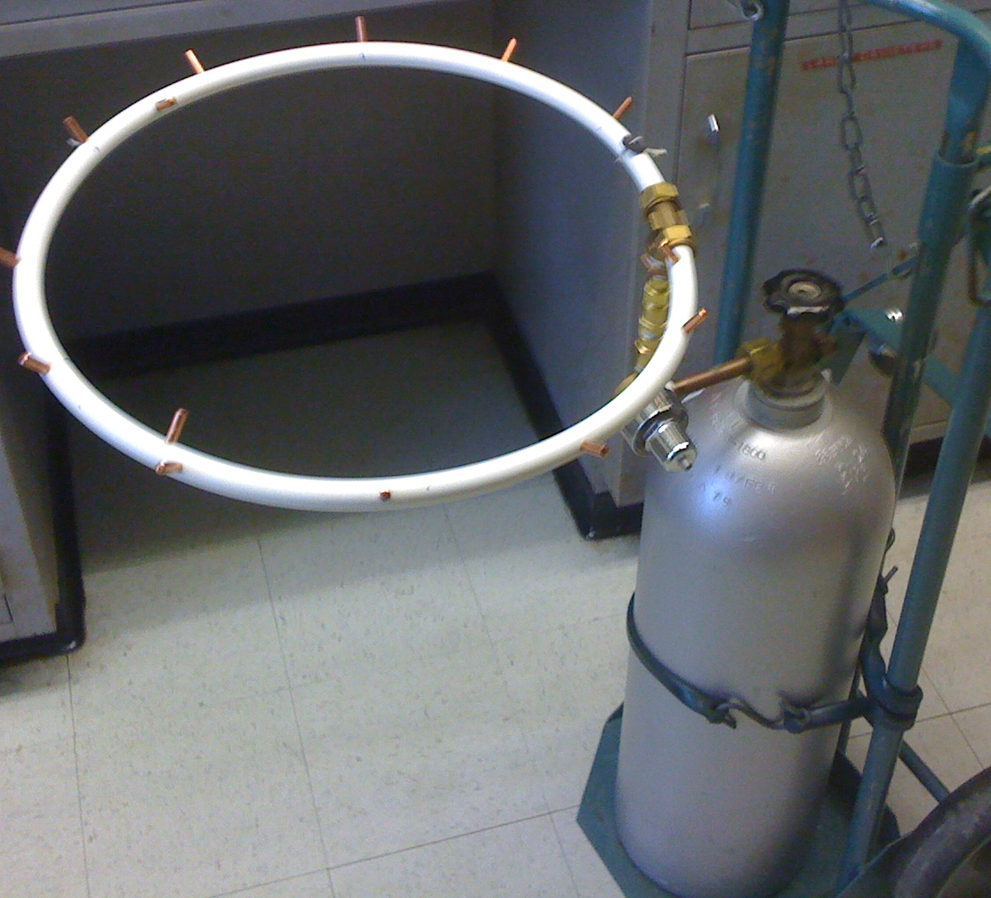
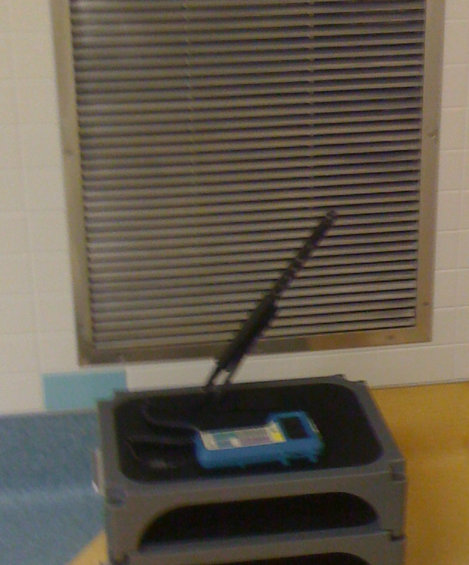
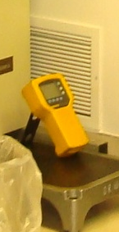
Air movement velocity (fps) and decay of carbon dioxide can
demonstrate ventilation efficacy.

Slide 43
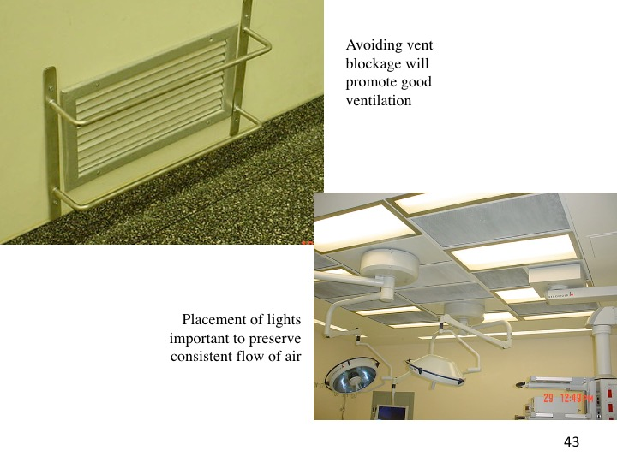

Slide 45
Surgical Smoke Generated During Hip Resection

Slide 46
Controlling Airborne Infectious Agents in Surgery
Extra pulmonary disease (TB, BBP)
Scavenging of smoke or aerosol?
Personal protective equipment
Human shed microbes
Air velocity over surgical site
Overcome thermal plume with 35-40 lfpm velocity
Air handling deficiencies
Booster steam or humidification problems (condensation)
Insufficient air flow (gas accumulation)
Depressurized operating rooms (air balance)

Slide 47
Functional Performance Testing Baseline Data for Future Reference
List:
- patient care unit
- room number
- type of room
- monitoring system
- local display monitor
- AC/hr
- differential pressure
- offset
- airflow direction
- room size square feet
- supply volume
- return/exhaust volume

Slide 48
Case Study- Barrier Management “Leakage”
Total Barrier Management
Infection control
Sound
Energy/ Movement
UL systems
Total Barrier Management practices increase build integrity beyond UL systems with additional secondary attributes
DISCLOSURE HILTI SPONSORED STUDY

Slide 49
Case Study- Barrier Management
Control of aerosol important principal for airborne infectious agents causing tuberculosis or aspergillosis depends on airflow control. Aerosol management due to patient derived symptoms needs masking and special room ventilation. Aerosol control is dependent on airflow direction intensity.
Excess room leakage will diminish pressure management design. A sealed room will help provide consistent direction for prevention of occupational exposures to droplet nuclei containing Mycobacterium tuberculosis or chicken pox
INFECTION PREVENTION
Total Barrier Management
Infection control
Sound
Energy/ Movement
UL systems
Total Barrier Management practices increase build integrity and infection prevention secondary attributes

Slide 50
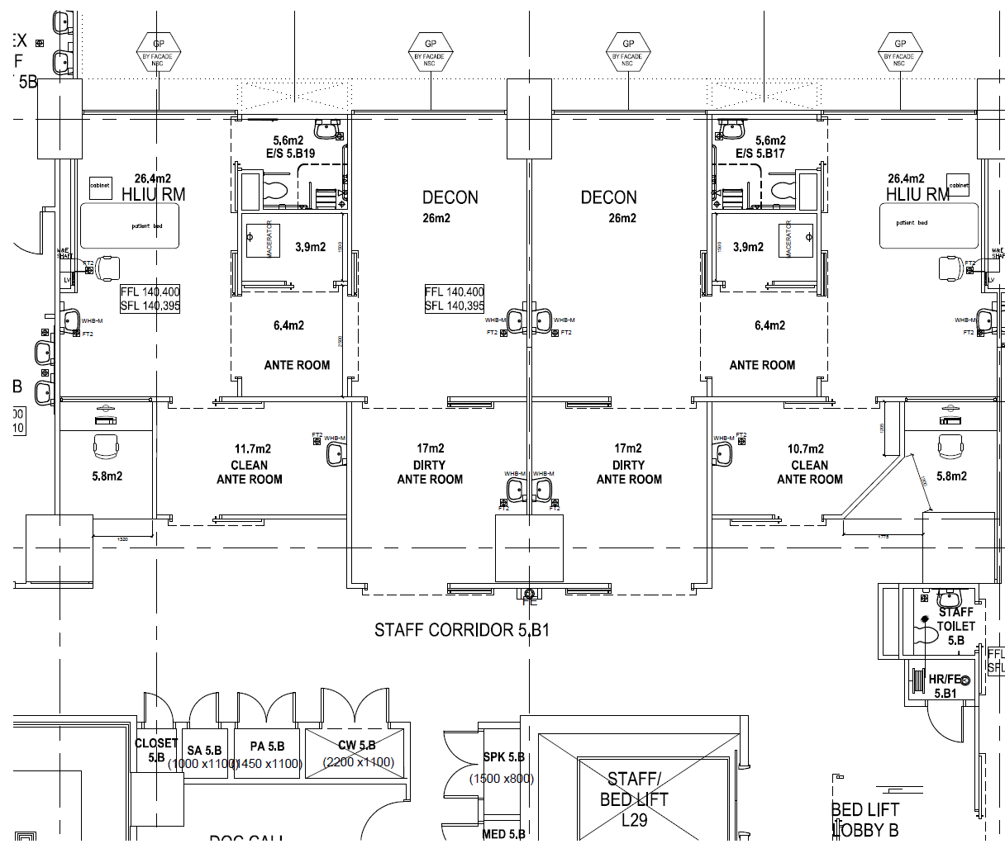
Staff/Housekeeping/Clean equipment in-flow
HLIU FLOW
Patient in-flow
Patient/Staff/Housekeeping/Dirty Equipment out-flow
Dirty
Decon
Dirty
Decon
Dirty
Ante
Dirty
Ante
Clean
Ante
Dirty
Ante
Dirty
Ante
Clean
Ante

Slide 51
PROPOSED AIR PRESSURE
-5pa
-7.5pa
-5pa
-5pa
-7.5pa
-5pa
-10pa
-10pa
-7.5pa
-7.5pa
-2.5pa
-2.5pa
-2.5pa
-2.5pa
Interlocking doors

Slide 52
Competency Principals for Hospital Design to Control Certain Infectious Diseases
Ventilation indoor air quality control
Pressure intensity
Air exchanges for dilution
Filtration for cleanliness
Clean to dirty airflow
Surface management
Durable and Cleanable
Water Quality assurance
Flush or Disinfect

Slide 56
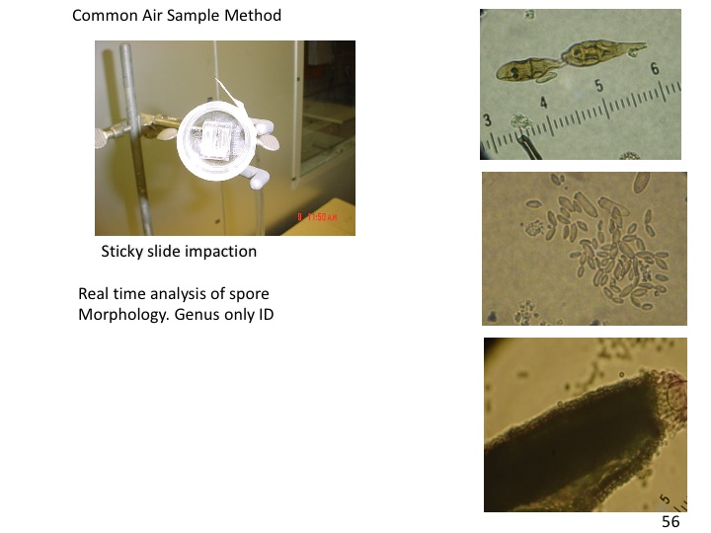

Slide 57
Air sample interpretation (problem)
Indoor/Outdoor ratio >1 (Precipitation not present)
Indoor problem area different from indoor control
Indoor organisms are not similar to outdoor organisms
Aggressive samples have higher counts than passive samples.

Slide 58
Surface sampling strategy
Indoor problem
Indoor control
Plate control
Looking for:
Suspected poor maintenance
Area with previous water damage
METHODS
Rodac contact plate (viable)
Swab plate (viable)
Tease tape (non-viable)
Vacuum method (viable)

Slide 60
CDC EIC MMWR JUNE 6, 2003
AIA & ASHRAE DESIGN GUIDELINES FOR VENTILATION
VENTILATION ASSURANCE BEFORE PATIENT OCCUPANCY

Slide 61
Objectives for Infection Control during Construction in Healthcare Facilities
Respectful of patients
Control aerosols
Maintain a clean environment
Prevent water damage
Respond to emergencies
Provide documentation
Be trained & communicate

