Slide 1
Infection Prevention in Nursing Homes and Palliative Care Pat Stone, PhD, RN, FAAN Columbia University, Center for Health Policy ps2024@cumc.Columbia.edu
Hosted by Prof. Ruth Lynne Carrico Columbia University
www.webbertraining.com
March 8, 2018

Slide 2
2

Slide 3
3

Slide 4
4

Slide 5
5

Slide 6
6

Slide 7
Today’s Discussion
Background/context of nursing homes (NH) and infection prevention in the US
Prevention of Nosocomial Infections and Cost-Effectiveness in Nursing Homes (PNICE-NH)
Five analyses
Next steps
Integration of Infection Management and Palliative Care
Concluding Remarks
7

Slide 8
Prevention of Nosocomial Infections and Cost-Effectiveness in Nursing Homes (PNICE-NH)
R01 NR013687, Stone PI
8

Slide 9
Growing Elderly Living in Nursing Homes (NHs)
Approximately 1.4 million residents in 15,700 NHs
85% are ≥ 65 years
Americans aged ≥ 65 years will ↑ from 47.7 million in 2015 to 83.7 million in 2050
NH residents are becoming more diverse
This may be due to increased options for some
These residents are vulnerableⁱⁱ
22% of NH residents experienced adverse events, 59% were preventable
ⁱVital Health Stat. 2013
ⁱⁱDHHS, OEI-06-00370, 2014
9

Slide 10
Infections in NHs
765,000 to 2.8 million healthcare-associated infections (HAIs) annuallyⁱ
Most estimates are old and based on small sample sizes
HAIs are the most common reason of resident transfer to acute care and 30-day readmission and often these admissions come at the end of lifeⁱⁱ
ⁱStrausbaugh LJ, Joseph CL, ICHE, 2000; Koch AM et al, JHI, 2009; Dwyer et al JAGS 2013
ⁱⁱKoch AM, JHI, 2009
10

Slide 11
Antibiotic Usage and MDROs in NHs
Antibiotics account for 40% of all medications administered
Between 50-80% of residents receive antibiotics at least once a year
Antibiotics are often initiated in the absence of clinical evidence of a bacterial infection
Older persons are susceptible to adverse side effects due to altered pharmacokinetics, polypharmacy, dosing errors and increased risk of Clostridium difficile
In a systematic review, we found up to 63% of residents were infected with a gram negative MDRO
In 35 NHs in Boston, 67% of advanced dementia patients in a NH were colonized or infected with MDRO
11

Slide 12
Aim 1
Estimate trends in infections in NH residents, 2006 – 2013 and a point prevalence of infections in NH residents in 2013
Herzig CTA, Dick AW, Sorbero M, Pogorzelska-Maziarz M, Cohen CC, Larson EL, Stone PW (2017) Infection Trends in United States Nursing Homes, 2006 – 2013. JAMDA. 2017
12

Slide 13
Minimum Data Set (MDS)
Clinical assessments performed on all NH residents
Upon admission, at least quarterly and with significant change in status
Infection data have a “look back” period
Revised October 2010 (MDS 3.0)
13

Slide 14
Revised MDS: Infections
MDS 2.0
(2006-9/2010)
UTI
MDRO
MDS 3.0
(10/2010-Present)
UTI
Pneumonia
Wound infection
Viral hepatitis
Septicemia
Tuberculosis
C. difficile
Conjunctivitis
HIV
Respiratory infection*
Sexually transmitted diseases
Pneumonia
MDRO
Wound infection
Viral hepatitis
Septicemia
Tuberculosis
C. difficile
Conjunctivitis
HIV
Respiratory infection*
Sexually transmitted diseases
*Other than pneumonia
14

Slide 15
Sample
NH residents with a quarterly or annual MDS assessment in 2006 – 2013
30,366,807 assessments
15,000 NHs
15

Slide 16
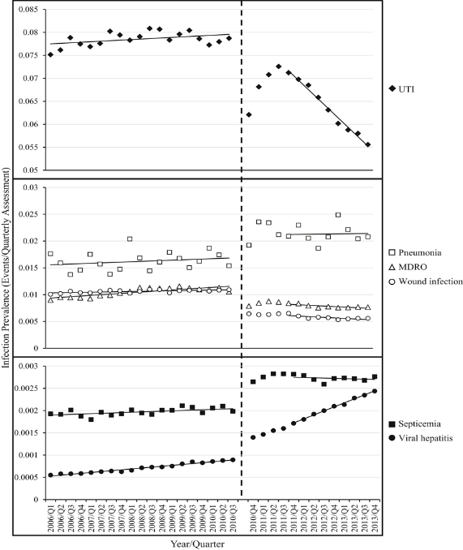
Trends in Infection Prevalence
2006 – 2010 (MDS 2.0)
Prevalence of all infection types increased (p-values <.01)
2011 – 2013 (MDS 3.0)
Prevalence of UTI, MDRO, and wound infections decreased (p-values <.0001)
Prevalence of viral hepatitis increased (p-value <0.0001)
16

Slide 17
Estimated Number of Infections in US Nursing Homes, 2013
 | Count of infections
Infection type | Assuming 1 week duration | Assuming 1 month duration
UTI | 660,553 | 660,553
Pneumonia | 1,071,603 | 247,293
MDRO | 394,131 | 90,953
Wound infection | 287,203 | 66,278
Septicemia | 142,314 | 32,842
Viral hepatitis | 125,523 | 28,967
Total | 2,681,327 | 1,126,886
17

Slide 18
Aim 2
Obtain a national perspective of infection prevention and control programs in NHs using mixed methods
18

Slide 19
Qualitative Methods
Purposively sampled 10 NHs across the country
Recruited 6 to 8 employees
Semi structured interviews were audio taped
Directive content analysis conducted to identify themes
Stone, P.W., Herzig, C.T., Pogorzelska-Maziarz, M., Carter, E., Bjarnadottir, R.I., Semeraro, P.K., Cohen, C.C., Travers, J., Schweon, S. (2015). Understanding infection prevention and control in nursing homes: A qualitative study. Geriatric Nursing. doi: 10.1016/j.gerinurse.2015.02.023.
19

Slide 20
Results
73 interviews including administrators, infection preventionists, staff nurses, aids, MDS coordinators and environmental services
5 themes
Resident needs: with tension between the facility being a person’s home and the need for infection prevention and control
Roles and training: multiple responsibilities of staff and lack of formal infection prevention and control training
Using infection data: while there was variations in surveillance methods/definitions, data were used to improve care
External resources: A need for external information and support
Focus on hand hygiene: All NHs focused on hand hygiene, however monitoring compliance was often informal
20

Slide 21
National Survey of NH Infection Control Programs
Facilities
Eligibility
Design
Survey
Certification and Survey Provider Enhanced Reporting (CASPER) data
Free-standing
Non-specialized
30-900 beds
Cross-sectional survey
Random sample of 2514 NHs
Paper-based
34 items
Open and closed-ended questions
Infection preventionist
Herzig CTA, Stone PW, Castle N, Pogorzelska-Maziarz M, Larson EL (2016) Infection Prevention and Control Programs in US Nursing Homes: Results of a National Survey. JAMDA. 17(1):85-89.
21

Slide 22
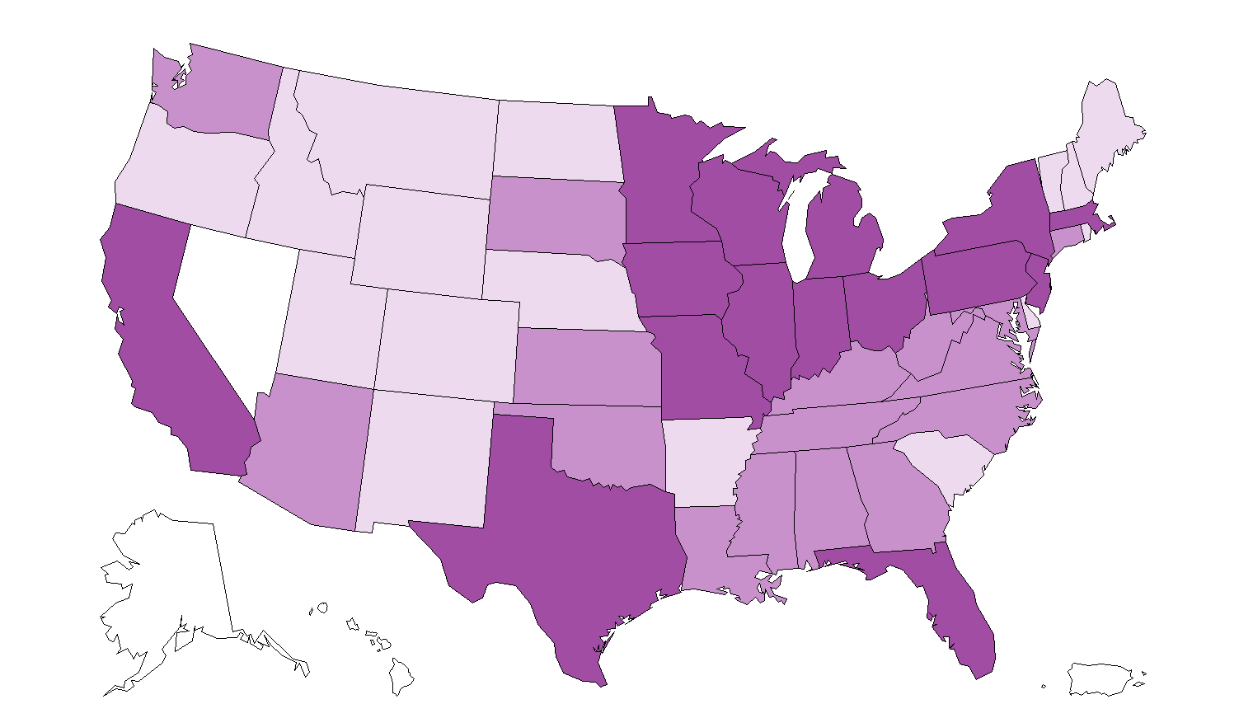
Geographic Distribution of NHs (n=990)
Key:
Not included
0 – 9 respondents
10 – 25 respondents
26 – 65 respondents
22

Slide 23
Percent of NHs that ranked each infection as one of three top challenges
23

Slide 24
Those in charge of infection prevention wore multiple hats
24

Slide 25
Those in charge of infection prevention wore multiple hats
29% of their time on infection control-related activities
25

Slide 26
Only 39% of respondents had received any specific infection control training or certification
Infection Control Training
26

Slide 27
There was substantial variation in policies related to UTI prevention
Policies/programs for UTI prevention | %
Hydration protocols | 80
Use of portable bladder ultrasound scanner | 22
For men, use of condom catheters | 7
For mobile residents, leg bags for daytime use | 65
Specimen collection prior to initiating antimicrobial therapy | 59
For residents with leg bags, leg bag cleaning | 44
Nurse-initiated urinary catheter discontinuation | 33
Urinary catheter reminder or stop-orders | 22
Policies NOT specific to residents with indwelling catheters
On average, facilities had 1.1 of these 3 policies (SD=0.6)
Policies specific to residents with indwelling catheters
On average, facilities had 2.2 of these 5 policies (SD=1.4)
27

Slide 28
Aim 3
Evaluate relationships between the adoption of UTI policies and the occurrence of UTI
With and without indwelling urinary catheters
28

Slide 29
Data Sources
CASPER data:
Facility characteristics
Survey data:
Policies & Program characteristics
MDS data:
Infections & Resident characteristics
29

Slide 30
Prevalence of UTI among NH Resident Assessments in 2013
n=273,125 assessments:
14,809 (5.4%) UTI
UTI among resident assessments WITHOUT indwelling urinary catheters (n=260,920 assessments):
12,628 (4.8%)
UTI among resident assessments WITH indwelling urinary catheters (n=12,192 assessments):
2,181 (17.9%)
30

Slide 31
Associations between UTI catheter prevention policies and UTI
 | All resident assessments |  | Resident assessments WITHOUT indwelling catheters |  | Resident assessments WITH indwelling catheters
 | OR | 95% CI | OR | 95% CI | OR | 95% CI
For residents with leg bags, leg bag cleaning | 0.93 | 0.83, 1.04 | 0.94 | 0.84, 1.06 | 0.81 | 0.67, 0.97
Note: All models adjusted for: resident age, sex, race/ethnicity, cognitive function, functional status, existing conditions; facility size, payer mix, staffing levels, ownership, location, infection preventionist training
31

Slide 32
Associations between UTI prevention policies NOT specific to residents with an indwelling urinary catheter and UTI
 | All resident assessments |  | Resident assessments WITHOUT indwelling catheters |  | Resident assessments WITH indwelling catheters
Number of policies (ref=no policies) | OR | 95% CI | OR | 95% CI | OR | 95% CI
1 policy | 0.95 | 0.84, 1.09 | 0.96 | 0.84, 1.10 | 0.93 | 0.75, 1.16
2 policies | 0.90 | 0.77, 1.06 | 0.91 | 0.77, 1.07 | 0.86 | 0.67, 1.12
All 3 policies | 0.73 | 0.54, 0.99 | 0.69 | 0.50, 0.95 | 1.08 | 0.64, 1.84
Note: All models adjusted for: resident age, sex, race/ethnicity, cognitive function, functional status, existing conditions; facility size, payer mix, staffing levels, ownership, location, infection preventionist training
32

Slide 33
Aim 4
Examine Isolation Use in MDRO+ Residents
33

Slide 34
Results: Rate of Isolation Use
191,816 MDRO+ Assessments
13% are isolated
138,294
Residents
31% used isolation that year
11,773
NHs
Isolation use for MDRO is infrequent
Majority of NHs do not use isolation for MDRO
69% did not use isolation at all
34

Slide 35
Aim 5
Examine associations between state HAI reporting efforts in NHs and NHs citations for deficiencies
35

Slide 36
Few States Have Mandatory or Voluntary HAI Reporting in NHs
States with HAI Reporting in NH*
Vermont: Multi-drug resistant organisms, C. difficile
Pennsylvania: C. difficile, Device-associated infections, and other infections and conditions
Iowa: C. difficile
Georgia: Catheter-associated urinary tract infection
Oregon: Urinary tract infection
Key:
= Mandatory
= Voluntary
*Note: Data were obtained by calling state HAI coordinators when state laws and forms were particularly difficult to discern
36

Slide 37
NH Statements of Deficiencies (F-tags)
2012-2013 Certification and Survey Provider Enhanced Reporting (CASPER) dataⁱ
37.6% of NHs receive infection control deficiency citation
64.3% of NHs receive quality of care deficiency citation
37

Slide 38
NH Statements of Deficiencies (F-tags)
2012-2013 Certification and Survey Provider Enhanced Reporting (CASPER) dataⁱ
37.6% of NHs receive infection control deficiency citation
64.3% of NHs receive quality of care deficiency citation
NHs in states with mandatory or voluntary HAI reporting were less likely to receiveⁱ
Infection control citation (OR: 0.61; 95% CI 0.49, 0.75)
Quality care citation (OR: 0.75, 95% CI: 0.55, 0.95)
38

Slide 39
Conclusions about NHs
Some evidence that state department of health policies/investment help
MDS data are useful for identifying infection trends and isolation use
Infections are a major and persistent problem in NHs
Infection preventionists in NHs have little training
Wide variation in infection prevention policies and practices in NHs across the US
Evidence that NHs with more UTI prevention policies had lower prevalence of UTI
Isolation is not being used consistently
39

Slide 40
Conclusions about NHs
Some evidence that state department of health policies/investment help
MDS data are useful for identifying infection trends and isolation use
Infections are a major and persistent problem in NHs
Infection preventionists in NHs have little training
Wide variation in infection prevention policies and practices in NHs across the US
Evidence that NHs with more UTI prevention policies had lower prevalence of UTI
Isolation is not being used consistently
MORE NEEDS TO BE DONE!
40

Slide 41
Selected USA Federal Efforts
42 CFR RULE (§483.80) UPDATES NH INFECTION PREVENTION AND CONTROL PROGRAMS
System for preventing, identifying, reporting, investigating and controlling infections
Antibiotic stewardship program
Designated IP with specialized training
IP participates on quality assurance committee
SURVEILLANCE
CDC’s NHSN Long-term care module
CMS C.difficile INITITIAVE
Learning Collaborative
NATIONAL ACTION PLAN
Reducing HAIs
In Long-term care
NATIONAL ACTION PLAN
Combating Antibiotic-Resistant Bacteria
NATIONAL ACTION PLAN
Improvement of NH Quality
2012
2013
2014
2015
2016
2017
41

Slide 42
Closing Thoughts
NHs and HHC have less infection prevention resources
Infections and HAI are problematic in the community
Patients and visitors live in the community and infection prevention is a regional issue.
To decrease the problem of infections in the hospital, we also need to pay attention to the community we are serving
42

Slide 43
Infection Prevention in Home Health Care (InHOME)
R01 016865
Multiple PIs: Shang and Stone
43

Slide 44
The Study of Infection Management and Palliative Care at End-of-Life (SIMP-EL)
Describe the integration of infection management and palliative care (re-survey)
Examine factors associated with antibiotic use in NH residents at End-of-Life (Medicare claims data including Part D, survey, county level data)
Examine factors associated with hospital transfer due to infections at End-of-Life (Medicare claims, MDS, survey, other data)
44

Slide 45
Thanks to a fabulous interdisciplinary team!
45

Slide 46
Questions, comments?
ps2024@cumc.Columbia.edu
46

Slide 47
