Slide 1
IP Resources: Too few? Too many?
A discussion of strategies to calculate appropriate IP personnel resources
Kathleen A. Gase, MPH, CIC
Center for Clinical Excellence
BJC Learning Institute
St. Louis, MO
Hosted by Paul Webber
paul@webbertraining.com
www.webbertraining.com
May 12, 2016

Slide 2
No Financial Disclosures

Slide 3
Background – A little about me
Washington University in St. Louis
  BA Psychology, Biology Minor
  WUSM Research Tech – Infectious Diseases
Memorial Sloan-Kettering Cancer Center
  Infection Control Surveillance Specialist
Certification Board of Infection Control and Epidemiology
  CIC®
City University New York – Hunter College
  MPH Community Health Education
New York State Department of Health
  Hospital Acquired Infection Reporting Program Regional Representative
BJC HealthCare
  Manager, Infection Prevention and Quality Patient Care
Washington University in St. Louis
  Executive MBA Candidate 2017

Slide 4
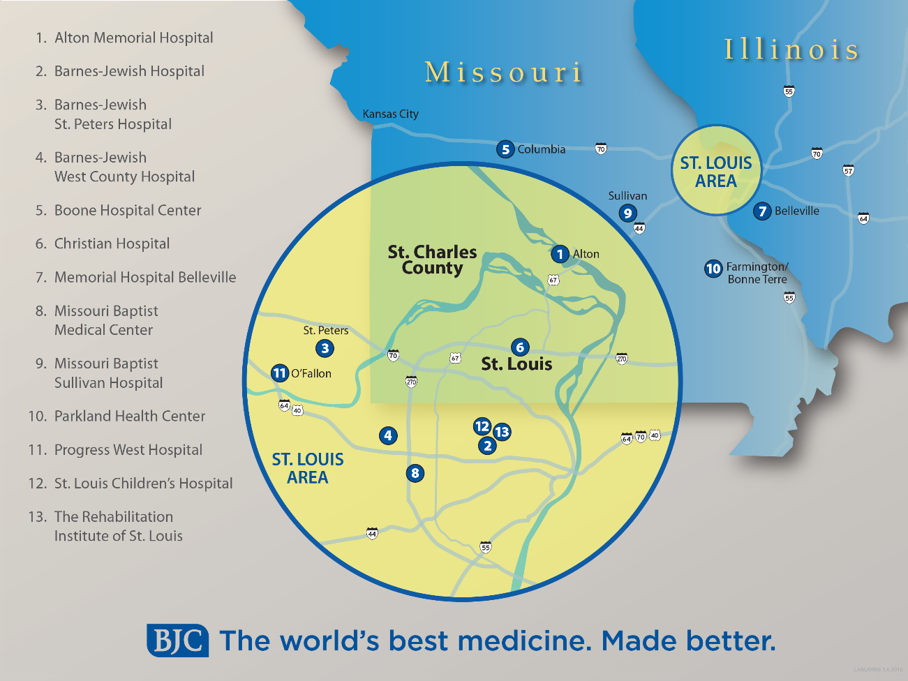
Background – BJC HealthCare
12 acute care facilities
  Critical Access
  Rural
  Community
  Urban
  Specialty
  Academic
Inpatient Rehab
WUSM
Goldfarb Nursing

Slide 5
Objectives
Upon completion of this teleclass, participants will be able to:
  Describe historical recommendations and models for IP staffing
  Describe the strengths and weaknesses of these historical recommendations
  Identify at least one alternative strategy for calculating ideal IP resources
Note: Opinions expressed in this presentation are my own, and do not represent the opinion of, or endorsement by, BJC HealthCare

Slide 6
The real question…
Do you have everything you need to succeed today?
  Right people
  Right equipment
  Right support
  Evaluate regularly

Slide 7
Background – IP Personnel Resources
Study on the efficacy of nosocomial infection control (SENIC Project)
  Mid-1980s: 1 IP professional for every 250 acute care beds
U.S. IP Staffing recommendations (Delphi Project)
  Published 2002: 0.8 to 1.0 IP per 100 occupied acute care beds (1 per 100 to 125 beds)
Canada IP Staffing models (Infection Prevention and Control Alliance)
  Published 2004: 3 IP per 500 acute care beds (1 per 167 beds); 1 IP per 150 to 250 LTC beds
Limitations
  Panel opinions
  Outdated

Slide 8
Background – IP Personnel Resources
The scope of IP programs have expanded since these recommendations were made
Center for Disease Control and Prevention (CDC)
  NNIS Participants: 1 IP for 1st 100 beds, then 1 for each additional 250 beds
  NHSN Participants: Trained IP required to be in charge of program
Little is known about how IP programs are staffed across the country, but they appear to differ greatly
  Average IP resource to acute care beds ranges from 1:151 to 1:83
    Studies limited by small samples sizes
    Likely not representative of the >4,000 acute care hospitals in the U.S.
  How does IP staffing influence patient outcomes?

Slide 9
For consideration…
How much is enough?
  How many IPs do I need for a comprehensive and effective infection prevention and control program?
    Must define “comprehensive” and “effective”
    Deliverables of the program
    Prospective prevention or retrospective insight

Slide 10
How we’re using our time…
Surveillance
Prevention activities
Education
Committees
Professional development
Face time
Emerging diseases/issues

Slide 11
Surveillance
The data on how we manage data varies
  “Generally low” vs. over 5 hours per day
  Manual vs. electronic-assisted vs. fully automated vs. outsourced
  Required only vs. risk assessment
Quantify locally how much time
  Denominator collection
  Numerator investigation
  Data entry
  Data validation

Slide 12
Prevention activities
Development
Implementation
Measurement
Detail current state
Gap analysis
Identify ideal state

Slide 13
Education
New employee
Annual competencies
Collaborative efforts

Slide 14
Committees
Meetings, meetings, and more meetings
Be as specific as possible
  Include preparation time required, not just the meeting time

Slide 15
Professional development
What’s that?
How do you maintain your knowledge and skills?

Slide 16
Face time
Don’t forget the importance of being present
  Inpatient floors
  ICU
  OR
  ER
  Clinics
  CSPD
  So many others…
Current state vs. Ideal state

Slide 17
Emerging diseases/issues
Ebola anyone?
Zika?

Slide 18
What does it all add up to?
IP Risk Assessment and Plan!!
  Serves as the basis for developing goals and measurable outcomes
    Prioritize risks
    Assess resources
  Use local data and facts
    Population served, services provided, regulatory requirements
    Program purpose, goals, objectives
      SMART
  Vision statement: what your organization believes in the ideal
    IP Mission Statement: Describe how your program will help achieve the vision
      Concise, outcome-oriented, inclusive

Slide 19
What does it all add up to?
IP Risk Assessment and Plan!!
  Make the case
    Cost savings
    Cost avoidance
    Reputation
    Data-driven evaluations
  Recommend changes
    Be smart
    Be brief
    Be gone

Slide 20
Bottom line
Ongoing investment in infection prevention programs is a cost-effective strategy
  Approach to making the case for resources is much less important than the strength of the facts presented

Slide 21
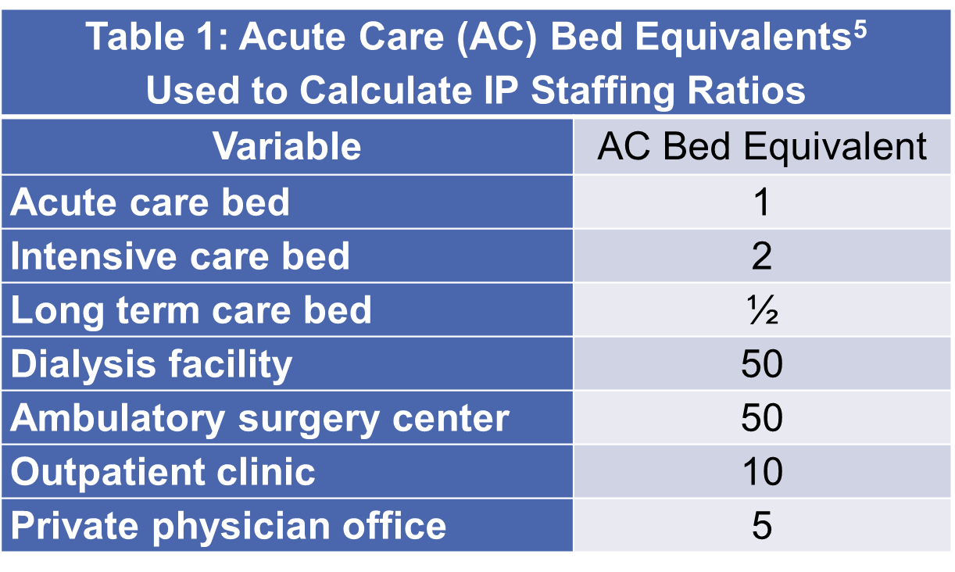
One approach to consider
Developed by NYSDOH

Slide 22
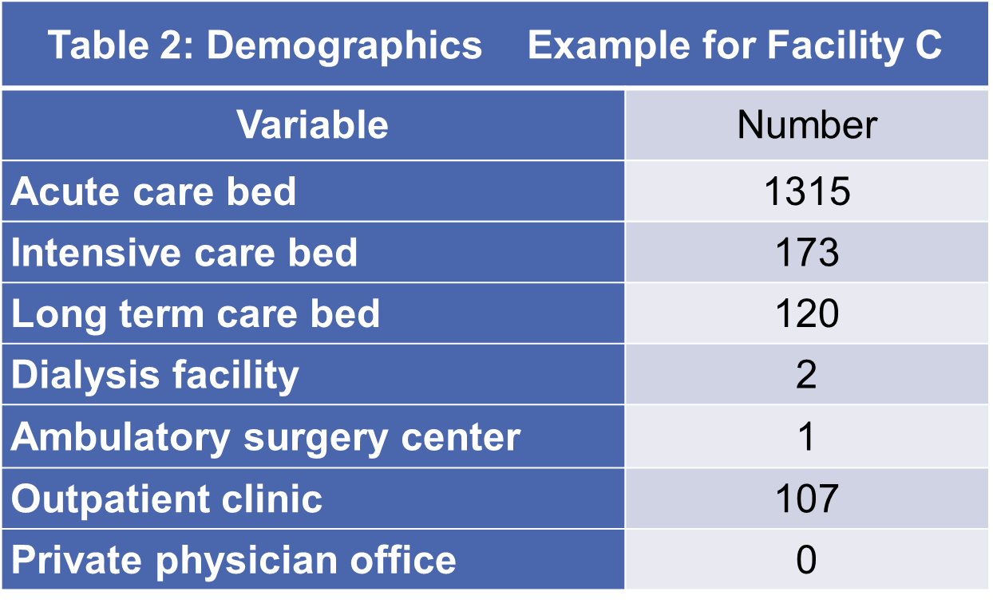
One approach to consider

Slide 23
One approach to consider
Aggregate Calculation Using Acute Care Bed Equivalents Example: Facility C
Variable | Number | Acute Care Bed Equivalent | Aggregate Total
Acute care beds | 1315 | 1 | 1315
Intensive care beds | 173 | 2 | 346
Long term care beds | 120 | ½ | 60
Dialysis facilities | 2 | 50 | 100
Ambulatory surgery centers | 1 | 50 | 50
Outpatient clinics | 107 | 10 | 1070
Private physician offices | 0 | 5 | 0
Total Acute Care Beds = 1315 |  | Total Aggregate Beds = 2941

Slide 24
One approach to consider
Facility C has 9 IP resources, so…
  Acute care bed ratio = 1:146
  Aggregate acute care bed ration = 1:327
Reminder: recommendations range from 1:100 to 1:167 to 1:250

Slide 25
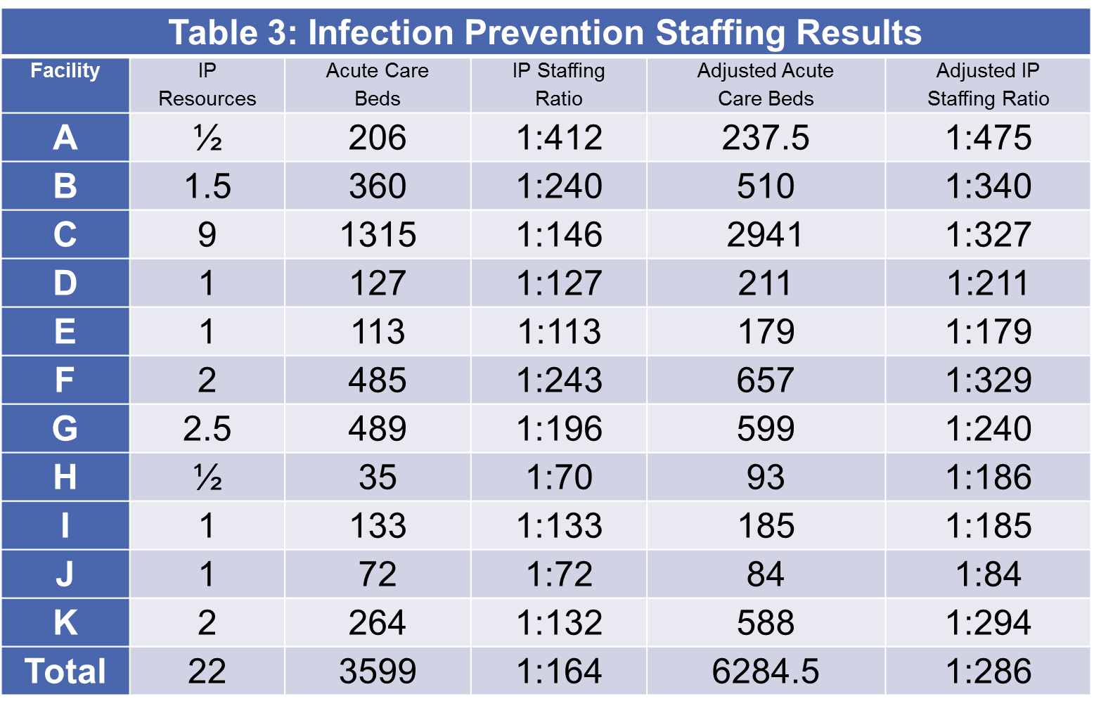
One approach to consider

Slide 26
References
Haley RW, Culver DH, White JW, Morgan WM, Emori TG, Munn VP, et al. The efficacy of infection surveillance and control programs in preventing nosocomial infection in US hospitals. Am J Epidemiol 1985; 121:182-205.
O’Boyle C, Jackson M, Henly SJ. Staffing requirements for infection control programs in US health care facilities: Delphi project. Am J Infect Control 2002; 30:321-33.
Health Canada. Development of a resource model for infection prevention and control programs in acute, long term, and home care settings: Conference proceedings on the infection prevention and control alliance. Am J Infect Control 2004 Feb;32(1)2-6.
Stone PW, Dick A, Pogorzelska M, Horan TC, Furuya EY, Larson E. Staffing and structure of infection prevention and control programs. Am J Infect Control 2009;37:351-7.
New York State Department of Health. Hospital-Acquired Infections – New York State 2012. Available at http://www.health.ny.gov/statistics/facilities/hospital/hospital_acquired_infections/.
Stone PW, Pogorzelska-Maziarz M, Herzig CT, Weiner LM, Furuya EY, Dick A, et al. State of infection prevention in US hospitals enrolled in the Nation Healthcare Safety Network. Am J Infect Control 2014;42:94-9.
Stricof RL, Schabses KA, Tserenpuntsag B. Infection control resources in New York State hospitals, 2007. Am J Infect Control 2008;36:702-5.
Nguyen GT, Proctor SE, Sinkowitz-Cochran RL, Garrett DO, Jarvis WR. Status of infection surveillance and control programs in the United States, 1992-1996. Association for Professionals in Infection Control and Epidemiology, Inc. Am J Infect Control 2000;28:392-400.

Slide 27
Contact Information
Questions?
Kate Gase
BJC HealthCare
kag9373@bjc.org

Slide 28

May 16 (FREE Teleclass - Broadcast live from the 2016 IPAC-Canada conference)
PHYSICIANS, FARMERS, AND THE POLITICS OF ANTIBIOTIC RESISTANCE
Dr. Laura H. Kahn, Woodrow Wilson School of Public and International Affairs,
Princeton University
Sponsored by Virox Technologies Inc. (www.virox.com)
May 16 (FREE Teleclass - Broadcast live from the 2016 IPAC-Canada conference)
WHAT’S NEW IN NUMBER 2? UPDATE ON DIARRHEAL DISEASE FROM A
GLOBAL PERSPECTIVE
Dr. Dave Goldfarb, BC Children’s Hospital, Vancouver
Sponsored by GOJO (www.gojo.com)
May 26 IMPLEMENTATION OF CLINICAL INDICATION DWELL TIME FOR
PERIPHERAL IV – CHECK THE PATIENT NOT THE CLOCK
Chellie DeVries, Methodist Hospital, Schererville, Indiana
June 6 ARE YOUR CLEANING WIPES SAFE? EVIDENCE SUPPORTING THE “ONE
ROOM - ONE WIPE” APPROACH IN HEALTHCARE SETTINGS

Slide 29


Slide 30


