Slide 1
Live broadcast from Infection Prevention 2017
What makes infection prevention and control work?
Julie Storr
Director and Consultant, S3 Global,
Contracted by World Health Organization
www.webbertraining.com
September 18, 2017

Slide 2
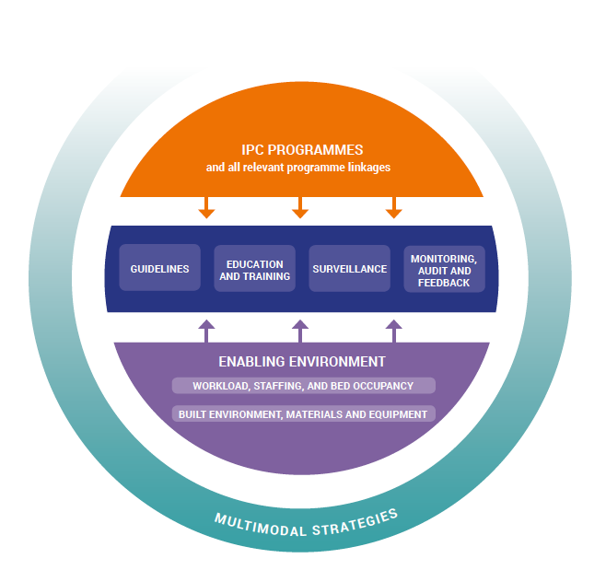
WHO (2016) Core components of IPC programmes at the national and acute health care facility level

Slide 3
WHO (2016) Core components of IPC programmes at the national and acute health care facility level

Slide 4
WHO (2016) Core components of IPC programmes at the national and acute health care facility level

Slide 5
WHO (2016) Core components of IPC programmes at the national and acute health care facility level

Slide 6
LEADERSHIP
WHO (2016) Core components of IPC programmes at the national and acute health care facility level

Slide 7
Two questions
What do you expect of people in leadership roles?
Why do you think we’re sometimes disappointed in our leaders?
Gundlach AM (2017) Johns Hopkins School of Public Health. Foundations of Organizational Leadership.

Slide 8
Most common answers
Expectations
Integrity
Visionary
Inspirational
Decisive
Team builder
Disappointments
Don’t walk the talk
Self-centered
Non-participative
Poor communication
Dishonest
Center for Creative Leadership 2011

Slide 9
“The vision thing”
Roy Lilley (2017) The Vision Thing. NHS Managers.Net http://myemail.constantcontact.com/The-vision-thing.html?soid=1102665899193&aid=Y5yv0aevPiI

Slide 10
Assumptions
Leaders think differently to non-leaders
Leaders commitment and passion are not mechanical – they must be authentic
“Felt” leadership is essential especially in times of uncertainty and change
The only leadership is ethical leadership – our integrity defines us
Every leader has a story – what’s yours???
Gundlach AM (2017) Johns Hopkins School of Public Health. Foundations of Organizational Leadership.

Slide 11
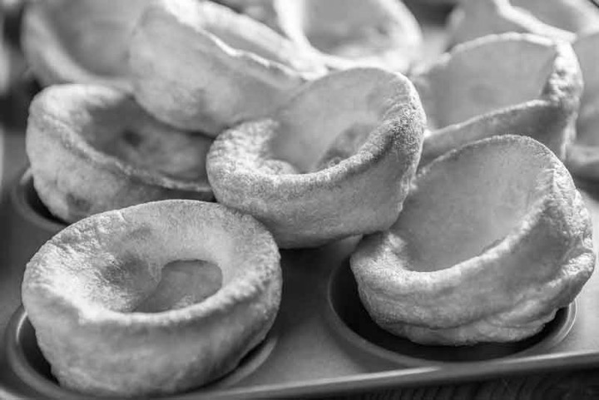
My story in 60 (ish) seconds

Slide 13
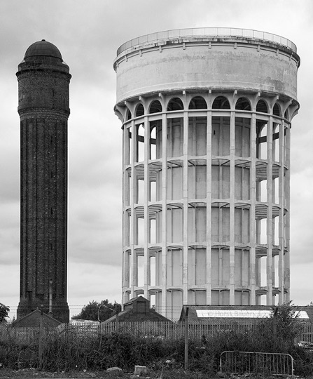

Slide 14
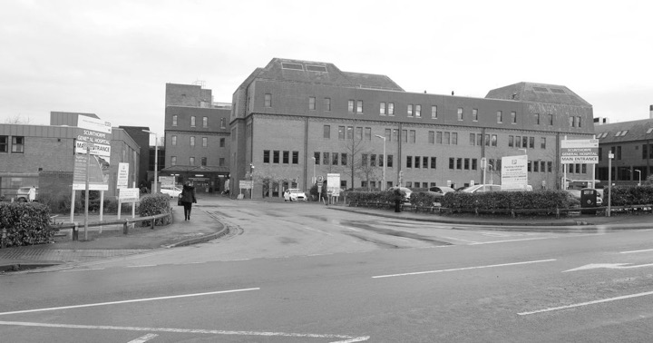

Slide 15
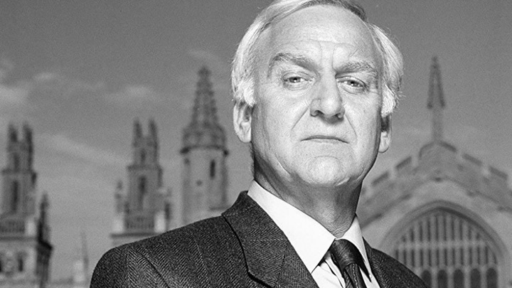

Slide 18
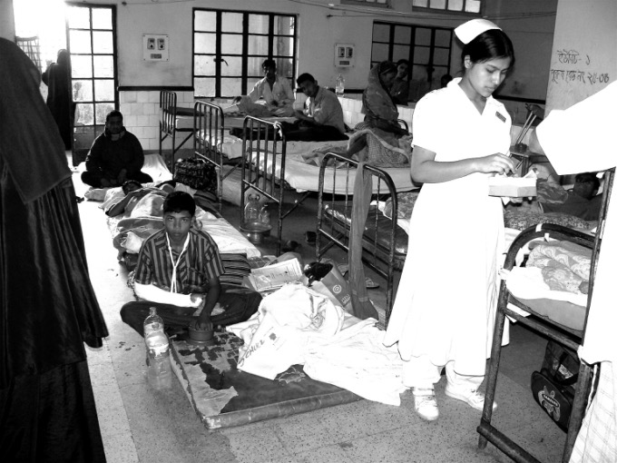

Slide 19
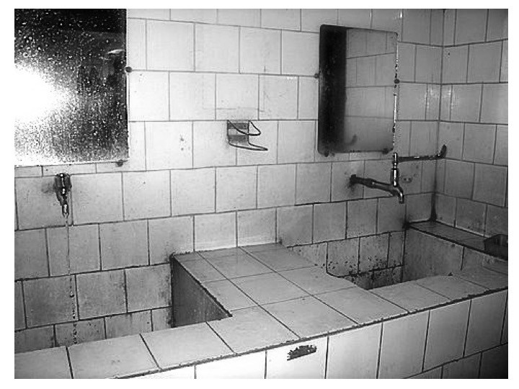
Notes:
Mention autoclacve in Liberia – get some quotes from Liberia

Slide 20
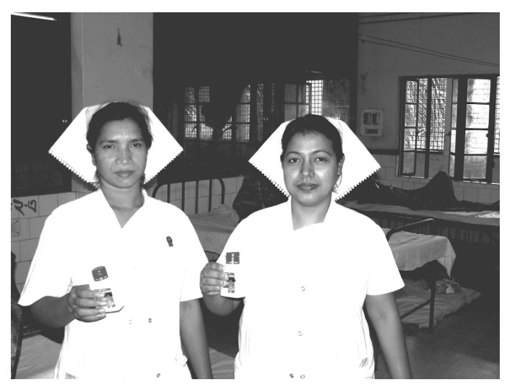

Slide 21
Storr et al (2016) Redefining infection prevention and control in the new era of quality universal health coverage. Journal of Research in Nursing. Vol 21(1) 39-52
Notes:
Draw out some quotes from this – how IPC brings everyone e round the table- build on it – when we are addressing eg AMR

Slide 22
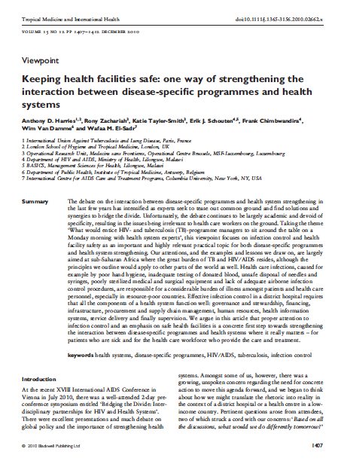
Harries et al (2010) Keeping health facilities safe: one way of strengthening the interaction between disease specific programmes and health systems. Tropical Medicine and International Health vol 15(12) 1407-1412

Slide 23
“For health care workers in different disciplines in a busy district hospital or health centre to gather around the table on a Monday morning requires a topic of mutual interest, importance and relevance. Infection control and health facility safety fulfill these criteria, both for the health care worker fraternity and the constituency of patients who utilize the facility.
Harries et al (2010) Keeping health facilities safe: one way of strengthening the interaction between disease specific programmes and health systems. Tropical Medicine and International Health vol 15(12) 1407-1412

Slide 24
“Infection control fills the void, and provides relevant issues for discussion that require local leadership, a sound understanding of disease epidemiology, clarity of thought, community inputs and a pragmatic approach to finding solutions.”
Harries et al (2010) Keeping health facilities safe: one way of strengthening the interaction between disease specific programmes and health systems. Tropical Medicine and International Health vol 15(12) 1407-1412

Slide 25
“Health systems cannot and should not be discussed in the abstract. They have to exist to optimally deliver services for real people, and they have to prevent and treat diseases that have names, such as TB and HIV ⁄ AIDS. A focus on infection control provides the necessary specificity, the exemplary practice of which requires that all components of the health system function.”
Harries et al (2010) Keeping health facilities safe: one way of strengthening the interaction between disease specific programmes and health systems. Tropical Medicine and International Health vol 15(12) 1407-1412

Slide 26
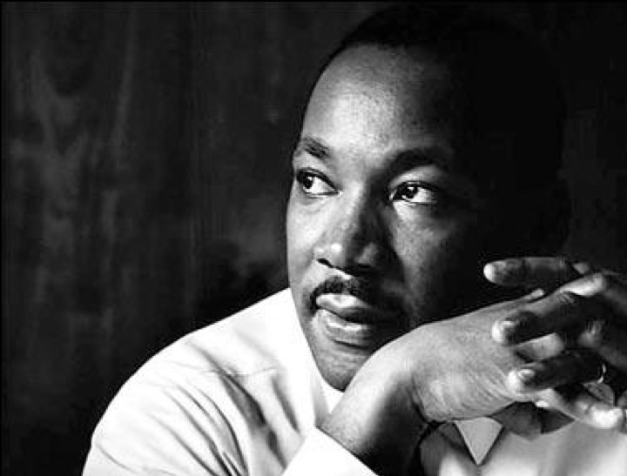
“Of all the forms of inequality, injustice in health care is the most shocking and inhumane." Dr. Martin Luther King Jr
.
Notes:
"There is no better way to reduce the devastating injustice of global poverty than by trying to improve peoples health“
The national health systems in Africa have inadequately human and financial resources, and limited infrastructures, especially in regard to laboratories, information and communication systems, and this leads to a weak capacity to provide universal coverage and respond to outbreaks and disasters.
Maternal mortality is one of Africas most tragic heal problems...
At present 31 countries have maternal mortality ratios ranging from 550 to 1000 per 100,000 live births
Good health services are those which deliver effective, safe, quality personal and non personal health interventions to those that need them, when and where needed with minimum waste of resources (Sambo 2010)

Slide 27
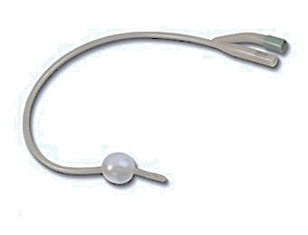
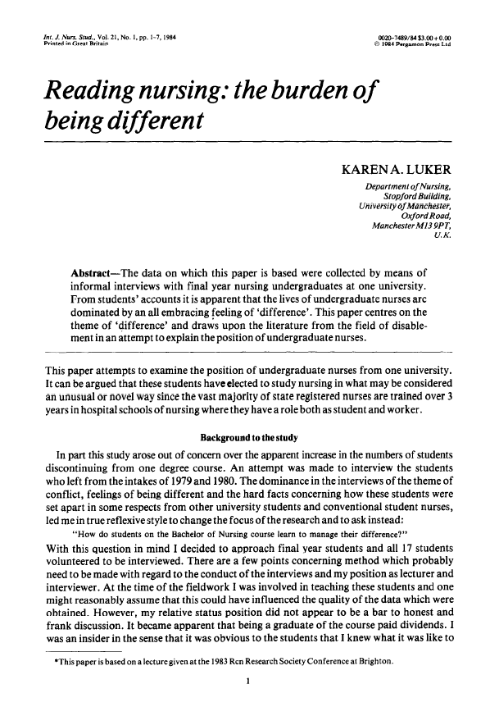
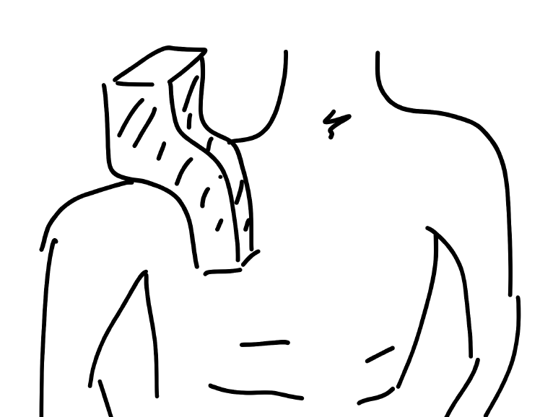
Luker KA (1984) Reading nursing: the burden of being different. International Journal of Nursign Studies. Vol 21, no 1. 1-7

Slide 28
Walsh M, Ford P (1989) Nursing Rituals: research and rational actions. Butterworth-Heinemann

Slide 29
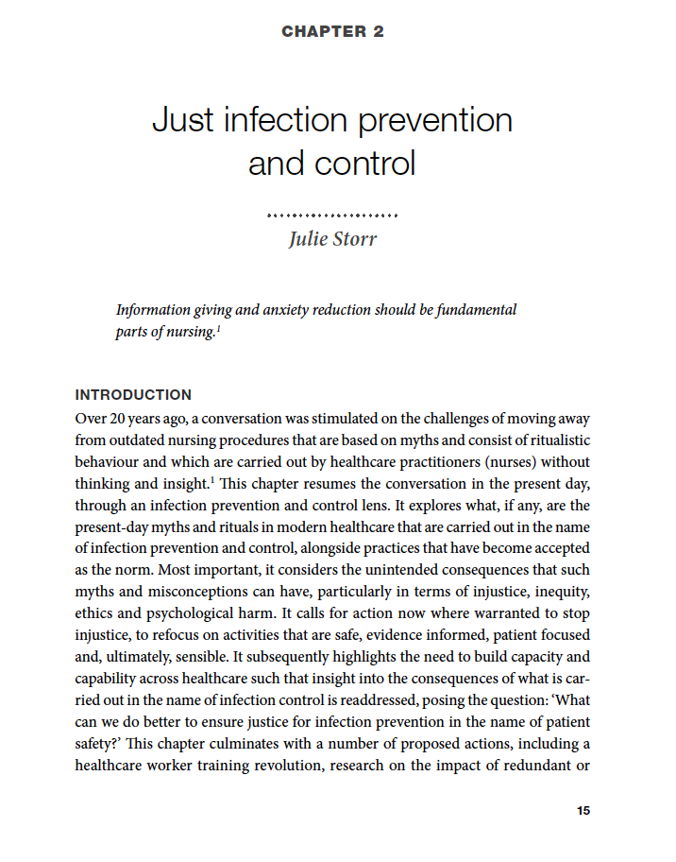
Elliott P, Storr J, Jeanes A (2015) Infection prevention and control: perceptions and perspectives. CRC Press

Slide 30
WHO (2016) Core components of IPC programmes at the national and acute health care facility level

Slide 31
Viv Duncanson
Wendy Feirn
Rozilla Horton
Tricia Hart
Helen Glenister
Anne Michelle Gundlach

Slide 32
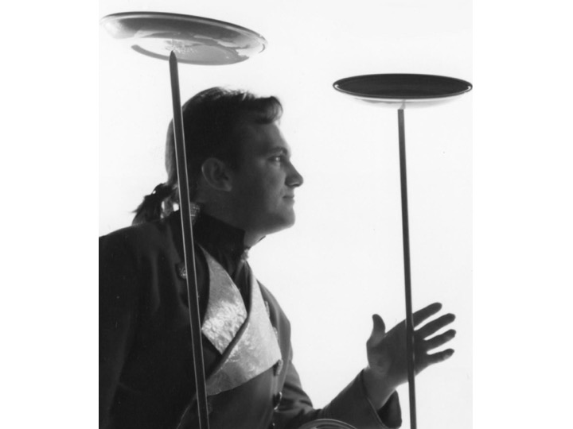

Slide 33
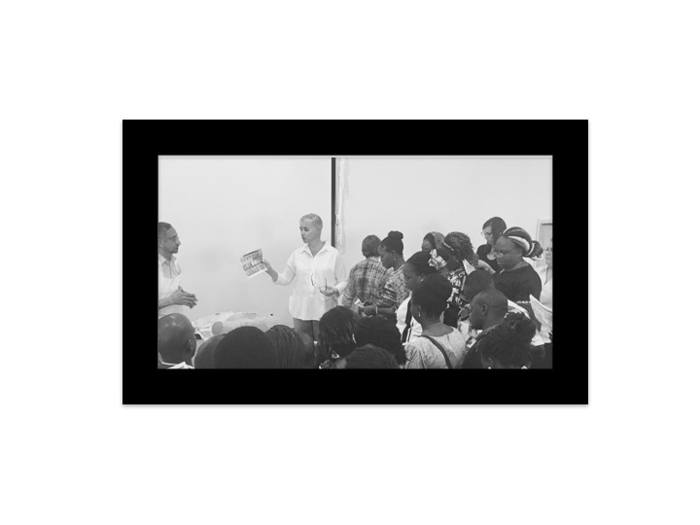

Slide 34
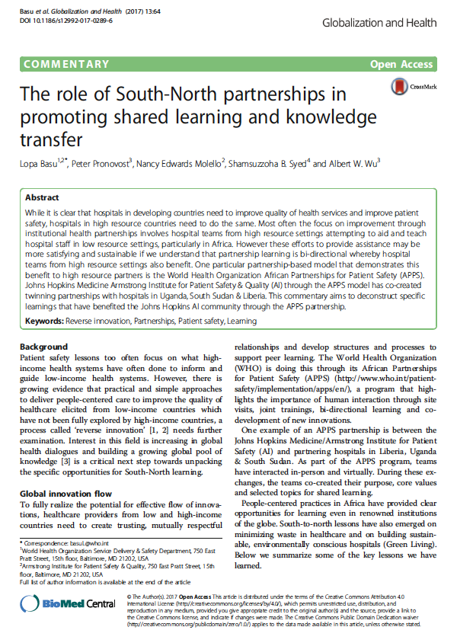
“As we must recognize. Good ideas with impact - of course - emerge everywhere.”
Basu L et al (2017) The role of South-north partnerships in promoting shared learning and knowledge transfer. Globalization and Health 13: 64

Slide 35
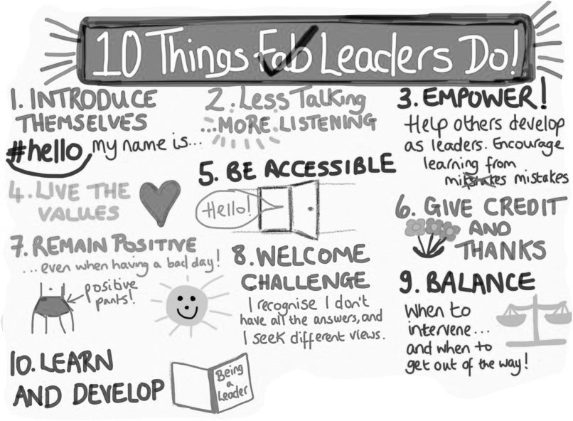
Helen Bevan (2017) New and revised: 10 things fab leaders do https://twitter.com/helenbevan/status/850038936361738244?lang=en

Slide 36
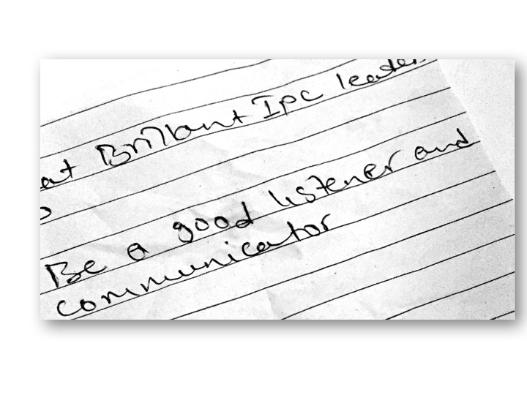

Slide 37
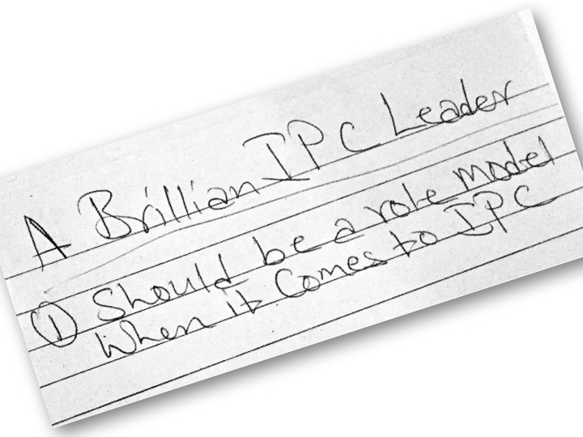

Slide 38
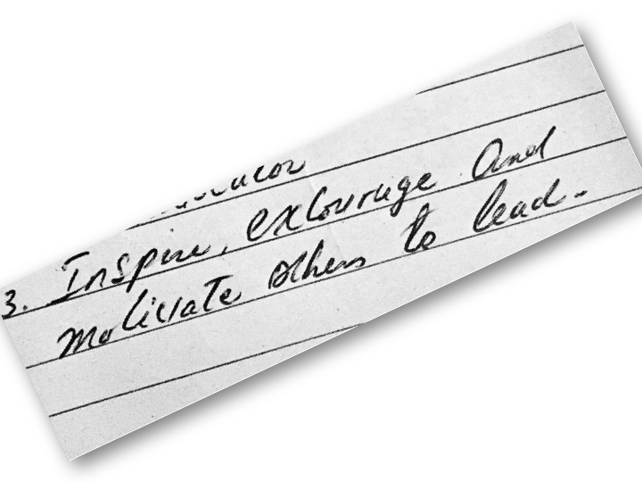

Slide 39
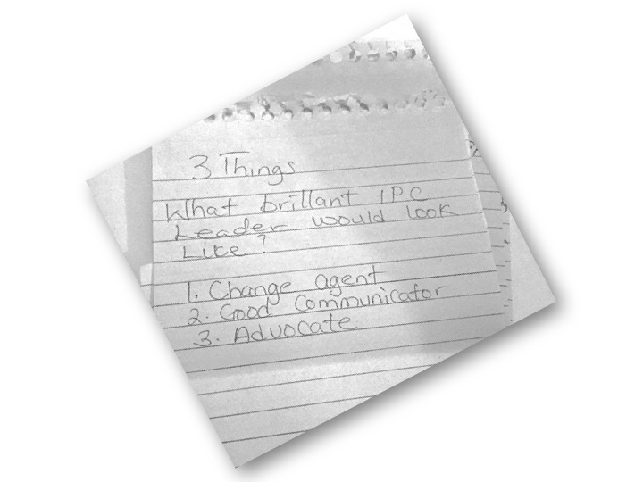

Slide 40
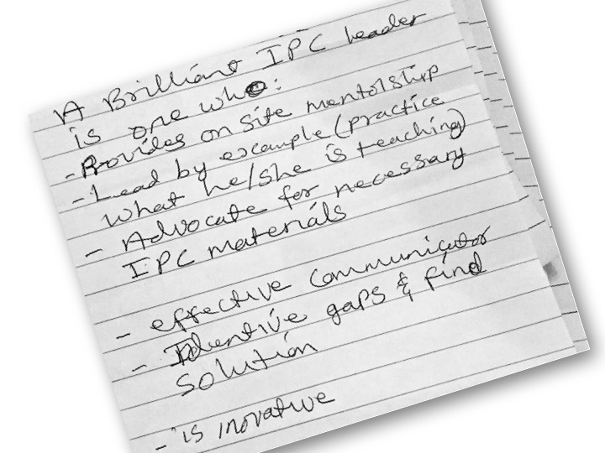

Slide 42
Thank you

