Slide 1
Influenza and Viral Pneumonia
Rodrigo Cavallazzi, MD
University of Louisville
Hosted by Paul Webber paul@webbertraining.com
www.webbertraining.com
March 21, 2019

Slide 2
Influenza and Viral Pneumonia
Conflicts of interest
Site investigator for a clinical trial investigating a new antiviral for adults with respiratory syncytial virus infection (Gilead)
Site investigator for a clinical trial investigating a new drug for influenza (GlaxoSmithKline)

Slide 3
Influenza and Viral Pneumonia
Objectives
Review the epidemiology of the main respiratory viruses
Highlight the difficulty to recognize a viral infection on clinical grounds
Lay out a treatment strategy for patients with pneumonia and respiratory viral infection
Point future directions

Slide 4
Influenza and Viral Pneumonia
Outline
Cases
Epidemiology
Clinical manifestations
Treatment
Future directions

Slide 5
Influenza and Viral Pneumonia
Case 1
A 65-year-old lady presents to the ER in January with the sudden onset of high temperatures, pleuritic chest pain and shortness of breath over the last 24 hours. She also has runny nose and malaise. She admitted having a household contact recently diagnosed with influenza. On physical examination, the patient appears ill and has a temperature of 39.9°C. A chest radiograph shows infiltrate in the right middle lobe. You diagnose the patient with community-acquired pneumonia and decide to admit her on the basis of vital signs and co-morbidities. You obtain blood and sputum cultures. A rapid influenza immunoassay sent by the triage staff member returns negative. What actions do you take?

Slide 6
Influenza and Viral Pneumonia
Case 1
Start treatment for community acquired bacterial pneumonia with azithromycin only
Start treatment for community acquired bacterial pneumonia with ceftiaxone and azithromycin
C. Start treatment for community acquired bacterial pneumonia with antibiotics and for influenza with oseltamivir
D. Start treatment for community acquired bacterial pneumonia with antibiotics and for influenza with amantadine

Slide 7
Influenza and Viral Pneumonia
Case 1
Start treatment for community acquired bacterial pneumonia with azithromycin only
Start treatment for community acquired bacterial pneumonia with ceftiaxone and azithromycin
C. Start treatment for community acquired bacterial pneumonia with antibiotics and for influenza with oseltamivir
D. Start treatment for community acquired bacterial pneumonia with antibiotics and for influenza with amantadine

Slide 8
Influenza and Viral Pneumonia
Case 2
A 41 year-old gentleman presents to the ER with cough, sputum production, pleuritic chest pain, and shortness of breath over the last 2 days. He had been diagnosed with influenza infection 3 weeks ago and received a treatment course with oseltamivir. On physical examination, his temperature is 39°C, respiratory rate is 28 breaths/min, blood pressure is 110/60 mmHg, and heart rate is 115 beats/min. On lung auscultation there are crackles on the right base. The CXR reveals an infiltrate in the right lower lobe. In addition to Streptococcus pneumoniae, which other pathogen would be of particular concern in this scenario:

Slide 9
Influenza and Viral Pneumonia
Case 2
a) Klebsiella pneumoniae
b) Moraxella catarrhalis
c) Pseudomonas aeruginosa
d) Acinetobacter baumannii
e) Staphylococcus aureus

Slide 10
Influenza and Viral Pneumonia
Case 2
a) Klebsiella pneumoniae
b) Moraxella catarrhalis
c) Pseudomonas aeruginosa
d) Acinetobacter baumannii
e) Staphylococcus aureus

Slide 11
Influenza and Viral Pneumonia
Epidemiology
Respiratory viral infections are prevalent
Affect vulnerable, such as children, elderly, and people living in developing areas
Molecular techniques
Pandemics and outbreaks
Cavallazzi R, Ramirez JA. Clin Chest Med. 2018 Dec;39(4):703-721.

Slide 12
Influenza and Viral Pneumonia
Epidemiology
Pandemics and Outbreaks
1918 to 1919 Spanish influenza pandemic
1957 H2N2 Asian influenza pandemic
1968 H3N2 Hong Kong influenza pandemic
1977 H1N1 Russian influenza pandemic
2009 H1N1 pandemic
201,200 respiratory deaths
83,000 cardiovascular deaths
Most of these deaths occurred in patients younger than 65 years old
Cavallazzi R, Ramirez JA. Clin Chest Med. 2018 Dec;39(4):703-721.

Slide 13
Influenza and Viral Pneumonia
Epidemiology
Pandemics and Outbreaks
February 28 2013– Hospital contacted the Hanoi office of the WHO
Patient presented with unusual influenza-like virus
Reilley B et al. N Engl J Med. 2003 May 15;348(20):1951-2.

Slide 14
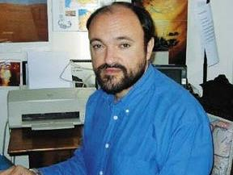
Influenza and Viral Pneumonia
Epidemiology
Pandemics and Outbreaks
Dr. Carlo Urbani answered the call
He worked on the hospital, documented findings, arranged for samples to be tested
Reilley B et al. N Engl J Med. 2003 May 15;348(20):1951-2.

Slide 15
Influenza and Viral Pneumonia
Epidemiology
Pandemics and Outbreaks
Of the first 60 patients with the illness, more than half were health care workers
Many of the staff members made the difficult decision to quarantine themselves
Some health care workers decided to sleep in the hospital
Reilley B et al. N Engl J Med. 2003 May 15;348(20):1951-2.

Slide 16
Influenza and Viral Pneumonia
Epidemiology
Pandemics and Outbreaks
On March 9 2013 Dr. Urbani had a meeting with the Vice Minister of Health of Vietnam
4 four-hour discussion– the hospital was quarantined
March 11, he began to have symptoms during a flight to Bangkok
Reilley B et al. N Engl J Med. 2003 May 15;348(20):1951-2.

Slide 17
Influenza and Viral Pneumonia
Epidemiology
Pandemics and Outbreaks
2003: Severe acute respiratory syndrome – Urbani strain of severe acute respiratory syndrome–associated coronavirus
2012: Middle East respiratory syndrome—coronavirus
Cavallazzi R, Ramirez JA. Clin Chest Med. 2018 Dec;39(4):703-721.

Slide 18
Influenza and Viral Pneumonia
Immunocompetent vs immunosuppressed
Epidemiology
Community respiratory viruses
Endogenous reactivation
Community-acquired respiratory viruses
Cavallazzi R, Ramirez JA. Clin Chest Med. 2018 Dec;39(4):703-721.

Slide 19
Influenza and Viral Pneumonia
Epidemiology
 | Proportion of viral infection
Community-acquired pneumonia | 24.5%
Hospital-acquired pneumonia
Non-immunocompromised | 11.2%
Immunocompromised | 36.1%
Cavallazzi R, Ramirez JA. Clin Chest Med. 2018 Dec;39(4):703-721.

Slide 20
Influenza and Viral Pneumonia
Epidemiology
Cavallazzi R, Ramirez JA. Clin Chest Med. 2018 Dec;39(4):703-721.

Slide 21
Influenza and Viral Pneumonia
Epidemiology
Virus is a “bystander” and does not have a pathogenic effect. | Although uncommon in adults, asymptomatic carriage of respiratory viruses occurs.
Virus has a pathogenic effect and is causing pneumonia in isolation. | Potential mechanisms include dysregulation of cytokines and chemokines, infection of epithelial cells in the lungs, and apoptosis.
Virus has a pathogenic effect and is causing pneumonia along with a bacterial pathogen | A study showed that the mortality for patients with community-acquired pneumonia and bacterial and viral co-infection is higher.
Virus caused a recent infection that prompted a secondary bacterial infection. | This occurs particularly with Streptococcus pneumoniae or Staphylococcus aureus infection following influenza infection. Lag time of 2 to 4 weeks between the viral and bacterial infection. Polymerase chain reaction test may remain positive for up to 5 weeks after a viral infection.
Cavallazzi R, Ramirez JA. Clin Chest Med. 2018 Dec;39(4):703-721.

Slide 22
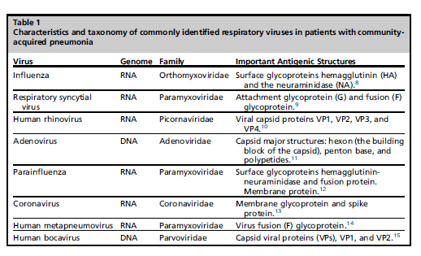
Influenza and Viral Pneumonia
Epidemiology
Characteristics of the viruses
Cavallazzi R, Ramirez JA. Clin Chest Med. 2018 Dec;39(4):703-721.

Slide 23
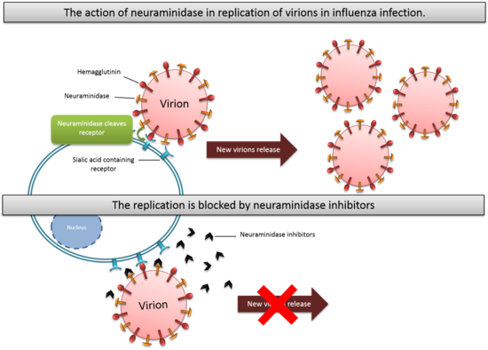
Influenza and Viral Pneumonia
Epidemiology
Influenza
Available at: https://en.wikipedia.org/wiki/Discovery_and_development_of_neuraminidase_inhibitors

Slide 24
Influenza and Viral Pneumonia
RNA virus
Types A, B, and C based on its nucleoprotein and matrix protein
Influenza A
H1N1, H1N2, and H3N2 based on hemagglutinin and neuraminidase
Influenza B
B/Yamagata and the B/Victoria lineages
Epidemiology
Influenza
Cavallazzi R, Ramirez JA. Clin Chest Med. 2018 Dec;39(4):703-721.

Slide 25
Influenza and Viral Pneumonia
Antigenic drift: gene mutation that influenza undergoes every year
Antigenic shift: new hemagglutinin or neuraminidase subtypes are acquired
Epidemiology
Influenza
Cavallazzi R, Ramirez JA. Clin Chest Med. 2018 Dec;39(4):703-721.

Slide 26
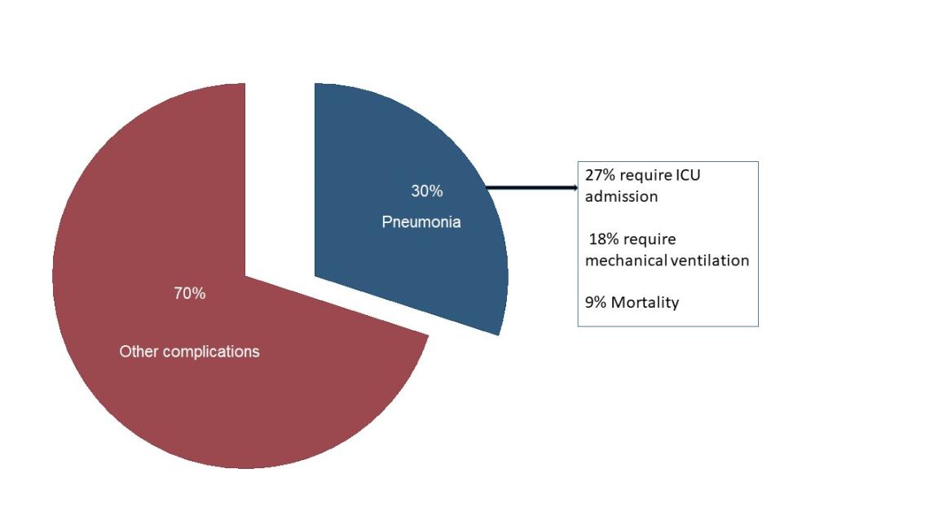
Influenza and Viral Pneumonia
Epidemiology
Influenza
Cavallazzi R, Ramirez JA. Clin Chest Med. 2018 Dec;39(4):703-721.

Slide 27
Influenza and Viral Pneumonia
Epidemiology
Respiratory Syncytial Virus
In older subjects, the burden of RSV infection is similar to that of influenza
RSV–associated hospitalization rate per 100,000 person-years
age 50 to 64 years: 12.8
> 65 years: 86.1
Cohort of hospitalized patients > 65 years with RSV:
31% had an infiltrate on chest radiograph
15% required ICU admission
13% required mechanical ventilation
8% died
Cavallazzi R, Ramirez JA. Clin Chest Med. 2018 Dec;39(4):703-721.

Slide 28
Influenza and Viral Pneumonia
Epidemiology
Rhinovirus
Most common cause of common cold (2 to 4 times per year in adults)
Sneezing, nasal discharge, sore throat, and low-grade fever
Rhinovirus tends to occur more often in the early fall or spring
Most commonly identified pathogen in a large cohort of adult patients hospitalized with community-acquired pneumonia conducted in the United States
Cavallazzi R, Ramirez JA. Clin Chest Med. 2018 Dec;39(4):703-721.

Slide 29
Influenza and Viral Pneumonia
Winter and follows seasonal pattern similar to influenza
HCoV-229E, HCoV-NL63, HCoV-OC43, and HCoV-HKU1 are common cause of common cold
Adult hospitalized patients with coronavirus infection are often immunocompromised, and pneumonia is a common
Severe acute respiratory syndrome coronavirus and Middle East respiratory syndrome coronavirus
Epidemiology
Coronavirus
Cavallazzi R, Ramirez JA. Clin Chest Med. 2018 Dec;39(4):703-721.

Slide 30
Influenza and Viral Pneumonia
Common cause of upper respiratory tract symptoms and conjunctivitis
Adult patients with adenovirus pneumonia are relatively young
Causes serious infection in immunocompromised patients
Outbreaks
Epidemiology
Adenovirus
Cavallazzi R, Ramirez JA. Clin Chest Med. 2018 Dec;39(4):703-721.

Slide 31
Influenza and Viral Pneumonia
Most infections are caused by parainfluenza 1 and 3
Influenzalike symptoms are a common manifestation of parainfluenza
In children, common presentations are croup and bronchiolitis
In hospitalized patients, age ranged 61.5 to 77.5 years
Of those infected by parainfluenza-3, 59% had an infiltrate on chest radiograph
Epidemiology
Parainfluenza
Cavallazzi R, Ramirez JA. Clin Chest Med. 2018 Dec;39(4):703-721.

Slide 32
Influenza and Viral Pneumonia
4.5% of acute respiratory illnesses of adults prospectively followed as outpatients
4% of patients with community-acquired pneumonia
Mean age in CAP and metapneumovirus infection: 62 years
Epidemiology
Metapneumovirus
Cavallazzi R, Ramirez JA. Clin Chest Med. 2018 Dec;39(4):703-721.

Slide 33
Influenza and Viral Pneumonia
More common in children
More common in the winter
Common clinical presentations include upper respiratory tract symptoms, bronchiolitis, and pneumonia
Detected in acute respiratory illness of adults with immunosuppression and chronic lung disease
Epidemiology
Human bocavirus
Cavallazzi R, Ramirez JA. Clin Chest Med. 2018 Dec;39(4):703-721.

Slide 34
Influenza and Viral Pneumonia
Clinical Manifestations
Influenza
Cough
Fever
Fatigue
Myalgia
Runny nose
Wheezing
Dyspnea
Cavallazzi R, Ramirez JA. Clin Chest Med. 2018 Dec;39(4):703-721.

Slide 35
Influenza and Viral Pneumonia
Clinical Manifestations
Influenza
Cavallazzi R, Ramirez JA. Clin Chest Med. 2018 Dec;39(4):703-721.

Slide 36
Influenza and Viral Pneumonia
Clinical Manifestations
Influenza
Symptoms or clinical impression are not enough to rule in or rule out influenza
Clinicians failed to clinically diagnose influenza in approximately two-thirds of influenza-confirmed patients
Surveillance data
Contact with persons with acute febrile illness
Recent travel
Cavallazzi R, Ramirez JA. Clin Chest Med. 2018 Dec;39(4):703-721.

Slide 37
Influenza and Viral Pneumonia
Clinical Manifestations
Respiratory Syncytial Virus
Wheezing
Clinical-radiological dissociation
Cough (97%)
Dyspnea (95%)
Wheezing (73%)
Physical examination
Wheezing (82%)
Temp > 39°C (13%)
Cavallazzi R, Ramirez JA. Clin Chest Med. 2018 Dec;39(4):703-721.

Slide 38
Influenza and Viral Pneumonia
Clinical Manifestations
Other Viruses
No specific clinical manifestations
Diagnosis of viral infection in patients with pneumonia relies on the recognition that respiratory viruses are a common etiology
Cavallazzi R, Ramirez JA. Clin Chest Med. 2018 Dec;39(4):703-721.

Slide 39
Influenza and Viral Pneumonia
Radiological Manifestations
Cavallazzi R, Ramirez JA. Clin Chest Med. 2018 Dec;39(4):703-721.

Slide 40
Influenza and Viral Pneumonia
Radiological Manifestations
Cavallazzi R, Ramirez JA. Clin Chest Med. 2018 Dec;39(4):703-721.

Slide 41
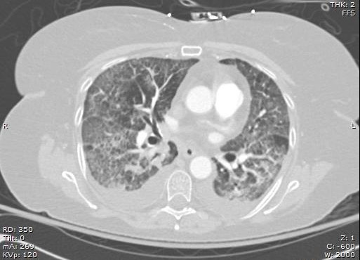
Influenza and Viral Pneumonia
Radiological Manifestations
Cavallazzi R, Ramirez JA. Clin Chest Med. 2018 Dec;39(4):703-721.

Slide 42
Influenza and Viral Pneumonia
Treatment
Approach to the patient with community-acquired pneumonia
Empirical treatment for influenza
Point-of-care PCR available
Influenza season
Cavallazzi R, Ramirez JA. Clin Chest Med. 2018 Dec;39(4):703-721.

Slide 43
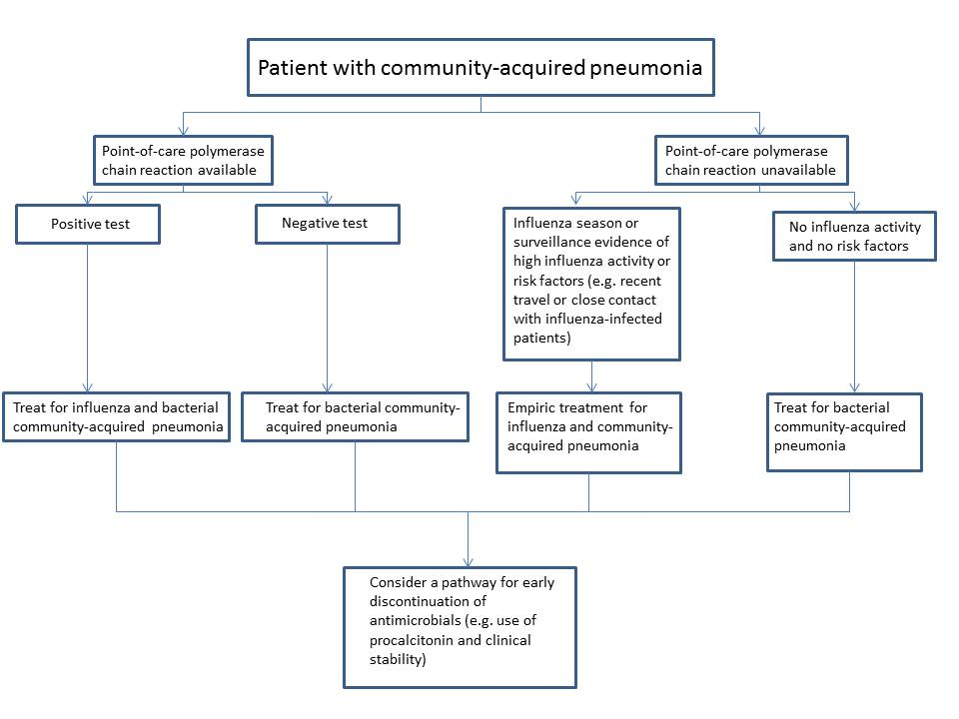
Cavallazzi R, Ramirez JA. Clin Chest Med. 2018 Dec;39(4):703-721.

Slide 44
Influenza and Viral Pneumonia
Treatment
Viral pathogen-directed therapy
Immunocompetent vs Immunosuppressed
Risk factors (e.g. pregnancy)
Severity of illness
Cavallazzi R, Ramirez JA. Clin Chest Med. 2018 Dec;39(4):703-721.

Slide 45
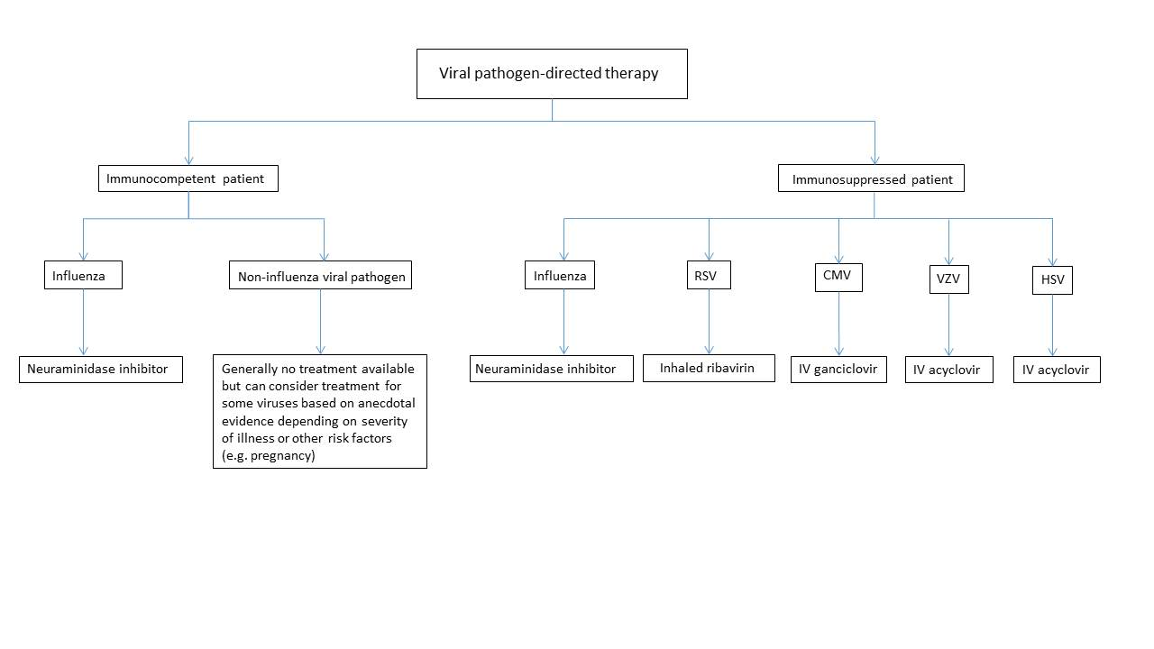
Influenza and Viral Pneumonia
Treatment
Viral pathogen-directed therapy
Cavallazzi R, Ramirez JA. Clin Chest Med. 2018 Dec;39(4):703-721.

Slide 46
Influenza and Viral Pneumonia
Treatment
Viral pathogen-directed therapy
Influenza
Alleviation of symptoms | 8 studies | 2208 patients oseltamivir 1746 patients in placebo | 16.8 hours; 95% CI 8.4–25.1 hours
Pneumonia prevention | 8 studies | 2694 patients oseltamivir 1758 in the placebo group | Risk difference of 1% [0.22%–1.49%]
Hospitalization prevention | 7 studies | 2663 patients oseltamivir 1731 in the placebo group | Risk ratio 0.92; 95% CI 0.57–1.5
Cavallazzi R, Ramirez JA. Clin Chest Med. 2018 Dec;39(4):703-721.

Slide 47
Influenza and Viral Pneumonia
Treatment
Viral pathogen-directed therapy
Influenza
Hospitalized
Severe, complicated, or progressive disease
Higher risk for influenza complications
Benefit greatest when it is started early
Survival benefit has been demonstrated with treatment up to 5 days after symptom initiation
Cavallazzi R, Ramirez JA. Clin Chest Med. 2018 Dec;39(4):703-721.

Slide 48
Influenza and Viral Pneumonia
Discontinuation of Antibiotics
Clinical pathway
Viral microbiology testing plus procalcitonin
Cavallazzi R, Ramirez JA. Clin Chest Med. 2018 Dec;39(4):703-721.

Slide 49
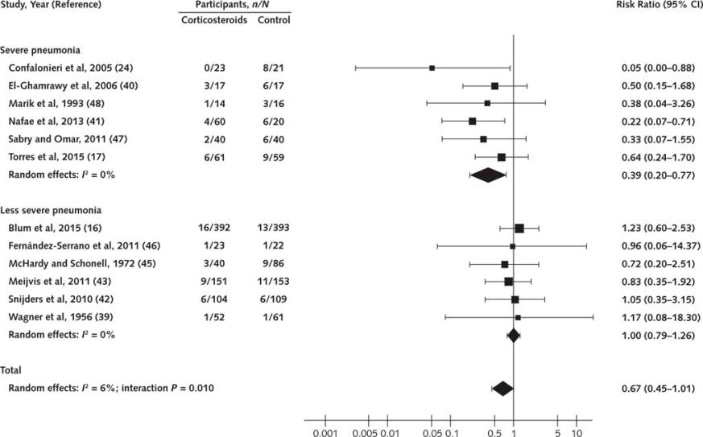
Influenza and Viral Pneumonia
Corticosteroid therapy
Siemieniuk RA et al. Ann Intern Med. 2015 Oct 6;163(7):519-28.

Slide 50
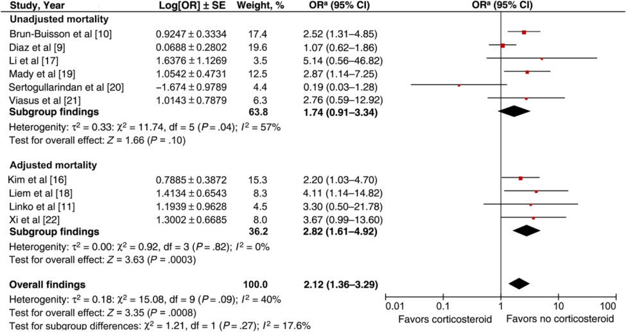
Influenza and Viral Pneumonia
Corticosteroid Therapy
Rodrigo C et al. J Infect Dis. 2015 Jul 15;212(2):183-94.

Slide 51
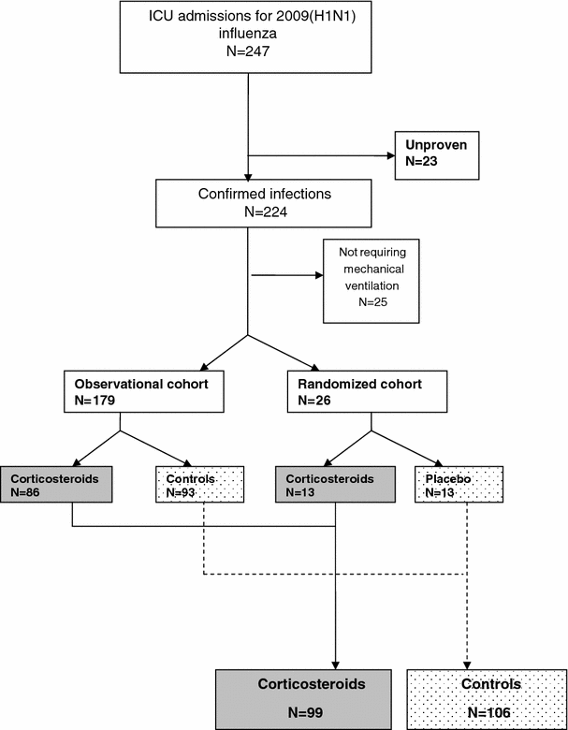
Influenza and Viral Pneumonia
Corticosteroid Therapy
Annane D et al. Intensive Care Med. 2012 Jan;38(1):29-39.

Slide 52
Influenza and Viral Pneumonia
Future Research
Clinical pathways using point-of-care tests
New antivirals
Fusion inhibitor for RSV
Inhibition of mRNA synthesis for influenza
Combination therapy for influenza and other viruses

Slide 53
Influenza and Viral Pneumonia
Take-home points
Respiratory viral infections are common
25% of patients with community-acquired pneumonia
Also common in hospital-acquired pneumonia
Outbreaks and pandemics
Immunocompetent vs Immunosuppressed
It is difficult to diagnose influenza or other viral infection on clinical grounds

Slide 54
Influenza and Viral Pneumonia
Take-home points
PCR based tests
Pathogen directed therapy
Immune status
Risk factors
Severity of illness

Slide 55
THANK YOU

Slide 56
