Slide 1




Is mandatory influenza vaccination the best way to protect our patients?
Michael Gardam MSc, MD, CM, MSc FRCPC
Division of Infectious Diseases
Director, Infection Prevention and Control
Chair, Medical Advisory Committee
University Health Network
University of Toronto
Canada
Teleclass broadcast sponsored by
www.schuelke.com
www.webbertraining.com
September 3, 2015

Slide 2
Overview
Why this policy?
Influenza
  epidemiology
  transmission
  vaccine
Vaccine or mask policies
  development and implementation
Other approaches
Conclusion

Slide 3
Influenza or mask policy
Receive the influenza vaccine by the start of influenza season
OR
Wear a surgical mask in clinical areas for the duration of the season

Slide 4
Arguments in support
Influenza kills the elderly and infirm
We cannot wait for better studies
  Precautionary approach
  it would be unethical to do further studies
  Randomized controlled trials are gold standard
Patient safety comes first
The policy is better than nothing
Moral/ethical obligation
Nothing else works to increase vaccination rates
Patients support it
Others countries are doing it

Slide 5


Slide 6

Policy decisions
Moral, ethical, safety
consequences
Scientific evidence

Slide 7
How many people die from/with influenza each year (CDN data)?
4000-8000?
  mathematical models typically assign all/majority of excess winter mortality to influenza
  clearly an overestimate
<500?
  actual number of deaths with influenza that are reported
  Not all cases detected
  clearly an under estimate

Slide 8
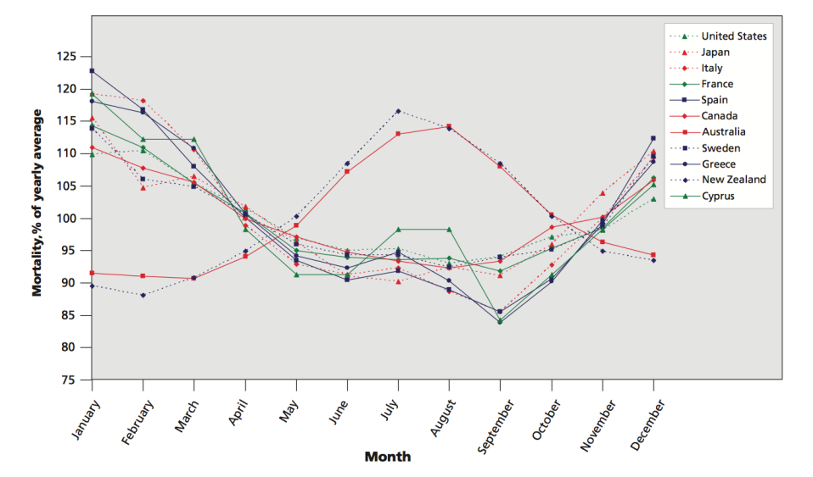
Excess Winter Mortality
Range: 5-30%
Falagas et. al., CMAJ 2009

Slide 9
Is it fair to assign excess winter mortality to influenza?
Some, yes (estimated 10%)
But average community attack rate is roughly 10-20%
Influenza is a minority cause of influenza-like illness (ILI) so it should not be used as a surrogate

Slide 10
CDN 2014-2015 influenza

Slide 11
CDN 2014-2015 Non-influenza

Slide 12
All viruses combined

Slide 13
NZ 2012 data influenza

Slide 14
NZ 2012 data Non-influenza

Slide 15
NZ all viruses combined

Slide 16
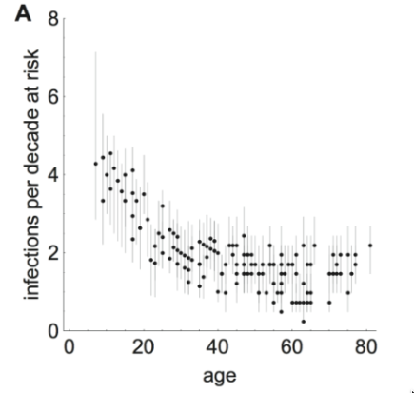
How often do we catch influenza?
Examined antibody levels to 9 influenza strains from 1968-2009 in China
roughly 2 infections per decade >age 40
Kucharski et. al. PLOS Biology 2015

Slide 17
3-8 patients/ 10 000 admissions develop nosocomial influenza
What proportion comes from healthcare workers?
All of it
Some of it
We have no idea
Answer: 3

Slide 18
Healthcare workers with influenza
Prospective study of ill healthcare workers
  54% had a viral pathogen
    8% had influenza
      51% of these were febrile
      no difference in fever if vaccinated/unvaccinated (45% vs 61%, p=0.32)
If using fever as a work exclusion criteria, will miss half of staff with influenza
Ridgway et. al. Clin Infect Dis 2015

Slide 19
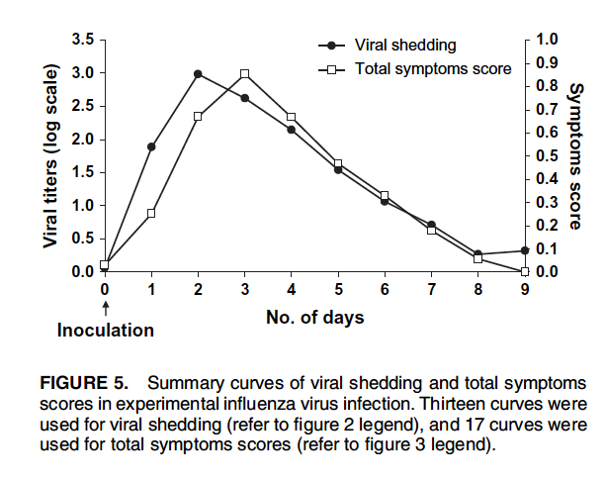
asymptomatic transmission?
Carrat et. al., 2008

Slide 20
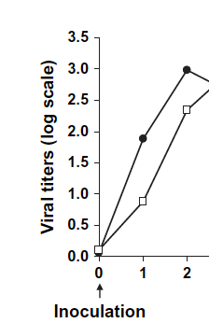
Many symptoms, >100 fold more virus
some symptoms, 10-fold more virus
No symptoms, little virus
Carrat et. al., 2008

Slide 21
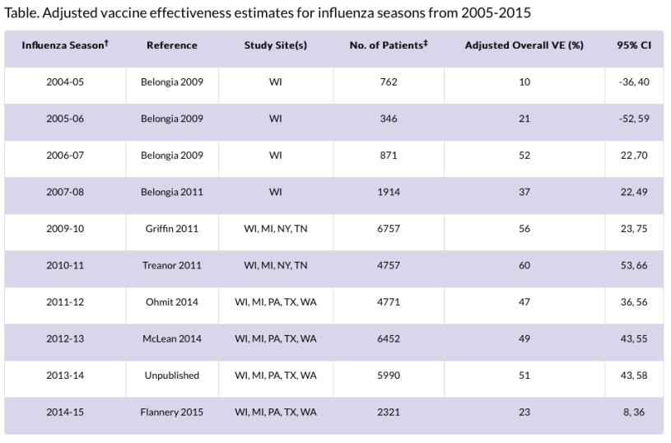
Vaccine Effectiveness, 2005-2015
mean=41
CDC, 2015

Slide 22
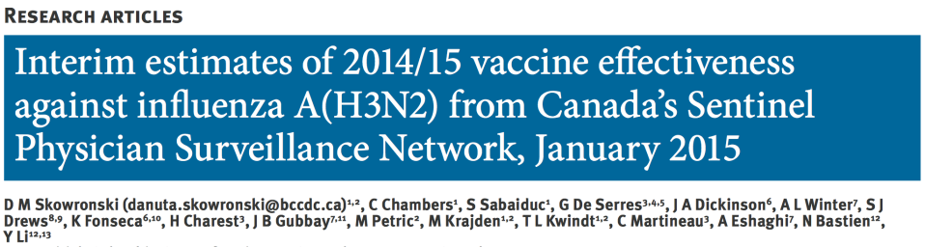
-8% Vaccine Effectiveness (95% CI: -50 to 23%)

Slide 23
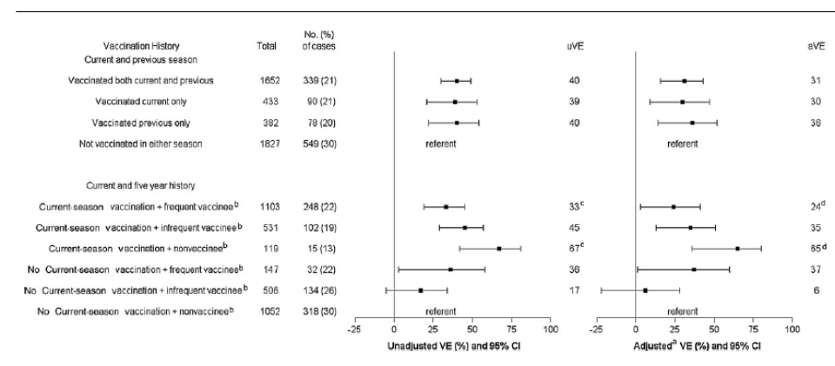
Vaccination paradox
McLean et. al., CID 2014

Slide 24
Conclusions
Influenza causes a minority of influenza-like illness
<<1% of patients will get nosocomial influenza
The risk of influenza transmission to patients from healthcare workers is unknown
The vaccine is mediocre and repeat vaccination may make it more so
Asymptomatic transmission is likely negligible

Slide 25
On to the Randomized
Controlled Trials

Slide 26
4 RCTs in long term care
Pooled data (3 studies) showed no significant impact on influenza-specific (or even influenza-related) outcomes
Pooled data (3 studies) showed a significant reduction in all cause mortality
  CDC RR=0.71 (0.59-0.85)—29% reduction
  Cochrane RR=0.66 (0.55-0.79)—32% reduction

Slide 27
How can this be?
In two studies most of the differences in all cause mortality occurred before the onset of influenza activity
The reduction in mortality is greater than that for all excess winter mortality
  only 10% is believed to be due to influenza
The vast majority of healthcare workers remained unprotected

Slide 28
Hayward et. al.
35% vaccination coverage
30% reduction in all-cause mortality
“the number of staff needed to be vaccinated to prevent one death… was 8”
What?
Hayward BMJ, 2006

Slide 29
Why influenza-specific mortality matters
Total cases of ILI=100
  Influenza: 15/100 = 15%
  Non-flu: 85/100 = 85%
With placebo (effectiveness 0%)
  % reduction in flu = 0
  % reduction in non-flu = 0
  % total reduction = 0
All non-influenza causes of ILI
n=85
Influenza
n=15

Slide 30
60% effectiveness
(assuming 100% vaccine penetration)
Total cases of ILI=91
  Influenza: 6/91 = 7%
  Non-flu: 85/91 = 93%
  % reduction in flu: 60%
  % reduction in non-flu: 0%
  Total reduction: (100-91/100)*100=9%
All non-influenza causes of ILI
n=85
Influenza
n=6

Slide 31
Example: Pneumococcal vaccine
decreased risk of invasive pneumococcal disease OR 0.26 (0.14-0.45)
decreased all-cause pneumonia (low income population) OR 0.54 (0.43-0.67)
no effect on all-cause mortality
Moberley et. al. Cochrane database 2013

Slide 32
A decrease in all cause illness > specific illness is mathematically impossible
The long term care RCTs must have inherent biases
  Not-blinded
  Other outbreaks
  Changes in behaviour that affected flu rates
    other infection control practices
    biased case detection
  note that inadequate influenza diagnosis is very unlikely in these trials

Slide 33
The reason there is no reduction in influenza-specific mortality is because the vaccine has very little impact on this outcome

Slide 34
The Acute care RCT
Studied the impact of an educational intervention on vaccination rates
Secondary outcomes:
  nosocomial influenza + pneumonia
11% increase in vaccination rates resulted in a 50% decrease in influenza/pneumonia on one ward
Researchers acknowledged many sources of potential bias
Riphagen-Dalhuisen et. al., Eurosurveillance 2013

Slide 35
Are all clinical settings the same?
Long term care
Acute care
Complex continuing care
Home care
Ambulatory care

Slide 36



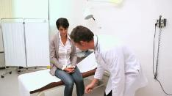

A trip to the family doctor

Slide 37
Conclusions
The available evidence is significantly flawed
All-cause mortality decrease cannot be due to vaccinating healthcare workers
To cite these studies as definitive (or even moderate) proof that healthcare worker vaccination saves lives is to mislead.
Patient care settings are not the same

Slide 38
What about this past CDN influenza season?
Vaccine effectiveness is zero for H3N2
Vaccinated staff do not need to mask, even when ill
  not necessarily required to take prophylaxis during outbreaks
Unvaccinated staff need to mask, even when not ill
  must take prophylaxis during outbreaks

Slide 39

How not to develop policy

Slide 40

Policy decisions
Morale, ethical, safety consequences
Flawed scientific evidence

Slide 41
“Misleading towards the truth”
Misleading toward the truth is exceedingly common. It is well-intentioned – or at least it is grounded in a normal mix of self-serving and altruistic intentions.
So what’s the problem? Misleading people, even toward the truth, is a very dangerous behavior. If and when people learn they have been misled, they have great trouble thereafter believing the truth they were misled toward. If and when they discover that the company or agency they have been listening to cannot be trusted, they jump to the conclusion that the facts it withheld or papered over must be damning. In our field, risk communication, this is predictable – as sound as Sound Science gets.
Sandman and Lanard

Slide 43

Is moral indignation a sound basis for policy?

Slide 44
Consequences of this policy
Negligible impact on patient safety
Eroded medical and scientific credibility
Ammunition for the anti-vaccination movement
Disenfranchised and potentially disciplined staff
Wrongful dismissal suits

Slide 45
Arguments in support of the policy
Influenza kills the elderly and infirm
We cannot wait for better studies
  Precautionary approach
  it would be unethical to do further studies
  Randomized controlled trials are gold standard
Patient safety comes first
The policy is better than nothing
Moral/ethical obligation
Nothing else works to increase vaccination rates
Patients support it
Others in Canada and the USA are doing it

Slide 46
Policy alternative
Encourage influenza vaccination
Avoid coming to the healthcare setting with influenza-like illness symptoms
If you must attend work/visit, wear a mask while ill
Sounds simple, but is isn’t.

Slide 47
Final conclusions
Vaccine or mask policies are fatally flawed
They will not significantly improve patient safety
They will potentially cause harm
There is a better, more logical policy alternative

Slide 48
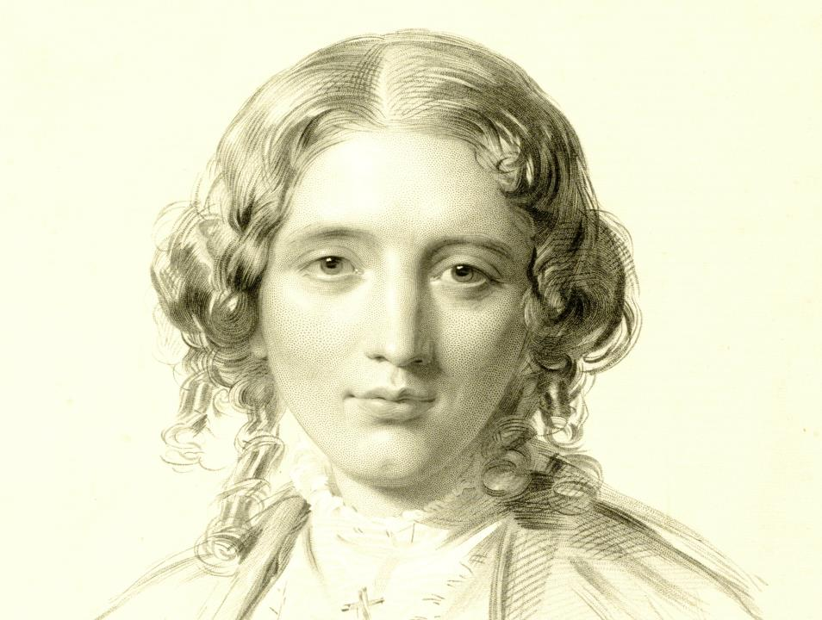
Physicians are quite as intolerant as theologians. They never had the power of burning at the stake for medical opinions, but they certainly have shown the will
Harriet Beecher Stowe

Slide 49
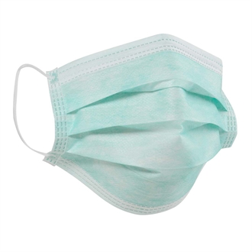
Questions

Slide 50


Slide 51

September 17 CAN ENERGY MANAGEMENT BENEFIT INFECTION PREVENTION?
Andrew Streifel, University of Minnesota
September 24 (Free Teleclass)
EVIDENCE VS. TRADITION: EXAMINING THE EVIDENCE OF BATHING TO
REDUCE HAI’S
Kathleen Vollman, Advanced Nursing LLC
Sponsored by Sage Products (www.sageproducts.com)
September 28 (Free British Teleclass ... Broadcast live from the 2015 IPS conference)
WHAT DID THE ROMANS EVER DO FOR US?
Carole Fry, Healthcare Infection Society
September 29 (Free British Teleclass ... Broadcast live from the 2015 IPS conference)
FAECAL TRANSPLANT TO TREAT CLOSTRIDIUM DIFFICILE DISEASE
Carole Fry, Healthcare Infection Society
September 30 (Free British Teleclass ... Broadcast live from the 2015 IPS conference)
THE EMERGENCE OF MERS: FROM ANIMAL TO HUMAN TO HUMAN

Slide 52


