Slide 1


Look at What the Cat Scratched In
Pet Associated Zoonoses:
What’s New and Relevant for Infection Prevention and Control
Jason Stull, VMD, MPVM, PhD, DACVPM
Assistant Professor
Hosted by Martin Kiernan
martin@webbertraining.com
www.webbertraining.com
September 10, 2010

Slide 2
Conflict of Interest Statement
The speaker declares he has no competing interests

Slide 3
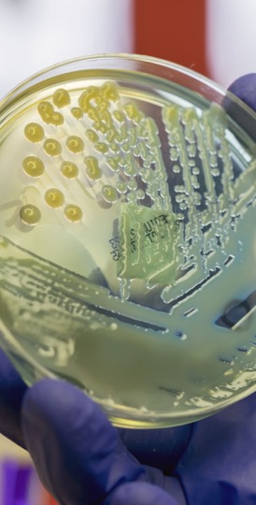
Objectives
Recall key pathogens associated with companion-animal (pet) zoonoses
Describe current knowledge on the epidemiology of these pathogens in human disease
Apply knowledge to develop and implement prevention strategies in various human-animal settings

Slide 4
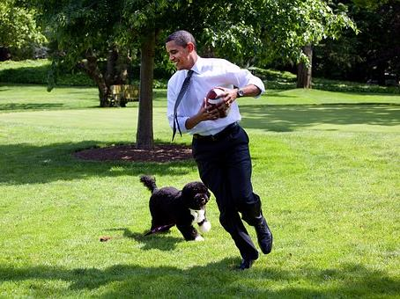
Pet Ownership is Common
Majority of homes have at least 1 pet
  Dog or cat (>50%)
  Fish
  Birds
  Rabbits, hamsters, guinea pigs, gerbils, ferrets, snakes, frogs, turtles, lizards
Photo Source: Pixabay

Slide 5

Human-Animal Bond
Distress & social isolation: ↓ health
Often strong bonds pets and owners
    ↓ stress, anxiety, loneliness, depression¹
    ↓ risk cardiovascular disease²
    Children: better social skills, self-esteem, empathy³
    Catalyst for harm reduction (e.g., tobacco, drug use)⁴
Photo Source: Pixabay
¹ Friedmann 2009 ² Patronek 1993 ³ Melson 1997 ⁴ Lem 2013

Slide 6
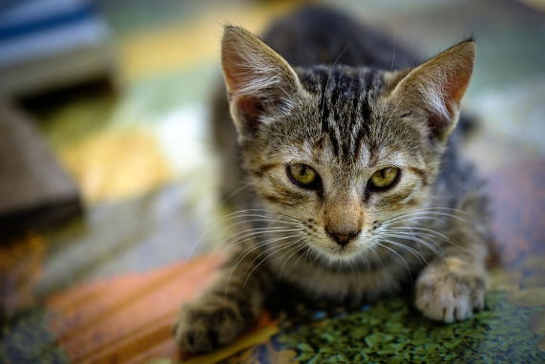
Immunocompromised
Mental & physical isolation
HIV-infected¹
  Pet as family member
  Source of support and affection
  Protect against loneliness
  Pet-owners with AIDS less depression than non-pet owners
Cancer patients²
  High level of attachment to pets
  Having a pet provided health benefits (67%)
Immunocompromised children³
Photo Source: Pixabay
¹ Siegel 1999 ² Larson 2010 ³Stull 2014

Slide 7

Pets incorporated into Human Healthcare¹
Builders of social capital
Harm reduction
Motivators for healthy behavior change
Participants in treatment plans
Photo Source: Pixabay
¹ Hodgson et al., 2015

Slide 8


Slide 9
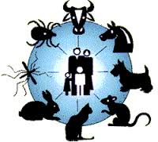
Zoonoses
Naturally transmitted from animals to people
Of 1,415 species pathogenic to people¹
  61% zoonotic
  75% emerging pathogens zoonotic
¹ Taylor 2001

Slide 10

Pet-Associated Disease
70+ pathogens of pets transmissible to people
Pets often subclinical shedding
Emerging & remerging diseases
Animal and human reservoirs
Further transmission possible
Dogs visiting human healthcare facilities¹
Photo Source: Pixabay
¹ Lefebvre 2009

Slide 11

Pet-Associated Disease Risks
Disease risk greatest
  Extremes of age (<5 yrs, ≥ 65 yrs)
  Pregnant
  Immunocompromised
Higher risk groups
  Particular pathogens
  Longer duration
  More severe/unexpected complications
Pet factors
Photo Source: Pixabay

Slide 12
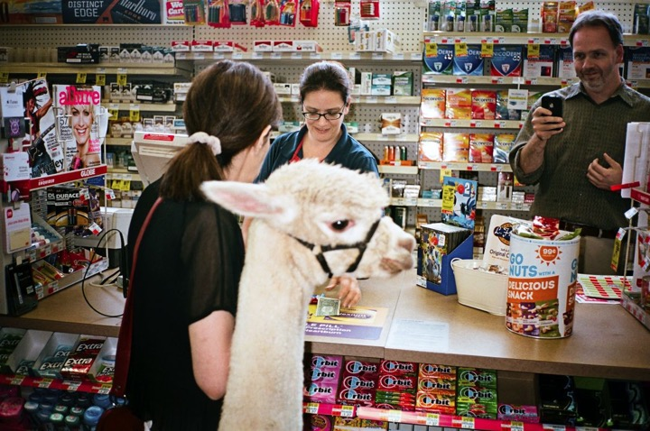
Photo Source: The New Yorker

Slide 13
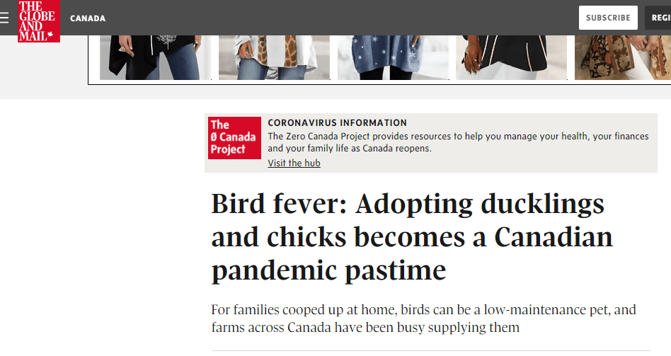

Slide 14
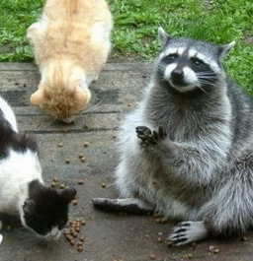
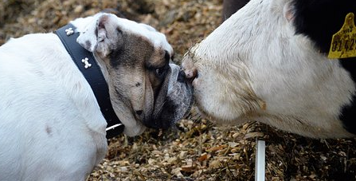
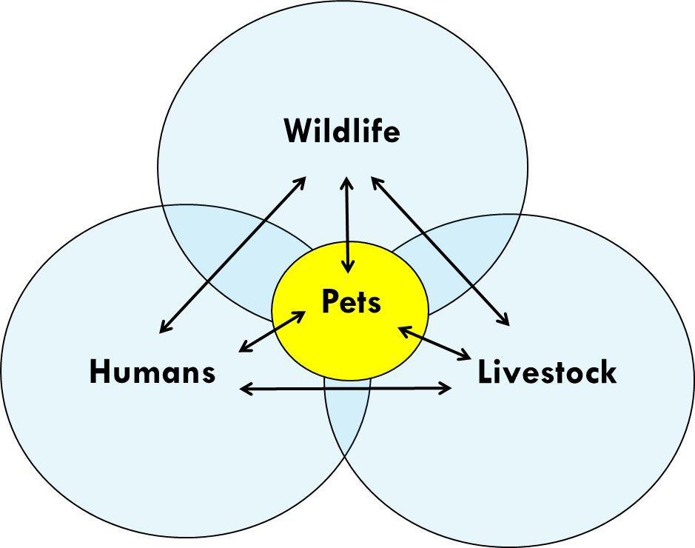
Pet-Associated Disease Transmission
Photo Source: Pixabay

Slide 15
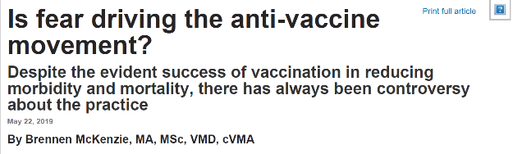
Relevance of Pet-Associated Zoonoses for Infection Prevention
Healthcare programs
  Service animals, patient’s pets, therapy animals, visitation animals
Patients
  Sick, preventive care, One Health
Simple precautions to greatly reduce risk
  Barriers: Lack of knowledge, reduced compliance preventive care
Incorporate into planning & patient history taking

Slide 16
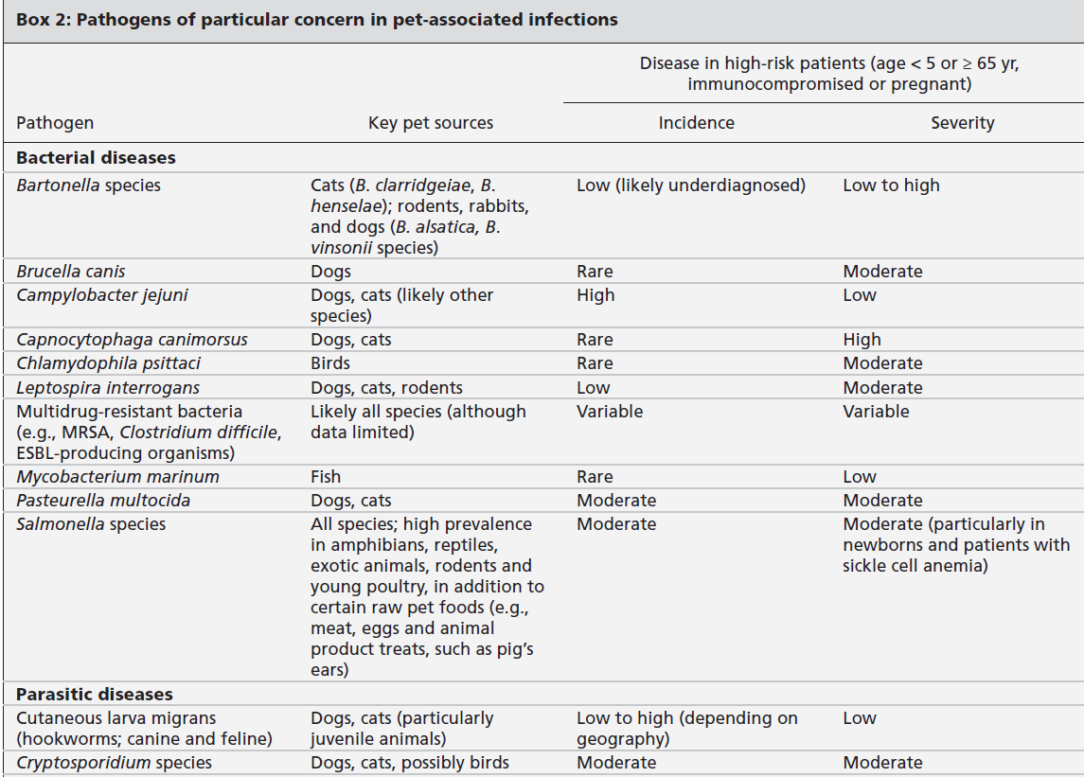
Stull JW, et al. CMAJ 2015
16

Slide 17
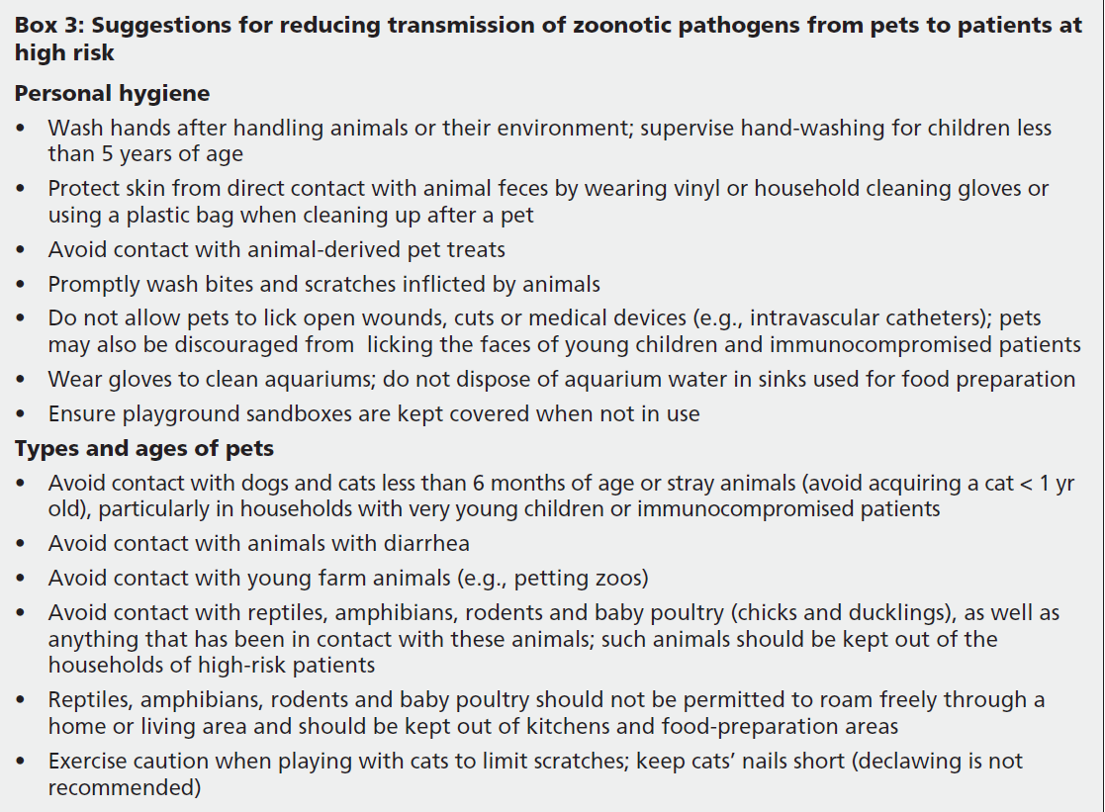
Stull JW, et al. CMAJ 2015
17

Slide 18
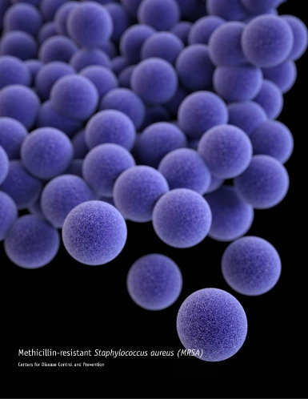
Staphylococcus aureus
MSSA: 12-14% dogs/cats; 50% dog-owner indistiguishable¹
MRSA
  0-9% of cats and dogs^{1,2}
  RFs: contact children, human hospitals, owned HCW, antimicrobial therapy^{3,4}
  Concurrent colonization between pets and owners
  14% pets in households with MRSA infected person (14% ↓ odds/day after person dx)⁵
  Colonization short-term (weeks)
  Pets: clinical cases skin and soft tissue infections
Photo Source: Centers for Disease Control and Prevention
¹ Hanselman 2009 ² Hoet 2013 ³ Lefebvre 2009 ⁴Faires. et al. 2010 ⁵Morris 2012

Slide 19

Methicillin-resistant Staphylococcus pseudintermedius (MRSP)
Antimicrobial resistant bacterium
Predominately in dogs
  Uncommon: cats, people
Rapidly emerging
  80% resistant to ≥ 7/11 antimicrobials¹
  41% dogs with bacterial pyoderma²
Photo Source: Pixabay
¹ Perreten, 2010 ² Beck, 2012

Slide 20
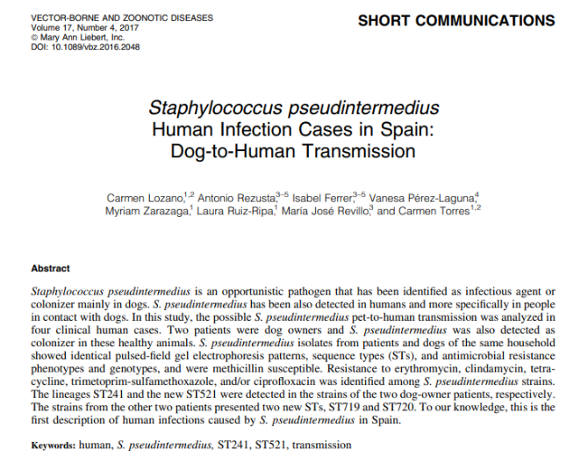
Methicillin-resistant Staphylococcus pseudintermedius (MRSP)
  Dogs often colonized without clinical signs
  Source of infection
  Common cause canine opportunistic infections
  Zoonotic (rarely)
¹ Weese, 2012 ²Eckholm, 2012 ³Nienhof, 2011 ⁴Bergstrom, 2012

Slide 21
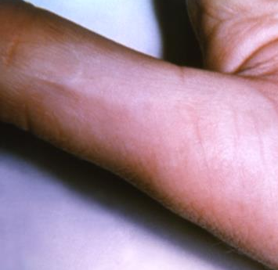
Bartonella Spp (Cat-Scratch Disease)
Bartonella henselae most common
Many species of Bartonella
  B. clarridgeiae and B. vinsonii subsp. berkhoffii transmissible from pets
Feline most important reservoir for zoonotic transmission
Transmitted by cat flea (Ctenocephalides felis) feces
Scratches or bites from cats: flea feces enters scratch wound
Photo Source: Centers for Disease Control and Prevention
21

Slide 22
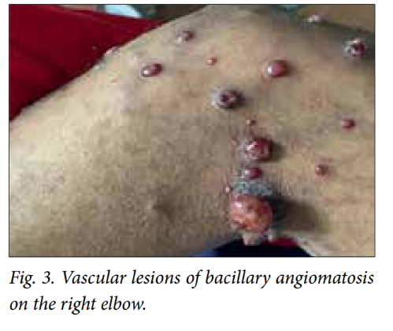
CSD: Frequency of Infection
People
  Estimated 22,000 cases diagnosed/yr in US
  Children < 10 yrs (33% of all diagnoses)
  Most often self-limiting benign disease; regional lymphadenopathy
  Cats
    Very common (up to 80% seropositive); bacteremia in 25-50% of healthy cats
    Chronic, asymptomatic bacteremia for months to years; esp young cats (< 1 year), flea-infested, strays
Photo Source: M C Madua 2015.

Slide 23

Prevention and Control
Flea control on cats
Avoid bites and scratches (training)
Wash (soap and water) bites and scratches
Immunocompromised individuals and pet cats
  Flea control!
  Promptly wash bites, scratches; prevent licking wounds
  Avoid higher risk cats: young (< 1 yr), stray, outdoor
Photo Source: Pixabay

Slide 24

Clostridium difficile: Dogs
Identified in healthy dogs (5-10%)¹
  Same strains in people and dogs
  Dog-human transmission risks unclear
  Healthcare: human to dog
Risk factors
  Human healthcare settings²
    Accepting treats, licking human patients
  Immunocompromised owner⁴
  Recent antimicrobials to dog or owner⁴
Photo Source: Pixabay
¹ Clooten, 2007 ² Lefebvre, 2009 ⁴ Weese, 2010

Slide 25
Extended-Spectrum beta-Lactamase–Producing Enterobacteriaceae
  Healthy and sick dogs
  Same strains as people¹
  Pet contact associated with increased risk ESBL colonization²
Antimicrobials RF for ESBL acquisition³
Interest in raw food diets
¹ Damborg P, 2015 ²Meyer, 2012 ³Wedley AL, 2017

Slide 26
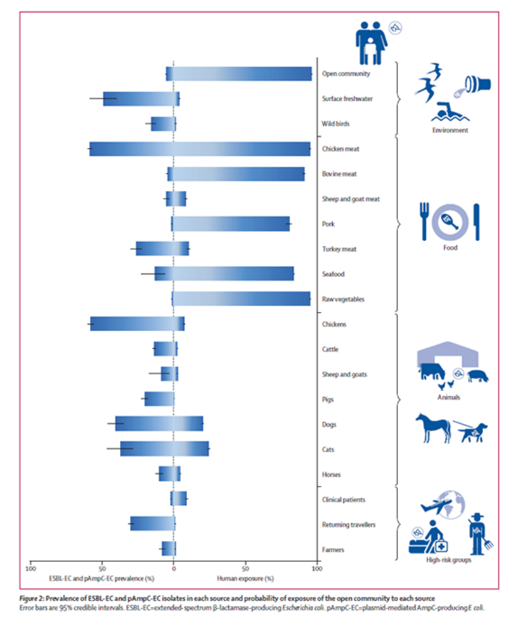
Attributable Sources: ESBL & CMY
E. coli data from Netherlands
Source attribution model based on prevalence and human exposure
Mughini-Gras, 2019
Mughini-Gras, 2019
26

Slide 27
Community Acquired ESBL & AmpC Attributed to…
Other people: 60% (40–74)
Food: 19% (7–38)
Dogs: 5% (0.2–16)
Cats: 2% (0.1–8)
Intracommunity spread alone unlikely to be self-maintaining without transmission to and from non-human sources
Mughini-Gras, 2019

Slide 28
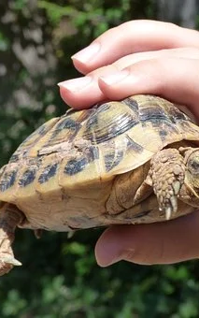
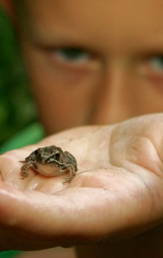
Salmonella spp
Reptiles, amphibians, and exotic species very high prevalence
Photo Source: Pixabay

Slide 29
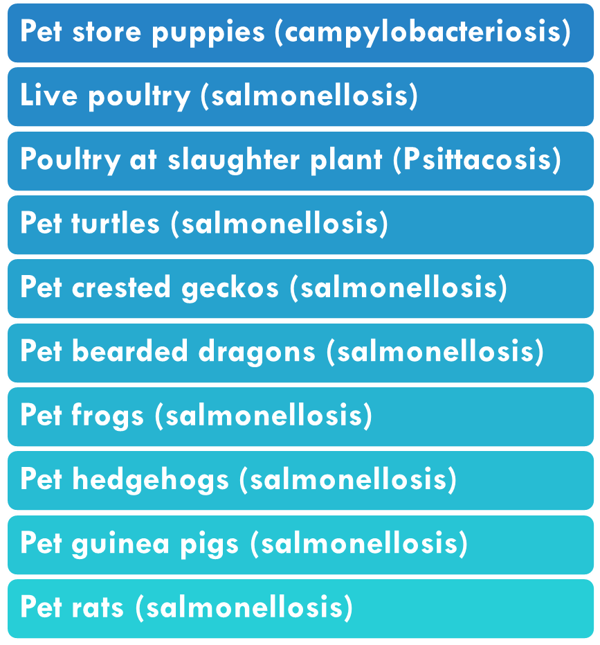
(Some) Animal-associated Human Outbreaks, USA
(2011-2020)
Source: Centers for Disease Control and Prevention (https://www.cdc.gov/healthypets/outbreaks.html)

Slide 30
Salmonella spp
Reptiles, amphibians, and exotic species very high prevalence
Overall uncommon in healthy dogs and cats
  Raw food diets and treats increase greatly risks (OR=23)¹
  Diarrhea
¹ Lefebvre, 2008

Slide 31
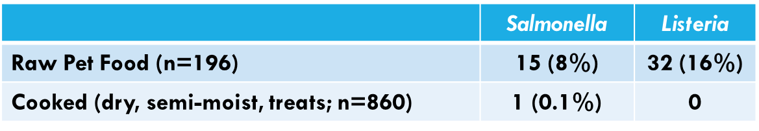
Raw Meat-Based Diets and Pets
Bacterial and protozoal contamination
  Salmonella, Listeria, E. coli
  T. gondii and Cryptosporidium
  Exotic agents (e.g., Brucella suis)¹
  Asymptomatic shedding
FDA Study (2010-2012)
¹ van Dijk, 2018

Slide 32
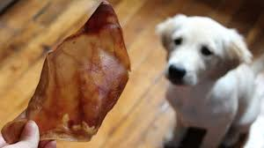
Raw-Meat Based Treats
Outbreaks of human salmonellosis associated with animal-derived pet treats (pig ears)¹
Recent pig ears outbreak²
Photo Source: Pixabay
¹ Clark, 2001 ² CDC, 2019

Slide 33
Fed Raw at Higher Risk
Dogs ate raw 11X as likely to shed 3rd generation cephalosporin-resistant E. coli ¹
Dogs ate raw poultry 48X as likely to shed ESBL E. coli ²
Dogs ate raw poultry 104X as likely to shed E. coli resistant to fluoroquinolones ²
Dogs ate raw meat 2X as likely to shed ESBL producing E. coli ³
Cats ate raw 32X as likely to shed ESBL-producing bacteria⁴
¹ Schmidt, 2015 ² Wedley, 2017 ³ Baede, 2015 ⁴Baede 2017

Slide 34
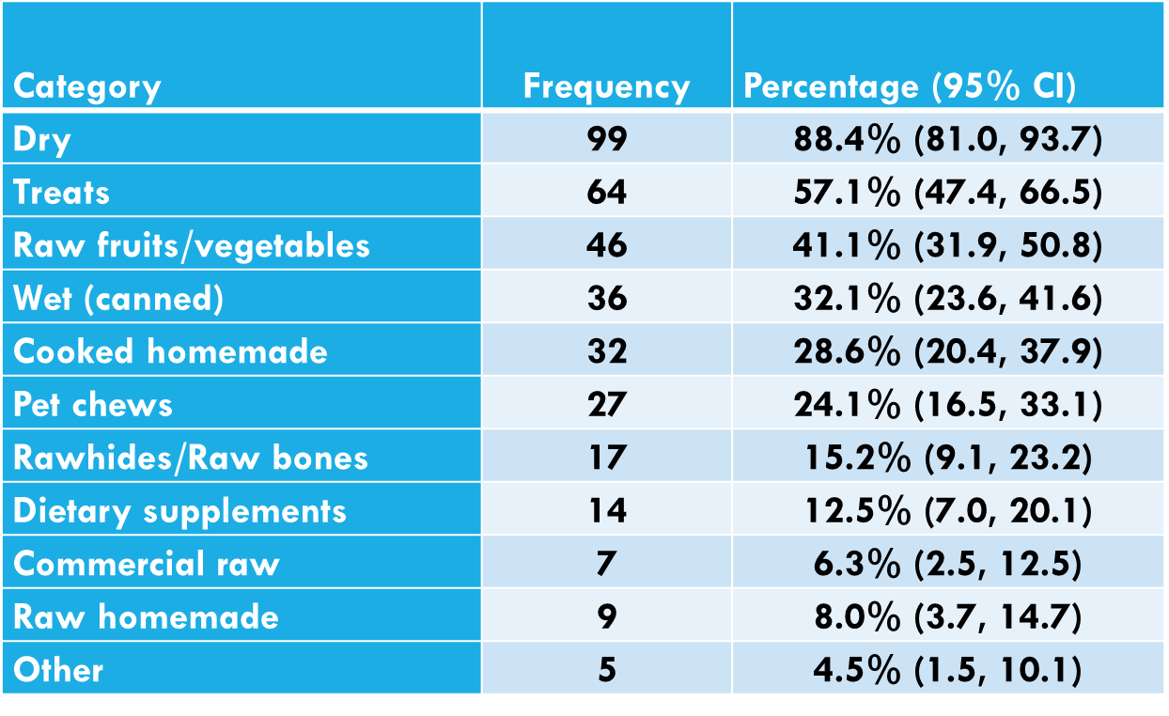
Atlantic Veterinary College Clients¹
(Reportedly fed during a typical week; n=112)
¹ Evason, 2019

Slide 35


Bite/Scratch Pathogens

Slide 36
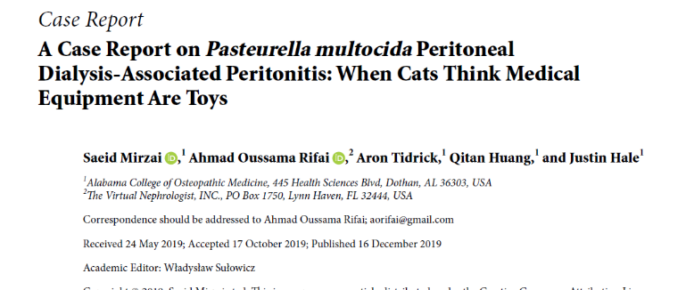
Common Oral Pathogens
Infections typically involve both aerobes and anaerobes
Each animal species carries different resident flora
  Some high consequence
    Capnocytophaga canimorsus
    Pasteurella multocida
    Methicillin-resistant Staphylococcus aureus (MRSA)
    Streptobacillus moniliformis

Slide 37
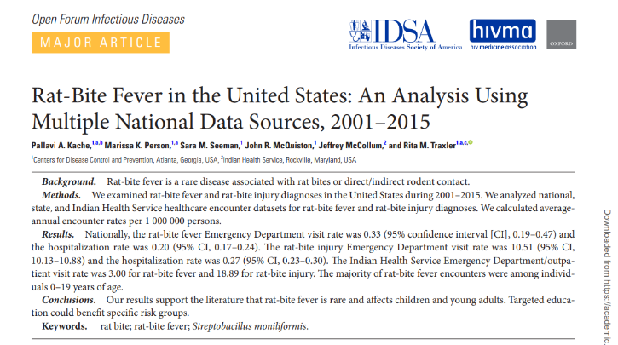
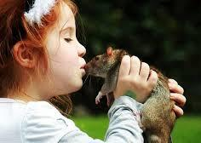
Rat-Bite Fever
Streptobacillus moniliformis
Reservoir: rodents (often rat)
Transmission: bites & scratches
  Other direct & indirect contact (kissing, cage cleaning)
Normal rat flora (50-100%); no clinical disease
Rare but ↑ frequency with “pocket pet” ownership?

Slide 38
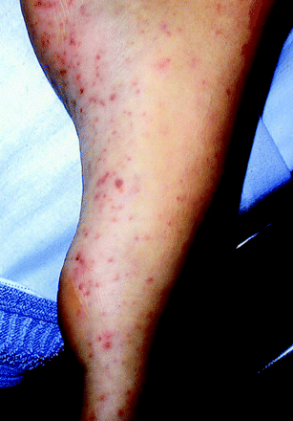
RBF: Disease & Prevention
People (2-3 days up to 3 wks after exposure)
    Fever, joint/muscle pain, rash (soles, palms, extremities)
    Rarely endocarditis, meningitis, sepsis
    High risk: children, those with high rodent exposure
Antimicrobials
    Untreated: 7-13% fatality
Sean P. Elliott Clin. Microbiol. Rev. 2007;20:13-22

Slide 39
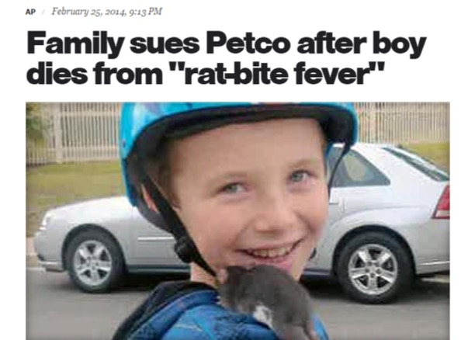
39

Slide 40
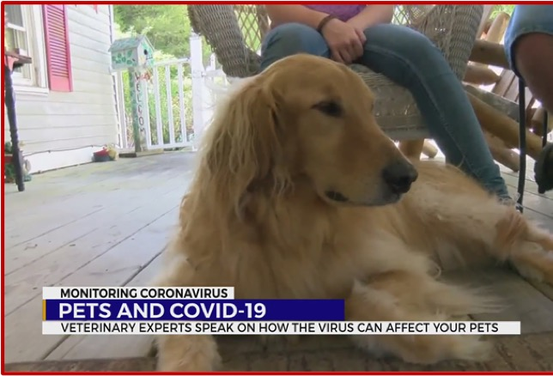
40

Slide 41


Animals & SARS-CoV-2
Infected? Infectious?
Experimental/natural infections¹
  Dogs
  Cats, ferrets, hamsters
  Mink
Virus on fur?
Limited testing
Source: people with COVID-19
El Masry, et al.. 2020. Exposure of humans or animals to SARS-CoV-2 from wild, livestock, companion and aquatic animals: Qualitative exposure assessment. FAO animal production and health,, FAO. https://doi.org/10.4060/ca9959en
Photo Source: Pixabay

Slide 42
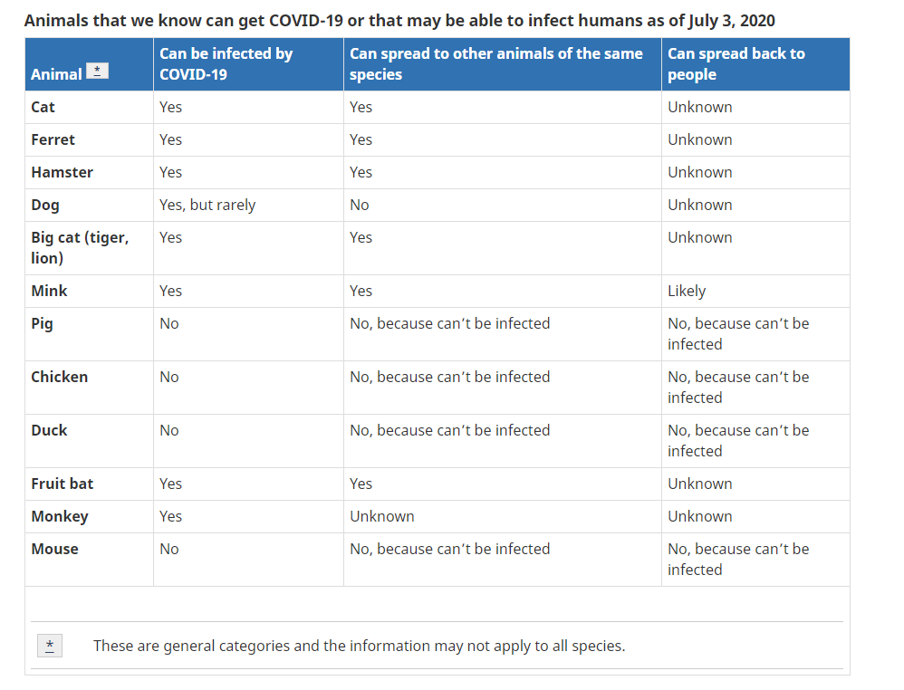
https://www.canada.ca/en/public-health/services/diseases/2019-novel-coronavirus-infection/prevention-risks/animals-covid-19.html#a1

Slide 43
Animals and Healthcare/Public Settings (SARS-CoV-2)
Main risks people (owners, handlers) of pets
Screen handler and pet before entry
  Low-risk (eg no exposure in past 14 days)
Routine COVID-19 measures
  Hand hygiene, not with COVID-19 cases/suspects, mask use for all people
  Limit: closed/crowded spaces, close/continuous contact
  Limit # handlers, single facility
Follow existing (general) recommendations
  Maintain log for contact tracing (who, how long)
  Communication between handler and facility

Slide 44


Slide 45
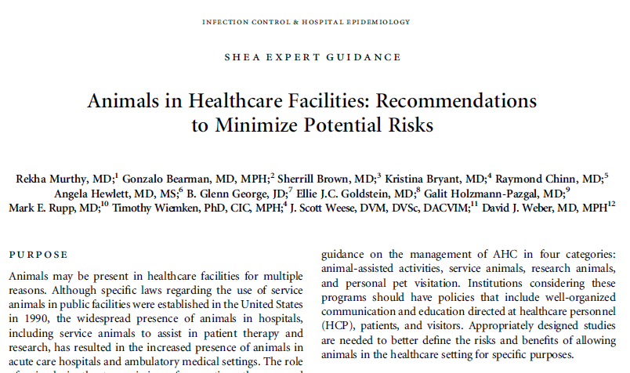
Murthy R, et al. Animals in healthcare facilities: recommendations to minimize potential risks. Infect Control Hosp Epidemiol. 2015
45

Slide 46
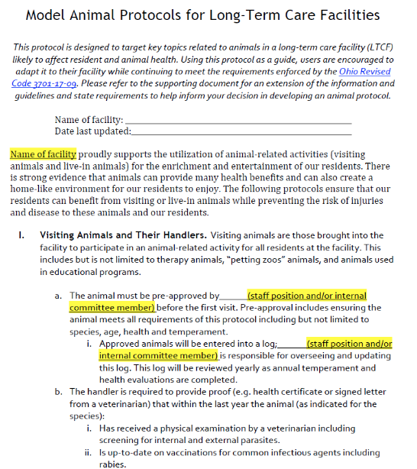

http://www.go.osu.edu/nhpets

Slide 47
Prevention: Final Tips
Develop/refine protocols for animal interactions
  Hand hygiene
  Exclusion policies – species, illness, recent antimicrobial therapy, preventive care
Incorporate questioning and prevention advice into well & sick patient visits
Stay up-to-date on zoonotic diseases
  https://www.wormsandgermsblog.com/

Slide 48

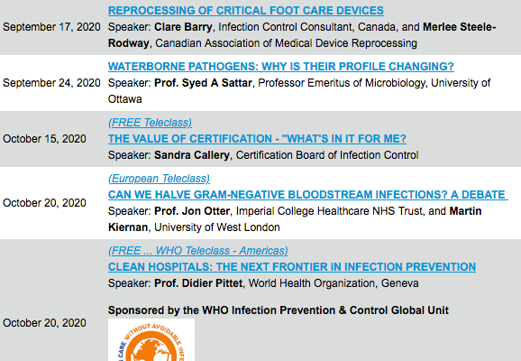

Slide 49


