Slide 1

We have met the enemy ... and he is us:
Can we change?
Allison McGeer, MSc, MD, FRCPC, FSHEA, FAMMI
Sinai Health System, University of Toronto
Hosted by Nicole Kenny
Webber Training Inc
www.webbertraining.com
September 16, 2021

Slide 2

We have met the enemy
And he
is us

Slide 3
Objectives
To convince you of what the future will be if we do not accelerate change in hospital infection prevention
To persuade you that it is possible to change this future
To discuss what we need to do to get there

Slide 4
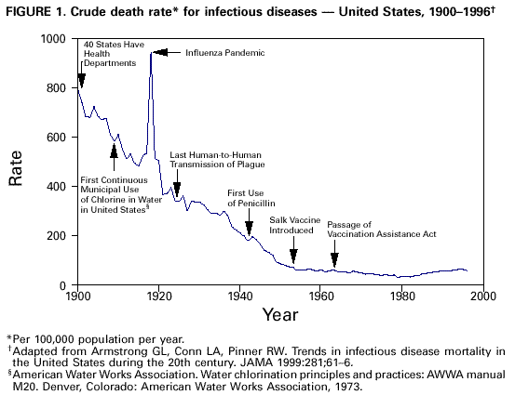

Slide 5
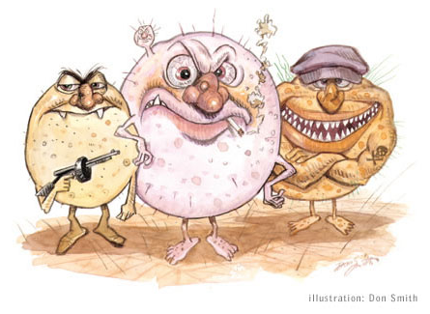
No Antimicrobials – What Would That Mean?
“If antibiotics stopped working, we would find that instead of 7% of deaths being related to infection at the moment in the developed world, it would go back up to about half (50%) of deaths.”
Dame Sally Davies, UK Chief Medical Officer (Feb 2015)
“In a world with few effective antibiotics, modern medical advances such as surgery, transplants, and chemotherapy may no longer be viable due to the threat of infection”
  US National Strategy for Combating Antibiotic-Resistant Bacteria (Sep 2014)

Slide 6
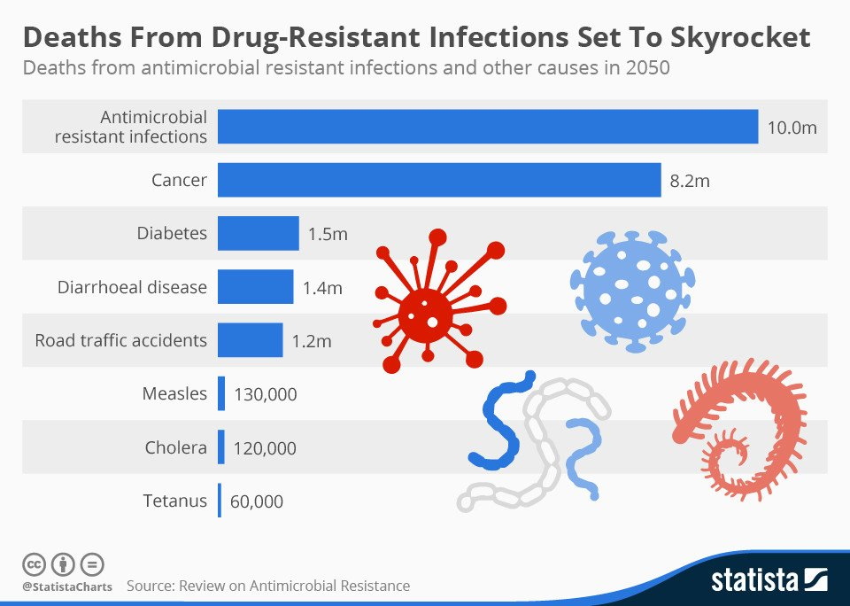

Slide 7

“Without policies to stop the ..spread of AMR, today’s already large 700,000 deaths every year would become an extremely disturbing 10 million every year, more people than currently die from cancer.”
“The cost in terms of global production between now and 2050 would be an enormous 100 trillion USD if we do not take action”
Jim O’Neill, Chair, UK review on antimicrobial resistance, 2016

Slide 8
Most common bacteria causing infection
Staphylococcus aureus
Escherichia coli
Streptococcus pneumoniae
Klebsiella pneumoniae
Clostridium difficile
Salmonella, Campylobacter spp.
Chlamydia, T. pallidum, N. gonorrhea
Group A streptococcus, Group B streptococcus, H. influenza, Legionella
Mycobacterium tuberculosis
Enterococci, P. aeruginosa, Acinetobacter spp.
N. meningitides

Slide 12
Disability associated life-years due to antibiotic resistance, EU
65% of AR infections were hospital acquired, representing 127 DALYs per 100,000 population
Sum of HIV, TB, influenza is 183 DALYss
Cassini LancetID 2019

Slide 13
Evolution of penicillin and methicillin resistant
S. aureus, US, 1940-2002
McDonald LC, Clin Inf Dis 2006

Slide 14
Science 1993; 259:227-30
Therefore, that mecA may have been acquired just once by S. aureus

Slide 15
Number of MRSA bacteremias per year, Ontario, 2000-2018

Slide 16
VRE appeared in the community in northern Europe and Australia in the 1980s in association with the use of avoparcin (an antibiotic related to vancomycin) in animal feed
  Avoparcin was banned in 1997, with prompt reductions in VRE in food chains
In North America, VRE were first reported in 1988 in New York City and spread rapidly (400 cases in first 18 months)
  In Ontario, <5% of reported VRE are thought to be community acquired

Slide 17
Number of VRE bacteremias per year, Ontario, 2000-2018
https://www.publichealthontario.ca/-/media/documents/a/2020/aro-survey-2018.pdf?la=en

Slide 19
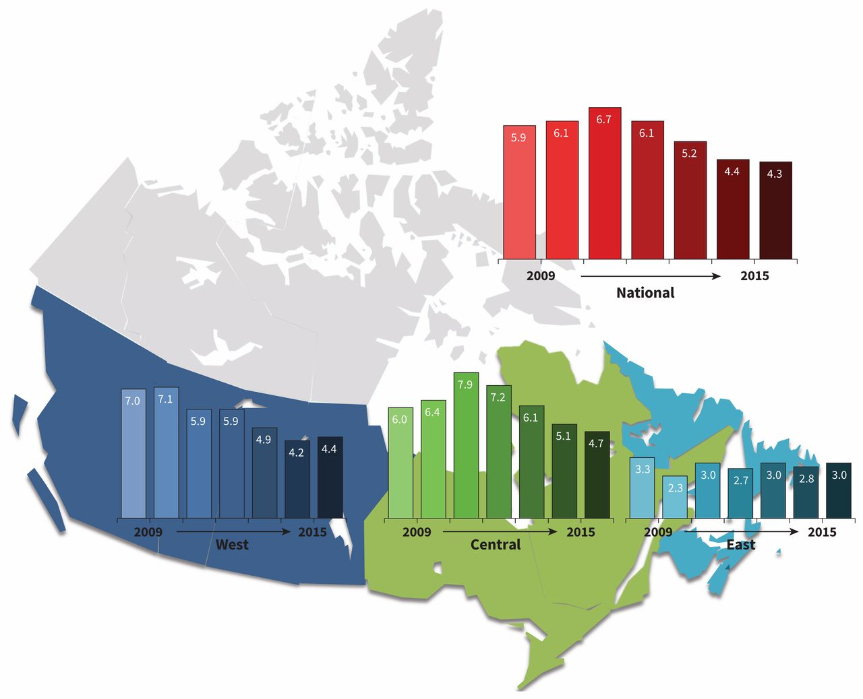
C. difficile infection in CNISP hospitals, 2009-2015
Katz, CMAJ 2019

Slide 20
Population incidence of CPE, Toronto/Peel region, 2007-2018

Slide 21
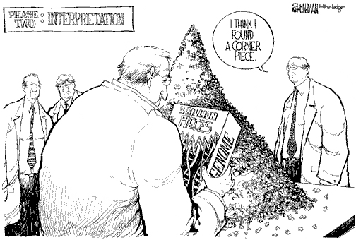
Whole Genome Sequencing

Slide 22
How many SNVs different defines an outbreak?
Type of transmission | No. (%) clusters (n=62ª) | Median (IQR, range) no. cases in cluster | Median (IQR) time between first and last case isolates, in days
Person-person transmission only | 50 (81) | 5 (2-12, 2-31) | 158 (55-362)^{b}
Person-environment/environment-person transmission only | 7 (11) | 1 (1-2, 1-3) | 53 (10-215)^{c}
Combination of person-environment/environment-person/person-person transmission | 5 (8) | 17 (4-18, 3-89) | 280 (183-456)
All | 62 (100) | 4 (2-12, 1-89) | 162 (53-362)
Jamal, unpublished

Slide 23
MRSA transmission

Slide 24
~33% of C. difficile is community acquired
34% of C. difficile is community acquired
Lessa NEJM 2015;372;825;

Slide 25
~33% of C. difficile is community acquired
7297 in-patient diarrheal samples from 2 sampling days at 482 hospitals in 20 EU countries
1211 C. difficile isolates
  624 represent the most common 10 ribotypes
Lessa NEJM 2015;372;825; Eyre CID 2018;67:1035

Slide 26
~33% of C. difficile is community acquired
Lessa NEJM 2015;372;825; Eyre CID 2018;67:1035

Slide 28
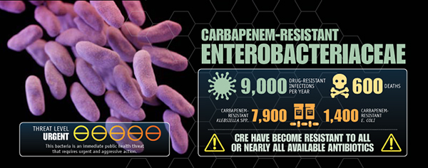

Slide 29
European Survey of Carbapenemase-Producing Enterobacteriaceae
(EuSCAPE)
1717 isolates
244 hospitals
32 countries

Slide 30
European Survey of Carbapenemase-Producing Enterobacteriaceae
(EuSCAPE)

Slide 31
K. pneumoniae ST258 phylogenetic tree

Slide 32
CP-KP in long-term acute care, Los Angeles
Han AAC 2019 (ahead of print)

Slide 33
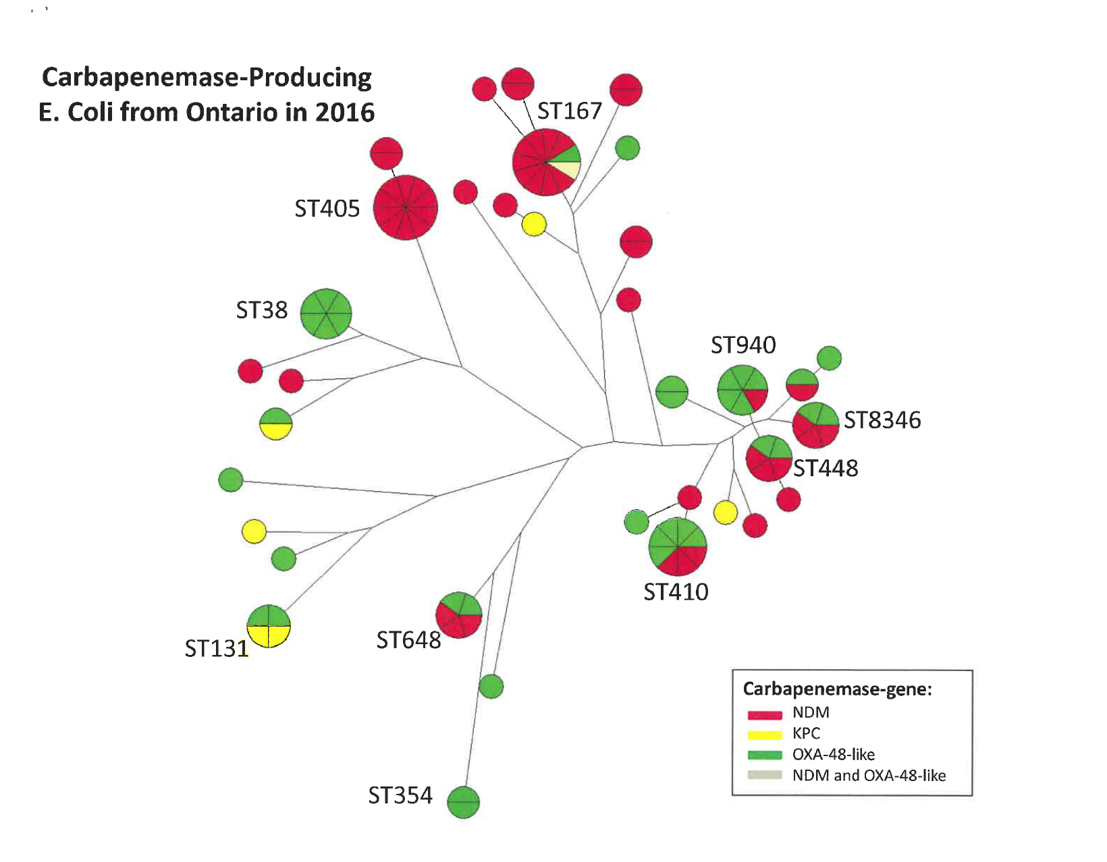
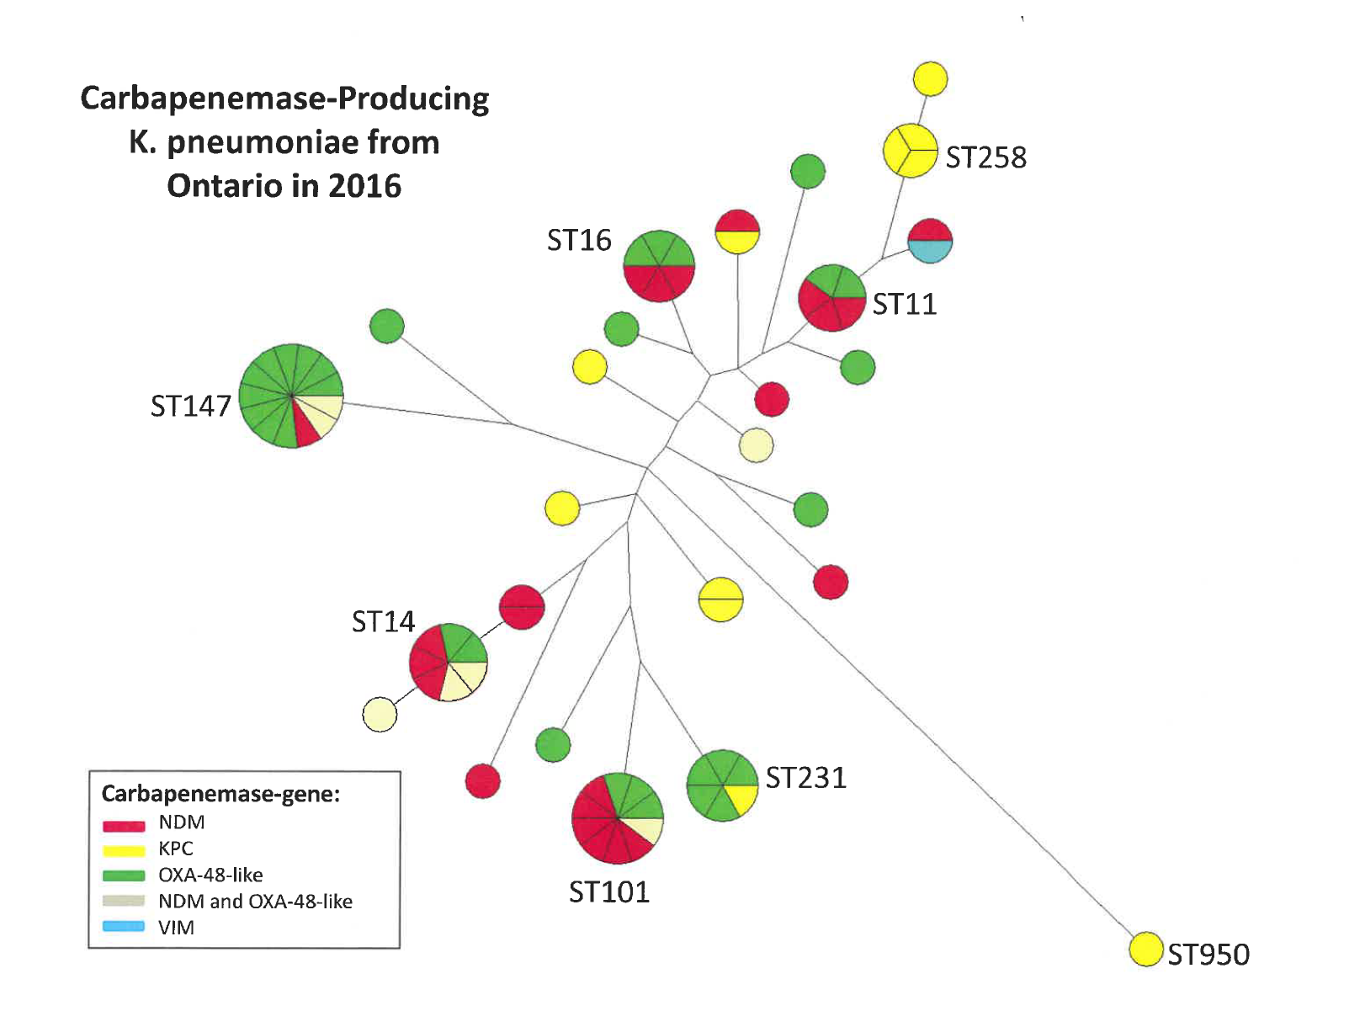
(n=99)
(n=78)
Notes:
This is a phylogenetic tree that Roberto and Nathalie put together based on the sequencing data so far for the K. pneumoniae isolates. The different colours represent the different carabepenmase genes and the sequence types are marked.
As you can see there are clusters.

Slide 34
Identified risk factors, CPE colonized/infected patients, by year

Slide 35
We have met the enemy and he is hospitals

Slide 36
How do we stop transmission of AROs in hospitals?

Slide 37
Antibiotic resistant organisms
All these organisms are primarily transmitted from patient to patient via the hands of staff, or the environment (including the “mobile” environment)
Colonized patients are as likely to transmit as those who are infected (except for C. difficile)
Many infections are device-related
Antibiotic exposure increases the risk of acquisition

Slide 38
Additional issues
Seeing the benefits of prevention
Accepting hospital acquired infections as “normal”
Interpreting evidence when you can’t randomize hospitals or regions

Slide 39
What do we need?
Reduction in overall infection risk
  Better hand hygiene (electronic monitoring)
  Reduced risk of device-related infections
  Better environmental cleaning
Transmission control programs
  Screening to identify colonized patients
  Private rooms/additional precautions/cleaning to reduce transmission
  Investigation of transmission/on-going evaluation
  Funding for laboratories

Slide 40
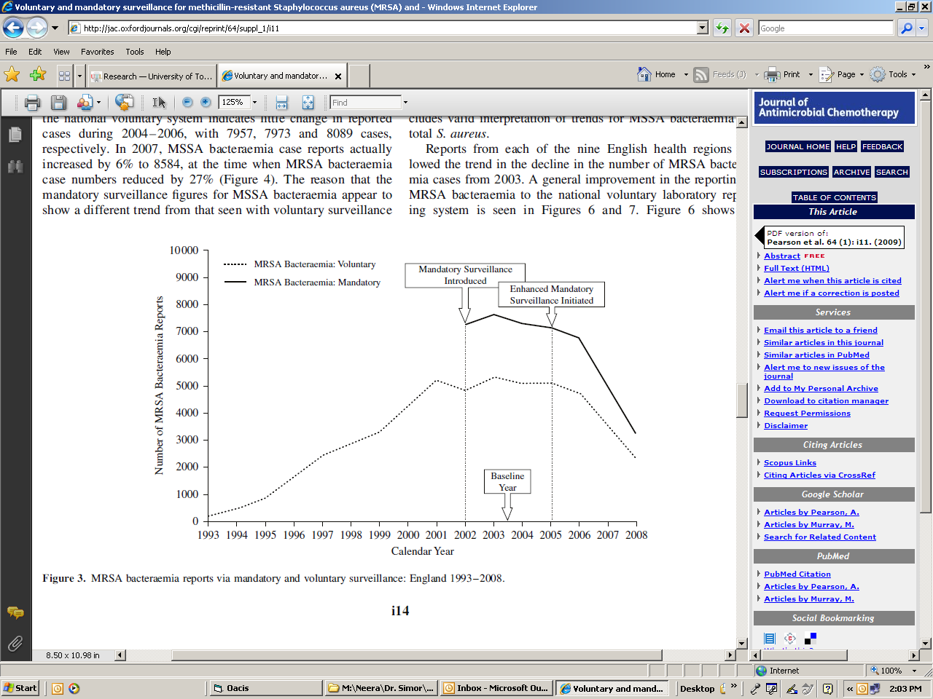
MRSA Bacteremia - England
Pearson, J Antimicrob Chemother 2009

Slide 41
Incidence of hospital onset S. aureus infections, VA medical system, 2005-2017
Jones, MMWR 2019

Slide 42
MRSA bacteremia rates in adjacent regions of the Netherlands and Germany, 2009
Van Cleef PlosOne 2012

Slide 44
Incidence of CPE clinical cultures in Israeli acute care hospitals, 2005-2008
By 2012, 4.8 per 100,000 pt days

Slide 45
Reduction in prevalence of CPE colonization, long term care, Israel

Slide 46
Base case: $81/QALY

Slide 47
Lapointe-Shaw
EJCMID 2017

Slide 48
What can individuals do?
Work at believing the evidence for prevention
Don’t normalize hospital acquired infections
Support electronic monitoring for hand hygiene
  Are your hands clean EVERY time before you touch a patient?
Join a patient safety team, or the anti-microbial stewardship team
Ask questions:
  Are hospital acquired infection rates are on the QUIP? – if not, why not?
  How well is the hospital environment, especially mobile equipment, being cleaned?
Advocate for your patients

Slide 50

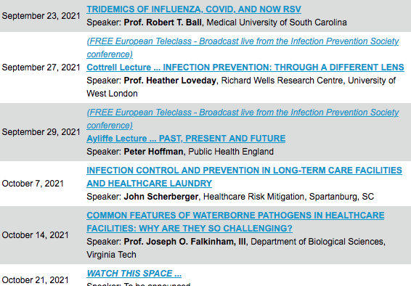

Slide 51


