Slide 1


Malnutrition risk and healthcare infection – a MUST do
Dr. Fidelma Fitzpatrick
Senior Lecturer, Royal College of Surgeons in Ireland,
Consultant Microbiologist, Beaumont Hospital
Twitter: @ffitzP
Instagram: RCSI Clin Microbiology
Enter subtitle here (24pt, Arial Regular)
Enter date: 25.06.13
Hosted by Prof. Jean-Yves Maillard
Cardiff University, Wales
www.webbertraining.com
February 13, 2020

Slide 2
Learning Outcomes
2
Describe the Malnutrition Universal Screening Tool (MUST) for nutritional risk screening.
Discuss the association between malnutrition risk and healthcare-associated infection
Explain how MUST screening could be incorporated into a HAI prevention programme in hospitals

Slide 3
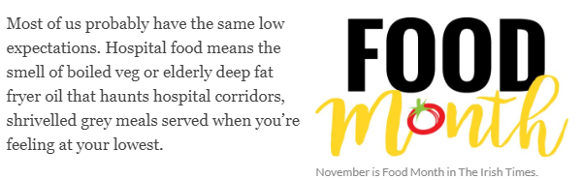
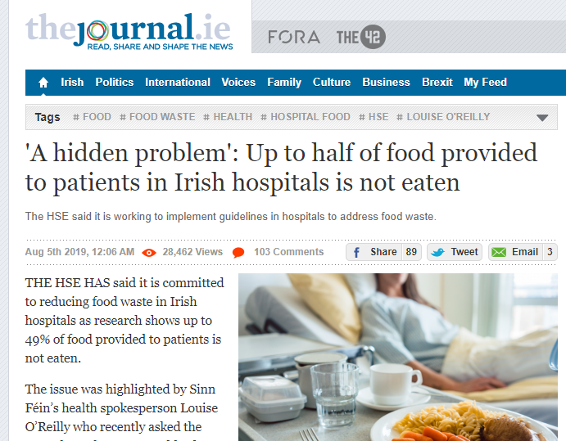
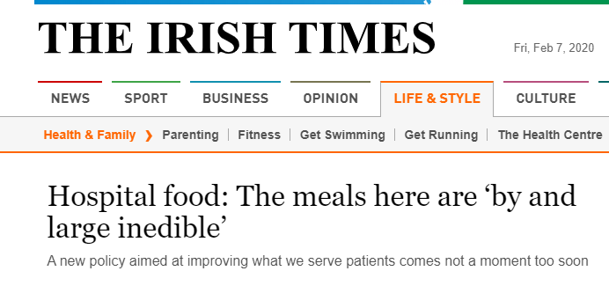
3
https://www.irishtimes.com/life-and-style/food-and-drink/is-this-the-best-hospital-food-in-ireland-1.4095743

Slide 4
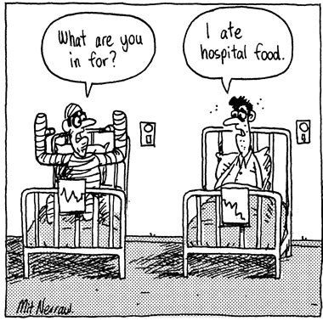
4

Slide 5
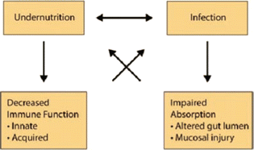

Interaction between malnutrition and infection
5

Slide 6
The “vicious cycle” of nutrition and infection
6
Inadequate dietary intake
Weight loss
Lowered Immunity
Mucosal Damage
Infection:
Incidence
Duration
Severity
Appetite loss
Nutrient loss
Malabsorption
Altered metabolism

Slide 7
7
20-50%
inpatients
Barker LA, Gout BS, Crowe TC. Barker LA, Gout BS, Crowe TC. Hospital malnutrition: prevalence, identification and impact on patients and the healthcare system.
Int J Environ Res Public Health 2011. 8(2): 514-27.

Slide 8
Why bother?
8
Malnourished patients
access health services more often (acute hospital and GP)
when admitted, have more complications, longer inpatient stays and higher mortality rates
€1.4 billion per annum (10% Irish healthcare budget)
NICE (2006) Nutrition Support for Adults Oral Nutrition Support, Enteral Tube Feeding and Parenteral Nutrition.
Rice, N., & Normand, C. (2012). The cost associated with disease-related malnutrition in Ireland. Public Health Nutrition, 15(10), 1966-1972. doi:10.1017/S1368980011003624

Slide 9
Why bother?
9
Can do something about it!
= nutrition support

Slide 10

Recognising malnutrition in hospital patients?
10

Slide 11
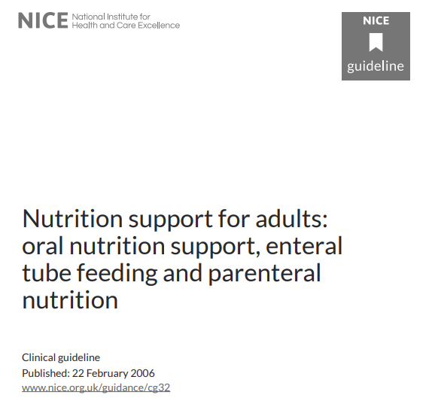
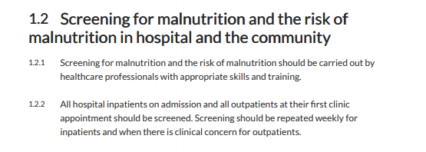
11

Slide 12
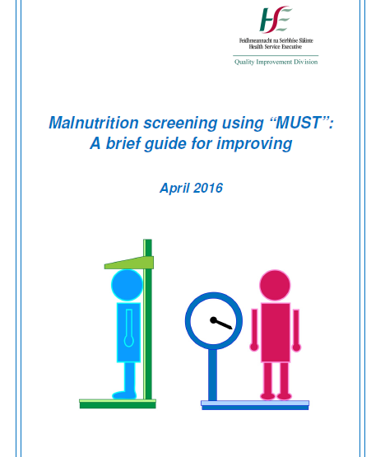
12
Malnutrition
Universal
Screening
Tool
https://www.hse.ie/eng/about/who/qid/other-quality-improvement-programmes/nourish/must-improving-guide-nourish.pdf

Slide 13
13
BMI (kg/m³)
>20: score 0
18.5-20: score 1
<18.5: score 2
Score 0: low risk
Routine clinical care
Score 1: medium risk
Observe
Document dietary +
fluid intake X 3 days
2. Unplanned weight loss past 3-6 mths
<5%: score 0
5-10%: score 1
>10%: score 2
Score 2+: HIGH RISK Treat
Refer for nutritional assessment
3. Acutely ill plus has been or
likely no nutritional intake > 5 days
Score 2

Slide 14
Malnutrition RISK + mortality
14
X 2 mortality risk in hospital patients
X 3 in older patients
[MUST]
X 12 fold increase in hospital mortality
5,051 patients 26 hospitals in 12 countries
[Nutritional Risk Screening (NRS)-2002 tool]
Stratton RJ, Elia M. Deprivation linked to malnutrition risk and mortality in hospital. Br J Nutr, 2006. 96(5):870-6.
Sorensen J, Kondrup J, Prokopowicz J, Schiesser M, Krähenbühl L, Meier, R, et al., EuroOOPS: an international, multicentre study to implement nutritional risk screening and evaluate clinical outcome. Clin Nutr 2008. 27(3): 340-9.

Slide 15

15
Malnutrition associated with:
Healthcare-associated infection (HAI)
Factors that increase HAI risk;
  pressure ulcers
  lean body mass loss
  prolonged length-of-inpatient stay

Slide 16

16
MUST
score
HAI

Slide 17


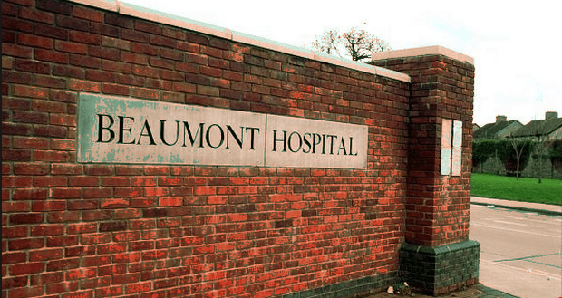

17

Slide 18
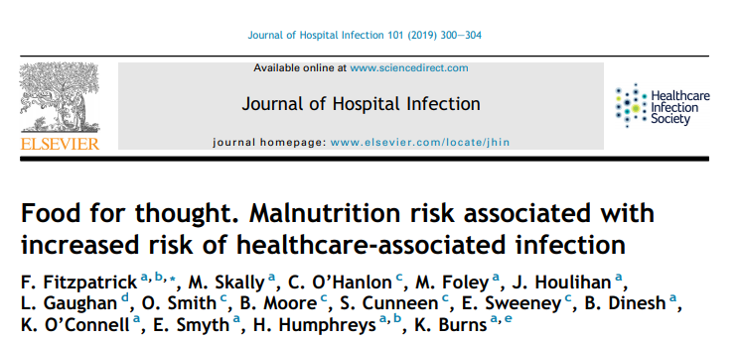
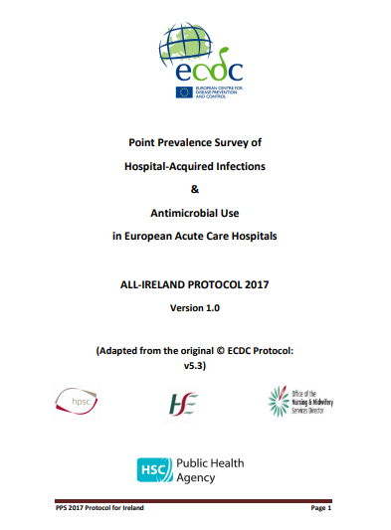

18

Slide 19
What did we find?
19
240 patients, mean age 68 years (range = 19 – 97)
63 patients (26%) at high risk of malnutrition.

Slide 20
20

Slide 21
21

Slide 22
22
Patients with HAI more likely to have
  had surgery (OR 5.5, P<0.001, C.I 2.1 to 14.3)
  central vascular catheter (OR 10.0, P<0.001, C.I 3.6 to 27.2)
  urinary catheter in situ (OR 7.5, P<0.001, C.I 2.8 to 20.0)
  at high risk of malnutrition (OR 4.3, P<0.001, CI 1.7 to 11.2)
  Multivariate regression analysis: MUST score ≥ 2 predictor of a HAI
  (P<0.001 CI: 0.2 to 0.6)

Slide 23
What have others found?
23
Surgical patients at nutritional risk = 1.81 X Surgical site infection (NRS-2002 tool)
Malnutrition/weight loss + Surgical site infection, postoperative pneumonia and catheter-associated UTI
Hospitalised elderly patients - Geriatric Nutritional Risk Index (GNRI)
  well-nourished patients (GNRI >98) less likely to acquire a HAI
  low GNRI associated with increased HAI risk.
Skeie E, Koch AM, Harthug S, Fosse U, Sygnestveit K, Nilsen RM, Tangvik RJ. A positive association between nutritional risk and the incidence of surgical site infections: A hospital-based register study. PLoS One 2018. 13(5): e0197344.
Fry DE, Pine M, Jones BL, Meimban RJ. Patient characteristics and the occurrence of never events. Arch Surg 2010. 145(2): 148-51.
Gamaletsou MN, Poulia KA, Karageorgou D, Yannakoulia M, Ziakas PD, Zampelas A, et al., Nutritional risk as predictor for healthcare-associated infection among hospitalized elderly patients in the acute care setting. J Hosp Infect 2012. 80(2): 168-172.

Slide 24
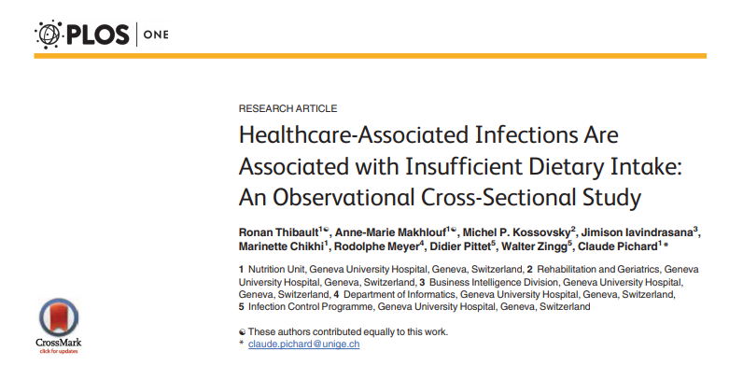
24
Swiss point prevalence study
Nutritional risk assessed with NRS-2002 (n=1091)
Dietary intake assessed by dieticians (n=1024)
CDC HAI definitions used
6.8% HAI prevalence
30% nutritional risk
No association between HAI and nutritional risk
Patients with HAI more likely to be identified with decreased energy intake
Thibault R, Makhlouf A, Kossovsky MP, Iavindrasana J, Chikhi M, Meyer R, et al., Healthcare-associated infections are associated with insufficient dietary intake: an observational cross-sectional study. PloS One, 2015. 10(4): e0123695-e0123695.

Slide 25
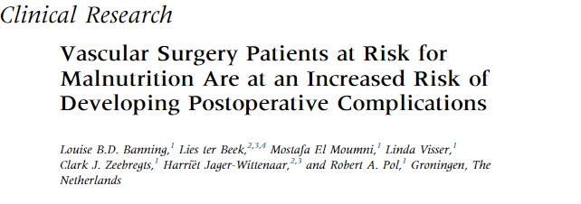

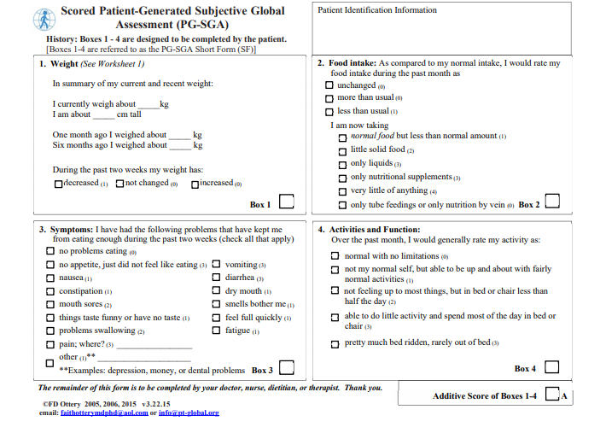
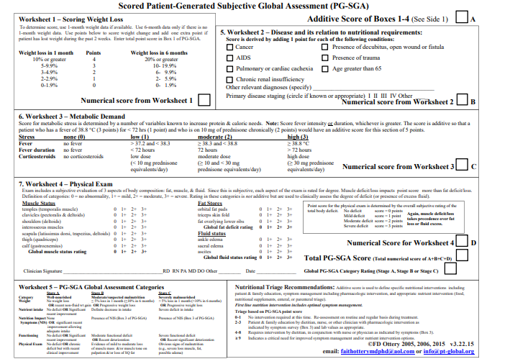
25

Slide 26
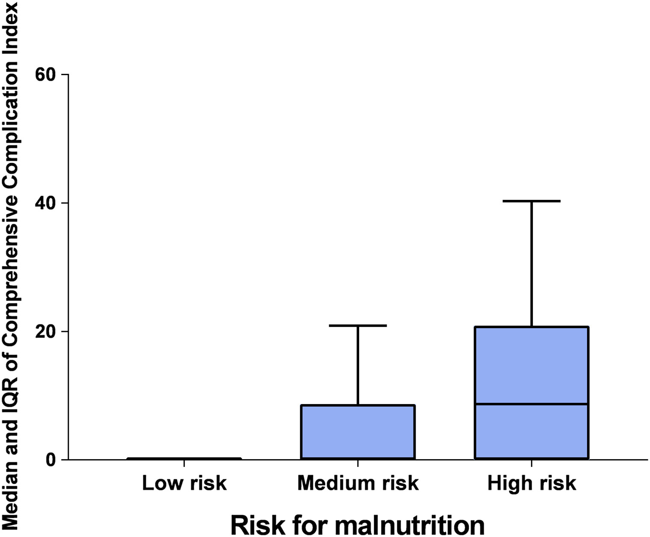
26
468 patients
- 113 (24.1%) at risk for malnutrition

Slide 27
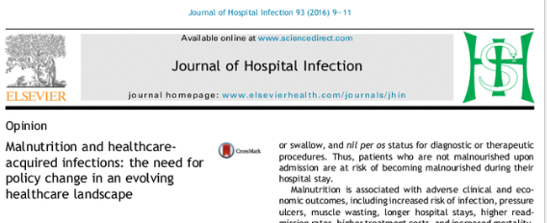
27
Addressing malnutrition is a frequently overlooked component of healthcare-associated infection reduction strategies.
So why has malnutrition screening not been incorporated more into HAI preventative strategies?

Slide 28
28
Time-consuming nature of some screening/assessment tools
Staff shortages / hospital activity / complexity of patients
Need a tool that can be used easily in daily clinical practice.

Slide 29
29
Malnutrition
Universal
Screening
Tool

Slide 30
Advantages of using MUST
30
Quick
  Simple (3 questions)
  Does not require specialist input, laboratory investigations or mathematical calculations
Inter-user reproducibility
Validated
Suitable on-going use by non-dietitians to prompt specialist dietitian evaluation and intervention
  Ensures dietitians focus their time on those patients most at-risk.
Henderson S, Moore N, Lee E, Witham MD. Do the malnutrition universal screening tool (MUST) and Birmingham nutrition risk (BNR) score predict mortality in older hospitalised patients? BMC Geriatrics 2008;8:26.
Stratton RJ, Hackston A, Longmore D, et al. Malnutrition in hospital outpatients and inpatients: prevalence, concurrent validity and ease of use of the 'malnutrition universal screening tool' ('MUST') for adults. The British Journal of Nutrition 2004;92:799-808.

Slide 31
Nutritional screening
(e.g., MUST)
Targeted assessment
Intervention

Slide 32
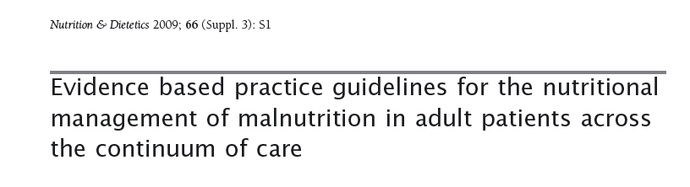
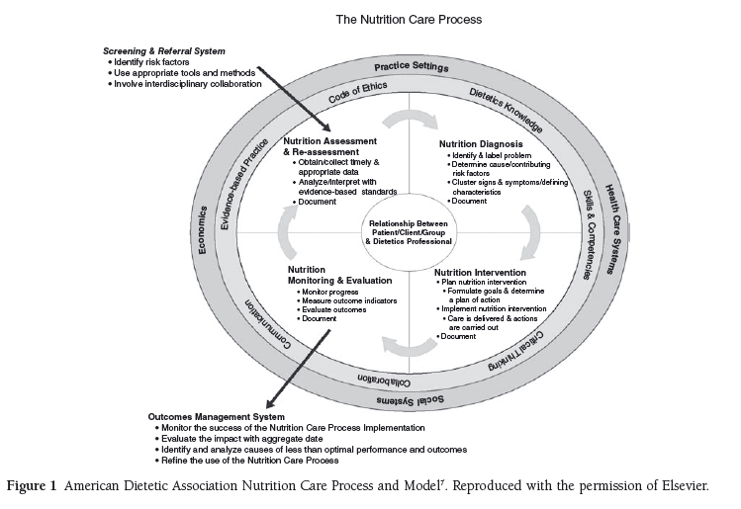
32

Slide 33
Implementation?
33
https://www.hse.ie/eng/about/who/qid/other-quality-improvement-programmes/nourish/must-improving-guide-nourish.pdf

Slide 34
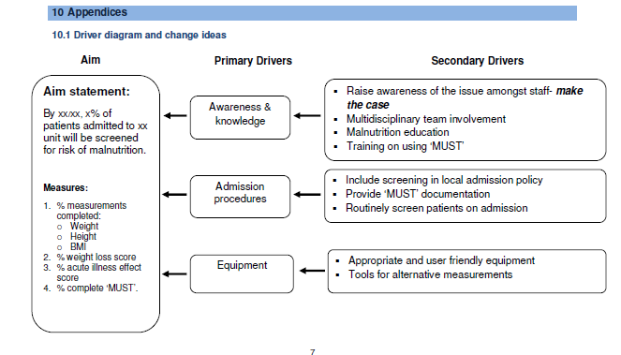
34
https://www.hse.ie/eng/about/who/qid/other-quality-improvement-programmes/nourish/must-improving-guide-nourish.pdf

Slide 35
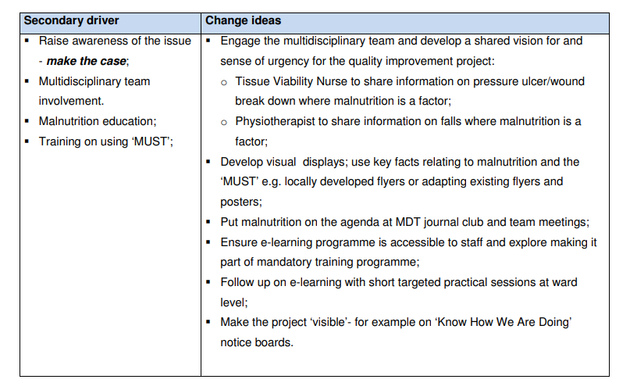
35
https://www.hse.ie/eng/about/who/qid/other-quality-improvement-programmes/nourish/must-improving-guide-nourish.pdf

Slide 36
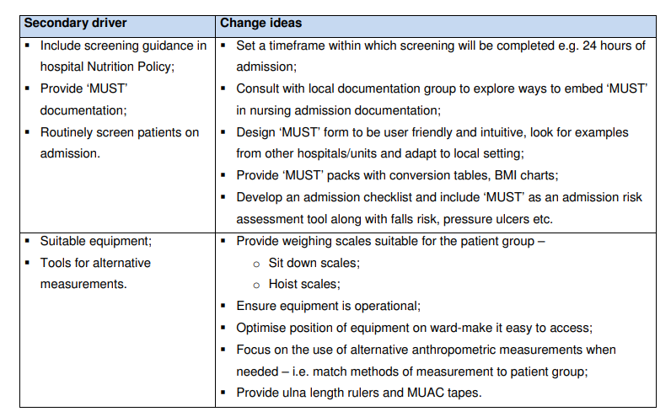
36
https://www.hse.ie/eng/about/who/qid/other-quality-improvement-programmes/nourish/must-improving-guide-nourish.pdf

Slide 37
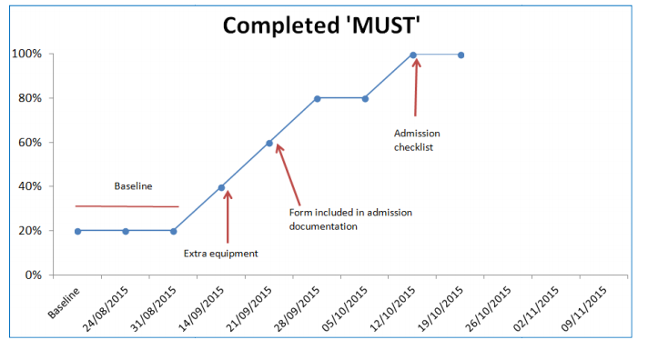
37
https://www.hse.ie/eng/about/who/qid/other-quality-improvement-programmes/nourish/must-improving-guide-nourish.pdf

Slide 38
Summary
38
Malnutrition = cause and effect of illness
If untreated, can lead to poorer health outcomes, increase morbidity and significantly reduce quality of life.
Its worth screening for as you can intervene
Lots of tools! Malnutrition risk and malnutrition

Slide 39
Things to consider when choosing a nutrition screening tool
39
  your context (and resources!)
  evidence based
  validated
  reliable
  practical.
  link to specified protocols for action e.g. referral of those identified as ‘at risk’, to a Dietitian for more detailed assessment or rescreen for those at low risk at regular intervals.

Slide 40
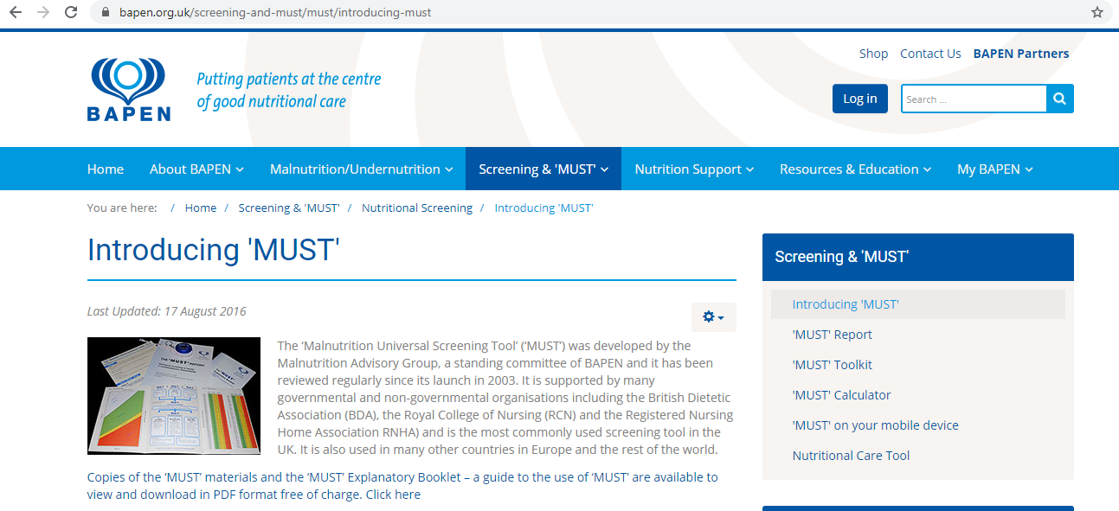

More information
40

Slide 41

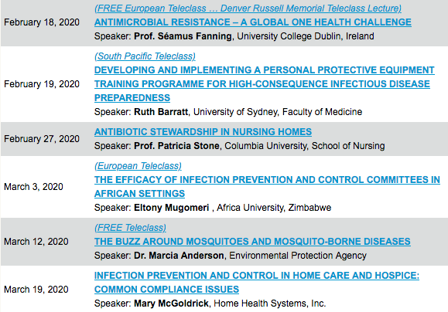

Slide 42


