Slide 1

Epidemiologic and Molecular Patterns of Hospital and Community-Associated MRSA
Geoffrey Taylor MD, FRCP(C ), FACP
Division of Infectious Diseases
University of Alberta
Edmonton, Alberta
Hosted by Bruce Gamage
Provincial Infection Control Network, BC
www.webbertraining.com
January 28, 2016

Slide 2
I have no disclosures relevant to this presentation

Slide 3
MRSA – a potpouri of recent cases
21 year old male with relapsing skin/soft tissue infection following long board crash
  Wound culture: MRSA , (R) clox, clinda, (S) vanco, doxy, tmp-smx
      Rx wound management, IV vancomycin , step down to po doxycycline
45 yr old IDU , previous MRSA endocarditis, admitted after recent discharge AMA for recurrent MRSA endocarditis. At last discharge given po linezolid but may not have taken it
  Multiple blood cultures: MRSA, (R ) clox, clinda, (S) vanco (MIC 1.0), linezolid

Slide 4
MRSA cases - continued
35 year old male with AML post Rx for Hodgkins Lymphoma. Multiple hospitalizations in multiple sites since 2008. Prior MRSA colonization. In hosp receiving chemotherapy, ANC <0.5. Developed abscess in axilla
  Culture: MRSA , (R ) clox, clinda, (S) vanco, tmp-smx, doxy

Slide 5
Outline
Evolution of betalactam resistance in Staphylococcus aureus
S aureus microbiology
  Methicillin resistance in S. aureus
  S aureus toxins
  Non-betalactam susceptibility
  Genetic profiles of MRSA
  Clinical profiles of MRSA strains
Evolution of epidemiologic patterns of MRSA in hospital and community settings in North America
  MRSA in Alberta

Slide 6
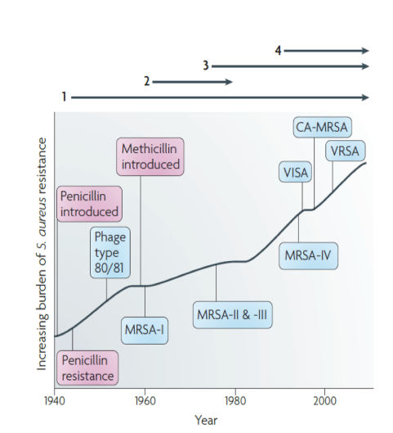
Evolution of antibiotic resistance in S. aureus
Chambers and Delo, Nat Rev Microbiol 2009
1940’s – 1960’s: emergence and spread of penicillin resistance due to penicillinase production
1959 – 1980’s : emergence and spread, primarily in Europe, of semisythethic penicillin (methicillin) resistance due to PBP mutation (PBP2’)
1980’s: Emergence and spread of novel MDR strains of MRSA (such as USA100/CMRSA 2)
Late 1990’s: Emergence and spread of community based MRSA strains ( such as USA300/CMRSA 10)

Slide 7
MRSA 101
Microbiology
Methicillin resistance is a genetic trait in S. aureus based on chromosomal mecA gene
  mecA encodes a mutant Penicillin Binding Protein (PBP) 2 (a cell wall enzyme) designated PBP2’
  mecA is part of a larger a larger chromosomal cassette (SCC), with 8 types (SCCmecI-VIII)
  Results in resistance to all betalactam antibiotics
  Imposes no fitness burden on S aureus

Slide 8
S aureus: non-betalactam resistance
Vancomycin
  Very little full resistance (MIC >/= 16)
  ‘non-susceptible’ isolates with elevated MIC (>/= 2) may fail Rx
    A result of transient increase in cell wall thickness after prolonged non-curative vancomycin exposure
Oral agents:
  In the past hospital isolates typically MDR, community isolates have broader susceptibility
    Clindamycin
      Variable. Inducible resistance
    Trimethoprim – sulfamethoxazole, Tetracyclines
      Reasonable choices for non-invasive infections in susceptible strains. Ineffective for co-existing Streptococci
    Linezolid (IV/po). Little resistance. Pneumonia. Endocarditis? Limited by toxicity
Novel parenteral alternatives to vancomycin
  Daptomycin
  Telavancin
  Ceftaroline
  …

Slide 9
MRSA typing & nomenclature
Typing MRSA isolates is not required for clinical management , but is useful to explain and describe epidemiologic relationships: outbreaks or emerging epidemiologic patterns
Typing methods:
  Multilocus sequence typing (MLST)
  Pulsed-field gel electrophoresis (PFGE)
  spa-typing
Nomenclature:
  USA 100/CMRSA2 – classic HA-MRSA
  USA 400/CMRSA7 – initial CA-MRSA, first described in children
  USA 300/CMRSA10 – predominant CA-MRSA, unrelated to USA 400 or USA 100

Slide 10
Biologic distinctions between typical Community and typical Hospital MRSA strains
Antimicrobial susceptibility
Presence of virulence factors
USA 100/CMRSA2: only reliably susceptible to vancomycin (and novel agents such as linezolid, daptomycin , telavancin, ceftaroline)
USA300/CMRSA 10: typically also susceptible to tmp-smx, tetracycline, fuscidic acid +/- clindamycin
USA 300 has increased prevalence of:
  Paton Valentine Leucocidin (PVL)
    Associated with skin/soft tissue infection (“spider bite”) and severe- hemorrhagic pneumonia
  α-haemolysin
    Associated with endocarditis and pneumonia

Slide 11
Issues in MRSA Surveillance data
Surveillance intensity
  Numbers of cases you find can depend on how hard you look – especially colonization
Clinical status
  Some infections are treated without obtaining cultures
  In lab based surveillance it can be difficult to distinguish infection from colonization
    Eg - skin/wounds, sputum
    No debate about significance of positive blood culture
Source of MRSA
  Hospital vs Community acquisition of MRSA is often speculative since acquisition is usually silent
  Source of infection is easier to determine based on standard definition

Slide 12
MRSA – USA
Carrel et al Emerging Inf Dis 21:1973, (2015)
Rhee et al Infect Control Hosp Epidemiol 36:1417 (2015)
USA 100 has been present for many years in US hospitals. Since ~ 2007 it has been in relative decline in several regions (coincident with increased attention to IPC)
USA 300 was introduced in the late 1990’s but did not emerge simultaneously: starting in western states and spreading east
  Disproportionately affects children , incarcerated and inner city populations

Slide 13
MRSA BSI in a large Chicago hospital
2007-2013
Community Onset BSI
Hospital Onset BSI

Slide 14
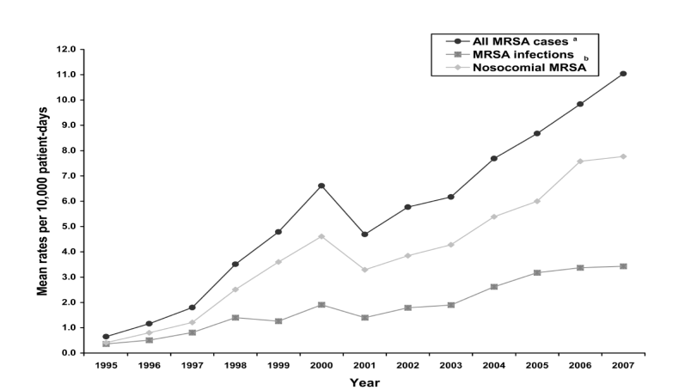
Emergence of MRSA in a network of Canadian Hospitals (CNISP)
(Simor et al , ICHE , 2010)

Slide 16
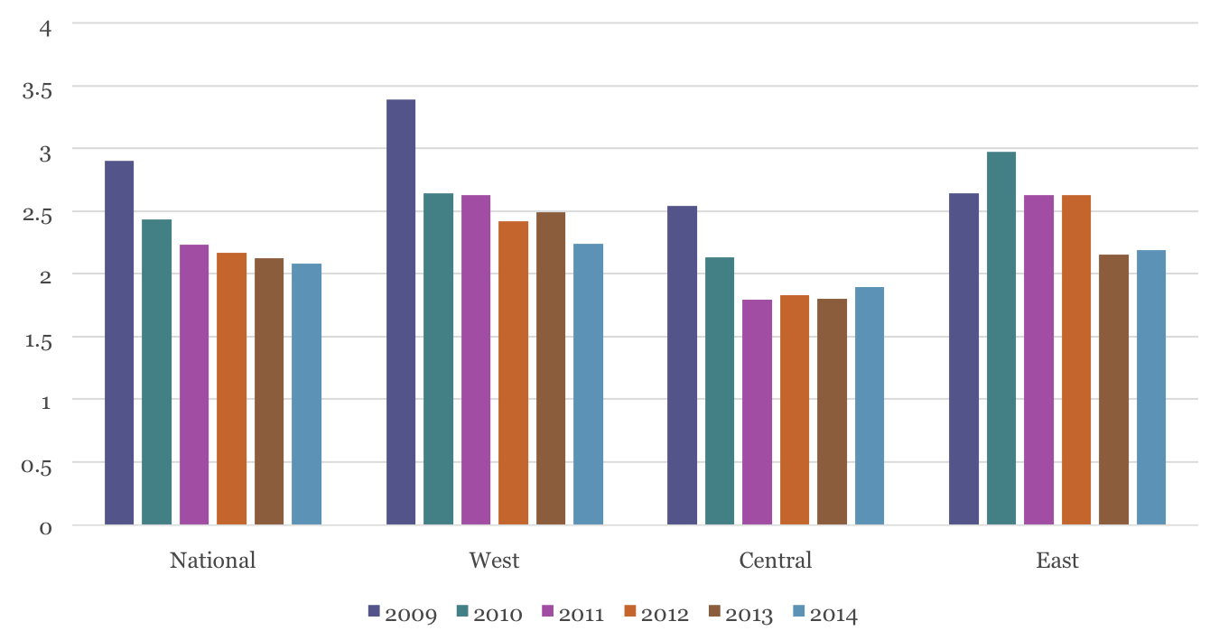
MRSA Infections/1,000 admissions in Sentinel Canadian Hospitals
Source: CNISP

Slide 17
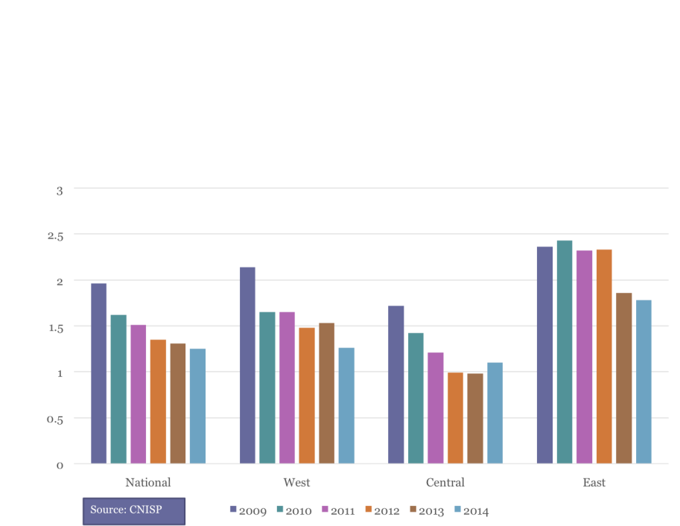
Healthcare Associated MRSA Infections in Sentinel Canadian Hospitals

Slide 18
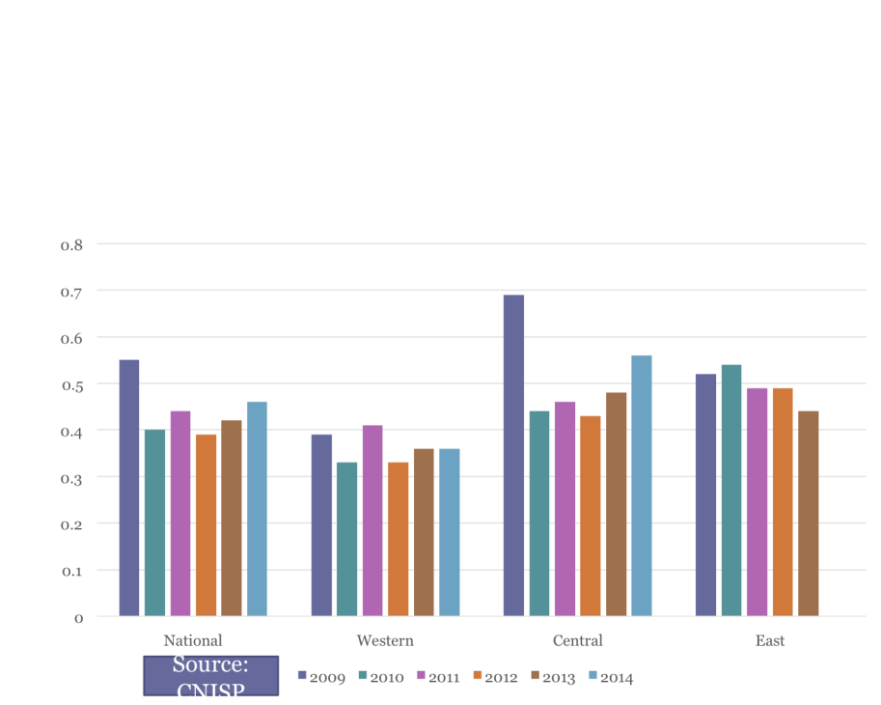
MRSA BSI in Sentinel Canadian Hospitals/1000 Admissions

Slide 19
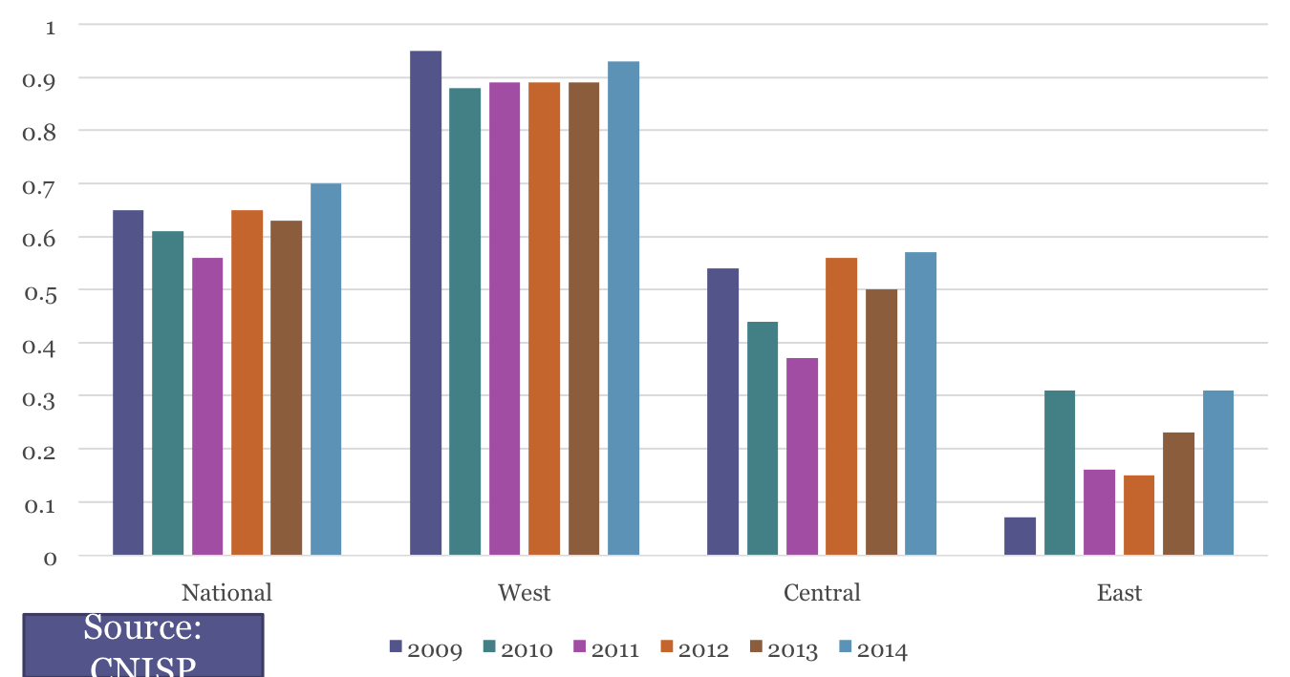
Community Acquired MRSA Infections in Sentinel Canadian Hospitals/1000 Admissions

Slide 20

Alberta
Population 4.2 million (2014)
2 major urban centres (Edmonton, Calgary) with 68% of population
2 medical schools
Academic medical centres in Edmonton and Calgary

Slide 21
Alberta Health Services (AHS)
As in other Canadian provinces all medically necessary healthcare is provided publically
AHS founded in 2009 to provide all medically necessary hospital care in Alberta
Currently (2015) provides 3.1 million annual inpatient days through
  2 tertiary hospitals
  2 pediatric hospitals
  1 cancer hospital
  7 large urban hospitals
  7 regional hospitals
  82 small suburban /rural hospitals

Slide 22
MRSA in Alberta: a retrospective cohort study
Bush et al
Antimicrobial Resistance and Infection Control , 2015
Methods:
  Incident MRSA in AHS hospitals between 01/04/2011 and 31/03/2013
  Epidemiologic definitions of source of MRSA
    Hospital Acquired
      Identified >48 hr after hospital admission
    Healthcare Associated (HCA)
      <48 hr after admission, healthcare risk (eg LTC, hemodialysis)
    Community Acquired
  Spa-typing and PFGE of a subset of isolates

Slide 23
Results
4818 incident MRSA cases
  32.7% clinical, 67.4% screening
  41.1% HA, 20.8% HCA, 38.1% CA
  43.4% large urban, 23.6% small suburban rural
2248 (46.7%) isolates available for typing

Slide 24
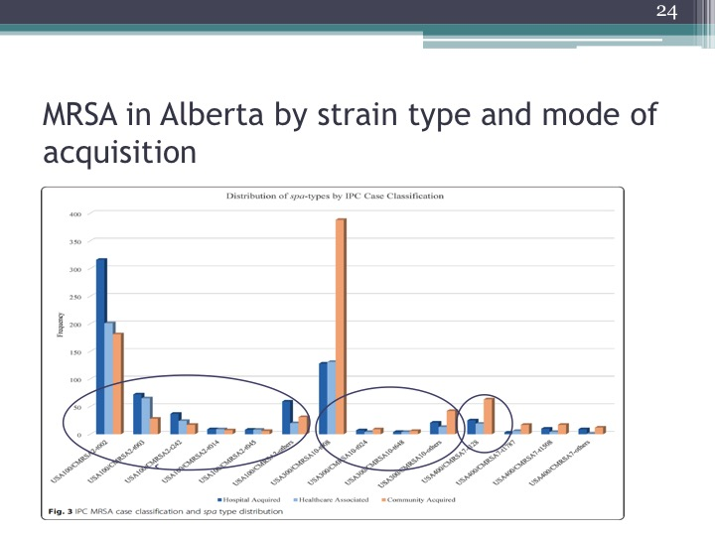

Slide 25
Epidemiology of MRSA BSI in Alberta
Taylor et al
J Hosp Infect, 2015
Background
  Focus is on infection
    By surveying only BSI , avoids problems related to surveillance intensity, definition of clinical status and permits comparison to other jurisdictions
  Source = source of BSI not MRSA
Methods
  MRSA blood culture isolates between 04/11-03/13 were assessed by site based ICP’s
  Isolates were spa-typed

Slide 27
MRSA BSI in Alberta

Slide 28
Molecular and Epidemiologic Patterns of MRSA
Conclusions
MRSA epidemiology is in transition and varies geographically
Across North America , there has been a decline in traditionally hospital acquired MRSA
Community sourced MRSA is variable, but well established/predominant in several areas
In Alberta, MRSA BSI is predominantly community onset
While USA 300/CMRSA 10 is still predominantly a community strain and USA 100/CMRSA 2 is still predominantly a hospital strain, presumption of source of MRSA based on strain type is no longer viable

Slide 29

February 17 (Free WHO Teleclass ... North America)
SUCCESSFUL IMPLEMENTATION STRATEGY FOR THE
PREVENTION OF SURGICAL SITE INFECTIONS
Prof. Sean Berenholtz, Johns Hopkins Schools of Medicine, Baltimore
February 24 (South Pacific Teleclass)
PATIENT EMPOWERMENT AS PART OF AN ASIAN HAND HYGIENE
PROGRAMME
Prof. Yee Chun Chen, National Taiwan University Hospital and College of Medicine
March 3 MERS-COV: IMPLICATIONS FOR HEALTHCARE FACILITIES
Prof. Sotirios Tsiodras, University of Athens Medical School, Greece
March 10 (FREE Teleclass)
BARRIERS TO TB INFECTION CONTROL IN DEVELOPING COUNTRIES
Dr. Eltony Mugomeri, National University of Lesotho

Slide 30

THANKS FOR YOUR SUPPORT

Slide 31
