Slide 1
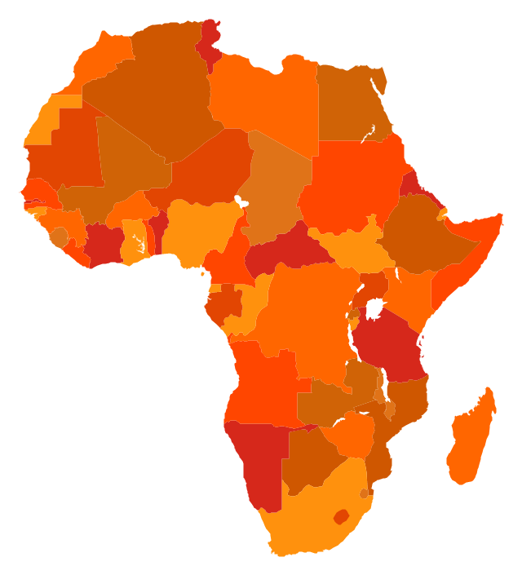
‘Superbugs’: Filoviruses
Adriano G Duse
Professor and Head: Division of Clinical Microbiology and Infectious Diseases School of Pathology of the NHLS and University of the Witwatersrand, Johannesburg, South Africa Hosted by Prof. Sade Ogunsola President, Infection Control Africa Network, Nigeria
Presentation design by Lindi Spezialetti – lindi@topaz-inc.co.za
www.webbertraining.com
July 9, 2019

Slide 3
The Filoviruses
3
Family: Filoviridae, at least 4 genera
Genus: Marburgvirus
Species: Marburg Marburgvirus;
2 strains: Marburg (MARV) – ancestral location ? Uganda; RAVN (RAAV) [Ravn name of the Danish patient from whom first isolated]– ancestral location, ? Kenya
Genus: Dianlovirus
Species: Mengla virus ; Other species ?
Newly identified, China, phylogenetically between Ebola & Marburg viruses
Has potential to cause severe; actual disease-causing capability unknown
Genus: Cuevavirus
Species: Lloviu cuevavirus (LLOV) – Spain; also France & Portugal
Pathogenic to bats; no human infections described

Slide 6
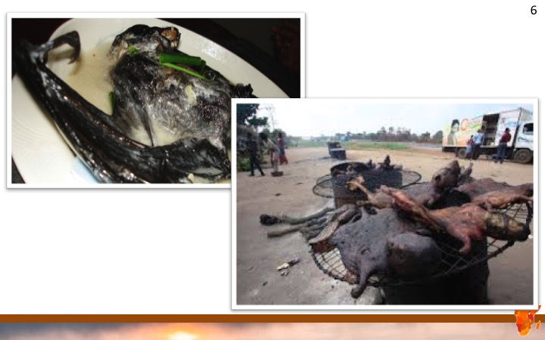

Slide 8
Marburg virus activity over time (1967 – 2017)
8
Year | Virus | Geographic Location | Human Deaths | Cases | CFR
1967 | MARV | Marburg and Frankfurt, GERMANY | 7 | 29 | 24%
1967 | MARV | Belgrade, YUGOSLAVIA | 0 | 2 | 0%
1975 | MARV | Johannesburg, SOUTH AFRICA | 1 | 3 | 33%
1980 | MARV | Nairobi, KENYA | 1 | 2 | 50%
1987 | RAVV | Nairobi, KENYA | 1 | 1 | 100%
1988 | MARV | Koltsovo, RUSSIA | 1 | 1 | 100%
1990 | MARV | Koltsovo, RUSSIA | 0 | 1 | 0%
1998-2000 | MARV & RAVV | Durba & Watsa, DEMOCRATIC REPUBLIC OF CONGO | 128 | 154 | 83%
2004-2005 | MARV | Uige, ANGOLA | 227 | 252 | 90%
2007 | MARV & RAVV | Kamwenge District, UGANDA | 1 | 4 | 25%
2008 | MARV | Colorado, USA | 0 | 1 | 0%
2008 | MARV | Lieden, NETHERLANDS | 1 | 1 | 100%
2012 | MARV | Kampala, Ibanda, Mbarara and Kabarole, UGANDA | 9 | 18 | 50%
2014 | MARV | Mpigi, UGANDA | 1 | 1 | 100%
2017 | MARV | Kween District, UGANDA | 2 | 2 | 100%
Ref: wikipedia.org

Slide 9
Ebola virus activity over time (1976 – 2001)
9
Year | Virus | Geographic Location | Human Deaths | Cases | CFR
1976 | SUDV /EBOV | Porton Down, UNITED KINGDOM (laboratory accident) | 0 | 1 | 0%
1976 | SUDV | Juba, Maridi, Nzara and Tembura, SUDAN | 151 | 284 | 53%
1976 | EBOV | Yambuku, ZAIRE | 280 | 318 | 88%
1977 | EBOV | Bonduni, ZAIRE | 1 | 1 | 100%
1979 | SUDV | Nzara, SUDAN | 22 | 34 | 65%
1994 | TAFV | Tai National Park, CŎTE D’IVOIRE | 0 | 1 | 0%
1994-1995 | EBOV | Woleu-Ntem and Ogooué-Ivindo Provinces, GABON | 31 | 52 | 60%
1996 | EBOV | Johannesburg, SOUTH AFRICA | 1 | 2 | 50%
1995 | EBOV | Kikwit, ZAIRE | 254 | 315 | 81%
1996 | EBOV | Mayibout , GABON | 21 | 37 | 57%
1996 | EBOV | Sergiyev Posad, RUSSIA (laboratory accident) | 1 | 1 | 100%
1996-1997 | EBOV | Ogooué-Ivindo Province, GABON; Cuvette-Ouest Department, REPUBLIC OF THE CONGO | 45 | 60 | 75%
2000-2001 | SUDV | Gulu, Mbarara and Masindi Districts, UGANDA | 224 | 425 | 53%

Slide 10
Ebola virus activity over time (2001 – current)
10
Year | Virus | Geographic Location | Human Deaths | Cases | CFR
2001-2002 | EBOV | Ogooué-Ivindo Province, GABON; Cuvette-Ouest Department, REPUBLIC OF THE CONGO | 107 | 135 | 79%
2002 | EBOV | Ogooué-Ivindo Province, GABON; Cuvette-Ouest Department, REPUBLIC OF THE CONGO | 10 | 11 | 91%
2002-2003 | EBOV | Cuvette-Ouest Department, REPUBLIC OF THE CONGO; Ogooué-Ivindo Province, GABON | 128 | 143 | 90%
2003 | EBOV | Cuvette-Ouest Department, REPUBLIC OF THE CONGO | 29 | 35 | 83%
2004 | EBOV | Koitsovo, RUSSIA (laboratory accident) | 1 | 1 | 100%
2004 | SUDV | Yambio County, SUDAN | 7 | 17 | 41%
2007 | EBOV | Kasai Occidental Province, DEMOCRATIC REPUBLIC OF THE CONGO | 186 | 264 | 71%
2007-2008 | BDBV | Bundibugyo District, UGANDA | 37 | 149 | 25%
2008-2009 | EBOV | Kasai Occidental Province, DEMOCRATIC REPUBLIC OF THE CONGO | 14 | 32 | 45%
2012 | SUDV | Kibaale District, WESTERN UGANDA | 36 | 77 | 47%
2012 | BDBV | Orientale Province, DEMOCRATIC REPUBLIC OF THE CONGO | 34 | 62 | 54%
2013-2016 | EBOV | Liberia, Sierra Leone, Guinea, Limited and local: Nigeria, Mali, United States, Senegal, Spain, United Kingdom, Italy | 11, 310 | 28, 616 | 70-71 / 57-59 %
2014 | EBOV | DRC | 49 | 66 | 74%
2018 | EBOV | DRC | 33 | 54 | 61
2018-present | EBOV | DRC | 1277 | 2189 | ongoing

Slide 11
Increasing frequency of recognized filovirus outbreaks in Africa since 1990
11
Possible reasons:
Better surveillance and capability to rapidly diagnose and characterize filovirus infections
Spread among wild non-human primates and other animals > human epidemics d/t hunting, slaughtering, butchering and human consumption of infected dead animals (food chain)
Epidemiology and ecology is more complex than previously understood
Animal-human spillover infections because of human encroachment on natural ecosystems
Increased human exposure driven by legal and illegal financial incentives, particularly mining activities; tourism (Marburg)
Proximity of outbreaks to larger cities and human movement > spread to other areas outside of the outbreak epicenter

Slide 12
Ebola and Marburg viruses: Transmission
12

Slide 13
13

Slide 14
Infection rates
14
The number of people that one sick person will infect, on average and in the absence of an effective control intervention) is called R_{0.} For Ebola in 2 epidemics 1.3 – 1.8 (Chodwell, et al, J Theoretical Biology 2004;229:119-126)
1 > 2 infection rate
Hepatitis C
Ebola
1 > 4 infection rate
HIV
SARS
1 > 10 infection rate
Mumps
1 > 18 infection rate
Measles
R₀
More contagious

Slide 15
Filovirus transmission: what is known and what is not …
15
Limited data on how viral genomics affect phenotype/pathotype, patient VLs and epidemiological features of more recent filovirus strains
Further study:
Role of aerosol (large droplets/small particles close to patients) transmission
Role on environmental contamination and fomite transmission
Degree to which minimally or mildly ill persons transmit infection
How long clinically relevant infection persists or persistence of Ebolavirus during convalescence
Role of ‘super-spreading events’ play in transmission dynamics
Whether strain differences or repeated serial passage in outbreak settings can impact virus transmission
Source: MBio 2015 Feb 19;6(2):e00137. doi:10.1128/mBio.00137-15

Slide 16
Ebola West Africa 20(13)14 – 2015(6)
16

Slide 17
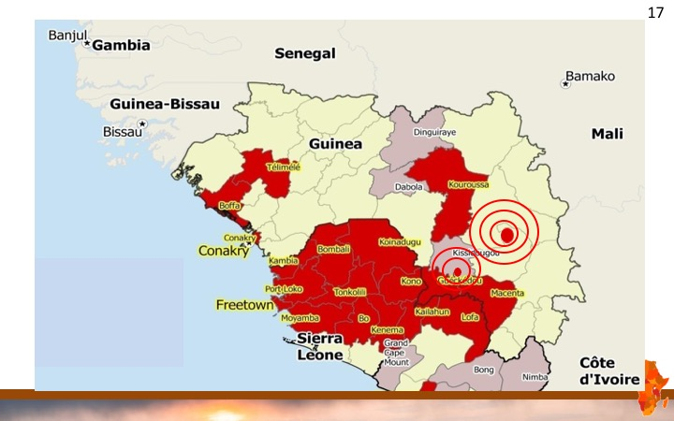

Slide 20
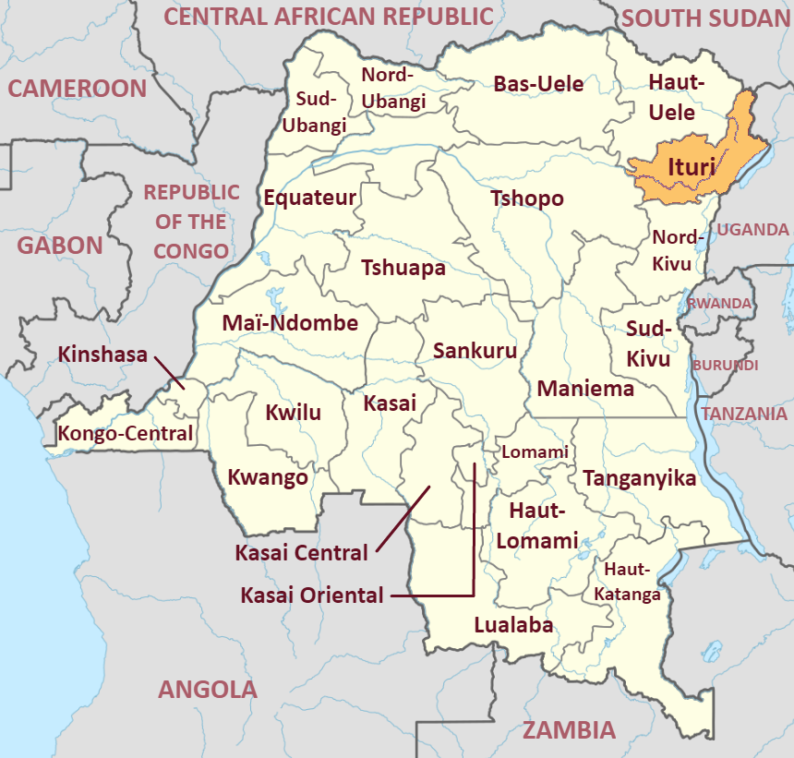
DRC – North Kivu and Ituri provinces
20
Nord-Kivu .

Slide 21
Ebola DRC – as at 21 May 2019
21

Slide 23
PPE for filovirus infections: a big challenge
23

Slide 32
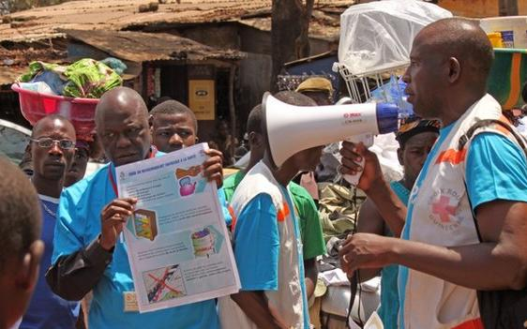
Challenges inc. controversial public health messages
32
‘Do not eat bush game’
Social distancing; no handshaking
Closure of markets (economic implications) and recreational areas e.g. bars and discotheques
Inequity regarding who gets vaccination / treatment
Stopping of flights; border closures; travel bans
Closure of mining operations (force majeur) - serious economic consequences for the W African sub-region

Slide 33
Social media: the blame and misconceptions
33
Ebola is the lifeline for the American economy that has already tumbled over the edge. The virus can be more powerful than any bomb; especially if America holds the "cure".
I say drop a bomb on them they a third world country destroy their kings a boom we get Africa and we can sell it
America is going to release ebola in America and blame it on isis. New 9/11 and population control.
This virus has the same symptoms with ZOMBIFICATION which was a voodoo practices; Zombie is defined as corpse said to be revived by witchcraft
Bull*** our government is spreading it to reduce the population. Remember satan has control over governments. Also our own government worships satan.
Wow look at all this Bible prophecy coming true this tell me that it's time for all of us to give our lives to JESUS right now and be covered by his blood we all need to repent of all our sins and ask JESUS to forgive us
Our elites are particularly into genocide in Africa. You must not think that all white men wish to kill all black people. Its really all about oligarchs and elite Jew pigs.
Americans have vaccine and probably they invent this virus during cald war and use on who else than poor africans !! but they dont give vaccine to anyone except of this 2 or 3 persons from USA few weeks ago who are healed while others (africans especially)you will be died !!

Slide 34
Social media: the blame and misconceptions
34
Ebola is the lifeline for the American economy that has already tumbled over the edge. The virus can be more powerful than any bomb; especially if America holds the "cure".
I say drop a bomb on them they a third world country destroy their kings a boom we get Africa and we can sell it
America is going to release ebola in America and blame it on isis. New 9/11 and population control.
This virus has the same symptoms with ZOMBIFICATION which was a voodoo practices; Zombie is defined as corpse said to be revived by witchcraft
Bull*** our government is spreading it to reduce the population. Remember satan has control over governments. Also our own government worships satan.
It comes to me as if the doctors dont even care about Ebola victims. Once their infected, they’re no longer human, treat them like scum and leave them for dead as they slowly rot on the inside and die alone never to see their family again
Wow look at all this Bible prophecy coming true this tell me that it's time for all of us to give our lives to JESUS right now and be covered by his blood we all need to repent of all our sins and ask JESUS to forgive us
Our elites are particularly into genocide in Africa. You must not think that all white men wish to kill all black people. Its really all about oligarchs and elite Jew pigs.
Americans have vaccine and probably they invent this virus during cald war and use on who else than poor africans !! but they dont give vaccine to anyone except of this 2 or 3 persons from USA few weeks ago who are healed while others (africans especially)you will be died !!

Slide 35
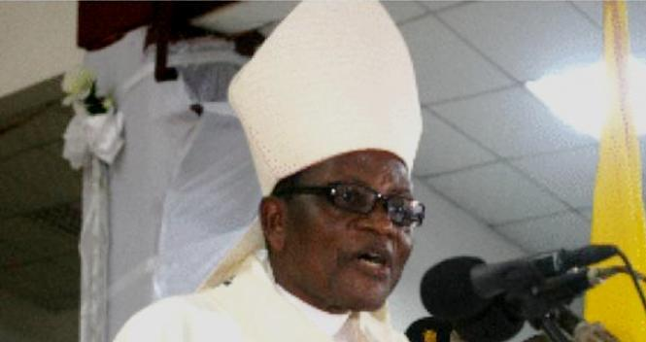
Social media: the blame and misconceptions
35
Ebola is the lifeline for the American economy that has already tumbled over the edge. The virus can be more powerful than any bomb; especially if America holds the "cure".
I say drop a bomb on them they a third world country destroy their kings a boom we get Africa and we can sell it
America is going to release ebola in America and blame it on isis. New 9/11 and population control.
This virus has the same symptoms with ZOMBIFICATION which was a voodoo practices; Zombie is defined as corpse said to be revived by witchcraft
Bull*** our government is spreading it to reduce the population. Remember satan has control over governments. Also our own government worships satan.
It comes to me as if the doctors dont even care about Ebola victims. Once their infected, they’re no longer human, treat them like scum and leave them for dead as they slowly rot on the inside and die alone never to see their family again
Wow look at all this Bible prophecy coming true this tell me that it's time for all of us to give our lives to JESUS right now and be covered by his blood we all need to repent of all our sins and ask JESUS to forgive us
Our elites are particularly into genocide in Africa. You must not think that all white men wish to kill all black people. Its really all about oligarchs and elite Jew pigs.
Americans have vaccine and probably they invent this virus during cald war and use on who else than poor africans !! but they dont give vaccine to anyone except of this 2 or 3 persons from USA few weeks ago who are healed while others (africans especially)you will be died !!

Slide 38
38
Geo-climatic, geographical and ecological
Socio-cultural
Traditional beliefs, Traditional healers and Witchdoctors,
Religion,
Burial practices
Suspicion and misconceptions
Political
Low-socioeconomic
Individual human behavior and movement
Host susceptibility
Host
Filovirus
Microbe
Environment

