Slide 1


Personal protective equipment implementation in healthcare: A scoping review
Prof. Dr. Maria Clara Padoveze
School of Nursing, University of São Paulo, Brazil
Hosted by Paul Webber
paul@webbertraining.com
www.webbertraining.com
January 26, 2023

Slide 2

I declare not having a conflict of interest related to the subject of this presentation

Slide 3

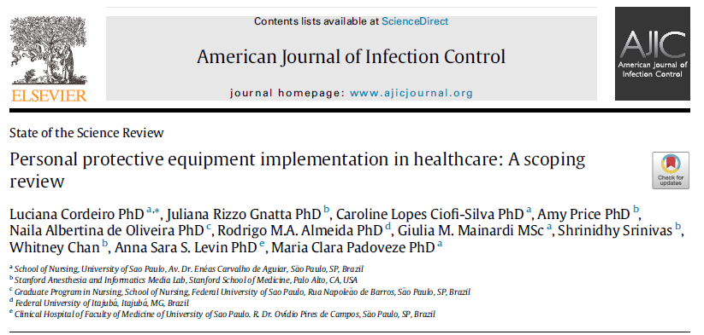
Authors acknowledge that this study derived from a COVID-19
program project funded by WHO based on a grant from the German
Federal Ministry of Health (BMG).
We also acknowledge Ying Ling Lin for supporting the development of the review

Slide 4

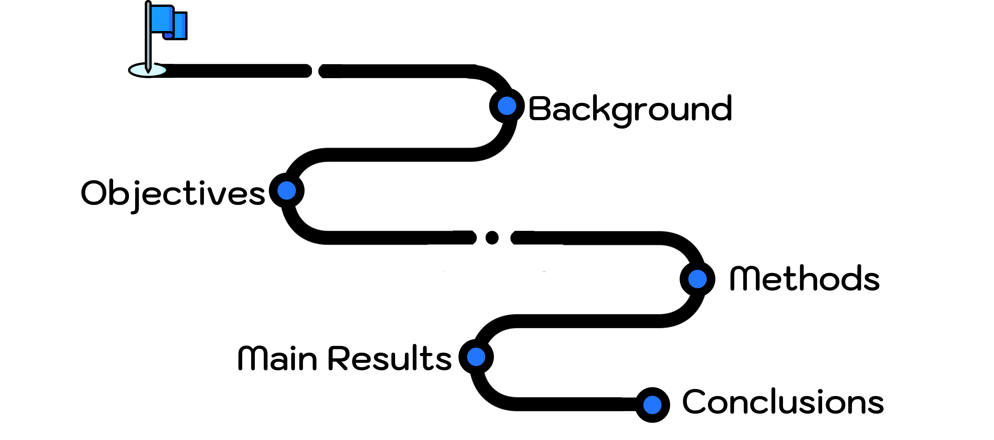
Roadmap of the presentation

Slide 5
Backgound
7%-8.7% of health workers (HWs) were infected with COVID-19 while working due to:
  inadequate access to or use of personal protective equipment (PPE)
  health facilities’ organization and lack of preparedness
  limited availability of PPE
  Low PPE adherence

Slide 6
Outbreaks: opportunity to reinforce IPC recommendations
Isolated interventions such as education and training and other behavioral interventions do not have a considerable effect on IPC measures adherence
PPE adherence is not a matter of only individual HW decision:
multiple factors influence HW ability and willingness to adhere to IPC guidelines
Integrated implementation strategies: ensure uptake of evidence-based practices and technologies in health care
The effective PPE implementation is a complex practice!

Slide 7
Objective
To map how PPE is implemented in health care, focusing on barriers and facilitators.

Slide 8

Methods
Joanna Briggs Institute methodology, and PRISMA recommendations
2 independent investigators for data search, selection and extraction and one expert for consensus achievement
Scoping Review
14 databases until May 11th 2021
How is PPE implemented in health care?
What does the process of PPE selection, acquisition, training, maintenance, acceptance, adherence, and assessment entail in health care?
What are the barriers and facilitators to the implementation process for PPE in health care settings?
Guiding questions:

Slide 9
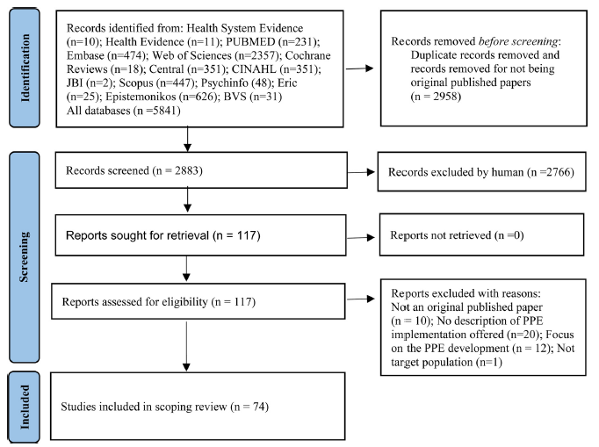
Results

Slide 10
Results
Results of barriers and facilitators were matched with the Consolidated Framework for Implementation Research (CFIR)
Intervention Characteristics
Individual characteristics domain
PPE impact on clinical work
HW anxiety and stress
HWs lack of preparedness, knowledge, or training
PPE non adherence
Outer and inner setting
PPE shortage/unavailability
Supply and logistics problems
HF inadequate infrastructure, lack of preparedness and policies
Policy and procedure communications

Slide 11
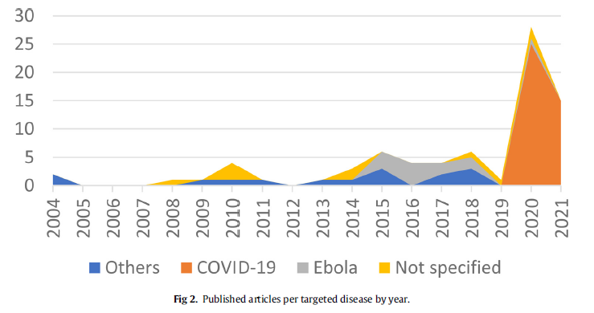
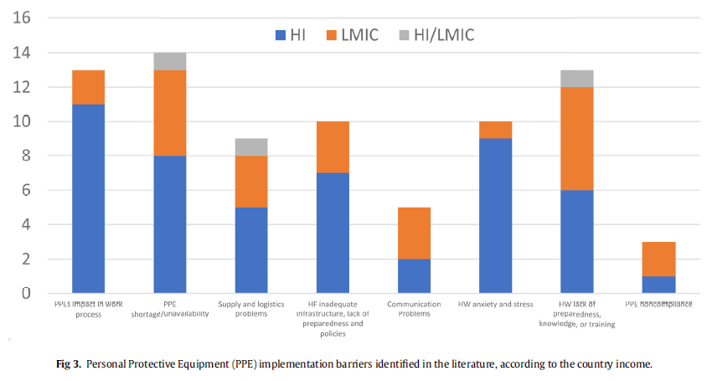

Slide 12
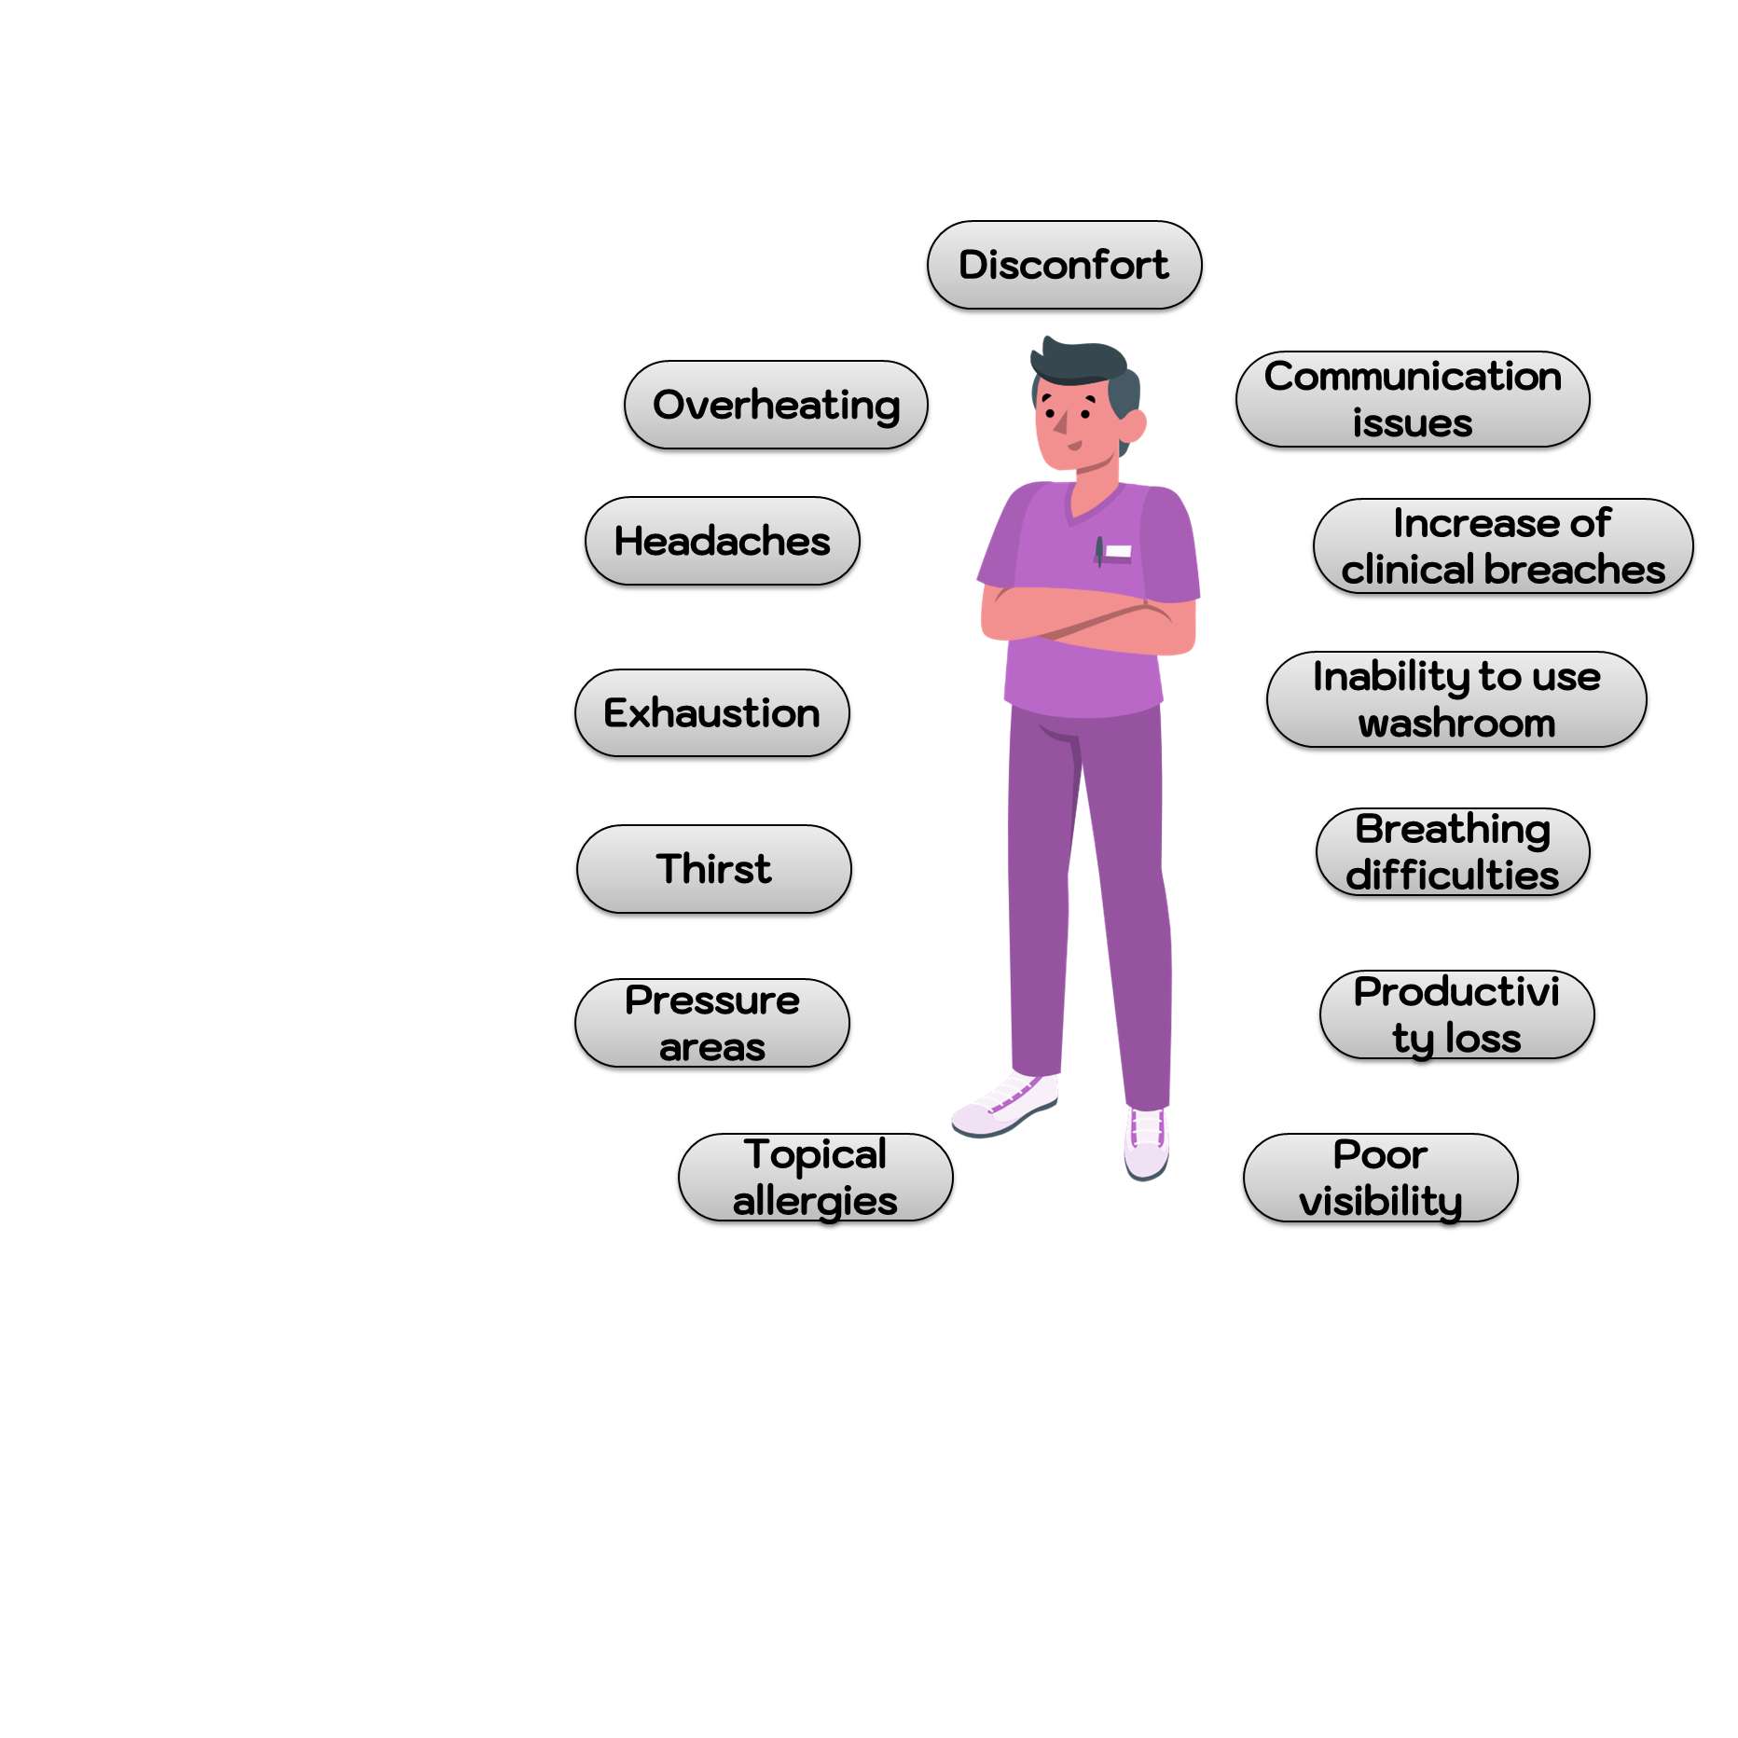
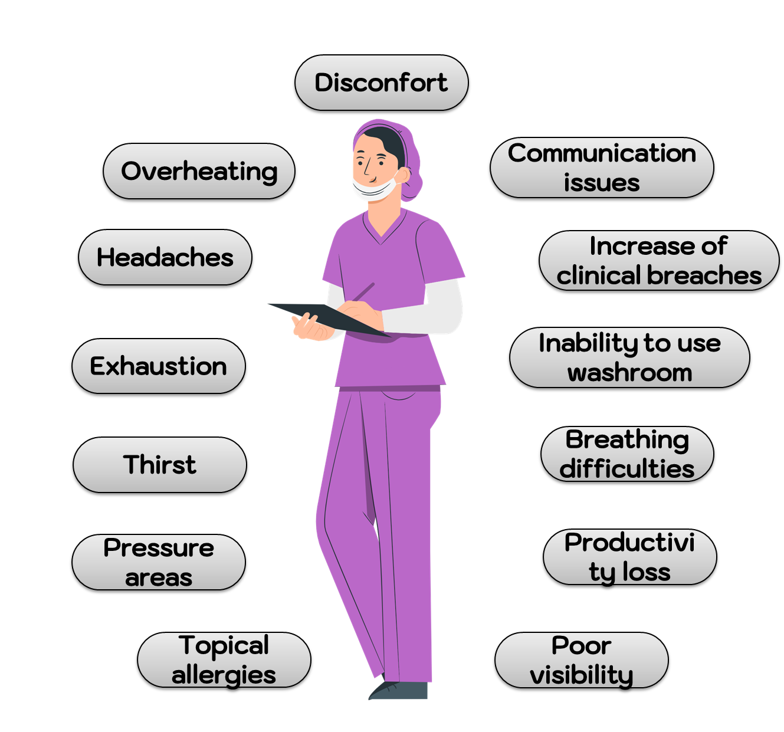
Intervention Characteristics
PPE impact on clinical work
Implementation interventions:
Improvement of personal well-being and minimization of adverse effects of PPE:
Both HF and HW should co-design and co-produce implementation and sustainability strategies.
Adjustments in the duty area like temperature control, improvement ventilation in the building, and limiting time spent in the clinical zone
Comfort should be taken into consideration when PPE is selected and purchased
HWs be provided with PPE design that allows them to drink water and take breaks as needed

Slide 13

Inner and Outter settings
PPE shortage / unavailability
Implementation interventions
Mobile teams replace PPE actively
Procedures to reduce the degradation of the equipment
Education to reduce unnecessary PPE use and waste
PPE reprocessing systems during extreme conditions
  Identification and tracking of reprocessed PPE
Improved implementation of PPE stock control and supply procedures
Barriers
Shortages in public and private HFs
Specific sizes needed for adequate protection were unavailable, which led to the use of poorly fitted PPE
Inadequate adaptations: non-evidence-based reuse, extended use, and reprocessing practices.
HW to purchase their own PPE

Slide 14

Inner and Outter settings
Supply and logistics problems
Barriers
Implementation interventions
Implementation of specific PPE protocols as part of a HF policy, involving HWs.
Have a response plan in the context of pandemic
robust regular training and qualifications periodic
fit testing and appropriate mask sizing
PPE compliance monitoring
PPE provision as per the level of risk in different zones
Use of additional PPE like powered air purifying respirators (PAPRs) in all areas allocated for aerosol-generating procedures
Donning and doffing area designations
Lack of biocontainment unit to discharge disposable PPE
Inadequate space layout between clean and contaminated area
Inadequate donning and doffing zones
Unavailability fit test performance of respirators
Conflicting or lack of PPE protocols
Inefficient communication between HF leaders or managers and frontline HWs
External influences in the adherence to PPE good practice

Slide 15
Inner and Outter settings
HF inadequate infrastructure, lack of preparedness
Implementation interventions
PPE can be selected and purchased according to HW’s body sizes and preferences
Institutional processes established & monitored for quality and performance
Processes to manage supply of PPE and maintain a baseline inventory of every critical item
To conduct a routine facility-level assessment of the PPE supply
PPE can be allocated and organized to maximize space and to optimize access and distribution
Barriers
PPE supply chain and stockpiling efforts were thwarted by logistics, planning and communication challenges

Slide 16
Inner and Outter settings
Policy & procedures communication
Barriers
Implementation interventions
Alternative communication might be used:
hand-signs taught to all HWs,
writing on glass doors with markers,
creation of laminated cards for use by the team and text messaging apps to discuss key points with the staff
More complex strategies such as:
routine evaluation and feedback regarding PPE adherence
departmental bulletins
and face-to-face briefings
PPE policies not consistent or constantly changing
Too much irrelevant information creates confusion among HWs
Daily updates were not helpful because HWs needed consistent PPE recommendations and guidelines
Lack of leadership and team cohesion

Slide 17
Individual characteristics domain
HW anxiety & stress
Barriers
Implementation interventions
PPE training and simulations more as part of preparedeness decrease latent threats making HWs more confident and more prepared
Trained problem solving HWs who listen to staff members’ concerns about PPE
Sign post information, and promotion positive attitudes towards PPE and reduce fear and anxiety levels
HWs were psychologically affected by clinical practice, especially in the context of the COVID-19 pandemic
Situations like unannounced simulations involving mock patients and others related to risk perception concerning PPE problems engendered anxiety
HWs were concerned that patients could experience anxiety and distress when they were unable to stay close or even see the face of the person treating them due to PPE use
HWs were confused and lacked confidence about the available IPC guidelines and protocols

Slide 18
Individual characteristics
HWs lack of knowledge & preparedness
Barriers
Implementation interventions
Online and in-person training with practice exercises or simulations improved knowledge, safety and competency of PPE usage among HWs.
Training must be completed before HWs start working, and be refreshed at regular intervals
Informing HW practices by making learning materials freely available in repositories group chats, and social media
HWs lack knowledge and preparedness concerning PPE selection, correct use, and decontamination processes (if applicable)
Lack of regular training programs related to PPE
Nonmandatory IPC training to all HWs (mainly medical staff)

Slide 19
Individual characteristics
PPE non adherence
Barriers
Implementation interventions
Involvement of stakeholders to develop a culture of safety, a local IPC policy, and training
Development of PPE monitoring programmes to provide compliance surveillance
Presence of an observer to periodically inspect the PPE in the clinical area, and monitor HW well being
Cross-checking of PPE donning, working in red zone, and doffing using a buddy system
Development of a quality assurance checklist for PPE self monitoring to identify breaches
Adjustments in the donning and doffing areas, such as mirror installation, designation of step-by-step pictorial instructions
Suboptimal levels of HW PPE correct usage and adherence
Adherence was not consistently monitored

Slide 20
Conclusions
Evidence-based implementation strategies are required to reduce the barriers and strengthen the enablers.
Governments, HF managers, HWs should be engaged
We advocate for sustainable PPE implementation strategies that address its multilevel transdisciplinary complexity, which will enhance safety and health care quality and effectiveness.
We hope the lessons learned in this review can inform decision makers and providers to collectively develop more robust and structured PPE implementation worldwide.

Slide 21

Thank you!
padoveze@usp.br

Slide 22

