Slide 1
Practical Approaches for Monitoring Cleaning in Healthcare Facilities
Curtis Donskey, M.D.
Louis Stokes VA Medical Center
Cleveland, Ohio
Hosted by Bruce Gamage
Provincial Infection Control Network of BC
www.webbertraining.com
January 25, 2018

Slide 2
Disclosures
Research support
  GOJO, Clorox, Pfizer, Merck, EcoLab, Altapure
Consultant
  Synthetic Biologics

Slide 3
Objective
To discuss practical approaches to improve environmental cleaning through monitoring and feedback
Deshpande A, Donskey CJ. Practical approaches for assessment of daily and post-discharge disinfection in healthcare facilities. Curr Infect Dis Rep 2017;19:32
Notes:
3

Slide 4

Transmission of healthcare-associated pathogens
InfectedPatient
Susceptible Patient
Environment

Slide 5
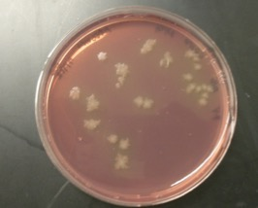
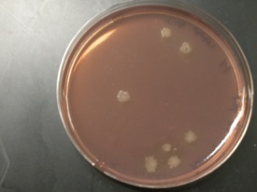
Acquisition of C. difficile on hands after contact with skin and environment
Hand contamination after contact with skin sites: 50%
Hand contamination after contact with high-touch surfaces: 50%
Abdomen
Bedrail
Guerrero DM, et al. Acquisition of spores on gloved hands after contact with skin of CDI patients and with environmental surfaces in their rooms. AJIC 2012;40:556-8

Slide 6
Basic infection control practices
Hand washing, gloves, gowns
InfectedPatient
Susceptible Patient
Environmental Cleaning
Environment
Dubberke ER, et al. Strategies to prevent CDI in acute care hospitals. Infect Control Hosp Epidemiol 2008;29:S81-S92

Slide 7
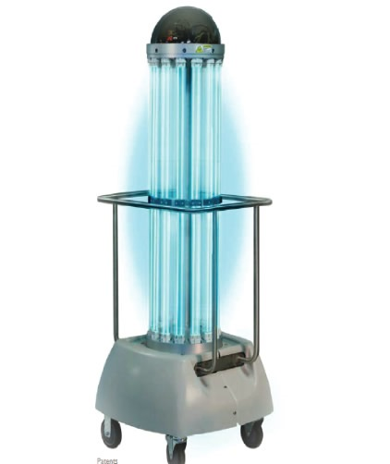
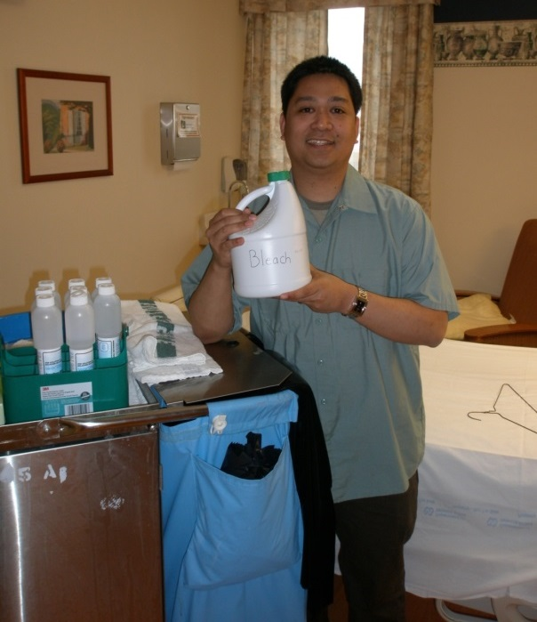
Strategies to improve environmental disinfection
Improve standard cleaning and disinfection
Product substitution
New technologies
Quaternary ammonium disinfectant
Improved hydrogen peroxide
Peracetic acid
Bleach

Slide 8
Substitution of bleach for non-sporicidal cleaning agents to control C. difficile
Ref | Setting | Effect on CDI rates | Monitoring to ensure efficacy of disinfection
1 | Medical Ward | Outbreak ended | Surface contamination reduced to 21% of initial levels
2 | Bone marrow transplant (BMT) unit, Medical Ward, ICU | Significant decrease on BMT unit, but not on the other 2 wards | No
3 | 2 medical wards | Decreased on 1 of 2 wards | No decrease in prevalence of environmental contamination
4 | Medical and surgical ICUs | Decreased on both units | No
5 | 3 hospitals | 48% decrease in prevalence density of CDI | No
6 | 2 medical wards | 85% decrease in hospital acquired CDI | Yes (ATP bioluminescence)
1). Katz G. Am J Epidemiol 1988;127:1289-94; 2). Mayfield JL. Clin Infect Dis 2000;31:995-1000;
3). Wilcox MH. J Hosp Infect 2003;54:109-114; 4). McMullen KM. Infect Control Hosp Epidemiol 2007;28:205-7; 5). Hacek DM. Am J Infect Control 2010;38:350-3; 6). Orenstein R. Infect Control Hosp Epidemiol 2011;32:1137-9
Notes:
8
8

Slide 9
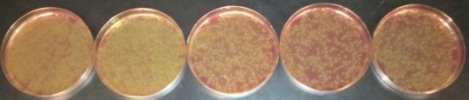
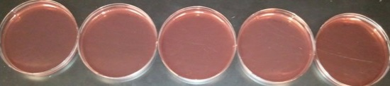
Microbiological plausibility
Transfer of C. difficile spores by a nonsporicidal wipe
Quat wipe
Bleach wipe
Cadnum JL, et al. Infect Control Hosp Epidemiol 2013;34:441-2

Slide 10
Crossover trial of improved hydrogen peroxide versus a quaternary ammonium disinfectant
 | Improved hydrogen peroxide | Quaternary ammonium disinfectant | P value
Mean aerobic colony counts | 14 | 22 | .003
% surfaces with no growth | 48% | 35% | <.0001
Incidence of nosocomial colonization or infection* | 8 | 10 | .07
*, composite of VRE and MRSA colonization or infection and Clostridium difficile infection
Boyce JM, et al. Am J Infect Control 2017;45:1006-10; Alfa MJ, et al. Am J Infect Control 2015;43:141-6 (substitution of improved hydrogen peroxide wipes for a daily cleaner applied using cotton rags associated with reduced HAIs)

Slide 11
New technologies

Slide 12
Impact of UV-C radiation devices on healthcare-associated infections
Multiple quasi-experimental studies have reported reductions in CDI and other HAIs with UV-C ¹⁻⁸
Cluster randomized, multicenter, crossover study⁹
  No decrease in CDI for bleach versus bleach plus UV
  Significant reduction in targeted MDROs (MRSA, VRE, Acinetobacter, C. difficile) when UV added to a quaternary ammonium disinfectant
Systematic review: UV-C reduced CDI and VRE⁸
1. Miller R. AJIC 2015;43:1350-3; 2. Levin J. AJIC 2013;41:746-8; 3. Nagaraja A. AJIC. 4. Vianna PG. AJIC 2016;44:299-303; 5. Haas JP. AJIC 2014;42:586-90; 6. Nagaraja A. AJIC 2015, July 6; 7. Pegues DA. ICHE 2017;38:39-44 (CDI decreased 25% on 3 study units and increased 16% on non-study units); 8. Marra AR. ICHE 2017; 9. Anderson D. Lancet 2017;389:805-814.

Slide 13
Improving standard cleaning and disinfection
Education
Written policies and procedures
Recognition of environmental services personnel
Institutional commitment
Monitoring and feedback essential
  Objective monitoring tools
Carling P. Am J Infect Control 2013;41:520-5;
Havill NL. Am J Infect Control 2013;41:S26-S30

Slide 14
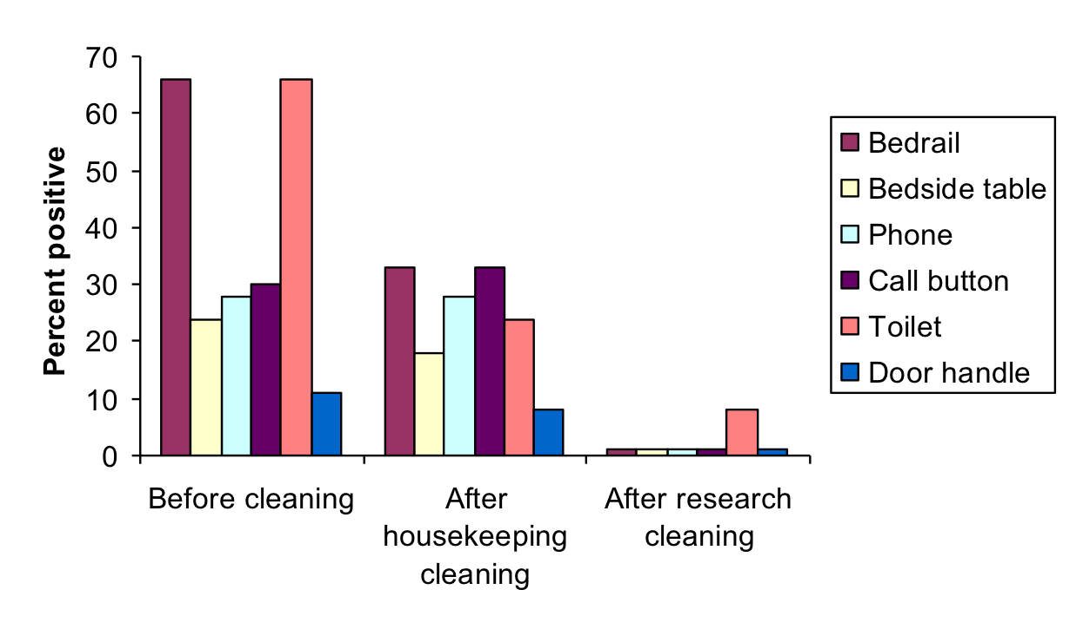
Process not product
Eckstein B, et al. Reduction of C. difficile and VRE contamination after an intervention to improve cleaning methods BioMed Central Infect Dis 2007;7:61

Slide 15

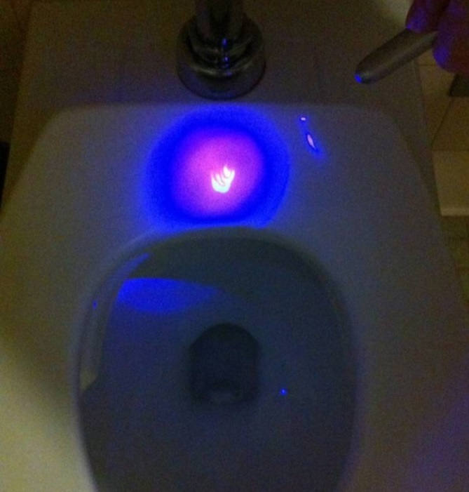
Fluorescent markers
Phil Carling
Fluorescent marker on a toilet seat after housekeeping cleaning
1. Carling PC, et al. Clin Infect Dis 2006;42:385-8; 2. Carling P, et al. Infect Control Hosp Epidemiol 2008;29:1035-41; 3. Carling P. Am J Infect Control 2013;41:520-525

Slide 16
Advantages of the fluorescent marker method
Can provide aggregate feedback on thoroughness of cleaning
Can provide immediate, objective feedback to individual employees
Evidence of benefits
  Improvements in thoroughness of cleaning ¹
  Reductions in MRSA and VRE transmission and C. difficile infection ²⁻⁴
1. Carling PC. ICHE 2008;29:1035; 2. Goodman ER. ICHE 2008;29:593-9; 3. Datta R. Arch Intern Med 2011;171:491-4; 4. Smith A. J Hosp Infect 2016;92:161-6

Slide 17
Limitations of the fluorescent marker method
EVS personnel may focus efforts on removal of marks rather than improving cleaning
  Obtain own black lights to locate marks ¹
Monitoring by EVS personnel may not correlate with findings of independent observers ²
Marker may not be thoroughly removed from irregular surfaces despite wiping
1. Kundrapu S. ICHE 2014;35:202-4; 2. Anderson DJ. ICHE

Slide 18
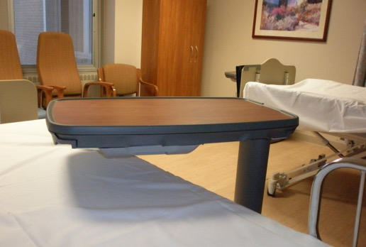
Removal of marker may not correlate with cleaning of alternate sites on the same surface
Table top surface
Table hand grip
Sitzlar B. ICHE 2013;34:459-5

Slide 19
Pathogens often recovered from sites with complete marker removal
Ref | Fluorescent marker method culture results
1 | Despite intervention, 27% of rooms contaminated with MRSA or VRE after cleaning (versus 45% at baseline)
2 | 33% of toilet seats in CDI rooms with complete marker removal grew C. difficile
3 | 21% of sites with complete marker removal not clean based on aerobic colony counts
1. Goodman ER et al. Infect Control Hosp Epidemiol 2008;29:593-9; 2. Alfa MJ, et al. BMC Infect Dis 2008;8:64; 3. Boyce JM, et al. Infect Control Hosp Epidemiol 2011;32:1187-93

Slide 20
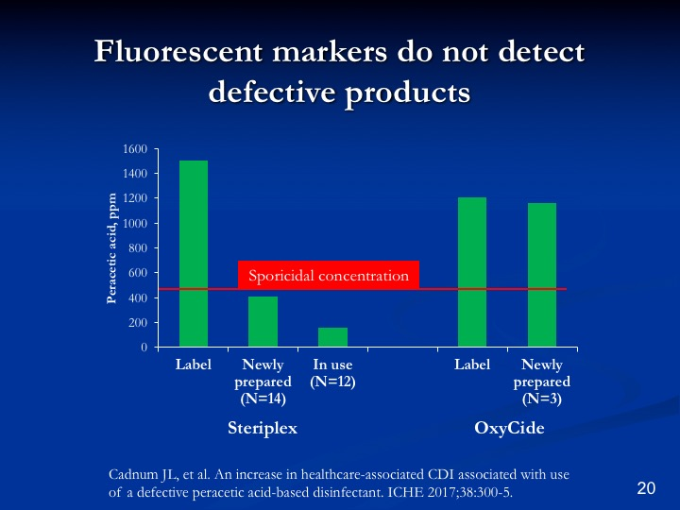

Slide 21
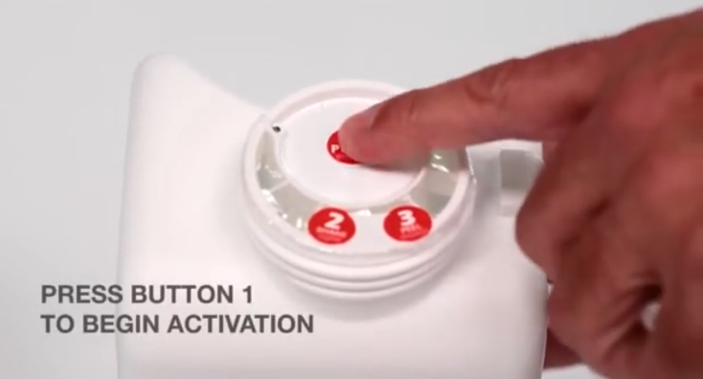
Steriplex
Malfunction of the Smart Cap reservoir led to insufficient amounts of the activator component, possibly due to sensitivity to certain shipping and handling conditions
Cadnum JL, et al. An increase in healthcare-associated CDI associated with use of a defective peracetic acid-based disinfectant. ICHE 2017;38:300-5.

Slide 22
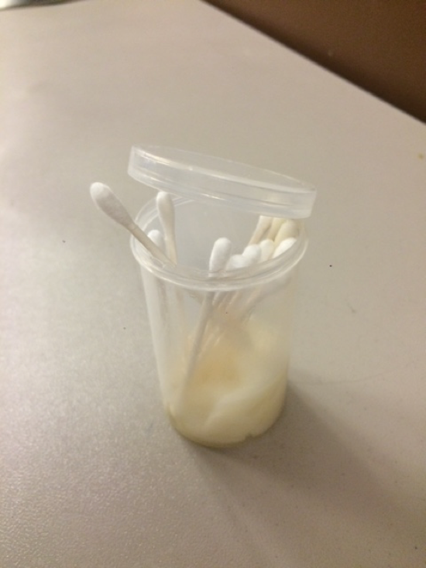
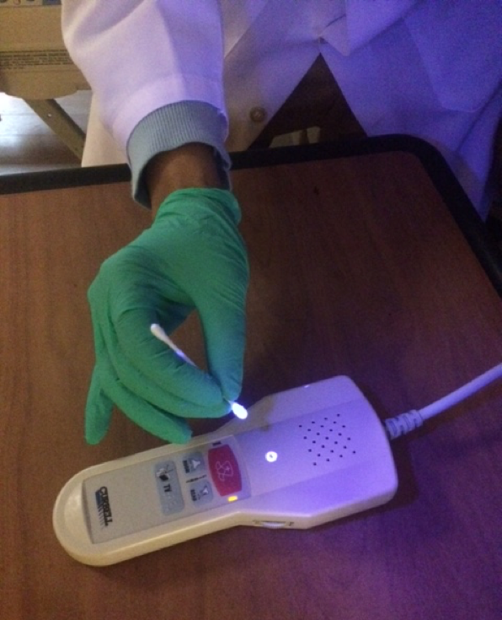
Low-cost fluorescent marker:
Tide free & gentle laundry detergent

Slide 23
ATP bioluminesence
Quantitative measurement of organic material (bacteria, food, bodily secretions)
Expressed as relative light units (RLUs)
No established benchmark for defining clean
ATP readings may correlate with aerobic colony counts ^{3, 5}
Rapid results can be used to provide immediate feedback to personnel
1. Boyce JM. ICHE 2009;30:678-84; 2. Boyce JM. ICHE 2011;32:1187-93; 3. Luick L. Am J Infect Control 2013;41:751-2; 4. Amodio E, Dino C. J Infect Public Health 2014;7:92-8; 5. Huang Y. AJIC 2015;43:882-6

Slide 24
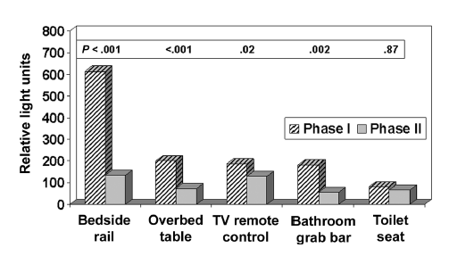
Improved cleaning after providing education and feedback based on ATP readings ¹
1. Boyce JM. Monitoring effectiveness of hospital cleaning practices by use of an ATP bioluinescence assay. ICHE 2009;30:678-84; 2. Branch-Elliman W. Direct feedback with the ATP luminometer as a process improvement tool for terminal cleaning of patient rooms. AJIC 2014;42:195-7

Slide 25
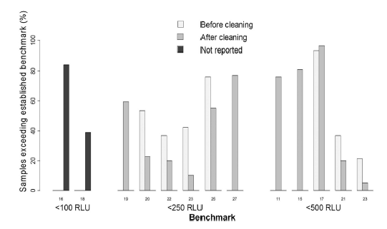
Failure rates at different ATP benchmarks before vs after cleaning
Amodio E, Dino C. J Infect Public Health 2014;7:92-8

Slide 26
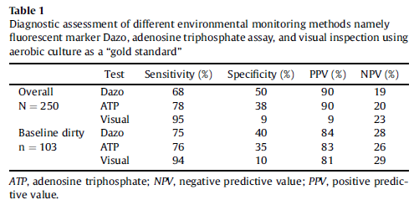
Comparison of fluorescent marker and ATP methods to aerobic colony counts
Luick L. Am J Infect Control 2013;41:751-2

Slide 27
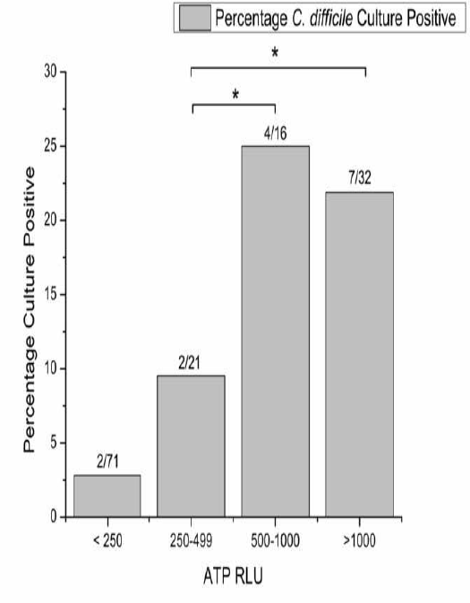
Correlation between ATP readings and cultures in cleaned CDI rooms
Deshpande A, et al. Infect Control Hosp Epidemiol 2013;34:865-7

Slide 28
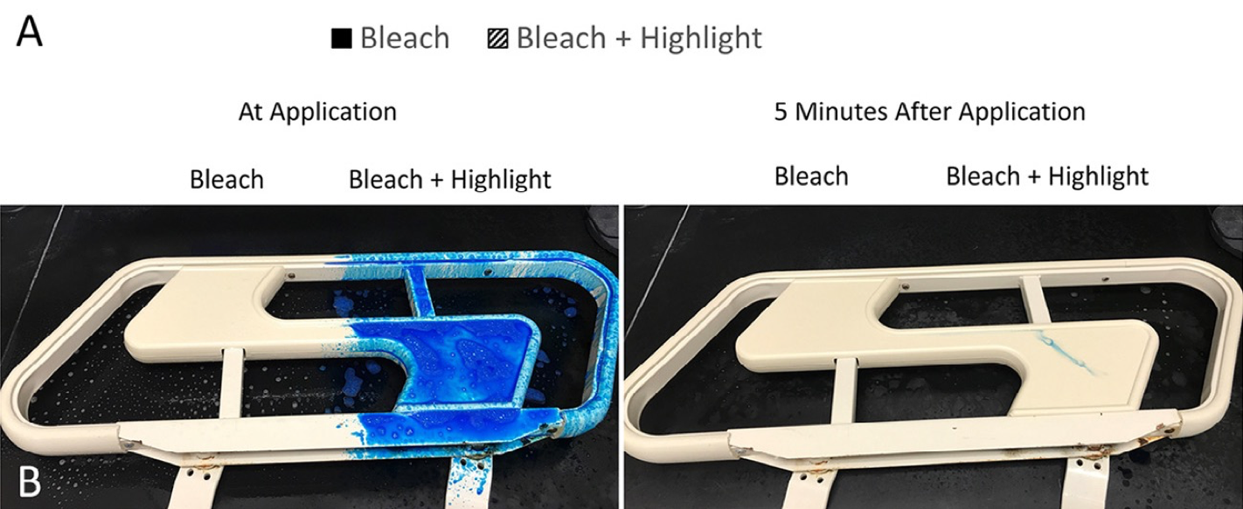
Chemical additive to colorize chlorine-based disinfectants to improve visualization
Mustapha A. Evaluation of novel chemical additive that colorizes chlorine-based disinfectants to improve visualization of surface coverage. AJIC 2018;46:119-121.

Slide 29
Direct observation of cleaning practices and interviews with EVS staff
Interviews with EVS staff
  Knowledge deficits
  Other issues that impact job performance
Direct observation
  Identifies variation in performance ¹⁻²
    Time, number of wipes used, level of cleanliness
    Incorrect application such as application of bleach followed by immediate wiping
Boyce JM. ICHE 2009;31:99-101; Rupp ME. ICHE 2013;34:100-2

Slide 30
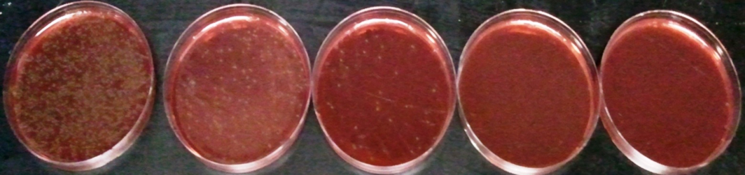
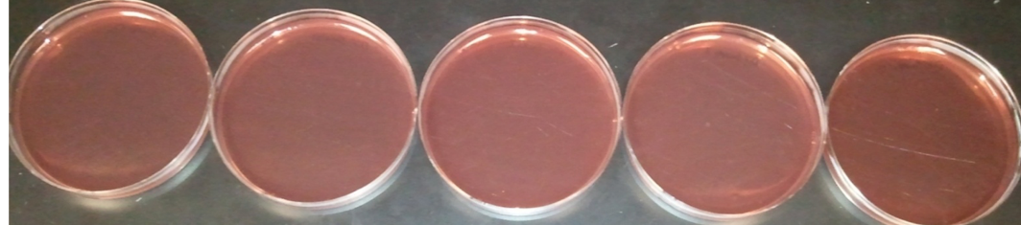
Fluorescent markers do not detect incorrect use of products
Transfer of C. difficile spores by a bleach wipe¹
Bleach wipe after multiple uses
Fresh wet bleach wipe
1. Cadnum JL, et al. Infect Control Hosp Epidemiol 2013;34:441-2; 2. Manian FA, et al. Infect Control Hosp Epidemiol 2011;32:667-72 (Suspected transfer of MRSA and Acinetobacter from dirty to clean sites during room cleaning)

Slide 31
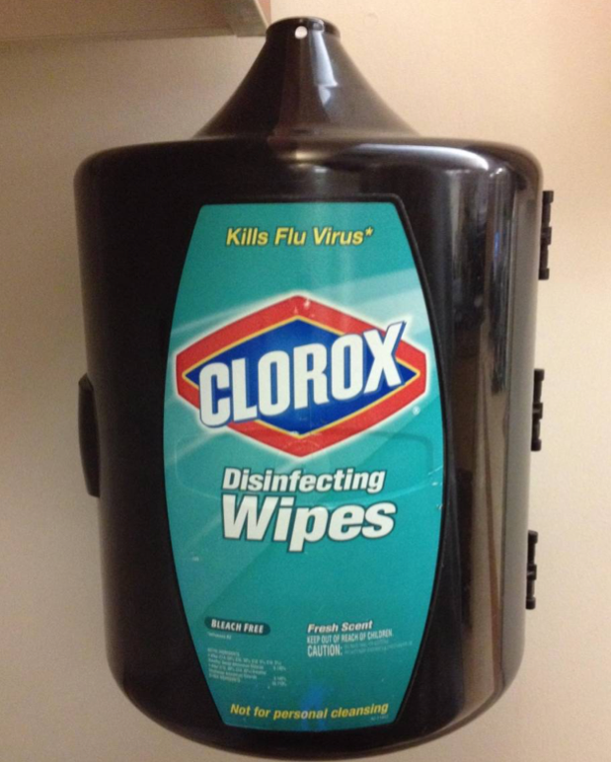
Confusion about products
Dharan S, et al. J Hosp Infect 1999;42:113-7

Slide 32
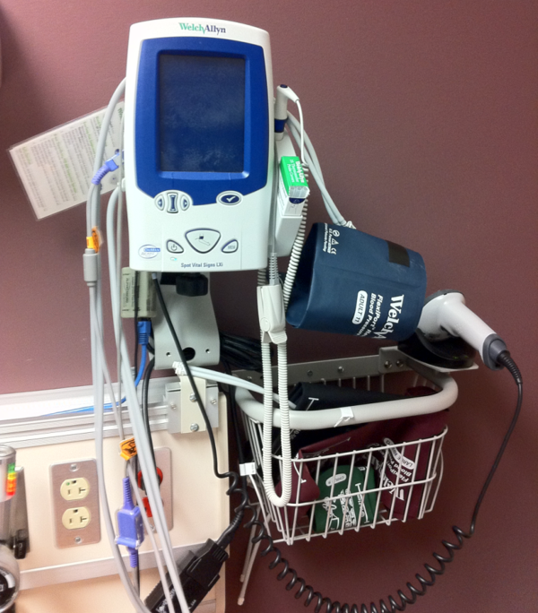
Confusion about who cleans what
Wall-mounted vital signs equipment
Dumigan DG, et al. Am J Infect Control ;38:387-92;
Goodman ER, et al. Infect Control Hosp Epidemiol 2008;29:593-9

Slide 33
Portable equipment
Hospitalized patients frequently have direct or indirect interactions with shared medical equipment and other fomites ¹
Portable equipment is often contaminated with pathogens, but rarely cleaned ²
Portable equipment has been associated with outbreaks ³
1. Suwantarat N. Quantitative assessment of interactions between hospitalized patients and portable medical equipment and other fomites. AJIC 2017; 2. Havill N. Cleanliness of portable equipment disinfected by nursing staff. Am J Infect Control 2011; 3. Kanamori H. The role of patient care items as a fomite in healthcare-associated outbreaks and infection prevention. Clin Infect Dis 2017

Slide 34

Quantitative assessment of interactions between hospitalized patients and portable medical equipment and other fomites
Suwantarat N, et al. Am J Infect Control 2017; 2017;45:1276-1278.

Slide 35
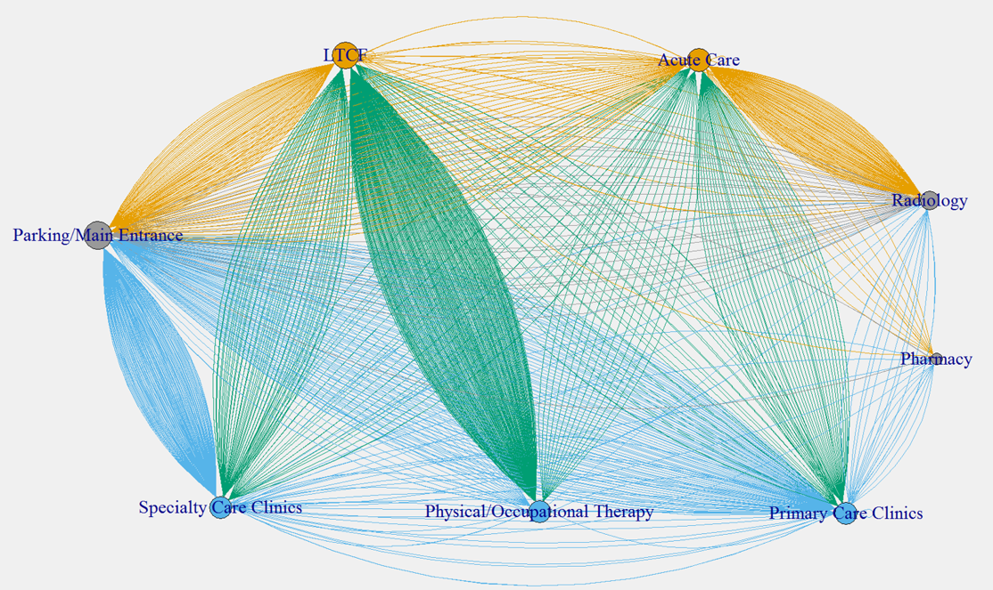
Movement of wheelchairs within the hospital and LTCF
Alhmidi H, et al. SHEA 2018

Slide 36
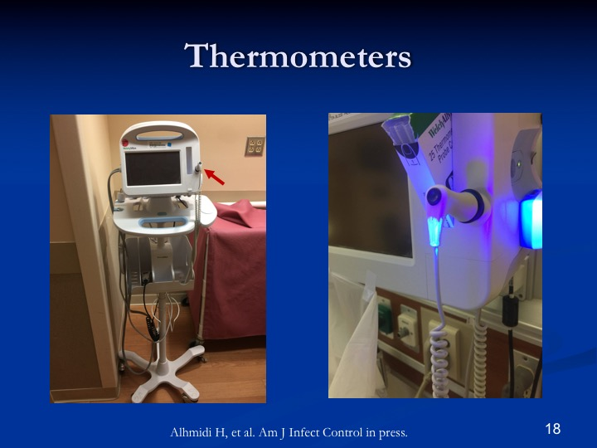


Slide 37
Dedicated teams of motivated workers for isolation rooms

Slide 38
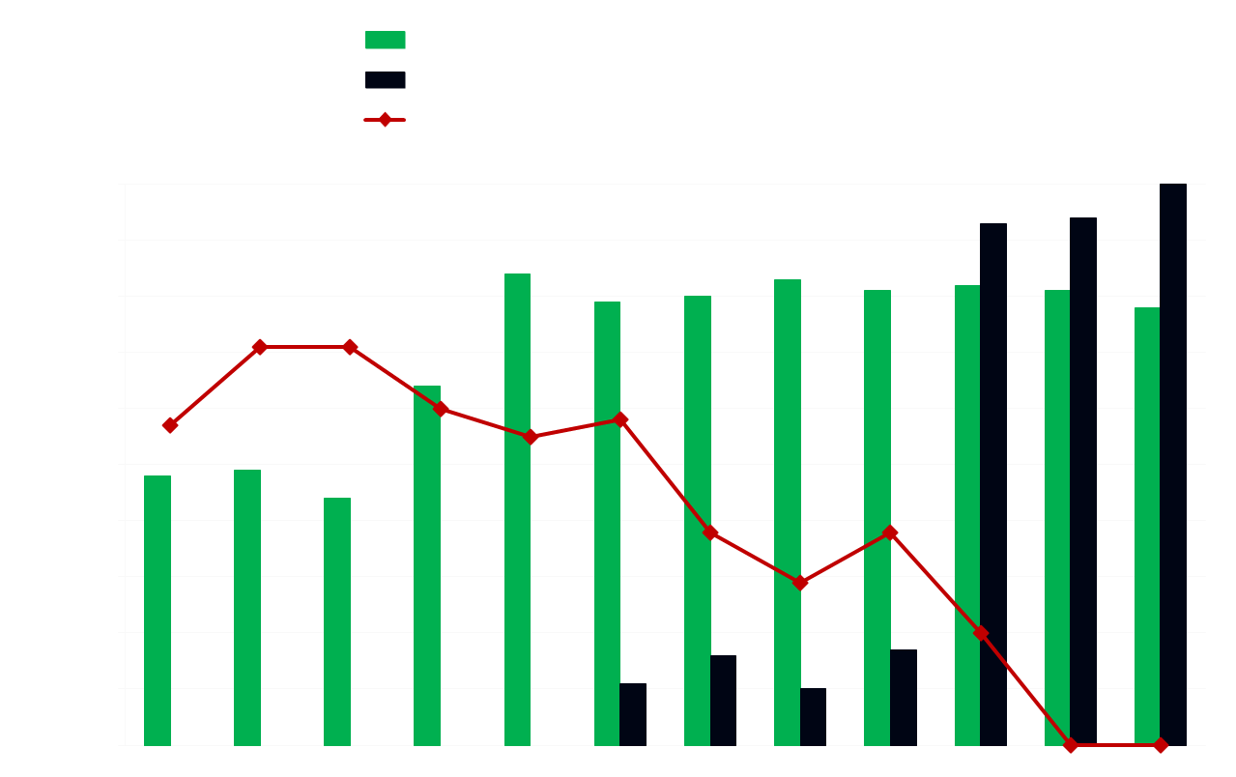
An environmental disinfection odyssey
Baseline
Fluorescent markers
UV device
Enhanced daily & terminal cleaning
Sitzlar B, et al. Infect Control Hosp Epidemiol 2013;34:459-65

Slide 39
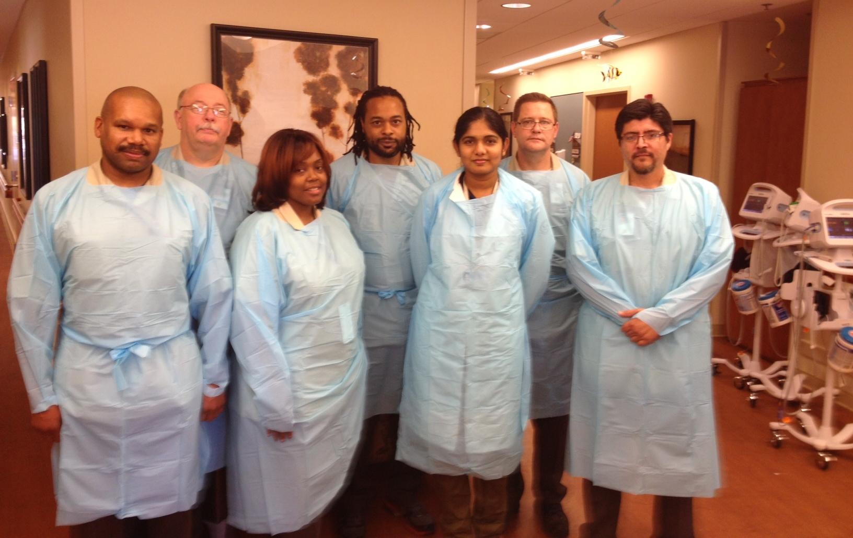
More cleaning, less screening:
C. difficile daily disinfection team
Kundrapu S, et al. ID Week poster 1394; Infect Control Hosp Epidemiol (in press).

Slide 40

Monitoring and feedback can be time-consuming
Kundrapu S, et al. More cleaning, Less screening: Evaluation of the time required
for monitoring vs performing environmental cleaning. ICHE 2014;35:202-4.

Slide 41
Environmental monitoring at the Cleveland VA Medical Center
Fluorescent markers
  Terminal cleaning all rooms
  Daily cleaning C. difficile rooms
Direct observation of environmental services personnel
ATP
Cultures

Slide 42
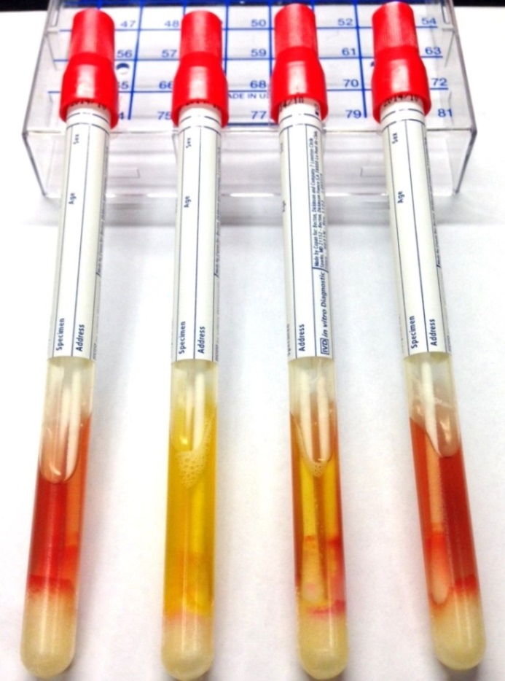
Microbiologic monitoring: culture for C. difficile without anaerobic conditions
Negative Positive Positive Negative
Aerobic Anaerobic
Cadnum JL, et al. J Clin Microbiol 2014

Slide 43
Effective implementation of UV-C devices requires monitoring and feedback
Fleming M. Deployment of a touchless UV light robot for terminal room disinfection: The importance of audit and feedback. AJIC 2017 Nov 3. pii: S0196-6553(17)31102-1.

Slide 44
Summary
Monitoring and feedback is essential in order to improve cleaning and disinfection
Current methods for monitoring have advantages and disadvantages
Direct observation of practices is useful
Monitoring and feedback can have a positive impact on EVS programs

Slide 45
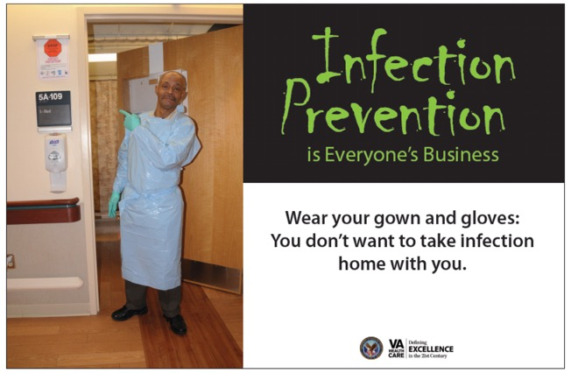

Slide 46

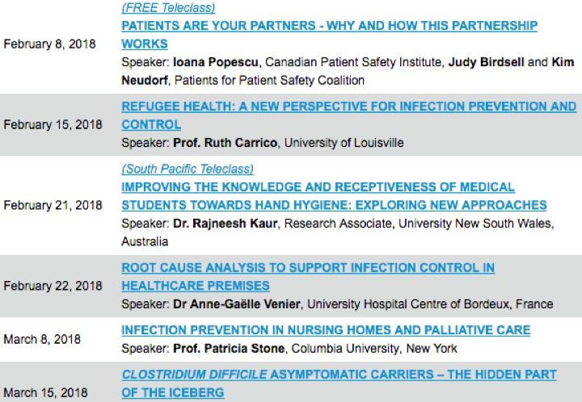

Slide 47


