Slide 1
Preventing Catheter-Associated Urinary Tract Infection (CAUTI): Making It Happen
Sanjay Saint, MD, MPH
Chief of Medicine, VA Ann Arbor Healthcare System
George Dock Professor of Internal Medicine
University of Michigan Medical School
Hosted by
Paul Webber
paul@webbertraining.com
www.webbertraining.com
March 5, 2015

Slide 3
Consistently Using Evidence-Based Practices Remains a Challenge…

Slide 4
Hand Hygiene Compliance in Healthcare Workers (Erasmus et al. Infect Control Hosp Epidemiol March 2010)
Systematic review of 96 studies
Overall median compliance of 40%
Lower rates in physicians (32%) than nurses (48%)
Lower rates “before” (21%) patient contact rather than “after” (47%)

Slide 5
Given this Gap Between What Should Be Done and What Is Done…
Focus on “implementation science”
“The scientific study of methods to promote the systematic uptake of research findings into routine practice” (Eccles & Mittman. Implementation Science. Feb 2006)

Slide 6
Healthcare-Associated Infections: Common, Costly, & Harmful
~1 million
Americans develop a healthcare-associated infection each year
~50% of infections could be prevented
Preventive practices used inconsistently

Slide 7
Catheter-Associated Urinary Tract Infection (CAUTI)
One of the most common infections
1/4 of inpatients receive catheters
1/3 of catheter days unnecessary
1/3 of physicians unaware their patient has a catheter
1/3 of the time no order for a catheter

Slide 8
Why are some facilities
better than others?
What can we learn
from successful facilities?
How can we implement change broadly to improve care?

Slide 9
Preventing Infection
Technical
Socio-
adaptive

Slide 10
Catheter-Associated Urinary Tract Infection (CAUTI)
UTI is a common cause of hospital-acquired infection
Most due to urinary catheters
Up to 20% of inpatients are catheterized
Leads to increased morbidity and healthcare costs www.catheterout.org

Slide 11
SEPTEMBER 17, 2013
“Many noninfectious catheter-associated complications are at least as common as clinically significant urinary tract infections.”

Slide 12
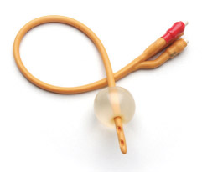
Disrupting the Lifecycle of the Urinary Catheter
1. Preventing Unnecessary and Improper Placement
1
4. Preventing Catheter Replacement
2. Maintaining Awareness & Proper Care of Catheters
4
2
3
3. Prompting Catheter Removal
(Meddings. Clin Infect Dis 2011)

Slide 13
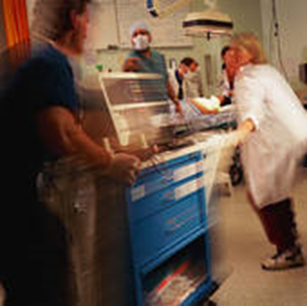
The Most Common Venue for Foley Placement?
Emergency Department

Slide 14
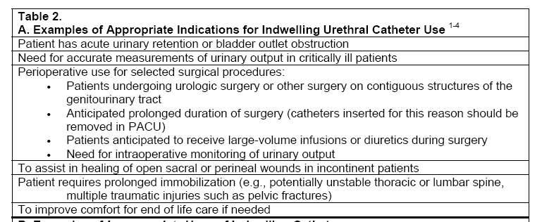
2009 Prevention of CAUTI HICPAC Guidelines (Gould et al, Infect Control Hosp Epidemiol 2010; 31: 319-326)

Slide 15
Alternatives to Consider
Accurate daily weights
Urinal/commode/bedpan
Condom catheters
Intermittent catheterization with bladder scanning

Slide 16
Avoiding Indwelling Catheter Insertion in the ED
2 studies have intervened in the ED to reduce insertion:
Gokula et al. ER staff education and use of a urinary catheter indication sheet improves appropriate use of Foley catheters. Am J Infect Control. 2007:
75% fewer indwelling catheters inserted after the intervention
Fakih et al. Effect of establishing guidelines on appropriate urinary catheter placement. Acad Emerg Med. 2010:
Physicians ordered 40% fewer insertions after the intervention

Slide 17
But if the patient really, really needs a Foley…
Ensure proper aseptic technique is used during insertion

Slide 18
Disrupting the Lifecycle of the Urinary Catheter
1. Preventing Unnecessary and Improper Placement
1
4. Preventing Catheter Replacement
2. Maintaining Awareness & Proper Care of Catheters
4
2
3
3. Prompting Catheter Removal
(Meddings. Clin Infect Dis 2011)

Slide 19
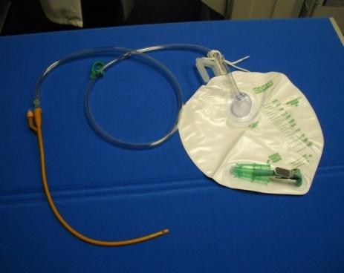
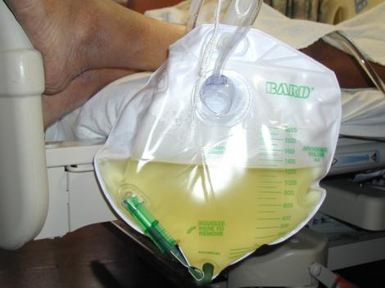
Proper Maintenance
Keep the urinary system closed
Make sure flow is unobstructed:
No kinking or coiling
Drainage bag should be lower than the bladder
Regularly empty the bag

Slide 20
Disrupting the Lifecycle of the Urinary Catheter
1. Preventing Unnecessary and Improper Placement
1
4. Preventing Catheter Replacement
2. Maintaining Awareness & Proper Care of Catheters
4
2
3
3. Prompting Catheter Removal
(Meddings. Clin Infect Dis 2011)

Slide 21
The Technical: Timely Removal of Indwelling Catheters
30 studies have evaluated urinary catheter reminders and stop-orders
Significant reduction in catheter-associated urinary tract infection (53%)
No evidence of harm (ie, re-insertion)
Will also address the non-infectious harms of the Foley Meddings J et al. BMJ Qual Saf 2013

Slide 22
What about the ICU?

Slide 23
NHSN Data: Intensive Care vs. General Wards (Edwards, Am J Infect Control 2009; Dudeck, Am J Infect Control. 2011)
Urinary Catheter Use: ICU > General Units
Unit | 2006-8 Urinary Catheter Utilization Ratio | 2009 Urinary Catheter Utilization Ratio
ICU (med-surg) | 0.79 | 0.72
General Wards (med-surg) | 0.22 | 0.19
(Slide courtesy of M. Fakih)

Slide 24
Just because a patient is in the ICU does NOT mean that the patient needs a Foley… The Key Question is this:
Are hourly assessments of urine output required?

Slide 25
Trigger Point: ICU To Floor
ICUs have very high urinary catheter use
Utilization may be reduced hospital-wide if patients transferred out of the ICU are evaluated for catheter necessity at time of transfer
ICU
Transfer from ICU
Floor
(Slide courtesy of M. Fakih)

Slide 26
Trigger Point: OR To Floor
Operating Rooms have very high urinary catheter use
Utilization may be reduced hospital-wide if patients transferred out of the PACU are evaluated for catheter necessity at time of transfer
PACU
Transfer from PACU
Floor

Slide 27
Disrupting the Lifecycle of the Urinary Catheter
1. Preventing Unnecessary and Improper Placement
1
4. Preventing Catheter Replacement
2. Maintaining Awareness & Proper Care of Catheters
4
2
3
3. Prompting Catheter Removal
(Meddings. Clin Infect Dis 2011)

Slide 28
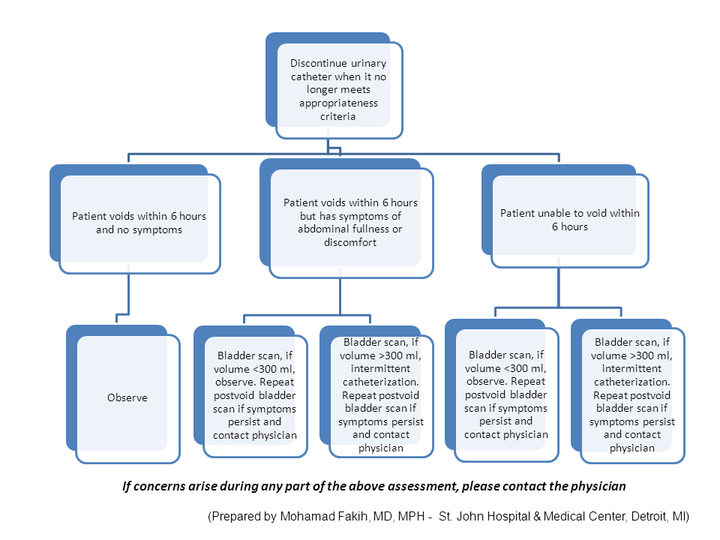

Slide 29
Preventing Infection
Technical
Socio-
adaptive

Slide 30
“The hospital is the most complex human organization ever devised…”
Peter Drucker

Slide 31
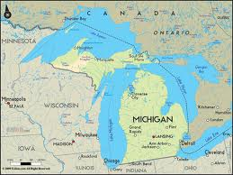
Implementing Change Across the State of Michigan in 71 Hospitals
CAUTI ↓ by 25% in Michigan hospitals (95% CI: 13 to 37% ↓ )
CAUTI ↓ by 6% in non-Michigan hospitals (95% CI: 4 to 8% ↓) (Saint et al. JAMA Intern Med 2013)

Slide 32
Broad Implementation
Federally-funded project aimed to reduce CAUTI rates
4-year project (Sept 2011 – Aug 2015)
To date: 40 states, District of Columbia, & Puerto Rico
~1000 hospitals
30% reduction on medical-surgical units (Fakih IDWeek 2014)
World Health Organization
Italy, Japan, Africa, Latin America …

Slide 33
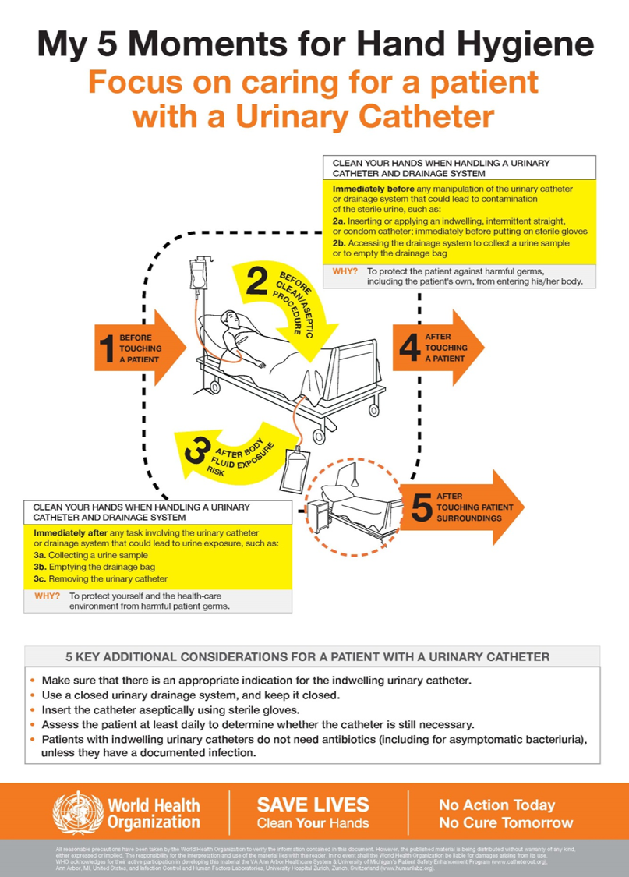

Slide 34
What if you need further help in preventing CAUTI?

Slide 35
Additional Approaches
Tier 1 & Tier 2
CAUTI GPS
Applying Mindfulness to CAUTI

Slide 36
Tier 1 Protocol: Use of Indwelling Urinary Catheter Kit
Assess and document competency of healthcare workers performing insertion
Measure monthly for 6 months; re-evaluate. If rate has dropped below indicated levels proceed back to Tier 1
Measure CAUTI rates monthly
Encourage use of alternatives to indwelling catheter
Tier 2 Protocol: Enhanced Practices – Evaluation of indication for use, maintenance, and removal technique
Follow maintenance and removal template for care and removal of the catheter
Assess daily the necessity of the indwelling catheter
Use standard indwelling urinary catheter kit with pre-sealed junction
Ensure proper aseptic insertion technique
Sources:
HICPAC CDC Guidelines on CAUTI Prevention
www.catheterout.org
Consider Root Cause Analysis or Focused Review of CAUTI or catheter use to identify improvement opportunities
Monitor CAUTI rates closely. Proceed to Tier 2 if either of the following conditions are met over a period of 6 months:
ICU ≥ 9 CAUTIs/10,000 patient days
2 CAUTIs/1,000 catheter days
Non-ICU, Acute Care ≥ 3 CAUTIs/10,000
pt days & 2 CAUTIs/1,000 catheter days

Slide 37
Additional Approaches
Tier 1 & Tier 2
CAUTI GPS
Applying Mindfulness to CAUTI

Slide 38
Self-Assessment Tool for Hospitals and Units
CAUTI Guide to Patient Safety (“CAUTI GPS”)
A 1-page (10-item) trouble-shooting guide
Help identify the key reasons why hospitals may not be successful in preventing CAUTI
Once the barriers are identified, can then propose and implement solutions

Slide 39
CAUTI Guide to Patient Safety (GPS)
On-line tool
Each question linked to trouble-shooting tips
www.catheterout.org

Slide 43
Additional Approaches
Tier 1 & Tier 2
CAUTI GPS
Applying Mindfulness to CAUTI

Slide 44
A Dilemma
Much of what we do in healthcare – especially in the hospital – is reflexive
If a patient is hypoxemic: we give oxygen
Low BP: IV fluids
Positive blood cultures: antibiotics
Frequency, urgency, and dysuria: dx UTI

Slide 45
A Dilemma
These rote responses are usually helpful
However, this reflex-like approach can lead to problems
Pt sick enough to be admitted from the ED: Foley catheter
Asymptomatic catheterized patient has a “dirty” urine: antibiotics

Slide 46
One Possible Solution: “Medical Mindfulness”

Slide 47
One Possible Solution: “Medical Mindfulness”
Being in the moment and considering decisions carefully before jumping to reflexive action
Daniel Kahneman:
Intuition (System 1): fast, automatic, effortless; difficult to alter
Reasoning (System 2): slower, effortful, & flexible
In medicine, we are constantly toggling back-and-forth between the reflexive and the complex
How can we apply this to everyday practice?

Slide 48
Applying Mindfulness to Bedside Nursing: Catheter-Associated Urinary Tract Infection (Kiyoshi-Teo et al. Infect Cont Hosp Epid 2013)
Taking a 5-second “pause” before…
Inserting an indwelling catheter
Emptying the drainage bag or transporting the patient
Asking…
Is it absolutely necessary to use an indwelling catheter in this patient? Can I use an alternative?
Am I using proper technique? Do I need to ask for help? Can the catheter be removed today?

Slide 49
Summary
CAUTI and indwelling catheter use are important patient safety issues
There are proven approaches to reduce catheter use and thereby prevent CAUTI
Both technical and socio-adaptive aspects are important in preventing infection
Several options if you still have not achieved the results you would like

Slide 50
Conclusion
Preventing CAUTI is a Team Sport!

Slide 51
Thank you! saint@umich.edu @sanjaysaint

Slide 52
March 11 (Free WHO Teleclass - Europe) USING THE CORE COMPONENTS OF INFECTION CONTROL DURING THE EBOLA OUTBREAK Dr. Sergey Eremin, World Health Organization March 12 INFECTION PREVENTION AND CONTROL IN CORRECTIONAL SETTINGS Carolyn Herzig, Columbia University Mailman School of Public Health March 26 PREVENTION OF CLOSTRIDIUM DIFFICILE INFECTION – WHAT WE FIND IN GUIDELINES Prof. Walter Zingg, University of Geneva Hospitals, and Dr. Maria Martin, University Medical Center Freiburg April 09 FAECES MANAGEMENT: TIME TO ADDRESS THE RISKS
Jim Gauthier, Providence Care, Kingston, Ontario Sponsored by Meiko (www.meiko.de)

