Slide 2
Objectives
Understand how COVID-19 is transmitted and implications for prevention in the workplace
Learn how employers’ can manage employees’ expectations about returning to work during COVID-19
Overview of current vaccines and treatments

Slide 3
All stock photos sourced from Canva

Slide 5
Droplets & Aerosols
Droplets are generally considered to be > 5 μm
Aerosols are generally considered to be < 5 μm
Experts disagree on the cutoffs.
Spectrum rather than a dichotomous distinction
Droplets can behave like aerosols depending on atmospheric conditions or airflow dynamics

Slide 6
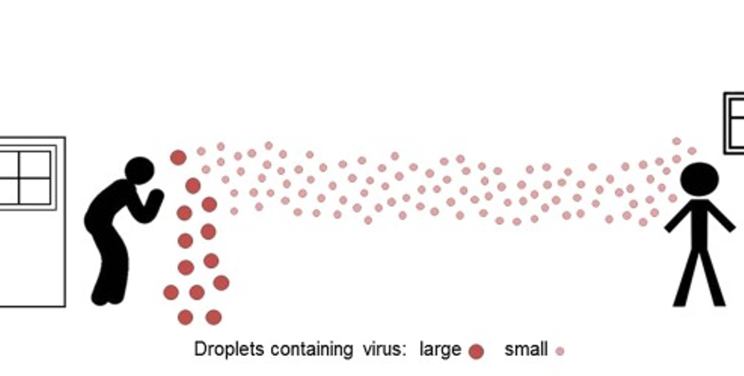

Slide 7
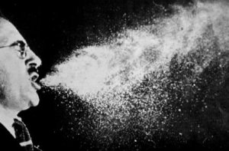
Droplets
Generated by breathing, talking, coughing, sneezing, singing, laughing.
Relatively heavy so fall within a few metres landing on fomites or people.
Deposit in the UPPER airways
Droplet transmission can be mitigated by distancing, cough/sneeze etiquette, hand hygiene, cleaning/disinfecting surfaces, avoiding touching face/nose/eyes

Slide 8
Aerosols
Generated by breathing, talking, coughing, sneezing, singing, laughing.
Defy gravity so can remain airborne for hours unless removed by air currents, dilution ventilation or air purification
Deposit in the LOWER airways
Most important implications for mitigation of aerosol transmission are ventilation, air purification, avoiding overcrowded enclosed spaces, and distancing.

Slide 9
Research has indicated that as many as 80-90% of the particles generated by human exhalation are smaller than 1 µm in size. (Papineni 1997)
The exact size of droplets produced is debated but most sources agree that speaking, coughing, and sneezing produce droplets that are sufficiently small to remain airborne.
Papineni RS, Rosenthal FS. The size distribution of droplets in the exhaled breath of healthy human subjects. J Aerosol Med. 1997;10(2):105–116.

Slide 10
Ventilation
Open windows (with caution)
Ensure HVAC systems are working properly, well-maintained and filters are clean.
Some HVAC systems can be adjusted to increase percentage of outdoor air. More costly!
Disable demand-control ventilation
Ensure exhaust fans in bathrooms are working and directing exhaust outdoors
Consult with building owner or facilities manager, HVAC expert, occupational hygienist

Slide 11
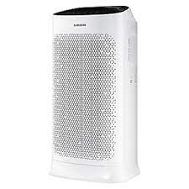
What if ventilation can’t be improved?
Air purifiers
Reduce the number of people in enclosed spaces together

Slide 12
Fans and Split-Systems
These recirculate air
Do not allow people to sit directly in front of or under devices that recirculate air
Open windows if possible
Ceiling fans on reverse mode

Slide 13
UV Germicidal Irradiation
“Can consider using UV germicidal irradiation as a supplemental technique to inactivate potential airborne virus in the upper-room air of common occupied spaces.” – CDC
Can cause skin and eye damage
Likely to be unnecessary in non-healthcare settings
If used, must be installed by knowledgeable technicians to avoid harm and work properly to reduce pathogens

Slide 14
Fomites
SARS CoV 2 can remain viable on surfaces for a few days
Risk of contracting COVID-19 from surfaces is probably possible but not the most likely way
Cleaning and disinfecting should still be done – but don’t go overboard

Slide 15
How big is the risk from fomites?
“In my opinion, the chance of transmission through inanimate surfaces is very small, and only in instances where an infected person coughs or sneezes on the surface, and someone else touches that surface soon after the cough or sneeze (within 1–2 h). I do not disagree with erring on the side of caution, but this can go to extremes not justified by the data”
-Emanual Goldman, Rutgers University

Slide 16
Cleaning and Disinfecting
Risk-based frequency/intensity
Community transmission rates
Number of people using the area/touching surfaces
Type of setting
High touch vs low touch surfaces
Product Selection
Detergent and water for cleaning
Approved disinfectant for disinfecting
2-in-1 products can be used
Provide wipes for staff to use

Slide 17
Cleaning and Disinfecting
Align with your local government regulations

Slide 18
To fog or not to fog?
Probably more about optics than effectiveness
Can introduce new health and safety risks
Some countries explicitly recommend against fogging

Slide 19
Physical Distancing
Space reconfigurations
Staff “bubbles” with alternating schedules
Staggered start/finish times
Reminders (signs/markers)
Encourage walking meetings, breaks outdoors when feasible
Capacity limits on enclosed spaces

Slide 20
Case Management
Be prepared to deal with positive cases
Contact tracing tools; notifying close contacts
Business continuity plans
Working with local department of health/public health units

Slide 21
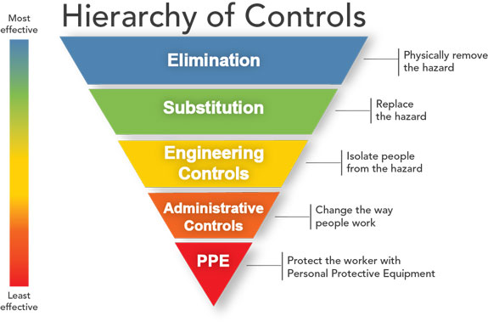
Work from home
Virtual meetings
Adjusting HVAC systems; physical barriers
Policies, procedures protocols, education/training
Face coverings; PPE for cleaning/disinfecting
Source: Centers for Disease Control and Prevention
21

Slide 25
What else can employers do?
Risk assessments – especially for vulnerable employees
Flexibility – especially with sick leave and family care leave
Mental health support, promoting EAPs, wellness programs
Consider COVIDSafe Marshals/Champions

Slide 28
COVID-19 Vaccines
Efficacy: percentage reduction in outcomes of interest in vaccinated group vs non-vaccinated group in optimal conditions (RCTs)
Effectiveness: ability of vaccine to prevent outcomes of interest in real-world
Outcomes of interest: preventing serious illness and death

Slide 30
Are some vaccines better than others?
Efficacy percentages mean vaccine is effective at preventing symptomatic COVID-19
Example: AZ vaccine is 79% effective at preventing symptoms and 100% effective at preventing serious illness/death. Pfizer vaccine is 95% effective at preventing symptoms and 100% effective at preventing serious illness/death.
Remember – efficacy is reported for controlled trials. We do not yet know the true effectiveness of the vaccines

Slide 31
Developer | How it works | Status
Pfizer/BioNtech | mRNA | Approved in several countries. Emergency use in U.S., E.U., AUS, other countries.
Moderna | mRNA | Approved in Switzerland. Emergency use in U.S., E.U., other countries.
Gamaleya | Ad26; Ad5 | Early use in Russia. Emergency use in other countries.
AstraZeneca | ChAdOx1 | Approved in Brazil. Emergency use in U.K., E.U., other countries.
CanSino | Ad5 | Approved in China. Emergency use in Mexico, Pakistan, Hungary.
Johnson and Johnson | Ad26 | Emergency use in U.S., E.U., other countries.
Vector Institute | Protein | Early use in Russia
31

Slide 32
Developer | How it works | Status
Sinopharm | Inactivated | Approved in China, U.A.E., Bahrain. Emergency use in other countries.
Sinovac | Inactivated | Approved in China. Emergency use in other countries.
Sinopharm-Wuhan | Inactivated | Approved in China. Limited use in U.A.E.
Bharat Biotech | Inactivated | Emergency use in India, other countries.
Novavax | Protein | Expected to be approved soon
32

Slide 33
Treatments
Remdesivir (antiviral) only approved treatment by the FDA for critically ill patients requiring supplemental oxygen
Dexamethasone (steroid) shows promising results in reducing deaths. Can be harmful in people in early stages of COVID.
Tocilizumab (cytokine inhibitor) shows promising results at reducing deaths and preventing patients from going on ventilator
Prone position and ventilator

Slide 34
Thank You!

