Slide 1

Preventing Infections in Healthcare Workers:
Strategies and Challenges
Bruce Gamage, RN BSN CIC
IPAC Canada President 2014/2015
Broadcast live from the 2015 Congress
of the French Society for Hospital Hygiene
www.webbertraining.com
June 3, 2015

Slide 2
Disclosures
I have no disclosures
I have a French name, but I don’t speak French ☺

Slide 3
Outline
Why don’t healthcare workers follow infection control protocols?
What hasn’t worked?
What strategies have promise?
Let’s talk about Ebola…
Lessons learned

Slide 4
Why don’t healthcare workers follow infection control protocols?

Slide 5

Human nature
People don’t do what they don’t have to
For the most part there are no consequences
There are no immediate impacts
No one is watching…

Slide 6

People follow IC when…
There is fear
There is media attention
E.g. SARS, H1N1, Ebola
  Leads to over-reaction
  We saw very high vaccine rates during H1N1
  HCW demanded highest level protection during SARS and Ebola outbreaks

Slide 7
What doesn’t work?

Slide 8

Education
We assume that if we provide healthcare workers with education they will follow the protocols
Time and time again this hasn’t worked
  Influenza shots
  Hand Hygiene compliance

Slide 9

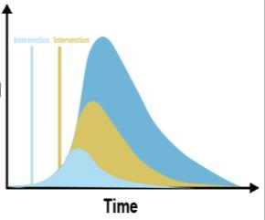
Promotions
Posters
Campaigns
Incentives
All have short term effects, but compliance always returns to baseline after short term improvements

Slide 10
How do we get healthcare workers to change their behaviour?

Slide 11
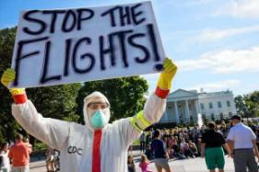
Fear/Media hype
Healthcare workers do change their behaviour based on fear and media – but this is not sustainable
Need people to understand that there is always threats to their lives…
Media campaigns can work
  Seatbelts
  Drunk driving
  Cigarettes
  Safe Sex
Resulted in cultural shift – but takes a long time

Slide 12

Punishment/Financial Penalty
Loss of admitting privileges
Loss of job
Has worked in some US hospitals – influenza vaccine rates of 99.9%

Slide 13

Big Brother is Watching…
Direct observation of healthcare workers has worked to increase hand hygiene compliance
Public reporting of infection rates/hand hygiene compliance rates
Competition between units
But there is the Hawthorne effect

Slide 14
Fundamental to getting healthcare workers to change their behaviour is addressing culture…

Slide 15
Culture eats Strategy for Lunch

Slide 16
Positive Deviance
Has had some success in getting improved compliance
PD doesn’t come up with new IC interventions
  All interventions are already proven effective in literature
  Individuals need to come up with interventions that work within their micro-culture
PD is best applied to complex problems that are deeply rooted in culture

Slide 17
Leading Questions…
How do you know when someone has an infection?
What do you do to protect yourself and others from this infection?
What keeps you from doing this every time?
Who do you know who seems to do a better job?
Does anyone have any ideas about what we should do next?

Slide 18
Let’s talk about Ebola…

Slide 19
840 healthcare workers have been infected during the recent Ebola outbreak in West Africa…
491 have died…

Slide 20
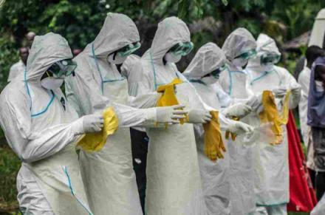
What’s the best approach?
Evidence or fear based approach?
We know that Ebola is spread by droplet and contact transmission (not airborne)
But patients who are acutely ill are having projectile vomiting and explosive diarrhea..

Slide 21
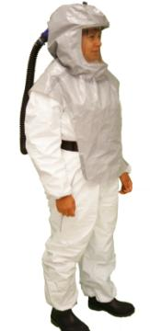
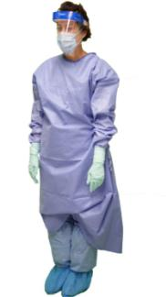
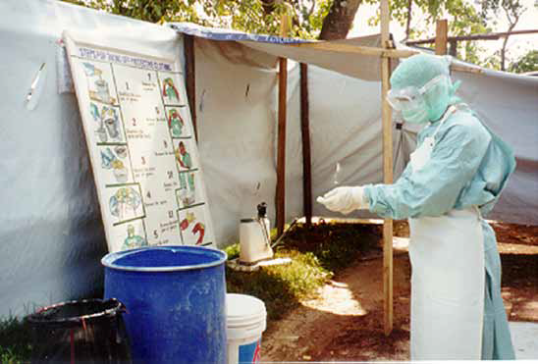
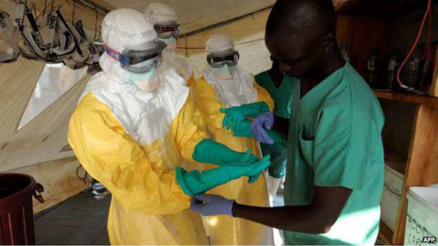
Attention to detail

Slide 22
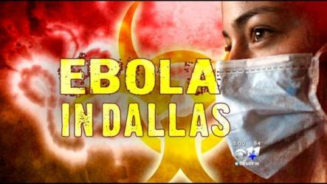
Then along came Dallas
Patient travelled from Liberia
Sent home initially
returned with advanced symptoms and died
2 nurses infected
None of his close contacts in the community became ill

Slide 23

IPAC changes
Fear and overreaction
‘No skin in the game’
Differentiation between low transmission risk (‘dry’) and high transmission risk (‘wet’) patients
Recognition that the greatest danger is in late stage disease with copious body fluids, particularly vomitus and bloody diarrhea
Importance of fluid impermeable PPE

Slide 24

Controversies
Can it be ‘airborne’?
Need for respirators
Can we be ready everywhere?
Centralized care versus regional model
We will need to be prepared…

Slide 25
What have we learned?

Slide 26
Lessons Learned
Educating healthcare workers doesn't get them to change behaviour
Campaigns work but are short-lived
Negative consequences seem to be the strongest motivator
Healthcare workers are most likely to follow protocols when they are afraid for their own safety
We need to effect change at a cultural level

Slide 27
Questions

Slide 28


www.sf2h.net/sf2h_in-english-as-well.html

Slide 29


