Slide 1




Prevention of Clostridium difficile Infection - What We Find in Guidelines
Dr. Walter Zingg, MD
Dr. Maria Martin, MD, MPH
Hosted by Paul Webber
paul@webbertraining.com
www.webbertraining.com
March 26, 2015

Slide 2
Outline
PROHIBIT work package 2
Guidelines in WP 2
C. difficile
  Studies and guidelines
  Treatment
  Summary

Slide 3
PROHIBIT WP2
Identification and analysis of current guidelines for prevention of HAI (CDI, VAP, CABSI, SSI, UTI) in European countries
Overview on current surveillance systems in European countries
Overview of public reporting of HAI in European countries and consensus statement about benefits and challenges of public reporting

Slide 4
Deliverables WP2
Systematic review of guidelines and recommendations in European countries
Report on surveillance programmes in European countries
Report on public reporting of HAI in European countries

Slide 5
Description WP2
Countries enclosed: 27 EU member states plus Switzerland, Norway, Iceland and Croatia (total 34)
Topics of interest:
  CDI
  SSI
  VAP
  CABSI
  UTI

Slide 6
Questionnaires
1st Q: sent out End of August 2010
  Elements: basic questions on available guidelines, surveillance systems and practices in (public) reporting of HAI rates
  Return rate 100% (last in April 2011)
2nd Q (decided in Berlin Dec. 2010): sent out in March 2011
  Elements: financing of health care services with focus on HAI („pay for performance“); public interest in HAI prevention
  Return rate 91%

Slide 7
PROHIBIT WP2
Guidelines

Slide 8
Guidelines
Extensive internet search according to specifications of NCPs or recontact
Translation into English
Development of matrices with QSR NVivo software (basis German and CDC guidelines)

Slide 9
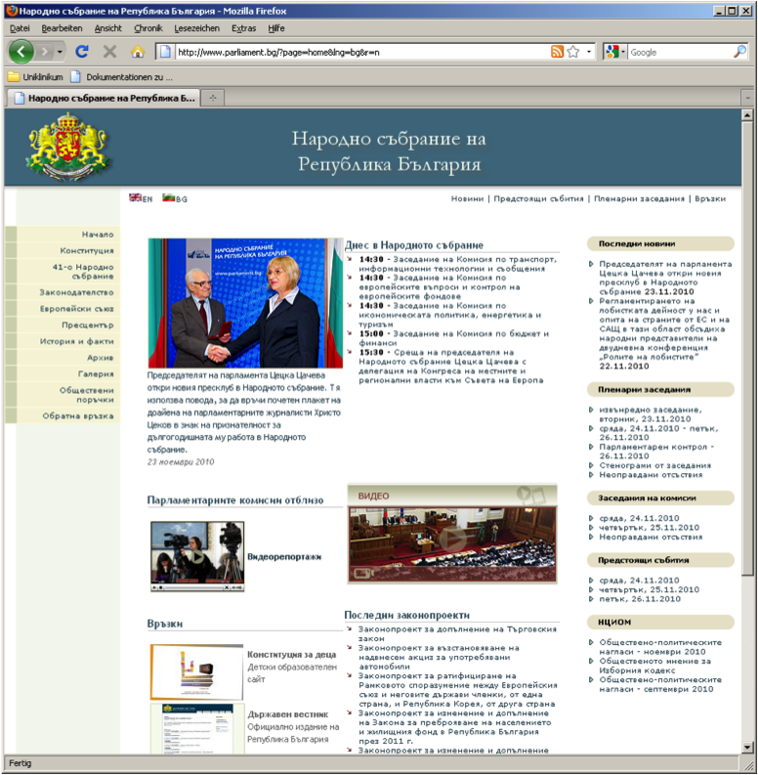
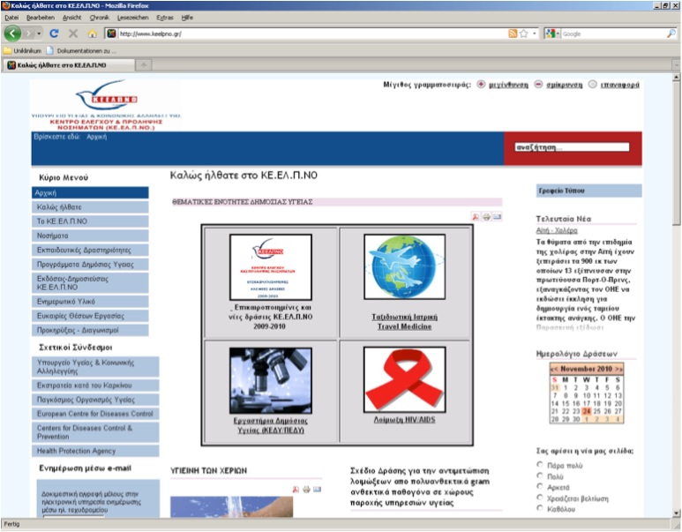
Challenges: „Where are the guidelines…?“

Slide 10
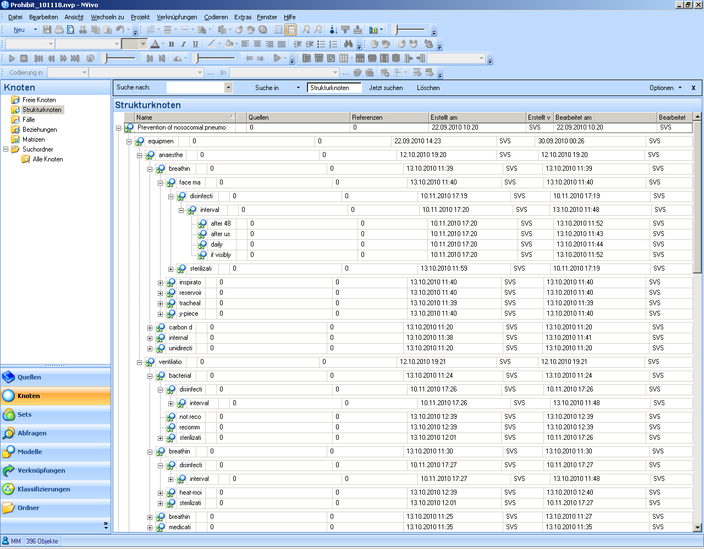
Matrix for systematic review (NVivo software)
Example: Pneumonia

Slide 11
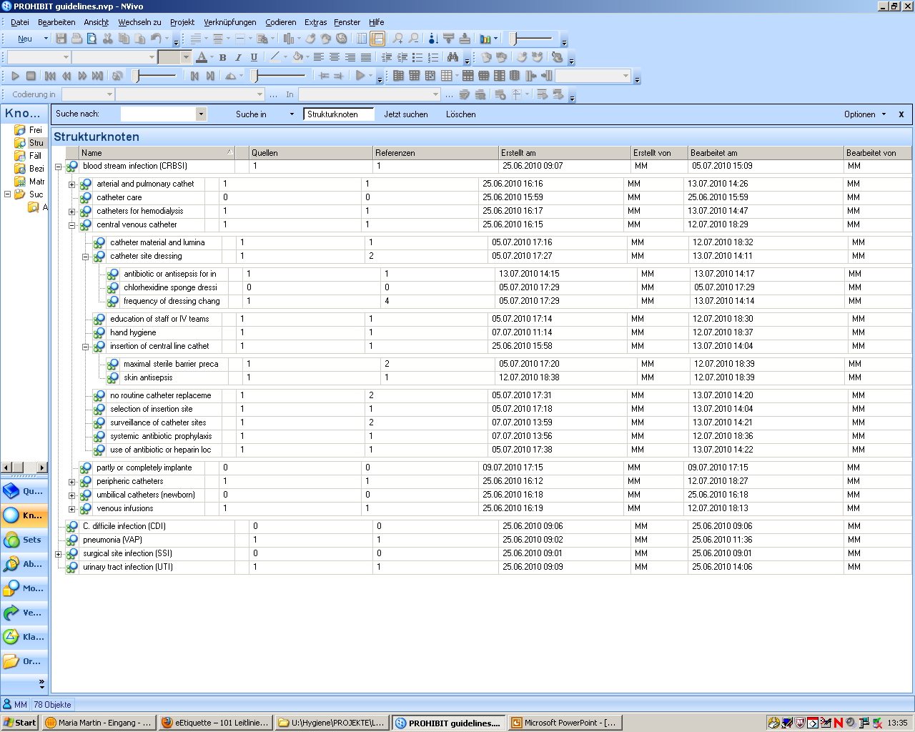
Matrix for systematic review (NVivo software)
Example: CABSI

Slide 12
Guidelines in Europe
No guidelines
One guideline
Two guidelines
Three guidelines
Four guidelines
Five guidelines
In total: 101 national guidelines on the five topics of interest
No guidelines
One guideline
Two guidelines
Three guidelines
Four guidelines
Five guidelines
No guidelines
One guideline
Two guidelines
Three guidelines
Four guidelines
Five guidelines
No guidelines
One guideline
Two guidelines
Three guidelines
Four guidelines
Five guidelines
No guidelines
One guideline
Two guidelines
Three guidelines
Four guidelines
Five guidelines
No guidelines
One guideline
Two guidelines
Three guidelines
Four guidelines
Five guidelines
No guidelines
One guideline
Two guidelines
Three guidelines
Four guidelines
Five guidelines

Slide 13
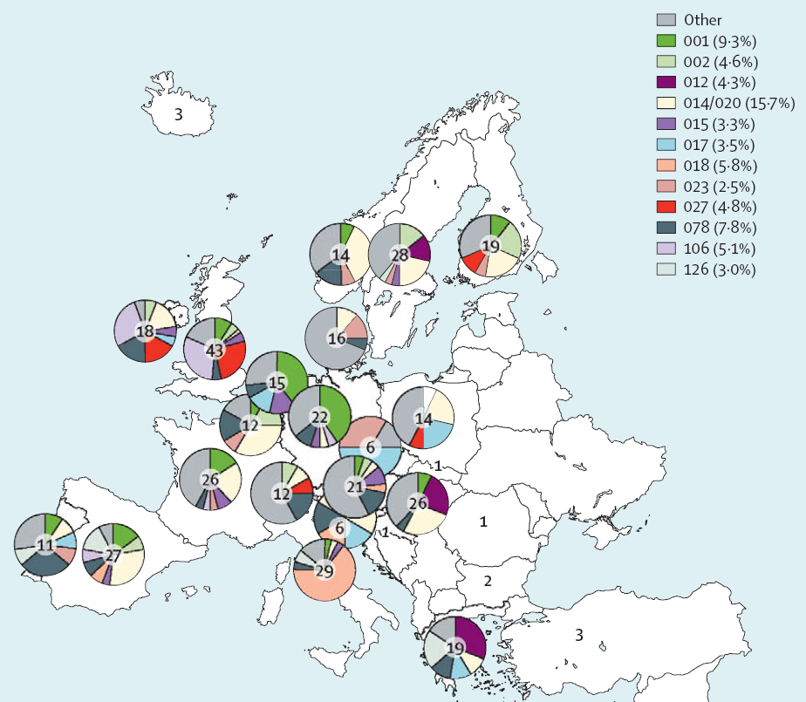
C. difficile in Europe
Ribotype n/n (%)
014/020* 61/389 (16%)
001 37/389 (10%)
078 31/389 (8%)
018 23/389 (6%)
106 20/389 (5%)
027 19/389 (5%)
002 18/389 (5%)
012 17/389 (4%)
017 14/389 (4%)
015 13/389 (3%)
126 12/389 (3%)
023 10/389 (3%)
046 8/389 (2%)
003 7/389 (2%)
011 6/389 (2%)
053 6/389 (2%)
056 6/389 (2%)
*reported together because of close relatedness
Bauer MP. Lancet 2011;377:63

Slide 14
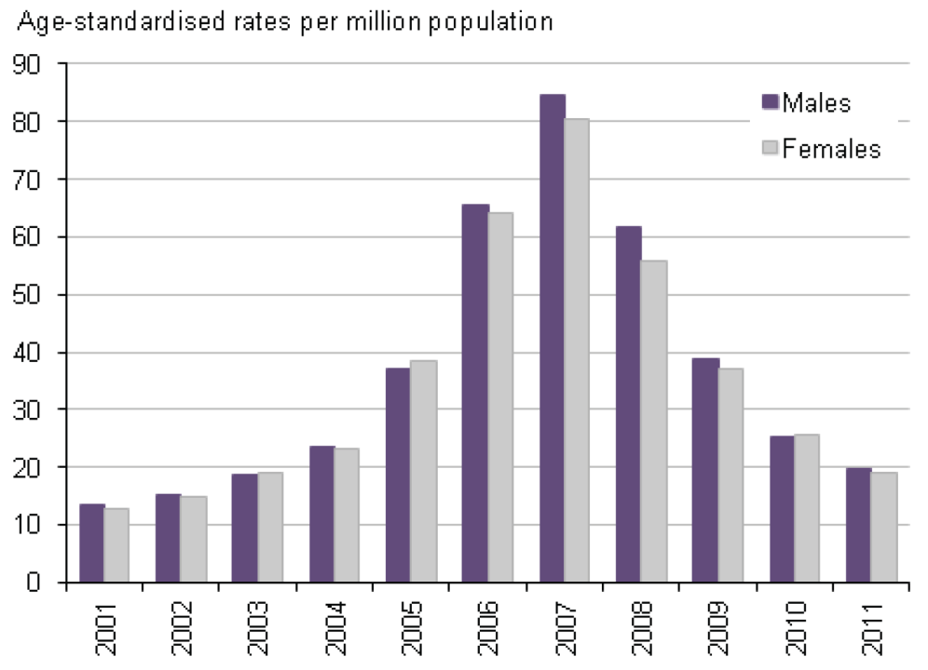
Mortality – England & Wales
UK Office for National Statistics

Slide 15
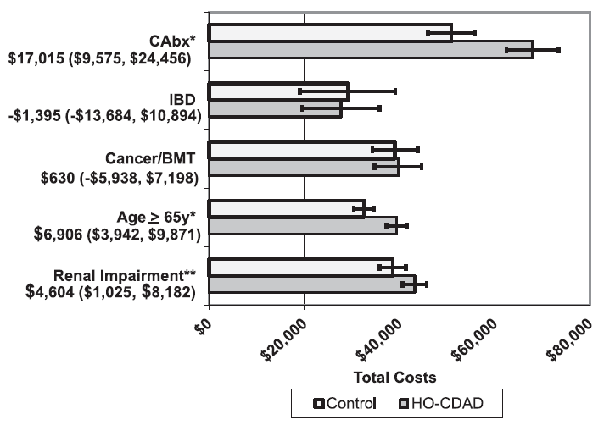
Costs
BMT: bone marrow transplant; CAbx, concomitant antibiotics; IBD, inflammatory bowel disease
*p-value for difference < 0.001; **p-value for difference = 0.012.
Campbell R. J Med Econ 2013;16:440

Slide 16
C. difficile guidelines
UK = England, Northern Ireland, Wales
Sc = Scotland
Total: 16 guidelines
FIN
S
Sc
LV
Sc
DK
IRL
UK
NL
B
D
L
F
A
CH
I
Presented on DGHM 2011
M

Slide 17
Year of publication
CDI prevention guidelines
ECDC guidance

Slide 18
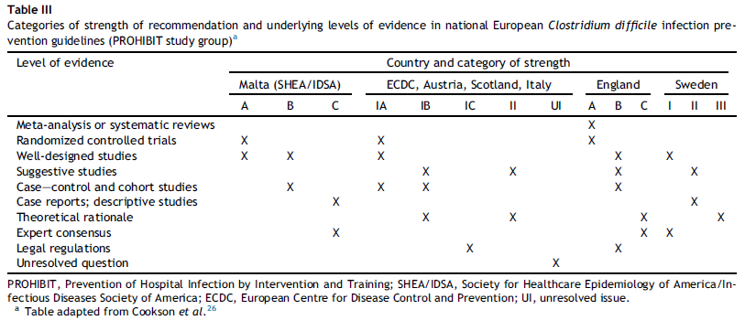
Level of evidence
Martin M et al., JHI 2014

Slide 19
Transmission and CDI

Slide 20
Proximity is a risk for transmission
Likelihood of C. difficile transmission from CDI patients to roommates, direct neighbors or patients hospitalized at the same bed position sequentially
Setting | Transmission, n/n (%) | Risk, RR (95%CI)
Sequential patient | 4/135 (3.0%) | 1.21 (0.32-3.39)
Roommate | 4/71 (5.6%) | 2.37 (0.63-6.95)
Neighbor | 16/249 (6.4%) | 3.40 (1.95-5.94)
Chang VT. Clin Infect Dis 2000;31:717

Slide 21
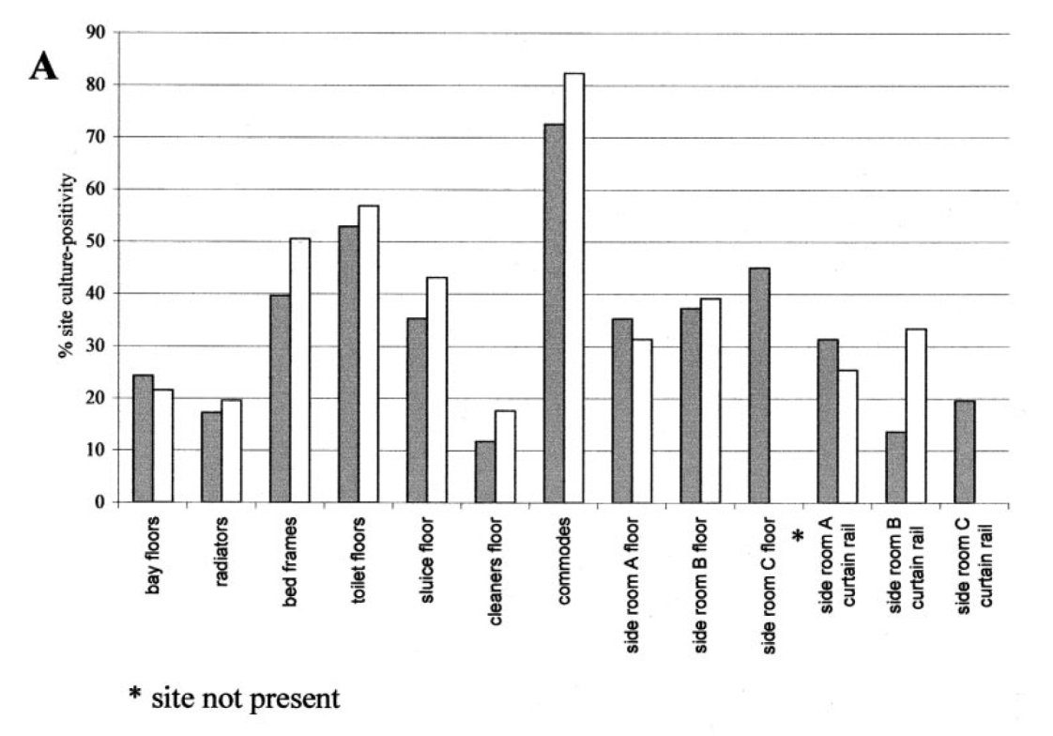
C. difficile in the environment
Department of Microbiology, Leeds Teaching Hospitals & University of Leeds
Fawley WN. J Clin Microbiol 2005;43:2685

Slide 22
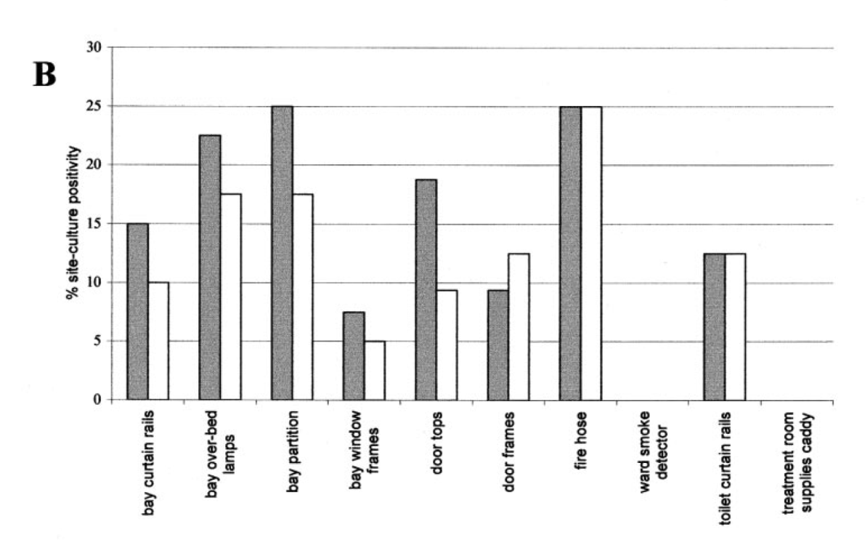
C. difficile in the environment
Fawley WN. J Clin Microbiol 2005;43:2685

Slide 23
Colonization pressure
Systematic review; three studies about CDI-transmission in the hospital setting:
Colonization pressure* was significantly associated (OR 2.9-4) with C.difficile transmission
*measured as the presence of CDI-cases as a risk factor for C. difficile transmission
Ajao AO. Infect Control Hosp Epidemiol 2011;32:481

Slide 24
Environmental disinfection (CDI)
→ ECDC:
  Regular disinfection, chlorine-based prefered - IB (Evidenz 2b (1), 2c (2), 4 (1))
  Frequently touched surfaces, at least 1x /d - IB (Evidenz 1b (1), 2a (1), 4 (1))
  Bathroom, toilets etc. clean scrupulously – IB (Evidenz 1b (1), 2a (1))
Martin M et al., JHI 2014

Slide 25
Environmental disinfection (CDI)
measure
 | agent | Frequently touched surfaces | Bathroom, toilet etc.
Austria (2007) | Sporicidal | 1x d | 2x d
Belgium (2008) | Chlorine based | 1x d | Min. 1x d
Denmark (2011) | Chlorine based | 1x d | 1x d
Finland | Chlorine based | Min. 1x d | Min. 1x d
France (2010) | Chlorine based | Not specified | Not specified
Germany (2009) | H2O2 or chlorine | 1x d | 1x d
Ireland (2008) | Chlorine based | 1x d | After each use
Italy (2009) | Chlorine based | Min. 1x d | Not specified
Latvia (2007) | Chlorine based | Not specified | Not specified
Luxembourg (2007) | Chlorine based | Min. 1x d | Min. 1x d
Malta (SHEA 2008) | Chlorine based | Not specified | Not specified
Netherlands (2006) | Not specified | Not specified | Not specified
Sweden (2006) | Peracetic acid | Not specified | Not specified
Switzerland (1995) | mechanic effect of cleaning | „Die kontinuierliche Reinigung…“
GB (2008) | Chlorine based | Min. 1x d | After each use
Sc (2009) | Chlorine based | Min. 1x d | Not specified
Country (year)
Martin M et al., JHI 2014

Slide 26
Effectiveness of disinfectants
Spore germination after exposure to different disinfectants
Hydrogen-peroxide (G-Force®); 1 : 64
Control
Non-ionic surfactant and NaDCC (Chlor-clean®); 1,000 ppm Chlor
Non-ionic surfactant and phosphate (Hospec®); 0.10%
Detergent and NaOCl (Dispatch®); 5,500 ppm NaOCl
NaDCC (Sanichlor®); 1,000 ppm chloride
Fawley WN. Infect Control Hosp Epidemiol 2007;28:920

Slide 27
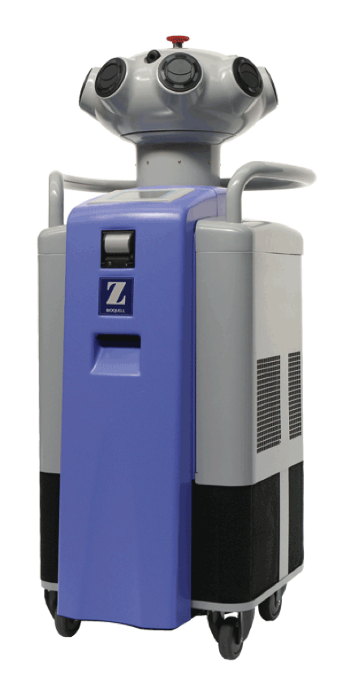
Vaporized hydrogen-peroxide
Preintervention period (June 2004 through March 2005)
Intervention period (June 2005 through March 2006)
Boyce JM. Infect Control Hosp Epidemiol 2008;29:723

Slide 28
Contamination of healthcare worker‘s hands
Contamination of healthcare worker’s hands after touching different skin areas of CDI-patients
Bobulsky GS. Clin Infect Dis 2008;46:447

Slide 29
Hand hygiene (CDI)
ECDC: wearing of gloves for patient contact and immediate vicinity - IB (Evidenz 1b (2), 2b (2))
All guidelines recommend wearing of gloves
Washing or disinfecting?
ECDC: Hand washing with soap, alcohol-based hand rub not sufficient – IB (Evidenz 2a (2), 2b (3), 2c (1), 4 (1))
  Disinfecting, then washing (2): A, D
  Washing, then disinfecting (5): B, DK, F, GB, S
  Only washing (7): FIN, IRL, I, L, M, NL, Sc
  Latvia: washing or disinfecting with Chlorhexidine
  Switzerland: disinfecting or antiseptic soap
Martin M et al., JHI 2014

Slide 30
Antibiotics and CDI: a meta-analysis
Owens RC. Clin Infect Dis 2008;46:S19

Slide 31
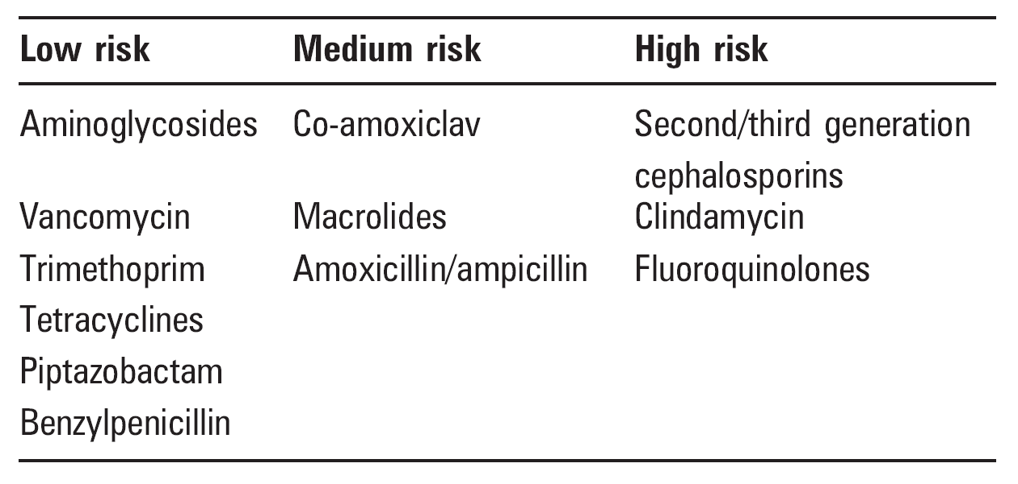
Antibiotics and CDI
Monaghan T. Postgrad Med J 2009;85;152

Slide 32
- Contact isolation precautions
- Bleach → 100 ppm first, then 1000 ppm
- Electronic flags and alerts
- Hand washing
- Prolongation of contact isolation (entire length of stay)
- Audits
Muto CA. Clin Infect Dis 2007;45:1266

Slide 33
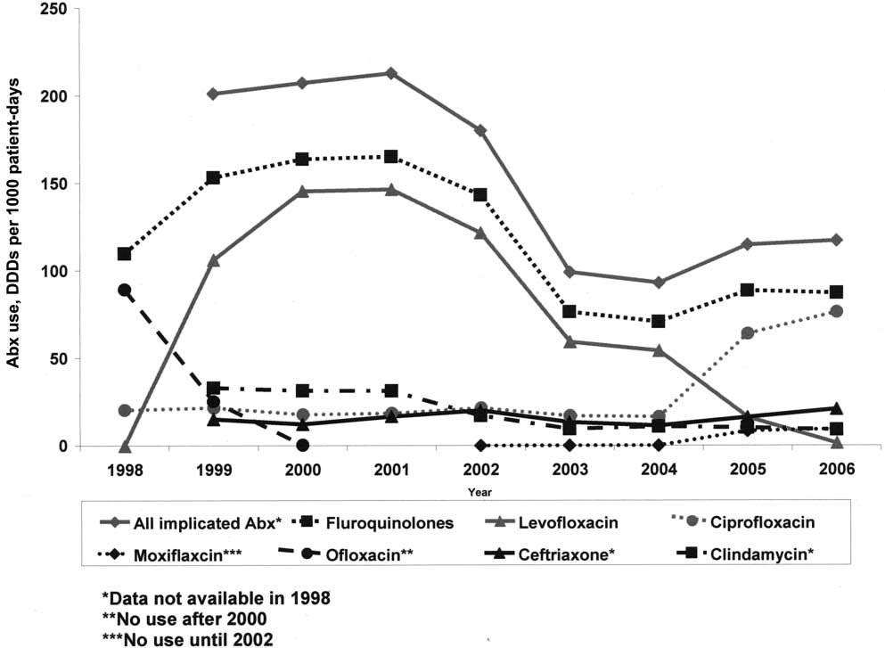
Muto CA. Clin Infect Dis 2007;45:1266

Slide 34
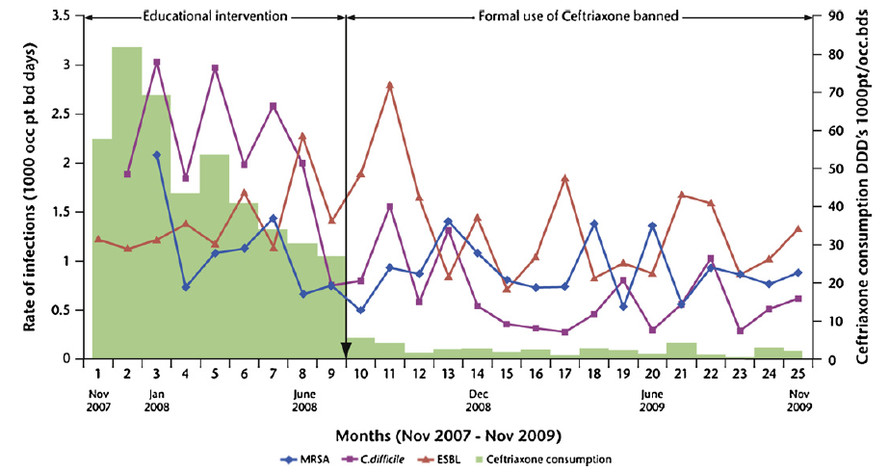
Effects of a restrictive antibiotic policy on hospital-acquired Clostridium difficile – a district hospital
Dancer S. Int J Antimicrob Agents 2013;41:137

Slide 35
Antibiotic Stewardship
ECDC: Stop antibiotic treatment - IA
(Evidenz 1a (1))
A, B, CH, FIN, GB und Sc, I, IRL, L (9)
→ ECDC: good antibiotic stewardship in outbreaks or in high endemic situations - IB
(Evidenz 1a (1), 2b (5), 3b (9), 4 (4))
according ECDC (2): B, M
General recommendation for good antibiotic stewardship (8): A, B, D, GB und Sc, IRL, L, S
Martin M et al., JHI 2014

Slide 36
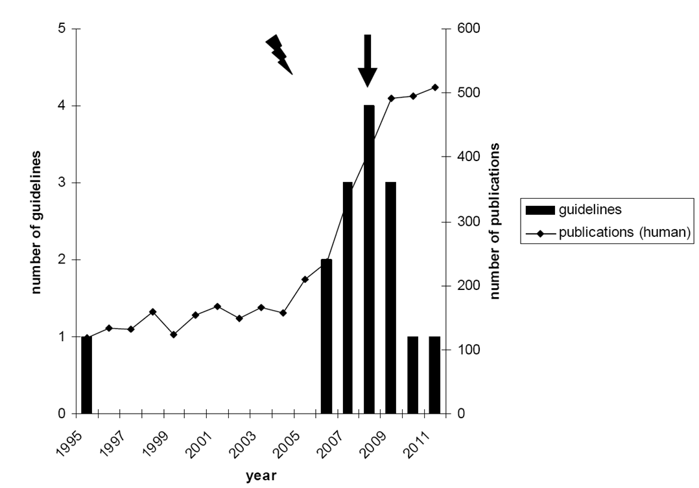
Publications and Guidelines
Martin M. et al

Slide 37
Guidelines - Conclusions
Most national CDI guidelines published or revised in last 10 years
Only about half of guidelines state evidence and strength of recommendations
Guidelines vary in scope and detailing
Heterogeneity in terminology

Slide 38
ESCMID treatment guidelines
Teicoplanin/vancomycin > metronidazole
Efficacy of teicoplanin may be superior to vancomycin
Vancomycin concentration in the colon is largely superior to
metronidazole, which is readily absorbed in the small intestines and is found in feces only in (very) low concentrations
High dose vancomycin is not superior to low dose vancomycin: most likely due to its non-absorption
Treatment duration: 10 days
There are studies of 7 days treatment duration; however, data to justify shorter treatment are not sufficient yet
Bauer MP. Clin Microbiol Infect 2009;15:1067

Slide 39
“Outside the box” CDI management
Intraluminal toxin-binders or neutralizers
Cholestyramine, cholestipol, tolevamer, whey protein in immunized cow’s milk
Biotherapeutic agents to restore the protective microbiota
Probiotics, faecal transplants, nontoxigenic C. difﬁcile strains, synthetic mixture of bacteria
Antibodies to improve CDI-immunity
Monoclonal antibodies, active vaccination
Anti-sporulation
CamSA, a bile salt analog, inhibits C. difficile spore germination in vitro
Gerding DN. Clin Infect Dis 2010;51:1306
Howerton A. J Infect Dis 2013; epub, ahead of print

Slide 40
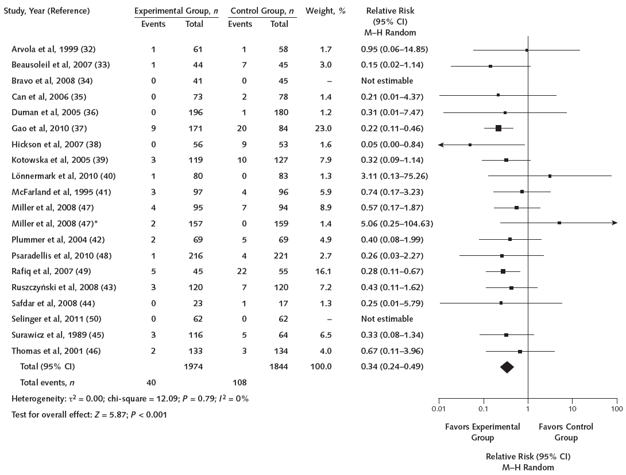
Probiotics
S. boulardii
S. thermophilus
(L. rhamnosus)
L. casei
L. acidophilus
Effective in the adult and in the paediatric population
Johnston BC. Ann Intern Med 2012;157:878

Slide 41
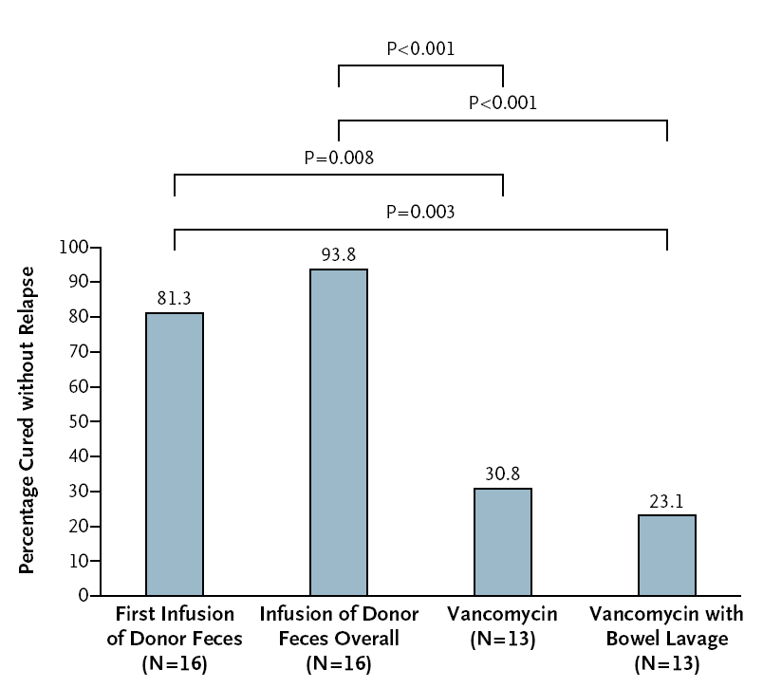
Fecal transplantation
RCT – 41 Adult patients with CDI relapse after at least one course of adequate antibiotic therapy (≥10 days of vancomycin or ≥10 days of metronidazole)
Vancomycin 4-5 days + bowel lavage (4 liters macrogol) + nasoduodenal infusion of donor feces
Standard vancomycin regimen for 14 days (500 mg orally four times per day)
Standard vancomycin regimen for 14 days + bowel lavage
Van Nood E. New Engl J Med 2013;368:407

Slide 42
Cochrane: Antibiotic treatment for CDI
Uncertainty whether mild CDAD needs to be treated
Little evidence for antibiotic treatment of severe CDAD as many studies excluded these patients
Small numbers of patients were included in the studies and there was high risk of bias, especially related to dropouts
Most of the active comparator studies found no statistically signiﬁcant difference in efficacy between vancomycin and other antibiotics including metronidazole, fusidic acid, nitazoxanide or rifaximin
Teicoplanin may be an attractive choice
Nelson RL. Cochrane Database Syst Rev 2011;9:CD004610

Slide 43
Summary
Infection control measures
Contact precautions (gloves, gowns)
→ Gloving is the most important measure of „hand hygiene“
→ Use disposable gowns
Hand washing during outbreaks or increased CDI-rates
→ Rinsing removes spores mechanically
→ No advantage by using medicated products
Isolation/cohorting
→ Given the high contamination of spores and patients moving in the room mixed accommodation of CDI and non-CDI- patients is a risk – isolate if possible!
Cleaning of the patient‘s environment
→ Bleach (>1000 ppm)
→ Daily cleaning of the patient‘s room

Slide 44
Prevention measures
Antibiotic stewardship
→ Treat as narrow as possible (improve diagnosis, local resistance data)
→ Almost all antibiotic groups have been shown to be associated with CDI!
Surveillance
→ Good surveillance detects problems in good time
Audits
→ Implementation of infection control measures is complex and sometimes difficult – Audits help assure compliance

Slide 45
Special thanks to
National Contact Points
Markus Dettenkofer, Christine Wilson, Winfried Ebner and Barbara Schroeren-Boersch (Freiburg)
Didier Pittet and Walter Zingg (Geneva)
Petra Gastmeier and Sonja Hansen (Berlin)

Slide 46
Thank You !
Dr. Walter Zingg
Contact:
Service de Prévention et Contrôle de l’Infection, Genève Walter.Zingg@hcuge.ch
Dr. Maria Martin, MPH
Contact:
Institut für Infektionsprävention und Klinikhygiene
Regionale Gesundheitsholding Heilbronn-Franken GmbH
maria.martin@slk-kliniken.de

Slide 47

April 09 FAECES MANAGEMENT: TIME TO ADDRESS THE RISKS
Jim Gauthier, Providence Care, Kingston, Ontario
Sponsored by Meiko (www.meiko.de)
April 14 (British Teleclass)
SURGICAL SITE INFECTION: A SURGEON’S PERSPECTIVE
Prof. David Leaper, University of Huddersfield, UK
April 16 A PRAGMATIC APPROACH TO INFECTION PREVENTION AND CONTROL
GUIDELINES IN AN AMBULATORY CARE SETTING
Jessica Ng, Women’s College Hospital, Toronto
April 22 (South Pacific Teleclass)
COMING UP ROSES – A SUSTAINABLE COLUTION TO
CONTINENCE PRODUCT DISPOSAL
Julianne Munroe, Christchurch Women’s Hospital, New Zealand

Slide 48


