Slide 1
Antimicrobial stewardship research priorities: where do we go from here?
Caroline Nott, MBBS, FRCPC; and Kathryn Suh, MD, FRCPC, CIC® Antimicrobial stewardship program
The Ottawa Hospital, Ottawa, ON Canada
Hosted by Paul Webber
paul@webbertraining.com
www.webbertraining.com
November 21, 2019

Slide 2


Slide 3


Your presenters
Caroline Nott, MBBS, FRCPC
Director, Antimicrobial Stewardship Program, The Ottawa Hospital
Kathryn Suh, MD, FRCPC
Director, Infection Prevention and Control, and Antimicrobial Stewardship Physician, The Ottawa Hospital

Slide 4



Slide 5
Objectives
At the end of this session, participants will be able to:
Develop a plan for implementing an ASP (AMS program)
Describe methods for measuring success
Identify potential research questions to resolve current knowledge gaps related to ASP
Recognize determinants (barriers and facilitators) of appropriate antibiotic prescribing in hospitals

Slide 6
Outside of the scope of this presentation
Outpatient settings
Long term care facilities
Emergency departments

Slide 7
Objectives
At the end of this session, participants will be able to:
Develop a plan for implementing an ASP (AMS program)

Slide 8
ANTIMICROBIAL STEWARDSHIP
“coordinated interventions designed to improve and measure the appropriate use of antibiotic agents by promoting the selection of the optimal antibiotic drug regimen including dosing, duration of therapy, and route of administration”
OR
A systematic approach / set of actions to use antibiotics appropriately in order to 1) achieve optimal patient outcomes and 2) minimize unwanted effects….”to ensure sustainable access to effective therapy for all who need them”
IDSA; Dyar OJ et al, Clin Microbiol Infect 2017

Slide 9
Requirements for an asp
Recognition of the need and importance (executive leadership)
Sustainable finances
IT support
Human resources
  Physician leadership – credible, knowledgeable (Infectious Diseases or similar)
  Pharmacists
  Administrative support
  Data analyst

Slide 10
Core elements of an asp
Hospital leadership
Accountability and defined responsibility
Available expertise in infection management
Education and training (for both staff as well as ASP team)
Other support and actions
Monitoring and surveillance
Reporting and feedback
Pulcini C et al, Clin Microbiol Infect 2018

Slide 11
CDC (US) core elements of ASP
Hospital leadership commitment
Accountability
Pharmacy expertise
Action
Tracking
Reporting
Education
CDC 2019

Slide 12
Implementing an asp
Assess the population, current practices, and resources
Establish a multidisciplinary team
Consider targets for interventions
Measure and provide feedback

Slide 13
Strategies to improve antibiotic prescribing
Persuasive vs. restrictive measures (more later)
Laboratory:
  Antibiogram, cascading results, rapid diagnostic testing
Educational:
  Diagnostic aides, prescribing pathways and guidelines

Slide 14
Strategies to improve antibiotic prescribing
Pharmacy:
  IV to oral conversion, dose optimization, drug monitoring, formulary restrictions
Computer based:
  Computer order entry with justification, pathway based prescribing
Communication:
  Audit and feedback (real time and aggregate), availability of ASP team

Slide 15
Objectives
At the end of this session, participants will be able to:
Develop a plan for implementing an ASP (AMS program)
Describe methods for measuring success

Slide 16
measurements to demonstrate success
Process measures
  Compliance with prescribing guidelines, pathways
Outcome measures
  Antimicrobial use
  Drug costs
  Patient outcomes
  Facility (or unit) outcomes

Slide 17
Challenges with current measures
Evidence for optimal treatment may be lacking
No clear “best” measure of antibiotic use
Measures of antibiotic use do not assess appropriateness
Cost savings / costs are subject to other biases
Most appropriate clinical outcomes unclear
Broader outcomes (e.g. CDI, resistance rates) are multifactorial - impact of ASP is difficult to evaluate

Slide 18
Measures of Antibiotic use
Defined daily doses, DDD
Days of therapy, DOT
Length of therapy, LOT
Standardized antimicrobial administration ratio, SAAR
Desirability of outcome ranking (DOOR) and response adjusted for duration of antibiotic risk (RADAR)
WHO; van Santen et al, Clin Infect Dis 2018; Evans SR et al, Clin Infect Dis 2015

Slide 19
Measures of antibiotic use
Measure | Advantages | Disadvantages
DDD | Standardized “easy” to calculate | Doses for DDDs are sometimes not commonly prescribed doses Not accurate in some populations Subject to change (WHO)
DOT | Preferred metric (NHSN) More intuitive, comparable | Needs pharmacy data Favours broad monotherapy > more appropriate combination therapy
LOT | Allows assessment of treatment duration
SAAR | Allows comparison to benchmark | Relies on submission of data to NHSN – generalizability?
DOOR/RADAR | Research at present, not widely used
WHO; van Santen et al, Clin Infect Dis 2018; Evans SR et al, Clin Infect Dis 2015

Slide 20
Cost as a measure of success
Antimicrobial costs
  Based on use (actual dispensed drug)
  Purchasing costs
Initial large cost savings will decrease over time – cost containment vs cost savings
Costs of related outcomes, e.g. Clostridioides difficile infection, resistance, difficult to determine

Slide 21
Quality indicators for asp
 | Morris, 2012 | Moehring, 2017 | Science, 2019
Antimicrobial Use | DOTS/patient days | DOTs/patient days DOTs/admissions | DOTS/patient days Total antimicr days
Clinical Outcomes | ARO mortality All cause mortality Conservable days 30d readmission | --- | 30d readmission
Adverse Outcomes | No. patients with AROs | CDI incidence (2 categories) Drug-resist infection | ---
Process Measures | --- | Redundant therapy | Adherence to ASP recommendations
Morris AM et al, Infect Control Hosp Epidemiol 2012; Moehring RW et al, Clin Infect Dis 2017; Science M et al, Pediatrics 2019

Slide 22
Objectives
At the end of this session, participants will be able to:
Develop a plan for implementing an ASP (AMS program)
Describe methods for measuring success
Identify potential research questions to resolve current knowledge gaps related to ASP
Recognize determinants (barriers and facilitators) of appropriate antibiotic prescribing in hospitals

Slide 23
Areas for further research
Behavioural approaches to prescribing
Optimal prescribing practices
Strategies for implementing, sustaining AMS interventions
Optimal process and outcome measures
Research methods and reporting requirements to improve AMS studies
Evaluation of ASPs
Patient perspectives on AMS
Impact of government, policy
Morris AM et al, Infect Control Hosp Epidemiol 2019; Rzewuska M et al, Clin Microbiol Infect 2019

Slide 24
Why a Behavioural Approach?
Knowledge alone is insufficient to enable change ➔knowledge translation is key
Need to first understand the determinants of physician antibiotic prescribing
  Barriers
  Facilitators
Ultimately, develop and implement behaviour change techniques to influence prescribing behaviour

Slide 25
Behaviour is key
Cochrane review (2017): enablement and restriction both independently associated with increased compliance with prescribing
  Enablement (“increasing means/reducing barriers to increase capability or opportunity”)
  Restriction (“using rules to reduce the opportunity to engage in the target behaviour; or increasing the target behaviour by reducing the opportunity to engage in competing behaviours”)
  Enablement enhanced restrictions (high evidence)
  Including feedback may be more effective (moderate evidence)
Davey P et al, Cochrane Database of Systematic Reviews 2017

Slide 26
Behaviour change strategies
Charani et al (2011): systematic review of prescribing behaviour in acute care settings, including both qualitative and quantitative studies
Mixed results with respect to specified outcomes in 10 studies
None of the included studies applied behavioural science approaches to influence desired (positive) behaviours
Understanding barriers and facilitators of prescribing within the local context is requisite for effecting behaviour change
Clear roles and accountability, and actions, also need to be defined
Charani E et al, Clin Infect Dis 2011; Rzewuska M et al, Clin Microbiol Infect 2019

Slide 27
Using Theory to Understand Behavioural Determinants
Provides factors to focus on
Shared language for shared understanding
More efficient, can use established framework
Link to techniques and strategies best suited to address barriers

Slide 28
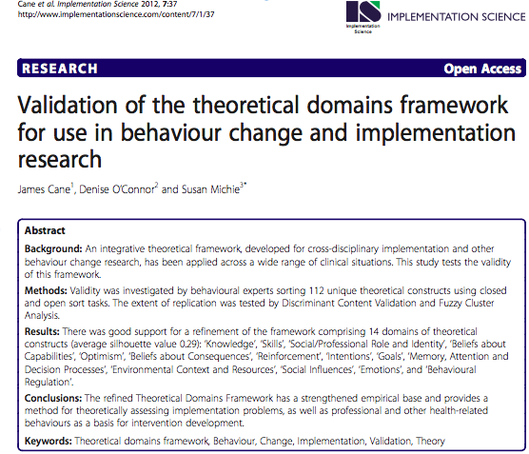
Using Theory to Understand Behavioural Determinants
Cane et al. Implementation Science 2012;7:37.

Slide 29
Using Theory to Understand Behavioural Determinants
Theoretical Domains Framework (TDF)
Modifiable factors that determine behaviour across a range of settings
Applicable to any target, action, context, time and actor (TACT-A)
Many theories and many more constructs distilled into 13 domains that may explain health-related behaviour
Makes the application of health psychology theory more available to those without a background in psychology
Cane et al. Implementation Science 2012;7:37.

Slide 30
Theoretical domains framework (TDF)
Domain | Description
Knowledge | Existing procedural knowledge, knowledge about guidelines, knowledge about evidence and how that influences what the participants do
Skills | Competence and ability about the procedural techniques required to perform the behaviour
Social / professional role and identity | Boundaries between professional groups (i.e., is the behaviour something the participant is supposed to do or someone else’s role?)
Beliefs about capabilities | Perceptions about competence and confidence in doing the behaviour
Optimism | Whether the participant’s optimism or pessimism about the behaviour influences what they do
Beliefs about consequences | Perceptions about outcomes, advantages, and disadvantages of performing the behaviour and how that influences whether they perform the behaviour
Reinforcement | Previous experiences that have influenced whether or not the behaviour is performed
Cane et al. Implementation Science 2012;7:37.

Slide 31
Theoretical Domains Framework (TDF)
Theoretical domains framework (TDF)
Domain | Description
Intention | A conscious decision to perform a behaviour or a resolve to act in a certain way
Goals | Priorities, importance, commitment to a certain course of actions or behaviours
Memory, attention, and decision processes | Attention control, decision-making, memory (i.e., is the target behaviour problematic because people simply forget?)
Environmental context and resources | How factors related to the setting in which the behaviour is performed (e.g., people, organisational, cultural, political, physical, and financial factors) influence the behaviour
Social influences | External influence from people or groups to perform or not perform the behaviour How the views of colleagues, other professions, patients and families, and doing what you are told, influence the behaviour
Emotion | How feelings or affect (positive or negative) may influence the behaviour
Behavioural regulation | Ways of doing things that relate to pursuing and achieving desired goals, standards, or targets Strategies the participants have in place to help them perform the behaviour Strategies the participants would like to have in place to help them
Cane et al. Implementation Science 2012;7:37.
Notes:
Need reference and pictures; explanation of each

Slide 32
TDF in Action: Systematic Review
Application of TDF to results of qualitative studies of behavioural determinants of physician antibiotic prescribing
Systematic review of qualitative studies (n=14), limited to high-income settings, hospitalized inpatient, physician prescribers
Results synthesized according to the TDF
Significant behavioural determinants of appropriate antibiotic prescribing were identified as potential targets for interventions to improve physician antibiotic prescribing

Slide 33
TDF in Action: Systematic Review
Prominent domains
  Environmental Context and Resources
  Social Influence
  Social and Professional Role and Identity
  Beliefs about Capabilities
  Knowledge
  Beliefs about Consequences
  Skills

Slide 34

TDF in Action: Systematic Review
Cross-cutting themes
  Differences in junior vs. senior physician determinants of antibiotic prescribing
  Relatively low perceived threat of antimicrobial resistance

Slide 35
TDF in Action: Non-ID Physician Barriers and Facilitators
What are the barriers to/facilitators of appropriate antibiotic prescribing by non-ID physicians?
Qualitative, semi-structured, in-depth interviews conducted with 16 physicians
Interviews were recorded, transcribed, quotes were coded into TDF domains
Themes developed from individual quotes
Determinants of appropriate antibiotic prescribing described

Slide 36
TDF in Action: Non-ID Physician Barriers

Slide 37
Using Theory to Enact Change
Behaviour Change Techniques (BCTs)
Which strategies can be effectively used to target those factors?
Which BCTs are best suited to specifically target the identified barriers and enablers?

Slide 38
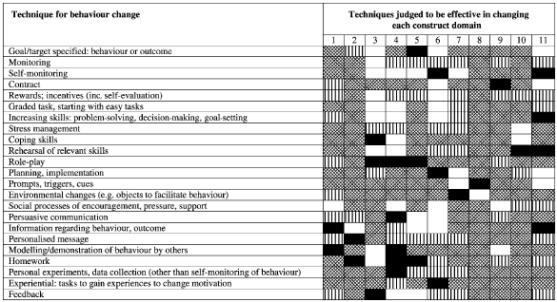

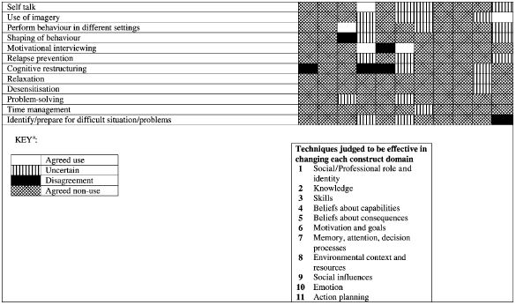
Behaviour Change Techniques (BCTs)

Slide 39
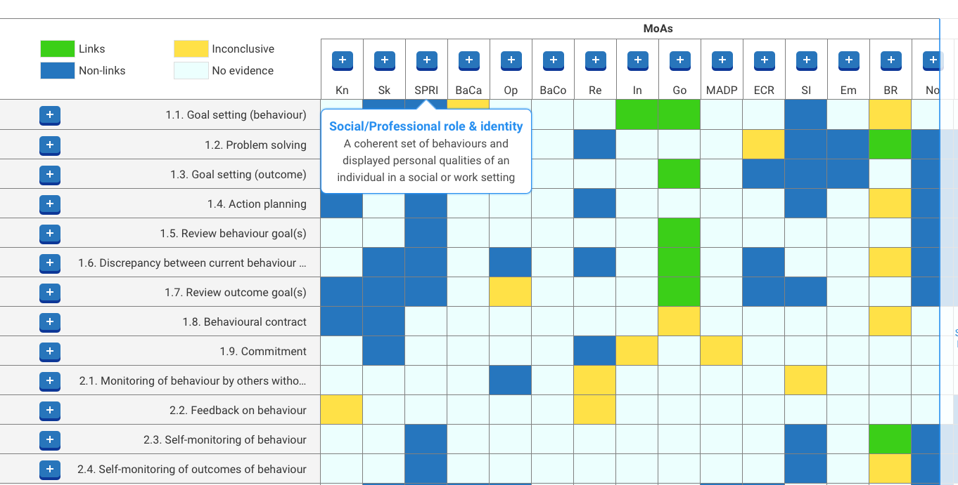
Using Theory to Enact Change
https://theoryandtechniquetool.humanbehaviourchange.org/tool

Slide 40
TDF in Action: ID Physician Behaviour Change Techniques (BCTs)
What BCTs are ID physicians currently using to influence their non-ID colleagues’ antibiotic prescribing behaviours?
Qualitative, semi-structured, in-depth interviews with 12 ID physicians
Interviews were recorded, transcribed, quotes were coded into TDF domains
Themes developed from individual quotes
Explored whether ID physicians see themselves as agents of change for their non-ID peers and described BCTs currently in use

Slide 41
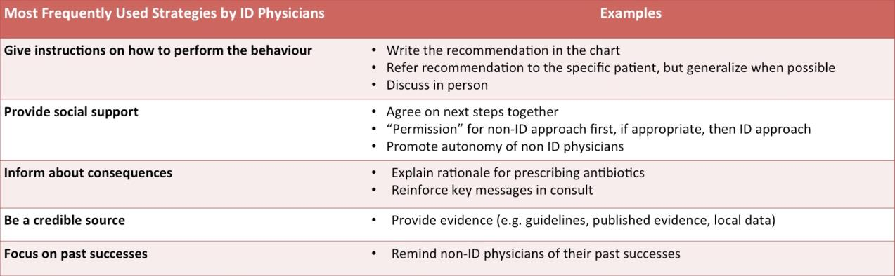
TDF in Action: ID Physician Behaviour Change Techniques (BCTs)

Slide 42
TDF and BCTs in Action
Themes were mapped to identify the highest impact BCTs that ID physicians might apply in clinical interactions, for inclusion in a BCT toolkit and workshop
Workshop designed to train ID physicians to
  ➔ “Diagnose” the barrier
  ➔ Choose from a toolkit of potential BCTs to address the barrier
Behaviour change skills represent a potential new area of competency for ID physicians and ASPs

Slide 43
TDF and BCTs in Action

Slide 44
TDF and BCTs in Action

Slide 45
Behavioural Research Gaps
Feasibility of introducing BCTs to change antibiotic decision-making
Effectiveness of using BCTs to improve antibiotic prescribing
Most effective method of providing antimicrobial prescribing feedback to individual physicians

Slide 46

ASP Research Gaps
Morris AM et al, Infect Control Hosp Epidemiol 2019

Slide 47
ASP Research Gaps
Optimal prescribing practices
Strategies for implementing, sustaining AMS interventions
Optimal process and outcome measures
Research methods and reporting requirements to improve AMS studies
Morris AM et al, Infect Control Hosp Epidemiol 2019

Slide 48
Optimal Antibiotic Prescribing
New data
  Duration of therapy
    Bacteremia (BALANCE, ongoing)
    Intra-abdominal infections (STOP-IT, 2015)
  PO vs. IV therapy
    Endocarditis (POET, 2019)
    Bone and joint infections (OVIVA, 2019)

Slide 49
Optimal Antibiotic Prescribing
Completion of therapy with PO beta-lactams
Relationship between treatment of asymptomatic bacteriuria and resolution of delirium
Role for prophylactic PO vancomycin for C. difficile prevention
... and many more!!

Slide 50
Effectiveness, Spread, and Sustainability of ASP Interventions
Combinations of strategies
Transitions of care (ex. ED to LTC/home, ICU to ward)
Spread through the hospital; interventions to address specific services’ needs
Sustainability over time (“self-stewardship”); less reliance on resource-intensive interventions
Behavioural, social and systems considerations

Slide 51
TOH Antimicrobial Stewardship Program 2017

Slide 52
Optimal and Standardized Outcome and Process Measures
Asses appropriateness of antibiotics
Benchmark antibiotic use between similar prescribers, similar services, similar institutions
Determine best antibiotic use measure (DOT vs DDD vs other)
Decide on a globally accepted metric for measuring ASP success
Incorporate patient outcomes and facility/healthcare systems outcomes

Slide 53
Advanced Study Designs
Standardize process metrics
Report patient-focused outcomes
Identify methods to avoid major sources of bias
Evaluate new initiatives in the context of established ASP activities
Incorporate economic analysis of interventions

Slide 54
summary
We have discussed how to:
Develop a plan for implementing an ASP (AMS program)
Describe methods for measuring success
Identify potential research questions to resolve current knowledge gaps related to ASP
Recognize determinants (barriers and facilitators) of appropriate antibiotic prescribing in hospitals

Slide 55
Additional resources
ESCMID generic competencies: Clin Microbiol Infect 2019;13-9. https://www.clinicalmicrobiologyandinfection.com/article/S1198-743X(18)30662-1/fulltext
Infectious Diseases Society of America Guidelines
  Developing an ASP: Clin Infect Dis 2007;44:159-77
  Implementing an ASP: Clin Infect Dis 2016;62:e51-77. https://www.idsociety.org/practice-guideline/implementing-an-ASP/
CDC. Core elements of hospital antibiotic stewardship programs. 2019. www.cdc.gov/antibiotic-use/core-elements/hospital.html
British Society for Antimicrobial Chemotherapy 2013. http://bsac.org.uk/wp-content/uploads/2013/07/Stewardship-Booklet-Practical-Guide-to-Antimicrobial-Stewardship-in-Hospitals.pdf

Slide 56
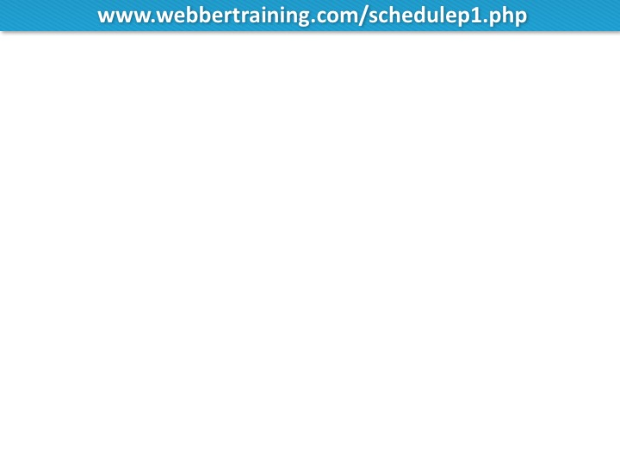
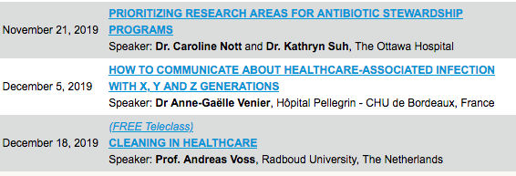

TELECLASS EDUCATION
(Coming December 1)

Slide 57


