Slide 1

PUBLIC REPORTING AND DISCLOSURE OF HAI RATES: POSITIVE IMPACT
OR CONFUSION?
MARYANNE MCGUCKIN, DR. SCED, FSHEA
JOHN GOVEDNIK, MS
PROJECT TEAM/CO-AUTHORS:
DAVID HYMAN, MD, JD,
BERNARD BLACK, JD, MS
JESSICA BUNSON, MT (ASCP), MS, CIC
Hosted by Dr. Walter Zingg
Hôpitaux Universitaires de Genève
SUPPORT FOR THIS STUDY WAS PROVIDED BY A GRANT
FROM THE ROBERT WOOD JOHNSON FOUNDATION’S
PUBLIC HEALTH LAW RESEARCH PROGRAM.
THE PRESENTERS HAVE NOTHING TO DISCLOSE.
Sponsored by
WHO Patient Safety Challenge Clean Care is Safer Care
www.webbertraining.com
October 8, 2014

Slide 2
OUTLINE
Background /Study Components
Infection Preventionist perspectives
Epidemiologist perspectives
State HAI Coordinator perspectives
Consumer websites usability
Consumer awareness, engagement, and intent

Slide 3
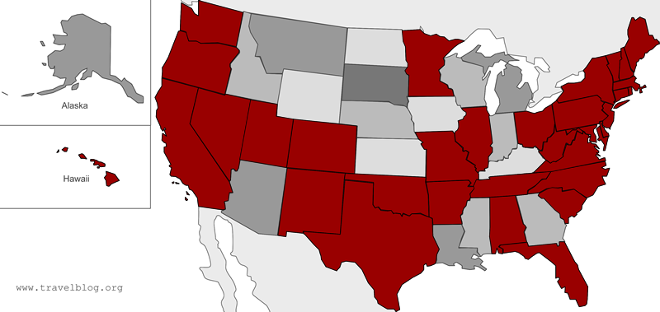
BACKGROUND
Little is known about the extent to which the public actually knows about HAI information and if they use it.
At the time of our study, 34 states have laws requiring hospitals to report HAI rates (shown in red).

Slide 4
STUDY COMPONENTS
Hospitals
IP/Epidem.
Data Reporting
Training
State HAI Coordinators
Reports
Consumers
Awareness
Engagement
Intent
Education
Law
Awareness Campaigns

Slide 5
STUDY COMPONENTS
Hospitals
IP/Epidem.
Data Reporting
Training
State HAI Coordinators
Reports
Consumers
Awareness
Engagement
Intent
Education
Law
Awareness Campaigns

Slide 6
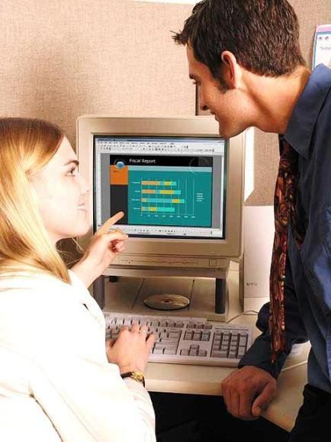
INFECTION PREVENTIONIST INTERVIEWS
WHY: - Key process stakeholders
  - State comparisons
HOW: - Phone interviews
WHO: - By Ms. Bunson, IP, CIC
  - APIC Chapter Presidents
  - MMI’s IP Consortium

Slide 7
IP RESULTS
What is one word to describe how your fellow IPs in your state regard public reporting to consumers?
Cumbersome
Misunderstood
Frustrating
“Unvalidated”
Good idea
Transparency
Quality-Improvement

Slide 8
IP RESULTS (CONT’D)
What is one word to describe how consumers in your state regard public reporting?
Unused
Misunderstood
Oblivious
Garbage!
Usable
Trustworthy

Slide 9
IP RESULTS (CONT’D)
If you were trying to improve consumer knowledge of HAI rates at hospitals, list 2 or 3 things you would do.
Simplify
Graphics not words
TV
Internet
Facebook
Hospital webs
Doctors
APIC consumer ed.
Half respondents did not have any suggestions

Slide 10
IP RESULTS (CONT’D)
If your state has mandatory public disclosure of HAI rates, where would a consumer get this information?
Official State Health Agency Websites
State Health Quality Commission Websites or the like.
IPs suggest the information sources are on the web. What do the Epidemiologists suggest?...

Slide 11

EPIDEMIOLOGIST SURVEY
Partnered with SHEA Research Network
Online survey
  Healthcare worker use
  Consumer understanding

Slide 12
EPIDEMIOLOGIST RESPONSES
165 invites to SRN members
53 responses from reporting states
  31%: 1-300 beds
  25%: 301-500 beds
  44%: 500+ beds
April-May 2013

Slide 13
EPIDEMIOLOGIST RESULTS

Slide 14
EPIDEMIOLOGIST RESULTS (CONT’D)

Slide 15
EPIDEMIOLOGIST RESULTS (CONT’D)
Awareness
Understanding
Priority

Slide 16
EPIDEMIOLOGIST RESULTS (CONT’D)

Slide 17
EPIDEMIOLOGIST TAKEAWAY
From which of the following sources can consumers learn about your facility’s HAI rates?
Remember earlier slide… IPs cited 100% web sources
Official state reports | 85%
HospitalCompare website | 74%
Hospital personnel | 28%
Physician or other HCW | 25%
Local News Source | 17%
Hospital Website | 15%
Don’t know | 4%

Slide 18
EPIDEMIOL. TAKEAWAY (CONT’D)
Which departments at your hospital are involved in providing information on HAI rates to patients?
Infection Prevention | 81%
Quality Assurance | 36%
Patient Safety | 28%
Administration | 23%
None | 17%
Note: Final slide has verbatim improvements for awareness and understanding

Slide 19
STUDY COMPONENTS
Hospitals
IP/Epidem.
Data Reporting
Training
State HAI Coordinators
Reports
Consumers
Awareness
Engagement
Intent
Education
Law
Awareness Campaigns

Slide 20
STATE HAI COORDINATOR INTERVIEWS
32 States have disclosed reports at time of study
Phone and Internet interviews, 28 states
  Design and disclosure
  Awareness promotions
  Consumer feedback
1 declined interview, 2 did not respond
  Information used from websites

Slide 21
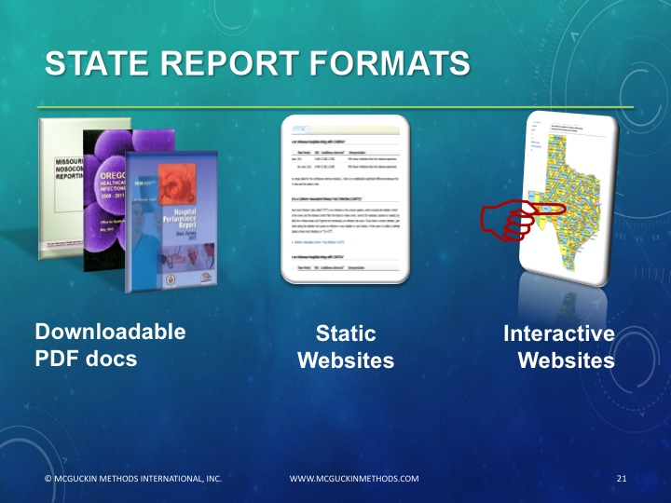

Slide 22
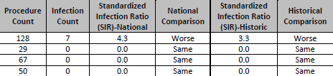
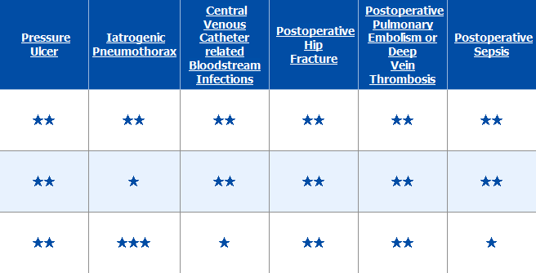
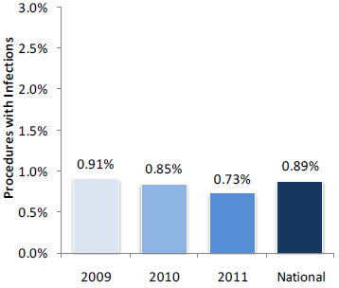
DATA ON STATE REPORTS
Words/Numbers
Colors/Symbols
Graphs/Charts

Slide 23
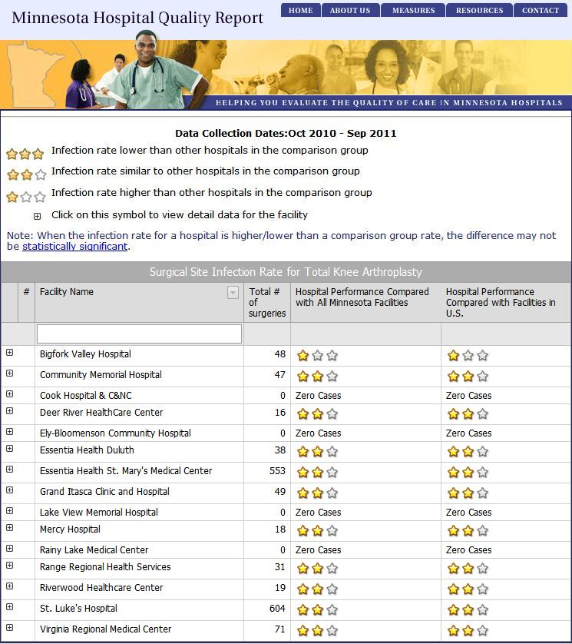
EXAMPLE 1
Interactive website
You choose the region within the state
Rank by 1-3 stars
Click on hospital name to get actual rate data

Slide 24
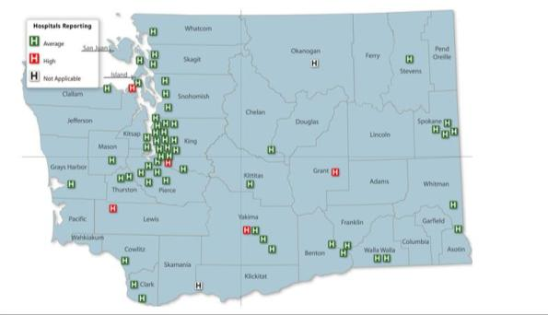
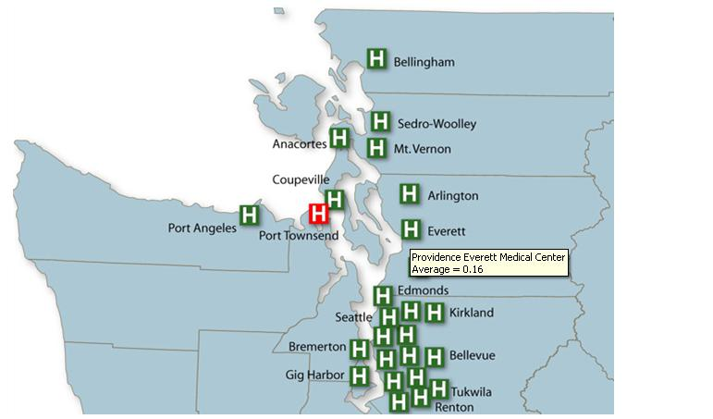
EXAMPLE 2
State web map
Green = average HAI rates; Red = above average HAI rates
Click to enlarge region
Mouse-over for pop-up note on rate data

Slide 25
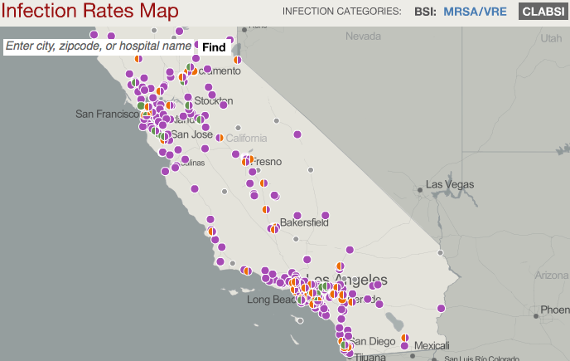
EXAMPLE 3

Slide 26

STATE RESULTS
Who determined format?
8 states used a template/model
15 cited state advisory committee
10 states used other states’ reports

Slide 27


STATE RESULTS (CONT’D)
25 states have consumers on advisory board
  7 of those had laws requiring consumer participation
  9 Used consumers in report design
    Regional panel for multistate
    Multiple panels for different educ. levels

Slide 28

STATE RESULTS (CONT’D)
Raising Public Awareness
  15 Press Release
  3 Press Conference
  4 Statewide Public Awareness Campaign
  4 Facebook, 3 Twitter, 1 RSS Feed

Slide 29
STUDY COMPONENTS
Hospitals
IP/Epidem.
Data Reporting
Training
State HAI Coordinators
Reports
Consumers
Awareness
Engagement
Intent
Education
Law
Awareness Campaigns

Slide 30
BACKGROUND: 2006 SURVEY
OF CONSUMER ATTITUDES
1,000 respondents asked to rank each factor as “very, somewhat, or not important” when choosing a hospital
McGuckin M, Waterman R, Shubin A. Consumer attitudes about health care-acquired infections and hand hygiene. Am J Med Qual. 2006 Sep-Oct;21(5):342-6.

Slide 31
CURRENT CONSUMER SURVEY METHODS
Non-incentive random phone survey of 3,000 consumers in 48 States/DC
Time: Three waves, April – May 2012
Age: 18 years and older
Gender: 50/50 (m/f) response pool
Contracted with ORC/International

Slide 32
CONSUMER METHODS (CONT'D)
Design: 12 questions in three parts:
Demographics
Awareness of law and HAI reports
Decision-making and HAI data

Slide 33
CONSUMER METHODS (CONT’D)
DATA ANAYLSIS*
Standard socioeconomic/demographics and location (State)
Sub-grouped by whether or not their state of residence had a publicly available.
Awareness and engagement analyzed for respondents from states with HAI reporting,
Intent to seek information for all respondents.
* All p-values are for a Pearson chi-squared test for differences.

Slide 34
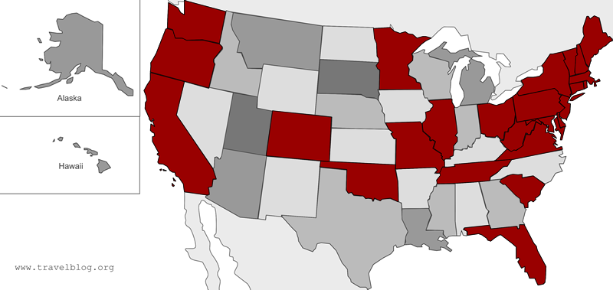
CONSUMER RESULTS
3,031 responses
  1895 from states where HAI data was disclosed to public by April 2012 (25 states, shown red)

Slide 35
CONSUMER RESULTS (CONT’D)
 |  | Awareness | Engagement | Intention
Sex | Male | 37% | 10% | 48%
 | Female | 42% | 15% | 55%
 |  | Females more aware¹ | Females more engaged² | Females more intent³
Age | 18-34 | 31% | 8% | 53%
 | 36-64 | 42% | 14% | 52%
 | 65+ | 38% | 11% | 52%
 |  | Older more aware⁴ | Older more engaged⁵ | Not significant⁶
¹P = 0.0248 ²P=0.0011 ³P=0.0002 ⁴P = 0.0143 ⁵P = 0.0183 ⁶P = 0.8620

Slide 36
CONSUMER RESULTS (CONT’D)
 |  | Awareness | Engagement | Intention
Educ | High Sch | 32% | 8% | 58%
 | College | 40% | 12% | 50%
 | Post Grad | 47% | 18% | 47%
 |  | More educ more aware¹ | More educ more engaged² | More educ less intent³
Inc | <$25,000 | 30% | 9% | 60%
 | $25-59,999 | 39% | 12% | 55%
 | $60-99,999 | 41% | 12% | 48%
 | $100,000+ | 46% | 16% | 43%
 |  | More income more aware⁴ | Not significant⁵ | More income less intent⁶
¹P < 0.0001 ²P < 0.0001 ³P < 0.0001 ⁴P = 0.0007 ⁵P = 0.0928 ⁶P < 0.0001

Slide 37
CONSUMER RESULTS (CONT’D)
 |  | Awareness | Engagement | Intention
Prior infection (self or fam) | Yes | 205 (48%) | 96 (23%) | 391 (59%)
 | No | 539 (37%) | 137 (9%) | 1143 (50%)
 |  | Prior infection more aware¹ | Prior infection more engaged² | Prior infection more intent³
¹P=0.0001 ²P < 0.0001 ³P<0.0001

Slide 38
CONSUMER RESULTS (CONT’D)
 |  | Of all respondents that are aware of public reports (n=1895)
Which two factors would you consider most important in choosing a hospital? | Recommendation from Physician, Nurse, other health professional | 46%
 | Reputation | 37%
 | Insurance coverage | 34%
 | Location or convenience | 31%
 | Recommendation from friends or family | 20%
 | Hospital infection rate | 14%
In contrast, (2006) 85% of respondents said HAI rates were an important factor in choosing hospital. Importance vs. Priority.

Slide 39
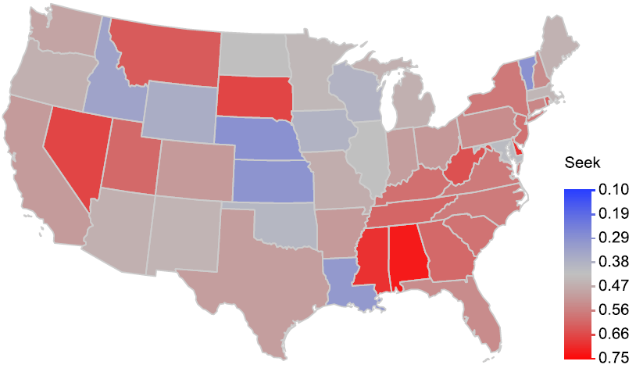
CONSUMER RESULTS (CONT’D)
Where are they most likely to seek information on HAIS when choosing a hospital in the future? red=most likely; blue = least likely
P=0.0009

Slide 40
CONSUMER RESULTS (CONT’D)
What can hospitals do to help move states to have more intent?
  Ownership
  Consumer empowerment
  Process
  Opportunities for APIC chapters

Slide 41


Slide 42
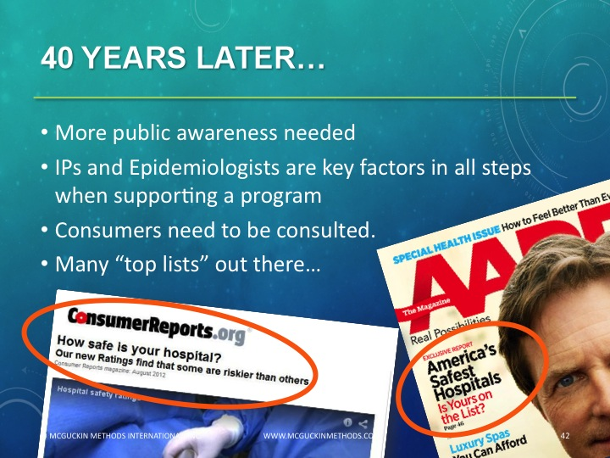

Slide 43
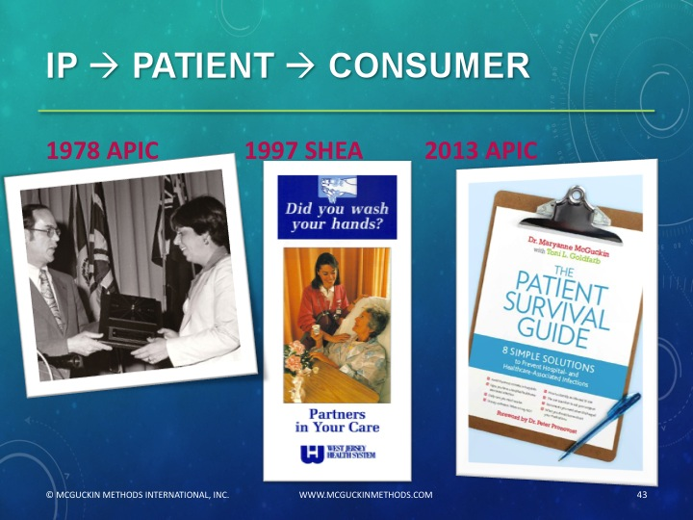

Slide 44
ADDITIONAL INFORMATION
McGuckin M, Govednik J, Hyman D and Black B. Public reporting of healthcare-associated infections: Epidemiologists perspectives. Infection Control and Hospital Epidemiology. November 2013. 1201-1203.
McGuckin M, Govednik J, Hyman D and Black B. (2013b) Public reporting of healthcare-associated infection rates: Are consumers aware and engaged? American Journal of Medical Quality. January/February 2014. 83-5.
Govednik J, McGuckin M, Bunson J, Hyman D and Black BS. Healthcare-Associated Infection Reports: How do states include and inform the public? Do people notice? Patient Safety and Quality Healthcare. November/December 2013. 24-31.

Slide 45
THANK YOU
We thank the Robert Wood Johnson Foundation for their support
RWJF Grant Title: Does Mandatory Public Reporting Affect Hospital Infection Rates?
Grant I.D.: 6375
Maryanne@mcguckinmethods.com
Govednik@hhreports.com

Slide 46
APPENDIX: EPIDEMIOLOGIST SUGGESTIONS FOR IMPROVED CONSUMER AWARENESS, UNDERSTANDING
What changes would you suggest to increase the public/consumer’s awareness, use, and understandability of your state’s HAI reports or website?
Clarity about rates for surveillance vs. actual events.
There needs to be active interaction between healthcare providers, epidemiologists and administrators of a healthcare facility and its patients to provide real Time and accurate information on patient safety (and not comparisons of "apples and oranges."
The consumers need to understand how the hospitals are compared and by what metrics we use to calculate the SIR.
Public information announcements , press releases directly to media from state.
The state report is only released on a year - to - year basis, so the data sometimes seems "old". I understand the need for validation and standardization which takes time, but a more timely report would be nice too
There has been very little publicity, so most people won't think to access it. Additionally, many people have little choice about where they are hospitalized -- much more affected by insurance and ambulance traffic.
My hospital receives patients from at least 3 states, so comparisons at the state level are not very useful. We do comparisons with similar-type hospitals and national level.
Promoting the website
Improve visibility and access on the state website. Difficult to navigate to the page.
The site is limited and well focused. There are almost no statistically relevant differences. Good news = The public sees we are doing something. Bad News = Almost no body cares and the few that do have no idea about it's relevance, accuracy and sensitivity. The public thinks that it represents "accountability" but they have no idea or interest in understanding the complexity of the issues.
Give a better sense of what differences are real. People focus on the second decimal place, or on the number of stars, without getting a clear story over the course of years.
Education
Role of risk stratification
Eliminate their reporting and use single, nationwide reporting process (eg NHSN, CMS)
Many facilities in our state are small. Perhaps we should treat all critical access hospitals in an area as a group and work on them as a group to improve rates. 25% of all hospitals in the US are CAH.
Need to 1) report HAI #s that matter (ie audits) 2) present them in an easy to understand format
Adds on TV and radio
Our state does not have such a site. If it did I hope there would be some means of data verification and risk stratification.
National, standardized reports so every state doesn't reinvent the not-so-great wheel, so you can see reports by national, regional, state, city, hospital etc.

Slide 47
What changes would you suggest to increase the public/consumer’s awareness, use, and understandability of your state’s HAI reports or website?
Consumer education about basic statistics is crucial to understanding and comparing data other than a basic higher/lower or equal to other institution breakdown.
The state website was supposed to have a lot of education for the public and explanations about rates, and why they may not be comparable between hospitals, but they did not follow through with all of those initial requirements.
Inform how the data are collected
In general, such reports need to statistically valid - not the garbage that many of the publicly reported data are, e.g. HCHAPS. HAI reports usually are, but patients tend to focus on numbers and do not understand what statistically insignificant differences mean.
Ours were recently revised, with our input, to have a "consumer-level" and "detail-level" reports. The consumer level is pretty basic and color-coded to make it more easily understood, and I think is a step in the right direction. The discussion of precision vs. statistical significance I think is still difficult for lay people to understand.
First step is (funded) research to evaluate approaches to improve the accessibility and usefulness to consumers of this data.
We provide a nice description of how the data are calculated with information about how to interpret the data. I think our state spent a lot of time upfront (with various stakeholders) developing the website so it would be consumer friendly. I think it would be a good model for other states.
Make them relevant to the consumer, ensure reliability of reporting by the hospitals
The rates of HAI can be misleading and knowing the actual numbers, complexity/comorbidities/severity needs to be taken into account at the time of interpretation of the HAI reports.
Explain the problem in simple real terms
The descriptions in the sample report are understandable only to persons with knowledge of SIR and other rates. Not oriented toward first level consumers and patients.
I don't think such an increase is necessary, valid or of any value.
More promotion and more user friendly.
Make public aware that there are major methodological problems with data that make it difficult to compare hospital data side by side.
Better explanations of the data - there's a bar graph "your hospital" vs. "other hospitals" where at first glance you look terrible but it turns out the confidence intervals overlap so there is statistically no difference in your rates - but the public doesn't get that.

Slide 48
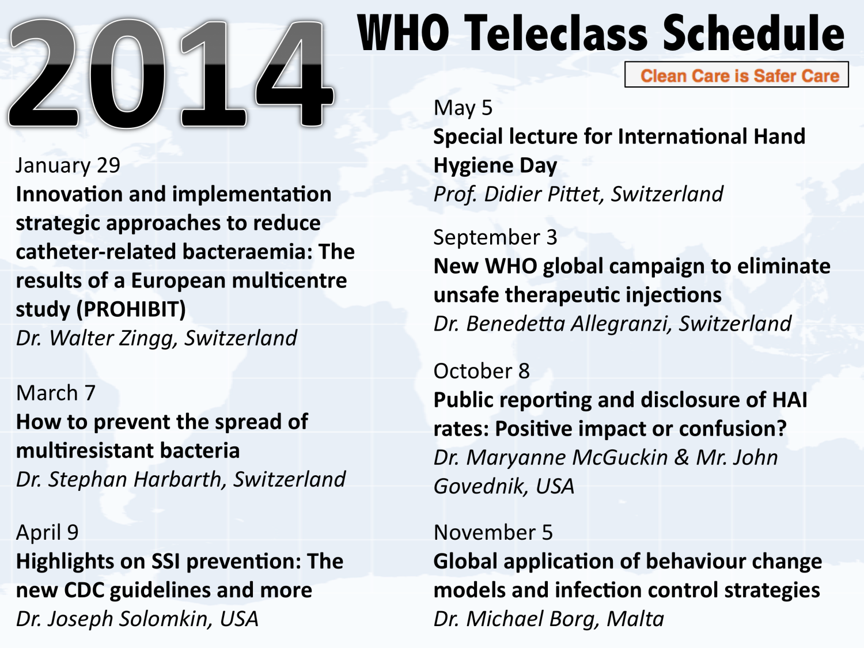

Slide 49


