Slide 1
Recurrent Clostridium difficile : The Role of Faecal Microbiota Transplants
Dr Jonathan Sutton
Ysbyty Gwynedd
Betsi Cadwaladr University Health Board
www.webbertraining.com
September 29, 2015

Slide 2
‘Toying with human motions’
*Borody et al. Journal of clinical gastroenterology 38(6) 2004

Slide 3
The Power of Poop

Slide 4
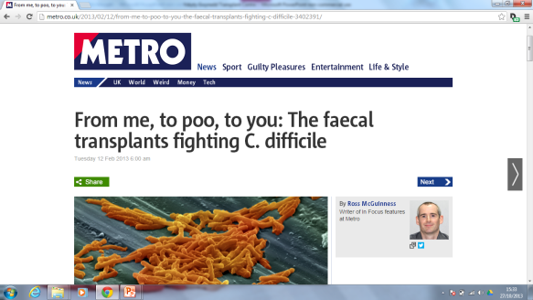
From me ... to poo

Slide 5
Overview
Case history
Recurrent CDI
Why FMT?
History of FMT
Our journey
The future?

Slide 6
Case history
Mr MW 76 year old man
Admitted to local hospital July 2014
Severe CAP- managed in ITU
Cardiac arrest on ITU
Coronary angioplasty
Developed ARF
Haemodialysis
Developed C diff
Metronadazole 14 days
Vancomycin 14 days
Vancomycin + metronidazole 28 days
Fidaxomicin 10 days

Slide 7
Referral
Sent: Tuesday, December 23, 2014 10:41 AM To: Jonathan Sutton (BCUHB - Medical) Subject: Stool transplant
Hi,
I am trying to get hold of the gastroenterologist who does stool transplants. Is that you?
We have a patient I would like to discuss.
Thanks

Slide 8
MW
Wife – post splenectomy on long term antibiotics
Daughter – recent tonsillitis
2 grandsons aged 8 and 12
Opted to treat with frozen material
8 months later no recurrence

Slide 9
Clostridium difficile
Difficult or obstinate
Gram positive, spore forming organism
Can be a minor part of normal colonic microbiota
Causes disease when competing bacteria are wiped out following antibiotic use

Slide 10
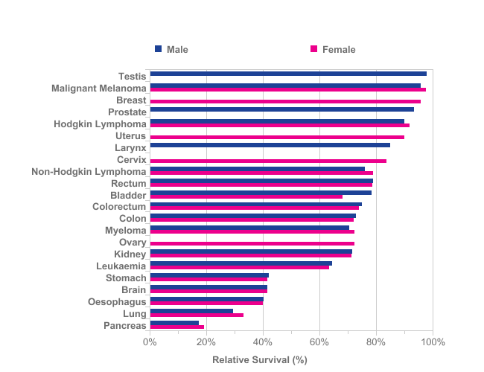
21 Common Cancers: Patients Diagnosed 2005 - 2009 and Followed up to 2010
One-Year Relative Survival, Ages 15–99, England
Clostridium difficile
Courtesy of Dr Robert Porter
Prepared by Cancer Research UK
Original data source: ONS Statistical Bulletin (2011) Cancer survival in England- Patients diagnosed 2005-2009 and followed up to 2010

Slide 11
Recurrent CDI
Complete abatement of symptoms whilst on appropriate treatment followed by reappearance of diarrhoea after treatment stopped
Molecular methods suggest up to 50% are reinfections rather than relapses.

Slide 12
Recurrent CDI
Most patients respond to initial antimicrobial therapy
Approximately 25% have recurrence
Second recurrence in 35-45%
Subsequent recurrence rates higher than 50%

Slide 13
Management of recurrence
Tapered or pulsed dose vancomycin
Persistent spores
Recurrence rates 31% compared with 45%
Fidaxomicin narrow spectrum antibiotic – less damaging to background microbiota.
Similar efficacy to vancomycin but less recurrence

Slide 14
Why does C. diff recur?

Slide 15
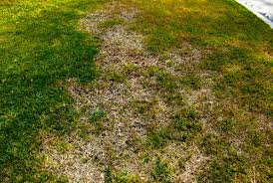
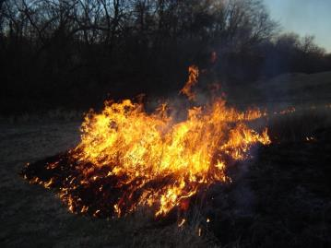
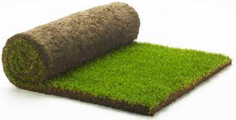
Antibiotics
Antibiotics
FMT
Emma Allen-Vercoe, Univ Guelph , Canada

Slide 17
Faecal Therapy
First described in 4th Century- Ge Hong described using human faecal suspension for food poisoning and diarrhoea
Li Shizhen described using ‘yellow soup’ to cure many abdominal symptoms C16th

Slide 18
Fast forward…….
Denver 1958
‘Fecal enema as an adjunct in the treatment of pseudomembranous enterocolitis . Eiseman et al Surgery 1958;44:854-9
Data limited to case reports and case series

Slide 20
Open labelled, RCT
3 treatment arms
Vancomycin , bowel lavage, FMT
Standard vancomycin regimen
Standard vancomycin +bowel lavage

Slide 21
Cure without relapse at 10 weeks

Slide 22
Microbiota Diversity

Slide 23
Trial stopped early as almost all the patients in the 2 control arms had recurrence
Success rate for FMT 80% consistent with case series data

Slide 24
Acceptable to patients?
Clinicians often state no patient would ever agree to this procedure
No patient (in YG)who has been considered for procedure has refused it.
Zipursky J. et al. Can J Gastroenterol Hepatol 2014 28(6):319-24

Slide 25
Patient Attitudes
Study in healthy volunteers
192 people attending OPD clinics
2 hypothetical scenarios
Zipursky J et al. Clinical Infectious Diseases 2012:55(12):1652-8

Slide 26
Scenario 1
Suffering with recurrent CDI, two treatment options
Another antibiotic course with a 65% success rate
Antibiotics plus ‘floral reconstitution’ with 90% success rate

Slide 27
Scenario 2
Same clinical scenario but detailed information about what FR is including potential routes of administration

Slide 28
Results
Scenario 1
85% chose antibiotics plus FR
Scenario 2
81% chose antibiotics plus FR
Increased to 94% if recommended by their doctor

Slide 29
Safety of FMT
Most current data is retrospective
Minor
Abdominal symptoms immediately post FMT are common
Serious
Related to mode of administration
Transmission of infection
Potential
Transmission of infective agent
Induction of chronic disease by altering the microbiome

Slide 30
Our Journey

Slide 31
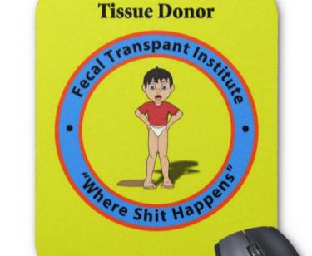
FMT AT YSBYTY GWYNEDD

Slide 32
Multidisciplinary
Interested in the concept
Lack of effective treatment for recurrent disease
Discussed with local microbiologists
Discussed with gastroenterology colleagues
RCT was trigger to look at developing a service

Slide 33
Discussions
Good evidence (better than anything else)
How?
Enema
NJT
Colonoscopy
Who prepares donation?
Where is it done?
Who do we ask?
D&T
CPG

Slide 34
Who, where and how?
Must have had 2 relapses – tapered vancomycin
Opted to use colonoscopy as preferred method
Preferred to use relatives as donor
Screening confirmed

Slide 35
Donor selection
Pt relative
BMI < 30
No bowel symptoms (IBS/IBD )
No autoimmune disease
No antibiotic use for 3 months prior to transplant

Slide 36
Screening of Donors

Slide 37
Specialist equipment

Slide 38
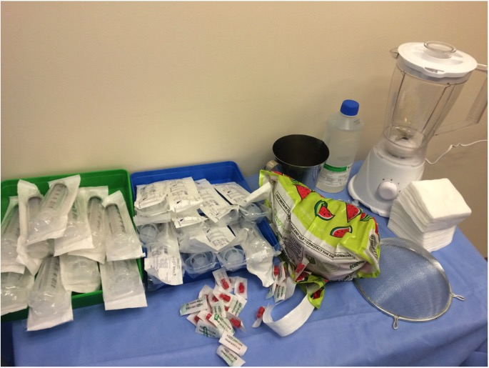

Slide 39
Transplant
Procedure performed in endoscopy unit
Donor provides sample on arrival
Material processed
2 staff masked and gowned
Mixed with N/saline in household blender
Homogenised
Drawn in 50ml syringes and capped

Slide 40
Patient
Vancomycin continued until 48 hours prior to transplant
Full bowel prep given
Colonoscopy performed to terminal ileum
10 x 50mls donor material given through the scope.
Loperamide given immediately
Bed rest for 6 hours
Loperamide repeated at 6 hours

Slide 46
Problems with suitable donors

Slide 47
Problems
Can be difficult to find donors who fulfil criteria
Takes time to perform screening
Messy to prepare stool!

Slide 48
The solution?

Slide 49
Openbiome
Non profit making company in Boston USA
Mission statement to make FMT:
Easier
Cheaper
Safer
Widely available

Slide 50
Easier?
Material provided screened, mixed, filtered and frozen
6 months shelf life in a -20⁰C freezer
No more donor finding or screening
Allows patients to be treated quickly

Slide 51
Cheaper?
Much more extensively screened than we would do locally
Screened at least twice in a 60 day windows
Equivalent testing is £150 per screen i.e. £300 per sample.
Cost to buy £200

Slide 52
How can they do it?

Slide 53
Payment by results
$40 per sample
If they donate 5 days in a week $50 bonus
Earn prizes
Biggest single donation of the month
Most donations in a month

Slide 54
Safer?
More extensively screened
Better quality control
Traceability
Tracker codes
Deep frozen reference samples
Established adverse event reporting system
Reduced hazard of processing locally

Slide 55
Methods 3-step process to determine stool donation eligibility
1) Donor Registry
2) Clinical Assessment
Potential donors answered a 10 question, pre-screen survey
Assess for most common reasons for exclusion
Logistics
Commitment
Age
BMI>30
Birth country
Travel history
Antibiotic use
Smoking
Recent vaccination
3) Laboratory Investigation
Qualified individuals completed an on-site 109-question clinical assessment
Transmissible diseases
Gastrointestinal conditions
Atopic conditions
Autoimmune conditions
Chronic pain syndromes
Metabolic conditions
Neurological conditions
Psychiatric conditions
Malignancy history
Medications
Diet
Family history
Those who passed completed a comprehensive stool and serological screening panel
Stool: Bacteria
Helicobacter pylori, EIA
Vibrio, Culture-based assay
Salmonella/Campylobacter/Shigella, Culture-based assay
Giardia, EIA
Clostridium Difficile, PCR
VRE, Culture-based assay
Stool: Parasites
Cryptosporidium, EIA
Cyclospora / Isospora, Acid fast stain
Ova & Parasites, Microscopic exam
Microsporidia, Microscopic exam
Stool: Viruses
Norovirus, PCR
Adenovirus, EIA
Rotavirus, EIA
Serological
HIV antibody, type 1 and 2
Hepatitis A (IgM)
Hepatitis B panel (HBsAg, anti-HBc [IgM and Total])
Hepatitis C (HCV antibody)
Treponema palladium, EIA
HTLV I and 2
CBC with differential
Hepatic function panel (AST, ALT, ALP, bilirubin, albumin)

Slide 56
Updated Results (as of 5/15/15) 5.0 % donor enrollment rate
Stool Donor Registry
Clinical Interview
Laboratory Investigation
Starting
6157
232
84
48 DONORS ENROLLED
4572
148
36
Excluded

Slide 57
OPENBIOME IN YG

Slide 58
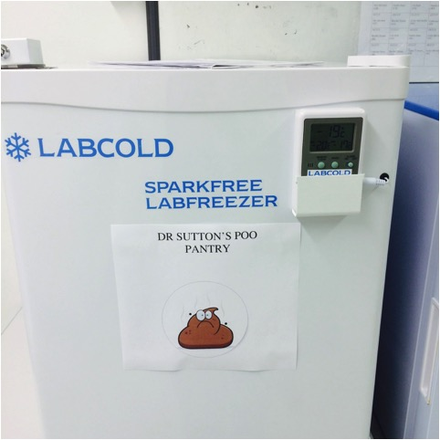
Specialist equipment

Slide 59
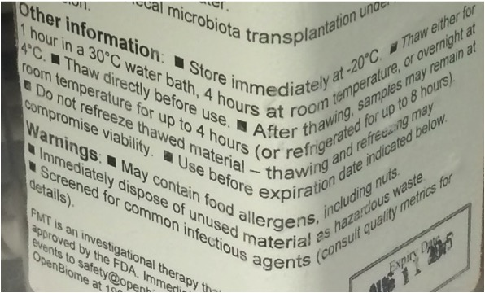

Slide 60
So far..
15 patients treated
8 with Openbiome
7 ‘blender’
No non responders
2 relapses following antibiotic treatment
1 treated with repeat FMT
1 with Fidaxomicin

Slide 61
The future

Slide 62
Improving FMT

Slide 63
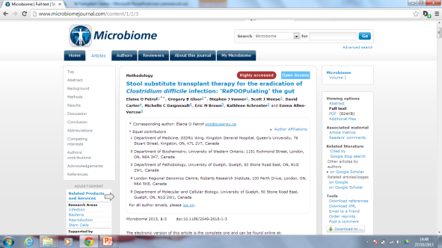
‘Artificial’ Microbiota ?
Cultured microbiota in capsules
‘RePOOPulate ‘

Slide 64
Summary
FMT is a very effective treatment for recurrent CDI
More long-term safety data is needed especially if indications expand
Stool banks may improve availability and safety
Optimisation of therapy
More focused therapy
Cultured material
Best route

Slide 65
Diolch Yn fawr iawn - Thank you very much
Email jonathan.sutton@wales.nhs.uk
Twitter @DrJGSutton

Slide 66
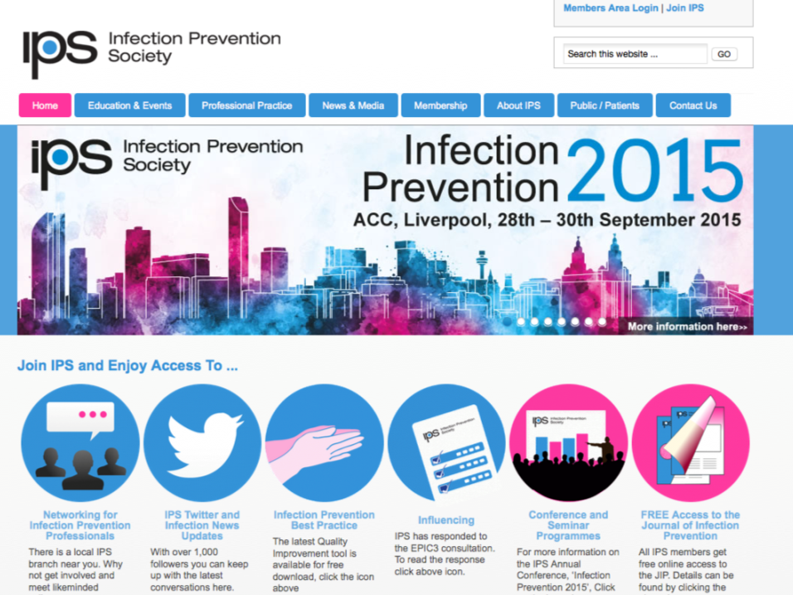
www.ips.uk.net

