Slide 1
Preventing Catheter-Associated Urinary Tract Infections
With a Focus on Resource-Limited Settings
Dr. Mariah Obino, MBChB, Kisii Hospital, Kenya
Dr. Gayani Tillekeratne, MD MSc, Duke University
Hosted by Paul Webber
paul@webbertraining.com
Some slides adapted from "Hospital-Acquired Urinary Tract Infections,” Diane Newman, RNC, MSN & Phil Hanno MD, Division of Urology, University of Pennsylvania.
www.webbertraining.com
June 25, 2015

Slide 2
Objectives
Define catheter-associated UTI (CA-UTI)
Epidemiology & risk factors for CA-UTI
Pathogenesis & microbiology of CA-UTI
Evidence-based strategies for reducing CA-UTI
Proper indications
Proper insertion & maintenance
Our study: A multi-faceted intervention to reduce CA-UTI in Kenya

Slide 3
Definition
Urinary Tract Infection (UTI) is a clinically detectable condition of some part of the urinary tract caused by disease-causing microorganisms.
CA-UTI: Infection in a patient with a catheter in-situ or within 48 hours of catheter removal, as shown by signs or symptoms compatible with UTI with no other identified source of infection, along with 1000 or more colony-forming units per mL of 1 or more bacterial species.
The catheter can be: urethral, condom or suprapubic
2009 Infectious Diseases Society of America (IDSA) guidelines

Slide 4
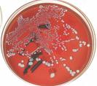
CA-UTI defined
Bacteriuria = bacteria in the urine
After 30 days of having a catheter 100% will have bacteriuria
Bacteriuria is not an infection and should not be treated, it represents colonization
Silverblatt, et al. (2000) Preventing the spread of vancomycin-resistant enterococci in a long term care facility. JAGS; 48:1211-1215.
Terpenning, et al.(1994) Colonization and infection with antibiotic-resistant bacteria in a long-term care facility, JAGS, 42(10): 1062-1069.

Slide 5
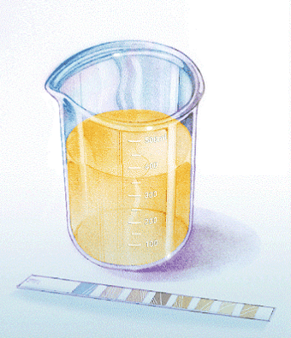
CA-UTI defined
Urinalysis
A positive leukocyte esterase in combination with positive nitrates strongly suggests a UTI.
Urine culture
A positive urine culture will show bacteriuria, but that alone is not enough to diagnose a symptomatic UTI. The patient must also have symptoms of a UTI, including fever, suprapubic tenderness or costovertebral angle pain.

Slide 6
Common s/s of UTI like: -URGENCY, FREQUENCY AND DYSURIA ... are voiding symptoms and WILL NOT BE PRESENT IN PATIENTS WITH INDWELLING URINARY CATHETERS!

Slide 7
Classification of CA-UTI
Asymptomatic
Symptomatic
1 of the following with no other recognized causes
Fever (>38C) or hypothermia (<36C)
Suprapubic tenderness
Costovertebral angle pain or tenderness
Not really infection, but colonization
Asymptomatic bacteruria is universal in patients with long term indwelling urinary catheters
Antimicrobial therapy will not prevent bacteruria or symptomatic infection.
Fever with hematuria or catheter obstruction has a high probability of being from a urinary source.

Slide 8
Catheter associated UTIs – not a small problem!
In the United States:
25% of hospitalized patients have a catheter
40% of hospital-acquired infections are UTIs
80% of hospital-acquired UTIs are catheter associated
Saint (2000) Clinical and economic consequences of nosocomial catheter-related bacteriruria. Am J Infect Control. 28:68-75.

Slide 9
The biggest risk factor for a UTI…
…Having a catheter!
The longer the catheter is in place, the higher the risk for infection
Single catheterization: 1– 2%
Short term (<7 days): 10– 40%
Long term (>30 days): 100%
Once catheter is placed, daily incidence is 3-10%
10-30% of pts with short-term catheterization (2-4) days develop asymptomatic bacteriuria
90-100% of patients who undergo long-term catheterization develop bacteriuria
Kalsi, et al. (2003) Hospital-acquired urinary tract infection. Int J Clin Pract. 57(5):388391.

Slide 10
So when is a catheter indicated?
Acute urinary retention or obstruction (e.g. enlarged prostate)
Need for accurate measurements of urinary output in critically ill patients
To assist in healing of open sacral or perineal wounds of incontinent patients
Patient requires prolonged immobilization (i.e. bone fracture)
Perioperative…for intra-op patients for accurate input/output measurements, abdominal surgery and C-sections (to empty/collapse the bladder)…usually removed immediately post-op
Surgical indications like post urethral dilatation in managing strictures, post delivery risk of vesico-vaginal fistula (following obstructed labour)
Hospice/palliative care

Slide 11
Examples of inappropriate use of catheters
Urinary incontinence
Use of diuretics
Bedrest or decreased mobility
Unconscious pts
Convenience of hospital staff
For routine monitoring of intake and output
Physician uncertainty about the patient’s medical course
Jain P, Parada JP, David A, Smith LG. Overuse of the indwelling urinary tract catheter in hospitalized medical patients. Arch Intern Med. 1995;155:1425-9.

Slide 12
A little more on why catheters can cause UTIs…

Slide 13
Biofilms
Micro-organisms colonize the internal surface of catheters and form biofilms
Organisms can detach from the biofilm and become free-floating which can then lead to symptomatic infection
Electron micrograph depicting round Staphylococcus aureus bacteria, with biofilm, the sticky-looking substance woven between the bacteria.
Stokowski, L.A.2009 Nursing perspectives Preventing Catheter Associated Urinary Tract Infections. Medscape Nurses

Slide 14
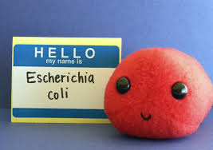
Involved species
Involved species: enteric pathogens like E.coli are most common
Others: Pseudomonas species, Enterococcus species, S. aureus, coagulase-negative staphylococci, Enterobacter species, and yeast.
Proteus and Pseudomonas species are the organisms most commonly associated with biofilm growth
Brusch JL et al. Catheter-Related Urinary Tract Infection. Medscape, 2013.

Slide 15
Catheter care affects biofilm formation
The catheter irritates the urethra and decreases its defense against bacteria
With decreased defenses, there is a port of entry for infection
Loss of the protective mucosal layer promotes development of the bacterial biofilm which binds along the catheter wall.
Trautner, B.W., & Darouiche, R.O. (2003). Role of biofilm in catheter-associated urinary tract infection. American J Infection Control, 32,177–183.

Slide 16
When infections are acquired
On insertion of catheter
Via cross contamination or inadvertent catheterization into the vagina
Not ensuring aseptic technique
Catheter Care
Ascending colonization
Within the catheter lumen (endoluminal) from the drainage bag
Between the catheter and urethra (extraluminal or periurethral)
Maintenance
Cross-contamination when emptying drainage bags

Slide 17
Other risk factors for CA-UTIs
Long duration of catheterization
Colonization of drainage bag… leads to ascending infection
Diarrhea
Diabetes
Female gender
Errors in catheter care and insertion
Immunocompromised patients (e.g. on corticosteroids, symptomatic HIV)

Slide 18
The risks of catheter-associated UTIs
Bacteremia
Occurs when bacteria enter the bloodstream
Urosepsis
Systemic inflammatory response to infection (sepsis) that appears to originate from a urinary tract source
Patient will have signs and symptoms of SIRS (temperature >38°C or <36°C, WBC >12x10⁹ or <4x10⁹, RR >20, HR >90bpm) combined with signs and symptoms of a UTI
Holroyd-Leduc, Sen, Bertenthal, Sands, Palmer, Kresevic, et al. (2007). The relationship of indwelling urinary catheters to death, length of hospital stay, functional decline, and nursing home admission in hospitalized older medical patients. J American Geriatrics Society, 55, 227–233.

Slide 19
How to prevent catheter-associated UTIs
Make sure catheter is indicated!
Follow appropriate infection control strategies
Proper catheter insertion
Proper catheter maintenance
REMOVE CATHETER AS SOON AS POSSIBLE!

Slide 20
Proper insertion of a catheter
Personnel
Should only be performed by persons trained in the proper insertion of a catheter

Slide 21
Proper insertion of a catheter
Aseptic technique
Perform hand hygiene immediately before & after catheter insertion or manipulation
Use sterile equipment
Sterile gloves
Sterile drapes
Sterile sponges
Antiseptic/ sterile solution for periurethral cleaning
Single-use packet of lubricant jelly
http://www.cdc.gov/hicpac/cauti/02_cauti2009_abbrev.html

Slide 22
Proper insertion of a catheter
New England Journal of Medicine -> Videos in Clinical Medicine
http://www.nejm.org/multimedia/medical-videos

Slide 23
Step-by-step instructions: catheter insertion
Perform hand hygiene
Perform peri-care
Re-perform hand hygiene
Don sterile gloves
Place sterile fenestrated drape over patient
Use smallest bore catheter possible that will allow adequate drainage
Spread the labia and keep retracted with non-dominant hand until the catheter is inserted.
This hand is now non-sterile

Slide 24
Step-by-step instructions: catheter insertion
With dominant hand, pick up anti-septic soaked cotton wool to cleanse each side of the labia minora using downward strokes & cleanse the meatus.
Pick up the catheter 3-4 in (8-10 cm) from the tip & insert into the urethra until urine begins to flow.
If the vagina is inadvertently catheterized, obtain a new sterile catheter. Leave the first catheter in place as a landmark.

Slide 25
Step-by-step instructions: catheter insertion
If urinary catheter is to be left in place, insert the catheter 1 in (2.5 cm) further into the urethra, then fill balloon.
Use water, not saline or air, to inflate the balloon.
Anchor the catheter tubing to the thigh
Place the bag in dependent position

Slide 26
Proper maintenance of a catheter
Maintain a closed drainage system
If breaks in system, replace catheter/ system
Maintain unobstructed urine flow
Free from kinking
Place bag in dependent position (below the level of the bladder)
Empty bag regularly (ie EVERY 8 hrs or with volumes >400 mLs)
Minimize urethral trauma after insertion by stabilizing or anchoring the catheter
PROPER PLACEMENT IS KEY!
http://www.cdc.gov/hicpac/cauti/02_cauti2009_abbrev.html

Slide 27
Proper maintenance of a catheter
Catheter should be changed if urine is not draining appropriately
DO NOT CHANGE CATHETER OTHERWISE!
Use standard precautions during any manipulation of the catheter or collecting system
Unless clinical indications exist, do not use systemic antimicrobials to prevent CAUTIs
Gently clean perineal area daily and after each stool with non-deodorant soap & water

Slide 28
Proper maintenance of a catheter
REMOVE CATHETER AS SOON AS POSSIBLE!
Perform daily review of need for catheter

Slide 29
Managing reduced mobility/ incontinence
Urinary incontinence predisposes to skin irritation & ulcers
Absorbent pads, urinals, bedpans, and frequent linen changes can reduce risk
May not be available/ possible in some settings
Can family be recruited to help with linen changes?
In many cases, risk of morbidity and mortality from CAUTI will be greater than from ulcer

Slide 30
Condom catheters
Preferable over indwelling urinary catheter because improves patient comfort, minimizes urethral trauma
Not appropriate for
Accurate urine measurement
Management of obstruction
Decreased rate of UTIs compared to indwelling catheters
If patient able to cooperate, minimize catheter manipulation

Slide 31
Preventing CAUTIs
Quality improvement programs
Provision of guidelines
Adequate education & training
Access to appropriate supplies
Surveillance

Slide 32
Our study

Slide 33
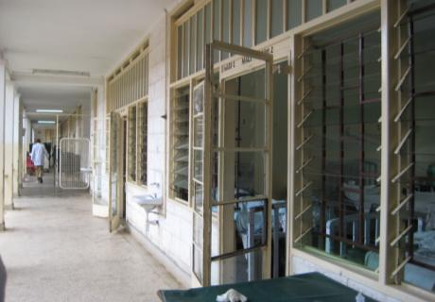
Mbagathi District Hospital, Nairobi
169-bed hospital
Only public district hospital in Nairobi
Serves an annual 73,783 patients each year

Slide 34
Study aims
To perform surveillance for CAUTIs at Mbagathi
To decrease rate of CAUTIs
Interventional, quality-improvement study

Slide 35
Study Design
Study design
Longitudinal, time-series study with intervention
4 weeks surveillance
1 week intervention
4 weeks surveillance
Hospitalized adult patients, March- July 2012, who received a urinary catheter as part of standard care
8 weeks surveillance
1 week intervention
8 weeks surveillance

Slide 36
Surveillance definitions
Indwelling urinary catheter in place at time of collection or w/i 48 hours before
AND
At least one of the following signs or symptoms with no other recognized cause
fever >38C
suprapubic tenderness
CVA tenderness
frequency/ urgency/ dysuria if cath removed
AND
A positive urinalysis demonstrated by at least one of the following:
Positive dipstick for LE or nitrite
Pyuria
Microorganisms seen on Gm stain of unspun urine AND a positive urine culture ≥10³ and <10⁵ CFU/mL with no more than 2 spp

Slide 37
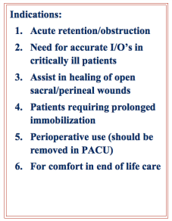
Intervention
Didactics/ educational sessions
Indications for catheter placement
Catheter placement & maintenance
Reminder signs
Weekly nurse matron rounds

Slide 38
Results
125 patients received urinary catheters
82 in the pre-intervention phase
43 in the post-intervention phase
77 (61.6%) patients were female
Mean age was 39.1 years
Mean duration of admission was 12.6 days
79 (71.2%) patients were HIV-infected
58.1% died during the hospitalization

Slide 39
Results
13 (10.4%) patients received catheters for guideline-recommended indications
urinary retention, need for accurate I/Os
20 (17.6%) patients had incontinence listed as a reason for urinary catheter placement.
114 (91.2%) patients had decreased mobility listed as a reason for urinary catheter placement.

Slide 40
Results
Drainage system
Placement of urinary bag
Open
Not to gravity
Closed
To gravity
Pre-intervention
Post-intervention
Pre-intervention
Post-intervention
p=.210
p=.005

Slide 41
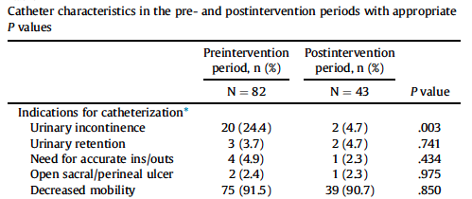
Results

Slide 42
Results
Measure | Pre-intervention period | Post-intervention period | p-value
Mean duration of catheterization | 6.9 days | 5.6 days | .322
Catheter utilization ratio | 0.14 | 0.09 | <.001
Number of CAUTIs | 13 | 0
CAUTIs per 1000 catheter-days | 30.4 | 0 | .002
CAUTIs per 1000 patient-days | 4.6 | 0 | .028

Slide 43
Summary/ conclusions on reducing CAUTIs
Prevention
Avoid catheters if at all possible!
If a catheter is necessary, place it aseptically
Manage incontinence without a catheter -> funding priorities
Interventions
Remove catheters as soon as possible
Maintain closed systems
Change bag frequently
Carefully monitor patients with catheters for any signs of infection
Perform surveillance for CAUTIs

Slide 44
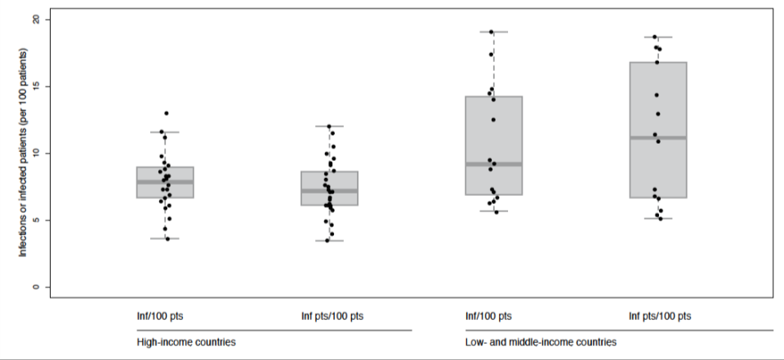
HCAI prevalence in high versus low- and middle-income countries, 1995- 2010
World Health Organization. (2011). The Burden of Health Care-Associated Infection Worldwide.

Slide 45
Takeaway
Preventing CAUTIs is important for ensuring the health of our patients
Even in resource-limited settings, simple measures can reduce CAUTIs
Take action today!

Slide 46
References
Brusch JL et al. Catheter-Related Urinary Tract Infection. Medscape, 2013.
Jain, P, Parada, JP, David, A., Smith, LG (1995) Overuse of the indwelling urinary tract catheter in hospitalized medical patients Arch Intern Med. 155:1425-1429.
Holroyd-Leduc, Sen, Bertenthal, Sands, Palmer, Kresevic, et al. (2007). The relationship of indwelling urinary catheters to death, length of hospital stay, functional decline, and nursing home admission in hospitalized older medical patients. J American Geriatrics Society, 55, 227–233.
Kalsi, et al. (2003) Hospital-acquired urinary tract infection. Int J Clin Pract. 57(5):388391.
Kennedy, V., O’Heron, S., Jaloway, J., Steinfield, C (2002) Nosocomial infections in intensive care patients. Crit Care Nurs Clin N Am. 417-426.
Newman, D.K. & Wein, A.J (2009). Managing and Treating Urinary Incontinence, 2nd Ed, Health Professions Press, Baltimore, Maryland.
Newman, D.K. (2007) Nursing Management: Renal and Urologic Problems In Medical Surgical Nursing Assessment and Management of Clinical Problems. 7th Edition, SL. Lewis, MM. Heitkemper, SR,Dirksen, PG,Brien, L Bucher. (eds) Mosby Elsvier: St Louis MS, 1154-1196
Newman, D.K., Fader, M., and Bliss, D.Z.. (2004) Managing incontinence using technology, devices and products. Nursing Research; Nov/Dec 53(6S):S42-48.
Newman, D.K. (2004) Incontinence products and devices for the elderly. Urologic Nursing; August 24(4):316-334.
Raz R. (2000) Chronic indwelling catheter replacement before antimicrobial therapy for symptomatic urinary tract infection Urol;164:1254-58.
Rosser, et al. (1999) Urinary tract infections in the critically ill patient with a urinary catheter. Am J Surg. 177(4):57-62.
Saint S, Kowalski CP, Kaufman SR, Hofer TP, Kauffman CA, Olmsted RN, Forman J, Banaszak-Holl J, Damschroder L, Krein SL (2008) Preventing hospital-acquired urinary tract infection in the United States: a national study. Clin Infect Dis. Jan 15;46(2):243-50.

Slide 47
References
Saint, S., & Chenoweth, C.E. (2003). Biofilms and catheter-associated urinary tract infections. Infectious Disease Clinics of North America, 17, 411–432.
Saint (2000) Clinical and economic consequences of nosocomial catheter-related bacteriruria. Am J Infect Control. 28:68-75
Saint, S., Kaufman, S.R., Rogers, M.A., Baker, P.D., Ossenkop, K., & Lipsky, B.A. (2006). Condom versus indwelling urinary catheters: A randomized trial. J American Geriatrics Society, 54,1055–1061.
Stokowski, L.A.2009 Nursing perspectives Preventing Catheter Associated Urinary Tract Infections. Medscape Nurses
Tillekeratne LG, Linkin DR, Obino M, Omar A, Wanjiku M, Holtzman D, Cohn, J. A multifaceted intervention to reduce rates of catheter-associated urinary tract infections in a resource-limited setting. American Journal of Infection Control. Vol 42: 1, 12-6, 2014.
Trautner, B.W., & Darouiche, R.O. (2003). Role of biofilm in catheter-associated urinary tract infection. American J Infection Control, 32,177–183.
Warren, JW. (2005) Nosocomial Urinary Tract Infections in Mandell, Douglas, and Bennett's principles and practice of Infectious Diseases [Edited by] Mandel, Bennett, Dolin. Philadelphia: Elsevier: 3370-3381
Widmer A. (2000) Replace hand washing with use of a waterless alcohol hand rub? Clin Infect Dis;31:136-43.
World Health Organization. (2011). The Burden of Health Care-Associated Infection Worldwide.
www.cdc.gov/hicpac/cauti/02_cauti2009_abbrev.html
www.nejm.org/multimedia/medical-videos
Suggested Readings:
Newman, D.K. (2004) Incontinence products and devices for the elderly. Urologic Nursing; August 24(4):316-334.
Mercer Smith, J. (2003) Indwelling catheter management: from habit-based to evidence-based practice. OstomyWound Management. 49(12):34-45.

Slide 48
Image references
http://www.keepcalm-o-matic.co.uk/p/keep-calm-and-prevent-cauti-1/
http://www.dailytech.com/Engineered+Bacteria+Could+Make+HighOctane+Biofuels+Replace+Gasoline/article31843.htm
http://blog.pshares.org/index.php/a-checklist-of-book-proposal-essentials-to-go-through-before-you-start-schmoozing-agents/
http://www.corporatewellnessmagazine.com/focused/road-to-health/

Slide 49
June 28 (FREE Broadcast live from the 2015 APIC conference) HEALTHCARE INFECTION CONTROL LESSONS LEARNED FROM RECENT OUTBREAKS Dr. Ryan Fagan, Medical Officer, CDC
June 29 (FREE Broadcast live from the 2015 APIC conference) NATURAL VENTILATION IN HEALTHCARE FACILITIES Linda L. Dickey, University of California, & Dick Moeller, AP Mazzetti, & Russell N. Olmstead, Trinity Health July 8 (FREE WHO Teleclass - Europe) THE USE OF SOCIAL MEDIA IN SUPPORT OF GLOBAL INFECTION PREVENTION AND CONTROL Jules Storr and Claire Kilpatrick, World Health Organization Sponsored by the World Health Organization July 16 THINKING TOOLS FOR INFECTION PREVENTION AND PATIENT SAFETY Dr. Hugo Sax, University of Zurich Hospitals, Switzerland

