Slide 1
Refugee Health: A New Perspective for Infection Prevention and Control
Ruth Carrico PhD DNP APRN FNP-C CIC
Associate Professor
Division of Infectious Diseases
Associate Founder, Global Health Center
University of Louisville School of Medicine
Hosted by Dr. Pierre Parneix
Hôpital Pellegrin, Bordeaux, France
www.webbertraining.com
February 15, 2018

Slide 2
Objectives
Describe the process of refugee resettlement in the US
Review existing surveillance processes for refugee health and the conditions identified
Explore the impact of refugee health from the perspective of the refugee as a patient, as a community member, and as an employee

Slide 3
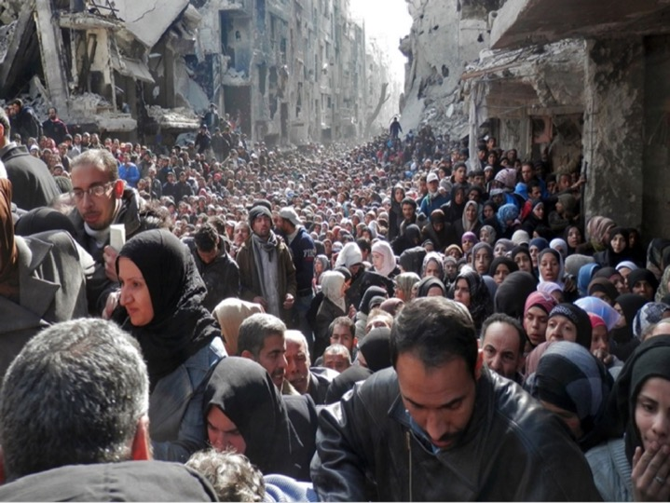

Slide 4
What is a “Refugee”
"owing to a well-founded fear of being persecuted for reasons of race, religion, nationality, membership of a particular social group or political opinion, is outside the country of his nationality, and is unable to, or owing to such fear, is unwilling to avail himself of the protection of that country."
(www.unhcr.org)

Slide 5
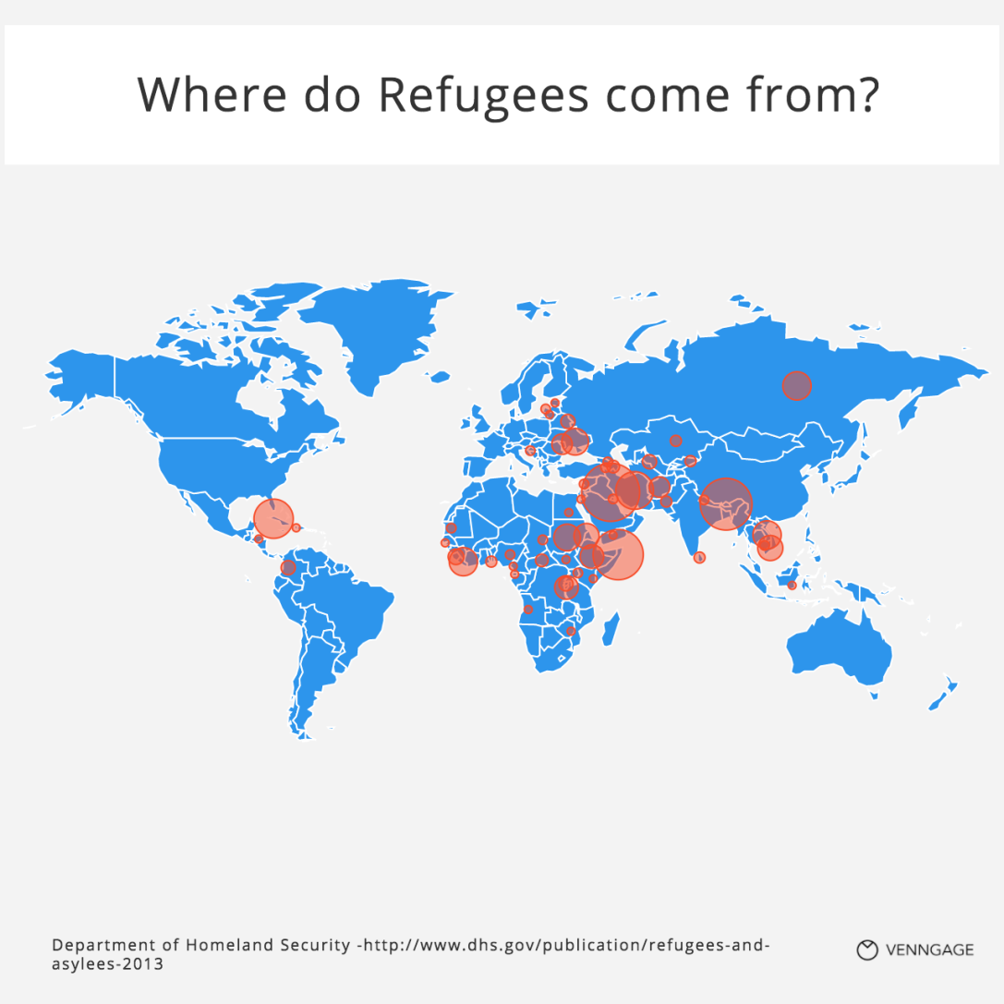

Slide 6
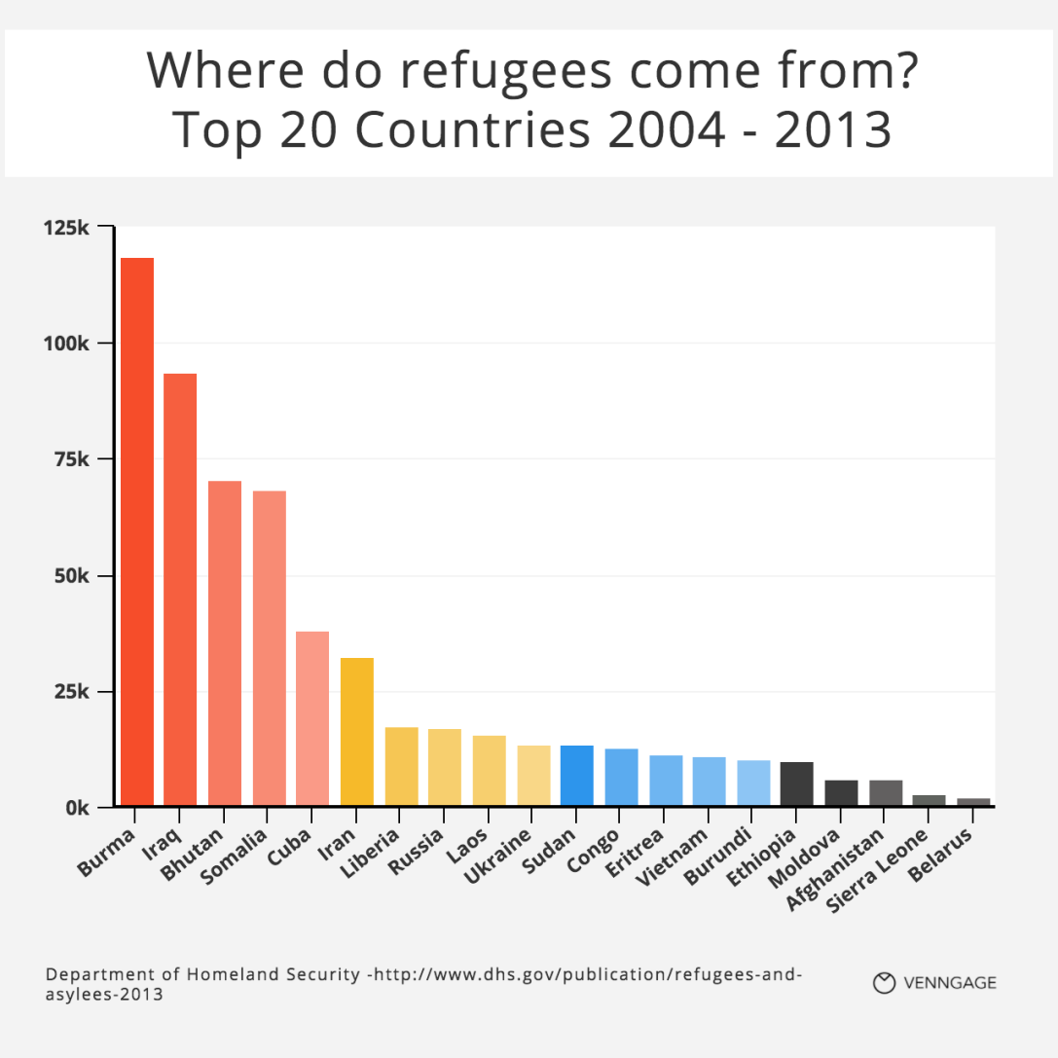

Slide 7
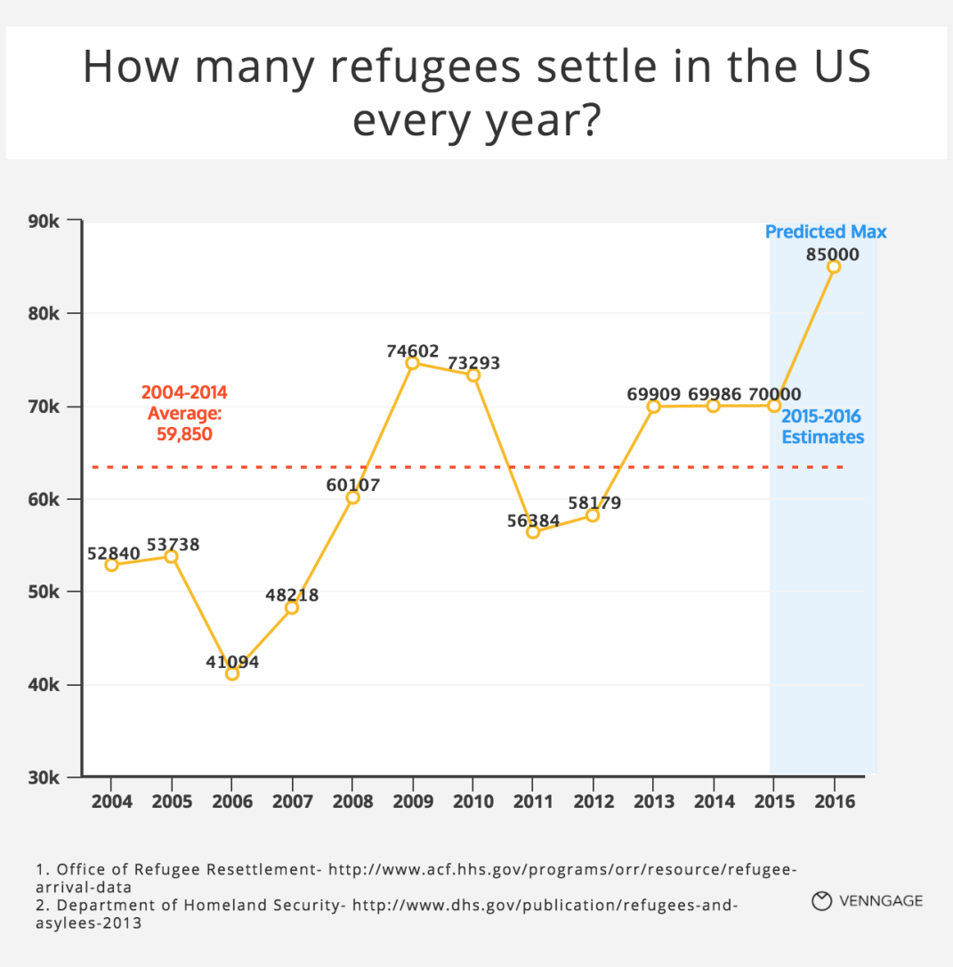

Slide 8
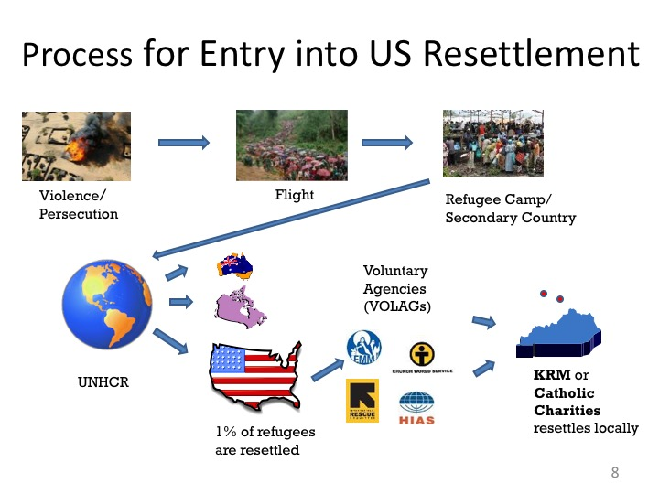

Slide 9
Refugee Resettlement in the US
Resettlement process managed differently among the US states
Some have the program managed through the state, usually the state health departments
13 states have refugee resettlement funds administered privately (Wilson-Fish States)
Kentucky is Wilson-Fish and resettlement managed by Catholic Charities (Kentucky Office for Refugees)

Slide 10
Health Assessment Prior to Resettlement
Cultural orientation
Overseas medical examination
Some receive immunization
Some receive presumptive treatment for parasites
Some are found to have health conditions that prevent them from entering resettlement
  Class A conditions
  Class B conditions

Slide 11
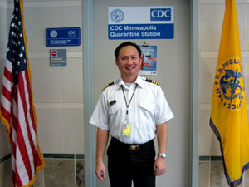
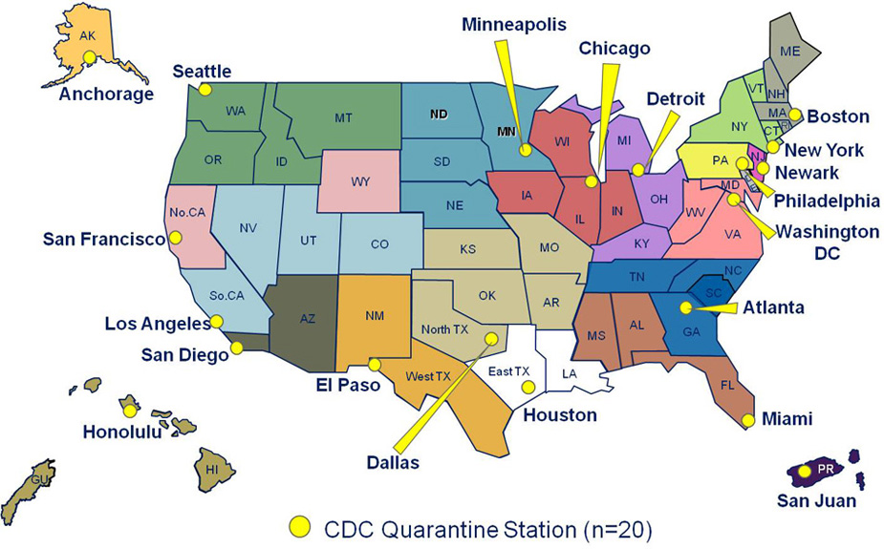
From Overseas to Quarantine
All refugees go into quarantine at the first “port of entry” into the U.S.; each airport has a CDC quarantine officer who clears them for the next flight.
20 U.S. ports of entry have quarantine stations, including New York City, San Francisco, Miami, and Chicago.
Final Destination State

Slide 12
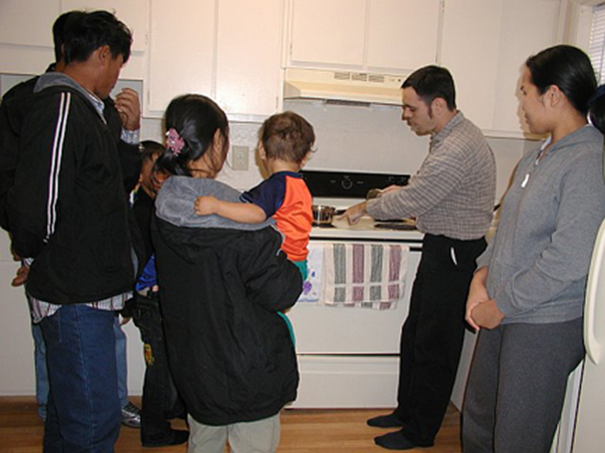
Local Resettlement Agencies
Designated by the U.S. Government to provide direct resettlement services– Self-sufficiency is expected
    Starts before arrival with apartment set-up, and airport pick-up
    Provide furnished housing
    Mental health services
    ESL classes
    Employment assistance
    Provide case management
    Cash assistance
    Cultural orientation
    Health Assessment

Slide 13
Resettlement Services
Refugees are eligible for all social programs for which U.S. citizens are eligible.
Refugees are eligible to work as soon as they arrive in the U.S. Self-sufficiency is the expectation.
Refugees are placed on track for citizenship.
Refugees receive intense services for 8 months but can access some level of service beyond that time.
Refugees must pay back the cost of their plane ticket to Homeland Security.

Slide 14
Health Assessment Upon Arrival
Each refugee eligible to receive a comprehensive health assessment upon arrival. This assessment is based on CDC guidelines and includes the following:
  Review of overseas medical records
  Testing for communicable diseases and parasites
  Evaluation of immunization records and referral for vaccines
  Screening for mental health issues (RHS-15)
  Referral to subspecialties as needed
Assessment serves as a bridge to primary care

Slide 15
Critical Junction
Diverse refugee population from diverse countries experiencing diverse health issues
Refugees assigned an “Alien” number. Not yet a citizen and no other identifying number such as social security
A numbers not included as an identifying number, therefore long term tracking is extremely difficult
Eligible for Medicaid or private health insurance through employer
No national health database and no standardized way to follow the health issues present or those that develop (e.g., reactivation of MTB)

Slide 16
State of Refugee Health in Kentucky
Each year approximately 3000 refugees resettled in KY
Health assessments performed in Louisville (85%), Lexington, Owensboro, Bowling Green
Approximately 75% of the health assessment data are submitted for inclusion in state report
State of Refugee Health in Kentucky reports available for review at http://globalhealth.center/rhp/state.php

Slide 17
Arriving Refugee Informatics SurVeillance and Epidemiology (ARIVE)
Overseas Records
ARIVE Database
Domestic Health Screen
Vaccination
Refugee
Electronic
Health Record
Refugee
Payers
Healthcare Providers
ARIVE database maintained in REDCap™

Slide 18
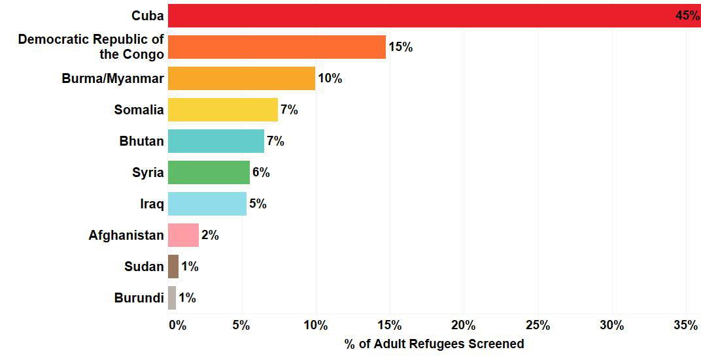
Refugees Screened Jan-Dec 2016
A total of 2047 adult and pediatric refugees were screened in Kentucky

Slide 19
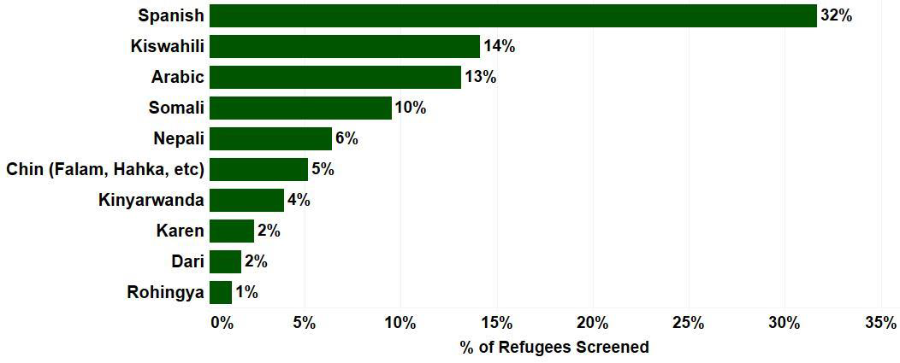
State of Refugee Health in Kentucky
Demographics: Primary Language

Slide 20
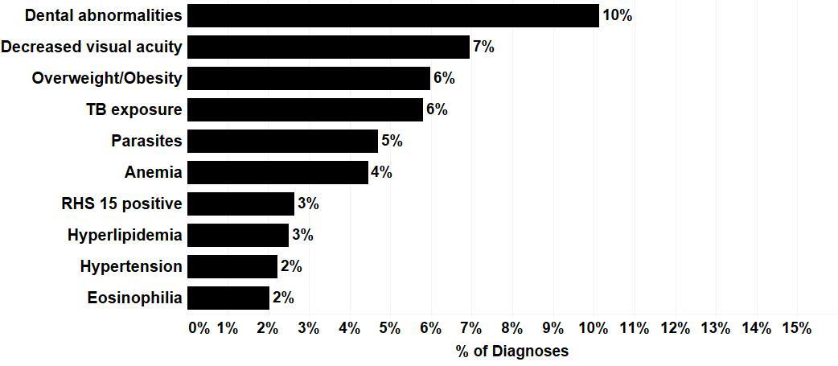
State of Refugee Health in Kentucky
Top Health Conditions: All Refugees

Slide 21
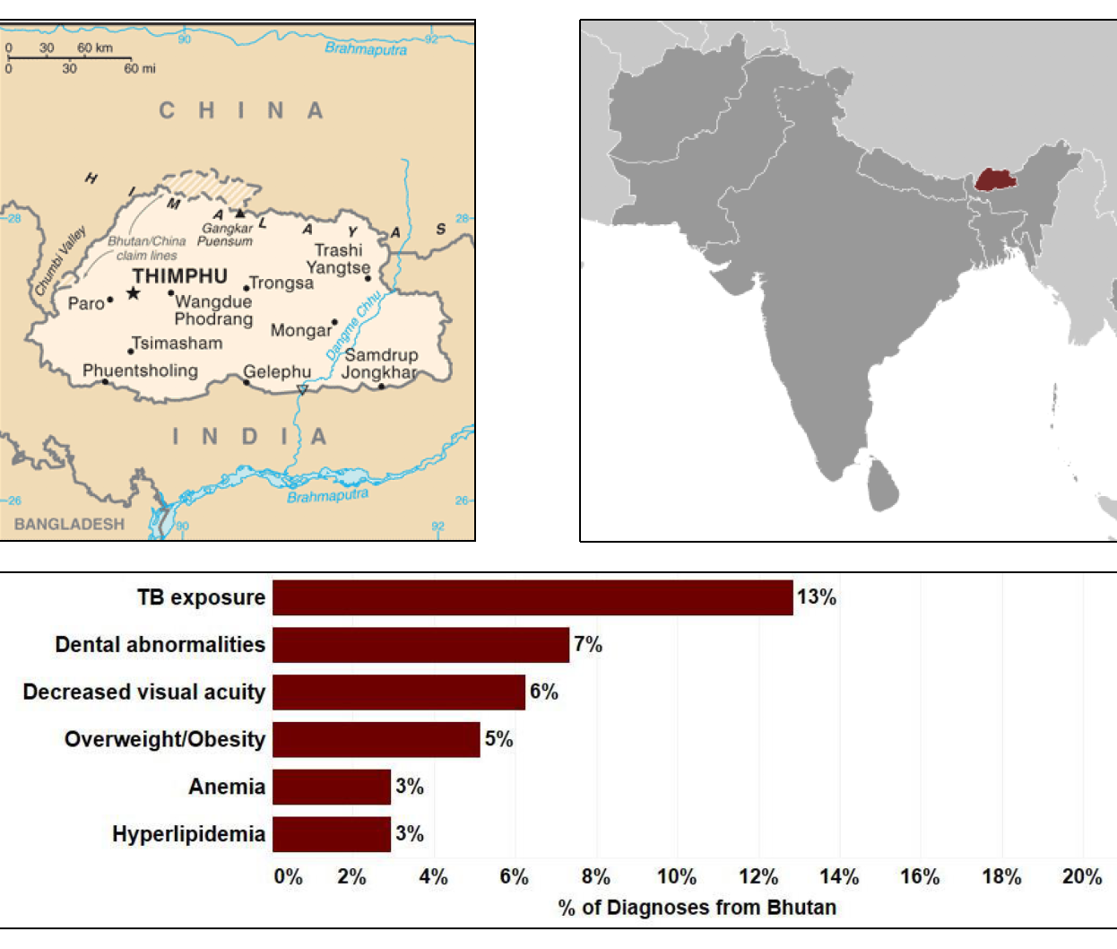
State of Refugee Health in Kentucky
Top Health Conditions: Bhutanese

Slide 22
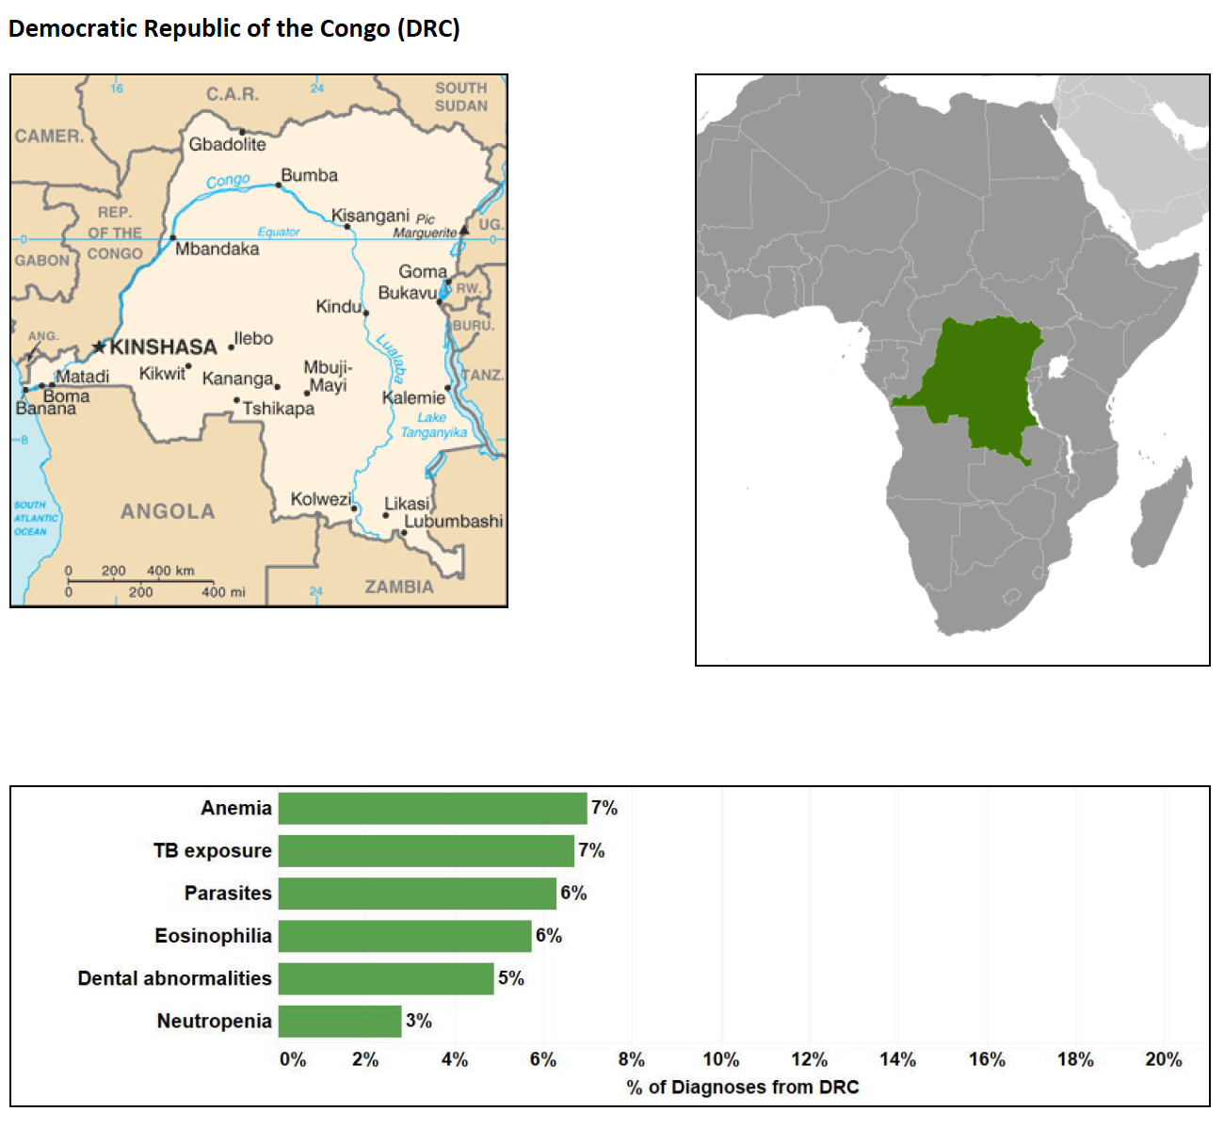
State of Refugee Health in Kentucky
Top Health Conditions: Congolese

Slide 23
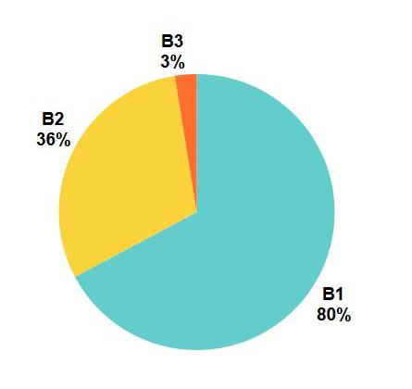
State of Refugee Health in Kentucky
Class B TB Conditions
17% of resettled refugees in 2016 had identified Class B TB condition
Class B Conditions: health conditions that may interfere with the wellbeing of the refugee and necessitate follow-up care soon after arrival in the US
B1: Abnormal chest x-ray with latent TB infection treated or untreated
B2: Latent tuberculosis infection
B3: Recent contact with an infectious case of TB

Slide 24
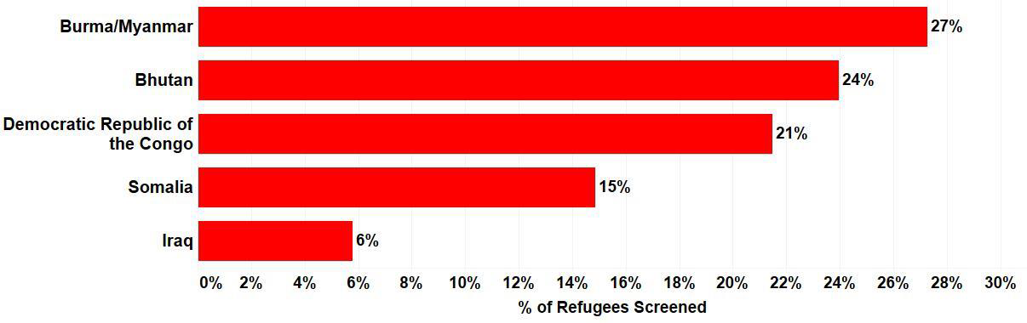
State of Refugee Health in Kentucky
Class B TB Conditions

Slide 25
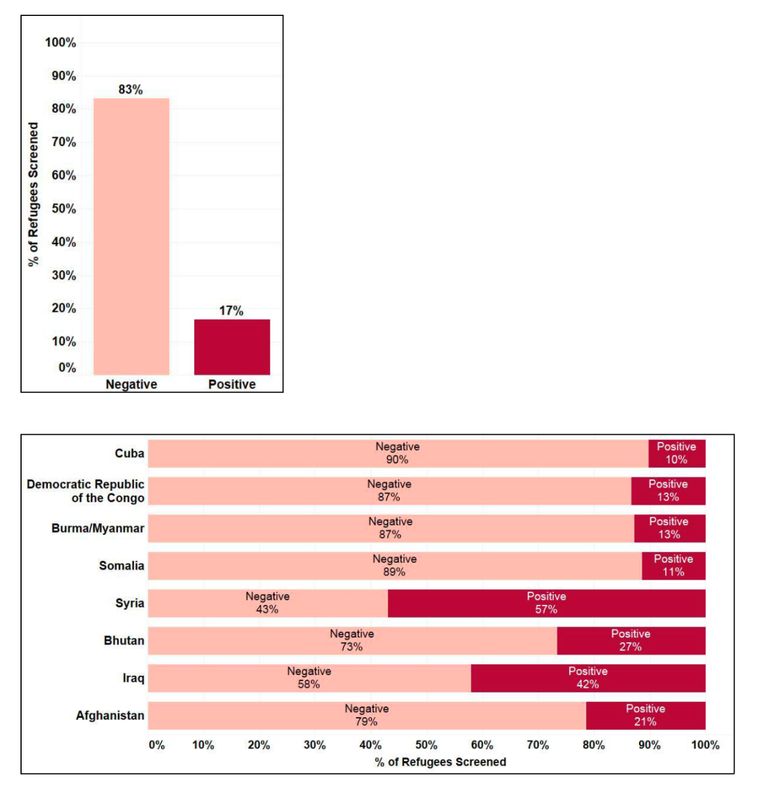
State of Refugee Health Kentucky Mental Health: RHS-15 Screen Positive
Mental health concerns are present across the entire refugee population
This is a complicating factor for all care and impacts all settings in which care is delivered

Slide 26
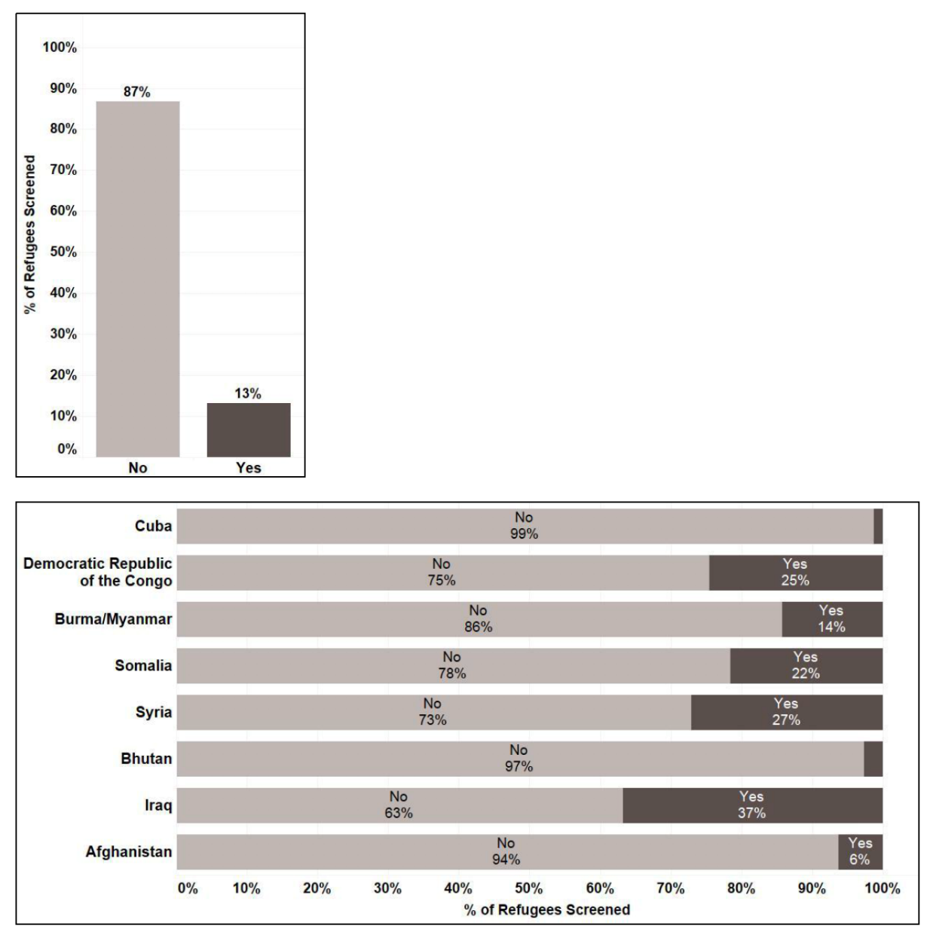
State of Refugee Health Kentucky
Mental Health: Torture
Consider the impact of witnessing or experiencing torture.
Influences abilities to ride public transportation, accept medical care, interact and communicate with providers, and general trust

Slide 27
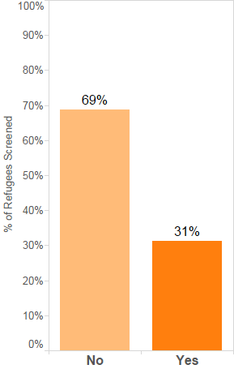
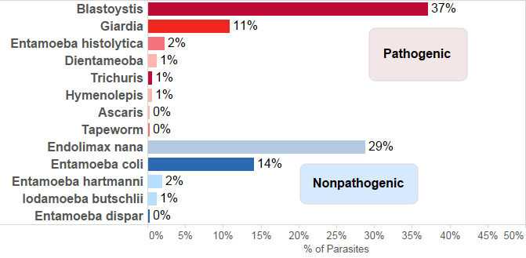
State of Refugee Health Kentucky Infectious Diseases: Parasites

Slide 28
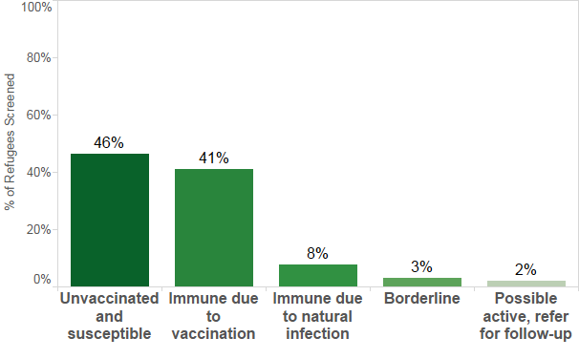
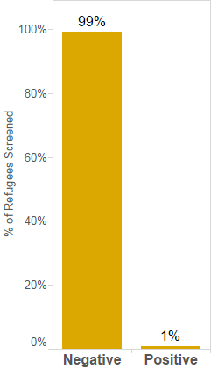
Hepatitis B
State of Refugee Health Kentucky:
Infectious Diseases: Hepatitis
Hepatitis C

Slide 29
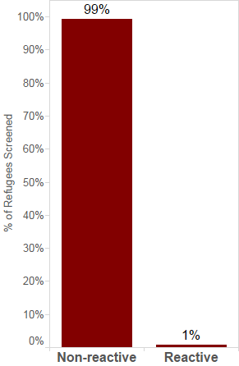
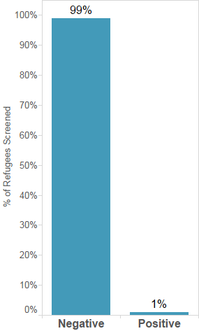
State of Refugee Health Kentucky
Infectious Diseases: HIV and Syphilis
HIV
Syphilis

Slide 30

Meet Maria
Refugee
Herbal remedies
Insulin dependent Diabetic
Not FDA approved in the US
Hypertension
She does not know what
she is taking
Hyperlipidemia
Palpable breast mass
Did not bring her medication
from overseas
History of breast cancer
On multiple medications
Chronic back pain

Slide 31
Meet Maria
Can’t sleep at night
Tearful
Anxious
Overwhelmed
Depression
On some antidepressant
she does not know name
Separated from family
in home country

Slide 32
Meet Maria
Does not know how to use
public transportation
No job
Doesn’t understand US
healthcare system
No personal
transportation
No childcare
Insurance pending
Doesn’t know services
available to help her
Does not speak English
Special needs child

Slide 33

Hyperlipidemia
Insulin dependent Diabetic
Chronic back pain
Does not speak English
Insurance pending
Refugee
Depression
Special needs child
Tearful
Doesn’t understand US
healthcare system
The ones she know are not FDA
approved in the US
Hypertension
No childcare
Herbal remedies
On multiple medications
History of breast cancer
Anxious
No job
Names of which she does not know
No personal transportation
Doesn’t know services available
to help her
Does not know how to use
public transportation
On some antidepressant she
does not know names
Overwhelmed
Can’t sleep at night
Run out of all medicine
Palpable breast mass
Separated from family in home country
I can’t access recent visit to local ED because her name or DOB
is entered differently in the system

Slide 34
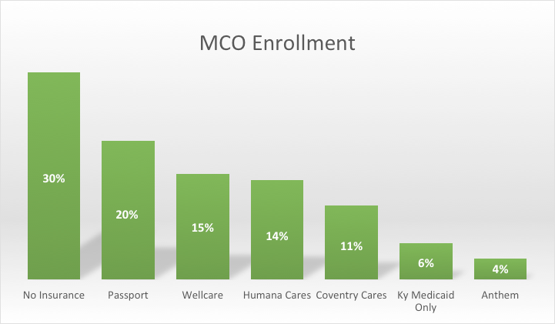
Insurance status of Refugees seen from January of 2015-September 2015 at UL-GHC

Slide 35
Refugees: As Patients
Chronic health conditions that differ among population groups
Obesity, malnutrition, metabolic syndrome
Anemia (etiologies parasitic and non-parasitic)
Lack of understanding of US healthcare system
Difficulties with finding primary care providers
Cultural drivers of care

Slide 36
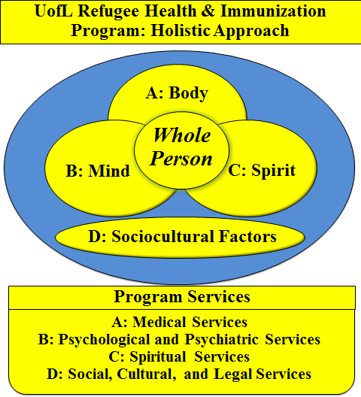

Slide 37
Refugees: As Community Members
Expected to get a job, learn language, acculturate, become self-sufficient
Often in jobs that are totally unaligned with existing skill sets
Inclination is to stay in groups which slows acculturation and hinders economic self-sufficiency
Cultural isolation may also maintain unhealthy practices (e.g., lead contaminated products)
Lack of knowledge regarding the public health impact of illness

Slide 38
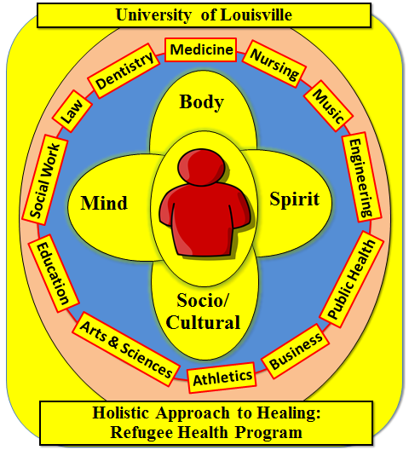

Slide 39
Refugees: As Employees
Have had access to health screening providing baseline health information
No database to access to employers/insurers may pay again (or not)
May have underlying health issues that are important for employment and safety of self and other workers
Without links to those with knowledge about conditions in countries of origin, public health at risk
Cultural contexts as they relate to job responsibilities

Slide 40
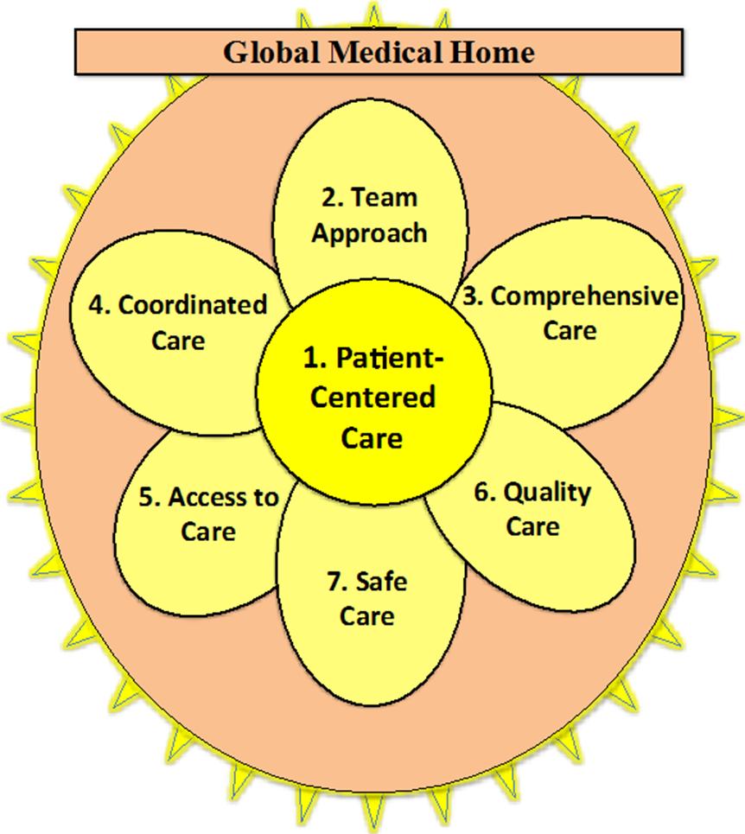

Slide 41
Refugees as Security Risks
Vetting occurs overseas
Majority of those applying are not accepted
Just because resettlement occurs in US does not mean refugees think like or act like ‘us’ (who is ‘us’, anyway?!?)
Integration into society is important for successful resettlement

Slide 42
Take Home Messages
Refugees are legal members of our communities
Health assessments before entry into US and eligibility for same once they arrive
Without organized process, refugees may be difficult to follow in order to monitor and impact health and health outcomes
Without followup, addressing health issues, health outcomes, and community risks may be difficult

Slide 43
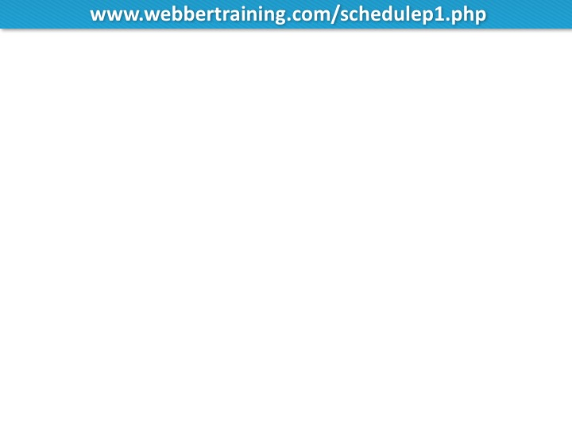
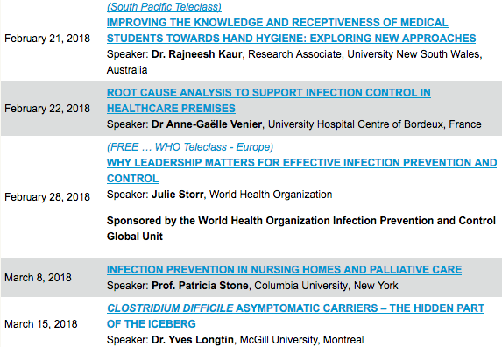

Slide 44


