Slide 1


Exploring the Relationship between Patient Safety Climate and Adherence to Standard Precautions
Amanda Hessels, PhD, MPH, RN, CIC, CPHQ, FAPIC
Associate Research Scientist, Columbia University, School of Nursing
Nurse Scientist, Hackensack-Meridian Health
Hosted by Prof. Elaine Larson
Columbia University School of Nursing
www.webbertraining.com
September 14, 2017

Slide 2
Objectives
Describe the design and testing of standard precaution and safety climate tools
Summarize key pilot study findings
Describe expanded study plans
Discuss potential use of tools

Slide 3
The Issues
Health Care Workers
Patients HAIs
1/25 RNs suffers an occupational blood-borne pathogen exposure annually
384,000 HCW/annually
56-88% are preventable
Direct and indirect costs ~$747 per case ($268 million USD)
1/25 patients has an HAI at any time
2 million patients annually
99,000 estimated deaths
10-70% are preventable
Attributable costs ~ $6.7 billion in U.S. hospitals

Slide 4
What are Standard Precautions (SP)?
“Primary strategy for the prevention of healthcare-associated transmission of infectious agents among patients and healthcare personnel,” (Seigel et al., 2007).

Slide 5
Scope of SP
SP apply to:
  all patients
  all healthcare settings
  all the time
Base of the HAI prevention pyramid

Slide 6
SP Components & Actions
hand hygiene
personal protective equipment (PPE)
safe use and disposal of sharps
decontamination of environment and equipment
patient placement
linen and waste management

Slide 7

Basic Behavior ?
“Standard” Simple
Complex behavior in a complex system

Slide 8
The Problem: Low SP Adherence
Current and important
Likely to continue
Affects large population: all patients and providers
Possible/significant consequences: HAIs and HCW exposure/injury
Incompletely described and explained
Antecedents include patient safety climate (PSC)

Slide 9
What is “Patient Safety Climate”?
Collective reflection of the perception, attitudes, and shared experiences of the safety culture
(Gershon, Stone, Bakken & Larson, 2004)
Attributes include:
teamwork
leadership support
communication
non- punitive response to errors
perception of organizational commitment
work design
staffing and workload
resources
emphasis on quality

Slide 10
Research Gaps
Neither PSC features nor reported SP adherence have been tested in relation to observed SP adherence
No psychometrically tested SP observation measures

Slide 11
Study Aims
Aim 1:
To develop and test two well-constructed tools that quantify observed and reported SP adherence.

Slide 12
Study Aims
Aim 2:
To pilot test the relationship among these measures of SP adherence and PSC factors in HCW in hospital settings.

Slide 13
Aim 1: Tool Development Challenges
What can you adapt and what must you create?
How to capture complex behaviors in a simple instrument?
Which SP indications/actions to observe?
What features of PSC and reported SP adherence to measure?

Slide 14
Observational Tools
Strengths
  direct observation “the gold standard”
Limitations
  train observers
  awareness of being observed can influence HCW behavior
  time and expense

Slide 15
Survey tools
Strengths
relatively inexpensive in direct cost and personnel resources
information on adherence
focus HCW attention to their own practices
Limitations
poor reliability and validity of self- report
HCW’s may overestimate adherence
(Haas & Larson, 2007, Waltz et al., 2005; WHO, 2009)

Slide 16
Standard Precautions Observation Tool (SPOT)
Designed to measure observed adherence to components of SP in hospital settings
Established construct validity, items drawn from CDC
Borrows from design and methods of the World Health Organization (WHO) hand hygiene observation tool

Slide 17
The SPOT
3 sections
  header: institutional and observer level information, session data, observer initials, date and time
  columns: provider role, encounter duration, indication and observed action
  footer: total number of indications and actions to calculate a percentage of adherence score

Slide 18

Standard Precaution Observation Tool (SPOT)
Observer Initials: _____________ Hospital: ________________Unit: __________________ Form Number: __ of ____
Date (MM/DD/YY): ____/____/____ Start Time (hh:mm): ___:___ ◻am ◻pm End Time (hh:mm): ___:___ ◻am◻pm
Encounters | RN |  |  | MD |  |  | Other HCW
1 | Minutes: ◻ <5 ◻ 5-10 ◻>10 |  |  | Minutes: ◻ <5 ◻ 5-10 ◻>10 |  |  | Type:___________ Minutes: ◻ <5 ◻ 5-10 ◻>10
Opportunities | Ind. | Done | Missed | Ind. | Done | Missed | Ind. | Done | Missed
1 HH Bef-patient 2 HH Aft- patient 3 HH Aft- surround. 4 PPE Gloves On 5 PPE Gloves Off 6 PPE Gown On 7 PPE Gown Off 8 PPE Mask On 9 Sharp 10 Linen | 1◻ 2◻ 3◻ 4◻ 5◻ 6◻ 7◻ 8◻ 9◻ 10◻ | 1◻ HR ◻HW 2◻ HR ◻HW 3◻ HR ◻HW 4◻ 5◻ 6◻ 7◻ 8◻ 9◻ 10◻ | 1◻ GLV◻ 2◻ GLV◻ 3◻ GLV◻ 4◻ 5◻ 6◻ 7◻ 8◻ 9◻ 10◻ | 1◻ 2◻ 3◻ 4◻ 5◻ 6◻ 7◻ 8◻ 9◻ 10◻ | 1◻ HR ◻HW 2◻ HR ◻HW 3◻ HR ◻HW 4◻ 5◻ 6◻ 7◻ 8◻ 9◻ 10◻ | 1◻ GLV◻ 2◻ GLV◻ 3◻ GLV◻ 4◻ 5◻ 6◻ 7◻ 8◻ 9◻ 10◻ | 1◻ 2◻ 3◻ 4◻ 5◻ 6◻ 7◻ 8◻ 9◻ 10◻ | 1◻ HR ◻HW 2◻ HR ◻HW 3◻ HR ◻HW 4◻ 5◻ 6◻ 7◻ 8◻ 9◻ 10◻ | 1◻ GLV◻ 2◻ GLV◻ 3◻ GLV◻ 4◻ 5◻ 6◻ 7◻ 8◻ 9◻ 10◻
2 | Minutes: ◻ <5 ◻ 5-10 ◻>10 |  |  | Minutes: ◻ <5 ◻ 5-10 ◻>10 |  |  | Type:___________ Minutes: ◻ <5 ◻ 5-10 ◻>10
Opportunities | Ind. | Done | Missed | Ind. | Done | Missed | Ind. | Done | Missed
1 HH Bef-patient 2 HH Aft- patient 3 HH Aft- surround. 4 PPE Gloves On 5 PPE Gloves Off 6 PPE Gown On 7 PPE Gown Off 8 PPE Mask On 9 Sharp 10 Linen | 1◻ 2◻ 3◻ 4◻ 5◻ 6◻ 7◻ 8◻ 9◻ 10◻ | 1◻ HR ◻HW 2◻ HR ◻HW 3◻ HR ◻HW 4◻ 5◻ 6◻ 7◻ 8◻ 9◻ 10◻ | 1◻ GLV◻ 2◻ GLV◻ 3◻ GLV◻ 4◻ 5◻ 6◻ 7◻ 8◻ 9◻ 10◻ | 1◻ 2◻ 3◻ 4◻ 5◻ 6◻ 7◻ 8◻ 9◻ 10◻ | 1◻ HR ◻HW 2◻ HR ◻HW 3◻ HR ◻HW 4◻ 5◻ 6◻ 7◻ 8◻ 9◻ 10◻ | 1◻ GLV◻ 2◻ GLV◻ 3◻ GLV◻ 4◻ 5◻ 6◻ 7◻ 8◻ 9◻ 10◻ | 1◻ 2◻ 3◻ 4◻ 5◻ 6◻ 7◻ 8◻ 9◻ 10◻ | 1◻ HR ◻HW 2◻ HR ◻HW 3◻ HR ◻HW 4◻ 5◻ 6◻ 7◻ 8◻ 9◻ 10◻ | 1◻ GLV◻ 2◻ GLV◻ 3◻ GLV◻ 4◻ 5◻ 6◻ 7◻ 8◻ 9◻ 10◻
3 | Minutes: ◻ <5 ◻ 5-10 ◻>10 |  |  | Minutes: ◻ <5 ◻ 5-10 ◻>10 |  |  | Type:___________ Minutes: ◻ <5 ◻ 5-10 ◻>10
Opportunities | Ind. | Done | Missed | Ind. | Done | Missed | Ind. | Done | Missed
1 HH Bef-patient 2 HH Aft- patient 3 HH Aft- surround. 4 PPE Gloves On 5 PPE Gloves Off 6 PPE Gown On 7 PPE Gown Off 8 PPE Mask On 9 Sharp 10 Linen | 1◻ 2◻ 3◻ 4◻ 5◻ 6◻ 7◻ 8◻ 9◻ 10◻ | 1◻ HR ◻HW 2◻ HR ◻HW 3◻ HR ◻HW 4◻ 5◻ 6◻ 7◻ 8◻ 9◻ 10◻ | 1◻ GLV◻ 2◻ GLV◻ 3◻ GLV◻ 4◻ 5◻ 6◻ 7◻ 8◻ 9◻ 10◻ | 1◻ 2◻ 3◻ 4◻ 5◻ 6◻ 7◻ 8◻ 9◻ 10◻ | 1◻ HR ◻HW 2◻ HR ◻HW 3◻ HR ◻HW 4◻ 5◻ 6◻ 7◻ 8◻ 9◻ 10◻ | 1◻ GLV◻ 2◻ GLV◻ 3◻ GLV◻ 4◻ 5◻ 6◻ 7◻ 8◻ 9◻ 10◻ | 1◻ 2◻ 3◻ 4◻ 5◻ 6◻ 7◻ 8◻ 9◻ 10◻ | 1◻ HR ◻HW 2◻ HR ◻HW 3◻ HR ◻HW 4◻ 5◻ 6◻ 7◻ 8◻ 9◻ 10◻ | 1◻ GLV◻ 2◻ GLV◻ 3◻ GLV◻ 4◻ 5◻ 6◻ 7◻ 8◻ 9◻ 10◻
Total (number indicated, done and missed per column)

Slide 19
SPOT Tool Testing
Face validity, feasibility, usability and inter-rater reliability
Incorporation of feedback into tool design
  simplify instructions
  add/eliminate items
  adjust number of observations

Slide 20
AHRQ Hospital Survey on Patient Safety Culture
Dimensions:
  supervisor expectations/actions
  organizational learning
  teamwork
  communication openness
  error feedback/communication
  non- punitive responses
  staffing
  hospital management support
  handoffs and transitions
  overall perceptions of safety
  frequency of event reporting
Measures HCW perceptions of safety culture
Established reliability and validity
12 dimension, 44 items, 5- point Likert scale
  (Sorra & Nieva, 2004)

Slide 21
SP Surveys
Identified two psychometrically sound tools (Gershon et al., 1995, 2000)
Respondents' rate perception of PSC barriers and facilitators of SP adherence and reported SP adherence
Selected 22 items, 5- point Likert scale

Slide 22
AHRQ + SP Surveys =
“Survey on Patient Safety & Standard Precautions”
66 item, 5- point Likert survey
HCW perceptions of PSC and reported SP adherence and influencing factors

Slide 23
Survey Tool Testing
Test- retest survey (21 nurses)
Moderate test stability:
  item level weighted Cohen’s Kappa statistic (ƙ= 0.442)
  dimension level intra- class correlation coefficient
  (ICC= 0.49, 95%CI: 0.39- 0.57)
Internal consistency reliability:
  dimension level Cronbach’s alpha (α= .52- .89)

Slide 24
Aim 2: Pilot Testing
Cross- sectional
11 medical surgical units from 5 hospitals in 2 states
  licensed bed size ranging between 211- 692
  includes community, acute- care, trauma, teaching and non- teaching hospitals
Site liaisons: staff nurses, nurse educators, advanced practice nurse and epidemiologists
March- September 2015

Slide 25
Pilot Observation Sample
Aim: 100- 200 observations/unit
Included
  Patient: English- speaking adults who provided permission for the observer to be in the patient room
  HCW: direct patient/immediate surroundings contact (nurses, nursing assistant/aide, medical doctor, physical therapist, technician, dietician, social worker)
Excluded
  Patient: isolation precautions or in acute crisis
  Students or volunteers

Slide 26
Pilot Survey Sample
Aim 50% FTE RNs/unit
Included
  licensed registered nurse
  currently having direct patient contact at least 16 hours per week
  work on unit for a minimum of six months
Excluded
  Per diem, float, <6 months experience on unit

Slide 27
Results
Observed:
540 HCW- patient encounters
1,713 SP indications
  RNs: 851
  MDs: 176
  Other: 447
Surveyed: 140 Nurses
Years in current profession
0 to 5 years | 58 (42%)
6 to 10 years | 31 (23%)
11 or more years | 48 (35%)
How long have you worked in this hospital
0 to 5 years | 63 (46%)
6 to 10 years | 36 (26%)
11 or more years | 39 (28%)
How long have you worked in this unit
0 to 5 years | 76 (56%)
6 to 10 years | 28 (21%)
11 or more years | 32 (24%)
Hours worked per week
16-39 hours | 81 (59%)
40 or more hours | 56 (41%)
27

Slide 28
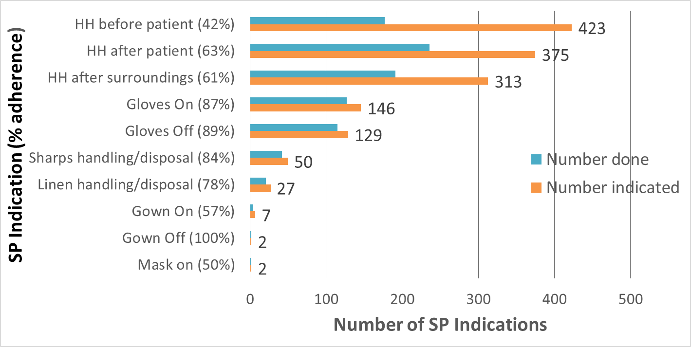
Observed SP adherence (n = 1,474)

Slide 29
Positive safety responses (rated 4 or 5) by dimension across 9 units
Dimension | Percent rating dimension positively
Standard Precaution Practices | 0.94
Teamwork Within Units | 0.82
Organizational Learning - Continuous Improvement | 0.81
Supervisor/Manager Expectations & Actions Promoting Patient Safety | 0.72
Standard Precaution Environment | 0.70
Feedback & Communication About Error | 0.66
Frequency of Events Reported | 0.65
Communication Openness | 0.62
Management Support for Patient Safety | 0.55
Teamwork Across Units | 0.53
Overall Perceptions of Patient Safety | 0.44
Handoffs & Transitions | 0.41
Nonpunitive Response to Errors | 0.35
Staffing | 0.30

Slide 30
Results
Majority (132, 94%) report "always" or "often" adhering to SP
Observed composite SP adherence was 62% (unit range 31- 80%)
Little difference by provider type
Generally positive scores on unit safety climate, though only 1 in 3 rated staffing positively

Slide 31
SP Adherence and Patient Safety Climate
Unexpected finding:
  Composite SP adherence score and
  staffing (r² = -.85, p =.03)
  teamwork within units (r² = -.60, p =.09)
  were inversely related.
Unmeasured factor at play???

Slide 32
Significance
Step towards understanding SP adherence
Development, adaptation and testing of tools that measure:
  observed SP adherence
  reported PSC, SP adherence and related factors
Objective, actionable knowledge for HCW, administrators and policy makers

Slide 33
Limitations
Units with lower rates of observed adherence also had fewer observations
Hawthorne effect; internal or external observers
Oversampling weekdays

Slide 34
Conclusions
Observed SP adherence was suboptimal.
Sizeable discrepancy between reported and observed adherence exists.
The relationship between safety climate, particularly staffing, and adherence to SP warrants further testing.

Slide 35
Next Steps
Evaluate use of vignettes and observational tool as an educational measure of SP knowledge
Refine tools for use by IPs
Develop training modules for observational tool
Examine the relationship between knowledge and adherence
  Test relationship/efficacy among SP, HAI and HCW outcomes

Slide 36
Aims
Evaluate use of vignettes and observational tool as an educational measure of SP knowledge
Examine the relationship between knowledge and adherence

Slide 37
Methods: Vignette development and selection
Twenty vignettes were developed and pre-tested by seven staff nurses and clinical nurse educators for:
content
usability
feasibility
inter-rater reliability

Slide 38
Methods: Vignette development and selection
Nine vignettes were selected using criteria of:
substantial to almost perfect agreement within and between sets of raters
statistically significant Cohen’s kappa statistics (p <.05)
readability, appropriateness for educational testing
minimal duration to complete

Slide 39
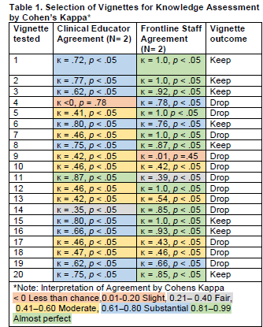

Slide 40
Methods: Knowledge and Recognition Testing
2016 convenience sample of nurses who worked on units for at least one year
  read the reduced set of vignettes
  used the SPOT
  graded against the answer key
Relationships among knowledge and recognition of SP indications and actions and observed adherence were assessed by Fisher’s exact test.

Slide 41
Results
37 nurses completed the assessment
27 (73%) scored 80% or greater identifying if an SP was indicated
25 (67%) scored 80% or greater if an action was taken
Respondents reported the vignettes were “life-like,” “realistic”, the tool “takes a minute to get used to” but was “easy to use.”
SPOT+ Vignettes: internal consistency (α= 0.87), test-retest reliability, construct and content validity demonstrated
No correlation between knowledge and observed adherence was evident (Fisher's exact p= 0.16).

Slide 42
Conclusions
Substantial knowledge deficits exist in this sample
Knowledge and recognition can be reliably measured using these vignettes and tool

Slide 43
Current Work
Conduct a multi-site, cross-sectional study in a sample of approximately 1600 hospital based nurses from 100 units in 50 U.S. hospitals
  surveys on patient safety climate and standard precaution adherence
  observational standard precaution adherence data
  unit level data on HCW blood-borne pathogen exposures and HAIs

Slide 44
Potential Use of Tools
Surveillance
Benchmarking internally and externally
Education and Training

Slide 45
How can these be used in your practice?
Consider use of survey to identify areas of opportunity to enhance safety climate
Consider using the SPOT and vignettes to:
  assess OHP and employee knowledge
  identify clinical workflow and potential exposure risks
  target interventions based on employees’ ability to identify when standard precautions behaviors are indicated and actions taken

Slide 46
Acknowledgements & Disclosures
All research team members and study participants for their valuable contributions!
Mentors: Dr. Elaine Larson and Dr. Robyn Gershon
Funding/Disclosures:
  This project was funded by the APIC Heroes of Infection Prevention Research Award which is supported by a grant from BD
  Currently supported by DHHS/CDC/ NIOSH K01 Career Development Award 1K01OH011186-01

Slide 47

Thank you for your time and interest!
Questions?
Amanda J. Hessels, PhD, MPH, RN, CIC, CPHQ, FAPIC
Associate Research Scientist, Columbia University
Nurse Scientist, Hackensack-Meridian Health
ah3269@cumc.columbia.edu
Amanda.hessels@hackensackmeridian.org

Slide 48
References/Resources
Chassin MR, Loeb JM. The ongoing quality improvement journey: next stop, high reliability. Health affairs (Project Hope). Apr 2011;30(4):559-568.
Efstathiou G, Papastavrou E, Raftopoulos V, Merkouris A. Compliance of Cypriot nurses with standard precautions to avoid exposure to pathogens. Nursing & health sciences. Mar 2011;13(1):53-59
Gershon RR, Vlahov D, Felknor SA, et al. Compliance with universal precautions among health care workers at three regional hospitals. American journal of infection control. Aug 1995;23(4):225-236.
Gershon RR, Stone PW, Bakken S, Larson E. Measurement of organizational culture and climate in healthcare. J Nur Admin 2004;34:33e40.
Haas, J.P, and Larson, E.L (2007). Measurement of Compliance with hand hygiene. Journal of Hospital Infection, 66, 6-14. doi: 10.1016/j.jhin.2006.11.013
Hessels, A.J., Genovese-Schek, V., Agarwal, M., Wurmser, T. &Larson, E.L. (2016). Relationship Between Patient Safety Climate and Adherence to Standard Precautions. American Journal of Infection Control, 44 (10), 1128-1132
Henriksen K, Dayton E, Keyes MA, Carayon P, Hughes R. Understanding Adverse Events: A Human Factors Framework. In: Hughes RG, ed. Patient Safety and Quality: An Evidence-Based Handbook for Nurses. Rockville, MD: Agency for Healthcare Research and Quality; 2008.
Grimmond T, Good L. EXPO-STOP: A national survey and estimate of sharps injuries and mucotaneous blood exposures among healthcare workers in US hospitals. Journal of the Association of Occupational Health Professionals in Healthcare. 2013;33(4):31-36.
RR, Karkashian CD, Grosch JW, et al. Hospital safety climate and its relationship with safe work practices and workplace exposure incidents. American journal of infection control. Jun 2000;28(3):211-221.
Mannocci, A., De Carli, G., Di Bari, V., Saulle, R., Unim, B., Nicolotti, N., . . . La Torre, G. (2016). How Much do Needlestick Injuries Cost? A Systematic Review of the Economic Evaluations of Needlestick and Sharps Injuries Among Healthcare Personnel. Infection Control &#x0026; Hospital Epidemiology, 37(6), 635-646. doi:10.1017/ice.2016.48

Slide 49
References/Resources
Magill SS, Edwards JR, Bamberg W, et al. Multistate point-prevalence survey of health care-associated infections. The New England journal of medicine. Mar 27 2014;370(13):1198-1208.
Powers D, Armellino D, Dolansky M, Fitzpatrick J. Factors influencing nurse compliance with Standard Precautions. American journal of infection control. 2016 Jan 1;44(1):4-7.
Pronovost PJ, Berenholtz SM, Goeschel CA, et al. Creating high reliability in health care organizations. Health services research. Aug 2006;41(4 Pt 2):1599-1617.
Riley W. High reliability and implications for nursing leaders. Journal of nursing management. Mar 2009;17(2):238-246.
Saia, M., et al., Needlestick Injuries: Incidence and Cost in the United States, United Kingdom, Germany, France, Italy, and Spain Biomedicine International, 2010. 1: p. 41-49
S, Sax H, Gastmeier P. The preventable proportion of nosocomial infections: an overview of published reports. The Journal of hospital infection. Aug 2003;54(4):258-266; quiz 321.
Siegel JD, Rhinehart E, Jackson M, Chiarello L, and the Healthcare Infection Control Practices Advisory Committee (2007). Guideline for Isolation Precautions: Preventing Transmission of Infectious Agents in Healthcare Settings. Retrieved: http://www.cdc.gov/ncidod/dhqp/pdf/isolation2007.pdf
MRCG, Souza ACS, Guimaraes JV, Tipple AFV, Prado MA, Zapata MTAG. Standard precautions: knowledge and practice among nursing and medical students in a teaching hospital in Brazil. International Journal of Infection Control. 2010;6:1-6.
The Joint Commission. Improving Patient and Worker Safety: Opportunities for Synergy, Collaboration and Innovation. November 2012; http://www.jointcommission.org/, August 27, 2015
Weick KE, Sutcliffe KM, Obstfeld D. Organizing for High Reliability: Processes of Collective Mindfulness. In: Sutton RI, Staw BM, eds. Research in Organizational Behiavor. Vol Vol. 21. Stamford, CT: JAI Press, Inc.; 1999:81-123.
World Health Organization. (2009). Hand hygiene technical reference manual. Retrieved from http://whqlibdoc.who.int/publications/2009/9789241598606_eng.pdf
Zimlichman E, Henderson D, Tamir O, et al. Health care-associated infections: a meta-analysis of costs and financial impact on the US health care system. JAMA internal medicine. Dec 9-23 2013;173(22):2039-2046.

Slide 50
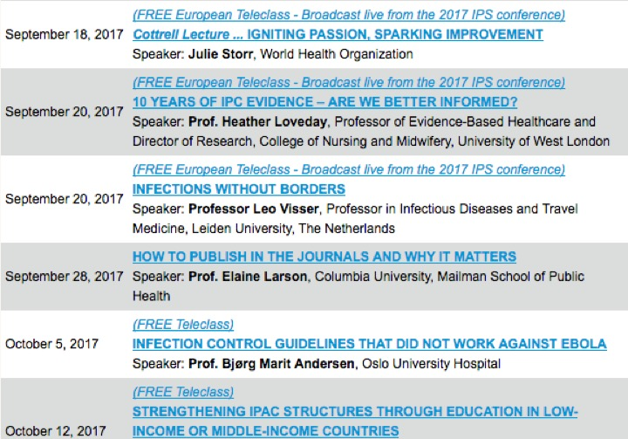

Slide 51


