Slide 1
Rising to the challenge of multidrug-resistant Gram-negative bacteria
Jon Otter, PhD FRCPath
Imperial College Hospitals NHS Trust
Hosted by Paul Webber paul@webbertraining.com
www.webbertraining.com
December 10, 2015

Slide 2
THE END OF ANTIBIOTICS IS NIGH

Slide 3
What’s the problem?
“CPE are nightmare bacteria.”
Dr Tom Frieden, CDC Director
“If we don't take action, then we may all be back in an almost 19th Century environment where infections kill us as a result of routine operations.”
Dame Sally Davies, Chief Medical Officer
“If we fail to act, we are looking at an almost unthinkable scenario where antibiotics no longer work and we are cast back into the dark ages of medicine where treatable infections and injuries will kill once again.”
David Cameron, Prime Minister, UK
“The rise of antibiotic-resistant bacteria, however, represents a serious threat to public health and the economy.”
Barack Obama, President USA

Slide 4
Rising threat from MDR-GNB
% of all HAI caused by GNRs.
% of ICU HAI caused by GNRs.
Non-fermenters | Acinetobacter baumannii Pseudomonas aeruginosa Stenotrophomonas maltophilia
Enterobacteriaceae | Klebsiella pneumoniae Escherichia coli Enterobacter cloacae
CPO
CPE
Hidron et al. Infect Control Hosp Epidemiol 2008;29:966-1011.
Peleg & Hooper. N Engl J Med 2010;362:1804-1813.

Slide 6
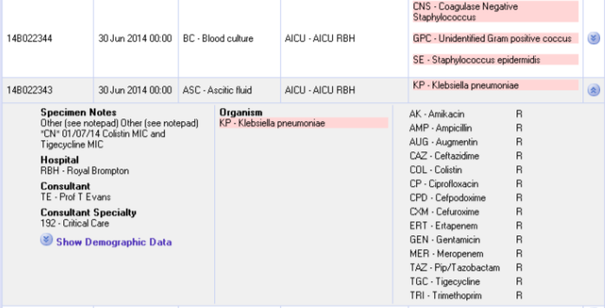
What’s the problem? Resistance
Courtesy of Pat Cattini

Slide 7
What’s the problem? Mortality
 | Enterobacteriaceae |  | Non fermenters
Organism | AmpC / ESBL | CPE | A. baumannii
Attributable mortality | Moderate | Massive (>50%) | Minimal
Shorr et al. Crit Care Med 2009;37:1463-1469.
Patel et al. Iinfect Control Hosp Epidemiol 2008;29:1099-1106.

Slide 8
What’s the problem? Rapid spread
Rapid spread
Clonal expansion
GI carriage
Horizontal gene transfer

Slide 10
Acronym minefield
CPC
CPE
MDR-GNB
CRO
MDR-GNB
ESBL
CPE
CRC
CPE
KPC
CRAB

Slide 11
What are CPE?
Carbapenem-resistant Enterobacteriaceae (CPE) – Enterobacteriaceae that are resistant to carbapenems by any mechanism.
Carbapenemase-producing Enterobacteriaceae (CPE) – Enterobacteriaceae that are resistant to carbapenems by means of an acquired carbapenemase.
CPE
CPE

Slide 12
When CPE is not CPE
Wild-type
Carbapenemase
ESBL / AmpC + porin loss
or true carbapenemase ?
N
0.5 16
Carbapenem MIC
Courtesy of Dr Katie Hopkins, PHE.

Slide 13
Understanding the enemy
Pathogen | CPE¹ | CPAB² | MRSA | VRE | C. difficile
Resistance | +++ | +++ | + | + | +/-
Resistance genes | Multiple | Multiple | Single | Single | n/a
Species | Multiple | Single | Single | Single | Single
HA vs CA | HA & CA | HA (ICU) | HA | HA | HA
At-risk pts | All | ICU | Unwell | Unwell | Old
Virulence | +++ | +/- | ++ | +/- | +
Environment | +/- | +++ | + | ++ | +++
Carbapenemase-producing Enterobacteriaceae.
Carbapenemase-producing Acinetobacter baumannii.

Slide 14
CPE in the USA
NHSN / NNIS data; MMWR 2013;62:165-170.

Slide 15
CPE in the USA 25 community hospitals in Southwestern USA
Thaden et al. Infect Control Hosp Epidemiol 2014;35:978-983.

Slide 16
CPE in LTACs, USA
Lin et al. Clin Infect Dis 2013;57:1246-1252.

Slide 17
Who’s carrying CPE?
Author | Year | Location | Setting | n patients | n carriers | % carriers
Adler¹ | 2015 | Israel | CPE carriage in post-acute hospitals, 2008 | 1147 | 184 | 16.0
– | – | – | CPE carriage in post-acute hospitals, 2013 | 1287 | 127 | 9.9
Mack | 2014 | London | ‘High-risk’ inpatients and admissions. | 2077 | 7 | 0.3
Rai² | 2014 | East Delhi, India | Outpatients | 242 | 24 | 9.9
Zhao³ | 2014 | Fujian, China | Stool samples from hospitalized patients | 303 | 20 | 6.6
Birgand⁴ | 2014 | Paris, France | Patients repatriated or recently hospitalized in a foreign country | 132 | 9 | 6.8
Kim⁵ | 2014 | Seoul, Korea | ICU admissions | 347 | 1 | 0.3
Girlich⁶ | 2014 | Morocco | Hospitalized patients | 77 | 10 | 13.0
Lin⁷ | 2013 | Chicago, USA | Long term acute care hospitals | 391 | 119 | 30.4
– | – | – | Short stay hospital ICU | 910 | 30 | 3.3
Villar⁸ | 2013 | Buenos Aires, Argentina | Non-hospitalized individuals | 164 | 8 | 4.9
Kothari⁹ | 2013 | New Delhi, India. | Healthy neonates | 75 | 1 | 1.3
Day¹⁰ | 2013 | Pakistan | Patients attending a military hospital | 175 | 32 | 18.3
Swaminathan¹¹ | 2013 | New York | All admissions to 7 units, including ICU, of 2 hospitals | 5676 | 306 | 5.4
Nüesch-Inderbinen¹² | 2013 | Zurich, Switzerland | Healthy community residents and outpatients | 605 | 0 | 0.0
Armand-Lefèvre¹³ | 2013 | Paris, France | ICU patients | 50 | 6 | 12.0
Wiener-Well¹⁴ | 2010 | Jerusalem, Israel | Hospitalized patients | 298 | 16 | 5.4
For refs see: http://reflectionsipc.com/2014/12/22/whos-harbouring-cre/

Slide 18
Invasive multidrug-resistant K. pneumoniae
EARS-Net

Slide 19
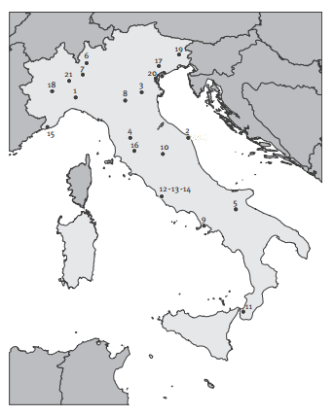
Colistin resistance in Italy
Survey of 191 CPE from 21 labs across Italy.
43%
Colistin resistant K. pneumoniae.
Range = 10-80% for the 21 labs.
Monaco et al. 2014; Euro Surveill 2014;19:pii=20939.

Slide 20
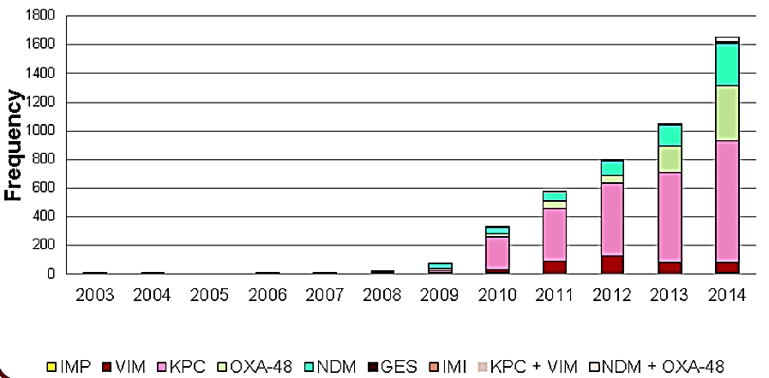
Emergence of CPE in the UK
PHE.

Slide 22
Evidence-free zone

Slide 23
Guidelines = Policy
23

Slide 24
MDR-GNB Toolbox
Hand hygiene
Contact precautions
Active screening
Antibiotic stewardship
Cleaning / disinfection
Cohorting staff / patients
Note flagging
HCW screening
Education
Env. screening
Decol.
Otter et al. Clin Microbiol Infect 2015 in press.

Slide 25
MDR-GNB Toolbox
Hand hygiene
Contact precautions
Active screening
Antibiotic stewardship
Cleaning / disinfection
Cohorting staff / patients
Note flagging
HCW screening
Education
Env. screening
Decol.
Otter et al. Clin Microbiol Infect 2015 in press.

Slide 26
Who do I screen?
UK PHE CPE Toolkit screening triggers:
an inpatient in a hospital abroad, or
an inpatient in a UK hospital which has problems with spread of CPE (if known), or
a‘previously’positive case.
Also consider screening admissions to high-risk units such as ICU, and patients who live overseas.

Slide 28
How do I screen?
Rectal swab
Agar plate
NAAT
(PCR)
AST
MADLDI-TOF MS
WGS
NAAT
(PCR)
NAAT = nucleic acid amplification techniques
AST = antimicrobial susceptibility testing
MALDI-TOF = Matrix-assisted laser desorption /ionization – time of flight mass spectrometry
WGS = whole genome sequencing

Slide 29
Does screening and isolation work?
 | All MDROs | MRSA | VRE | ESBLs
Baseline trend | – | ↑ | – | –
Hygiene intervention step-change | – | – | – | –
Hygiene intervention trend change | ↓ | ↓ | – | –
Screening step-change | – | – | – | –
Screening trend change | – | ↑ | – | –
Rapid vs. conventional step-change | ↑ | – | – | ↑
Rapid vs. conventional trend-change | – | – | – | –
Derde et al. Lancet Infect Dis 2014;14:31-39.

Slide 30
MDR-GNB Toolbox
Hand hygiene
Contact precautions
Active screening
Antibiotic stewardship
Cleaning / disinfection
Cohorting staff / patients
Note flagging
HCW screening
Education
Env. screening
Decol.
Otter et al. Clin Microbiol Infect 2015 in press.

Slide 31
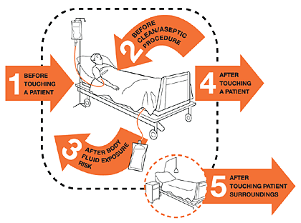
Hand hygiene
40%
Median hand hygiene compliance from 95 studies.
Erasmus et al. Infect Control Hosp Epidemiol 2010;31:283-294.

Slide 32
MDR-GNB Toolbox
Hand hygiene
Contact precautions
Active screening
Antibiotic stewardship
Cleaning / disinfection
Cohorting staff / patients
Note flagging
HCW screening
Education
Env. screening
Decol.
Otter et al. Clin Microbiol Infect 2015 in press.

Slide 33
Surface survival
Otter & French. J Clin Microbiol 2009;47:205-207.

Slide 34
Surface survival – strain variation
Otter & French. J Clin Microbiol 2009;47:205-207.

Slide 35
Conclusion
K. pneumoniae vs. E. coli
K. pneumoniae seems to be more environmental than E. coli.^{1,2}
Surface contamination on five standardized sites surrounding patients with ESBL-producing Klebsiella spp. (n=48) or ESBL-producing E. coli (n=46).¹
P<0.001
Risk factors for ESBL-E contamination = ESBL-KP, urinary catheter; carbapenem therapy was protective.³
P<0.001
Guet-Revillet et al. Am J Infect Control 2012;40:845-848.
Gbaguidi-Haore. Am J Infect Cont 2013;41:664-665.
Freeman et al. Antimicrob Resist Infect Control 2014;3:5.
Notes:
35

Slide 36
Persistent contamination
140 samples from 9 rooms after 2xbleach
5705 samples from 312 rooms after 4xbleach
2680 sites from 134 rooms after HP vapor
HP vapor decon
26.6% of rooms remained contaminated with either MRSA or A. baumannii following 4 rounds of bleach disinfection
Manian et al. Infect Control Hosp Epidemiol 2011;32:667-672.

Slide 37
Enterobacteriaceae “less environmental”
Nseir et al. Clin Microbiol Infect 2011;17:1201-1208.
Ajao et al. Infect Control Hosp Epidemiol 2013;34:453-458.

Slide 38
MDR-GNB cleaning & disinfection checklist
Clean / declutter
Monitor cleaning process (e.g. fluorescent markers)
All equipment disinfected before leaving room
Enhanced daily disinfection using bleach
Terminal disinfection using bleach or, ideally, H₂O₂ vapor¹⁻³
Gopinath et al. Infect Control Hosp Epidemiol 2013;34:99-100.
Snitkin et al. Sci Transl Med 2012;4:148ra116.
Verma et al. J Infect Prevent 2013;7:S37.

Slide 39
MDR-GNB Toolbox
Hand hygiene
Contact precautions
Active screening
Antibiotic stewardship
Cleaning / disinfection
Cohorting staff / patients
Note flagging
HCW screening
Education
Env. screening
Decol.
Otter et al. Clin Microbiol Infect 2015 in press.

Slide 40
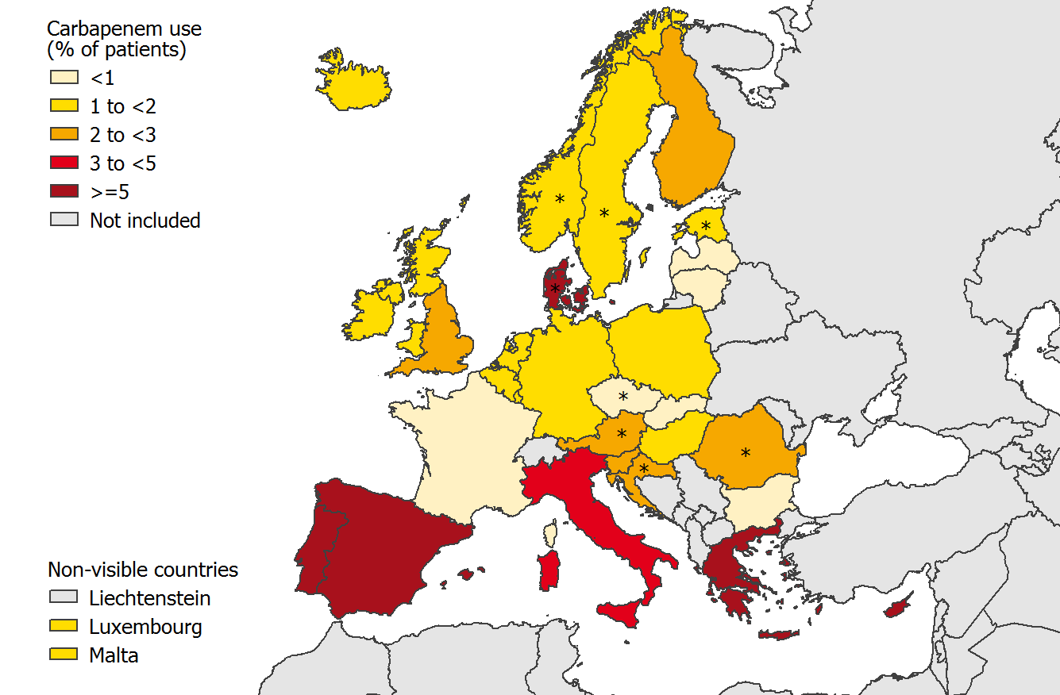
Carbapenem use, Europe
ECDC point prevalence survey 2013.

Slide 41
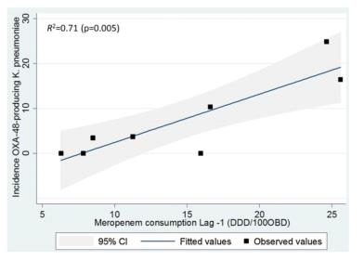
Can we forecast a CPE storm?
Could we find and implement an “alert” level of carbapenem use?
The authors claim a stewardship intervention brought the CPE outbreak under control – but also implemented ‘case isolation, screening of contacts, barrier nursing and other infection control interventions’.
Study focussed only on OXA-48 K. pneumoniae; what about other Enterobacteriaceae and non-fermenters.
What drives carbapenem resistance? The use of meropenem in the previous year plotted against the incidence rate of OXA-48-producing K. pneumoniae
Gharbi et al. Int J Antimicrob Agents 2015 in press.

Slide 42
Antimicrobial stewardship – impact
Evaluating impact of 6 month antimicrobial stewardship intervention on an ICU by comparing bacterial resistance for matched 6 month periods either side of intervention.
*
*
*
*
*
*
Hou et al. PLoS ONE 2014;9:e101447; * = significant difference before vs. after.

Slide 43
MDR-GNB Toolbox
Hand hygiene
Contact precautions
Active screening
Antibiotic stewardship
Cleaning / disinfection
Cohorting staff / patients
Note flagging
HCW screening
Education
Env. screening
Decol.
Otter et al. Clin Microbiol Infect 2015 in press.

Slide 44
Deisolation?
Author | Year | Setting | N pts | Organism | Duration of colonization
Bird¹ | 1998 | Elderly care facilities, Scotland | 38 | ESBL K. pneumoniae | Mean 160 days (range 7-548)
Pacio² | 2003 | Long term care facility, USA | 8 | Resistant Gram-negative rods | Median 77 days (range 47-189)
Zahar³ | 2010 | Paediatric hospital, France | 62 | ESBL Enterobacteriaceae | Median 132 days (range 65-228)
O'Fallon⁴ | 2009 | Long term care facility, USA | 33 | Resistant Gram-negative rods | Median 144 days (range 41–349)
Zimmerman⁵ | 2013 | Patients discharged from hospital, Israel | 97 | CRE | Mean 387 days
Bird et al. J Hosp Infect 1998;40:243-247.
Pacio et al. Infect Control Hosp Epidemiol 2003;24:246-250.
Zahar et al. J Hosp Infect 2010;75:76-78.
O'Fallon et al. Clin Infect Dis 2009;48:1375-1381.
Zimmerman et al. Am J Infect Control 2013;41:190-194.

Slide 45
‘Selective’ digestive decontamination
20 CRE colonized patients in each arm given gentamicin + polymyxin (SDD arm) or placebo (Control arm)
Saidel-Odes et al. Infect Control Hosp Epidemiol 2012;33:14-19.

Slide 46
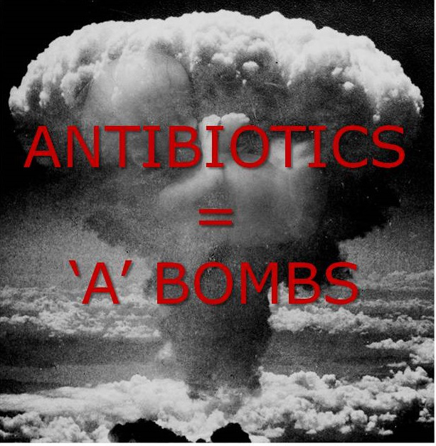

Slide 47
Decolonisation using faecal microbiota transplantation (FMT)
82 year old colonised with CPE.
Carriage was delaying her admission to a nursing home.
Single dose of FMT decolonised her at 7 and 14 days.
Laiger et al. J Hosp Infect 2015 in press.
Buffie & Pamer. Nat Rev Microbiol 2013;13:790-801.

Slide 48
Chlorhexidine – efficacy
Impact of chlorhexidine gluconate (CHG) daily bathing on skin colonization with KPC-producing K. pneumoniae in 64 long-term acute care patients.
Lin et al. Infect Control Hosp Epidemiol 2014; 35:440-442.

Slide 49
Chlorhexidine – reduced susceptibility
Proportion of BSI isolates with reduced susceptibility to chlorhexidine on units using chlorhexidine gluconate (CHG) daily bathing (n=28) or not (n=94).
33% (p=0.028)
Suwantarat et al. Infect Control Hosp Epidemiol 2014;35:1183-1186.

Slide 50
MDR-GNB Toolbox
Hand hygiene
Contact precautions
Active screening
Antibiotic stewardship
Cleaning / disinfection
Cohorting staff / patients
Note flagging
HCW screening
Education
Env. screening
Decol.
Otter et al. Clin Microbiol Infect 2015 in press.

Slide 51
Which do you consider to be the most important measure to prevent transmission?
Data from around 150 webinar participants, mainly in the US, 2014.

Slide 53
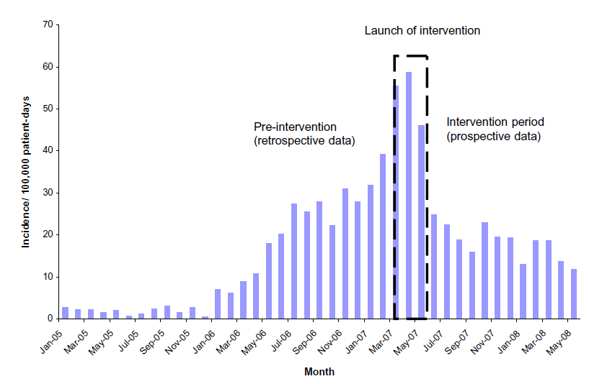
What works? Israel
*
* Physical segregation of CRE carriers; cohorted staff; appointed taskforce.
Schwaber et al. Clin Infect Dis 2011;52:848-855.

Slide 54
Key questions
Which interventions work?
Are they different for Enterobacteriaceae and non-fermenters? (Probably, given their epidemiology.)
What is the prevalence of CPE?
How much do we believe a single negative screen? What is the duration of colonisation?
Do we need rapid molecular diagnostics?
Are there decolonisation strategies other than (virtually non) ‘selective decontamination’ using abx?

Slide 55
Summary
MDR-GNB are emerging worldwide and represent a unique threat.
CPE in particular combine resistance, virulence and the potential for rapid spread.
Prevalence in the US appears to be patchy, but increasing.
We do not yet know what is effective in terms of prevention and control, but screening and isolation of carriers seems prudent.
Diagnosis can be challenging, and relies on close liaison with the microbiology laboratory.

Slide 56
Jon Otter, PhD FRCPath
Imperial College Hospitals NHS Trust
jon.otter@imperial.nhs.uk
@jonotter
Blog: www.ReflectionsIPC.com
www.jonotter.net

Slide 57
2016

