Slide 1

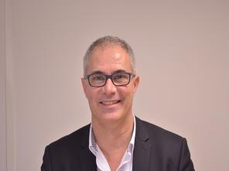

Root Cause Analysis used in the field of infection control
Pierre Parneix
pierre.parneix@chu-bordeaux.fr
@peyo3319
Hosted by Dr. Hugo Sax
University Hospital Zurich
www.webbertraining.com
October 15, 2015

Slide 2
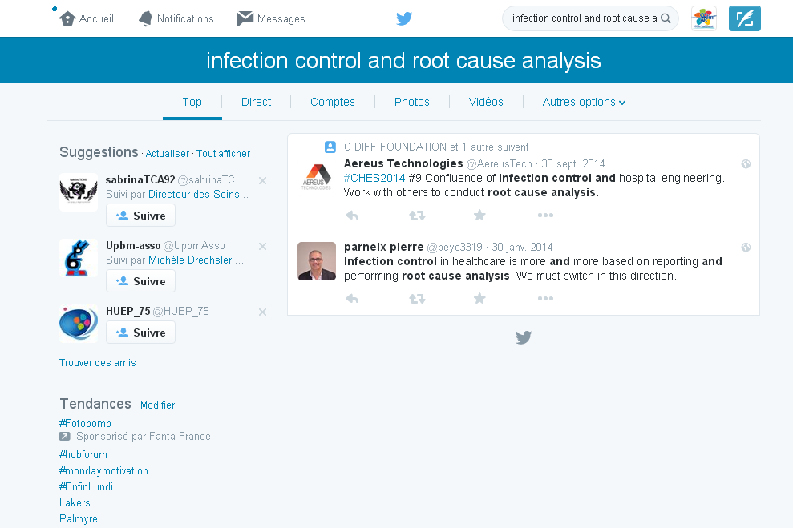

Slide 3


Slide 4


http://www.chfg.org/wp-content/uploads/2012/03/Vincent-Essentials-of-Patient-Safety-2012.pdf

Slide 5
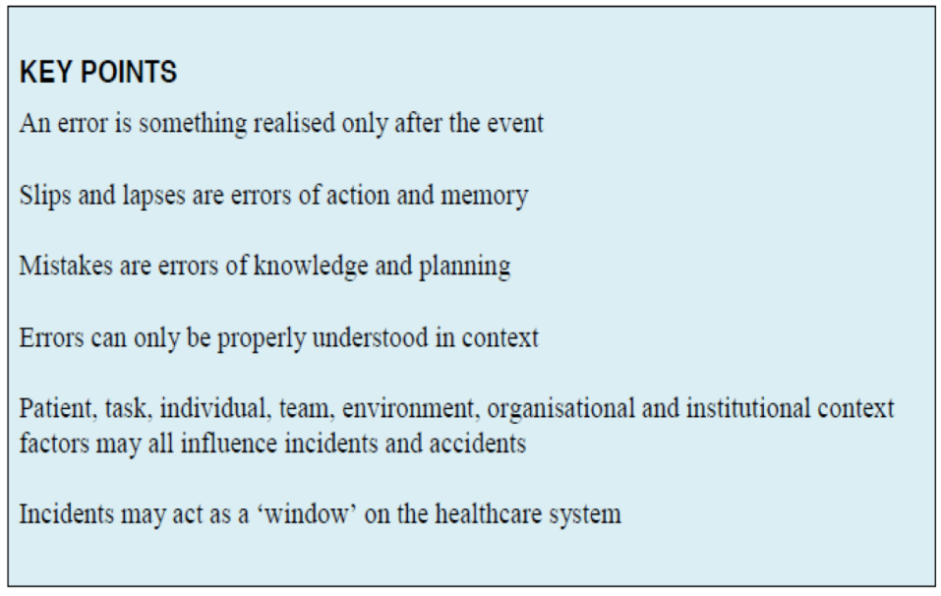
RCA and infection control
http://www.chfg.org/wp-content/uploads/2012/03/Vincent-Essentials-of-Patient-Safety-2012.pdf

Slide 6
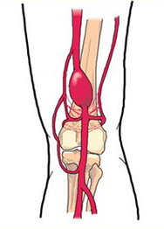
RCA and infection control
Why we need to broaden our vision
Bypass of popliteal aneurysm – Wrong side surgery
contralateral pain in the foreground,
no cross checking prior induction (no check list),
absence of marking on the side to operate by the surgeon during the preoperative visit,
http://www.ccecqa.asso.fr/page/prage

Slide 7
RCA and infection control
Why we need to broaden our vision
Bypass of popliteal aneurysm – Wrong side surgery
contralateral pain in the foreground,
no cross checking prior induction (no check list),
absence of marking on the side to operate by the surgeon during the preoperative visit,
extension of hair removal to both legs for « esthetic concern ».
http://www.ccecqa.asso.fr/page/prage

Slide 8
Plan
RCA and infection control
Don’t miss the power
of root cause analysis!

Slide 9
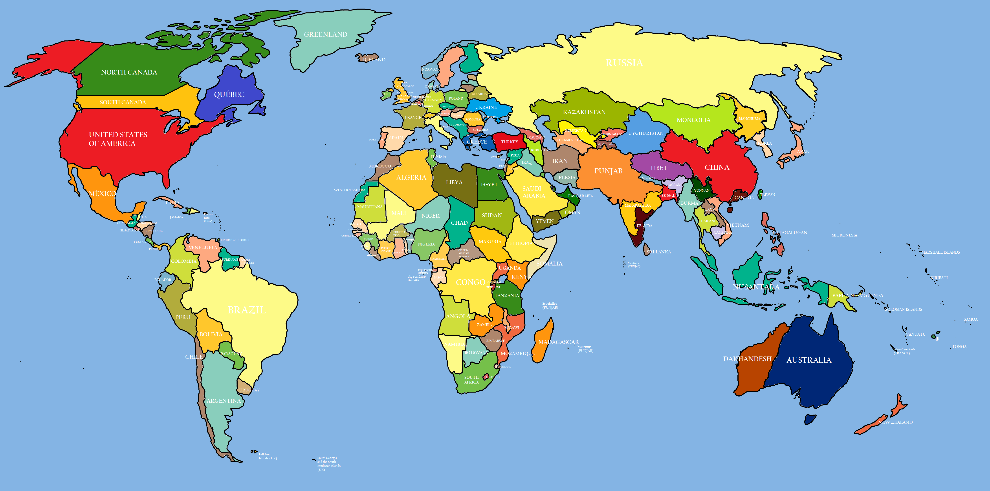
RCA and infection control
Just enjoy a little trip to France!

Slide 10
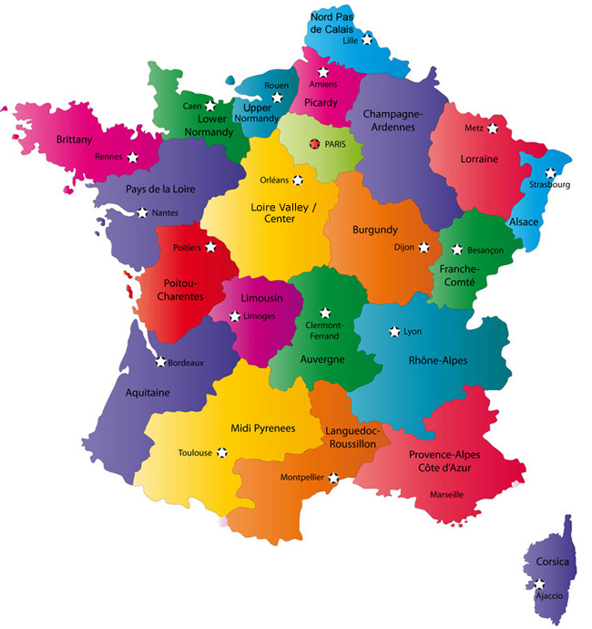

Slide 11

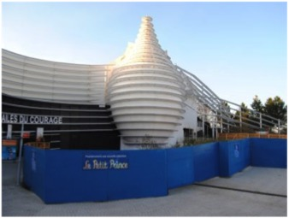
RCA and infection control
Root cause analysis
A delight to return

Slide 12

RCA and infection control
Root cause analysis
A delight to return

Slide 13
WHO RCA definition
RCA and infection control
Systematic analysis of all the factors which (…) have the potential to prevent an error
Explains how the incident occurred
Designs mechanisms to prevent the incident from happening again
Can be applied to incidents or to ‘near misses’.

Slide 14
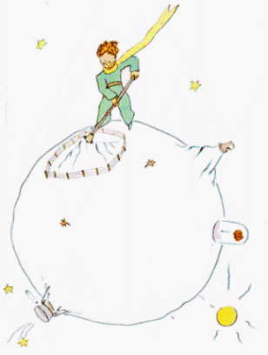
RCA and infection control
RCA
Work on near misses

Slide 15

RCA and infection control
RCA
Work on near misses

Slide 16
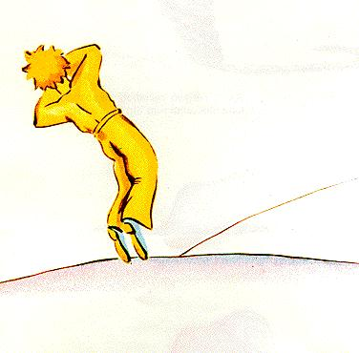
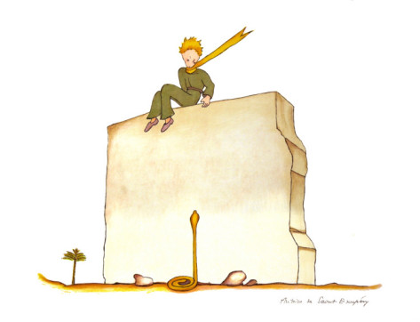
RCA and infection control
Understand the complexity of life

Slide 17

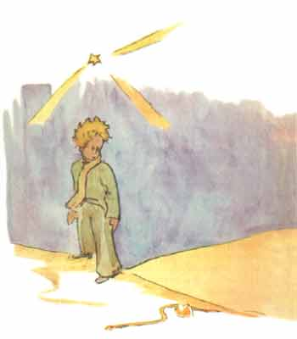
RCA and infection control
Understand the complexity of life

Slide 18

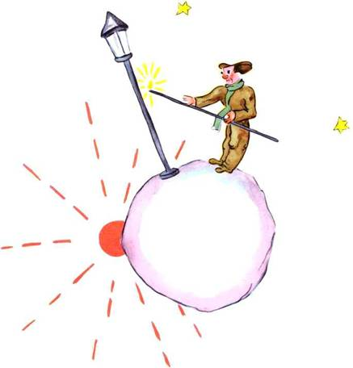
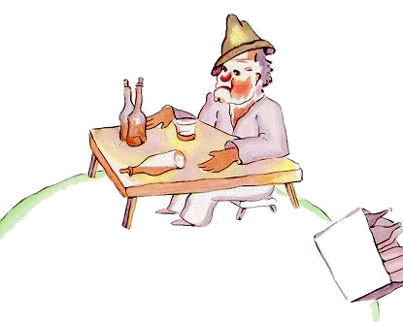

Understand the complexity of life

Slide 19



Understand the complexity of life

Slide 20
Understand the complexity of life

Slide 21
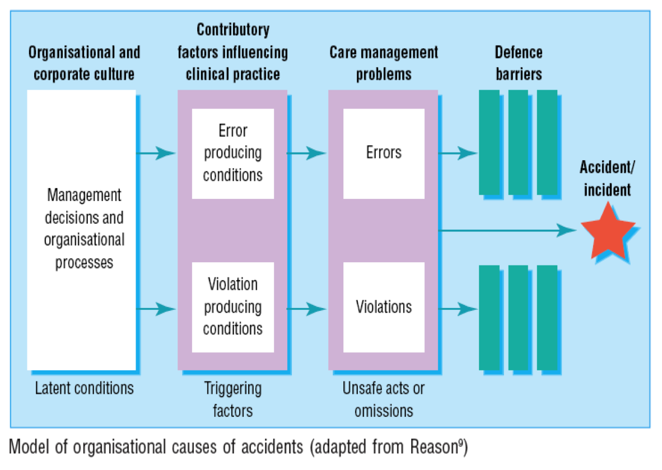
RCA and infection control
Root cause analysis
http://www.ncbi.nlm.nih.gov/pmc/articles/PMC1117773/pdf/777.pdf

Slide 22
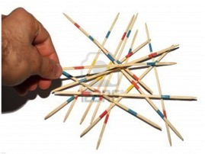
Philosophy
RCA and infection control
A single and simple answer to a complex situation is most often not appropriate

Slide 23
Root Cause Analysis
RCA and infection control
Patient factors:
Clinical condition
Physical factors
Social factors
Psychological/
mental factors
Interpersonal relationships
Task factors:
Guidelines/
procedures/
protocols
Decision aids
Task design
Working condition factors:
Administrative
Design of physical environment
Environment
Staffing
Workload and hours
Time
Team factors:
Role congruence
Leadership
Support + cultural factors
Organisational + strategic factors:
Organisational structure
Priorities
Externally imported risks
Safety culture
http://www.nrls.npsa.nhs.uk/resources/collections/root-cause-analysis/

Slide 24
Plan
RCA and infection control
The French vision of the topic

Slide 25

RCA process
RCA and infection control
Define the incident or near-miss to investigate
Select a multidisciplinary team
Gather information (interviews, documents, observations)
Establish the timeline of the event
Identify problems
Identify contributory factors and root causes
Identify solutions
Prioritize and implement solutions
Write a report
Flu.0©

Slide 26
Field experience in South West France
RCA and infection control
Surgical site infections following bariatric surgery
  In a two-month period, 4 surgical site infections following bariatric surgery (mostly by-pass surgery) occurred. The IC team investigations showed universal precautions needed to be optimized.
  The IC team gave recommendations regarding hand hygiene and skin preparation.
  During the next 4 months, 7 new surgical site infections occurred. Surgical site infection rate was 8.7% in this six-month period whereas usual surgical infection rate in this ward was only 3.1%. Various micro-organisms were involved (cutaneous and digestive flora).
  The IC team decided to perform RCA.

Slide 27
RCA and infection control
Surgical site infections following bariatric surgery
 | Problems | Causes | Solutions
Patients | Patients usually with poor cutaneous state. | Patients with comorbidities.
 | Difficulties to shower alone before surgery. | Mechanical difficulties due to obesity. | Help patients to shower.
 | Patients did not ask for help to shower before surgery. | Psychological difficulties accepting someone looking at them. | Patients education to make them aware that showering before surgery is necessary.

Slide 28
Surgical site infections following bariatric surgery
RCA and infection control
 | Problems | Causes | Solutions
Health care workers | Did not check the cutaneous state of patients neither that they correctly shower before surgery. | No protocol for such checking. | To integrate in the check-list the cutaneous state and the realization of the shower.
 | Did not offer to help patients to shower. | Psychological difficulties to ask patients about showering and to offer help. | Awareness to make them be confident that showering before surgery is a care which needs to be checked.
 |  | No training or protocol to help patients shower. | HCWs training + protocol.
 | Wearing rings and wrist watches in the ward. | Underestimation of the risk. | Forbid rings and wrist watches.

Slide 29
RCA and infection control
Surgical site infections following bariatric surgery
 | Problems | Causes | Solutions
Tasks | Boxes of surgery devices were opened a long time before surgery. | Increase in the activity. Small time between interventions. | Stop early box opening by respecting time between interventions and adapting the program activity.
 | Complex postoperative dressings. | Ward habits. | Discussion on medical prescriptions.
 | Increased nursing workload because of many patients with a Picc-line. | Picc-line were used instead of peripheral venous access in obese patients because physicians thought it was easier to use. | Only use Picc-line when justified.

Slide 30
RCA and infection control
Surgical site infections following bariatric surgery
 | Problems | Causes | Solutions
Context and organization | Increased nursing workload because of reduction in paramedical workers. | Institutional strategy.
 | Nurses were regularly interrupted when performing cares and dressings. | Nurses had to frequently answer the telephone. | To be more organized to stop answering the phone when performing a care.

Slide 31
RCA and infection control
Surgical site infections following bariatric surgery
Prioritized solutions
  Help the patient to shower before surgery
    Protocol
    Patients and healthcare workers education
    CCLIN Sud-Ouest Video https://www.youtube.com/playlist?list=PLyBYWsX9QAMHlatjHkD2kdEa3GgoSxJWV
  To be more organized to limit cares’ interruption
  To restrict the indication of PICC lines
  Return to SSI baseline rate.

Slide 32
Plan
RCA and infection control
The French MRSA tool

Slide 33
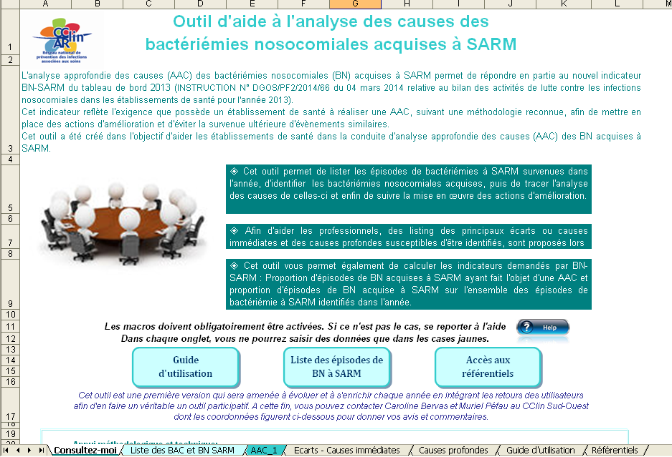
RCA and infection control
http://www.cclin-arlin.fr/GDR/Analyse_causes/Outil_BacteriemieSARM_Reseau_Cclin_Arlin_2015.xls

Slide 34

RCA and infection control
RCA basics
What has arrived?
Time line /
Chronology
How it has arrived?
Gaps /
Immediate
causes
Why it has arrived ?
Root - latent
causes
http://www.cclin-arlin.fr/GDR/Analyse_causes/Outil_BacteriemieSARM_Reseau_Cclin_Arlin_2015.xls

Slide 35
RCA and infection control
RCA basics
What has arrived?
Time line /
Chronology
Prevention phase
(before the event)
How it has arrived?
Gaps /
Immediate
causes
Attenuation phase
(after the event)
Why it has arrived ?
Root - latent
causes
http://www.cclin-arlin.fr/GDR/Analyse_causes/Outil_BacteriemieSARM_Reseau_Cclin_Arlin_2015.xls

Slide 36
MRSA Bacteraemia RCA
RCA and infection control
Facts
Death from MRSA bacteraemia associated to a peripheral venous catheter (PVC) on a patient admitted in emergency seven days before in the cardiology department of a hospital for left heart failure
People met, two group interviews
1 with the emergency team:
  Doctors, head nurse, nurse, nurses aid.
1 wtih the cardiological team : Doctors, head nurse.
Notes:
36

Slide 37
RCA and infection control
Prevention phase
Tuesday
  20h00 : Patient of 89 years covered by the SMUR for left heart failure with chest tightness; PVC posed by SMUR simple skin disinfection (Multilpe patient risk factors)
  20h30 : Admitted to the emergency. Support information transcribed by the physician on the emergency SMUR software.
  00h00 : Patient transferred in cardiology; no change of the PVC
Friday 15h30 : Redness at the puncture site of the PVC observed and reported internally; PVC removed and rested in the other arm, prescription of an alcoholic dressing
Saturday 8h13 : Presence of pus at the puncture site, sampling prescribed by resident for the next day; low-grade fever in the afternoon.
!
!
Notes:
37

Slide 38
RCA and infection control
Prevention phase
Wednesday 00h00 : Patient transferred in cardiology; no change of the PVC
Saturday 8h13 : Presence of pus at the puncture site, sampling prescribed by resident for the next day; low-grade fever in the afternoon
!
Gap/IC: no change of the PVC neither at the emergency unit nor in the cadiological ward
LC:
Emergency unit: Not the habit of the service to change PVC posed by SMUR, leave it to the downstream service to do but communication error on this point between units.
Cardiology: traceability of PVC emergency poses non clear in the software. Lack of knowledge of indications of PVC max duration.
!
Gap/IC : pas de PEC / pas de prélèvement
LC: Weekend, resident alone / Communication default between nurse / resident and resident / Senior / Under estimation of the risk / Lack of protocol for vascular access infections in the first-line antibiotics guide / No national recommendations for local PVC infection treatment
Notes:
38

Slide 39
RCA and infection control
Attenuation phase
Sunday
  Morning: At the dressing refection, evacuation of pus, sampling, fever
  23h20: 1st series of blood cultures, fever
Monday
  5h20: 2nd series of blood cultures, fever
  7h30: Sepsis, fever treatment
  Morning: Information from the lab about positive blood cultures (cocci gram +)
  23h00: 3rd and 4th series of blood cultures, fever, patient deterioration (Acute pulmonary edema, call the intensivist, treatment with Linezolide and Beta lactam antibiotics.
Tuesday
  7h30 : Stable ; painless ; Glasgow 14/15
  8h30 : Patient found dead
!
!
!
Notes:
39

Slide 40
RCA and infection control
!
Gap / Immediate causes :
Sampling delay (30h) / delay in antibiotic treatment (60 h)
Antibiotic treatment adequacy? Patient surveillance?
Latent causes:
Poor alert transmission of the of blood culture positiveness between lab and unit.

Slide 41
MRSA Bacteraemia RCA
Actions proposed and Priorities
RCA and infection control
 | Proposed action | Responsible
1 | New configuration of computer software to be able to notify a PVC emergency insertion by checking a box | IT services
2 | Review PVC practices through an observational audit | IC team
3 | Probabilistic antibiotic treatment protocol to complete with a part on PVC infection | Infectiologists
4 | Positioning of positive blood cultures results as a management priority. Inform your doctor as soon as the alert by the laboratory for immediate care. | All wards of the hospital
✓
✓

Slide 42
Plan
RCA and infection control
Root cause analysis of
blood and body fluid exposures

Slide 43
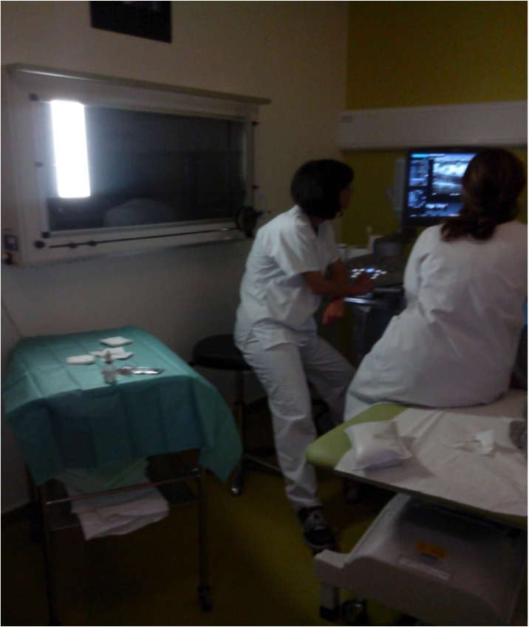
Exploring BBFE
RCA and infection control

Slide 44
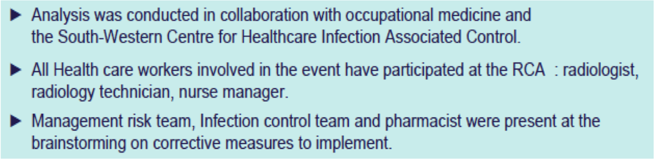
Exploring BBFE
RCA and infection control
The starting point of the RCA was the report of a BBFE by a radiologist to occupational medicine. BBFE occurred during a non scheduled breast biopsy.

Slide 45
Exploring BBFE
RCA and infection control
ORION comprises six steps:
  collecting data;
  rebuilding the chronology;
  identifying gaps;
  identifying contributing and influential factors;
  proposing actions to implement;
  writing the analysis report.

Slide 46
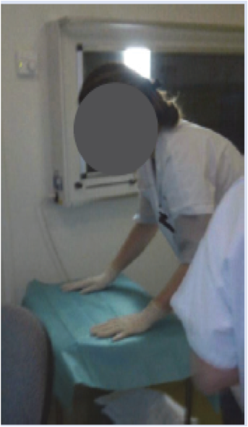
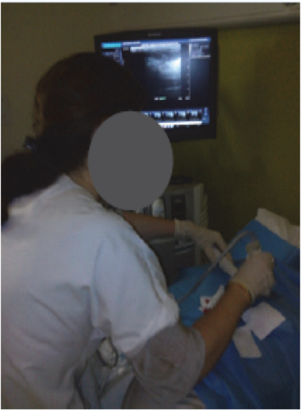
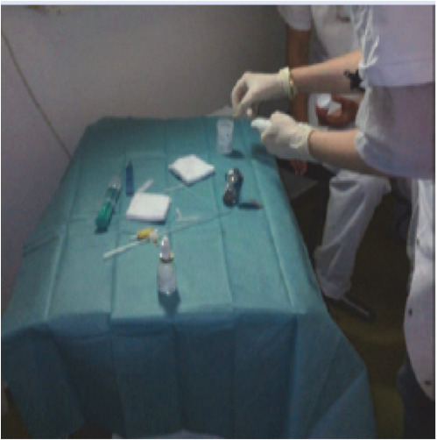
Exploring BBFE
RCA and infection control

Slide 47
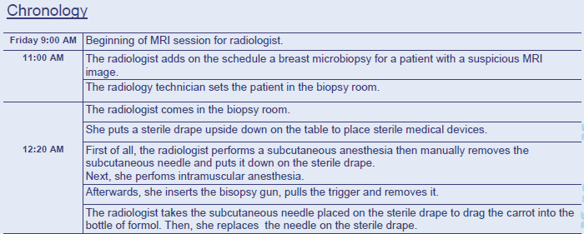
Exploring BBFE
RCA and infection control

Slide 48
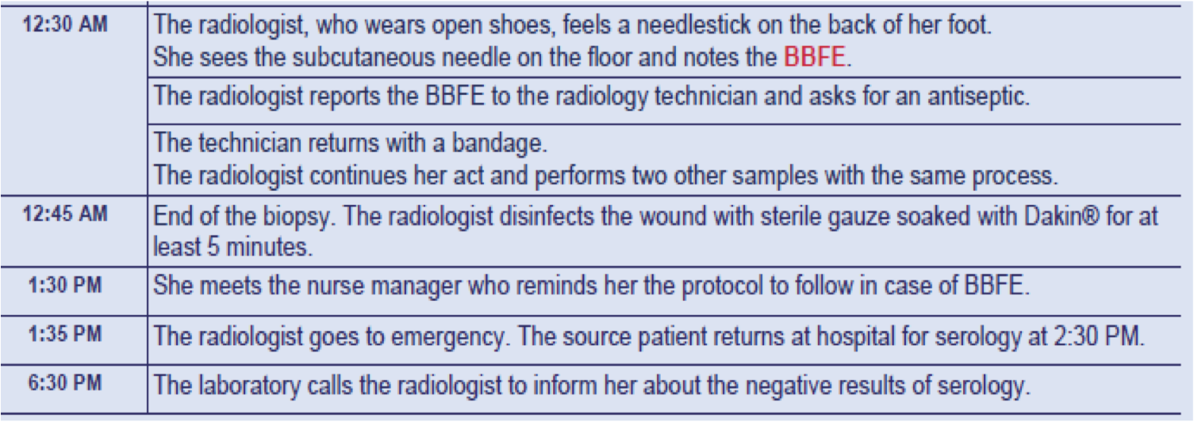
Exploring BBFE
RCA and infection control

Slide 49
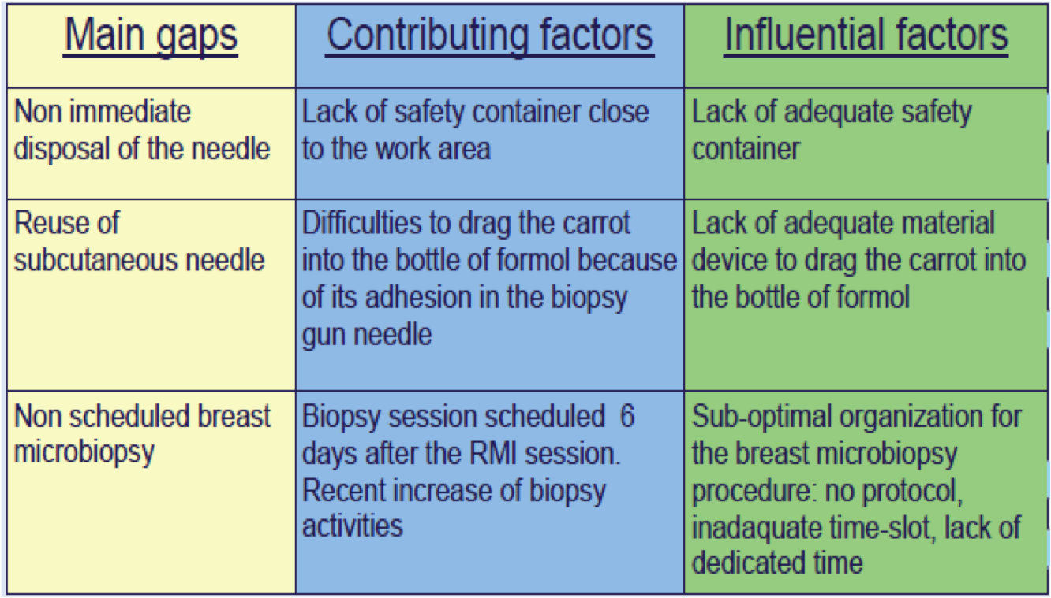
Exploring BBFE
RCA and infection control

Slide 50
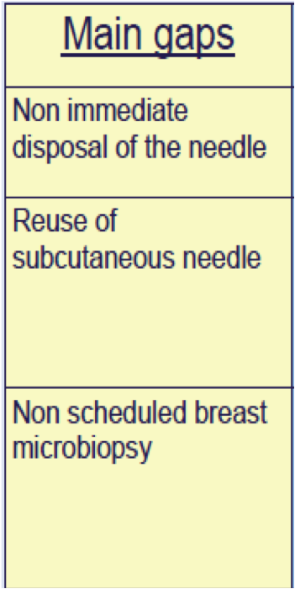
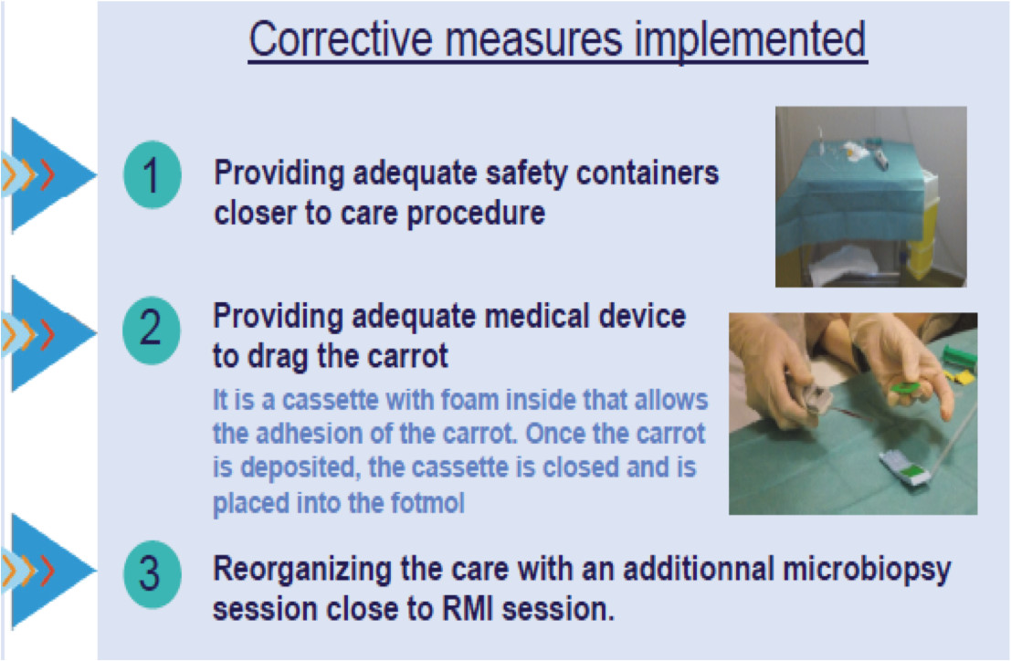
Exploring BBFE
RCA and infection control

Slide 51
Exploring BBFE
RCA and infection control
Lessons learnt:
  This first use of the ORION method to analyse a BBFE proved successful.
  This method seems quasi-intuitive and easier to conduct than previously described methods because it relies on a detailed chronology.
  It allows the implementation of BBFEs preventive measures and promotes collaborative teamwork..

Slide 52
RCA to support IC teams daily work
RCA and infection control
An IC team correctly using a RCA process for a HAI
  implements more adequate prevention measures
  improves clinical practices
  improves collaborative working and teamwork
  reduces the risk of HAI… and more!
IC teams could used RCA for their own errors and near-misses….

Slide 53

Conclusion
RCA and infection control
RCA should be integrated in IC teams daily work and state of mind:
  It is a useful tool for HAI investigation and prevention
  It is a useful tool to improve IC teams practices
RCA brings value to IC teams work
One healthcare-associated infection should lead to one safety improvement action!
RCA, yes we can!
Flu.0©

Slide 54

RCA and infection control
The grown-ups are very strange
http://download.bioon.com.cn/upload/201111/21084046_8501.pdf

Slide 55

Pierre Parneix
pierre.parneix@chu-bordeaux.fr
@peyo3319
www.cclin-arlin.fr

Slide 56

October 21 (South Pacific Teleclass)
ANTIMICROBIAL STEWARDSHIP
Osbert Cotta, University of Melbourne, Australia
October 29 AIR TRAVEL AND INFECTION TRANSMISSION
Dr. Paul Edelson, CDC JFK Quarantine Station
Sponsored by GOJO (www.gojo.com)
November 5 (Free Teleclass)
DEMYSTIFYING THE CIC® CERTIFICATION EXAMINATION
Roy Boukidjian, Northridge Hospital Medical Center
Linda Goss, Nurse Practitioner, Global Health Center
November 12 SALMONELLA - TRENDS, PREVALENCE AND CONTROL
Prof. Keith Warriner, Guelph University, Canada
November 17 (FREE British Teleclass … Denver Russell Memorial Teleclass Lecture)
THE ROLE OF WATER AS A VECTOR IN THE TRANSMISSION OF
INFECTIONS IN HOSPITALS

Slide 57


