Slide 1

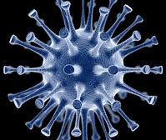
Safety in the Medical Device
Reprocessing Department
During COVID-19
Merlee Steele-Rodway RN
Educator/Consultant-IPAC/ MDR
Hosted by Garry Bassi
Mount Sinai Hospital, Toronto
www.webbertraining.com
March 25, 2021

Slide 2
Disclosures/Acknowledgements
Images in this presentation were obtained from Google Images unless otherwise identified
This presentation is for information as of the day of this presentation; ensure to review current National Standards and recommendations for COVID-19
Views and opinions expressed in this presentation are those of the presenter and may not represent official policy of other organizations
Reference document –Canadian Standards Association (CSA)Z314.18
May not remain current due to ever changing information

Slide 3
Objectives
Are there any ‘special’ Personal Protective Equipment (PPE) required for MDR staff who reprocess, or transport devices used on positive COVID-19 patients?
Discuss Coronavirus and COVID-19
Provide an overview of Infection Prevention and Control Routine Practices in the Medical Device Reprocessing (MDR)
Provide a refresher of donning and doffing personal protective equipment (PPE)
Discuss PPE required to be worn in the Decontam area of MDR Department (MDRD).
Discuss reprocessing single use N95 (PPE) risks and considerations to ensure quality when not available

Slide 4
Is there anything ‘special’ required for MDR staff who reprocess, or transport devices used on positive COVID-19 patients?
Answer :
No… MDR staff wear PPE according to Canadian Standards Association (CSA)- Z314-18 (medical device reprocessing) and appropriate for the task
Instruments and devices including those that have been used in procedures for patients with known or suspect COVID-19 should be handled the same as other instruments
    *this also includes the equipment used in aerosol generated procedures

Slide 5
What is the Coronavirus?
Coronaviruses are a large family of viruses (such as common cold)
COVID-19 is the name of the illness caused by this newly discovered (novel)coronavirus
COVID-19 is the most recent virus of the 7 known strains of Coronavirus that are known to cause illness in humans
4 cause minor respiratory symptoms like a cold
3 have more serious outcomes
    Severe Acute Respiratory Syndrome (SARS)
    Middle East Respiratory Syndrome (MERSCoV)
    COVID-19
First reported in December 2019
Reference PHAC

Slide 6
COVID-19- Transmission
Spread from a infected person through: respiratory droplets, close prolonged personal contact, and touching nose, mouth, or eyes before washing hands
Virus can persist on surface hours to a few days depending on temperature, surface and humidity. Clean surfaces frequently
Spread by Droplet and Contact
Therefore do not touch eyes, nose, and mouth before performing hand washing
May take up to 14 days for symptoms to appear after exposure¹ “Hence why self isolation for 14 days”

Slide 7
COVID-19 (www.Canada.ca/coronavirus)
Recent studies identified that COVID-19 may be spread by people who are not showing symptoms (asymptomatic)
Symptoms may include: cough, headache, fever, difficulty breathing, pneumonia in both lungs, some have experienced other symptoms
Highest number of deaths have been in the over 65 year population, anyone with chronic medical conditions and/or weakened immune systems; however people between the ages younger than 30 and30-60 years have also been hospitalized
Severe cases of infection can lead to death

Slide 8
Prevention and Treatment
Respiratory (cough and sneeze) etiquette is extremely important
Wearing a medical mask correctly in healthcare may limit the spread
Wash your hands often, during and after removing PPE
Use alcohol-based hand sanitizer if soap and water not available
Imperative to stay 6 feet apart, avoid crowded places- stay home as much as possible
Several vaccines and/or therapies to treat or prevent this disease have been developed and approved. The COVID-19 pandemic has resulted in a global review of many therapies that may be used to treat or prevent the disease¹.
Think about implementing a ‘buddy system’ to ensure PPE is donned and doffed correctly

Slide 9
Infection Prevention and Control (IPAC)-Routine Practices in MDR
Consistent use of Routine practices is the basic practice to protect health care providers and patients as Central Sterile Departments or Medical Device Reprocessing Departments (MDRD) handles all equipment as if potentially contaminated
Applies to all body fluids, non intact skin, equipment contaminated with blood, body fluid or tissue whether visible or not

Slide 10
Personal Protective Equipment in Decontam
ALL PPE worn in the MDRD shall be appropriate for the task(s).²
(fluid resistant facemask with eye protection or (full)face shield, gown,
gloves and head covering)
Shoe coverings as per hospital policy in decontamination area
When the integrity of gloves, liquid- or chemical-resistant garments, face shields, or protective eyewear is compromised, they shall be replaced immediately²
Hand hygiene shall be performed before donning fresh PPE² and upon removing
Care should be taken in putting on or taking off PPE, as PPE can be a source
of contamination²
Change PPE when or if it becomes grossly soiled, visibly contaminated with blood or body fluids
Reference CSA Z314.18

Slide 11
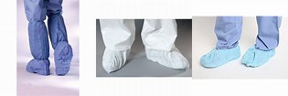
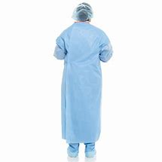
Donning (Putting on) PPE- In Decontamination
In This order of sequence:
Wash hands and wrists, do not wear jewellery
Don head covering (recommended for all areas of MDR) hair coverings are worn in all areas of SPD as part of dress code;
Don fluid-protective shoe covers if worn – not required but recommended to be worn in decontam area of MDR to protect from splashing. Follow your facilities policies; should be slip resistant
Wash hands
GOWN:
Don long sleeve fluid-resistant gown (should be Level 3 at a minimum, Level 4 recommended for decontam area) – opening is at the back (not a apron)
N.B.-Typical isolation gowns have very limited protection against fluids
Secure gown at neck and waist

Slide 12
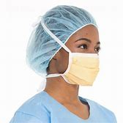
Don Fluid resistant Medical Mask Next
Risk of exposure
Secure ties or elastic bands at the crown of your head and neck
(or fit loops over ears)
Fit to face and chin
Form the flexible band at the nose bridge with clean hands

Slide 13
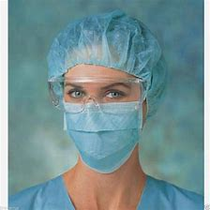
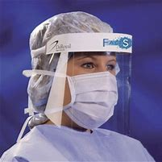
Don Eye Protection Next
Goggles, full face shield, or visor attached to mask are all accepted methods of eye protection
If using a face shield/visor, it should fit over the brow
Prescription or fashion eye glasses DO NOT offer sufficient eye protection
Place over face and eyes, adjust to fit

Slide 14
Gloves Next
Long fitted protective(consider dexterity, cut resistance, non latex)
Insert each hand into appropriate glove and extend over the cuffs of the gown for barrier
Keep gloved hands away from face and limit touching surfaces
Change gloves and clean hands as needed (e.g. visibly soiled, between contaminated and clean tasks)

Slide 15
Doffing (Taking off) PPE
Things to consider!
Which areas of the PPE are clean and contaminated:
The outside of the face protection and glove is contaminated
The front of the gown, sleeves are contaminated
The inside and back of the PPE is considered clean

Slide 16
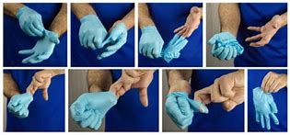
Doffing- Removing PPE
In this Sequence:
Shoe covers if worn, are most contaminated; remove first
Removing Gloves: do not touch the outer area of the glove as may be contaminated
Pinch the outer glove surface at the wrist and remove the first glove; hold this in your opposite gloved hand.
Slide finger of ungloved hand under the other glove at the wrist
Peel glove over wrist and discard

Slide 17
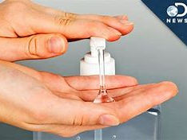
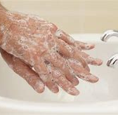
Hand Hygiene
Wash hands and wrists using soap and water or alcohol hand sanitizer after removing gloves

Slide 18
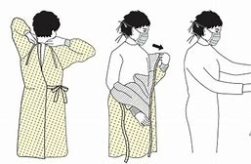
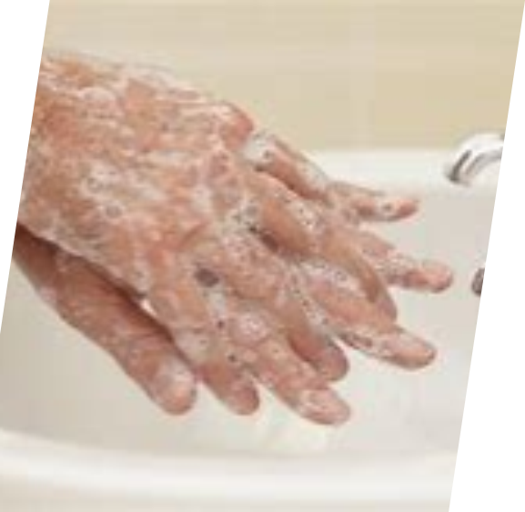
Removing Gowns
Gown front and sleeves are contaminated!
Unfasten gown ties, taking care sleeves do not contact your body when reaching for ties
Pull the gown away from your neck and shoulders, touching inside of gown only
Turn the gown inside out and fold or roll the gown into a bundle and discard in regular waste (disposable)
(some of you may be wearing the Level 3 or 4 ‘OR gowns’
–place in linen cart)
Perform hand hygiene after removal of gown
***be informed about your facilities protocols***

Slide 19
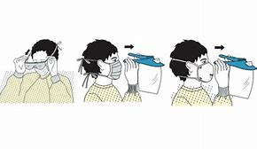
Removing Goggles or Face Shield
Outside of goggles or face shield are contaminated!
If your hands become contaminated during goggle or face shield removal; immediately wash your hands or use alcohol hand sanitizer
Remove goggles or face shield carefully from the back by lifting head band or ear pieces
If the item is reusable, place in designated receptacle for reprocessing. Otherwise discard in waste

Slide 20
Removing Mask & Head Covering
Front of mask is contaminated – DO NOT TOUCH!
If your hands get contaminated during removal; immediately wash them
Grasp bottom of ties or elastics of the mask, then the ones at the top, and lean forward slightly and remove without touching the front, lift off the mask
Discard in waste container
Remove head covering by lifting the head covering off of the head by grasping it in the center and lifting upward, discard it into a waste container
Wash hands or use alcohol hand sanitizer immediately after removing PPE & before leaving decontam area
Do not take MDR PPE home to launder.

Slide 21
What about Masks?
There are different ‘types’ of masks with or without a shield
Medical grade fluid resistant ( fluid barrier rating) mask is required for decontamination area

Slide 22
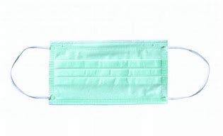
Facial Protection
A barrier that prevents droplets from an infected source from contaminating the skin, mucous membranes of the eyes, nose, and mouth from splashes or sprays of body fluids or blood of the wearer, or to trap droplets expelled by wearer, depending on the use; require eye protection
A standard surgical mask is a fluid resistant mask is designed to provide a barrier and droplets asks
Should be changed if the mask becomes moistened or damaged
Removed carefully to not contaminate yourself

Slide 23
What is the N95 Respirator?
N95 is a ‘disposable’ device worn on the face and covers nose and mouth to reduce the wearer from inhaling airborne particles
The ‘N’ indicates that it is not oil-resistant or oil-proof
Certified by the National Institute for Occupational Health and Safety (NIOSH) based out of USA
Also hold a Medical Device Establishment License (MDEL) authorized by Health Canada to be imported into Canada
Reference WHO-2019-nCov-IPC_Masks-2020-eng.pdf

Slide 24
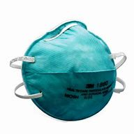
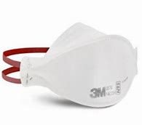
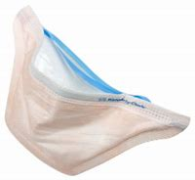
N95 Respirator
Different styles, cup-style, flatfold or duckbill & may or may not have an exhalation valve
Used when viruses or bacteria is spread via airborne route
Today, there are only 3 viruses spread via airborne route (Measles, TB, Chickenpox
Must be properly fitted and tested for leaks before considered safe and provides efficient filtration of airborne particles (user performs a seal check each time put on)
Worn in clinical settings when there are aerosol generating medical procedures on a person under investigation for COVID-19

Slide 25
What Facial/Eye Protection is required in Decontamination Area?
Mask with a fluid barrier rating with eye covering and full face shield is recommended
N95 not needed in MDR because there should be no aerosol generating procedures
Risk of cleaning soiled instruments is same for all; no different protocols; follow Canadian Standards Association (CSA)- Z314-18
Ensure to practice good hand hygiene practices

Slide 26
Decontam area Protection²
Completely submerge devices that require brushing/ cleaning below water line to minimize splashing as per CAN/CSA- Z314-18
Aerosolized water faucet sprays increases splashing/aerosolization of microorganisms, pre-cleaning should occur at point if use, fully submerge devices for cleaning and rinsing
Wear PPE as per CAN/CSA Standards–Z314-18 –medical device reprocessing. (including shoe covers(optional is some depts.) however possible risk of contaminating shoes, head covering –part of uniform, fluid resistant gowns, facial and eye protection, gloves)
Ensure to clean environmental surfaces regularly with hospital grade cleaners and disinfectants ; as the COVID-19 virus may survive up to 72 hours on hard surfaces and 24 hours on cardboard but they do not survive without a host to grow¹

Slide 27
Additional comments
Ensure staff are aware of hospital policy for transportation of clean and contaminated devices
No special PPE required for transportation of soiled carts; follow CAN/CSA-Z314-18 (however, your facility may be requiring masking for all staff due to community spread therefore follow hospital policy when outside of the MDR department)
Do not reuse single use ‘PPE’
Ensure to wear all PPE correctly required for the task
Instruments and devices that have been used in procedures for patients with known or suspected COVID-19 are handled the same as other instruments
Follow Manufacturers instructions for use for reprocessing and CSA Standard
Wash your hands after removing PPE and before leaving the department

Slide 28
Can we Reprocess N95 Respirators as a Crisis Capacity Strategy during COVID-19?
Unprecedented demand for certain supplies, including PPE during COVID-19
In Canada, we must follow Health Canada and Provincial emergency approved guidelines and standards
Health Canada invited manufacturers to submit innovative solutions with data for consideration and interim approval of normally disposable N95 respirators to meet current needs¹ and increasing domestic production
Much of literature that is available on the reprocessing of Used Single Use N95 respirators are laboratory studies
Laboratory studies may not reflect risks and outcomes in actual clinical settings (ECRI-March 2020)
Health Canada evaluated the guidance of the FDA for optimizing reuse of respirators¹ and introduced interim regulatory measures
Manufacturers must provide decontamination and reprocessing instructions¹

Slide 29
Reprocessing Used N95
If deciding to reprocess N95, encourage you to check your countries/state approved guidelines Review the most current science based-published literature
Current information:
  Cellulose based respirators cannot be reprocessed
  Ethylene Oxide (off-gassing) not recommended
  Ionizing radiation not recommended(performance degradation)
  Microwave not recommended (melting near metal components designed to fit the face)

Slide 30
Completed Interim Order applications for the re-processing of N95 respirators-April 24, 2020- slide courtesy –Health Canada
Device (method) | 3M N95 models evaluated (throughput) | Max Number of Process Cycles | Filtration Efficiency | Fit Evaluation | IO authorization
Stryker Sterizone VP4 (VHP, Ozone) | 1860 (480 masks/24h) | 2 | Pass | Pass | April 5, 2020
ASP Sterrad 100S, NX, 100NX (VHP, low temperature) | 8210, 1860, 1860S (620 masks/24h) | 2 | Pass | Pass | April 9, 2020
Clean Works Medical Clean Flow Healthcare Mini (VHP, UVC, Ozone) | 8210 1870 (1200 masks/hr) | 10 | Pass | Pass | April 13, 2020
Steris V-Pro 1 Plus, maX, maX2 Non-lumen cycle (VHP) | 1860 8210 | 10 | Pass | Pass | April 15, 2020
Ecolab Bioquell HPV generator (VHP) | 1860 | 20 | Pass | Pass | April 20, 2020

Slide 31
On-going reviews of IO applications for the re-processing of N95 respirators-April 24, 2020
Device (method) | 3M N95 models evaluated (throughput) | Max Number of Process Cycles | Filtration Efficiency | Fit Evaluation | IO authorization
Daavlin 1 Series (UVGI) |  |  |  |  | approved
 |  |  |  |  | approved
Clean Sleep Technology |  |  |  |  | approved
Data maybe changing as processes approved |  | **NB Data is not all inclusive of approvals. |  |  | Slides 30 & 31 -Courtesy-Health Canada

Slide 32
Optimizing Availability of N95 PPE
World Health Organization (WHO) provided interim guidelines for rational use of PPE for coronavirus disease (COVID-19)
Other countries developed guidelines

Slide 33
What about reprocessing other devices that are unavailable or in extreme short supply?
Canada- Health Canada will continue to respect the current oversight provided at the provincial and territorial level and guidance provided by the Public Health Agency of Canada
Health Canada advises that during a state of emergency, such as for a crisis capacity strategy:
“Individual hospitals can develop and conduct their own testing and validation of reprocessed devices, as long as this is done internally and for internal purpose”
“No sale of the reprocessed devices to another institution”

Slide 34
Can Reusable Face Shields and Goggles be Cleaned?
Follow Manufacturers instructions for cleaning and disinfection if reusable
Should be reprocessed as per facility Infection Prevention and Control approval and Occupational Health and Safety guidance

Slide 35
What about Single Use Face Shields
Any reprocessing approved by facility should be performed in the MDRD
Discuss with IPAC, MDR, Biomedical Engineering & Quality and Risk to decide on a process that can be performed safely
https://www.cdc.gov/coronavirus/2019-ncov/hcp/ppe-strategy/eye-protection.html

Slide 36
Considerations
Decontamination processes may compromise the filter depending on the process decided on, therefore, ensure consider loss of fit and filtration effectiveness
Consider the N95 Volumes required
Initiate good Quality Controls & to ensure the number of times the N95 can be reprocessed recommended by reprocessing manufacturer There is really no way to clean these once used
Identify and document a tracking method
Develop the method of collection and ensure excellent communication
Ensure consistency and identify a team member responsible to oversee any reuse protocols

Slide 37
Considerations
Expired N95 stocks- Devices beyond their labelled shelf life may retain adequate filtration if stored properly, bands and other elastic parts may not ensure a proper fit.¹
Heat and humidity can compromise the filter material. Inspect closely for damage and fit test before use (ECRI-March 2020).
Manufacturers of the N95 should provide you with instructions that have been tested in their laboratories
Follow Manufacturers Instructions

Slide 38
Considerations
Store used N95 in designated area
Ensure once this crisis is over, destroy the reprocessed N95 stock and resort back to the current Canadian standards and manufacturers recommendations as Single Use Device
What will the future hold for Single Use Items????

Slide 39
Summary
There is no change in the MDR PPE that should be worn in MDR
Reprocessing of the Single Use N95 is a crisis contingency plan ONLY to be used by staff as a last resort under the Emergency Plan; i.e. when and if there are no new N95 respirators available
  MDR, IPAC, Biomedical Engineering, Quality and Risk should be involved in approval and development of the facility plan on how the process will take place (collection, transportation & reprocessing plans)
  The processing the N95’s should be performed in the MDRD
  Education and a communication plan is critical for those staff assigned designated staff assigned to the task

Slide 40
Resources & Contact Information/
Ressources et coordonnées
Applications for medical devices under the Interim Order for use in relation to COVID-19 – Guidance document
https://www.canada.ca/en/health-canada/services/drugs-health-products/drug-products/announcements/interim-order-importation-sale-medical-devices-covid-19/guidance-medical-device-applications.html
Products authorized under the Interim Order:
https://www.canada.ca/en/health-canada/services/drugs-health-products/covid19-industry/medical-devices/products-authorized-interim-orde.html
Email:
hc.devicelicensing-homologationinstruments.sc@canada.ca
Demandes relatives aux instruments médicaux visés par l’arrêté d’urgence pour leur utilisation à l’égard de la COVID-19 - Ligne directrice
https://www.canada.ca/fr/sante-canada/services/medicaments-produits-sante/medicaments/annonces/arrete-urgence-importation-vente-instruments-medicaux-covid-19/document-applications-dispositifs-medicaux.html
Instruments autorisés en vertu de l'arrêté d'urgence:
https://www.canada.ca/fr/sante-canada/services/medicaments-produits-sante/covid19-industrie/instruments-medicaux/instruments-autorises-arrete-urgence.html
Adresse courriel:
hc.devicelicensing-homologationinstruments.sc@canada.ca Slide Courtesy of Health Canada

Slide 41
References
41
1. Health Canada, 2020. Retrieved from https://www.canada.ca/en/public- health/services/diseases/2019-novel-coronavirus-infection/health-professionals.html
2. Canadian Standards Association. CAN/CSA-Z314-18 Canadian medical device reprocessing. Rexdale, ON: February 2018
3. Health Canada, 2020. Retrieved from https://www.Canada.ca/en/public- health/services/diseases/2019-novel-coronavirus-infection/health-professionals/technical-brief- masking-face-shields-full-duration-shifts-acute-healthcare-settings.html
4. Centre for Disease Control and Prevention(CDC). Retrieved from https://www.cdc.gov/coronavirus/2019-ncov/hcp/ppe-strategy/decontamination-reuse- respirators.html
5. Health Canada April 17,2020. Retrieved from https://www.canada.ca/en/health- canada/services/drugs-health- products/medical-devices/activities/announcements/covid19-notice- reprocessing-n95-respirators- health-professionals.html
6. Health Canada 2020. Retrieved from https:www.ca/en/health-Canada/services/drugs-health- products/medical-devices/masks-respirators-covid19html

Slide 42
References
7. World Health Organization 2020. Retrieved from WHO-2019-nCov-IPC_Masks-2020- eng.pdf
8. Public Health Ontario April 6,2020. Retrieved from https://www.pubichealthontario.ca/-/media/documents/ncov/updated-ipac- measures-covid-19.pdf?la=en
9. Association od perioperative Registered Nurses (AORN). www.org. COVID-19 FAQ’s. March 25,2020
10. Canadian Agency for drug and Technologies in Health Care (CADTH) 2020. www.CADTH/COVID-19 web portal
11. Centers for Disease Control and Prevention (CDC). (March 27,2020). Recommended guidance for extended use and limited reuse of N95 filtering facepiece respirators in healthcare settings. Retrieved from: www.cdc.gov:https://www.cdc.gov/niosh/topics/hcwcontrols/re commendedguidanceextuse.html

Slide 43



43
Thank-you!
Contact info:
merleesrodway@gmail.com
www.camdr.ca

Slide 44

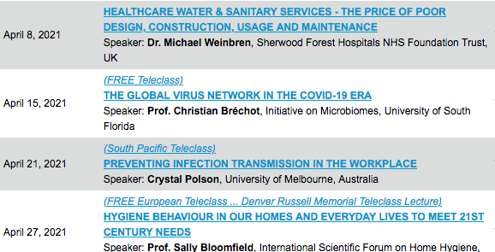

Slide 45


