Slide 1
Sharps Injury Prevention:
Challenges and Effective Strategies
Terry Grimmond FASM, BAgrSc, GrDpAdEd
terry@terrygrimmond.com
Hosted by Jane Barnett
jane@webbertraining.com
www.webbertraining.com
June 29, 2016

Slide 2
Webber Teleclass Disclosure
Grimmond and Associates are consultants in sharps injury prevention and healthcare waste management to the healthcare industry including users and producers of medical devices.
No corporate sponsorship was requested or received for this session.
An honorarium to cover telephone expenses and session time was received from Webber Training

Slide 3
Learning Objectives
Discuss Sharps Injury (SI) trends in US
Compare US trends with Australia & NZ
List 5 proven strategies to reduce SI
Discuss research needs in Australia & NZ

Slide 4
HIV and Hep Risk
Worldwide, among HCW…
40% of HBV and HCV infections
and 2.5% of HIV infections
…are acquired through accidental SI¹
…these are just 3 of 60 diseases transmissable through accidental SI!²
¹WHO-ICN: Preventing Needlestick Injuries among HCW: http://www.who.int/occupational_health/activities/5prevent.pdf.
²Tarantola A, et al. Infection risks following accidental exposure to blood or body fluids in health care workers: A review of
pathogens transmitted in published cases. Am J Infect Control 2006;34:367-75.
4

Slide 5
Learning Objectives
Discuss Sharps Injury (SI) trends in US
Compare SI trends in Australia & NZ
List 5 proven strategies to reduce SI
Discuss research needs in Australia & NZ

Slide 6
Why US?
It has an ongoing national database
No national database in:
                Canada
                UK
                Australia
                NZ

Slide 7
US OSHA History
1970: “You must protect employees”
1991:
“You must protect employees against BBP”
But sharps injuries kept rising every year

Slide 8
In 2000…
38 SI/100 Occ Beds;
11.6 MucoC Exp/100 OB
800,000 HCW sustained SI
240,000 HCW sustained MC exp.

Slide 9
Why SI rate so high? No SED?
There were hundreds of SED…
1985 = 40 SED patents
1995 = 1,100
Hospital managers…“SED are expensive… can’t justify the expenditure”
Urgent need for law re Safety Engineered Devices (SED)

Slide 10
2001:
BBP Needlestick Safety & Prevention Act
Develop an Exposure Control Plan
Update the plan annually to reflect:
  Changes in tasks, procedures and positions that affect occup expos
  Technological changes that eliminate or reduce occup exposure.
  Evaluation & adoption of appropriate, effective SED & work practice controls
  Involvement & documentation of frontline staff in SED evaluation
Maintain a log of SI.
Provide information and training to workers
Provide evaluation and follow-up of worker exposures
OSHA Bloodborne Pathogens Standard 1910.1030. US Department Labour, Occupational Safety and Health Administration. Jan 18, 2001. http://www.osha.gov/pls/oshaweb/owadisp.show_document?p_table=STANDARDS&p_id=10051.

Slide 11
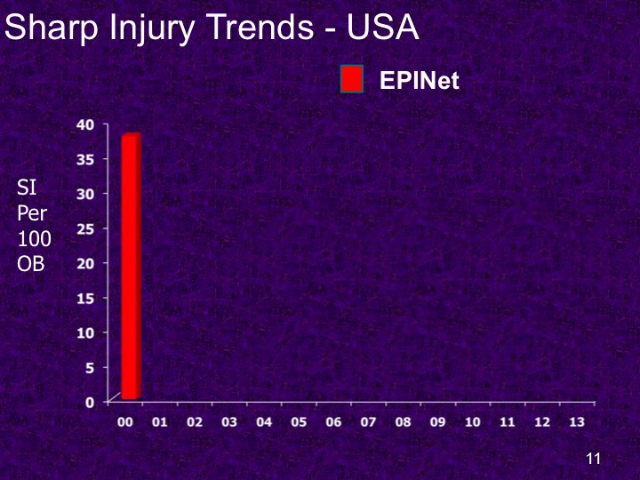

Slide 12
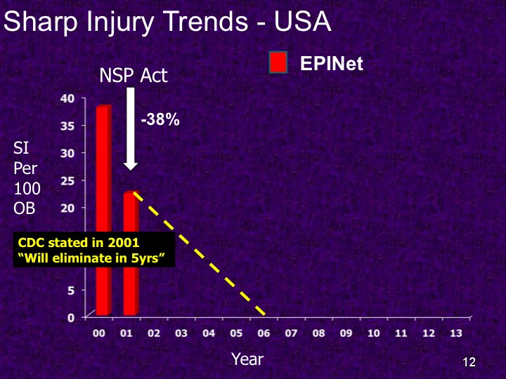

Slide 13
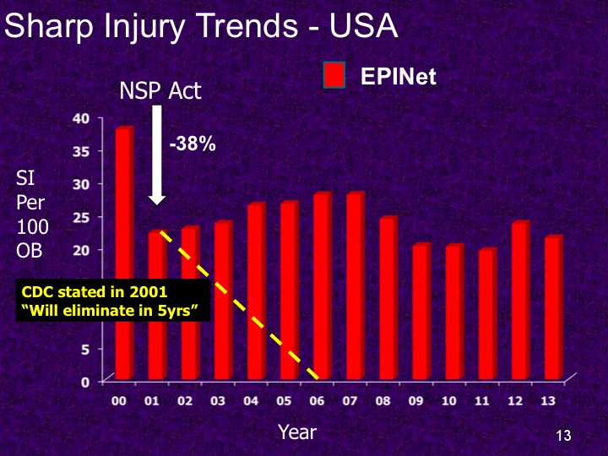

Slide 14
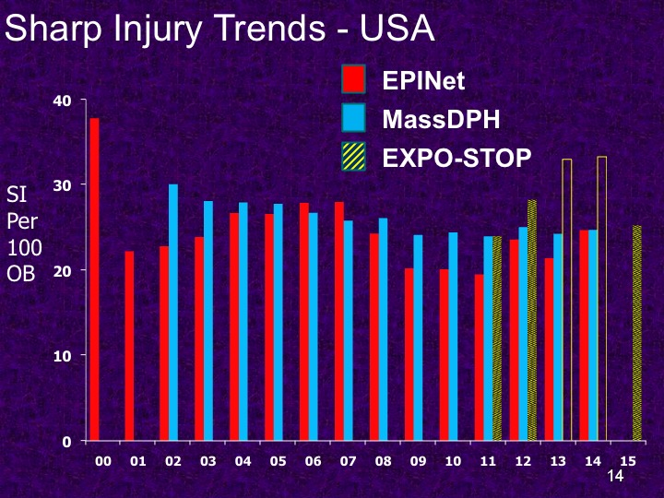

Slide 15
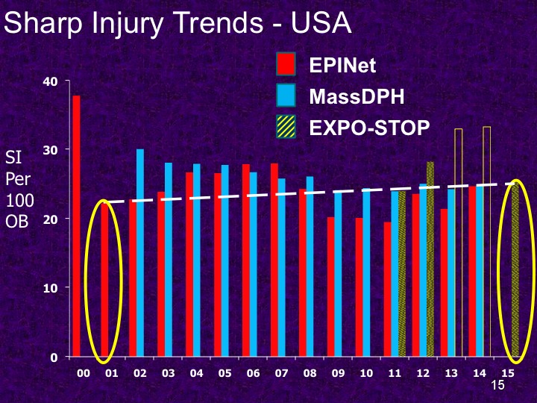

Slide 16
Is “Occup Beds” an appropriate denominator?
Does not accommodate the recent
changes in patient “throughput”
Grimmond T & Good L. EXPO-S.T.O.P.-2012: Year Two of a national survey of sharps injuries and mucocutaneous blood exposures among healthcare workers in USA hospitals. J Assoc Occ Hlth Prof 2015;35(2):52-57
Grimmond T & Good L. EXPO-S.T.O.P.-2015: Unpublished

Slide 17
Is “Occup Beds” an appropriate denominator?
Does not accommodate the recent
changes in patient “throughput”
Sharps Injuries SI) | 2012 | 2015
SI/100 FTE | 2.2 | 2.1
SI/100 Nurse FTE | 3.3 | 3.2
SI/1000 Adj patient days | 0.43 | 0.36
Grimmond T & Good L. EXPO-S.T.O.P.-2012: Year Two of a national survey of sharps injuries and mucocutaneous blood exposures among healthcare workers in USA hospitals. J Assoc Occ Hlth Prof 2015;35(2):52-57
Grimmond T & Good L. EXPO-S.T.O.P.-2015: Unpublished

Slide 18
US Nurse - SI rate / 100 FTE
Grimmond T & Good L. EXPO-S.T.O.P.-2012: Year Two of a national survey of sharps injuries and mucocutaneous blood exposures among healthcare workers in USA hospitals. J Assoc Occ Hlth Prof 2015;35(2):52-57
Grimmond T & Good L. EXPO-S.T.O.P.-2015: Unpublished

Slide 19

When did Sharp Injury Occur?
During Use e.g. suturing, blood-draw | 48%
After Use but before Disposal e.g. clean-up, recap, walk w sharp | 38%
During Disposal e.g. Overfilled, protrude, puncture | 8%
Improper Disposal e.g. bed, table, floor, trash bag | 5%
Data averaged from combination of EPINet 2013 + Massachusetts DPH 2014 + Grimmond et al 2010

Slide 20
Who gets Stuck?
Nurse/Nurse Asst | 46%
Doctor | 37%
Tech/Attend/Ther | 16%
Envir Serv | 4%
Average of combined EPINet 2013 + Massachusetts 2014 + EXPO-STOP 2015

Slide 21
% SI in Surgical procedures
42%
Reasons why now high…
  More surgeons reporting their SI
  Less SED used in Surg
  Increasing SED use in wards
Average of combined EPINet 2013 + Massachusetts 2014 + EXPO-STOP 2015

Slide 22
Why is incidence not decreasing?

Slide 23
Why is incidence not decreasing?
Workloads; Resources
Regulations: Nil / Weak / Avoid
Training not to “competency” level
Competition with other issues (HAI)
HCW safety culture is “bridesmaid”
Don’t know recent rates in Aust/NZ!

Slide 24
Learning Objectives
Discuss Sharps Injury (SI) trends in US
Compare US trends with Australia & NZ

Slide 25
ACIPC 2014 SI Survey
Terry Grimmond, Nicole Vause & Jane Woodley
10 Q’s
College website and email responses
151 hospitals responded
47% private (Aust total private = 45%)

Slide 26
ACIPC 2014 SI Survey Results
Comparison with US…
 | US EXPO-STOP 2015
SI/100 Occ beds | 25.2
SI/100 FTE | 2.1
Nurse SI/100 FTE | 3.2
Nurse as % of Total | 46%
Dr as % of total | 37%
Surg Proc as % of Total | 42%

Slide 27
ACIPC 2014 SI Survey Results
Comparison with US…
 | US EXPO-STOP 2015 | Aust ACIPC 2014
SI/100 Occ beds | 25.2 | 14.1
SI/100 FTE | 2.1 | 3.2
Nurse SI/100 FTE | 3.2 | 3.2
Nurse as % of Total | 46% | 52%
Dr as % of total | 37% | 36%
Surg Proc as % of Total | 42% | 50%

Slide 28
Q1. What % of hollow-bore sharps used are Safety Engineered Devices (SED)?
Ponder…
…how many HCW are using SED?
…are they activating SED correctly?
Research Q’s
Q2. Of the SED used, what % are activated correctly?
? Method

Slide 29
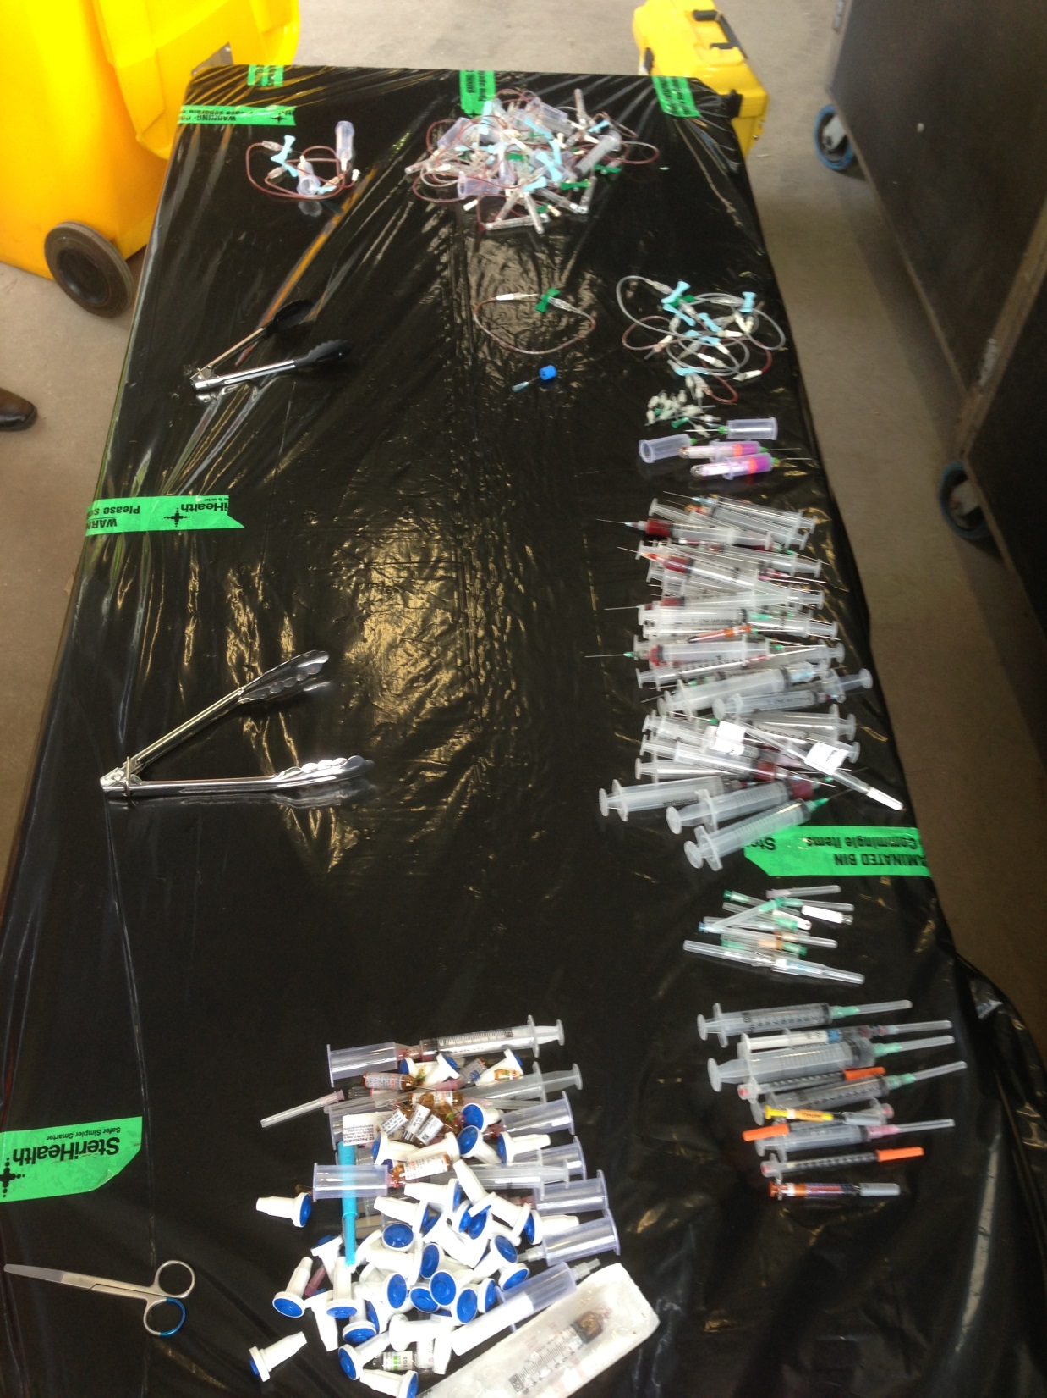
Notes:
A quick recap of US exposure history….
In the US in 2000 there was only one major database we could readily access – and that was from Janine Jagger’s EPINet Team.
Using data from 26 sentinel hospitals they documented that prior to OSHA’s Needlestick Prevention Act, the average US exposure incidence was
38 SI and 11.6 Mucocutaneous exposures per 100 Occupied Beds. This means 50 staff were exposed for every 100 of your Occupied beds!
CLICK… Extrapolating across US they calculated over ONE MILLION HCW were exposed each year, including 800,000 sharps injuries.
This was a travesty – it wasn’t because US didn’t have Safety devices – in 1996 US already had >1,000 SED patents registered ! No, it was COST and APATHY.
CLICK… There was an urgent need for action and many organizations lobbied together to successfully convince government to mandate the use of SED - and the Needlestick Safety and Prevention Act became law in April 2001 .
CLICK for next slide

Slide 30

Comparison of Sharps Audits
 | USA 2013*
% that were SED | 50%
% SED NOT activated | 22%
% “sharp” at disposal | 44%
% Needles capped | 33%
Can (ON) 2016⁺
86%
9%
18%
23%
Aust 2013^
30%
19%
54%
21%
*Grimmond T. Use and activation of safety engineered sharps devices in a sample of 5 Florida healthcare facilities. J Assoc Occ Hlth Prof 2014;34(1):13-15.
+Grimmond T. Use and activation of safety engineered sharps devices in 6 Ontario Hospitals. Unpublished data.
^Grimmond T. Frequency of use and activation of safety-engineered sharps devices: a sharps container audit in 5 Australian capital cities. Hlth Inf 2014;19(3):95-100.
Notes:
But Engineering Controls are NOT the first line of defense.
To eliminate ANY hazard, an international hierarchy of controls are recognised and these apply perfectly to Blood exposures:
Interestingly SED do NOT come first!
(go through each and cover examples)
CLICK for next slide

Slide 31
Why are SED not being activated?
Insufficient training
Laziness
Low safety culture
“not necessary”
No Time
Too hard
Too risky
Notes:
But Engineering Controls are NOT the first line of defense.
To eliminate ANY hazard, an international hierarchy of controls are recognised and these apply perfectly to Blood exposures:
Interestingly SED do NOT come first!
(go through each and cover examples)
CLICK for next slide

Slide 32
Learning Objectives
Discuss Sharps Injury (SI) trends in US
Compare US trends with Australia & NZ
List 5 proven strategies to reduce SI
Discuss research needs in Australia & NZ

Slide 33
Hierarchy of Hazard Controls
Elimination of hazards
  e.g. Needle-less drug delivery systems, oral treatment
Engineering Controls
  e.g. Safety engineered sharps devices
Administrative Controls (resources)
  e.g. Standard Precautions, Resources, Training
Work Practice Controls (rules)
  e.g. No re-cap, No needle removal, sharps container siting
Personal Protective Equipment
  e.g. gloves, faceshield
Joint ILO/WHO guidelines on health services and HIV/AIDS.
http://www.who.int/hiv/pub/prev_care/ilowhoguidelines.pdf?ua=1

Slide 34
How do low-incidence Hospitals reduce SI?
High Institutional safety culture
All staff
  well informed
  well trained
  Well equipped (with SED)
(But…neither Aust nor NZ have specific SED legislation…)

Slide 35
“Safety Culture”
Increasing staff “Sharps Awareness”
Internal Feedback
  Regular Review on Safety C’tee
  Regular Reports Out (not just up)
  Monthly Newsletters
  Publish “NIL SI Units” for month/Qtr
  Cafeteria Exhibit
External PR
  Assoc newsletters
  Conference papers
  Journals & Lay Press

Slide 36
Best Practices of Low-Exposure Hospitals
EDUCATION — New Hires
  One-to-One with every clinical new hire
  Sharp safety taught during orientation
  Practice & competency validation for all SED
  “Safety Responsibility” sheet

Slide 37
Best Practices of Low-Exposure Hospitals
EDUCATION — On-going
  Simulation Lab
  Mandatory review every 2 yrs
  Mandatory online program
  Use vendors, clinical educators, include weekends, nights
  Mandatory post-injury education
  Monthly e-mail “Safety Tips”

Slide 38
Best Practices of Low-Exposure Hospitals
MANAGEMENT INVOLVEMENT
  Reporting; Praise for safe units
  Include in Committee Reports
  Trends & Transparency
  Management + employee investigation
  On-line reporting
  Workplace Controls
    procedure scripts (phlebotomy “I need you to hold still”...)
    Signs on door (“Do not enter – sharps procedure”)
  “I require them to own it & be accountable”

Slide 39
Best Practices of Low-Exposure Hospitals
EMPLOYEE HEALTH ATTITUDE
  “Drill Down” on every injury
  Attention to trends, problem procedures
  Passion and professional commitment
  Sharps C’tee Waiver before use of non-SED
  “I don’t feel our results are that good –our goal is zero”
STAFF REPRESENTATION
  Safety Advocate Breakfasts
  (Users, OHS, Managers, CEO)

Slide 40
Learning Objectives
Discuss Sharps Injury (SI) trends in US
Compare US trends with Australia & NZ
List 5 proven strategies to reduce SI
Discuss research needs in Australia & NZ

Slide 41
SI Research
No data = “No problem”
“No problem” = no resources
We need SI incidence back on radar

Slide 42
Research needs in Aust & NZ
National, ongoing, public databases
Studies on SI reported vs not reported
Case studies of hospital SI incidences
Successful case studies of SI reduction
Incidences of SI in non-hospital sector

Slide 43
The importance of Zero

Slide 44


Slide 45

July 14 RESULTS OF QUALITATIVE RESEARCH ON IMPLEMENTATION OF
INFECTION CONTROL BEST PRACTICES IN EUROPEAN HOSPITALS
Dr. Hugo Sax, University Hospital Zurich, Switzerland
July 21 BEHAVIOURAL AND ORGANIZATIONAL DETERMINANTS OF
SUCCESSFUL INFECTION PREVENTION AND CONTROL INTERVENTIONS
Dr. Enrique Castro-Sánchez, Imperial College London, England
August 18 (Free Teleclass)
USE OF HYPOCHLORITE (BLEACH) IN HEALTHCARE FACILITIES
Prof. William Rutala, University of North Carolina Hospitals
August 25 APPLICATIONS AND LIMITATIONS OF DIPSLIDES AND PCR FOR
REAL-TIME ENVIRONMENTAL CONTAMINATION EVALUATION
Dr. Tobias Ibfelt, Copenhagen University Hospital, Denmark
Sponsored by Virox Technologies Inc, (www.virox.com)
September 15 INFECTION CONTROL AND PET THERAPY

Slide 46


Slide 47


