Slide 1

Joining the Ranks: Mannequins and the Inside Story
Live broadcast from the 2018 conference of
Infection Prevention and Control Canada – Banff, Alberta
Ghazwan Altabbaa MD MSc CHSE FRCPC and Dione Kolodka, IPC
Alberta Health Services
University of Calgary
www.webbertraining.com
May 29, 2018

Slide 2
CME Disclosure
Ghazwan Altabbaa is a physician at Alberta Health Services and Faculty member at University of Calgary.
Dione Kolodka is a staff at Infection Prevention Control at Alberta Health Service.
No financial disclosures for both.

Slide 3
Project Team
Team Lead
Dione Kolodka
Joseph Kim, MD
Gwyneth Meyeres
Ghazwan Altabbaa
IPC Team
Kim Houde
Pam Ritchie
Zaheeda Jessani
Kathyrn Linton
Nisha Punja
Corrinne Pidhorrney
Josephine Kalung
Ruziyya Ramazanova
RN Team
Jamie Lawrence
Laura Pratt
Robin Minhas

Slide 4
Agenda
What is simulation?
How does simulation look like for Infection Control?
IPC and Medical Education
Our story & their story: Mannequins reporting
Healthcare providers joining the conversation
What is next?

Slide 5
What is simulation
The technique of imitating the behaviour of some situation or process by means of a suitably analogous situation or apparatus, especially for the purpose of study or personal training.

Slide 6
Some definitions
Fidelity refers to the accuracy with which the simulation and/or simulation device imitates reality.
High, Medium, Low: high would be full body mannequin with physiologic modelling and low would be basic CPR manikin.
Task trainers: devices designated to provide experiences in specific skills or simulation (e.g. airway management).
Full-body simulator: electromechanical outfitted manikin of varying fidelity.
VR: computer-generated representation of a physical entity (e.g. bronchoscopy)
Haptic: physical feedback of device.
Immersive environment: full-scale simulation by physical devices alone or in combination with VR to recreate a health-care setting.
Debriefing: reflective post-scenario discussion of key activities, events and principles from experience.

Slide 7
Some history
First introduced in 1960’s in anaesthesia, then expanded to other medical specialties. Dr. Stephen Abrahamson at USC.
Especially in the 1990’s widespread: ability of simulation to provide a unique procedural and cognitive training platform and train repetitively on complex tasks where mistakes become powerful learning vehicles rather than negative outcomes at bedside.
The old axiom of see one, do one, teach one (practising on patients) may no longer be appropriate given concern with patient safety.
Now it is expected that trigness have some basic competencies before and during learning with actual patients.
This applies to all levels of education from UME to PGME and CME.
More ingrained in medical education given move towards development and demonstration of learner competencies.
Identified as a high research priority in medical education.
At the regulatory level, simulation is allowed to meet the minimum quotas for procedures, situations, and management challenges.
American board of anasthesiology has mandated simulation as part of its maintenance of certification program since 2000.
It’s category 3 in our MOC according to RC.
It is likely that simulation will play an increasing role in recertification activities.

Slide 8
Video 1
This is a sample video of a simulation based activity.

Slide 9
Video 2
This is a sample video of a simulation based activity that has an IPC learning objective.

Slide 10
IPC and Medical Education

Slide 11



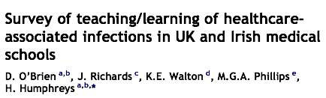



Slide 12
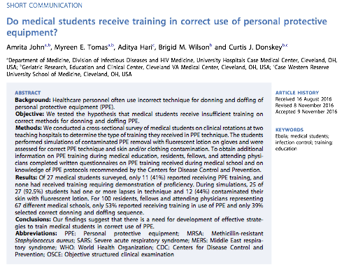

Slide 13



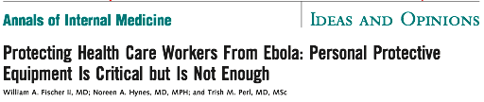
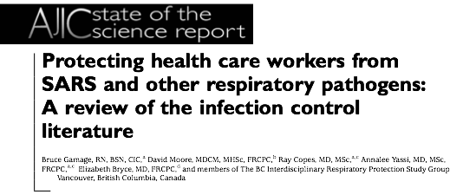

Slide 14
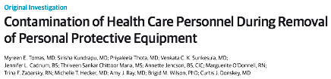
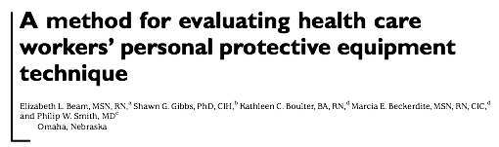
Most HCWs not very good at donning and doffing PPE
with high rates of skin/clothing contamination

Slide 15
Our story & their story: Mannequins reporting
Here we would like to review some of the observations from our Internal Medicine Residency Program

Slide 16
Healthcare providers joining the conversation
Here we would like to review some of the results in conversations with front line healthcare providers.

Slide 17
What is next?
Discuss some of the action steps applied at this time in residency program.

Slide 18
Discussion

Slide 19


Slide 20

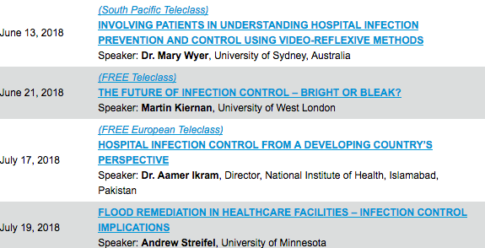

Slide 21


