Slide 1
Sleep Quality in Hospitalized Patients with Infection:
An Observational Study
Farrin A. Manian, MD, MPH
Department of Medicine,
Massachusetts General Hospital,
Visiting Associate Professor of Medicine,
Harvard Medical School,
Boston, Massachusetts, USA
Hosted by Paul Webber
paul@webbertraining.com
www.webbertraining.com
February 12, 2015

Slide 2
Disclaimers
The content of this presentation is solely the responsibility of the speaker and does not necessarily represent the official view of Harvard Catalyst, Harvard University, its affiliate academic healthcare centers, or its corporate contributors.

Slide 3
Disclosures
The speaker has no relevant disclosure

Slide 4
Outline
Background
  Sleep architecture
  Impact of sleep deprivation on physiological and psychological functions
  Impact of sleep deprivation on infections
  Impact of infections on sleep
  Sleep in hospitalized patients
Study of sleep quality in hospitalized patients with infection
  Methods
  Results
  Discussion
Conclusions

Slide 5
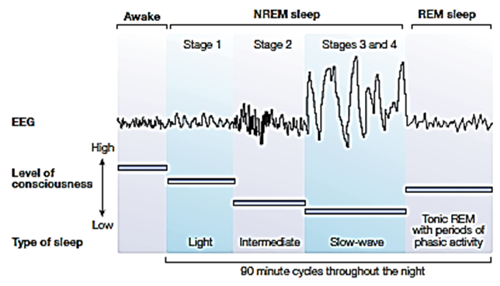
Stages of Sleep
Bryant PA, et al. Nature Reviews 2004;4:457-67

Slide 6
Hypotheses for the Function of Stages of Sleep
Bryant PA, et al. Nature Reviews 2004;4: 457-67
  NREM sleep
    Conserves energy; slow heart rate, decreased blood pressure, cardiac output
    Restores the CNS or components of the CNS e.g. frontal cortex
    Cools the body and the brain
    Promotes immune function
  REM sleep
    Enables psychological and/or emotional adaptation through dreams
    Endogenous stimulation of the CNS
    Reverses brain cooling, quiescence or restorative activity
    Sentinel role by allowing periodic awakenings to survey the environment
    Information processing

Slide 7
Potential Impact of Poor Sleep on Physiological and Psychological Health
Worsening glucose tolerance
Increased irritability, aggressiveness
Impaired memory consolidation
Increased delirium
Poor balance
Decreased ventilator drive
Increased sympathetic cardiovascular activation
Increased blood pressure
Immunological abnormalities/susceptibility to infections

Slide 8
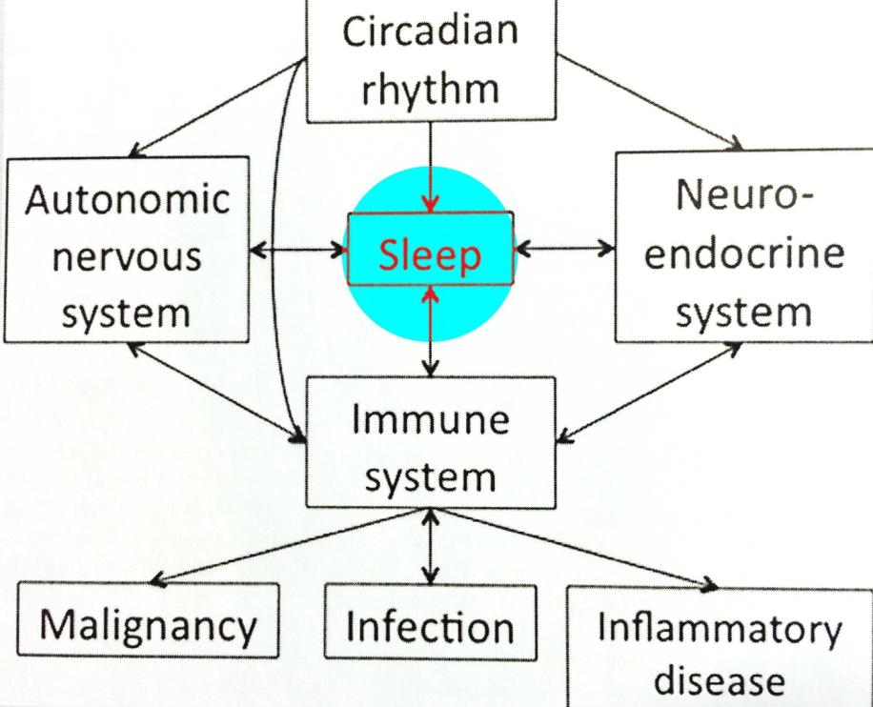
Sleep and Infection
Bryant PA, Curtis N. Ped Infect Dis J 2013;32:1135-37.

Slide 9
Impact of Sleep on Infection
Bryant PA et al. Nature Reviews 2004;4:457-67
Partial sleep deprivation ( 4 hrs) associated with increased TNF and IL-1β production following in vitro stimulation of peripheral blood mononuclear cells
Acute sleep loss may enhance the immune system
Chronic sleep loss may be detrimental to the immune system
Impact of sleep deprivation on cellular and humoral immunity in humans may not be consistent

Slide 10
Impact of Sleep on Pneumonia Risk in Women
Patel SR et al. SLEEP 2012;35:97-101
Prospective, observational cohort study of 56,953 female nurses (37-57 yrs of age)
Pneumonia diagnosis based on physician diagnosis and chest radiograph
Relative risk to 8-hr sleepers
  ≤ 5 hrs, 1.4 (1.1-1.8)
  ≥9 hrs, 1.4 (1.04-1.8)

Slide 11
Impact of Sleep on Susceptibility to Common Cold
Cohen S et al. Arch Intern Med 2009;169:62-67
Healthy volunteers
Challenged with intranasal rhinovirus
“Dose-response” relationship
  Those with < 7 hrs average sleep were 3 x more likely to develop cold symptoms than those who had 8 hrs or more.
  Similar (and stronger) effect with poorer sleep efficiency (proportion of time in bed actually asleep)

Slide 12
Impact of Acute Sleep Loss on
Immune Response to Vaccination
Influenza A: subjects immunized during a period of partial sleep deprivation had lower virus-specific antibody titers (< 50%) at 10 days post-vaccination compared to those of non-sleep-deprived (Spiegel K, et al. JAMA 2002;288:1471-2)
Hepatitis A:subjects immunized after 1 night of total sleep deprivation had significantly lower virus-specific titers at 4 wks (Lange T et al. Psychosom. Med 2003;65:831-5)

Slide 13
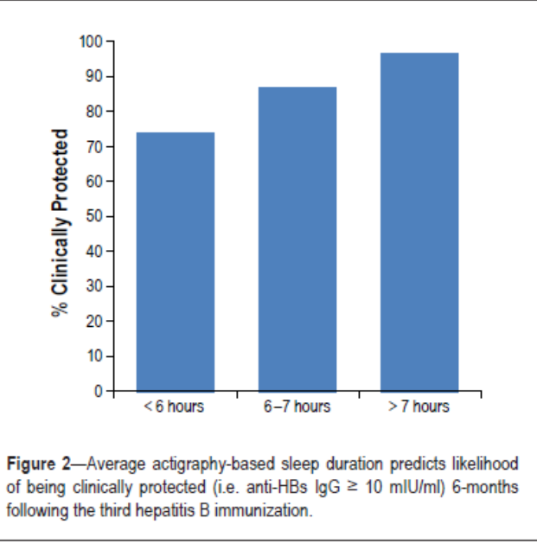
Sleep and Antibody Response to Vaccination
Prather AA, et al. SLEEP 2012; 35:1063-9
Hepatitis B: subjects immunized with < 7 hr of sleep around the time of vaccination, less likely to achieve protective antibody levels after completion of series

Slide 14
Impact of Sleep Deprivation on Patients
Bryant PA et al. Nature Reviews 2004;4:457-67
“Diminished immune responses that result from sleep deprivation in environments such as ICUs might increase the risk of infection…analogous to the proposition that pain has a detrimental effect on the immune response and hospital-acquired infections.”
“ The effects of sleep deprivation might be especially important in populations at particular risk of infection: the elderly, the severely unwell, and the immunocompromised.”

Slide 15
Impact of Infection on Sleep
Majde JA, Krueger JM. J Allergy Clin Immunol 2005;116:1188-98
The need to rest and sleep often reported subjectively in patients with infection e.g. influenza, infectious mononucleosis
Increased non-REM sleep and decreased REM sleep are characteristic of many non-neurotropic acute infection in which sleep has been studied, including viral, bacterial, fungal and parasitic infections
“Although the evidence is limited, it is likely that maintenance of immune function is one reason why we sleep.”

Slide 16
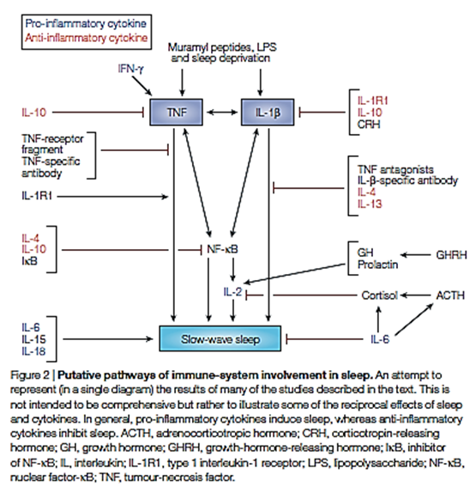
Sleep and the Immune System
Bryant PA, et al. Nature Reviews 2004;4:457-67

Slide 17
Impact of Infection on Sleep
Bryant PA et al. Nature Reviews 2004;4:457-67
Human experiments
  Influenza virus: reduced sleep during the incubation period, increased during the symptomatic period
  Rhinovirus: decreased sleep duration during symptomatic period
  Exposure to high dose LPS:
    increases body temperature, heart rate, cortisol, some cytokines (e.g. TNF)
    first decrease, then increase in slow-wave sleep duration with concomitant decrease in REM sleep.
  Exposure to low dose LPS: increases cytokines but not temperature, heart rate or cortisol level

Slide 18
Impact of Infection on Sleep
Bryant PA et al. Nature Reviews 2004;4:457-67
Human clinical infections and sleep
  Direct CNS infections (e.g. rabies)
  Human African trypanosomiasis (“sleeping sickness”)
  Asymptomatic HIV infection
  Sepsis

Slide 19
Impact of Sepsis on Sleep
Venkateshiah SB, Collop NA. Chest 2012;141:1337-45.
Increased non-REM sleep
Decreased REM sleep
  REM: greatest 02 desaturation/cardiopulmonary variability; ? Protective in pts with borderline hemodynamic status
Loss of normal circadian melatonin secretion
Increase in sleep promoting cytokines e.g. TNF, IL-1 β
Sleep deprivation after septic insult increases mortality in animal models

Slide 20
Sleep in Hospitalized Patients

Slide 21
Sleep Disturbances Among Hospitalized Patients
Common; ~25%-50% of patients on general medicine wards
Often underrecognized or poorly documented by physicians (Meissner HH et al. West J Med 1998;169:146-49)
Multifactorial including
  Noise
  Pain
  Anxiety
  Depression
  Delirium
  Medications
  Frequent awakenings for diagnostic testing
  Underlying illness
  Others…

Slide 22
Why study sleep in hospitalized patients with infection?

Slide 23
Potential Reasons…
Infectious disease-related conditions (e.g. pneumonia and skin and soft tissue infections) are common among hospitalized patients
Infections may lead to increased sleep requirement or poor sleep
Poor sleep may interfere with patients’ ability to recover from their infection
Dearth of data on sleep among patients with infection

Slide 24
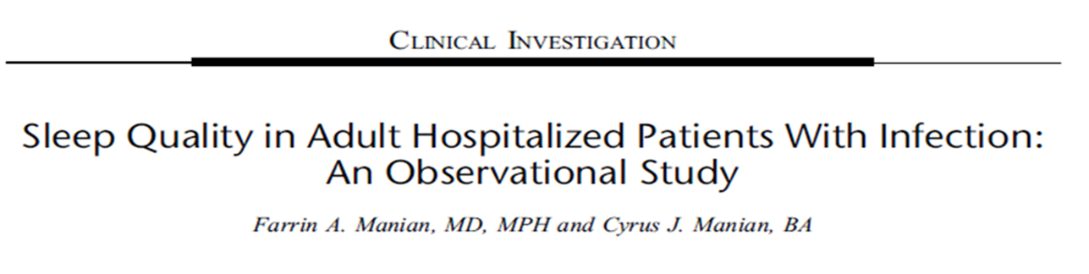
Am J Med Sci 2015;349:56-60
Am J Med Sci 2015;349:56-60

Slide 25
Sleep Quality In Adult Hospitalized Patients With Infection: Methods
Manian FA, Manian CJ. Am J Med Sci 2015;349:56-60
Prospective observational study at 900-bed tertiary care community hospital in St. Louis, Missouri, USA
Study period: June 26, 2008-December 31, 2011
Patients: all adult inpatients (≥ 18 y) seen in consultation by an infectious disease physician (FAM)
Data: Patient were routinely asked about their sleep quality during the previous night primarily as part of their initial encounter

Slide 26
Sleep Quality In Adult Hospitalized Patients With Infection: Methods
Manian FA, Manian CJ. Am J Med Sci 2015;349:56-60
Patient location: all adult hospital wards, including intensive care units (ICUs)
Patients routinely asked as part of their interview: “ How did you sleep last night?”
Categorization of responses
  “Sound” e.g. “great”, “good”, “no problem”.
  “ Unsound”
    “Fair” e.g. “Fair”, “so-so”, “on and off”
    “Poor” e.g. “terrible”, “bad”, “none”, “not much”

Slide 27
Sleep Quality In Adult Hospitalized Patients With Infection: Methods
Manian FA, Manian CJ. Am J Med Sci 2015;349:56-60
Patients reporting unsound sleep were asked to provide the reason (s) for their poor sleep experience
No patient was included in the study more than once
Enquiry was postponed to a later hospital date if the patient’s cognitive abilities did not allow for reliable responses, or if the patient had not spent a full night in the hospital wardroom

Slide 28
Sleep Quality In Adult Hospitalized Patients With Infection: Methods: Patient Data
Manian FA, Manian CJ. Am J Med Sci 2015;349:56-60
Age, race, gender
From 2.26.2008-8.30.2009
  Ward location (ICU vs. others)
  Number of days of hospitalization at enquiry
  Primary infectious disease diagnosis
  List of potentially sedating and/or hypnotic (S/H) medications administered between 8 PM-12AM night before enquiry

Slide 29
Sleep Quality In Adult Hospitalized Patients With Infection: Methods: Patient Diagnosis
Manian FA, Manian CJ. Am J Med Sci 2015;349:56-60
Based on providing physicians’ clinical diagnosis
No attempt made to distinguish surgical and non-surgical patients
Abdominal infections included diverticulitis, abscess and postoperative deep organ space infection
Bloodstream infections included those due to primary ( e.g. vascular access-related) and secondary (i.e. extravascular) sources
“Miscellaneous” infections included diagnoses initially presumed but not necessarily proven to be infectious in origin (e.g. fever of unclear source, encephalopathy, and leukocytosis)

Slide 30
Sleep Quality In Adult Hospitalized Patients With Infection: Methods: Sedative/Hypnotics Categories
Manian FA, Manian CJ. Am J Med Sci 2015;349:56-60
Narcotics
  Morphine, oxycodone, hydrocodone, fentanyl
Benzodiazepines
  Lorazepam, diazepam, temazepam, alprazolam
Nonbenzodiazepine gamma butyric acid agonists
  Zolpidem
Antihistamines
  Diphenhydramine
Miscellaneous
  Quetiapine, tricyclic antidepressants, trazodone, melatonin

Slide 31
Sleep Quality In Adult Hospitalized Patients With Infection: Methods:Institutional Review/Statistics
Manian FA, Manian CJ. Am J Med Sci 2015;349:56-60
Because enquiry into the quality of sleep should be part of the care of all hospitalized patients, patients were not made aware of the conduction of the study
Study protocol approved by the hospital Institutional Review Board with exemption for patient informed consent granted
Statistical analysis
  Chi-square with Yates’ correction
  Fisher’s exact test
  P<0.05 considered statistically significant

Slide 32
Sleep Quality In Adult Hospitalized Patients With Infection: Results
Manian FA, Manian CJ. Am J Med Sci 2015;349:56-60
1,357 potentially eligible patients
  119 (8.8%) excluded because of persistent cognitive limitations
1,238 evaluable cases
  626 (50.6%) were male; 612 (49.4%) female
  1,117 (90.2%) were white; 108 (8.7%) black, 13 (1.1%) other races
  Sound sleep: 646 (52.2%) patients
  Unsound sleep:592 (47.8%) patients
    183 (14.8%) “fair”; 409 (33.0%) “poor” sleep

Slide 33
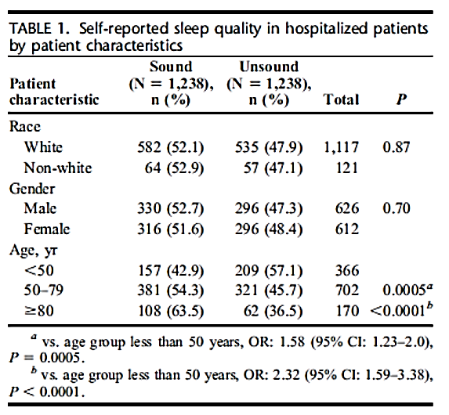
Sleep Quality In Adult Hospitalized Patients With Infection
Manian FA, Manian CJ. Am J Med Sci 2015;349:56-60

Slide 34
Top 10 reasons cited for unsound sleep
N=447 (%)
Manian FA, Manian CJ. Am J Med Sci 2015;349:56-60
Staff disruptions 129 (28.9)
Pain 118 (26.4)
Anxiety 43 (9.6)
Noise 30 (6.7)
Fever 20 (4.5)
Roommate 19 (4.3)
IV access 10 (2.2)
Urination 9 (2.0)
Diarrhea 9 (2.0)
Poor sleep at home 9 (2.0)

Slide 35
Miscellaneous (<2%) reasons cited for unsound sleep by hospitalized patients. N=447
Manian FA, Manian CJ. Am J Med Sci 2015;349:56-60
Uncomfortable bed
Sleep during daytime
Dyspnea
Cough
Hospital
Itching
No sleeping pill
Heartburn
Room cold
Chill
Room hot
Sweating
Constipation
Sinus drainage
Corticosteroids
Nocturnal profession
Watch television
I want my own bed
Baby in the room
10 cups of coffee
Bi-pap machine
Nosebleed
Burping
Hiccoughs

Slide 36
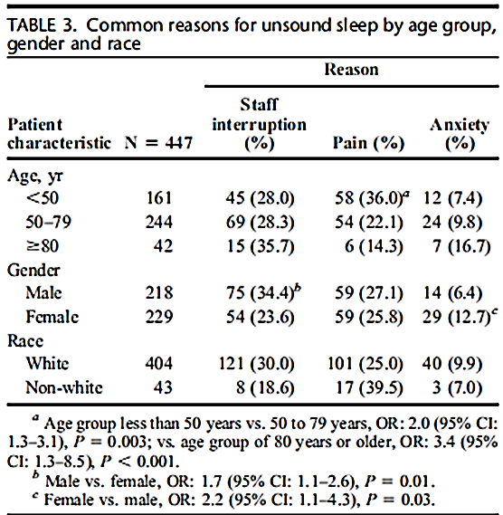
Sleep Quality In Adult Hospitalized Patients With Infection
Manian FA, Manian CJ. Am J Med Sci 2015;349:56-60

Slide 37
Duration of Hospitalization and Sleep Quality In Adult Hospitalized Patients With Infection. N=573
Manian FA, Manian CJ. Am J Med Sci 2015;349:56-60
Days of Hospitalization* Unsound Sleep (%)
1 d 96/163 (58.9)†
2 d 48/109 (44.0)
≥ 3 d 128/301(42.5)
______________________________________
*Range 1-81 d, mean 5.5 d, median 3.0 d
†df=2, P=0.002

Slide 38
Ward Location and Sleep Quality In Adult Hospitalized Patients With Infection. N=610
Manian FA, Manian CJ. Am J Med Sci 2015;349:56-60
Location Unsound sleep (%)
Non-ICU 260/546 (47.6)
ICU 31/64 (48.4)
_______________________________________
P=0.9
No significant differences in the rates of staff disruptions, pain, anxiety and noise between the 2 groups (data not shown)

Slide 39
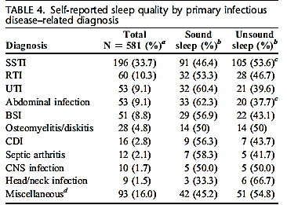
Manian FA, Manian CJ. Am J Med Sci 2015;349:56-60
P=0.045
SSTI:skin/soft tissue infection; RTI:respiratory tract infection; UTI: urinary tract infection; BSI: blood stream infection; CDI: C.difficile infection

Slide 40
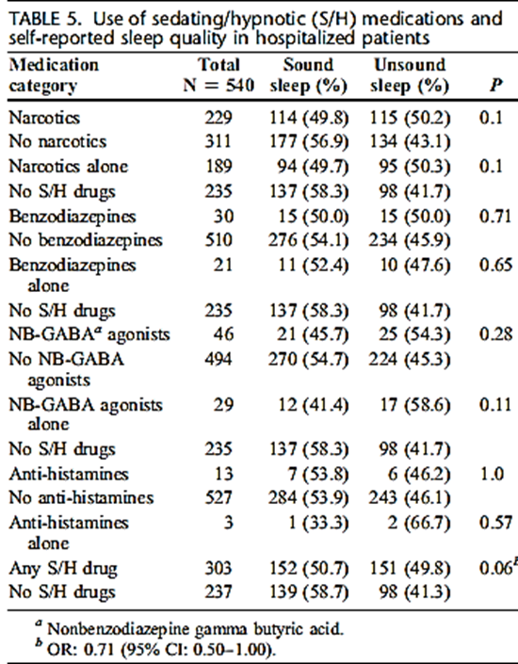
Manian FA, Manian CJ. Am J Med Sci 2015;349:56-60

Slide 41
Use of Sedating/Hypnotic Medications and Sleep Quality in Hospitalized Patients. N=540
Manian FA, Manian CJ. Am J Med Sci 2015;349:56-60
Medication No. (%)
Narcotics 229 (42.4)
NBGBAA* 46 (8.5)
Benzodiazepines 30 (5.6)
Antihistamines 13 (2.4)
Miscellaneous 31 (5.7)
Any S/H medication 303 (56.1)
*Nonbenzodiazepine gamma butyric acid agonists

Slide 42
Discussion of Selected Aspects and Findings

Slide 43
Selected Aspects and Findings of The Study
Manian FA, Manian CJ. Am J Med Sci 2015;349:56-60
Largest study to date of sleep quality in adult hospitalized patients
Only study to date focusing on the study of sleep in hospitalized patients with infection
Self-reported sleep quality under “real” conditions based on patients’ own words, avoiding potential bias inherent in more formal techniques
  Reflects patient’s perception and ultimately satisfaction
  If validated, easily adaptable to monitoring of sleep quality before and after intervention in hospitalized patients

Slide 44
Selected Aspects and Findings of The Study:
Prevalence of Unsound Sleep
Manian FA, Manian CJ. Am J Med Sci 2015;349:56-60
47.8% of our patients failed to report sound sleep
  Similar to 25%-47% rates of sleep difficulties previously reported in patients on general medicine wards
  For several infections (e.g. skin and soft tissue infections, osteomyelitis/diskitis, CNS infections, and head/neck infections) the rates were 50% or more
    ? More severe infections
    ? Patients seen later during their course of their infection

Slide 45
Selected Aspects and Findings of The Study:
Impact of Age and Gender
Manian FA, Manian CJ. Am J Med Sci 2015;349:56-60
Patients ≥ 80 y of age were least likely to report unsound sleep (36.5%) vs <50 y age group (57.1%) and 50-79 y age group (45.7%)
  Recent population-based U.S. survey reported improvement in sleep quality over lifetime with the fewest complaints among people in their 80s (Grandner MA et al. SLEEP 2012;35:395-406)
No significant differences in self-reported sleep quality between men and women (47.3% vs 48.4%, respectively)
  Women generally considered to have a higher rate of insomnia than men in the general population

Slide 46
Selected Aspects and Findings of The Study:
Reasons for Unsound Sleep: Staff disruptions
Manian FA, Manian CJ. Am J Med Sci 2015;349:56-60
Most common cited reason ( ~30% of patients); consistent with previous reports
Men more likely to cite as reason for unsound sleep (34.4% vs 23.6%)
Lower resilience and weaker homeostatic response to sleep disturbing effects of blood drawing among men reported (Vgontzas AN et al. J Clin Endocrinol Metab 2004;89:2119-26.)
Lab experiments: male mice more sensitive to disturbances by certain environmental stressors and more prone to initial loss of sleep (Koehl M, et al. SLEEP 2006;29:124-31).

Slide 47
Selected Aspects and Findings of The Study:
Reasons for Unsound Sleep: Pain
Manian FA, Manian CJ. Am J Med Sci 2015;349:56-60
Second most common cited reason (> 25%)
Younger age group ( <50 y) most likely to report (> 1/3)
Higher likelihood of significant pain among hospitalized patient ≤ 65 y previously reported on general medical wards (Whelan CT et al. Arch Intern Med 2004;164:175-80)
Effective control of pain in hospitalized patients often challenging
Sleep deprivation itself may increase sensitivity to pain (Lautnebader S, et al. Sleep Med Rev 2006;10:357-69)
Use of narcotics had no impact on sleep quality

Slide 48
Selected Aspects and Findings of The Study:
Reasons for Unsound Sleep: Anxiety
Manian FA, Manian CJ. Am J Med Sci 2015;349:56-60
3rd most commonly cited reason (~10%)
More frequent among women ( 12.7% vs 6.4%)
  Anxiety more common among women in the general population (Pigott TA. Psychiatr Clin North Am 2003;26:621-72)
Anxiety not uncommon among hospitalized patients (e.g. the elderly, following myocardial infarction) (Kvaal K, et al. Int J Geriatr Psychiatry 2001;16:690-3; Frazier SK, et al. Heart Lung 2002;31:411-20)
? Role of “infection anxiety” (e.g. “flesh-eating bacteria”, MRSA) due to lay press and media coverage

Slide 49
Selected Aspects and Findings of The Study:
Hospital Days and Ward Location
Manian FA, Manian CJ. Am J Med Sci 2015;349:56-60
First full night of hospitalization most likely to be associated with unsound sleep (58.9%) vs 2 d (44%) or ≥ 3d (42%)
  Previous reports of improved sleep later during hospitalization (Bartick MG, et al. J Hosp Med 2010;5:E20-4; Tranmer JE, et al. Clin Nurs Res 2003;159-73)
No significant difference in rates of or reasons for unsound sleep between ICU and non-ICU patients
  ? Infections as “equalizers”

Slide 50
Selected Aspects and Findings of The Study:
Study Limitations
Manian FA, Manian CJ. Am J Med Sci 2015;349:56-60
Single center study
Patients on consultative service only, usually based on data from first visit
Subjective assessment of sleep quality based on patient self-reporting
  Should be validated by more objective methodology

Slide 51
Selected Aspects and Findings of The Study:
Strengths
Manian FA, Manian CJ. Am J Med Sci 2015;349:56-60
Conducted under “real” conditions during the normal course of patient care, avoiding potential bias and limitations inherent in formal surveys
Virtually 100% response rate, minimizes possibility of sampling errors
Easily reproducible methodology

Slide 52
What can we take away?

Slide 53
Conclusions
Self-reported poor quality or unsound sleep is common among hospitalized patients with infection-related diagnoses
Many patient reported reasons for unsound sleep such as staff disruption, pain, and anxiety may be amenable to intervention
Given the increasingly recognized potential adverse impact of poor sleep on the immune system, more attention should be directed to improving the sleep experience of hospitalized patients

Slide 54
Thank You!

Slide 55

February 19 USE OF HYGIENE PROTOCOLS TO CONTROL THE SPREAD OF
VIRUSES IN A HOTEL
Prof. Charles Gerba, University of Arizona College of Public Health
March 5 PREVENTING CATHETER-ASSOCIATED URINARY TRACT INFECTION
Prof. Sanjay Saint, University of Michigan Medical School
March 11 (Free WHO Teleclass - Europe)
USING THE CORE COMPONENTS OF INFECTION CONTROL
DURING THE EBOLA OUTBREAK
Dr. Sergey Eremin, World Health Organization
March 12 INFECTION PREVENTION AND CONTROL IN CORRECTIONAL SETTINGS
Carolyn Herzig, Columbia University Mailman School of Public Health

Slide 56


