Slide 1

Successful Implementation of Catheter-Associated Urinary Tract Infection Prevention Bundles:
Lessons Learned
Sarah L. Krein, PhD, RN
Ann Arbor VA Center for Clinical
Management Research
University of Michigan
(Nothing to Disclose)
Hosted by Martin Kiernan
Visiting Clinical Fellow
University of West London
www.webbertraining.com
March 31, 2016

Slide 2
Support for this work provided by the U.S. Department of Veteran Affairs HSR&D Service and National Center for Patient Safety, the National Institute of Nursing Research, the Agency for Healthcare Research and Quality and BCBS of Michigan Foundation
The views expressed are those of the presenter and do not necessarily reflect the position or policy of the Department of Veterans Affairs or University of Michigan

Slide 3
Overview
Catheter-Associated Urinary Tract Infection (CAUTI) and indwelling catheter use
Technical components of a CAUTI prevention bundle
Common socio-adaptive (behavioral) challenges when implementing prevention practices
CAUTI Guide to Patient Safety (GPS) tool

Slide 4
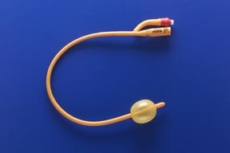
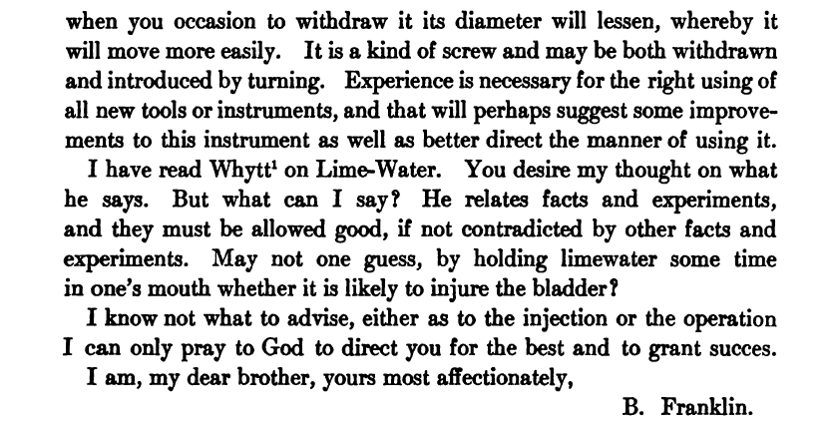
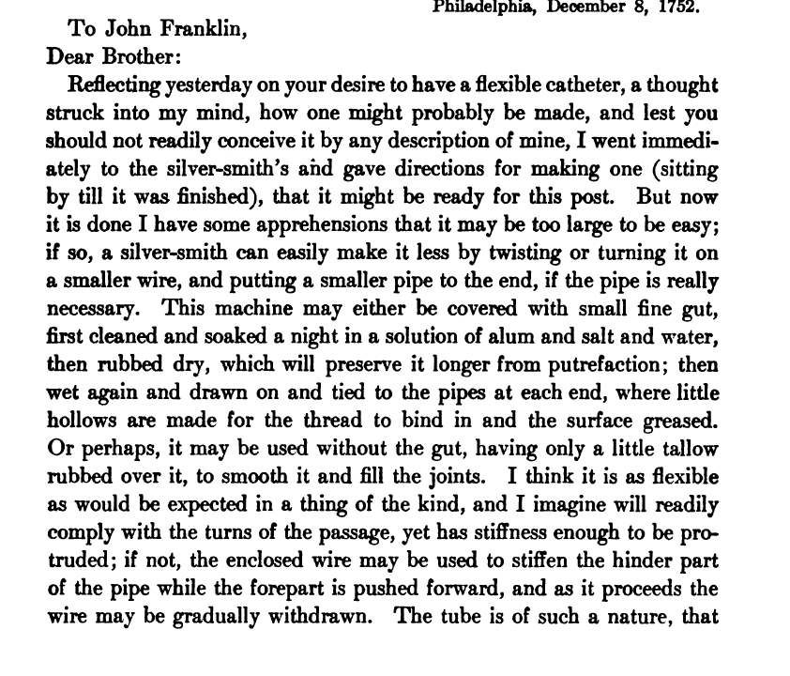
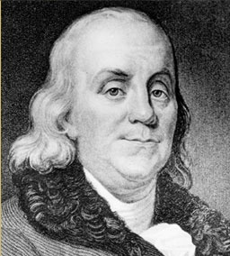
The Medical Side Of Benjamin Franklin (1911)
by William Pepper

Slide 5
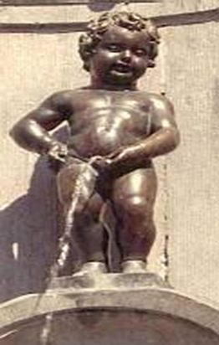
Catheter-Associated
Urinary Tract Infection (CAUTI)
UTI is a common hospital-acquired infection
Most due to urinary catheters
Up to 20 percent of inpatients are catheterized
Leads to increased morbidity and health care costs
Magill, NEJM, 2014; Weber, ICHE, 2011; Umscheid, ICHE, 2011, Rosenthal, Journal Infect, 2011; Ling, CID, 2015; Rosenthal, Infection, 2012; Tao, Int J of Infect Dis, 2011

Slide 6
Policy and Practice Considerations
Centers for Medicare and Medicaid Services (CMS) no longer reimburses U.S. hospitals for the additional costs of certain infections as of October 1, 2008
Reduction of HAIs is a Department of Health & Human Services Agency Priority Goal
Public reporting of infection rates
Joint Commission 2016 National Patient Safety Goals

Slide 7
The Indwelling Urinary Catheter:
A “1-Point” Restraint?
Satisfaction survey of 100 catheterized VA patients:
42% found the indwelling catheter to be uncomfortable
48% stated that it was painful
61% noted that it restricted their ADLs
2 patients provided unsolicited comments that their catheter “hurt like hell”
                Saint, JAGS, 1999

Slide 8

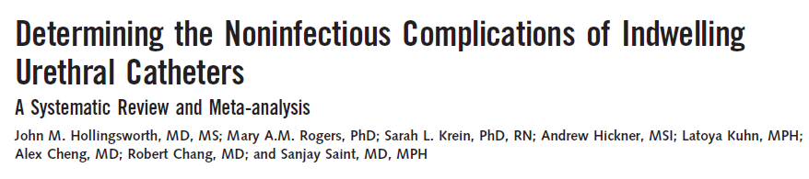
title
SEPTEMBER 17, 2013
“Many noninfectious catheter-associated complications are at least as common as clinically significant urinary tract infections.”

Slide 9
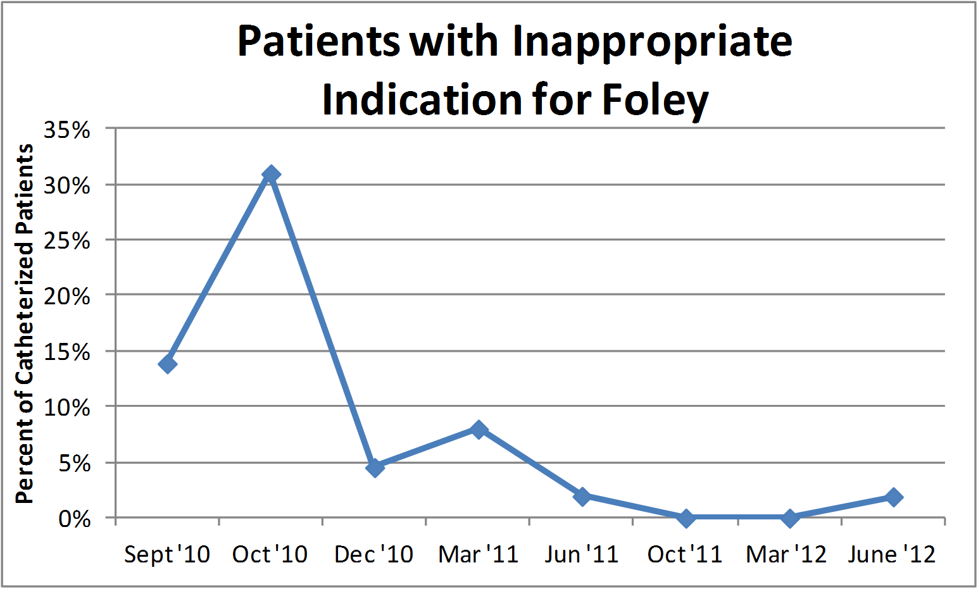
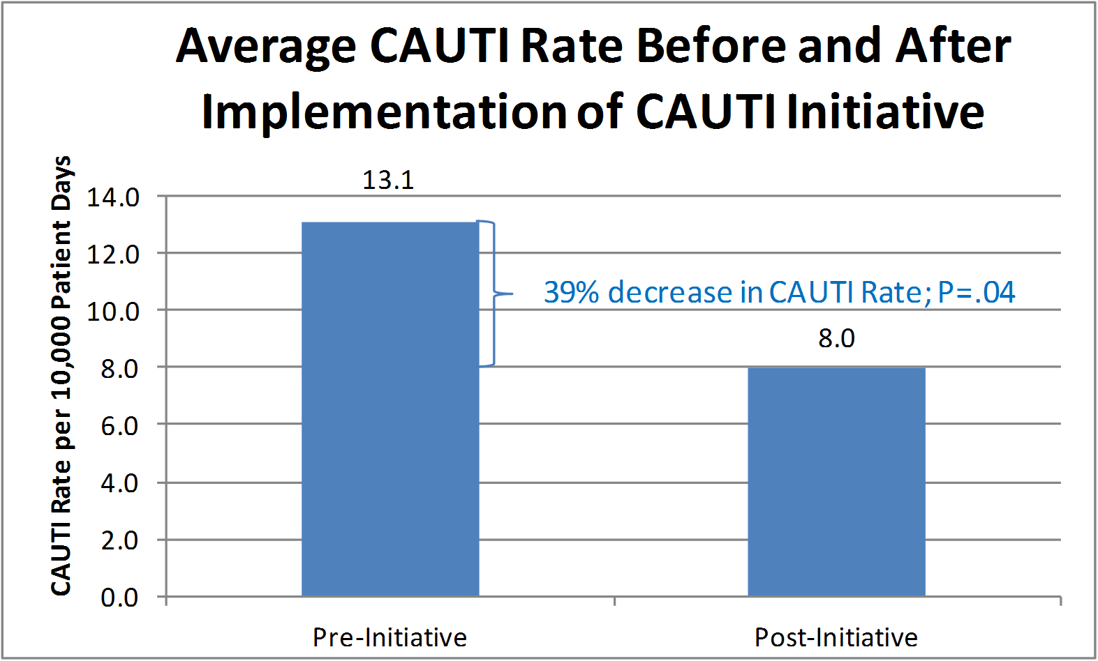
Successful CAUTI Prevention Bundle at a Single Hospital
Miller, ICHE, 2013

Slide 10
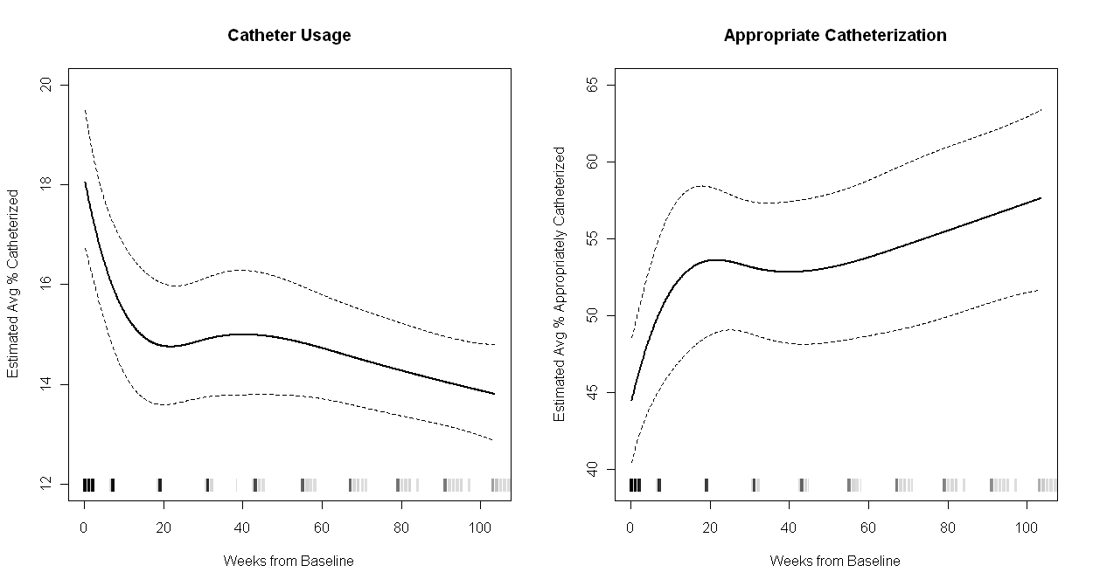
Successful CAUTI Prevention Bundle in Michigan, 2007-2010
~25% relative decrease
~30% relative increase
(Fakih et al. Arch Intern Med 2012)
CAUTI ↓ by 25% in Michigan hospitals (95% CI: 13 to 37% ↓)
CAUTI ↓ by 6% in non-Michigan hospitals (95% CI: 4 to 8% ↓)
Saint, JAMA Intern Med, 2013

Slide 11
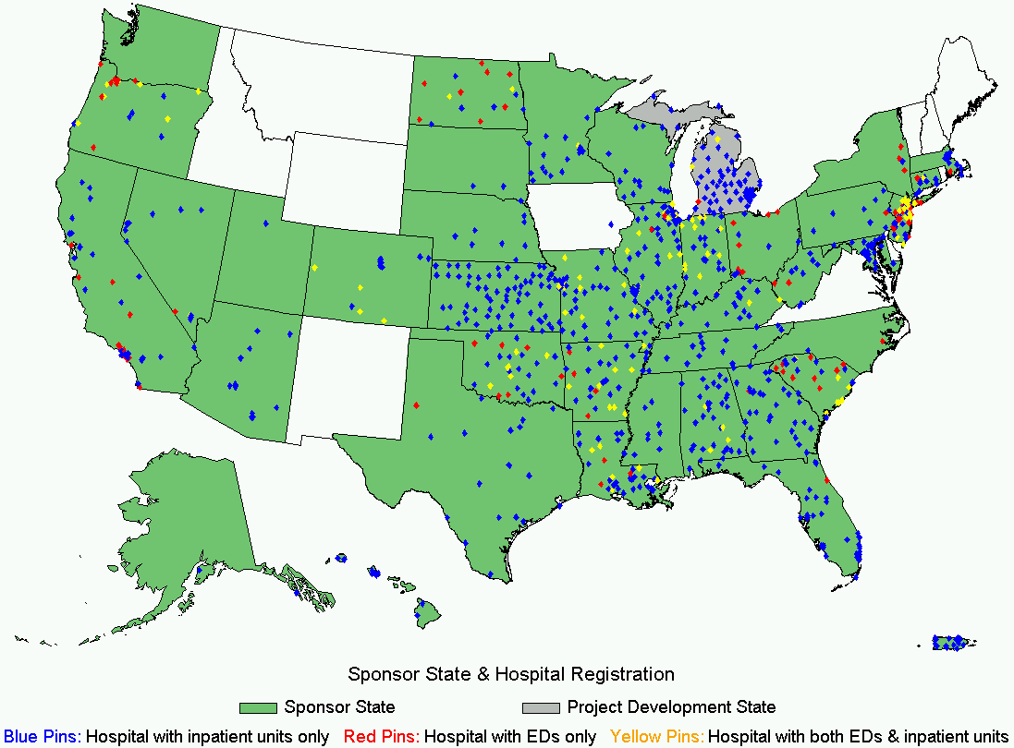
CAUTI Prevention Bundle Spread Throughout the U.S.
Reduction in CAUTI rates and a smaller reduction in catheter use in non-ICUs
No improvement in ICUs
http://www.ahrq.gov/sites/default/files/publications/files/cauti-interim.pdf

Slide 12
What is a Bundle?
    Care Bundles were first developed over 20 years ago. They were used in medical and surgical specialties. One of the first care bundles was fueled by early goal-directed treatment of sepsis.
    (Horner and Bellamy. Contin Educ Anaesth Crit Care Pain (2012)
    A care bundle is a set of evidence based interventions which, when performed together, have a better outcome than if performed individually.

Slide 13
Implementing a
CAUTI Prevention
(aka Bladder) Bundle
Technical
Socio-adaptive

Slide 14
Technical Elements of the CAUTI/ Bladder Bundle
Reducing indwelling catheter use
Proper insertion technique
Proper maintenance
Prompt removal of non-indicated catheters

Slide 15
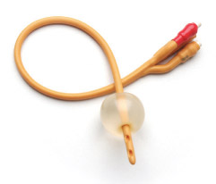
Lifecycle of the Urinary Catheter
1. Preventing Unnecessary and Improper Placement
1
2. Maintaining
Awareness &
Proper Care
of Catheters
4. Preventing
Catheter
Replacement
2
4
3
3. Prompting Catheter Removal
Meddings. Clin Infect Dis 2011

Slide 16
2009 HICPAC Urinary Catheter Indications
A. Examples of Appropriate Indications for Indwelling Urethral Catheters
Patient has acute urinary retention or obstruction
Need for accurate measurements of urinary output in critically ill patients
Perioperative use for selected procedures: urologic surgery or other surgery on contiguous structures of genitourinary tract anticipated prolonged surgery duration (removed in post-anesthesia unit) anticipated to receive large-volume infusions or diuretics in surgery operative patients with urinary incontinence need for intraoperative monitoring of urinary output
To assist in healing of open sacral or perineal wounds in incontinent patients
Requires prolonged immobilization (e.g., potentially unstable spine)
To improve comfort for end of life care if needed
16
Gould, ICHE, 2010

Slide 17
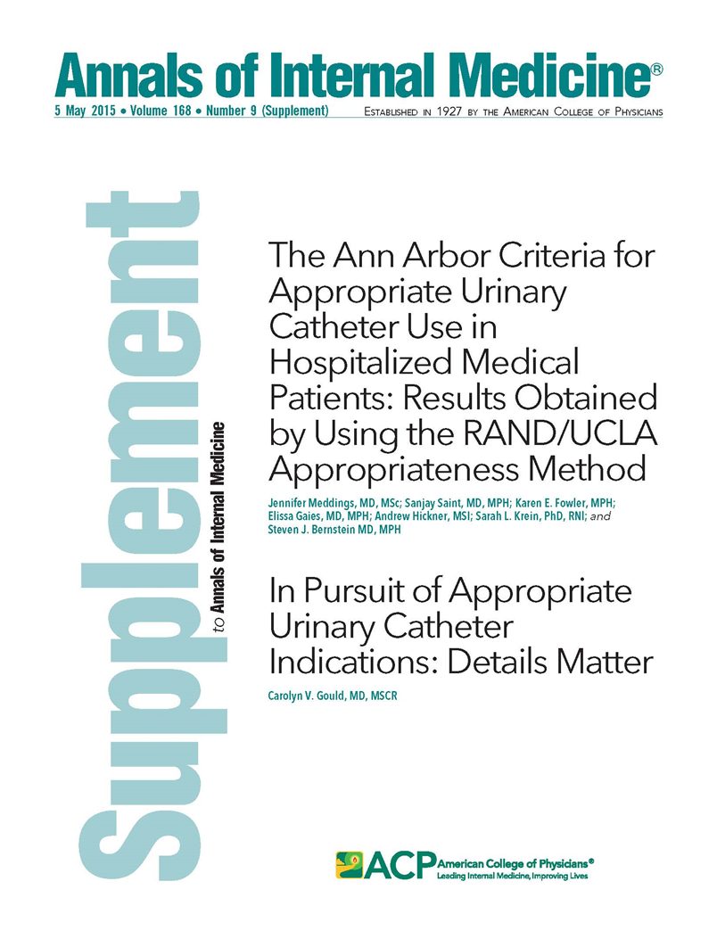
Ann Arbor Appropriateness Criteria
(Meddings, Annals of Internal Medicine, May 2015)

Slide 18
Just because a patient is in the ICU does NOT mean that the patient needs a Foley…
The Key Question is this:
Are hourly assessments of urine output required?

Slide 19
Consider Alternatives
Accurate daily weights
Urinal/commode/bedpan
Condom catheters
Intermittent catheterization with bladder scanning

Slide 20
But if the patient really, really needs a Foley…
Ensure proper aseptic technique is used during insertion

Slide 21
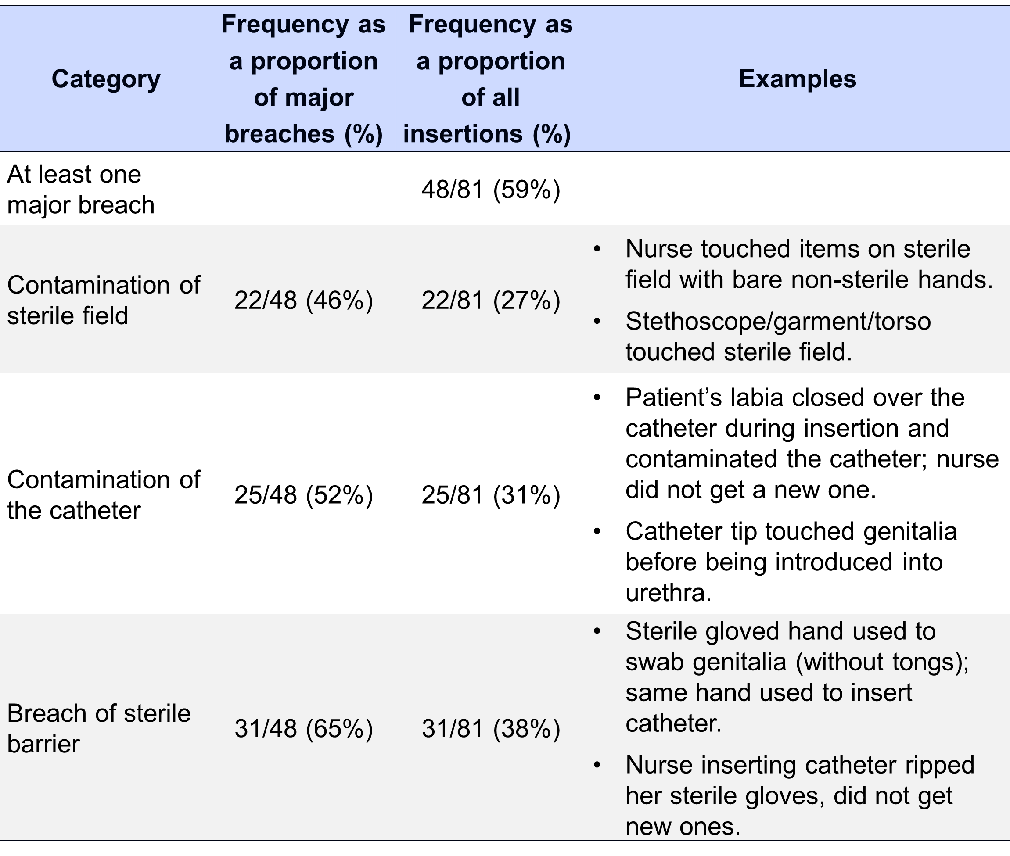
Manojlovich, ICHE, 2016

Slide 22
Lifecycle of the Urinary Catheter
1. Preventing Unnecessary and Improper Placement
1
2. Maintaining
Awareness &
Proper Care
of Catheters
4. Preventing
Catheter
Replacement
2
4
3
3. Prompting Catheter Removal
Meddings. Clin Infect Dis, 2011

Slide 23
Urethral Catheters: Lost in Place?
Training Level | Proportion Unaware
Medical Student | 18%
Intern | 22%
Resident | 28%
Attending | 38%
Saint, Am J Med, 2000

Slide 24
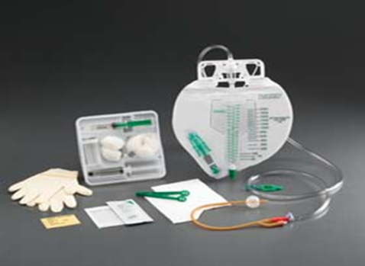
Proper Maintenance
Maintain a closed drainage system
Maintain unobstructed urine flow
  Free of kinks
  Collecting bag below the bladder
  Empty the bag regularly
Use routine hygiene, i.e., do not clean the periurethral area with antiseptics

Slide 25
Lifecycle of the Urinary Catheter
1. Preventing Unnecessary and Improper Placement
1
2. Maintaining
Awareness &
Proper Care
of Catheters
4. Preventing
Catheter
Replacement
2
4
3
3. Prompting Catheter Removal
Meddings, Clin Infect Dis, 2011

Slide 26
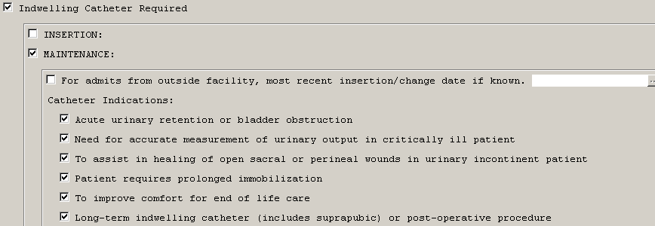
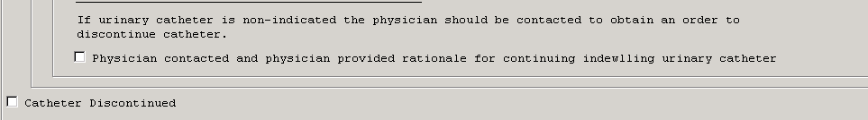
Nursing Template for Removal

Slide 27
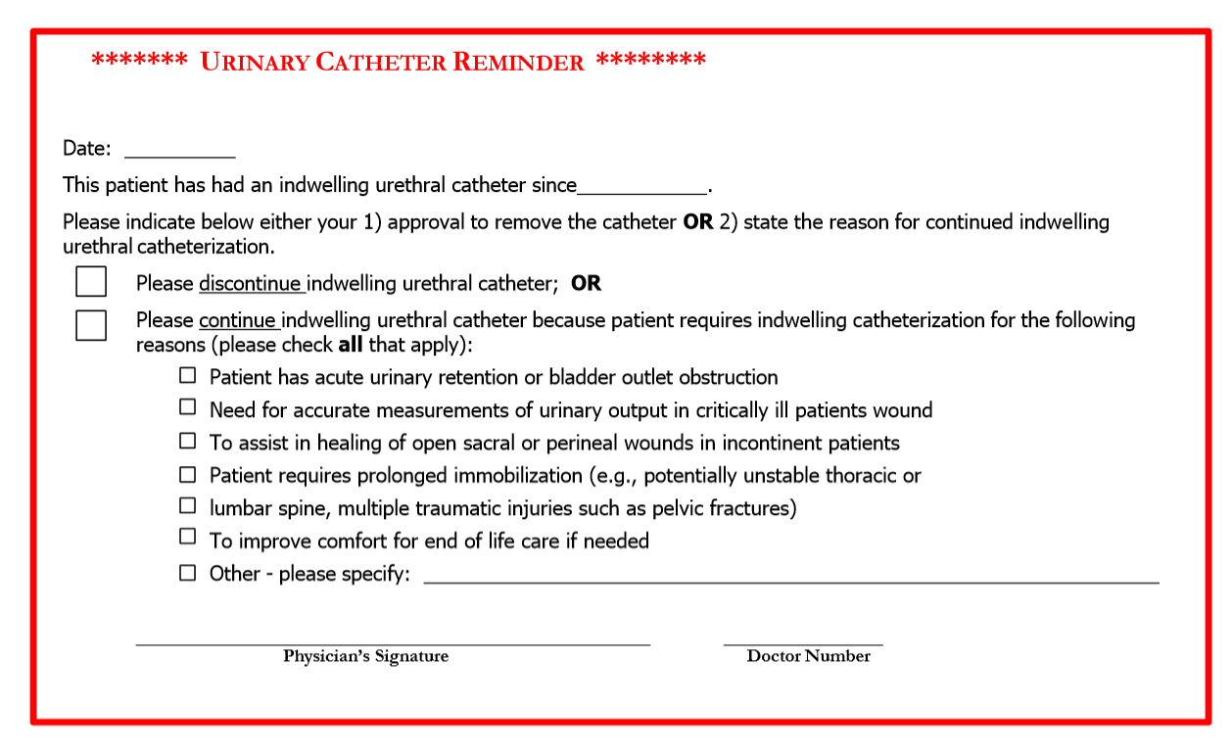
Timely Removal of Indwelling Catheters
30 studies evaluating urinary catheter reminders and stop-orders
  Significant reduction in catheter-associated urinary tract infection (53%)
  No evidence of harm
Meddings, BMJ Qual Saf, 2013

Slide 28
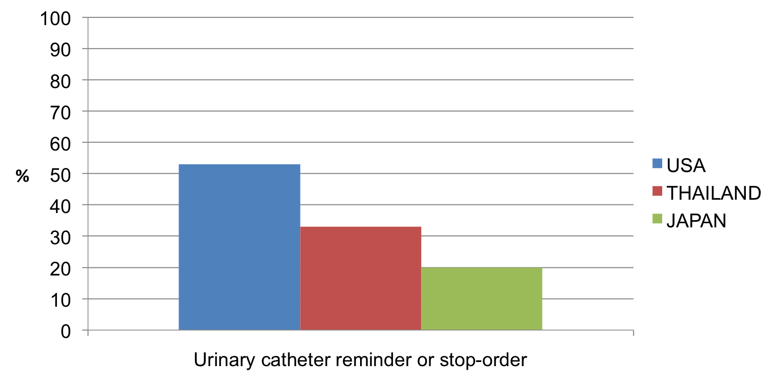
Variable use of urinary catheter reminders/stop-orders
Sakamoto, AJIC, 2014
Apisarnthanarak, ICHE, 2012
Krein, BMJ Quality & Safety, 2015

Slide 29
Lifecycle of the Urinary Catheter
1. Preventing Unnecessary and Improper Placement
1
2. Maintaining
Awareness &
Proper Care
of Catheters
4. Preventing
Catheter
Replacement
2
4
3
3. Prompting Catheter Removal
Meddings, Clin Infect Dis 2011

Slide 30
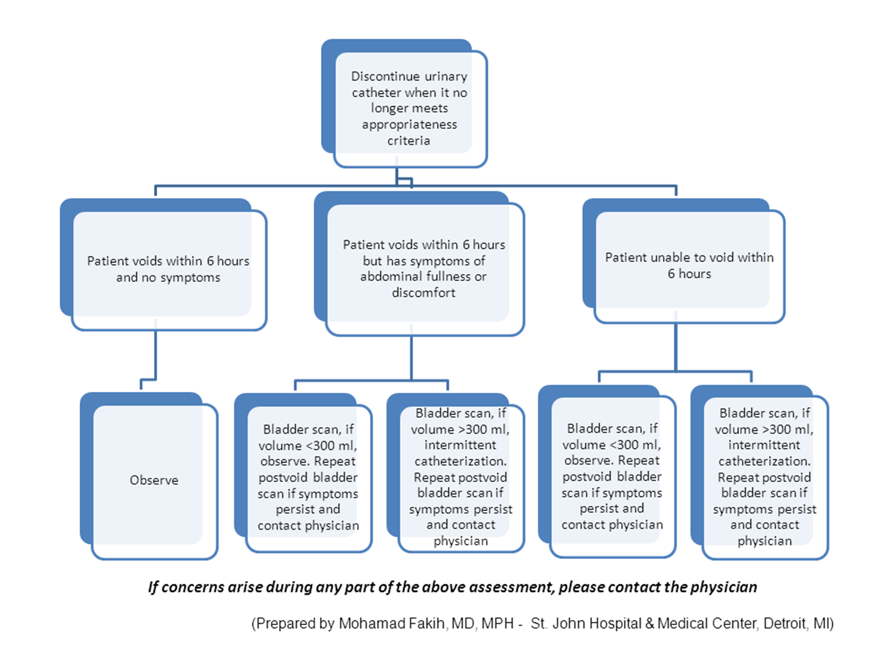

Slide 31
Primary Technical Components
Avoiding the use of the indwelling urinary catheter
Aseptic insertion technique and proper maintenance
Daily assessment and timely removal of the indwelling urinary catheter

Slide 32
Implementing a
CAUTI Prevention
(aka Bladder) Bundle
Technical
Socio-adaptive

Slide 33
Understanding why some hospitals are better than others in preventing infection
Mixed-methods national studies focusing on three device-related infections: CAUTI, CLABSI and VAP
Funded by VA, NIH and AHRQ
interviews and site visits to ~50 facilities across the U.S.
Interviews with over 450 people at various levels
Notes:
Sarah

Slide 34
Implementation challenges

Slide 35
Primary Socio-adaptive Challenge with CAUTI Prevention and Bundle Implementation
Infection Preventionist: “I would say there’s a general perception in the field that urinary tract infections don’t cause a lot of morbidity and mortality compared to the quote, sexy topics such as blood stream infection or surgical site infection or VAP.” (Saint, ICHE, 2008)
Hospital Epidemiologist: “I [nor] anyone else has really been able to get ourselves that excited about trying to prevent bladder colonization.” (Saint, ICHE, 2008)
Director of Nursing, described Foleys as “low tech, low glamour”, noted: “…if we get a Foley infection nobody says, ‘…let’s have a huddle and see how it happened’.” (Krein, JAMA Int Med, 2013)

Slide 36

Primary Socio-adaptive Challenge with CAUTI Prevention and Bundle Implementation
Lack of physician and nurse engagement

Slide 37
Lack of Physician Engagement
Often physicians are unaware or only passively involved in CAUTI prevention efforts
As a charge nurse explained: “If you don’t have the doctors on board you’re just going to be beating your head against the wall. . . .’”

Slide 38
How to Engage Physicians?
(James Reinertsen, IHI innovation Series White Paper, 2007)
Develop a common purpose (patient safety, efficiency)
View physicians as partners (not barriers)
Identify physician champions early
Standardize evidence-based processes
Provide support from leadership for the efforts of the physician champion

Slide 39
Use of data to engage physicians
Director of an intensive care unit:
“Data seems to be the best motivation for physicians… [they] compare rates …. it is sort of an incentive . .”

Slide 40
Reasons for physicians to be engaged or to care about CAUTI prevention and urinary catheter use
Infectious Disease Specialists | Urologists
Reduce CAUTI Reduce antibiotic use Reduce potential of increased resistance and Clostridium difficile disease | Reduce trauma (mechanical complications): Meatal and urethral injury Hematuria
Hospitalists | Geriatricians
Infectious and mechanical complications Potential catheter complications prolonging length of stay Often salaried physicians with incentives based on hospital-based quality and efficiency | Many elderly are frail Urinary catheters are placed more commonly in elderly inappropriately Urinary catheters increase immobility and deconditioning
Fakih, AJIC, 2014

Slide 41
Lack of Nursing Engagement
Concerns about nursing workload/convenience are common . . . .
Clinical Nurse Specialist “I think nurses are so busy . . . They have a lot of things they’re dealing with and trying to keep track of and if a patient has a catheter, it’s almost easier for them.”
BUT that may not be the only issue
Infection Preventionist “I think it’s not just that it’s easier. It’s that nurses are worried, ‘Well do I really want this person hopping out of bed and can I really be sure that they’re going to call me to help them?’ We don’t want there to be any falls. That’s considered to be a never-event in a hospital . . .”
Krein, JAMA Intern Med, 2013

Slide 42
How to Engage Nurses?
Develop a common purpose (patient safety)
View nurses as partners (not barriers)
Identify nurse champions early
Standardize evidence-based processes (and make the right thing to do, the easy thing to do)
Provide support from leadership for the efforts of the nurse champion

Slide 43
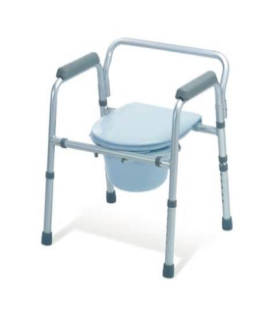
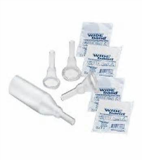
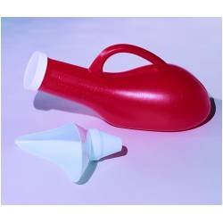
Getting Nurses Involved
Ensuring proper staffing and equipment

Slide 44
Capitalizing on Nurses Priorities
A physician administrator: “Because the nurses on the geriatrics unit wanted to have their patients regain mobility…they viewed mobility as very important …versus the other units where the nurses didn’t necessarily feel that was a real goal..”

Slide 45

Addressing CAUTI Prevention within the
Broader Patient Safety Context
Urinary Catheter Harm
CAUTI
Increased Length of Stay
Patient discomfort
Trauma
Pressure ulcers
Immobility
Venous thrombo-embolism
Falls

Slide 46
Champions
True champions tend to be intrinsically motivated and passionate about the practices they promote
Keep the effort a priority
Provide expertise
Serve as liaison with their peers
Damschroder, Qual Saf Health Care, 2009

Slide 47
First they ignore you, then they laugh at you, then they fight you, then you win.

Slide 48

But, also remember
Preventing CAUTI is a team sport

Slide 49
CAUTI Prevention Team:
Key Roles and Responsibilities
Role or Responsibility | Example of Personnel to Consider
Project coordinator | Infection preventionist, quality manager, nurse manager
Nurse champion (engage nursing personnel) | Nurse educator, unit manager, charge nurse, staff nurse
Physician champion (engage medical personnel) | ID physician, hospitalist, hospital epidemiologist, urologist
Data collection, monitoring, reporting | Infection preventionist, quality manager, utilization manager
(Modified from www.catheterout.org)

Slide 50
Putting our Findings to Work
Identifying and Addressing Common CAUTI Prevention Implementation Challenges

Slide 51
CAUTI Guide to Patient Safety (GPS)
Brief, trouble-shooting guide
Help hospitals or units identify key challenges in their CAUTI prevention efforts
Once the barriers are identified, can then help identify possible solutions
Saint, AJIC, 2014

Slide 52

CAUTI Guide to Patient Safety (GPS)
Online tool
Each question linked to trouble-shooting tips
www.catheterout.org

Slide 53
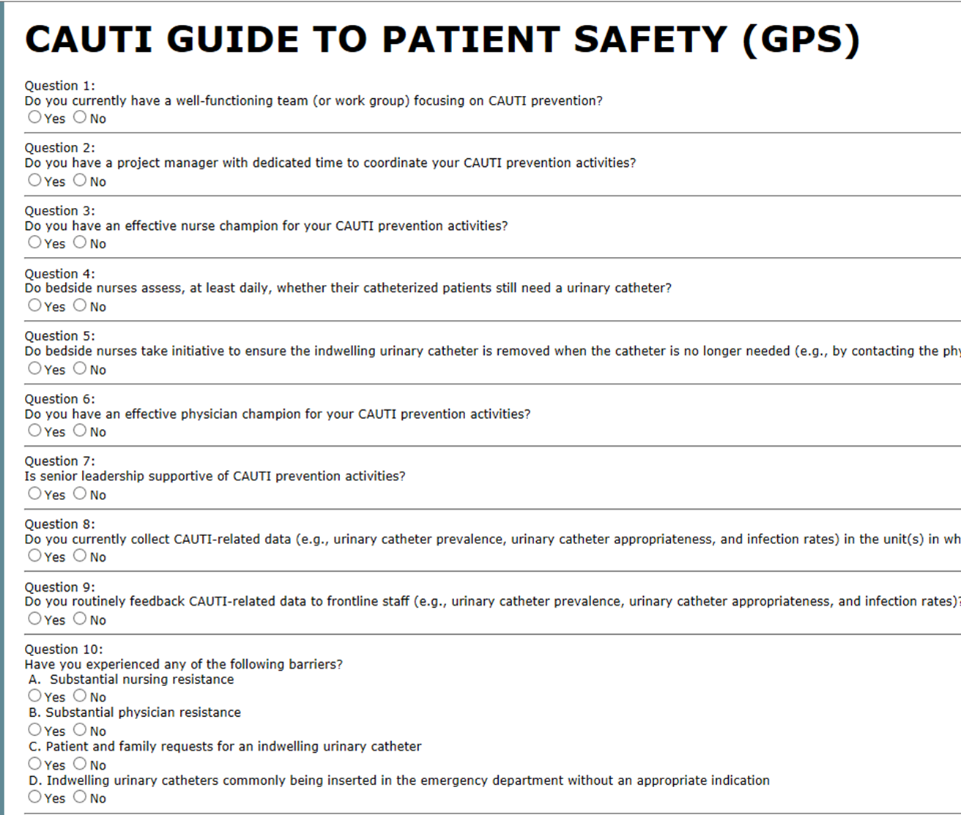
GPS

Slide 54
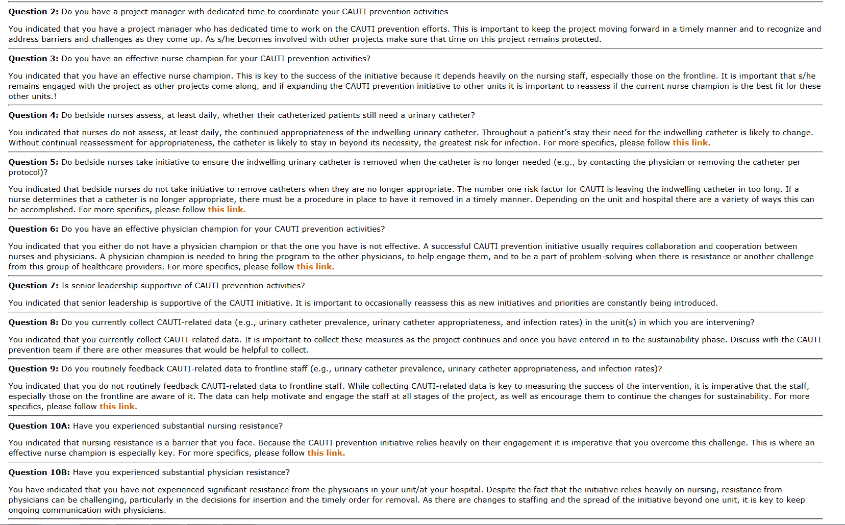
GPS questions

Slide 55
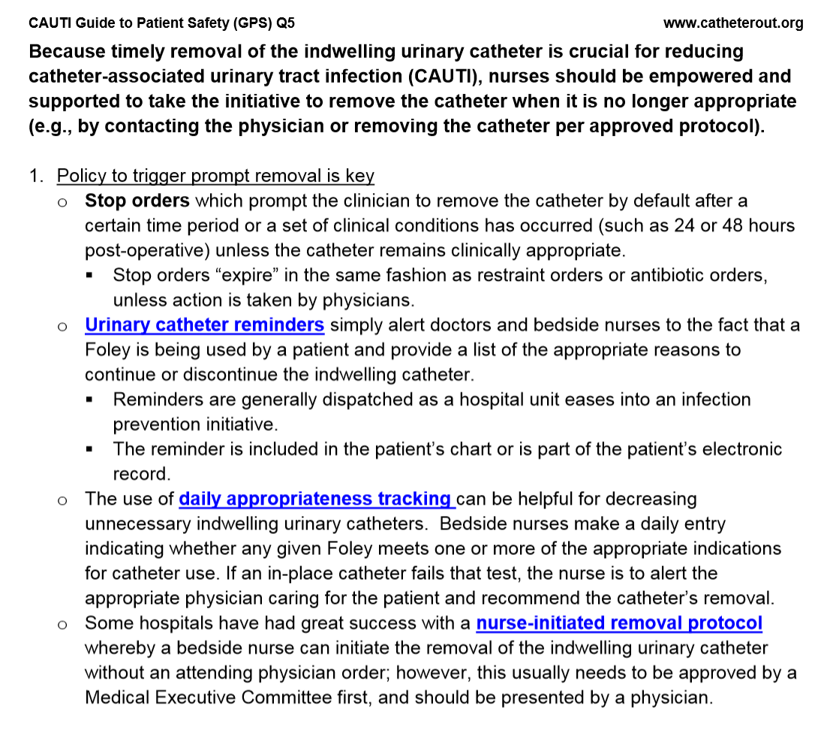
GPS questions 5

Slide 56
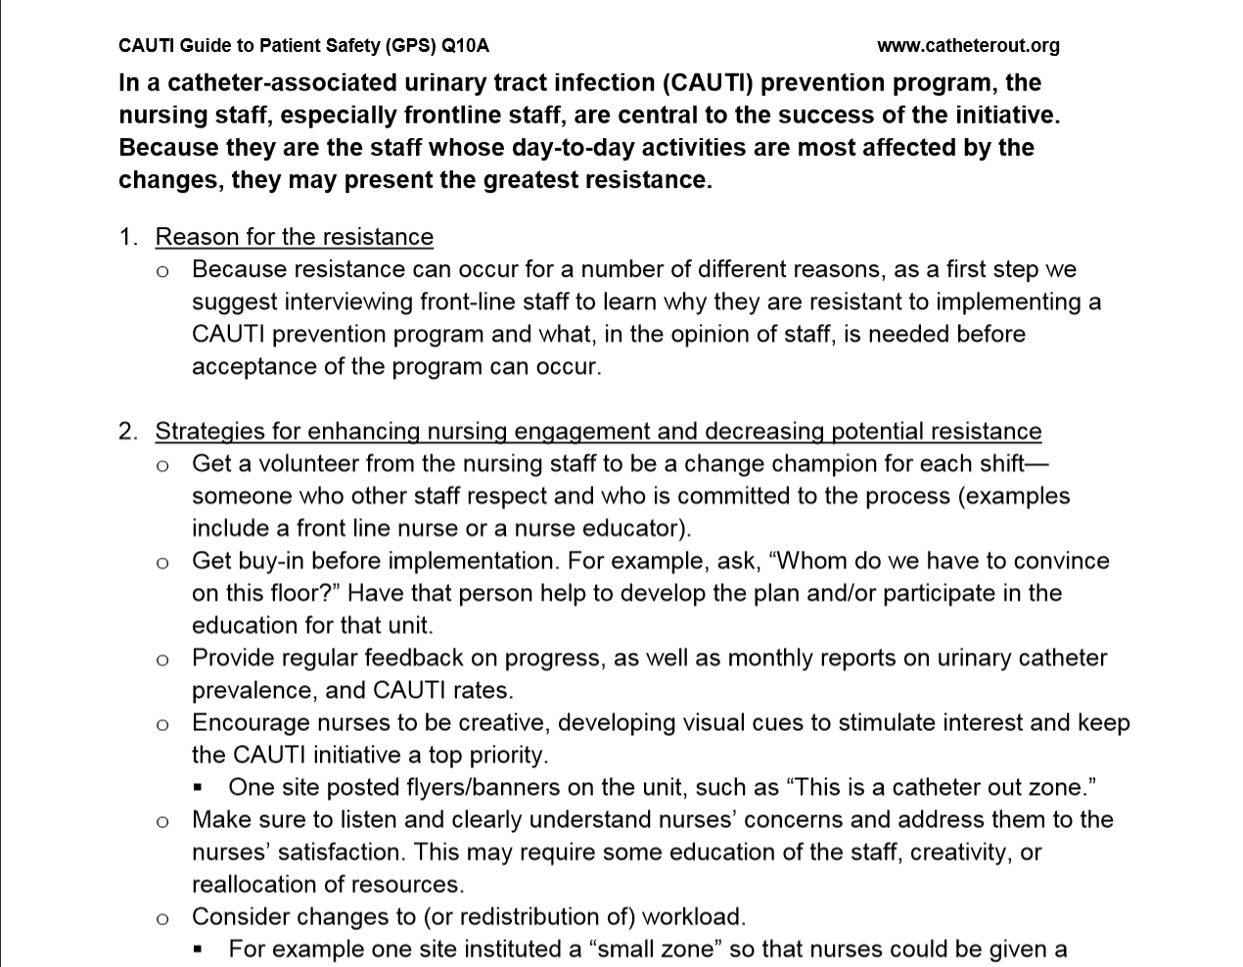

Slide 57

Catheter-Associated Urinary Tract Infection (CAUTI) and indwelling catheter use
Technical components of a CAUTI prevention bundle
Common Socio-adaptive (behavioral) implementation challenges
CAUTI GPS

Slide 58
Conclusions
CAUTI and indwelling catheter use are important patient safety issues
Proven approaches to reduce catheter use and prevent CAUTI but implementation requires attention to technical and socio-adaptive issues
Preventing CAUTI is everyone’s responsibility but takes courage, compassion and conviction

Slide 59

Thank You!
skrein@umich.edu

Slide 60

April 7 PREVENTING INVASIVE CANDIDA INFECTIONS – WHERE COULD WE DO
BETTER?
Dr. Philippe Eggimann, Centre Hospitalier Universitaire Vaudois, Switzerland
April 13 (South Pacific Teleclass)
UTILIZATION OF METHYLGLYOXAL IN MANUKA HONEY TO
REDUCE S. AUREUS NASAL COLONIZATION
Dr. Julian Ketel, Waiariki Institute of Technology, New Zealand
April 20 (Free WHO Teleclass ... Europe)
THE CORE DOMPONENTS FOR INFECTION PREVENTION AND
CONTROL PROGRAMS AND ACTION PLAN
Julie Storr, World Health Organization, Geneva
Sponsored by the World Health Organization
April 13 (Free British Teleclass .... Denver Russell Memorial Teleclass Lecture)
INFECTION PREVENTION – IT’S NOT JUST WASHING HANDS

Slide 61


Slide 62


