Slide 1
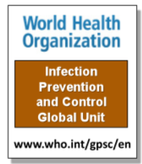
Successful Implementation Strategy for the Prevention of Surgical Site Infections
Sean Berenholtz, MD MHS FCCM Department of Anesthesiology & Critical Care Medicine Armstrong Institute for Patient Safety and Quality
Sponsored by
Hosted by Prof. Joseph Solomkin University of Cincinnati College of Medicine
www.webbertraining.com
February 17, 2016

Slide 2
Roadmap
Review an implementation model used in successful large-scale programs associated with reductions in healthcare-associated infections, mortality, and costs
Review how this model was adapted to achieve reductions in colorectal surgical site infections and improved patient satisfaction.

Slide 3
Preventable Harm in Surgery
50%
50% of all hospital adverse events linked to surgery
At least HALF of those adverse surgical events are avoidable
25% in-patient surgeries followed by complications each year
More than 250,000 avoidable deaths after surgery
http://www.who.int/patientsafety/challenge/safe.surgery/en/

Slide 4
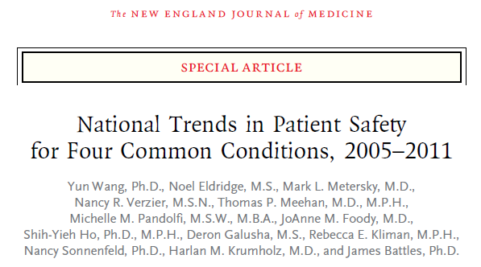
Increasing rates of infection-related and post-procedural adverse events among patients who required surgery
*
N Engl J Med; 370;4:341-351. (January 23, 2014)

Slide 5
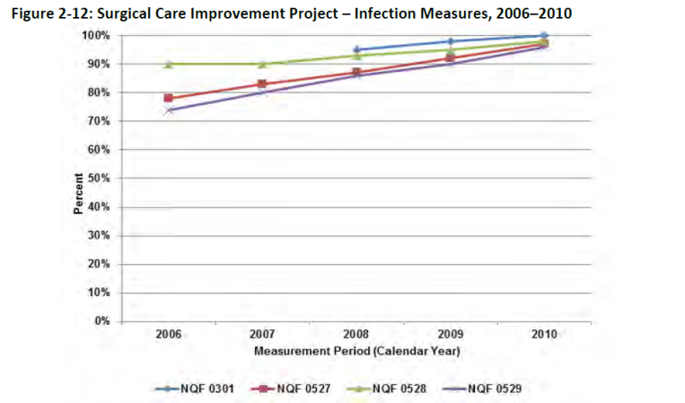
Surgical Care Improvement Project (SCIP)
However, improvements in SCIP measures did not translate into improvements in patient outcomes.
CMS National Impact Assessment of Medicare Quality Measures. March 2012; 42.

Slide 6
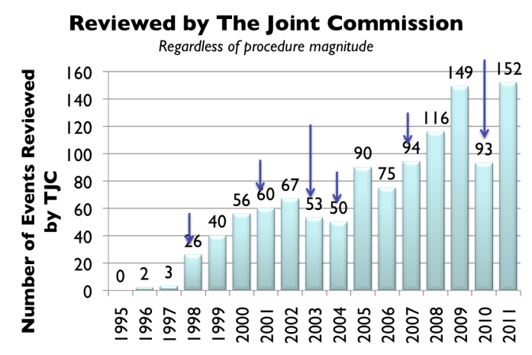
Despite Years Of Technical Intervention, Rates Rose
F
Sentinel Event Alert: Wrong-sided surgery Aug 98
Sentinel Event Alert: Follow-up review of wrong-sided surgery Dec 01
Wrong Site Surgery Summit I Jan 03
Universal Protocol 2004
Wrong Site Surgery Summit II Feb 07
Revised Wrong Site Surgery Definition Jun 10
E
C
B
D
A
“Checklists” do not translate into improved results.

Slide 7
Technical
Work
Evidence-based interventions
Adaptive
Work
Safety culture

Slide 8
How Will We Get There?
TECHNICAL WORK | ADAPTIVE WORK
Work that we know we should do, like appropriate antibiotic dosing and skin preparation | The intangible components of work, like ensuring team members speak up with concerns and hold each other accountable
Work that lends itself to standardization (e.g., checklists and protocols) | Work that shapes the attitudes, beliefs, and values of clinicians, so they consistently perform tasks the way they know they should
Evidence-based interventions | Safety culture, including teamwork

Slide 9
Why does Safety Culture Matter?
Safety culture is related to outcomes
Patient outcomes
Patient care experience
Infection rates, sepsis
Post op hemorrhage
Respiratory failure or puncture / laceration
Treatment errors
Clinician outcomes
Incident reporting
Burnout and turnover
Huang et al., 2010; Mardon et al., 2010; MacDavitt et al., 2007; Singer et al., 2009; Sorra et al., 2012; Weaver et al, 2011.

Slide 10
Why does Safety Culture Matter?
Safety culture influences the effectiveness of other safety and quality interventions
Can enhance or inhibit effects of other interventions
Safety culture can change through intervention
Best evidence so far for culture interventions that use multiple components (ie: CUSP)
Haynes et al., 2011; Morello et al., 2012; Van Nord et al., 2010; Weaver et al., 2011.

Slide 11
COMPREHENSIVE UNIT-BASED SAFETY PROGRAM (CUSP)
A practical approach to tap into the wisdom of frontline staff and improve teamwork and safety culture

Slide 12
CUSP Pre-work
Start in one unit and then spread
Imperative for frontline staff to be involved
Build strong partnerships:
Infection prevention staff
Hospital quality and safety leaders
Nurse educators
Physician leaders
ARMSTRONG INSTITUTE FOR PATIENT SAFETY AND QUALITY

Slide 13
CUSP Objectives Comprehensive Unit-based Safety Program
Educate staff on science of safety
Identify defects
Partner with a senior executive
Learn from defects
Improve teamwork and communication
Jt Comm J Qual Patient Saf 2010;36:252-60
Resources: http://www.ahrq.gov/cusptoolkit/

Slide 14
Generalizable
Central line-associated blood stream infections (CLABSI)
N Engl J Med 2006;355:2725-32;
Infect Control Hosp Epid. 2014 Jan;35(1):56-62.
Ventilator Associated Pneumonia (VAP)
Infect Control Hosp Epid. 2011;32(4):305-314.
Venous Thromboembolism (VTE)
Arch Surg. 2012;147(10):901-907.
ARMSTRONG INSTITUTE FOR PATIENT SAFETY AND QUALITY

Slide 15
Michigan Keystone ICU CLABSI Rate: 2004-2012
N Engl J Med 2006;355:2725-32;
BMJ 2010;340:c309.

Slide 16
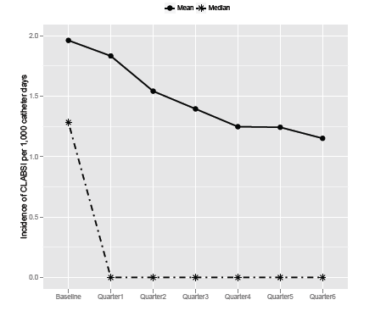
National Efforts On the CUSP:Stop BSI Program
1,071 ICUs in 45 states
43% CLABSI reduction
Number of ICUs that achieved CLABSI rate of ZERO, more than doubled
Infect Control Hosp Epidemiol 2014 Jan;35(1):56-62.

Slide 17
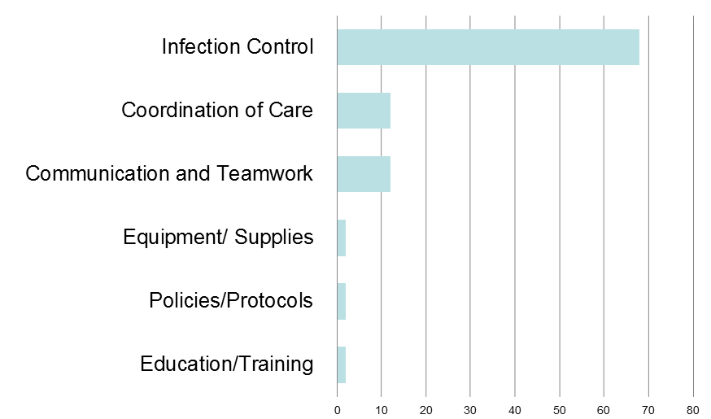
How will the next patient develop a SSI?
95 Responses from 36 Staff Members
95 Responses from 36 Staff Members
Percentage of Responses (%)
Wick, et al. J Am Coll Surg. 2012;215(2):193-200.

Slide 18
Colorectal NSQIP SSI Rate at Hopkins
Improvement Model Works In The OR
Wick, et al. J Am Coll Surg. 2012;215(2):193-200.

Slide 19
Care of colorectal surgery patients is highly variable…
Pre-operative education
Anesthetic plan
Pain management
Fluid resuscitation
Resumption of oral intake
Mobility efforts

Slide 20
Enhanced Recovery After Surgery (ERAS) Colorectal Surgery at Johns Hopkins
Operating Room
ERAS team members in room (CRNA, anesthesia attending and nurses)
Recovery Room
Early mobilization
Inpatient Unit
Mobility plan
Outpatient Clinic
Pre Anesthesia Clinic
Pre-op Area
Multimodal patient education
ERAS-specific anesthesia education
Coordinated phone call before surgery
Infection prevention (bowel preparation, CHG washcloths)
Regional anesthesia education
Education about carb drink
Pre-emptive analgesia and nausea prevention
Epidural placement
Warming
Pre-review of surgery documents
Standard narcotic sparing anesthetic protocol with epidural anesthesia
Goal-directed fluid therapy
Early resumption of oral intake
Standard post-operative orders early eating and fluid restriction
Early foley catheter removal
Pain management by APS

Slide 21
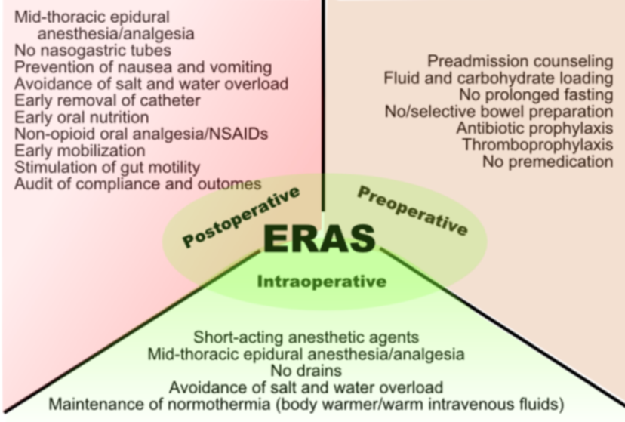
ERAS Society http://www.erassociety.org

Slide 22
Colorectal NSQIP SSI Rate
Baseline 27%
Hospital Target 15%
Post-ERAS 6%
Colorectal CUSP
ERAS

Slide 23
Reduction in LOS and Cost Savings Colorectal Surgery at Johns Hopkins
 | Baseline | ERAS | Difference *P <0.05
No. Patients | 310 | 330 | --
Mean Length of Stay | 7.2 days | 5.3 days | 1.9 days (26.4%)*
Variable Direct Cost | $10,933 | $9,036 | $1,897 (17.3%)*
J Am Coll Surg 2015;221:669-77

Slide 24
Reduction in complications and improvements in patient satisfaction
 | Baseline | ERAS | Difference *P <0.05
UTI Rate | 4.1% | 1.6% | - 2.5%
VTE Rate | 3.5% | 1.6% | - 1.9%
Patient Satisfaction (HCAPS) | 39% | 97% | + 58%*
J Am Coll Surg 2015;221:669-77

Slide 25
CUSP FOR SAFE SURGERY: SURGICAL UNIT-BASED SAFETY PROGRAM (SUSP)
An AHRQ funded national project to achieve significant reductions in surgical site infections and improvements in safety culture.

Slide 26
SUSP Project Overview
AHRQ funding project
5 year project, ended August 2015
Individual hospitals participated for 2 years
Leveraging leaders in field
Armstrong Institute for Patient Safety and Quality, ACS NSQIP, AHRQ, University of Pennsylvania, WHO
Adapts successful CUSP/TRIP model for surgery

Slide 27
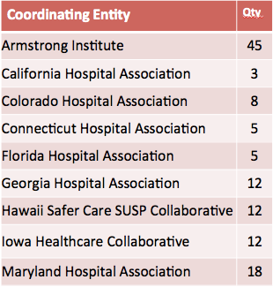
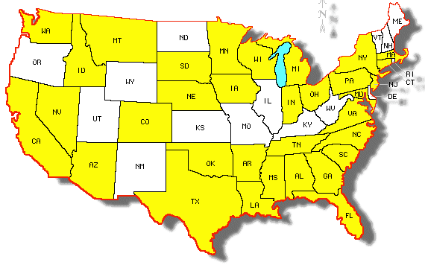
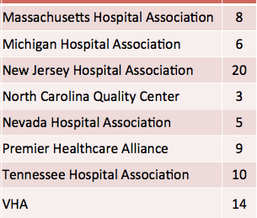
Enrollment
27

Slide 28
SUSP Is Tailored To Your Local Environment
No single SSI prevention bundle
Frontline staff identifies local defects
Develop a SSI prevention bundle to address local defects
Measure local safety culture using Hospital Survey of Patient Safety (HSOPS)
Implement CUSP to tap into wisdom of frontline staff and improve culture

Slide 29
Lessons Learned
Informed by science
Technical and adaptive teamwork
Focus on systems; Not individuals
Led by clinicians and supported by management
Tap into the wisdom of frontline staff
Interdisciplinary Clinical Community
Culture trumps strategy; can be improved
CUSP is a practical and effective strategy

Slide 30
The next WHO teleclass ....
March 16, 2016
THE GLOBAL MYCOBACTERIUM CHIMAERA OUTBREAK IN CARDIAC SURGERY
Dr. Hugo Sax University of Zurich Hospitals
Objectives: - How this patient safety threat was discovered in Zurich, Switzerland, and what is known so far - The story of the global outbreak response - How infected patients are diagnosed and treated - How the risk can be contained in the OR
www.webbertraining.com/schedulep1.php

