Slide 1
National University of Lesotho,
Southern Africa
The effectiveness of TB infection control strategies in high HIV/TB burden settings: The case of isoniazid preventive therapy in Lesotho
Eltony Mugomeri, DHSc Department of Health Sciences, Africa University, Zimbabwe
Hosted by Joseph Kaunda Alberta Health Services, Canada
www.webbertraining.com
February 7, 2019

Slide 2
Global TB Hot Spots, 2016
Global Tuberculosis Report (2017)

Slide 3
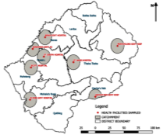
Global TB Hot Spots, 2016
Global Tuberculosis Report (2017)
Lesotho

Slide 4
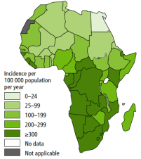
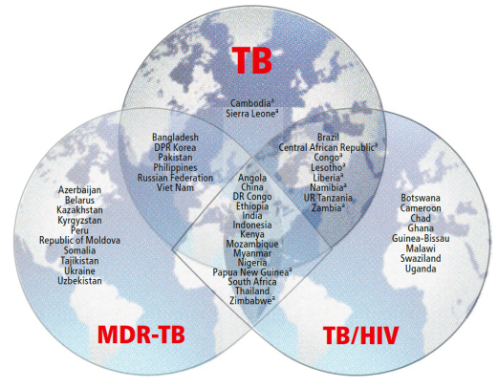
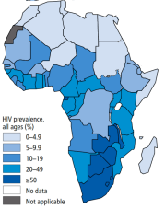
HIV/TB syndemic in sub-Saharan Africa
TB incidence, 2016
HIV rates in TB cases, 2016
Global Tuberculosis Report (2017)
PLHIV in SSA largest reservoir of TB globally (74% of all annual infections).
(Hermans et al, 2016).
How effective is universal IPT (all HIV+) in high HIV/TB burden settings?

Slide 5
HIV/TB syndemic in sub-Saharan Africa
TB incidence, 2016
HIV rates in TB cases, 2016
Global Tuberculosis Report (2017)
PLHIV in SSA largest reservoir of TB globally (74% of all annual infections).
(Hermans et al, 2016).
How effective is universal IPT (all HIV+) in high HIV/TB burden settings?

Slide 6
Provision of IPT to PLHIV, 2005-2014
WHO, 2014
WHO recommended 6 month IPT course for PLHIV in 2004.
Slow uptake of IPT common in SSA where needed most

Slide 7
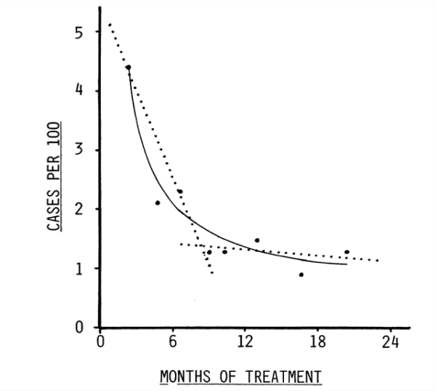
Efficacy of IPT in clinical trials
Comstock (1999)

Slide 8
Efficacy of IPT in clinical trials
Optimum course IPT (Clinical Trials)
36 months IPT = 3 yrs protection (Martinson et al, 2009 [S.Africa]; Samandari et al, 2011 [Botswana]).
6 months IPT = 6 months protection (Rangaka et al, 2014) in S. Africa where IPT reduced TB incidence by 60% in HIV+ adults with no history of TB.
Rifampicin & pyrazinamide?
How effective is universal IPT?
Comstock (1999)

Slide 9
Universal IPT for latent TB

Slide 10
Reactivation of persistent latent infection is a challenge
The durability of protection by IPT was lost within 6–12 months in this setting with a high HIV prevalence and a high annual risk of M. tuberculosis infection.
The observed rate of reinfection was higher than the modelled rate [1.3/100 pyrs, vs 2.2/100 pyrs (95 % CI, 1.8–2.7)], suggesting that reactivation of persistent latent infection plays a role in the rapid return to baseline TB incidence.

Slide 11
Poor contact investigations remains a barrier to TB infection control
Barriers included stigma, limited knowledge about TB among contacts, insufficient time and space in clinics for counselling, mistrust of health center staff among index patients and contacts, and high travel costs for lay health workers and contacts.
The most important facilitators identified were the personalized and enabling services.
The use of a behavioral theory and a validated implementation framework provided a comprehensive approach for systematically identifying barriers to and facilitators of TB contact investigation.

Slide 12
TB infection control in healthcare facilities remains a concern

Slide 13
Effective IPC governance is needed in some countries

Slide 14
Lesotho’s HIV/TB situation
HIV+ = 23.5% (adults) & TB incidence = 852 per 100,000 (WHO, 2016);
> 700 per 100,000 alongside S. Africa & Swaziland
74% of TB+ co-infected with HIV (WHO, 2014).
TB incidence & notification rates, Lesotho?

Slide 15
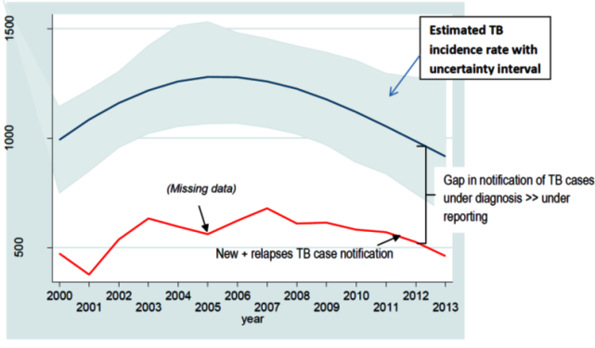
Lesotho’s HIV/TB situation
HIV+ = 23.5% (adults) & TB incidence = 852 per 100,000 (WHO, 2016);
> 700 per 100,000 alongside S. Africa & Swaziland
74% of TB+ co-infected with HIV (WHO, 2014).
TB incidence & notification rates, Lesotho?
TB incidence & notification rates, Lesotho? (2000-2013)

Slide 16
Lesotho’s HIV/TB situation
Poor TB treatment outcomes persist
TB treatment outcomes (2016) by category (a) and overall (b) (n = 812).
Southern African Journal of Infectious Diseases, 33:1, 18-23,

Slide 17
Lesotho’s HIV/TB situation
Poor TB treatment outcomes persist
TB treatment outcomes (2016) by category (a) and overall (b) (n = 812).
Southern African Journal of Infectious Diseases, 33:1, 18-23,

Slide 18
Lesotho’s HIV/TB situation
Poor TB treatment outcomes persist
Defaulted
Rx Failure
TB treatment outcomes (2016) by category (a) and overall (b) (n = 812).
Southern African Journal of Infectious Diseases, 33:1, 18-23,

Slide 19
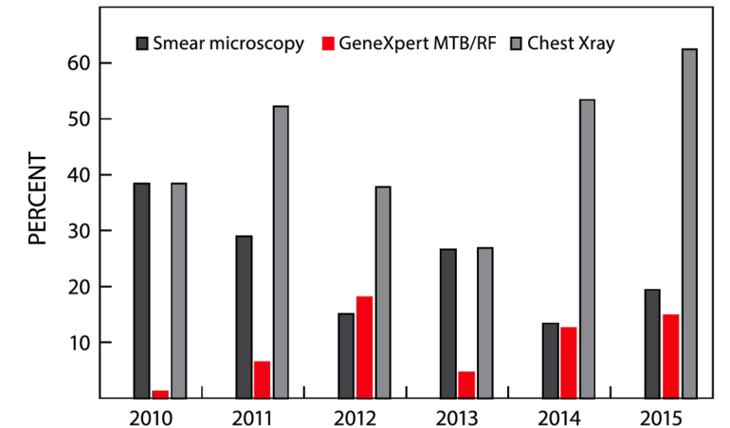
Diagnostic techniques for TB in Lesotho
Poor scale-up of GeneXpert (Mugomeri et al, 2017)
Southern African Journal of Infectious Diseases, 33:1, 18-23,

Slide 20
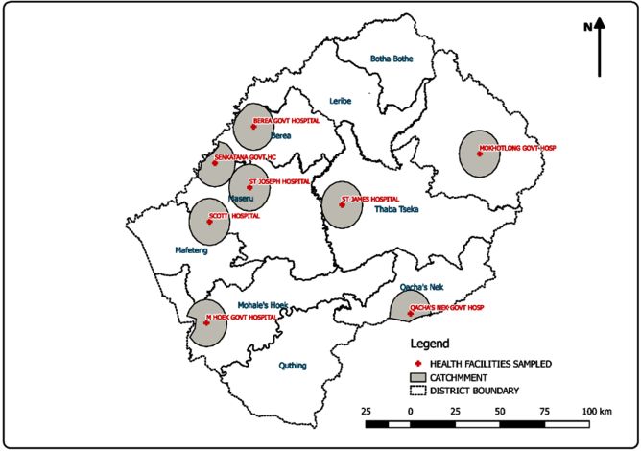
Study sampling criteria
Stratified systematic random sampling
PLHIV (2004 – 2016) from eight district hospitals (three in sparse & five in densely inhabited districts).

Slide 21
Data Collection
HIV-positive children, adolescents, adults, geriatric & pregnant in 2 cohorts (Before & after IPT launch.) NB. Lesotho launched IPT in 2011.
Discrete-time survival data (6-month intervals).

Slide 22
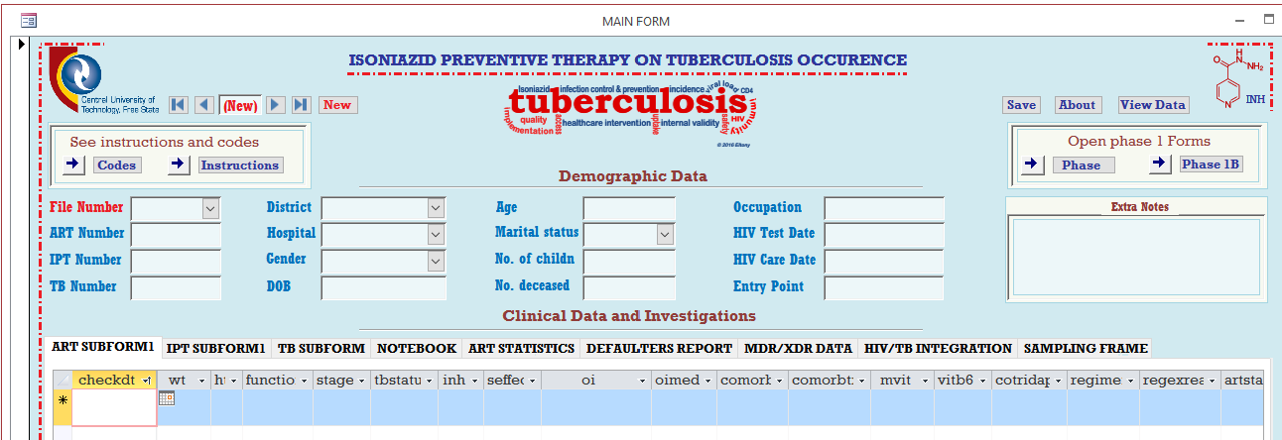
Data Abstraction Tool
Microsoft Access Relational Database Tool (SQL patient profiling)
TB Status Key
0 | No TB signs
1 | Active TB
2 | Past TB
3 | TB signs
INH Key
1 | Begin IPT
5 | Completed
Regimen Key
1f | tenofovir

Slide 23
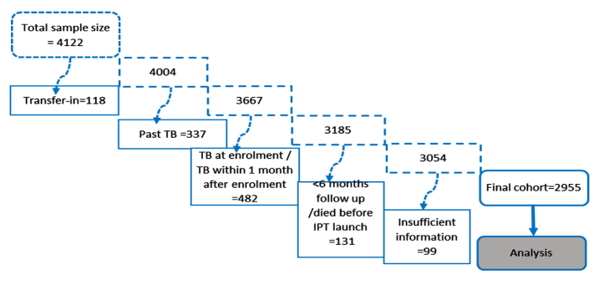
Sample size
Analysis?

Slide 24
Sample size
Analysis
Cox’s proportional hazard regression model for TB occurrence in Stata®

Slide 25
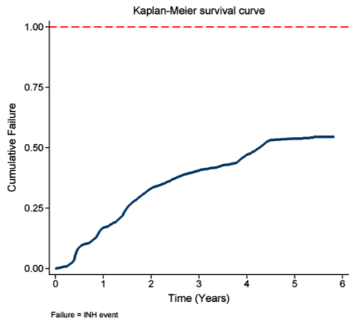
Rate of initiation on IPT
68.8% of 2,955 sample had received IPT by study exit time (Dec 2016).
IPT initiation was 20.6 per 100 person-years, with 135 (6.6%) defaults.
Slow IPT initiation?
Overall cumulative IPT uptake, 2011-2016

Slide 26
Rate of initiation on IPT
68.8% of 2,955 sample had received IPT by study exit time (Dec 2016).
IPT rate of initiation was only 20.6 per 100 person-years, with 135 (6.6%) defaults.
Slow IPT initiation: Children/adolescents, higher population density and longer duration of ART>=5 years
Overall TB incidence rate was 2.0 per 100 person-years in 12 208 person-years. (No previous TB)
Overall cumulative IPT uptake, 2011-2016

Slide 27
Rate of initiation on IPT
The rate of IPT implementation remains slow.
Using national coverage statistics, as is the current practice globally, may be misleading.
More bioinformatics tools and skills are needed to improve this.
Currently, data on rate IPT initiation is scarce, with only Brazil reporting such data – the rate of initiation in that country was 20.0 per 100 person-years in 2014 (Dowdy et al., 2014)

Slide 28
IPT uptake: sub Saharan Africa overview
National coverage for IPT in 15 of the 30 high HIV/TB burden countries ranged from 1% in Swaziland to 53% in South Africa (WHO, 2018).
Other countries in sub Saharan Africa with IPT coverage higher than 30% include Ethiopia (45%) and Nigeria (39%).
Sierra Leone (22%), Zambia (18%), Namibia (15%) and Angola (13%). Notably, IPT coverage in many sub Saharan countries, including Botswana, Malawi, Ghana and Uganda, was unknown in 2017 (WHO, 2018)

Slide 29
Data table: Cox proportional hazards model for initiation of IPT by patient characteristics in Lesotho

Slide 30
Data table (Cont.)

Slide 31
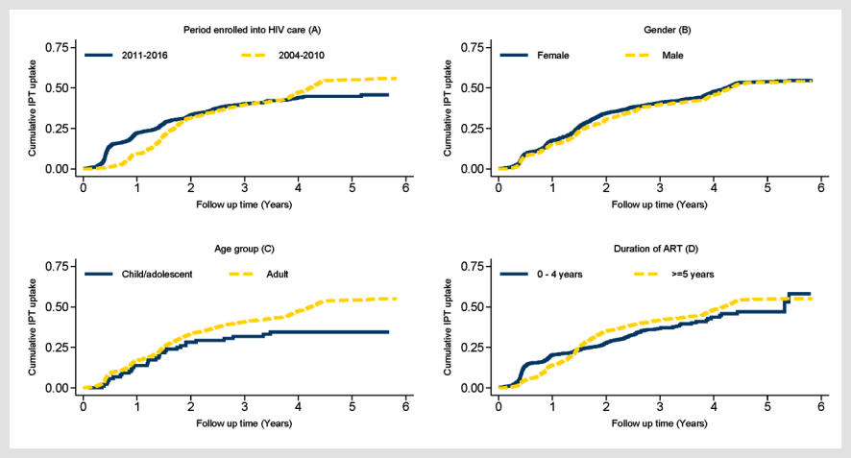
Age group, district category and duration of ART emerged as the most significant predictors of IPT initiation.
Comments:
Patients enrolled on ART after IPT was launched have a higher initiation rate in this setting. This disparity therefore needs to be addressed.

Slide 32
Patients in the sparsely populated districts [Odds ratio (OR)=1.6] and males [OR=2.1] had significantly (p<0.005) higher rates of defaulting IPT compared to those in the densely populated districts and females, respectively.
Comments:
The high rates of defaulting IPT in the sparsely inhabited districts is evidence to the need to improve the monitoring of this programme.

Slide 33
Implementation of IPT in Lesotho
Seven health system challenges to implementation of IPT in Lesotho:
Decentralisation of HIV services;
Monitoring and evaluation systems;
Service delivery;
Supply chains;
Health workforce;
Health system financing
Health information systems.
The median health system’s delay was 22 days (IQR: 4–88 days).
Predictors of patients’ delay
Poor knowledge of TB
First visit to non-formal health provider
Self-treatment
Patients’ age (≥45 years).
Predictors of health system’s delay
Smear-negative TB
First visit to public health centers
Health posts
Observation: Implementation of complex health interventions need a ‘health systems’ approach

Slide 34
Benchmarks for evaluating the effectiveness of health interventions
Source: Author

Slide 35
Better monitoring strategies needed to improve TB screening and IPT uptake
Source: Author

Slide 36
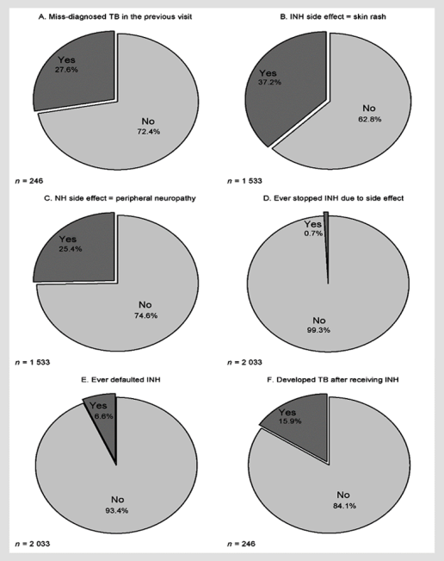
IPT side effects still a problem
Miss-diagnosis of TB persists
Side effects
IPT defaulting?
Patients in the sparsely populated districts (aOR)=1.6] and males [aOR=2.1] had significantly (p<0.005) higher rates of defaulting IPT compared to those in the densely populated districts and females, respectively.
Eltony Mugomeri emugomeri@yahoo.com

Slide 37
IPT treatment outcomes
Misdiagnosis of TB persists
Side effects
IPT defaulting
Patients in the sparsely populated districts (aOR)=1.6] and males [aOR=2.1] had significantly (p<0.005) higher rates of defaulting IPT compared to those in the densely populated districts and females, respectively.
TB after IPT?
Eltony Mugomeri emugomeri@yahoo.com

Slide 38
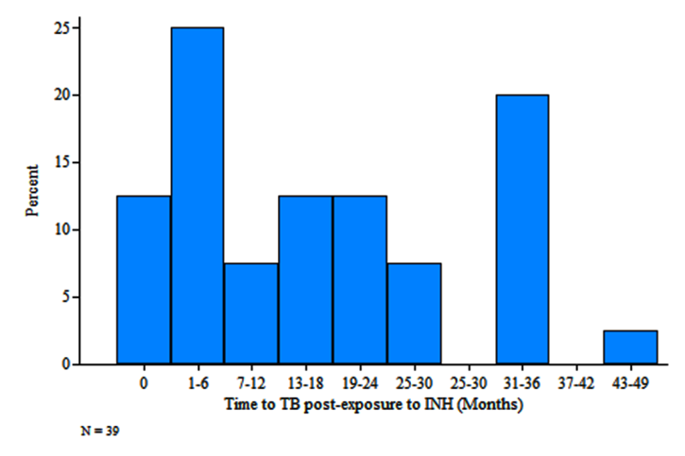
Time to TB event in IPT-exposed cohort
Thirty-nine (15.9%, n = 246) patients developed TB after IPT
Eltony Mugomeri emugomeri@yahoo.com

Slide 39
Time to TB event in IPT-exposed cohort
Misdiagnosed TB
Thirty-nine (15.9%, n = 246) patients developed TB after IPT

Slide 40
Effectiveness of IPT in Lesotho
TB incidences per 100 person-years by timing of IPT:
IPT before ART (1.7),
IPT after ART (1.8),
no IPT (2.6),
IPT within one year of ART commencement (1.3) &
IPT 3-5 years after ART initiation (2.3).

Slide 41
Effectiveness of IPT in Lesotho

Slide 42
Effectiveness of IPT in Lesotho
Loss of protection
Need to check resistance in cohort?

Slide 43
Predictor variables for TB event
43

Slide 44
Predictor variables for TB event

Slide 45
Significant Predictor variables for TB event
Based on Wilcoxon’s log-rank test & Kaplan-Meier survival plots (Categorical) and Cox regression analysis (Continuous)
Gender,
baseline WHO clinical stage,
district category
Time to IPT relative to ART commencement (Continuous variable)

Slide 47
Increasing time to IPT by one six-month interval increased the risk of contracting TB by between 6% and 59%, depending on the cohort.
Eltony Mugomeri emugomeri@yahoo.com

Slide 48
CONCLUSION
*Time to IPT relative to ART commencement is an important determinant
Ethiopia study: IPT-before-ART (aHR = 0.18, 95% CI = 0.08–0.42) better than simultaneously with ART (aHR = 0.20, 95% CI = 0.10–0.42) (Yardaw et al, 2014)
*High risk of reinfection in certain settings
Compared to no IPT, combined IPT and ART reduces the risk of contracting TB by 37% (HR = 0.63, 95 % CI 0.41-0.94) (Rangaka et al. 2014) in S.A;
60 % (HR = 0.40; 95 % CI 0.18 - 0.87) (Ayele et al, 2015) in Ethiopia;
Six months IPT = six months protection? (Rangaka et al, 2014) in S. Africa.
*Booster doses needed
Brazil: Six-month IPT course reduces the risk of contracting TB for at least seven years? Golub et al. (2015)

Slide 49
-Thank You-
Acknowledgements
D. Olivier and W. M.J. van den Heever
Central University of Technology, Free State, SA
National University of Lesotho, Maseru, Lesotho
Eltony Mugomeri emugomeri@yahoo.com

Slide 50
