Slide 2
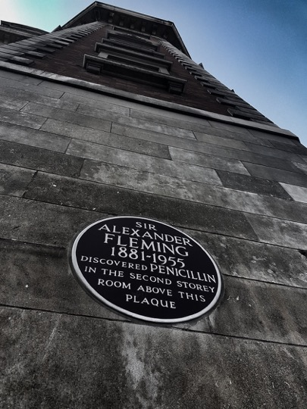

Slide 3
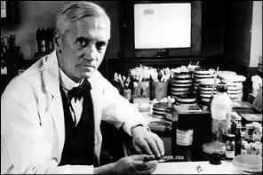
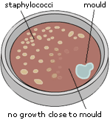
A discovery by accident
A fungal spore that the wind might have blown into his lab while Fleming was on vacation in 1928, forever changed the course of medicine...
Fleming named the substance Penicillin, after the mould Penicillium notatum – but was unable to isolate the substance
In the late 1930s and early 1940s, E. Chain & H. Florey managed to produce larger amounts of penicillin and ran successful trials on mice

Slide 4
Antibiotics
Modern medicine has only been possible because of them
Chemotherapy
Transplants
Implant surgery – no prophylaxis means that joint replacements may become too risky
Have added about 20 years to life in developed countries
Unique medications
Are not targeted against the person taking it
Prescribed by non-specialists

Slide 5
What also changed?
Ageing population
Increasing public expectancy that illness is treatable
More interventions and invasive techniques
Medical Science moved forward, but infection control was left to specialists
Not good when you have little real influence
In 2000, ICPs in England were asked what percentage of infections we thought were preventable; we said between 5% and 20%
So healthcare-associated infections increased
5

Slide 6
My early professional life in 1990
1 ICN for
1000 District General Hospital beds
1000 Mental Health beds
200 nursing and residential homes
56 General Practice Surgeries
100+ schools and nurseries
Half a medical microbiologist with no defined IC time
No administrative support
Also was the Tissue Viability Nurse

Slide 7
Guidance on the ICN Ayliffe et al (Control of Hospital Infection (1975)
The Infection Control Officer usually has commitments which prevent regular visits to wards…
At least one ICN or other suitable person should be appointed to assist
If a nurse… experience as Ward Sister or Tutor..
Of greater importance is an agreeable personality and an ability to deal tactfully with all grades of staff

Slide 8
Early issues with Gram-negatives Casewell M, Phillips, I. British Medical Journal 1977: 1316
Activity | No of Klebsiella (CFU)
Taking pulse, blood pressure | 1,000
Touching hand | 1,000
Oral temperature | 1,000
Touching shoulder | 7,000
Big outbreak
17% of staff had the outbreak strain on their hands, survival time 150 minutes
Klebsiellas were thought to be ‘sticky’ organisms
No problem – lots of antibiotics were available
Notes:
8

Slide 9
C. difficile
IPC Focus
9
VRE
Gram-negative Resistance
MSSA
MRSA
1950
1960
1970
1980
1990
2000
2010
2020
Sensitive
ESBL
Gent-resistant Gram-negatives
CPE
Resistant

Slide 11
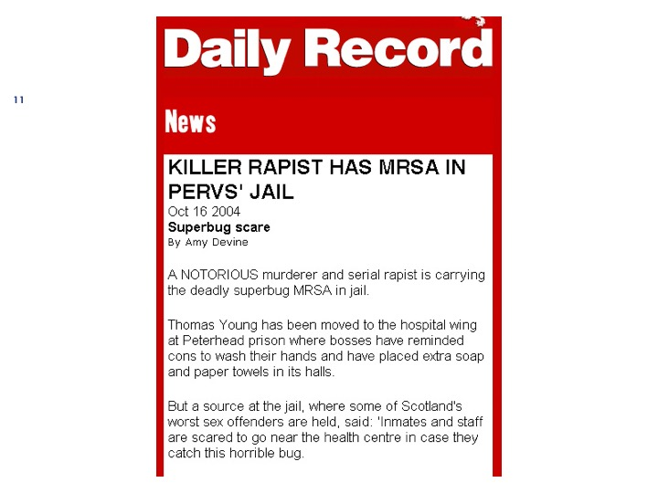

Slide 13
Quarterly MRSA Bloodstream Infections England: 2001-15
Surveillance
Target
Inspection
Failure

Slide 14
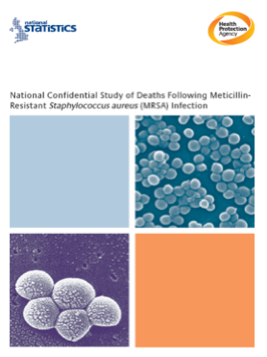
‘6 days postoperatively the patient was noted to have pus coming from a cannula site.’ Case Study 6
‘After 8 days the PVC inserted on
admission showed signs of infection with a purulent discharge.’ Case study 4
‘For almost half of the cases reviewed, The source of the MRSA infection was an invasive device, particularly PVC and CVC.’
14

Slide 15
What can we treat?
Organism | Antibiotic effectiveness
Streptococcus pyogenes | +++++
Staphylococcus aureus | +++++
MRSA | ++++
C. diffcile | +++
E. coli | ++++
ESBL-E. coli | ++
CPE E. coli | +
Acinetobacter baumanii | ++
CRE Acinetobacter baumanii | +
Colistin-resistant A. baumanii | -

Slide 16
Recent SSI data show the direction

Slide 17
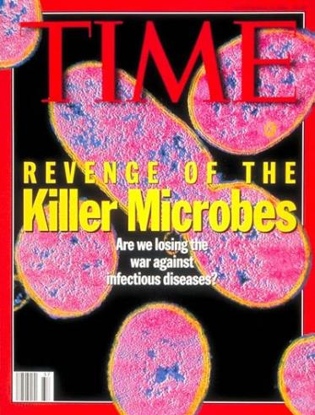
Concern over lack of antibiotics

Slide 18
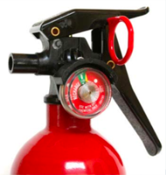
A Series of Unfortunate Events
Colonised person
Shedding of pathogens
Environmental contamination
Contamination persists
Failure to clean or disinfect
Staff acquire on hands
Staff fail to remove
Transfer to new patient
Patient becomes colonised
Patient becomes infected
Antibiotics

Slide 19
Opinions from ECCMID 2018 Jon Otter, www.reflectionsipc.com
Number of studies demonstrating this
N=1 (or not many)

Slide 20
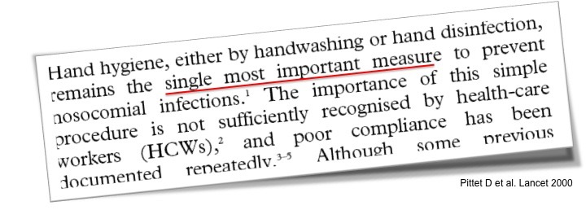

Slide 21
Hand Hygiene
In 2006 all Hospitals in England began to audit and report Hand Hygiene compliance to the Hospital Boards via the Director of Nursing
Which of course normally achieve >99%, so that’s all right then
What Director of Finance will invest in a hand hygiene programme when compliance is >95%?
If you send in a covert auditor, compliance is different..
But not a message that people want to hear

Slide 22
Hand Hygiene Audit
Everyone is brilliant, Hospital Boards are assured
I’m not
Covert audits showed compliance over three months to be 23%
Apart from my best unit, which was a genuine 65%
Beggs CB et al. Increasing the frequency of hand washing by healthcare workers does not lead to commensurate reductions in staphylococcal infection in a hospital ward. BMC Infectious Diseases. 2008;8(1):114

Slide 23
This is embarrassing
Why do we have to do this?
Would any other professional group spend it’s time monitoring other staff?
Can we really not convince our colleagues that they really do need to do this?

Slide 24
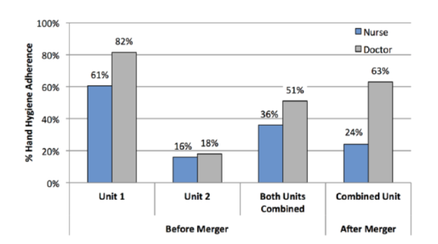
When Two Become One Petrilli et al., Journal of Infection Prevention, 2017
Looked at what happened to hand hygiene when two ID units merged
Medical staff had a committed IPC champion, the nurses did not
Medical staff goal adherence rate was 75–100%, while the nurses thought 50–70% adherence was acceptable

Slide 25
Evidence Shortage
Lack of evidence has been an issue, as have national dictats (in the UK)
Smith and Pell (BMJ, 2003) undertook a systematic review and found that there was no evidence that supports the use of parachutes in preventing death and trauma from gravitational challenge

Slide 26
Samuel Butler (1612-80)
26
He that complies against his will is of his own opinion still

Slide 27
Bare below the elbows
Great idea
Sends a strong positive message about the organisational culture and attitude towards infection prevention
Never formally UK Policy, adopted by SHEA
Terribly implemented
Stick not carrot
Problem: No evidence
Some did not like being made ‘look stupid’

Slide 31
Use of Video Monitoring Armellino et al, Clin Infect Dis (2011)
2-year study in a 17-bed ICU
Cameras with a view of every sink and dispenser, sensors in doorways
16-weeks no feedback, 91 with
HH 60% with direct observation pre-study
Results
When no feedback, compliance was 10%
First 16 weeks of feedback compliance 81.6%
Maintained through 75 more weeks at 87.9%
Performance feedback was almost real-time on video screens

Slide 32
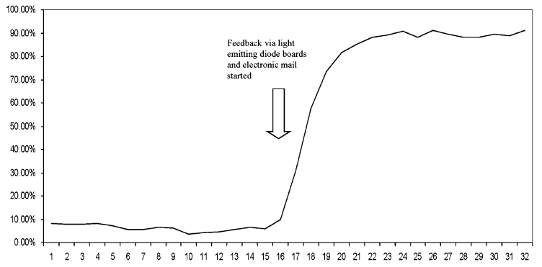
During the intervention period

Slide 33
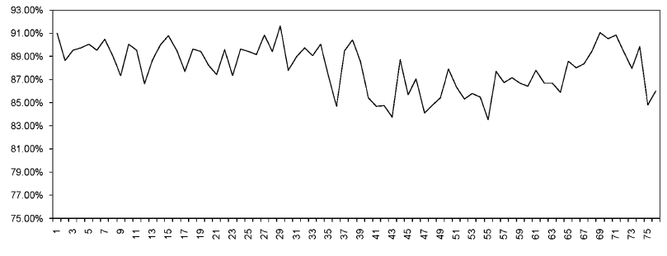
Maintenance Period Weekly Feedback

Slide 34
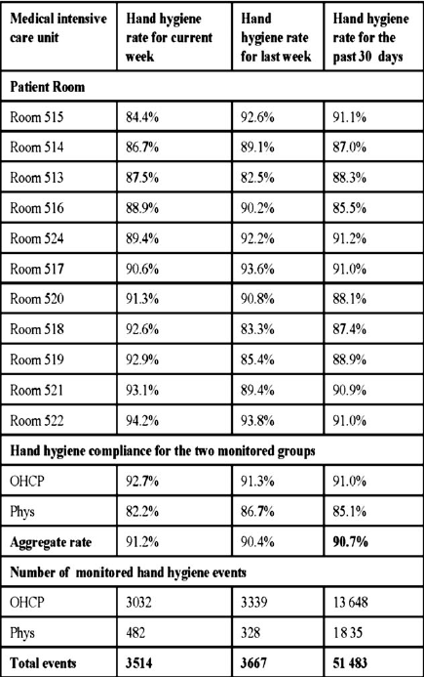
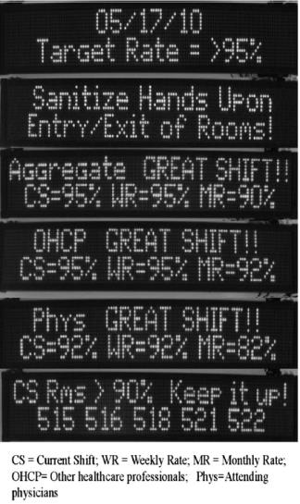
Reporting

Slide 35
My perfect HH monitoring system
Fully automated
Who has the time?
Standardisation of counting method
Includes all five moments
Objective not subjective
Instant, personalised reporting
At the end of the shift, person logs off and they get a personal printout of how they did for the patients that they cared for

Slide 36
Daily Personal Report
Patient | HH Opp’s | HH performed | Compliance | HCAI | Chance that it was you
Seto, W. H. | 16 | 8 | 50% | 1 | 75%
Pittet, D. | 10 | 9 | 90% | 0 | NA
Larson, E. | 8 | 8 | 100% | 0 | NA
Kiernan, M. | 20 | 2 | 10% | 2 | 100%
Jarvis, W. | 14 | 7 | 50% | 1 | 50%
Your hand hygiene compliance for the day was 50%
You are 17th of 20 staff on the ward
Your trend in hand hygiene for the past six months has declined
Your lowest compliance is with Moment 2
Red indicates that you have the lowest staff hand hygiene rate for this patient

Slide 37
Audit vs Bundle
Audit
identifies whether individual measures are being implemented
Bundle
To identify whether optimum care is being delivered

Slide 38
Are bundles effective? Lavallee, J. F., et al (2017) Implement Sci 12(1): 142
Systematic review comparing care bundles with usual care to evaluate the effects of bundles on risk of negative patient outcomes
Very low quality evidence from controlled before-after studies suggests that care bundles may reduce the risk of negative outcomes when compared with usual care
By contrast, the better quality evidence from six randomised trials is more uncertain..

Slide 39
Bundles for SSI
Systematic review and meta-analysis
Tanner, J., et al., Surgery, 2015. 158(1): p. 66-77.
SSI rate in bundle group 7.0% and 15.1% in standard care group
Compliance whole bundle ranged from 2.1% to 92%
direct correlation between implementation (full vs. partial) of bundle and colorectal SSI rate

Slide 40
So let’s see if our bundle works
We implemented a 9-point bundle
Antiseptic bathing
2% Alcoholic Chlorhexidine
MRSA Screening
Abx prophylaxis
Normothermia
Iodine incise drapes
Supplemental Oxygen
Glucose control
No hair removal or clippers
Tanner, J., et al., Effectiveness of a care bundle to reduce surgical site infections in patients having open colorectal surgery. Ann R Coll Surg Engl, 2016: p. 1-5.

Slide 41
Hang on a minute..
 | Baseline (127) | Cohort (166)
Superficial SSI | 9% | 17%
Deep SSI | 15% | 11%
Total SSI | 24% | 28%

Slide 42
Compliance with interventions
 | Baseline | Cohort
MRSA screening, decontamination | 88% | 89%
Pre-op wash | 63% | 63%
App. hair removal | Not recorded | 100%
App. antibiotic prophylaxis | 75% | 73%
Skin prep 2% CHG | Not used | 63%
Normothermia | 23% | 35%
Iodine incise drapes | Not recorded | 100%
Supplemental oxygen | Not recorded | 100%
Glucose for diabetics | 98% | 95%
19% received all elements

Slide 43
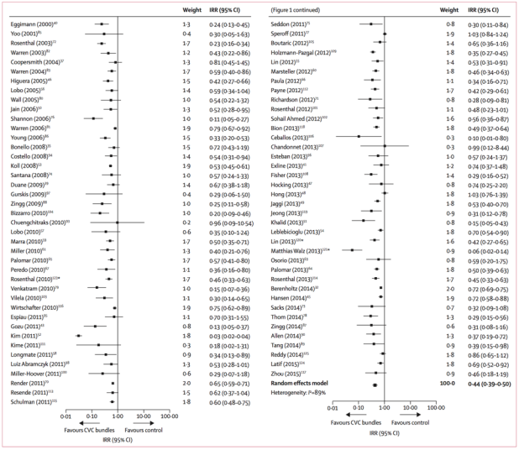
Do CLABSI Bundles Work? Ista, E., et al. Lancet Infectious Diseases, 2016. 16(6): p. 724-34

Slide 44
Bundles work but the story is compliance Ista, E., et al. The Lancet Infectious Diseases, 2016. 16(6): p. 724-734
Systematic review and meta-analysis
Conclusion: Bundles work (although 37% of 79 studies say they don’t)
Importantly, described bundle compliance in the analysis
Determined (or reported) in only 24% of pre-and post-implementation and in a further 11% post-implementation studies
That leaves 65% of papers not reporting on compliance at all
In the ones that did report, it was suboptimal in every one
Blog post
https://reflectionsipc.com/2017/06/12/the-big-c/

Slide 45
Good and Bad
The elements in a bundle are best practice based on evidence, and all should be very familiar with them
Sometimes the fact that clinical staff are aware of them may make them dismiss the bundle as ‘nothing new’
We must acknowledge that clinical practice is variable
During central line insertion, use chlorhexidine for site disinfectant and maximum sterile barrier precautions
2 practices highly recommended to prevent catheter-related bloodstream infection were carried out less than 75% of the time (Saint et al, ICHE 2010)

Slide 46
Why was CAUTI not reducing? Meddings, J. Abstract SHEA Spring Meeting, April 2018
Qualitative approach:grouped challenges and successes into intervention domains
Used rich data to construct a comprehensive ICU CAUTI reduction program include at least one strategy from each of 4 domains
Standardize use and care
Improve communication about catheter need
Build capacity for alternatives
Feedback data in real time
Basically, professionals like to be given a choice

Slide 47
Compliance Thesaurus.com

Slide 48
`The Big C’
Compliance
The wrong word
It affects everything – but is often absent from published papers
Research showing effectiveness of interventions and likelihood of implementation
And it is probably our fault
Poor implementation planning (often not described in the studies)
Failure of ‘selling the message’

Slide 49
Compliance with interventions Buchanan et al, American Journal of Infection Control (2018) In Press (last week)
Embedded a compliance coach (RN with experience in central line management into units managing these devices
conducted routine, housewide, unannounced audits of central venous access device dressings and intravenous (IV) tubing, using a model of observation, data capture, coaching, and reporting, followed by focused education
Results
Clean/dry/intact dressing compliance improved from 64% to 84% (P = .0001)
CHG sponge placement improved from 54% to 78% (P = .0001)
Feedback was instant and non-punitive

Slide 51
Everything got better

Slide 52
Review of a National CPE Toolkit J Hosp Infect. 2018 Mar 9. pii: S0195-6701(18)30145-2. doi: 10.1016/j.jhin.2018.03.007
Few reported consistent compliance with screening and isolation of CPE risk patients
Lower prioritization and weaker senior management support for CPE prevention associated with poorer compliance
80% did not believe that the guidance offered an effective means to prevent CPE or was practical to follow
Successful implementation can be hindered by a complex set of factors related to their practical execution, insufficient resources and a lack of confidence in the effectiveness of the guidance
Future CPE guidance would benefit from substantive user involvement

Slide 53
Meanwhile back on the planet.. Erik Hollnagel
Work as imagined
Policy, procedure etc
The ‘best’ way, the basis for design, training and control
Work as done
What really happens, what we have to do to get the job done
Er.. Often suboptimal
How well do those (us) writing a policy or guideline really understand the issues at the point of delivery?
A policy or guideline that has taken years to develop may fail within hours at the sharp end

Slide 54
Head above the parapet
WHO Hand Hygiene technique
Work as imagined or work as done?
Tschudin-Sutter, S., M. L. Rotter, R. Frei, D. Nogarth, P. Hausermann, A. Stranden, D. Pittet and A. F. Widmer (2017). "Simplifying the WHO 'how to hand rub' technique: three steps are as effective as six-results from an experimental randomized crossover trial." Clin Microbiol Infect 23(6): 409 e401-409 e404.
Easier to teach and do?
5 moments or ABC?

Slide 55
Bridging the image gap
Problem is not that different images of work exist
They arise when organizations (or individuals within them) are not sufficiently aware of the gap (or the extent) between images
Having a gap is not an indication of a dysfunctional organization, but not knowing about it and not learning why, is
It we ignore the gap, we may be investing in the wrong things

Slide 56
Narrowing the gap
We have to realize how difficult it is for the entire organization to clearly understand and “buy-in” to the vision and goals of the upper management
Therefore we must recognize that we have “work-as-imagined” and “work-as-done” throughout healthcare
Before we plan an intervention, we must collect real data on this gap to allow us to see the magnitude and extent of the problem so that we can put the right resources and right methodology to close the gap

Slide 57
Non-compliance index http://errorfree.com/probability-of-rule-non-compliance-error/
Burden Score + Inducement Score
Non-compliance =
Perceived Risk Score + Peer Pressure Score

Slide 58
Reducing the risk of non-compliance
Assessment of burden | 8 | 7 | 5 | 3
Inducement to perform | 1 | 3 | 5 | 8
Perceived risk | 1 | 3 | 7 | 9
Peer pressure | 2 | 3 | 6 | 8
Non-compliance risk | 3 | 1.66 | 0.77 | .64
Could we make an assessment of each parameter and then work out how they could be modified?
Lowest possible risk index would be 0.5; highest is 5.5

Slide 59
We have to teach old dogs new tricks
You can do that and there is science to prove it
Lisa J. Wallis, Zsófia Virányi, Corsin A. Müller, Samuel Serisier, Ludwig Huber and Friederike Range (2016). Aging effects on discrimination learning, logical reasoning and memory in pet dogs. Age, 38:6 DOI 10.1007/s11357-015-9866-x
Humans are far more difficult but the principle is the same
Treats!

Slide 60
Motivators
Towards
Away from

Slide 61
What Motivates Staff? McClung, L., et al., Am J Infect Control, 2017
Subconstruct | Theme
Patient needs and resource | Patient safety is primary motivation for prevention efforts
Available resources | Sufficient resources for some activities
Goals, monitoring, and feedback | Closer monitoring of improvements made, in combination with greater personal feedback and data transparency, would provide greater motivation
Culture | The idea that the organisation is “the best” motivates individuals to do their best
Leadership engagement | Leadership as great advocates for health care workers’ needs

Slide 62
The tools of our trade..

Slide 63
Be Positive!
The power of positive reinforcement
Skinner (1904-90)
Research suggests that positive reinforcement shows a 17% increase in performance
Studies of hand hygiene in healthcare also show this
Lent, V., et al., Evaluation of patient participation in a patient empowerment initiative to improve hand hygiene practices in a Veterans Affairs medical center. Am J Infect Control, 2009. 37(2): p. 117-20.
Mayer, J., et al., Dissemination and sustainability of a hospital-wide hand hygiene program emphasizing positive reinforcement. Infect Control Hosp Epidemiol, 2011. 32(1): p. 59-66.

Slide 64
A model of actionable feedback Hysong et al (2006) Imp Sci doi:10.1186/1748-5908-1-9
Yes
Timely?
No
Yes
Individualised??
No
Yes
Non-punitive?
No effect on performance
No
Yes
Customisable??
Diminished effect on performance
No
Negative or
diminished effect on performance
Optimal
Effect on
Performance
Possibly
diminished effect on performance

Slide 65
We will need leadership
The process of social influence in which one person can enlist the aid and support of others in the accomplishment of a common task
Chemers M. (1997) An integrative theory of leadership
The art of mobilising others to want to struggle for shared aspirations
Kounzes JM, Posner BZ. The leadership challenge. Jossey-Bass. New York:1995
Some have argued that leaders are born, not created
Galton (1869) Hereditary Genius
The plethora of books and self-help manuals suggests otherwise

Slide 66
Successful leaders in IPC Saint et al, ICHE (2010)
Think strategically while acting locally
involves canvassing before crucial committee meetings and votes
Deal directly with resistant staff
leverage personal prestige to move initiatives forward
form partnerships across disciplines
Hospital epidemiologists and infection preventionists often played more important leadership roles in their hospital’s patient safety activities than did senior executives

Slide 67
We will have to display leadership
Leadership inaction
vs. Leadership in action
Notes:
Barriers to this exist however:
Lack of practical application of tools and methods for epidemiology and quality improvement
• Inadequate staffing to ensure effective data collection
• Lack of automated data collection methods
• Inadequate computer resources and training
• Excessive data collection with minimal analysis
• Data not used to drive change
• Lack of formal training in hospital epidemiology for hospital managers

Slide 68
Watch for Resistors and Constipators Saint et al, Joint Commission Journal Quality and Safety 2009 35(5)
Two types of person impede HCAI activities
Active Resistors - hospital personnel who vigorously and openly oppose changes in practice; increase the difficulty of implementing new methods to prevent infection
Organizational Constipators - mid- to high level executives who prevent or delay actions without active resistance, thereby acting as covert barriers to change by increasing the work required to implement evidence based practice

Slide 69
Overcoming the Resistor
Effective championing by an engaged and respected change agent that can speak the language of the staff they are guiding (e.g., a surgeon to other surgeons)
Participation in collaborative efforts that generally align hospital leadership and clinicians in the goal of reducing health care–associated infection
Data feedback comparing local infection rates to national rates
Data feedback comparing rates of compliance with the practices to rates of others in the same area

Slide 71
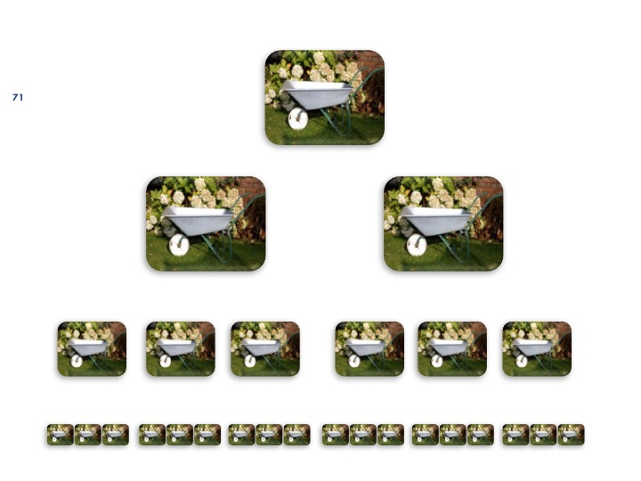

Slide 72
Dealing with Constipators
Include organizational constipators early in group discussions in order to improve communication and obtain buy-in
Work around individuals (only short-term solution)
Take advantage of ‘turnover opportunities’ when the constipator leaves the organization by hiring a person who has a very high likelihood of being effective
Terminate the constipator’s employment

Slide 73
Use of Leadership Rounds Knobloch, M. et al (2018) AJIC 46(3) 303-310
Explored unit-based HAI leadership rounds (LRs) at a large academic hospital
Two executive leaders (associate chief medical officer and the associate chief nursing officer) had a goal of visiting units regularly to determine whether evidence-based and best practices were being routinely integrated into daily unit operations
Staff members disclosed unit-specific problems and readily engaged in problem-solving with top hospital leaders
Findings revealed that leaders used words that demonstrated fallibility and modelled curiosity, 2 factors associated with learning climate and psychologic safety

Slide 74
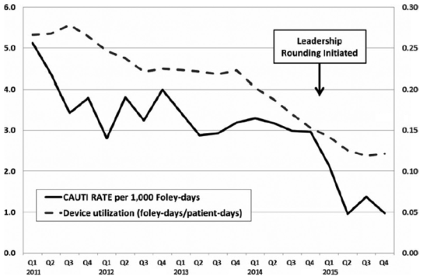
Clinical impact of LRs?
Because of a significant and rapid reduction in CAUTI rates after LR initiation, executives continued the initiative and, over a span of 6 months, LRs expanded to include CLABSI and CDI
CAUTI
DUR

Slide 75
Interview Themes
Listening is a strength of leaders
Modelling curiosity is a strength
“There’s nothing people like better than being recognized as an expert. And if the associate Chief Medical Officer says I don’t know what you’re talking about, can you draw me a picture; that de-escalates his profile, elevates the other person in front of them even momentarily”
Showing fallibility is a strength
“If you start off by showing your own fallibility, they (staff or others) start taking their armour off, and you can stand there face to face and have an honest conversation”

Slide 76
Unlearning
Getting someone to discard old knowledge and practices and overwrite with new is difficult as there has to be an acceptance that they have been wrong all this time..
Better to argue that these should now be set aside as no longer appropriate
There is almost an element of negotiation
The art of not losing face
This will not only apply to others, we also have to ‘unlearn’

Slide 77
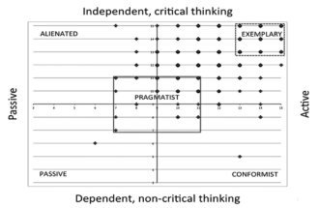
Are Infection Preventionists good followers? Todd Greene and Saint (2015) AJIC
Two surveys, one looking at followership characteristics, one looking at whether IPC Interventions are in place
Majority fell into the ‘exemplary category (self reported, so possible social desirability bias)
Hospitals with truly exemplary followers in infection control roles may be more likely to use recommended prevention practices

Slide 80
Thoughts from a Soccer Coach Gareth Southgate, July 2018
'If players feel you respect them, they are more likely to follow you...’
"I like players to have responsibility; to think about what we are asking them to do, to have an opinion on the way we are asking them to play and the way we are asking them to train,"
"I think if the players have some ownership of what's going on then that's going to help them make better decisions on the field and also buy into the way that we are trying to progress."
"I like the players to speak up in meetings... like them to have an opinion on the game, because in the 85th minute they have got to make a decision that might win or lose the game and we can't make all those decisions from the sideline."
Cross out 'player' and insert colleague, nurse, doctor, manager.
"I think it is important to listen and I think it is important to get a feel of what motivates the individual."

Slide 81
The future of Infection Prevention Patel & Kallen (2018) ICHE 39(7)
Will be based on human factors and systems engineering
Commentary on Leback et al ICHE (2018);39:84
Paper looking at barriers and facilitators of injection safety
Problems
low generalizability – meaning resource intensive
Lack of human factors and systems engineering expertise

Slide 82
The overall outlook
Is bright
In fact so bright, many cannot see it because of the glare
Infection control was our past before antibiotics; in a world without them infection prevention becomes critical if healthcare is to be provided at the same level
We have evidence for interventions, we must help colleagues to reliably implement them and look for new ones

Slide 83
Final Points
It is likely that new drugs will be developed at some stage but for now, this is our opportunity to embed best practice
Never waste a crisis
Prevention is better than cure
Especially when there is no cure

Slide 84
