Slide 1


The Good the Bad and the Ugly
Methods for Bedpan Management
Gertie van Knippenberg-Gordebeke, CCIP
Owner international consultancy Knowhow Infection Prevention KNIP
Advocate for Safe Bedpan Management
Hosted by Martin Kiernan
martin@webbertraining.com
Sponsored by
www.cleanis.com
www.webbertraining.com
May 30, 2017

Slide 2


Slide 3
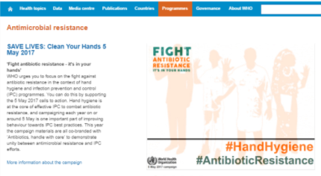
Antimicrobial Resistance & Standard Precautions
Safe
Bedpan
Management
Save Lives
Since the rise of multi drug resistant organisms (MDRO),
careful handling of human waste (faeces, urine, vomits)
is more important than ever
to minimize the risk for Healthcare Associated Infections (HAIs)

Slide 4
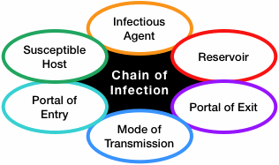

Every caregiver needs to understand the chain of infection
and every patient needs to be treated as if colonized or infectious
Bedpan Management seems a Weak Link
Picture Google

Slide 5
Definition Bedpan Management: every handling related to excreta of the human gastrointestinal tract
disposal of human excreta
(urine, faeces, vomits, sometimes including blood)
Seems a simple process
But
it is A complex process
in Healthcare facilities
and an important element for standard precautions

Slide 6
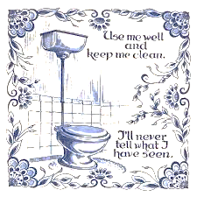






The Management of Human Excreta
We have to deal with it
If possible: we are looking for the best and cleanest toilet
Picture Google

Slide 7
Human Dignity and the management of excreta in healthcare facilities
A bedridden or wheelchair dependent patient /client
needs a device (a human waste container) to poop, pee or vomit
No free choice
A topic which is frequently marginalized and tacitly accepted
Use of clean devices is not always guaranteed

Slide 8
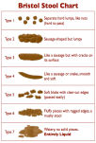
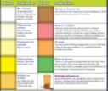
Facts 1.4
People do not like to talk about: urine, stool, poop, shit
Bowel: largest human microbiome (10¹⁴ per gr. faeces)
150 à 300 gram faeces per person per day
In case of diarrhea: liters fluid stool
Human waste containers are bedpans, urine bottles, kidney dishes
Bedpans are Medical Devices and they are
Underappreciated reservoirs for transmission of pathogens
Picture Google

Slide 9
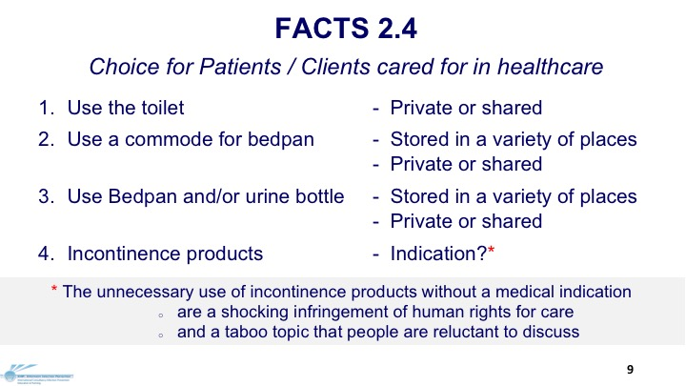

Slide 10
Facts 3.4
Transmission of these pathogens is an interaction of
patients/clients, healthcare workers and human waste
Full Bedpans/urine bottles are huge Reservoirs
Hands can Contaminate Environment & Patients
Contaminated Environment can Contaminate Hands
Bedpans & Hands can Transmit Microorganisms
Picture Google

Slide 11
Facts 4.4
Increasing prevalence of multidrug-resistance organisms (MDRO)
10% of population estimated (unknown) Carrier of MDRO e.g.:
  VRE, ESBL, CRE, MRSA, KPC, Pseudomonas aeruginosa,
  Acinetobacter baumannii, Enterobacter cloacae
10-20 % of patients may be colonized with Clostridium difficile

Slide 12
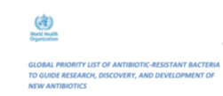
2017 WHO PRIORITY AMR PATHOGENS LIST 1.2
Acinetobacter baumannii, carbapenem-resistant
Pseudomonas aeruginosa, carbapenem-resistant
Enterobacteriaceae*, carbapenem-resistant, 3rd cephalosporin-resistant
includes: Klebsiella pneumoniae , Escherichia coli , Enterobacter species, Serratia species Proteus species, Providencia species, Morganella species
Priority 1: CRITICAL
Enterobacter faecium, vancomycin-resistant
Staphylococcus aureus, methicillin-resistant, vancomycin intermediate and resistant
Helicobacter pylori, clarithromycin-resistant
Campylobacter, fluoroquinolone-resistant
Salmonella spp, fluoroquinolone-resistant
Neisseria gonorrhoeae, 3rd generation cephalosporin-resistant, fluoroquinolone-resistant
Priority 2: HIGH
Priority 3: MEDIUM
Streptococcus pneumoniae, penicillin-non-suspectible
Haemophilus influenza, ampicillin-resistant
Shigella spp., fluoroquinolone-resistant
http://www.who.int/medicines/publications/WHO-PPL-Short_Summary_25Feb-ET_NM_WHO.pdf
‘
Carriers have these MDRO in faeces and on the skin
http://www.who.int/medicines/publications/WHO-PPL-Short_Summary_25Feb-ET_NM_WHO.pdf

Slide 13
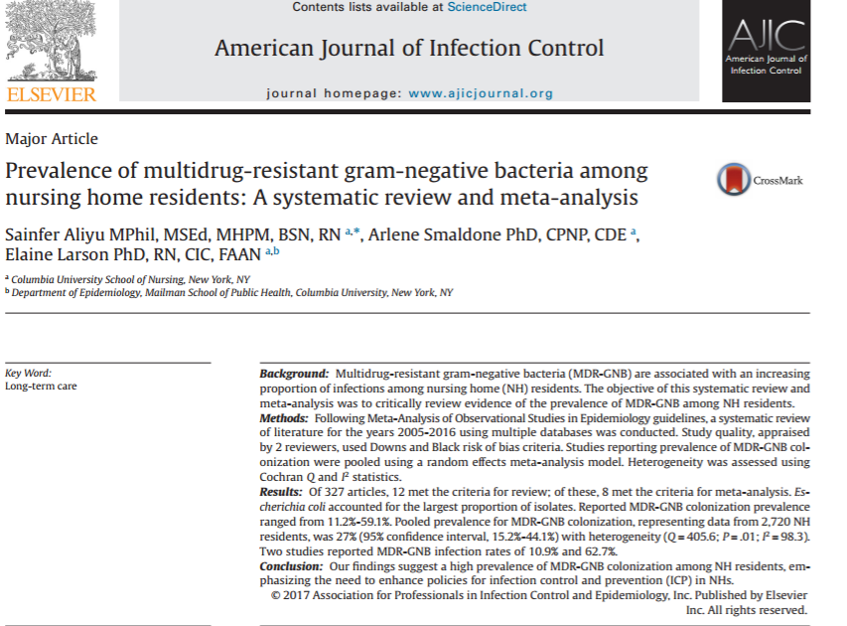
Reported MDR-GNB infection rates of 10.9% - 62.7%
http://www.ajicjournal.org/article/S0196-6553(17)30085-8/abstract
A systematic review and meta-analysis (May 1, 2017)

Slide 14
While optimizing hand hygiene and isolation practice is clearly important
there is no reason why the effectiveness and thoroughness of
Environmental hygienic cleaning should not also be optimized
Philip C. Carling, M.D. Boston University School of Medicine, 2010
The Environment is
everything that cannot walk and cannot talk
Dr. Peter Hoffman London, UK
Many infection prevention professionals do not consider
Bedpans as part of the Environment
Gertie van Knippenberg-Gordebeke, NL

Slide 15

Publications Google Scholar
Environment and hospital infections: 2,350,000
Interesting topic and International accepted Risk
Environment Mobile phones and hospital infections: 26,100
Interesting topic and International accepted Risk
Environment Bedpans and hospital infections: 5,260
No ‘sexy’ topic and (Not yet) International accepted Risk
Picture Google

Slide 16
Professional Publications
PUBMED AJIC
2008 | 2011 | 2017 | Topic | 2008 | 2011 | 2017
16 | 20 | 42 | Bedpan & infections | - | 22 | 75
12 | 14 | 20 | Bedpan & nosocomial infections | - | 13 | 41
1 | 3 | 6 | Bedpan & hospital assoc. infections | - | 19 | 65
0 | 1 | 19 | Bedpan & healthc. assoc. infections | - | 10 | 29
- | 5 | 9 | Clostridium & bedpans | - | 7 | 31
This minority number of published articles
gives not many evidence where IC professionals always looking for

Slide 17

Is Evidence always needed to make decisions?
Evidence:
The facts, signs or objects that make you believe that something is true Oxford Advanced Learner’s Dictionary
Non-Evidence ?
Does that mean the fact, signs or objects that make you believe
that something is NOT true?
Authors have searched literature for the words “parashute” and “trial”
They did not find any randomised controlled trials of the parashute
Conclusion: to wear a parachute to prevent death/severe
trauma when jumping from an airplane is not an Evidence Based Procedure
BMJ 2003;327.1459-1461
Picture Google

Slide 18
Global Observations Bedpan management 2006-2017
44 visits to low- and high income countries
Observations of the provided care in bedpan management
Observations in the sluice rooms (30-60 minutes)
69 standardized interviews about bedpan management
399 experience exchanges with infection prevention professionals
Observation :
KNIP Consultancy Infection Prevention

Slide 19
Results Global Observations Bedpan management 2006-2017
For convenience staff: no bedpans or urine bottles but instead:
  Diapers
  Urinary catheter,
  (sometimes including antibiotic prophylaxis to prevent urine tract infections)
Nurses, nurse aids and relatives do the job without training ‘how to’
Manual emptying in different places
Personal protective equipment (PPE) is seldom used
Cleaning & disinfection without attention to the right procedure
Sluice-rooms poorly equipped and designed
Poorly maintained/validated Macerators and Washer disinfectors
Observation :
KNIP Consultancy Infection Prevention

Slide 20
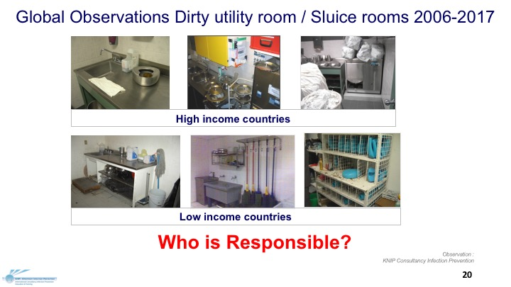

Slide 21

Categories of Healthcare waste
Pharmaceutical waste 2. Sharps 3. Radioactive waste
4. Genotoxic waste 5. Chemical waste 6. Pathological waste
7. Infectious waste
Suspected to contain pathogens, from isolation wards,
materials or equipment that have been in contact with:
        infected patients
        excreta contaminated with
        potentially infectious fluids or blood
How do we recognize infected patients?
Danger: Unknown carriers!

Slide 22
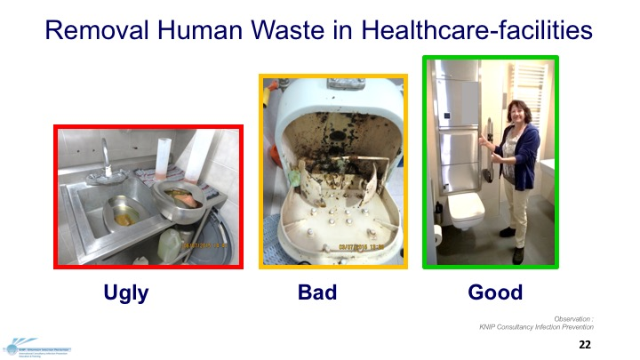

Slide 23
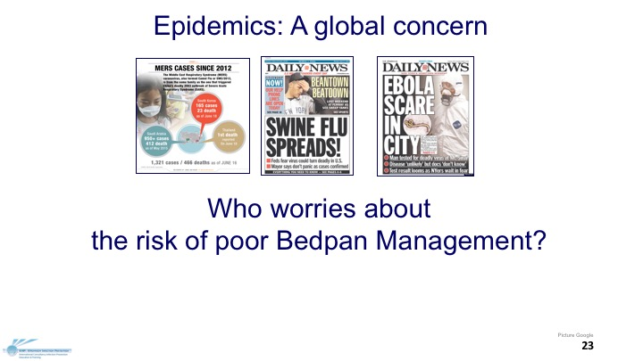

Slide 24
Global Survey Bedpan Management 2017 (1.3)
Digital survey in English, Spanish and PFD in Russian and French
233 Responders
44 Countries
Healthcare settings (10 - 2000 beds)
26 % Local guidelines for bedpan management in case of MDRO and C. difficile
38% Intensive Care Unit all bedridden patients gets ALWAYS incontinent products
for the convenience of the staff
These numbers do not representing ‘the world. Itgives an impression of the practice
Preliminary results Survey KNIP Consultancy Infection Prevention
With help from: Prof.dr. Pola Brenner, Chili
Tim Lieske, Germany, Jim Gautier, Canada

Slide 25
44 Participating Countries
Argentina 8 | Denmark 2 | Mongolia 1 | Netherlands 35
Aruba 1 | Egypt 3 | Peru 1 | Peru 1
Australia 1 | Ecuador 1 | Philippines 51 | Sweden 1
Austria 2 | France 23 | Qatar 1 | Switzerland 2
Belgium 8 | Germany 1 | Romania 3 | Thailand 6
Brazil 2 | Hong Kong 1 | Russia 4 | United Arab Emirates 1
Cameroon 1 | Iceland 1 | Saudi-Arabia 6 | United Kingdom 2
Canada 22 | Indonesia 3 | Singapore 4 | USA 5
Chile 3 | Kosovo 1 | South-Africa 3 | Uruguay 3
China Republic 1 | Malaysia 5 | South-Korea 1 | Vietnam 1
Congo 1 | Mexico 5 | Spain 2 | Zimbabwe 1
Preliminary results Survey KNIP Consultancy Infection Prevention
With help from: Prof.dr. Pola Brenner, Chili
Tim Lieske, Germany, Jim Gautier, Canada

Slide 26
Global Survey Bedpan-Management 2017
Equipment for emptying and decontamination for human waste containers
  45 % No equipment
  10,7 % Macerator (Mac)
  45.4 % Washer-Disinfector (WD)
  11.5 % Liner (Coverbag)
76 % Empties bedpans and urine bottles in toilets or slophoppers (even with WD or Mac)
urine bottles bedpans
Only Rinsing with tap water/ wand sprayer/water & brush 41 % 28 %
Only Soaking in a disinfection/detergent solution 29 % 25 %
Preliminary results Survey KNIP Consultancy Infection Prevention
With help from: Prof.dr. Pola Brenner, Chili
Tim Lieske, Germany, Jim Gautier, Canada

Slide 27
Global Survey Bedpan-Management 2017
Sluiceroom / Dirty utility room
10% No sluiceroom
15% Clean/dirty section is clearly indicated
28% Hand hygiene: soap and water at this dedicated sink
26% Hand hygiene: alcohol rub available in this room
Involvement Infection Control Professional in Bedpan Management
5% Not involved
16% Proces of bedpan management
12% Design sluiceroom
48% Developing requirements for chosen equipment
Preliminary results Survey KNIP Consultancy Infection Prevention
With help from: Prof.dr. Pola Brenner, Chili
Tim Lieske, Germany, Jim Gautier, Canada

Slide 28
Global Survey Bedpan-Management 2017
Role bedpan management in Outbreaks and Single HAIs
  26% I do not know / unknown
  21% Never searched
  16% Bedpan-Management as part of outbreak management
  3% Washer-disinfector played a role
  2 % Macerator played a role
  9 % Bedpans played a role
  7 % Urine bottles played a role
Preliminary results Survey KNIP Consultancy Infection Prevention
With help from: Prof.dr. Pola Brenner, Chili
Tim Lieske, Germany, Jim Gautier, Canada

Slide 29
Global Survey Bedpan-Management 2017
5-26 % reported Healthcare Associated Infections (HAIs)
  17 % Urine tract infections
  15 % Gastro-intestinal infections
  7 % Wound infections
  1 % Other infections
Causing Micro-organisms
VRE
C. difficile
Salmonella species
Rota virus
No published findings
One colleague sent me a poster
Preliminary results Survey KNIP Consultancy Infection Prevention
With help from: Prof.dr. Pola Brenner, Chili
Tim Lieske, Germany, Jim Gautier, Canada

Slide 30
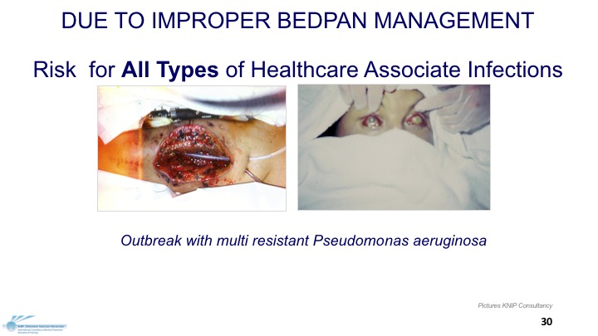

Slide 31
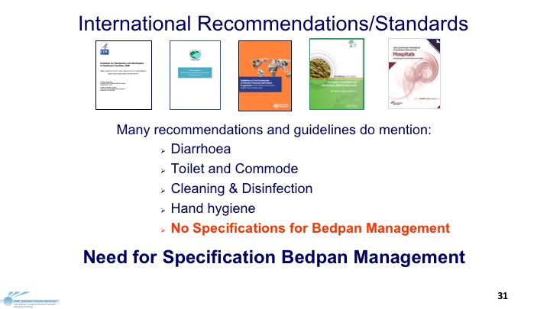

Slide 32

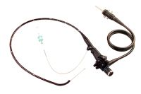
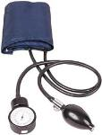

Cleaning, Disinfection, Sterilization
USA Classification scheme: Spaulding 1968, CDC HICPAC 2008
Critical Items: Sterilization
Affect normally sterile tissues or the blood system and represent the highest level of infection risk.
Surgical instruments , catheters, probes , etc.
Semi-critical Items: High level disinfection
Second in importance and affect mucous membranes and small areas of non-intact skin and represent
a high level of infection risk. Anaesthesia equipment, endoscopes ,etc .
Non-critical Items: Low Level disinfection
Items and practices that involve intact skin and represent the lowest level of risk: Bedpans, Bloodpressure cuffs, etc.
Notes:
32

Slide 33

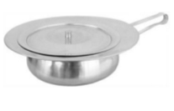
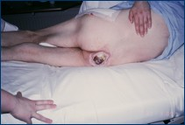
Spaulding’s Classification scheme:
2017 NOT SUFFICIENT for Bedpans
This scheme ignored the risk of:
Heavenly bacterial load of faeces and urine
Risks of contamination of hands and environment
Transmission by hands and unclean bedpans
Bedpans that come in contact with non- intact skin
Notes:
33

Slide 34

Bedpan Management
Care at the bedside
Transport to Empty
Emptying (manual or mechanical)
Flushing (manual or mechanical)
Cleaning (manual or mechanical)
Loading in Machine
Disinfection (manual or mechanical)
Drying (manual or mechanical)
Storage
34

Slide 35

Patientcare and Bedpan Management
Where to place the bedpan direct after use?
When remove gloves?
How to handle / carry bedpan?
Is the healthcare worker trained?
Picture Google

Slide 36

Transport to empty
Occupational Safety and Health Standards:
Specimens shall be placed in a container which prevents leakage
during collection, handling, processing, storage, and transport
To minimize the risk of spread of infection,
all blood and body substances should be treated as potentially infectious
Why no (Standard) Precautions
for transport of FULL bedpans?

Slide 37
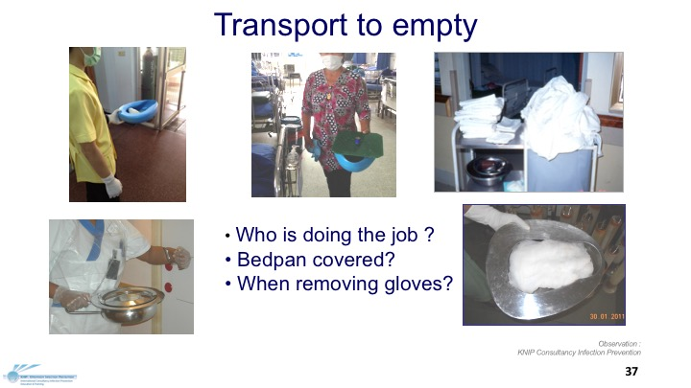

Slide 38
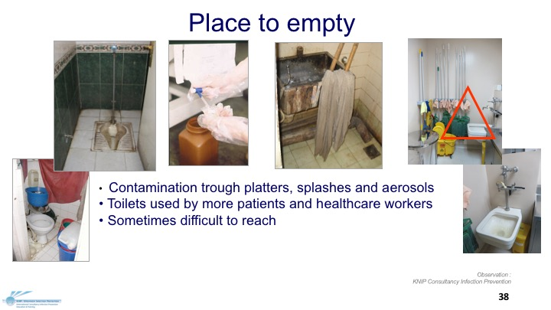

Slide 39
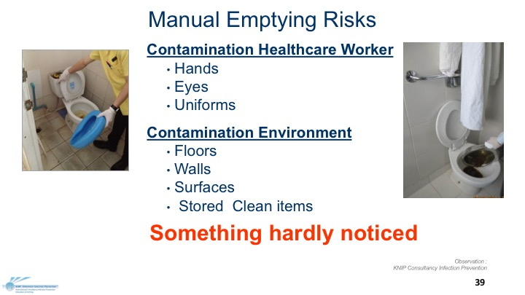

Slide 40
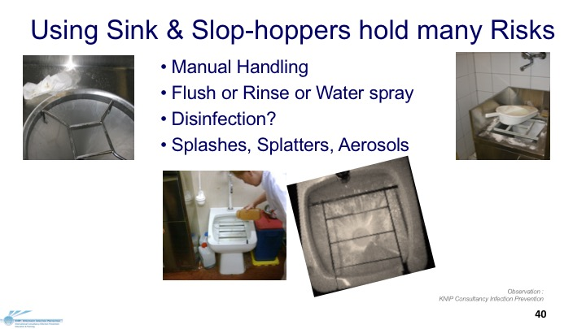

Slide 41
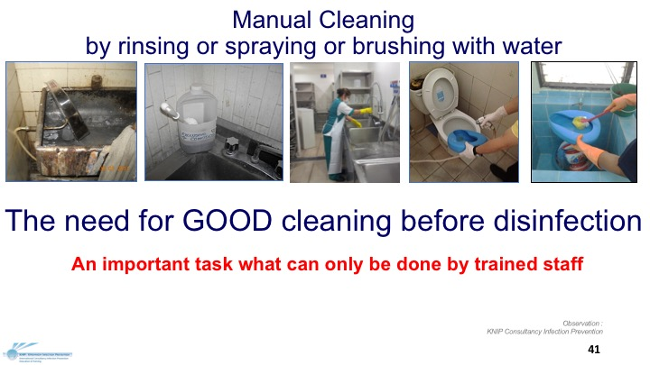

Slide 42
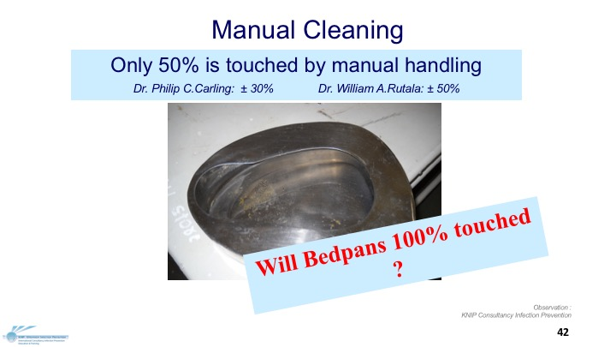

Slide 43
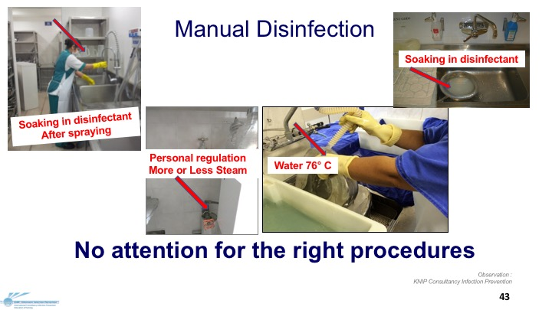

Slide 44
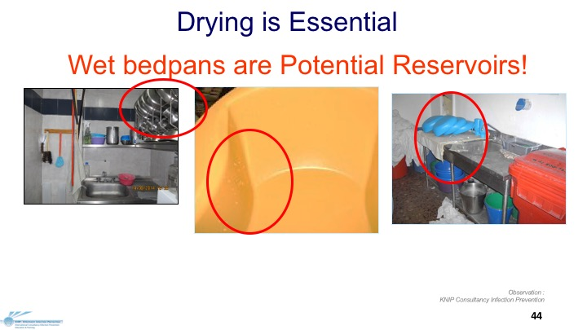

Slide 45














Shape and Material of Bedpans and Urine bottles are important
Bedpans and Urine-bottles are
Medical Devices
Picture Google

Slide 46
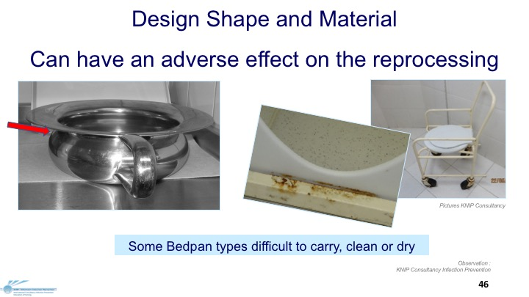

Slide 47
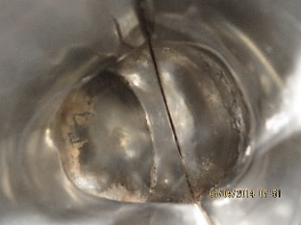
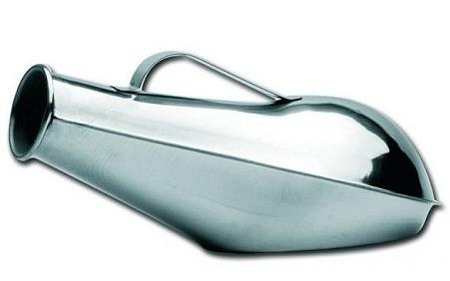
Design Shape and Material
Can have an adverse effect on the reprocessing
Impossible to:
Measure urine-volume
Inspection urine-color
Inside this urine- bottle,
High ATP value After Sterilization
Observation :
KNIP Consultancy Infection Prevention

Slide 48
Set Requirements for
Bedpans, Urine bottles, Kidney dishes
Reusable or disposable and/or covers
Easy to carry with lid /cover and firm grip
Cover
Seamless
Easy to clean & disinfect
Long lasting
Heat resistant
No water residue after reprocessing

Slide 49

Dirty Utility / Sluice Room
Reality check and analyse current situations
Focus on what people DO
Audit
Take photographs
Use nose and eyes
Microbial check ?
ATP?
Don’t Hear?
Don’t See?
Don’t Speak?
Picture Google

Slide 50
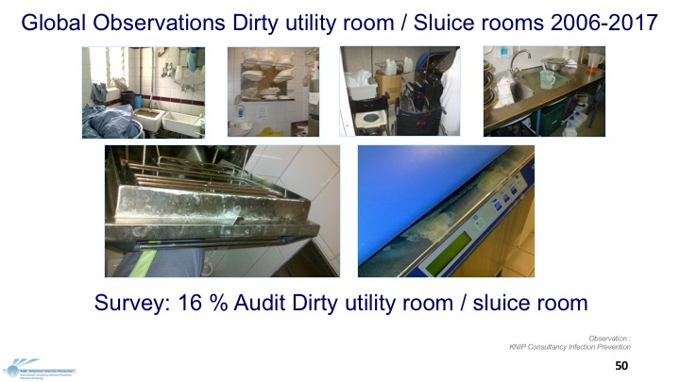

Slide 51

Improvement Dirty utility room / Sluice room
Designing
  Easy to clean
  Easy to maintain
  Prevent transmission & contamination
Operating
  Reduce
  Reuse
  Recycle
Trend (all) disposables (2017 APSIC)
Try to use as less as possible
Go for long lasting reusable
Reduce disinfectants

Slide 52
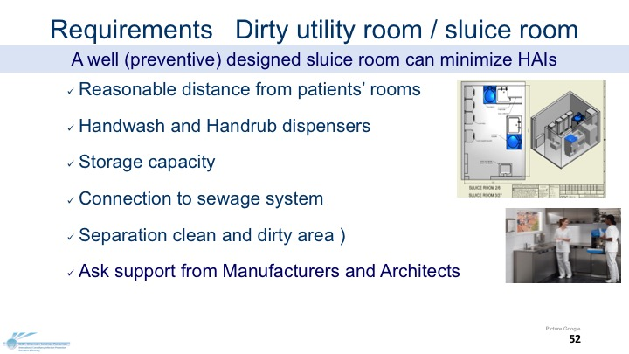

Slide 53
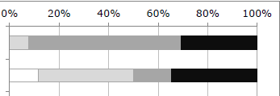
2013 Report Dutch Healthcare Inspection
Infection Prevention in Hospitals
”Report ”Chain of infection prevention in hospitals fragile: Several weak links lead to unsafe care”
Good
Sufficient
1
Moderate
2
Insufficient
1. General Cleaning & Disinfection
2. Washer Disinfectors for bedpans
2017
Dutch Healthcare Inspection
Monitoring /Review Infection Prevention in Hospitals
www.igz.nl/zoeken/document.aspx?doc=Keten+van+infectiepreventie+in+ziekenhuizen+breekbaar%3A+meerdere+zwakke+schakels+leiden+tot+onveilige+zorg&docid=6677

Slide 54
Bedpan Management in the Netherlands
1967 Ministry of Health: “Urine-bottles and bedpans have to be
automatically cleaned, rinsed and sanitized
with steam or hot water at least 1 minute for 80°C."
1980 Development of automatic bedpan Washer Disinfector (WD)
1990 1st Dutch survey: ”Bedpan washer disinfector - a forgotten problem? (Awareness)
1995 Working Group Infection Prevention (WIP) developed guidelines for WD
2006 International Standard BS- EN- ISO 15883 Part 1-6 WD
2010 2nd Dutch survey Bedpan management
^{st} International survey Bedpan management
New WIP Guideline for WD, Macerators and Liners (bedpan covers)
2017 - 2nd International survey Bedpan management

Slide 55
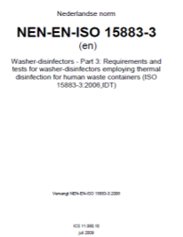

BS-EN-ISO 15883-Standard (2006)
Washer Disinfectors (WD) Part 1-7
Part 1 General requirements, terms and definitions and tests
Part 2 Requirements and tests for WD employing thermal
disinfection for surgical instruments, anaesthetic equipment
Part 3 Requirements and tests for WD employing thermal
disinfection for human waste containers
Part 4 Requirements and tests for WD employing chemical
disinfection for thermo-labile endoscopes
Part 5 Test soils and methods for demonstrating cleaning efficacy
Part 6 Requirements and tests for WD employing thermal
disinfection for non-invasive, non-critical medical devices
and healthcare equipment
Awareness Responders
ISO 15883-2 7%
ISO 15883-3 4%
ISO 15883-4 9%
Preliminary results Survey KNIP Consultancy Infection Prevention
With help from: Prof.dr. Pola Brenner, Chili
Tim Lieske, Germany, Jim Gautier, Canada

Slide 56
ISO15883 - Part 3
WD for human waste containers*
    *Intended for reusables such as Bedpans, Urine-bottles, Suction bottles, Wash bowls etc.
Emptying behind closed door direct in sanitary sewer system
Flushing with cold water
Cleaning with water pressure and (possible) detergent
Thermal disinfection (minimal 1 minute 80°C.)
Rinsing
Cooling down
Drying

Slide 57
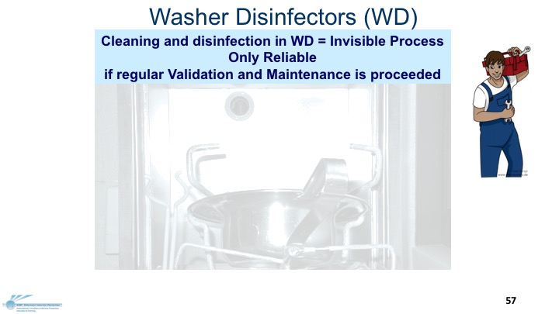

Slide 58
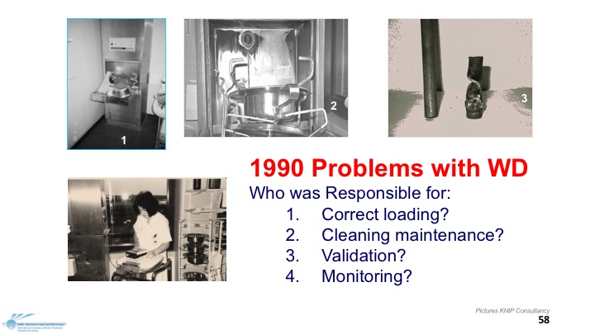

Slide 59
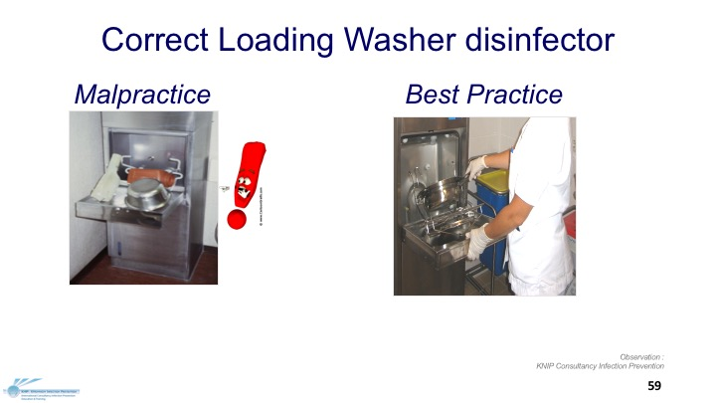

Slide 60
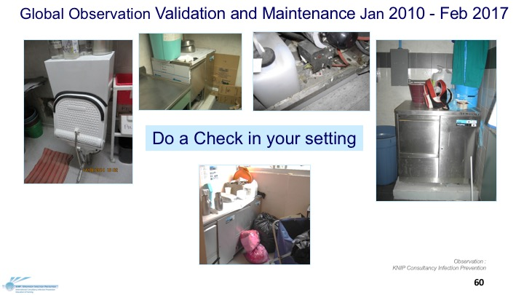

Slide 61
Systems for disposal human waste bedpans, urine bottles, commode buckets, kidney basins washing bowls
Manual Procedure
Cheap
Never a safe standard operated procedure (SOP)
Risks for contamination and transmission
Nasty Job
Should be avoid as much as possible
61

Slide 62
Systems for disposal human waste bedpans, urine bottles, commode buckets, kidney basins washing bowls
Pharmafilter
Bedpan liner
Macerator
Washer Disinfector
62

Slide 63

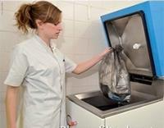
Pharmafilter
Shredder connected to special sewer system, processing waste and purifying waste water
2008 1st Dutch Hospital (Delft) 2017 2nd signed contract for new to build hospital Erasmus Uni. Rotterdam
Pro
No manual handling
All biodegradable plastics waste
Environmentally friendly
Reuse waste water
Contra
Blockage drains possible
Continuous costs disposables
Logistic supply chain
Maintenance
Noise
Plant for recycling waste water
Expensive
  Requirements Sufficient Electricity, Water supply and Sewage connection
Picture Google
63

Slide 64
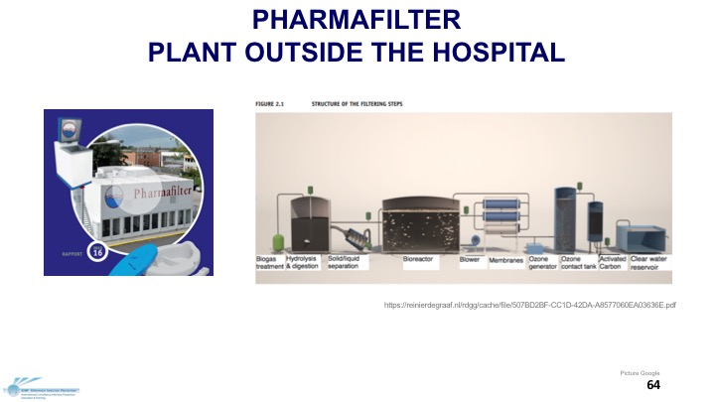

Slide 65
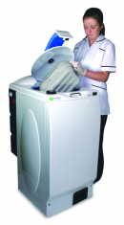






Macerator
Pulp bedpans, urine bottles, commode buckets ,kidney basins, washing bowls
Contra
Different quality on market
Allowed for sewage system?
Blockage drains is possible
Continuous costs disposables
Clean & disinfection Support
Logistic and supply chain
Urine measuring
Needs Maintenance
Storage capacity
PRO
No manual handling
Disposable bedpans etc.
Only cold water
  Requirements Sufficient Electricity, Water supply and Sewage connection
Picture Google
65

Slide 66
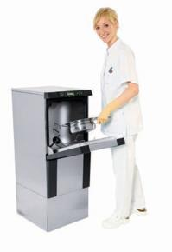




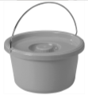

Washer Disinfector
Reuasable bedpans, urine bottles, commode buckets ,kidney basins washing bowls
Pro
No Manual handling
Reusable bedpans etc.
Elimination most spores
Validation possible
Contra
Different Quality on market
Needs Maintenance
Needs Validation
  Requirements Sufficient Electricity, Water supply and Sewage connection
Picture Google
66

Slide 67
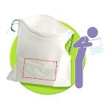
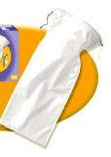
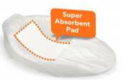

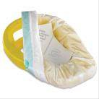
LINERS Absorbent devices for excreta collection bedpans, urine bottles, commode buckets, kidney basins washing bowls
Pro
Absorption Content
Disposable Covers
Absorption Content
Easy to use
Contra
Different quality on market
Continuous costs disposables
Decontamination Support
Logistic and supply chain
Storage capacity
Picture Google
67

Slide 68
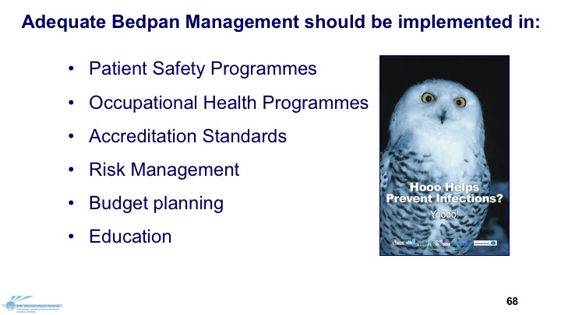

Slide 69







All countries need a Bedpan Queen/King
To PROMOTE the good methods and to FIGHT the bad and ugly methods
México
Francia
Equador
Mexico country
France
Thailand
Thank You
Singapor e
Mexico City
Philippines
Pictures KNIP Consultancy
68

Slide 70
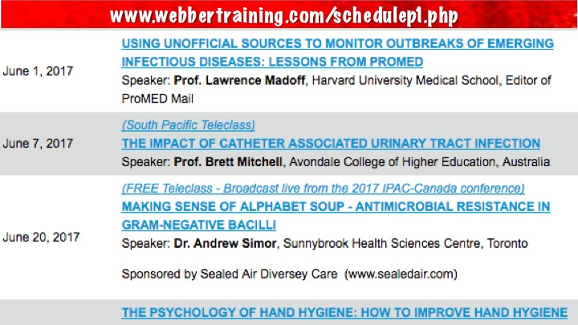

Slide 71


