Slide 1
The 2020 COVID-19 journey and its impact on New Zealand
Dr. Ian Town Chief Science Advisor Ministry of Health
Hosted by Jane Barnett jane@webbertraining.com
www.webbertraining.com
February 17, 2021

Slide 2
First media statement 6th January 2020
“The Ministry of Health is aware of some cases of pneumonia with an unknown cause being reported in Wuhan City, Hubei Province of China. We are monitoring the situation.
At this stage there appears to be no significant human-to-human transmission. As recommended by the World Health Organization there are currently no travel or border restrictions being put in place. “
2

Slide 3
Epidemiology - NZ
3

Slide 4
Over the longer term since elimination
4

Slide 5
Epidemiology - NZ
5

Slide 6
Case Summary February 2021
6

Slide 7
Managed Isolation
7

Slide 8
Publication in Lancet Public Health
8

Slide 9
The Rise and Rise of Public Health !
Alert levels based on very simple premises:
Physical distancing
Hand hygiene
Covering coughs and sneezes
Stay home if you are unwell
Restrictions on regional travel
Closing bars and restaurants
Limiting size of events
9

Slide 10
New Zealand Response – “go hard, go early”
10

Slide 11
The story so far…
11

Slide 12
Public Health – The Elimination Strategy
“Our elimination strategy is a sustained approach to keep it out, find it and stamp it out. We do this through: controlling entry at the border; disease surveillance; testing for and tracing all potential cases; isolating cases and their close contacts; physical distancing and hygiene advice and broader public health controls depending on the alert level we are in”
12

Slide 13
Border Measures
Keep it out , stamp it out
Controlled entry – limit the number of returnees
Use of managed isolation facilities versus self-isolation
14 day incubation period
Testing Day 0/1 and Day 12 prior to release
Post release self isolation for 5 days and testing on Day 5
13

Slide 14
Challenges at the border
Numbers game:
100,000 + returnees
Testing has shown steady stream of positive cases around 0.3% of returnees. Currently 4-8 per day, 100 per month)
Identified a number of UK and SA variants
Several incursions have occurred but they have been managed effectively and quickly
Risks increase when there are larger numbers in a specific facility e.g. Russian seafarers
Costing $2.4M per day
14

Slide 15
Surveillance and Testing Plans
Where to look? –where most likely to find – moving to a risk based approach:
Symptomatic (case definition)
Asymptomatic – only around clusters
Border workers including staff in facilities
Air crew / maritime crew
Any respiratory admissions to hospital
Returning travellers
Communities at risk
15

Slide 16
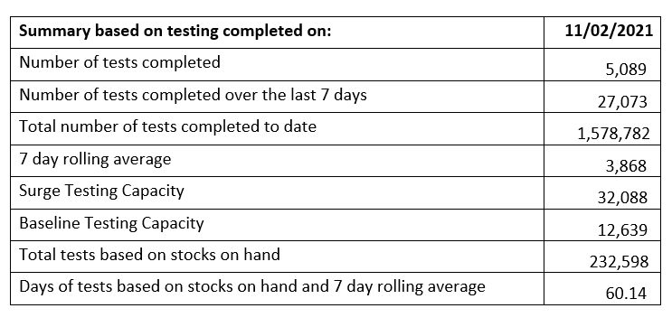
Testing – by the numbers
16

Slide 17
Testing Technologies
RT-PCR in 12 laboratories around New Zealand
Role of Environmental Science and Research (ESR):
Test development
Test validation
Rapid and POC tests
Whole genome sequencing has been a game changer
Assessing:
Antigen tests, saliva testing, wastewater testing, role of antibody testing
17

Slide 18
Whole Genome Sequencing
18

Slide 19
Cluster Mapping
19

Slide 20
Infection prevention and control
COVID-19 has triggered a renaissance for IPC
As with Public Health more generally, the IPC workforce has been inadequate for some time
IPC measures have been at the heart of the response
Hand hygiene
Personal protective equipment – major issues initially with supply and training
20

Slide 21
Infection prevention and control
Challenges for IPC colleagues have included:
Education for employer groups especially ARC, Border staff
Need to work alongside unions and non health colleagues in Managed Isolation facilities
Managing communications – high levels of fear
Role of masks – main emphasis has been for health care workers rather than the wider public
Confusion about the role of different sorts of masks, need for fit testing etc
Aerosol transmission science
21

Slide 22
Vaccines
A global research efforts has been underway for many months
Collaboration has been a key feature to date
WHO playing a key role
22

Slide 23
Vaccine procurement
New Zealand is a financial member of COVAX
We have also 4 signed Advance Purchase Agreements:
Pfizer
Janssen
Astra-Zeneca
Novavax
Immunisation programme to start in February 2021, starting with border workers, then health care and ARC staff.
23

Slide 24
Critical issues
We have eliminated COVID-19 from New Zealand (twice at least!)
The border remains the key risk area for our future well-being and the economy
The MIQ approach with 14 days quarantine will be reviewed carefully as may not be sustainable
Deploying the vaccines or effective therapeutics will be crucial for re-opening the border
Testing will play a key role in understanding risk profiles – especially old infections and antibody status
24

Slide 25
And in Hindsight
Triumphs have included:
A science-led response
Strong support from the Prime Minister supported by her Chief Science Advisor Prof Dame J Gerrard
Early closure of the border
Communications masterclass – PM and DG Health
Massive collective effort across our health sector
The rise of telemedicine
Massive reliance on Healthline (National telephone service)
25

Slide 26
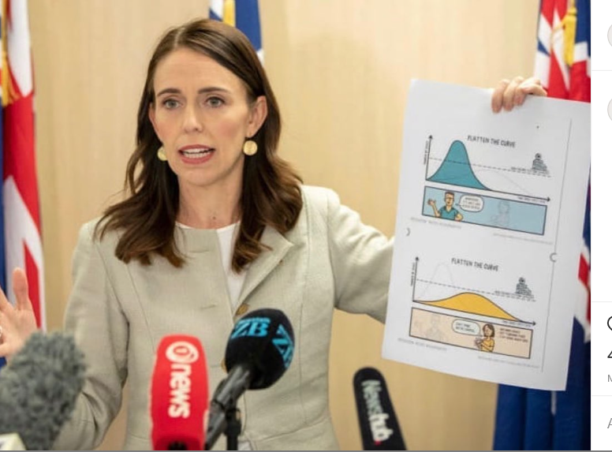
Images from 2020
26

Slide 27
And in Hindsight
Things we could have done better:
Preparedness – WHO ranking not good
Under investment in Public Health
PPE supply chain and distribution channels
Contact tracing too slow to start with and slow deployment of the NZ COVID Tracing App
Communication with Primary Care colleagues
Poor quality website design and content
Slave to media machine
Lack of engagement with Parliamentary opposition figures
27

Slide 28
Scenarios for 2021…
The pandemic continues to grow and there is no effective vaccine:
This means that we will need strong border measures for some (considerable) time
Some countries eliminate the virus and start to open their borders – reciprocal arrangements for the Pacific and Australia:
Tourism and business travel may re-start
In the longer term the impacts of climate change, AMR and new viruses mean that infectious disease become a major ongoing threat .. we are not prepared for that…
28

