Slide 1

THE ROLE OF COMPANION ANIMALS IN INFECTION TRANSMISSION
Timothy Landers, RN, CNP, PhD
College of Nursing
Jason Stull, VMD, MPVM, PhD, DACVPM
College of Veterinary Medicine
Hosted by Paul Webber
paul@webbertraining.com
www.webbertraining.com
November 20, 2014

Slide 2
Conflict of Interest Statement
The presenters declare they have no competing interests
2

Slide 3
Learning Objectives
Describe features of the human-animal bond and its implications for human health and infection prevention
Define zoonotic transmission and describe the role of pets in zoonotic outbreaks
Identify key strategies for preventing pet-associated zoonotic transmission in healthcare settings
3

Slide 4
HUMAN-ANIMAL BOND AND ITS IMPLICATIONS FOR HUMAN HEALTH AND INFECTION PREVENTION
4

Slide 5
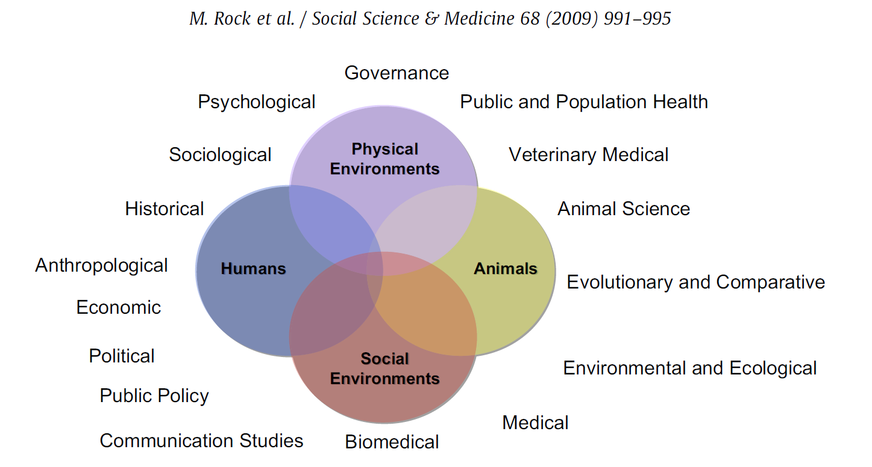
5

Slide 6
Dogs are special
Co-evolution of dogs and humans
Historical importance
Family members
Usefulness to humans
Emotional and psychological important
Social and cultural taboos
Human health benefits
6

Slide 7


Slide 8
Human-Animal Bond
Often strong bonds between pets and owners
  Adults with HIV: source of support, protect against loneliness¹
  Adult cancer patients: high attachment, provide health benefits²
  Immunocompromised children³
¹ Siegel 1999 ² Larson 2010 ³Stull 2014
8

Slide 9
Human-Animal Bond
Relationship between people and their pets
HAI = human-animal interaction
  Encompass human-animal bond from pet ownership, recreation (horseback riding), animal husbandry, therapy
9

Slide 10
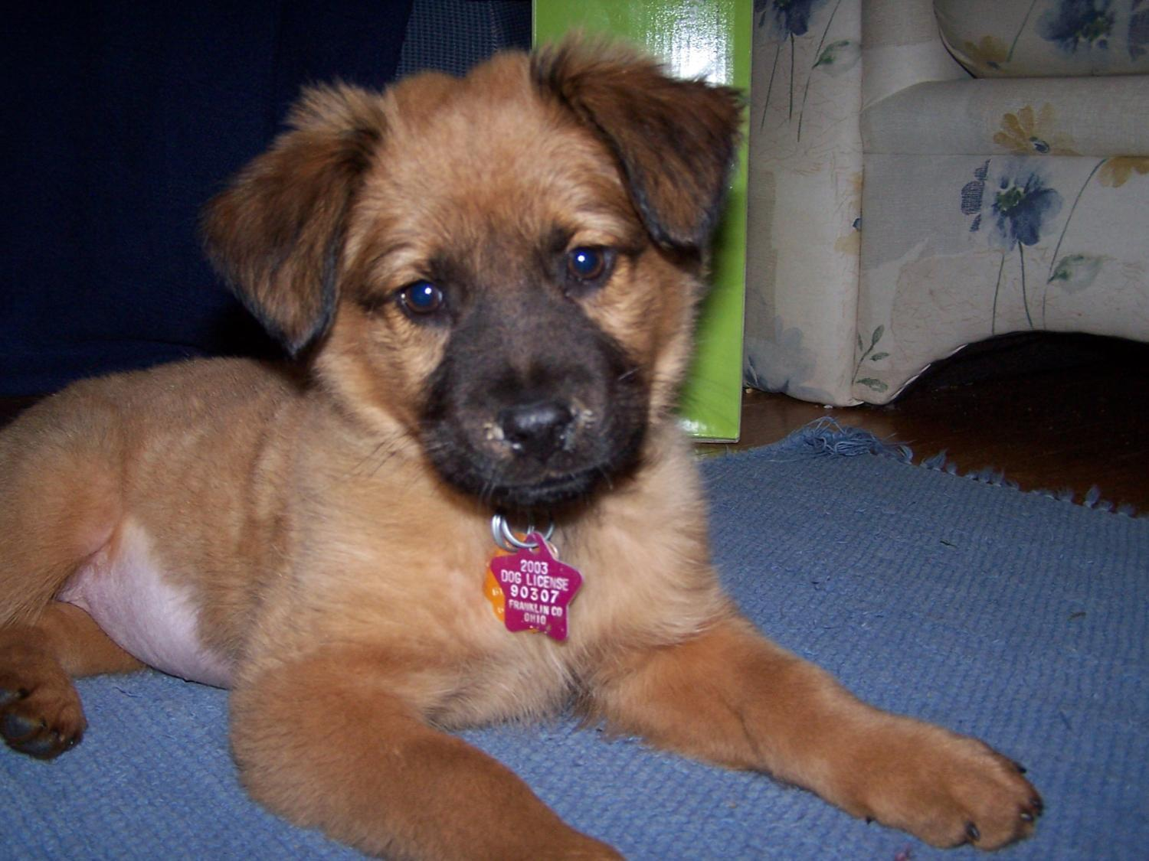

Slide 11
Human-pet dog interactions
Types of interactions
  Determinants of interactions
  Characteristics of interactions
Frequency
Social lives of dogs and dog owners
Interest in human benefits of interacting with animals
11

Slide 12
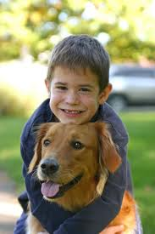
Human-Animal Bond
Distress & social isolation: ↓ health
Often strong bonds pets and owners
    ↓ stress, anxiety, loneliness, depression¹
    ↓ risk cardiovascular disease²
    Children: better social skills, self-esteem, empathy³
¹ Friedmann 2009 ² Patronek 1993 ³ Melson 1997

Slide 13
Human-Pet Scales
Lexington Attachment to Pets Scale (LAPS)
Pet Attitude Scale (PAS)
People and their pets instrument
Pet Relationship Scale
Monash Dog Ownership Relationship Scale (MDORS)
13

Slide 14
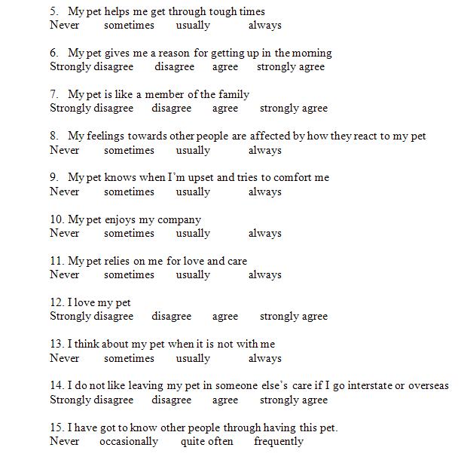
OPRS: citation available
14

Slide 15
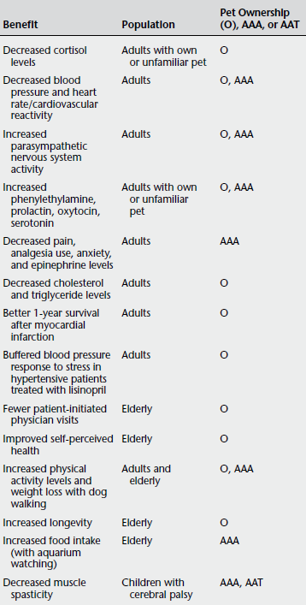
Physiologic Benefits
Ownership, AAA & AAT
“Low” and “high” stress situations
Variety of species
↓ health-care expenditures
Owned and loaner pets
  Dog-walking program (72% adherence)
Some document benefits for animals involved
  ↓ blood pressure
Johnson, 2010

Slide 16
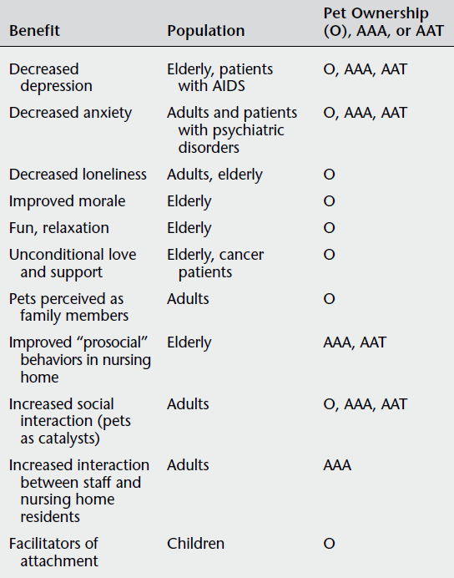
Psychosocial
Benefits
“High-risk” groups
  Nursing home
    ↑ prosocial behavior in residents
    ↑ positive interactions in staff
  AIDS
  Children autism
Interactions/perceived likability
Johnson, 2010
16

Slide 17
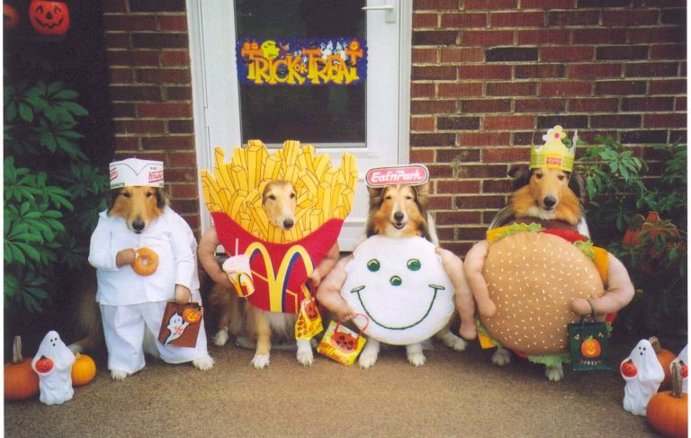
17

Slide 18

18

Slide 19

http://thehydrant.files.wordpress.com/2012/06
19

Slide 20
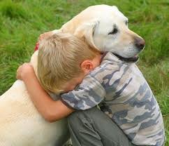
Children With Pets
Improved
  Social skills
  Self-esteem
  Empathy
As likely to talk to their pets about their emotions and secret experiences as with their siblings
20

Slide 21

Immunocompromised
Mental & physical isolation
HIV-infected:
  Pet as family member
  Source of support and affection
  Protect against loneliness
  Pet-owners with AIDS less depression than non-pet owners
Cancer patients:
  High level of attachment to pets
  Having a pet provided health benefits (67%)
Lung transplant recipients
  Pets ownership associated better quality of life
21

Slide 22
Health Benefits
Distress and social isolation → negative health effects
Depression and anxiety
  ↑ catecholamine release
  ↑ corticosteroids
  ↓myocardial perfusion (heart blood flow)
Improve health
  Improve psychosocial status
  Reduce distress and stress responses
  Moderate social interaction
22

Slide 23
Human-pet dog interactions
Types of interactions
  Determinants of interactions
  Characteristics of interactions
Frequency
Social lives of dogs and dog owners
Interest in human benefits of interacting with animals
23

Slide 24
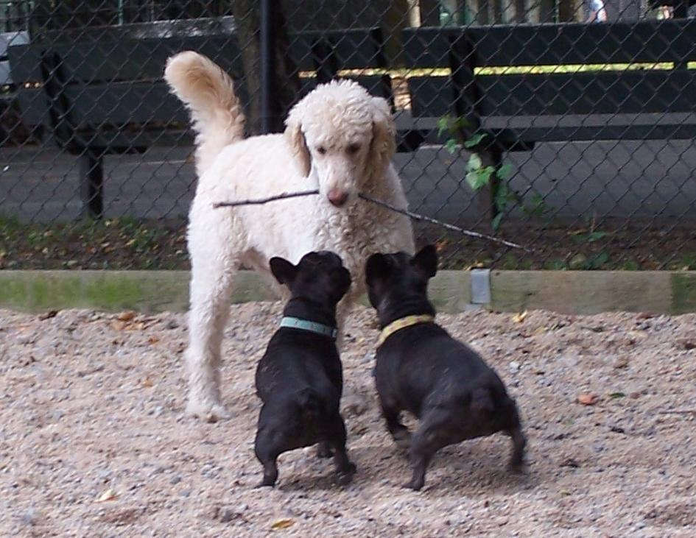

Slide 25


Slide 26
ROLE OF PETS IN ZOONOTIC TRANSMISSION & OUTBREAKS
26

Slide 27
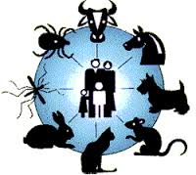
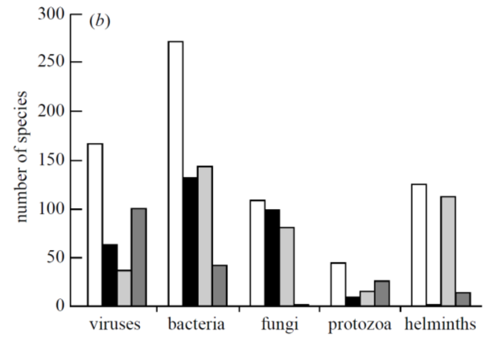
Zoonoses
Naturally transmitted from animals to people
Of 1,415 species pathogenic to people
  61% zoonotic
  75% emerging pathogens zoonotic
¹ Taylor 2001
27

Slide 28
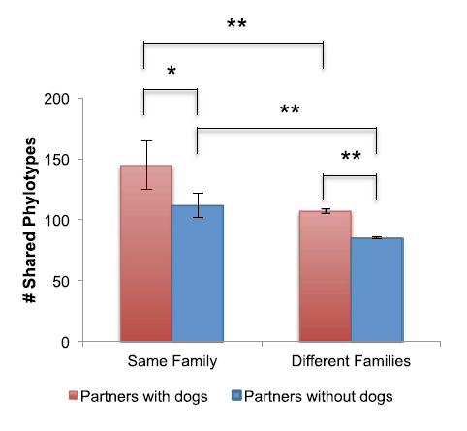
Share and Share Alike¹
Many factors shape human microbial community
  Household members
  Children
  Dogs
Household members more alike, esp. if dogs
Dog-owners shared more skin microbiota with own dog
¹ Song 2013
28

Slide 29
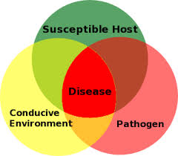
Elements for Effective Pet-Human Transmission
Pathogens with a broad host range
Opportunities for exposure
29

Slide 30
Pet-Related Risk Factors for Zoonotic Disease
Species
Diet
Age
Immunity
Prior antibiotic use
Opportunities for transmission
Opportunities for exposure
    Source, travel
    Management
    Hospitalization
    Contact with high-risk people
30

Slide 31
Pet-Associated Disease
70+ pathogens of “pets” transmissible to people
Pets often subclinical shedding
Emerging & remerging diseases
Animal and human reservoirs
  Dogs visiting human healthcare facilities¹
    C. difficile (OR=2.4)
    MRSA (OR=4.7)
¹ Lefebvre 2009
31

Slide 32
Pet-Associated Disease Risks
Disease risk greatest
  Extremes of age (<5 yrs, ≥ 65 yrs)
  Pregnant
  Immunocompromised
Higher risk groups
  Particular pathogens
  Longer duration
  More severe/unexpected complications
32

Slide 33
Pet-associated Infections of Greatest Concern
Bartonella spp.
Campylobacter spp.
Capnocytophaga canimorsus
Cryptosporidium spp.
Dermatophytes
Giardia lamblia
Lymphocytic choriomeningitis virus
MDROs (e.g., ESBLs, MRSA)
Pasteurella spp.
Salmonella spp.
Toxoplasma gondii
33

Slide 34
Staphylococcus
aureus
Staphylococcus
pseudintermedius
Common human pathogen
Uncommon canine pathogen
Colonizes approx. 30% of US residents
Approx. 10% of dogs colonized
Can contain resistance & virulence factors
Common canine pathogen
Uncommon human pathogen
Can contain resistance & virulence factors
Colonization in dogs and humans not well studied
34

Slide 35
Disease Attributable to Pets
Poorly understood
  Most not reportable
  Numerous exposure sources
  Subclinical carriage/shedding
  Reactivation during immunosuppression
Thought to be low^{1,2}
Risk not uniform
  Species, age, immune status
  High morbidity, mortality for some individuals
¹ Angulo 1995 ² Glaser 1994
35

Slide 36
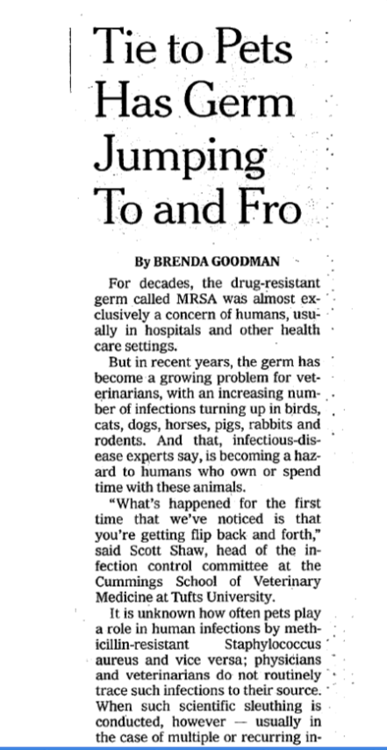

36

Slide 37
Author, year | Setting | Findings
Faires, et.al., 2009 (16) | US and Canada | 22 households in which pet had MRSA infection 10/56 (27.3%) of humans and 2/24 (8.3%) of non-infected dogs were colonized 8 households with recurrent human MRSA infections 1/16 (6.3%) of humans and 2/21 dogs (9.5%) were colonized Humans and dogs shared same PFGE strain
Weese, 2006 (11) | U.S. and Canada | Contacts of 6 index dogs with MRSA infection were evaluated. 14/88 (16%) of human contacts were positive, one secondary infection was identified (in a non-index dog).
Baptiste, et. al., 2005 (17) | Small animal hospital, UK | 55 dogs from hospital were MRSA negative 3 dogs with clinical infections had identical strains to 3/11 (27%) colonized staff
Van Duijkeren, et.al., 2004 (18) | Nursing home outbreak, Netherlands | Investigation of 48 patients and 15 nurses who were MRSA colonized After unsuccessful decolonization of one nurse, daughter and dog identified as MRSA colonized
Enoch, 2004 (19) | Pet therapy dog, UK | Pet therapy dog reported as MRSA-negative before visiting hospital ward, but positive after visiting
Manian, 2003 (10) | Case report, US | Patient and wife had recurrent MRSA infections with unsuccessful decolonization Therapy was successful only after treatment of dog Patient-dog isolates were similar based on PFGE
Table 1. Studies on the role of pets in SA/MRSA colonization and infection.
37

Slide 38
“Tie to Pets has germ jumping to and fro” New York Times | A well known expert “estimated that relatively few animals were infected…’In the grand scheme of things with MRSA, pets are a pretty minor thing,’ he said.”
“Can snuggling up to your pet give you MRSA?” Daily Mail, UK | “However, all experts agree there is no need to give up your beloved pet.” A local veterinarian who treated a MRSA-infected cat saated, “the cat would have picked it up from a human carrier. It wasn’t the cat’s fault.”
“Pets can give owners love, joy – and staph” The Columbus Dispatch | According to one expert, “dogs and cats are getting it from people.” A national expert stated, “I don’t want people to thing they’re going to get MRSA from their pets. More commonly, people get it because they’re carrying it themselves.”
“Beware of the dog: you may catch MRSA.” The Times Online | “Risks of infection from dog to Man at present are low.” According to a local animal behavioralist, “you are more likely to catch a disease from a child than a dog.
“MRSA in pets shouldn’t be a major concern.” KJCT News, Grand Junction, CO | A local expert stated that MRSA in animals is “not that prevalent…so you know, I don’t think people need to become frightened that if they touch a dog or a dog touches them that they’re all of the sudden going to get this horrible bacterial disease.”
38

Slide 39
Pet-associated Infections of Greatest Concern
Bartonella spp.
Campylobacter spp.
Capnocytophaga canimorsus
Cryptosporidium spp.
Dermatophytes
Giardia lamblia
Lymphocytic choriomeningitis virus
MDROs (e.g., ESBLs, MRSA)
Pasteurella spp.
Salmonella spp.
Toxoplasma gondii
39

Slide 40
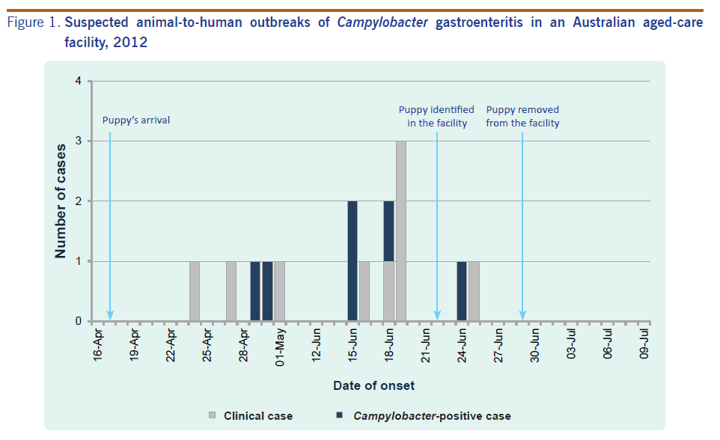
Campylobacter Outbreak¹
¹ Moffatt 2014
40

Slide 41
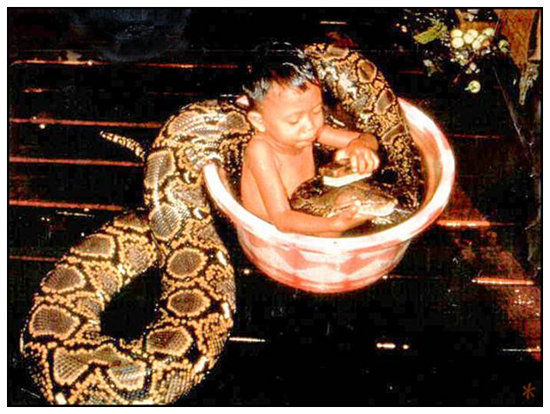

Slide 42


Higher Risk Animals:
Young Dogs/Cats (< 6 months)
Higher prevalence of pathogens
  Campylobacter spp.
  Hook and roundworms (e.g., Toxocara)
  Bartonella henselae
RF for human disease
  Campylobacteriosis
    <3yrs: puppy ownership (OR=17)¹
    Adults: ↑ risk with puppy ownership²
    Any age dog with diarrhea^{3,4}
¹Tenkate, 2001 ²Gras, 2013 ³ Fullerton 2007 ⁴Gillespie 2003
42

Slide 43
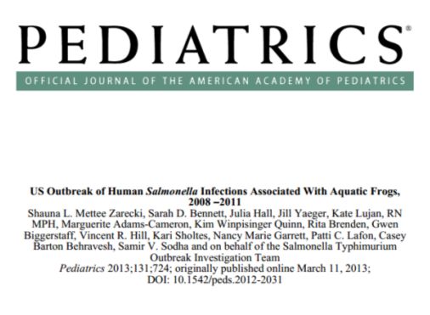
Higher Risk Animals:
Reptiles & Amphibians
Ex: Turtle, lizard, snake, frog, salamander
  High prevalence Salmonella
  RF human salmonellosis
    6-11% all cases¹
    Salmonella “travels”– hand hygiene, environmental disinfection
  Feeder rodents contaminated/ colonized with Salmonella
¹ Mermin 2004
43

Slide 44
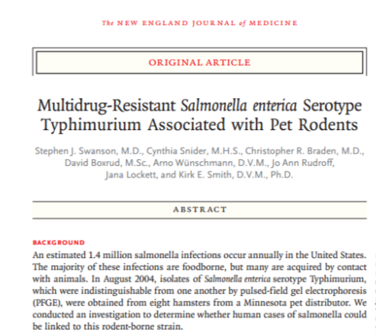
Higher Risk Animals:
Rodents
Ex: gerbil, hamster, guinea pig, mouse
  Increased prevalence
    Salmonella
    Lymphocytic choriomeningitis virus (LCMV)
44

Slide 45
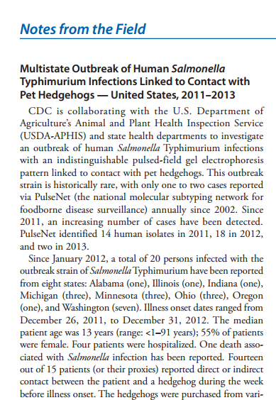
Higher Risk Animals:
Exotics
Ex. Chinchilla, hedgehog
  High prevalence
    Salmonella
    Other zoonotic pathogens?

Slide 46
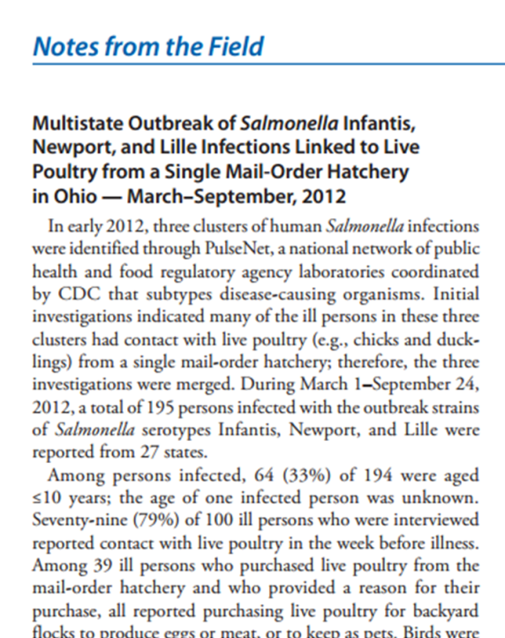
Higher Risk Animals:
Young Farm Animals
Ex. Chicks, calves, piglets, lambs, goat kids
  High prevalence
    Salmonella
    Cryptosporidium
    Campylobacter
    Clostridium difficile
    E. coli O157

Slide 47
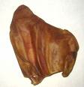
Risk Factors: Pet’s Diet
Dogs fed raw eggs or meat
  6x more likely to shed Salmonella¹
Outbreak: human salmonellosis associated with pig ear treats²
¹ Leonard 2010 ² Clark 2001
47

Slide 48
Opportunities for Transmission
Pets often members of households
Frequent pet contact by non-pet owning¹
Ownership and species owned similar for higher-risk people
Non-home locations
  Nursing homes, hospitals
  AAT, AAI
¹ Stull 2013
48

Slide 49
Opportunities for Transmission
Home high-risk practices frequent¹
  Lick faces several times/wk (24%)
  Fed high-risk foods (28%)
Dogs visiting health-care facilities¹
  ≥ 1 zoonotic agent 80% of therapy dogs¹
    Clostridium difficile
    MDR Escherichia coli
    Salmonella
  Licked patients or accepted treats increased risk for MRSA and C. difficile
¹ Stull 2014 ² Lefebvre 2009
49

Slide 50
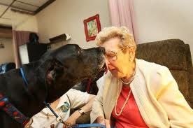
Opportunities for Transmission
Of 90 therapy dog handlers¹
  20% used no infection control measures
  40% could not name a zoonotic disease
  79% allowed their dogs to lick patients
¹ Lefebvre et al. 2006
50

Slide 51
KEY STRATEGIES FOR PREVENTING PET-ASSOCIATED ZOONOTIC TRANSMISSION
51

Slide 52
Overview of recommendations
Understand context!
  Benefits vs. risks of animal contact
Hand hygiene
Variety of interactions
  Human-animal-environment
Types and ages of animals
Pet health and husbandry practices
¹ Lefebvre 2008 ²Avery 2009 ³Hemsworth 2006
52

Slide 53
Hand hygiene
  Patients, visitors and HCWs before and after each animal contact
  Portable ABHR
  Follow facility’s protocols
53

Slide 54
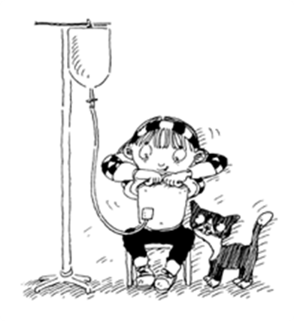
Environmental controls
Disposable, impermeable barrier if animal placed on bed
Routine cleaning after visits
54

Slide 55
Personal Hygiene
Patients not eating/drinking during pet visit
Do not allow pets to lick patients/staff (esp. faces)
Allow feeding (treats) only if important
No pet contact with invasive devices, open or bandaged wounds, surgical incisions or other breaches in the skin, or medical equipment
Report and promptly wash bites and scratches
55
Source: http://www.kidney.org.uk/

Slide 56
Animal Contact and Husbandry Recommendations
Existing Guidelines
  AAIs¹
  Specific conditions^{2,3}
Benefits vs. risks of animal contact
Additional attention to
  Personal hygiene
  Types and ages of animals
  Pet health and husbandry practices
¹ Lefebvre 2008 ²Avery 2009 ³Hemsworth 2006
56

Slide 57
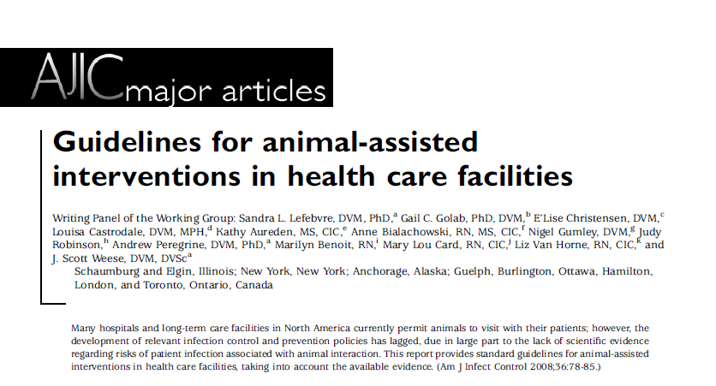
American Journal of Infection Control Volume 36, Issue 2, Pages 78–85, March 2008
57

Slide 58
General Concepts
Pathogen screening deemphasized
  What pathogens?
  How often (single point-in-time)
  May be indicated in situations
Emphasis on infection control practices
Records for tracing if needed
Patient-owned vs. AAI/live-in
  Patient: domestic companion animals; lenient if no other patient contact
  AAI/live-in: restrictions important
58

Slide 59
Facility Program
Animal liaison (visits, housed)
Animal policies (e.g., AAI)
  Part of formal program
  Temperament testing
  Evaluation by liaison; follow and revoke if problems
  Training for handler (e.g., zoonoses, health, confidentiality)
Inclusion criteria
59

Slide 60
Animal Contact?
Immunocompromised patients assessed by health care provider to give OK and any limitations
Identify patients with
  Animal phobias
  Lack of interest
  High risk
Appropriate locations
  Escort by hospital personnel
  Restrained by leash or cage
60

Slide 61
Restricted Areas
Food preparation areas
Operating rooms
Neonatal nurseries
Critical care
Isolation
High-risk areas with caution(e.g., dialysis, burn units)
61

Slide 62
Types and Ages of Animals
No high-risk animals
  Species
  Ages (cats/dogs > 1 yr)
  Source: none recently from animal shelter, pound
62

Slide 63
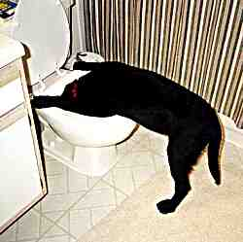
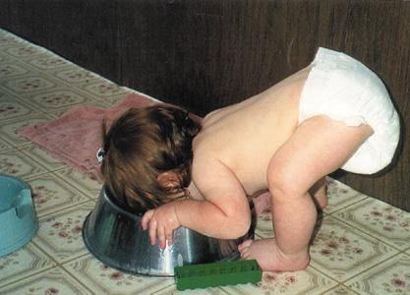
Pet Health and Husbandry
No raw foods, chews, or treats of animal origin within the past 3 months
Annual health evaluation (veterinarian)
Vaccinations current (rabies)
Ectoparasite and endoparasite parasite control program

Slide 64
Pet Health
No recent (i.e. in past wk)
  Vomiting/diarrhea
  Sneezing/coughing (susp infection)
  Urinary or fecal incontinence
  Antimicrobials (nontopical) or immunosuppressive doses of medications
  Infections (e.g., open wounds, skin/ear)
Before visit
  Brush/comb ± bathe
  Nails short
64

Slide 65
Other Considerations
Patients (and medical personnel) often limited knowledge pet-associated disease^{1,2}
  Risks
  Reduction methods
Patient pet contact infrequently assessed^{1,2}
Veterinary counterparts useful resource, but limited interaction³
¹ Stull 2013 ² Stull 2014 ³ Hill 2012
65

Slide 66
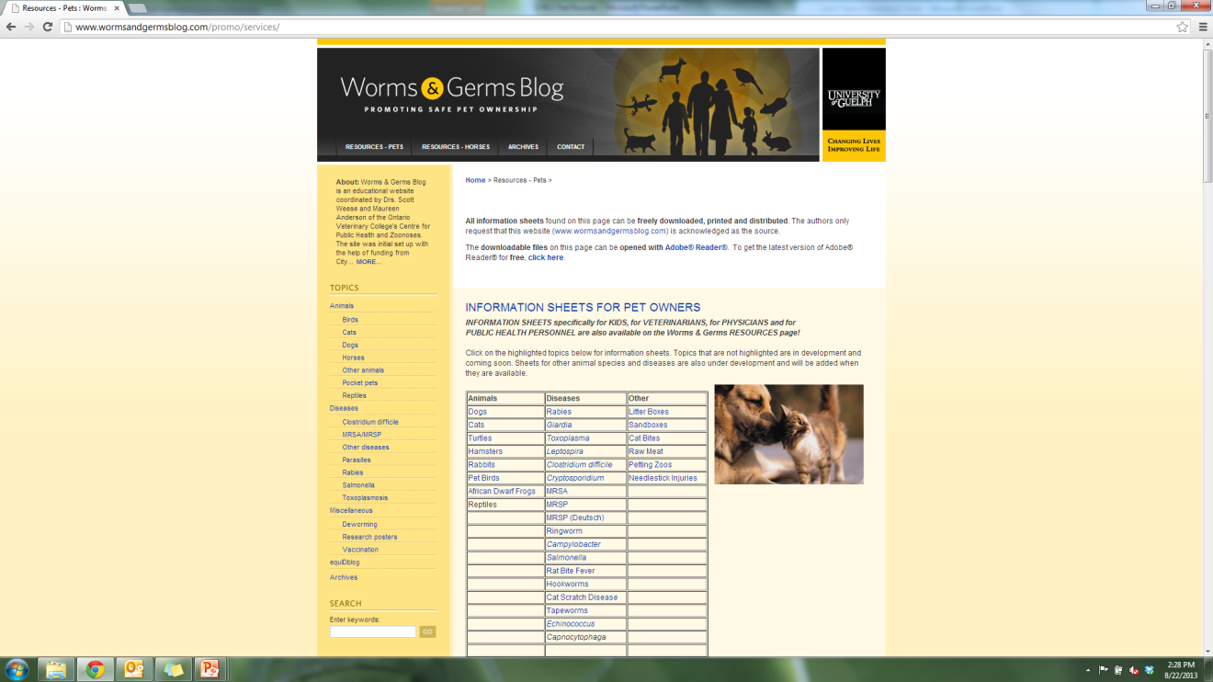
Resources: Pet-Associated Disease
66

Slide 67
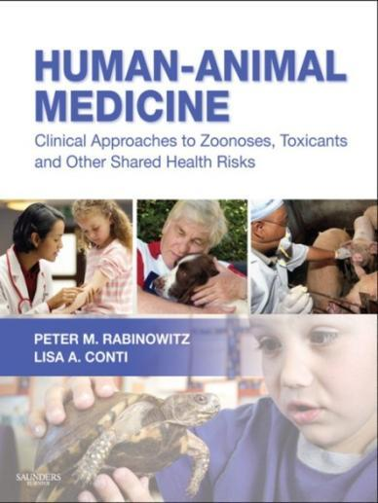
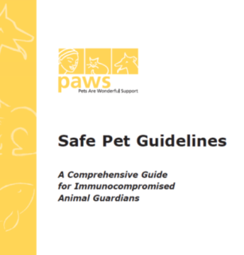
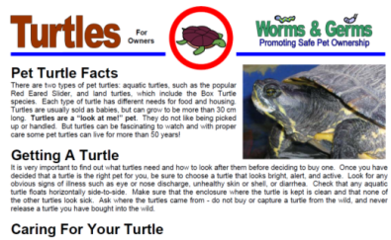
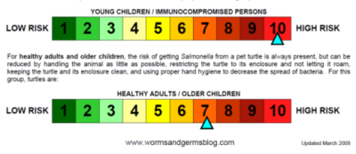

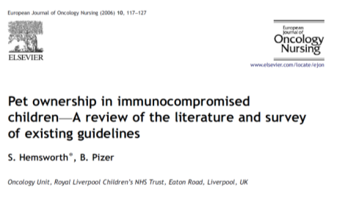
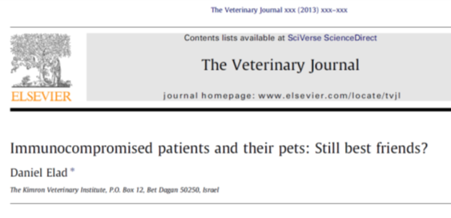
Resources: Pet-Associated Disease
pawssf.org
wormsandgermsblog.com
67

Slide 68
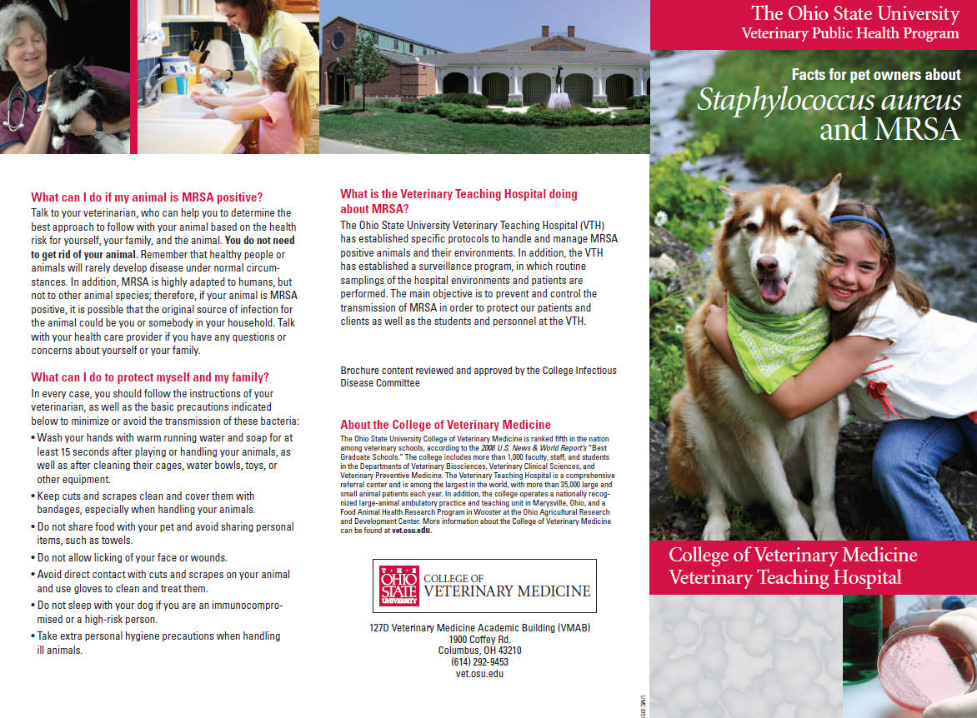
Hoet: citation available

Slide 69
Zoonoses and the Public
Low level of knowledge
Low recall of receipt of information
Comfortable with current level of knowledge (60-70%)
Frequent high-risk practices
Minimally concerned about zoonoses
Same for high-risk individuals
69

Slide 70
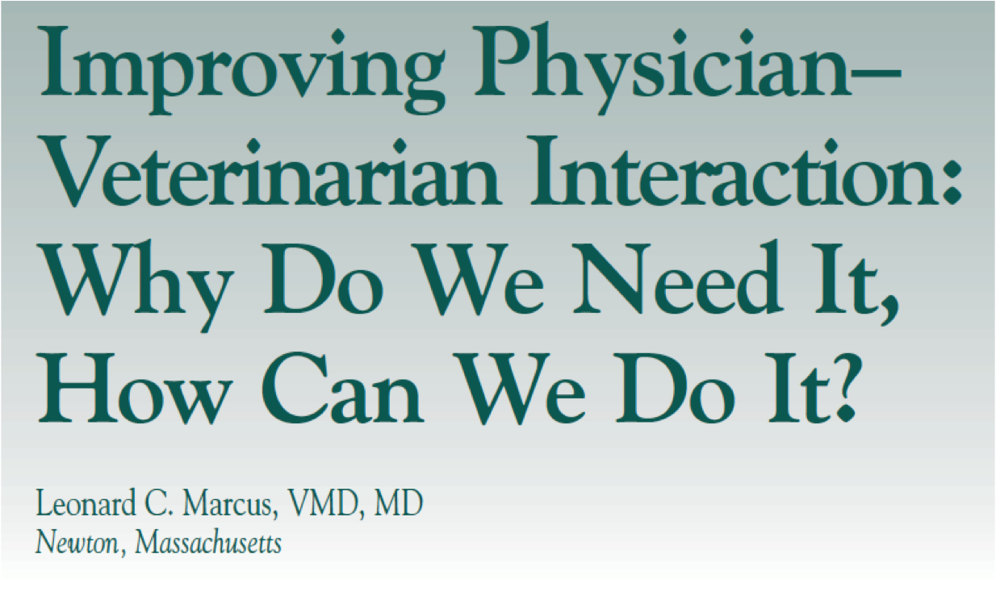
70

Slide 71
Reach out to Veterinary Colleagues
Survey of Connecticut health professionals
  Comfortable advising clients about zoonoses
    45% of veterinarians
    6% of pediatricians
  Ranking of responsibility for educating public re: zoonoses prevention
¹ Gauthier 2002
71

Slide 72
Reach out to Veterinary Colleagues
Limited communication¹
  100% physicians never/rarely contacted veterinarians
  97% veterinarians never/rarely contacted physicians
Veterinarians unaware of clients’ immune status
  58% told about status (children with cancer)²
  66% never discussed clients’ health³
¹ Hill 2012 ² Stull unpublished ³ Grant 1999
72

Slide 73
Summary
Pets provide important health benefits
Disease risks is modifiable in most cases
Identify higher risk pet husbandry practices
Resources and guidance available
73

Slide 74

December 2 (British Teleclass)
UPDATE OF CLOSTRIDIUM DIFFICILE INFECTIONS IN EUROPE
Prof. Ed Kuijper, Leiden University Medical Center, Germany
December 4 CHEMOTHERAPY – HEALTH, SAFETY, AND WASTE MANAGEMENT ISSUES
Ed Krisiunas, WNWN International, Connecticut
December 11 ENVIRONMENTAL CLEANINGIN HEALTHCARE: IS MONITORING OF CLEANING COMPLIANCE REALLY NEEDED?
Dr. Michelle Alfa, Diagnostic Services of Manitoba

Slide 75


