Slide 1



The Role of Intersectional Innovations in Preventing Infection
Sanjay Saint, MD, MPH
Chief of Medicine, VA Ann Arbor Healthcare System
George Dock Professor, University of Michigan
@sanjaysaint
Hosted by Dr. Hugo Sax
University of Zurich Hospitals
www.webbertraining.com
January 19, 2017

Slide 2
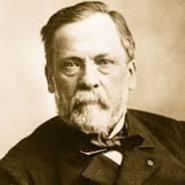
Louis Pasteur (1822 –1895)
“Chance rewards
the prepared mind.”

Slide 3



Japan: 1603 to 1868
Japan was shut-off from the outside world except for trade with the Dutch
Japanese pottery, lacquer ware, and porcelain sent to Rotterdam via ships…

Slide 4
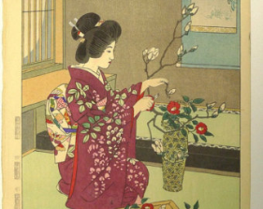
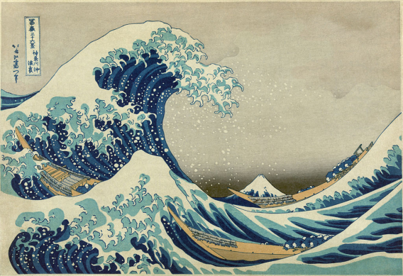

Wrapped in woodblock prints to prevent damage
Portrayed daily life of common people, landscapes, and Kibuki actors

Slide 5

“One day…a French artist named Claude Monet walked into a food shop in Amsterdam… There he spotted some Japanese prints being used as wrapping paper. He was so taken by the engravings that he bought one on the spot. The purchase changed his life – and the history of Western Art.”

Slide 6
Impressionism
Théodore Duret (1838-1927) – A French art critic who promoted Impressionism:
“The appearance…of Japanese prints…initiated us into an absolutely new system. Without the techniques revealed to us by the Japanese a whole methodology would have remained unknown to Western artists”

Slide 7
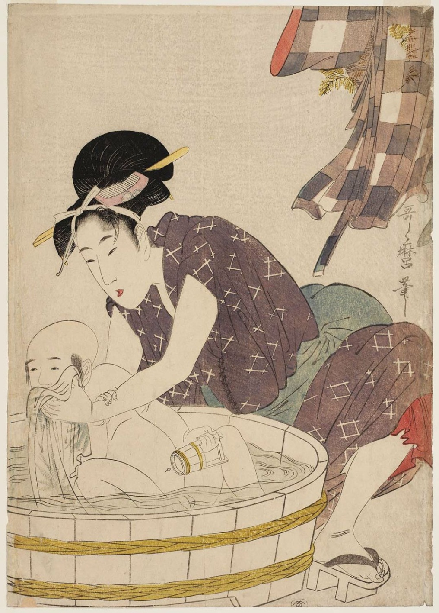
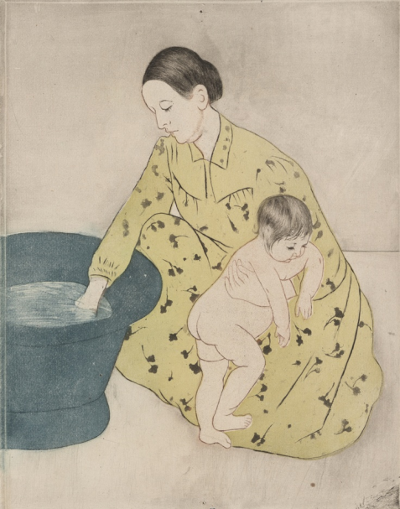
Utamaro, K. (1790). Woman Bathing a Baby in a Tub. The Metropolitan Museum of Art
Cassat, M. (1891) The Tub. The Metropolitan Museum of Art

Slide 8
    The introduction of Japanese woodblock prints into the French art scene in the mid-19th century is an example of an “intersectional innovation.”

Slide 9

The Importance of
“Intersectional Innovation”
“Diversity drives innovation. Your best chance for ground-breaking innovation is at the intersection where diverse concepts, disciplines, cultures, and industries collide.” (The Medici Group)

Slide 10
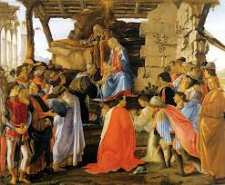
“The Medicis were a banking family in Florence who funded creators from a wide range of disciplines…sculptors, scientists, poets, philosophers, financiers, painters, and architects converged upon the city of Florence...[which] became the epicenter of a creative explosion…”

Slide 11
Innovation: Directional vs Intersectional
    Directional innovation = incremental; very common
    Intersectional innovation = game-changer
      Surprising and fascinating
      Go in new directions and open new fields
      Provides source of directional innovation for years
      Can affect the world in unprecedented ways

Slide 12

Outline
Intersectional Innovation
Infection Prevention
Can Intersectional Innovations Help?
Future Directions

Slide 13
Healthcare-Associated Infections:
Common, Costly, & Harmful
    5 to 10% of hospitalized patients develop an infection
  Half of infections are preventable
  Preventive practices used inconsistently

Slide 14
Catheter-Associated
Urinary Tract Infection (CAUTI)
One of the most common infections
1/4 of inpatients receive catheters
1/3 of catheter days unnecessary
1/3 of physicians unaware their patient has a catheter
1/3 of the time no order for a catheter

Slide 15
How can we reduce catheter use and prevent CAUTI?

Slide 16
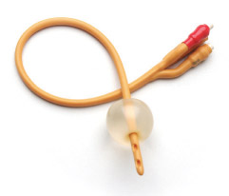
Disrupting the Lifecycle of the Urinary Catheter
1. Preventing Unnecessary and Improper Placement
1
4. Preventing Catheter Replacement
2. Maintaining Awareness & Proper Care of Catheters
4
2
3
3. Prompting Catheter Removal
(Meddings & Saint. Clin Infect Dis 2011)

Slide 17


Slide 18
Preventing CAUTI in Acute Care
(Saint et al. N Engl J Med 2016)
Federally-funded national program in the U.S.
Total of 603 hospitals (926 units) in 32 states
~60% non-ICU; ~40% ICU
Non-ICUs: CAUTI reduced by 32% (& decrease in catheter use)
ICUs: no change in CAUTI or catheter use

Slide 19
The key intervention is having the bedside nurse assess daily whether the catheter is necessary.

Slide 20

Q: What is the best way to prevent any type of hospital infection?
Answer: Hand Hygiene

Slide 21
Hand Hygiene Compliance in
Healthcare Workers
(Erasmus et al. Infect Control Hosp Epidemiol March 2010)
Systematic review of 96 studies
Overall median compliance of 40%
Lower rates in physicians (32%) than nurses (48%)
Lower rates “before” (21%) patient contact rather than “after” (47%)

Slide 22
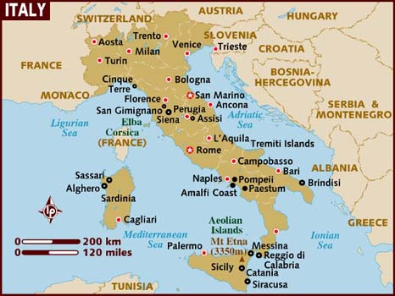
Tuscan-American Safety Collaborative (TASC)
Sabbatical to the U of Florence: Sept 2007 to June 2008
Studied diffusion of innovation within a centralized system of healthcare
Italy’s health system ranked #2 by W.H.O.

Slide 23
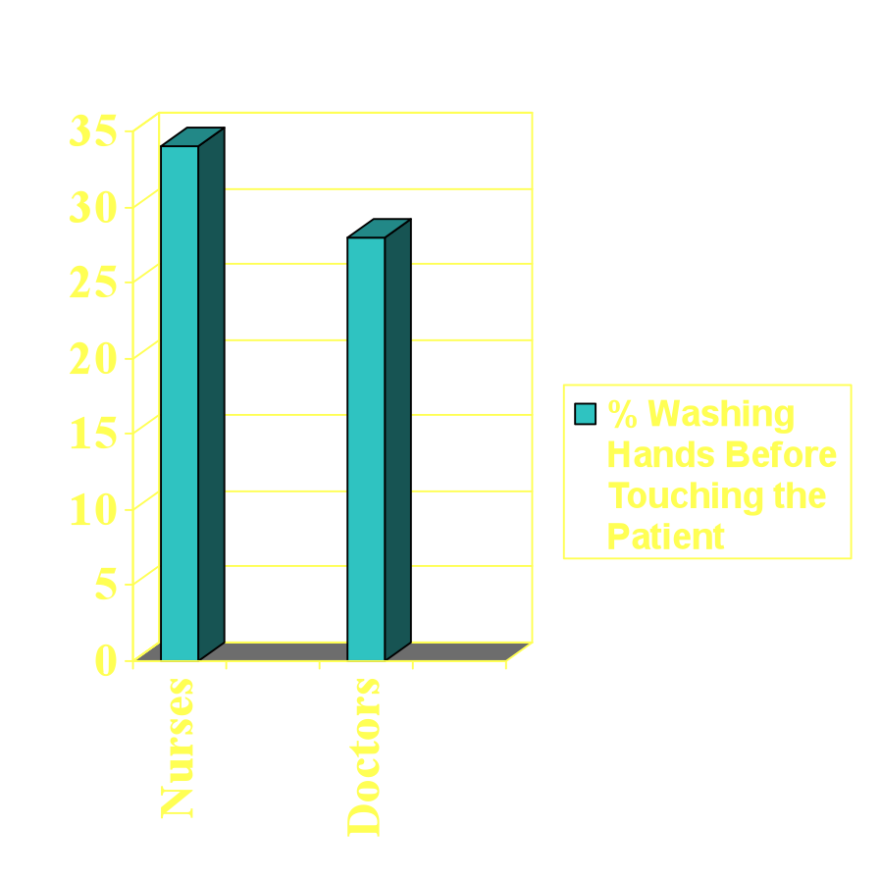
Hand Hygiene Adherence:
5 Unit Interventional Study in Florence
Pre-intervention observations:
6 nursing students (and me) were external observers
1147 nurse-pt observations
665 doctor-pt observations
Nurses: 34% washed hands
Doctors: 28% washed hands

Slide 24
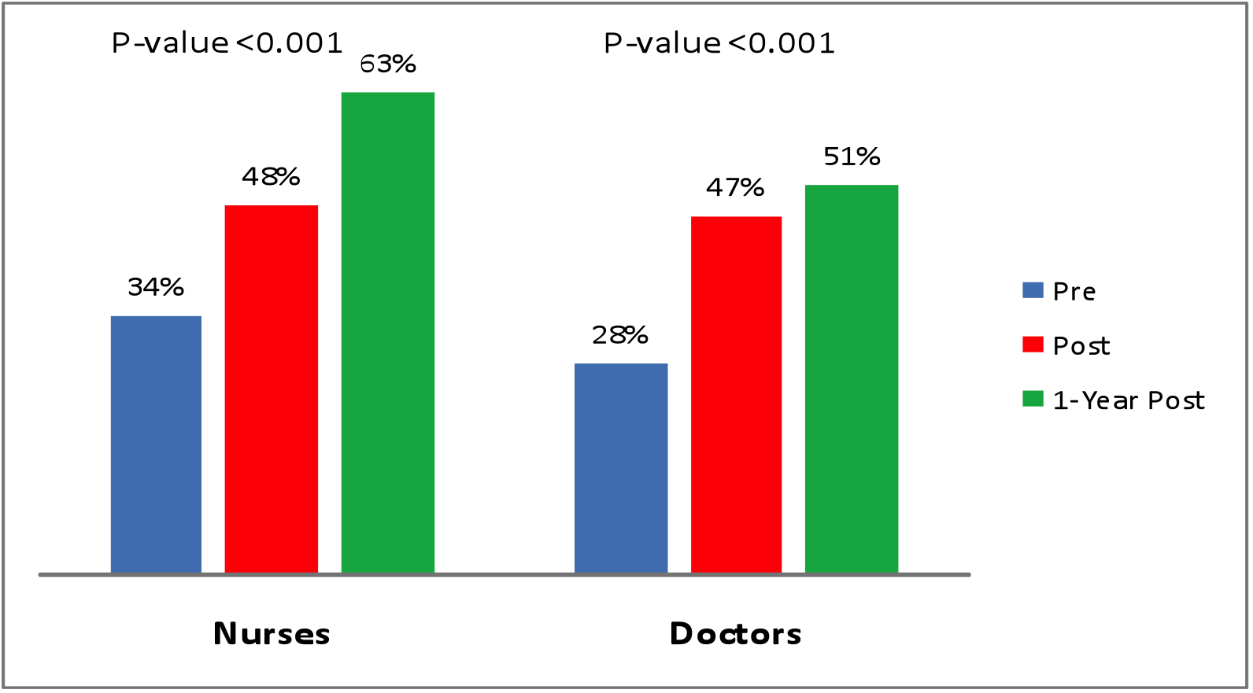
Hand Hygiene Prior to Touching the Patient: Overall Results on 5 Units
(N = 5823 observations)
P-Value = <0.001
P-Value = <0.001
(Saint et al. BMJ Qual Safety 2009)

Slide 25

Hand Hygiene Adherence:
4 Hospital Study in Japan

Slide 26
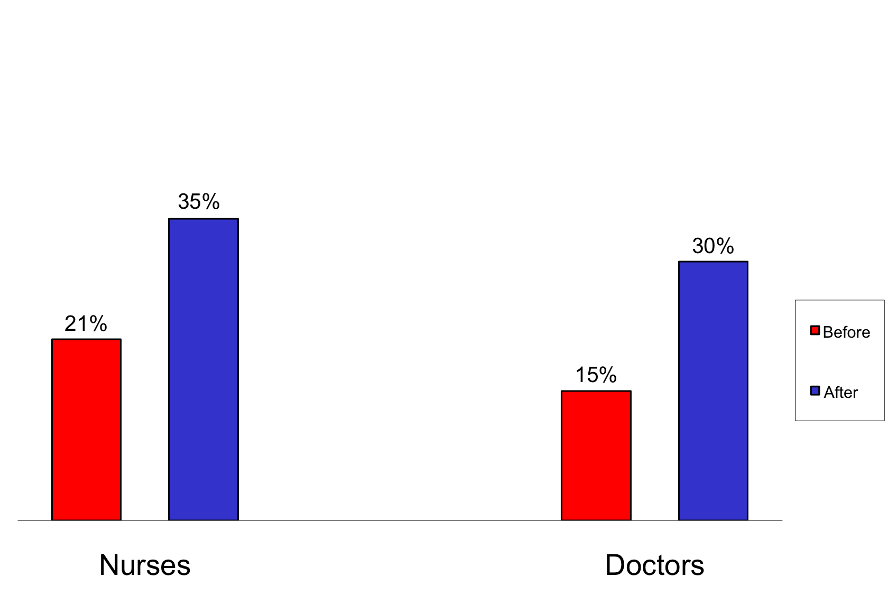
Hand Hygiene Prior to Touching the Patient: Overall Results in Japan
(Sakihama et al. J Hospital Med 2015)
P-Value = <0.001
5661 observations
P-Value = <0.001

Slide 27
Preventing infection is both simple – get the catheter out and wash your hands! – and complex: changing behavior.
Can intersectional innovations help?

Slide 28
The 1st intersectional innovation to consider is human factors engineering

Slide 29
Human Factors Engineering
The study of how humans interact with technology and the effect technology has on human behavior
A few examples…

Slide 30
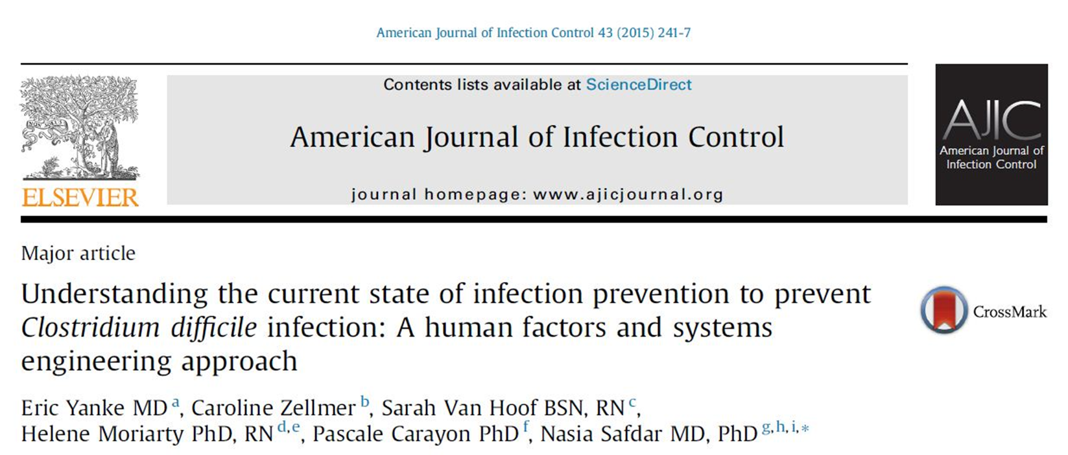
Utilizing Human Factors Engineering in Infection Prevention

Slide 31
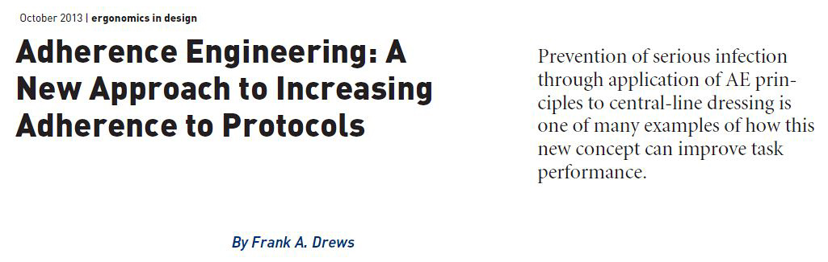
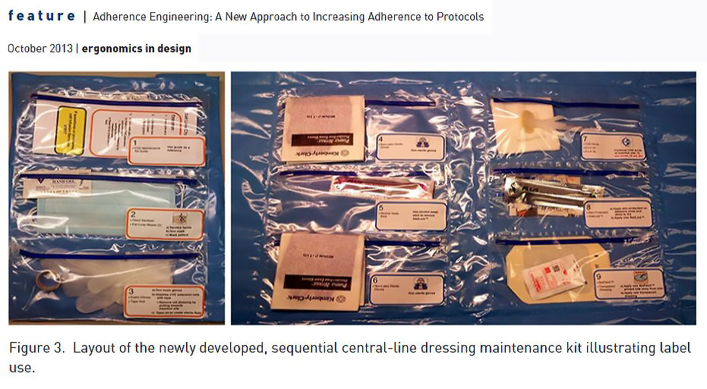
Frank Drews, PhD

Slide 32
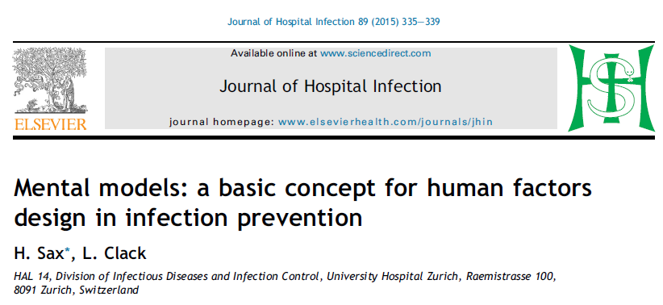
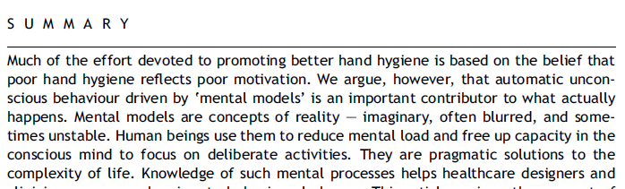

Slide 33
A 2nd intersectional innovation is understanding the powerful role both leaders and followers have in implementing & sustaining change.

Slide 34
Leadership: Definitions
    Leadership is “a process whereby an individual influences a group of individuals to achieve a common goal” (Northouse in “Leadership: Theory and Practice” 2010)
    “Assigned” leadership = leadership that is based on occupying a position in an organization
    “Emergent” leadership = leadership that emerges from an influential member of a group regardless of the person’s title or position

Slide 35
Leadership Research:
Transactional vs Transformational
    Transactional:
    Transaction (or exchange) of something leader has that the follower wants
    Specifies roles and tasks
    Reward & punishment used as motivation
    “One-size-fits-all”
    Transformational:
    Inspires followers to see beyond their self-interest
    Adapts to the needs and motives of followers
    Behaves in a way that engenders great trust
    The leader often relies on charisma

Slide 36
“The culture of any hospital is dictated by the worst behavior the leader tolerates.”

Slide 37
Good Followership
Question: What is the Secret to Good Leadership?

Slide 38


September 30, 2015

Slide 39
Followership
Follower: “a person who accepts the leadership of another”
An understudied area: Book search on Amazon revealed…
  >95,000 titles on leadership
  ~800 titles on followership (mostly spiritual or political)
  120:1 in favor of leadership
Unfortunate asymmetry since leadership and followership are intertwined
Most leaders are also followers! (Kelley, Harvard Business Review, 1988)

Slide 40
Followership: 5 Key Types
(Kelley: The Power of Followership, 1992)
Alienated: mavericks with a healthy skepticism of the organization; capable but highly cynical
Conformists: the “yes people” of the organization; limited independent thinking; often seen in rigid bureaucracies
Passive: require disproportionate supervision relative to their contribution; lack initiative and sense of responsibility
Pragmatists: hug the middle of the road; will do a good job but won’t stick their necks out
Exemplary followers: independent, innovative, and willing to question leadership; critical to organizational success

Slide 41
What Type of Followers are Infection Preventionists?
Lead infection preventionists from national sample of U.S. hospitals
Response rate 71% (403/571)
Robert Kelley The Power of Followership
5 styles of followers
Linked followership style to infection prevention practices

Slide 42
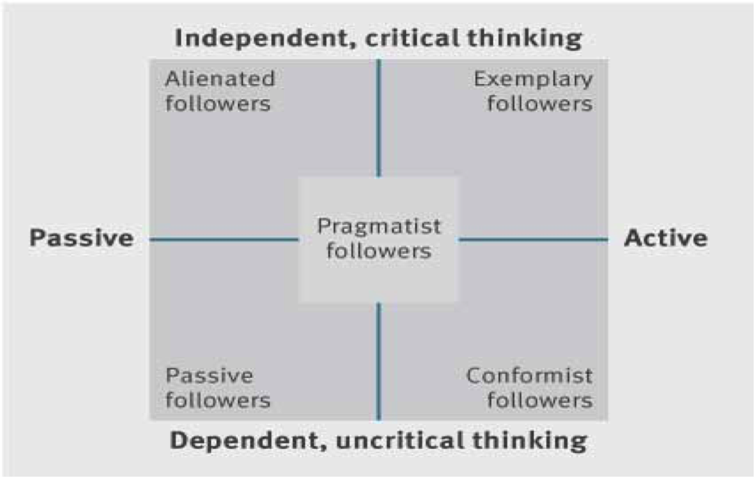

Slide 43
Sample Questions
Are you highly energized by your work?
Do you take initiative to seek out assignments that go above and beyond your job?
When you are not the leader of a group do you often do more than your share?
Do you independently think up and champion new ideas?
Do you assert your views on important issues, even though your supervisor may disagree?

Slide 44
What Type of Followers are Infection Preventionists?
Exemplary = ~74%
Pragmatist = ~18%
Conformist = <3%
Alienated = <3%
Passive = <1%
(Greene & Saint. Am J Infect Cont 2016)

Slide 45
(Greene & Saint. Am J Infect Cont 2016)

Slide 46
Regular Use of Select Prevention Practices
CAUTI
  Catheter reminder/nurse discontinuation = 64%
CLABSI
  Antimicrobial dressing with chlorhexidine = 79%
VAP
  Subglottic secretion drainage = 56%
General
  Chlorhexidine cleansing cloth = 46%
(Greene & Saint. Am J Infect Cont 2016)

Slide 47
Truly Exemplary Followership & Prevention Practices
CAUTI
  Catheter reminder/nurse-initiated discontinuation
    OR = 3.19 (1.69 – 6.01), p <0.001
CLABSI
  Antimicrobial dressing with chlorhexidine (BiopatchTM)
    OR = 1.12 (0.59 – 2.13), p = 0.74
VAP
  Subglottic secretion drainage via special endotracheal tube
    OR = 1.72 (1.01 – 2.93), p = 0.04
General
  Chlorhexidine cleansing cloth
    OR = 1.60 (0.97 -2.64), p = 0.07
(Greene & Saint. Am J Infect Cont 2016)

Slide 48
Take away
Intriguing preliminary findings suggesting that truly exemplary followership associated with increased use of certain infection prevention practices (e.g., urinary catheter removal)

Slide 49
The final intersectional innovation
is to engage the senses.

Slide 50


Slide 51
Cues of being watched…
(Bateson et al. Biology letters 2.3 (2006): 412-414.)
48 participants had the option to pay for tea, coffee and milk via an honesty box
A notice displayed above the box with an image that alternated weekly between a pair of eyes & flowers
10-week study
Compared the total amount of money collected in the honesty box per week
(Slide courtesy of H Sax)

Slide 52
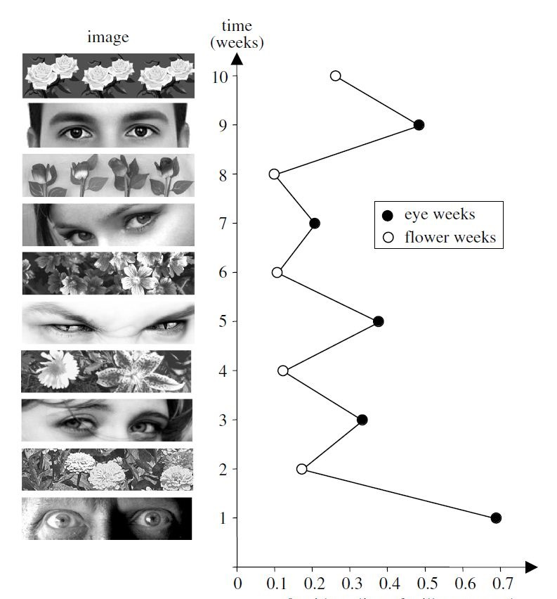
People paid 3X as much for their drinks when eyes were displayed rather than a control image
(Slide courtesy of H Sax)

Slide 53
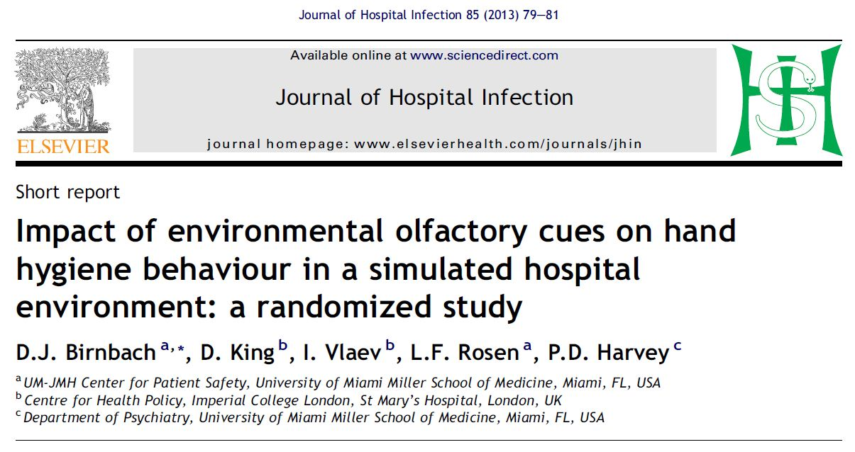
Engaging the Senses: Smell

Slide 54
Impact of environmental olfactory cues on hand hygiene behavior…
(Birnbach, et al. Journal of Hospital Infection. 2013)
165 students/interns examined a standardized patient
Randomly assigned to two groups:
  79 exposed to a fresh-smelling environment (citrus)
  86 exposed to a standardized smell
Focus was on hand hygiene prior to touching the patient

Slide 55


Impact of environmental olfactory cues on hand hygiene behavior…
(Birnbach, et al. Journal of Hospital Infection. 2013)
Results:
  Fresh scent (citrus) hand hygiene compliance: 80%
  Standard scent hand hygiene compliance: 51%
  P-value: <0.001

Slide 56
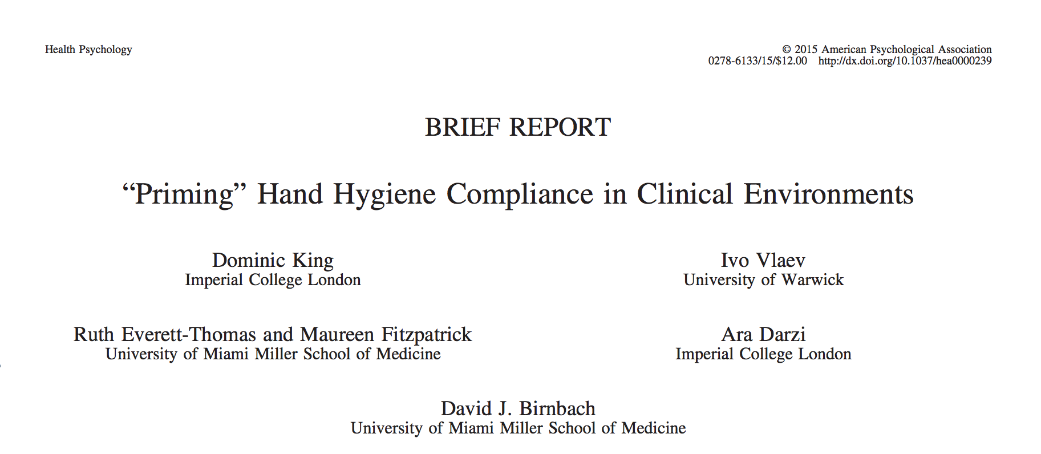

Slide 57
“Priming” Hand Hygiene Compliance in…
(King et al. Health Psychology 2015)
Randomized trial in a surgical ICU of hand hygiene before entering patient room; direct observation
Evaluated whether priming via olfactory (citrus smell) or visual (eyes) cues affects compliance
120 controls, 160 in the olfactory intervention, 124 in the visual intervention

Slide 58
“Priming” Hand Hygiene Compliance in…
(King et al. Health Psychology 2015)
A clean citrus smell: 15% to 47% (p=0.001)
A picture of “male eyes” above hand gel dispensers: 15% to 33% (p=0.038)
A picture of “female eyes”: 15% to 10% (p=0.6)

Slide 59
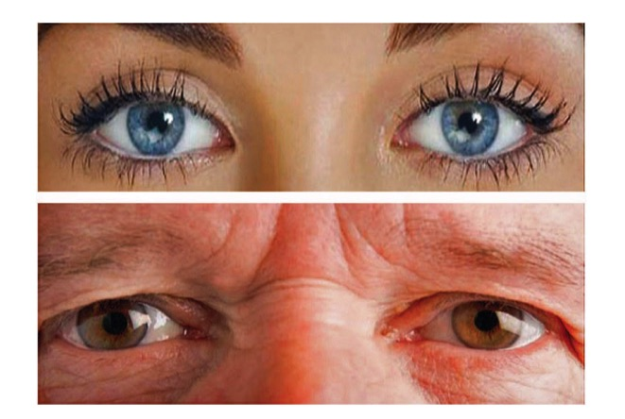
“Priming” Hand Hygiene Compliance in…
(King et al. Health Psychology 2016)

Slide 60
Outline
Intersectional Innovation
Infection Prevention
Can Intersectional Innovations Help?
Future Directions

Slide 61
Future Directions
Preventing hospital infection is important
CAUTI is a prototypical patient safety problem: preventing infection is both simple and complex
Human factors engineering, leadership, followership & engaging the senses may help
The final frontier is…

Slide 62
Engaging the Mind

Slide 63

“the awareness that arises by paying attention on purpose, in the present moment...”
(Gilmartin. BMJ 2016)

Slide 64
Applying Mindfulness to Prevent CAUTI
(Kiyoshi-Teo et al. Infect Cont Hosp Epid 2013)
A 2-second “pause” before inserting a Foley…
Is the Foley truly needed?
Am I using proper technique?
Do I need to ask for help?

Slide 65
Most importantly,
Preventing Infection is a Team Sport!

Slide 66

Thank you!

Slide 67
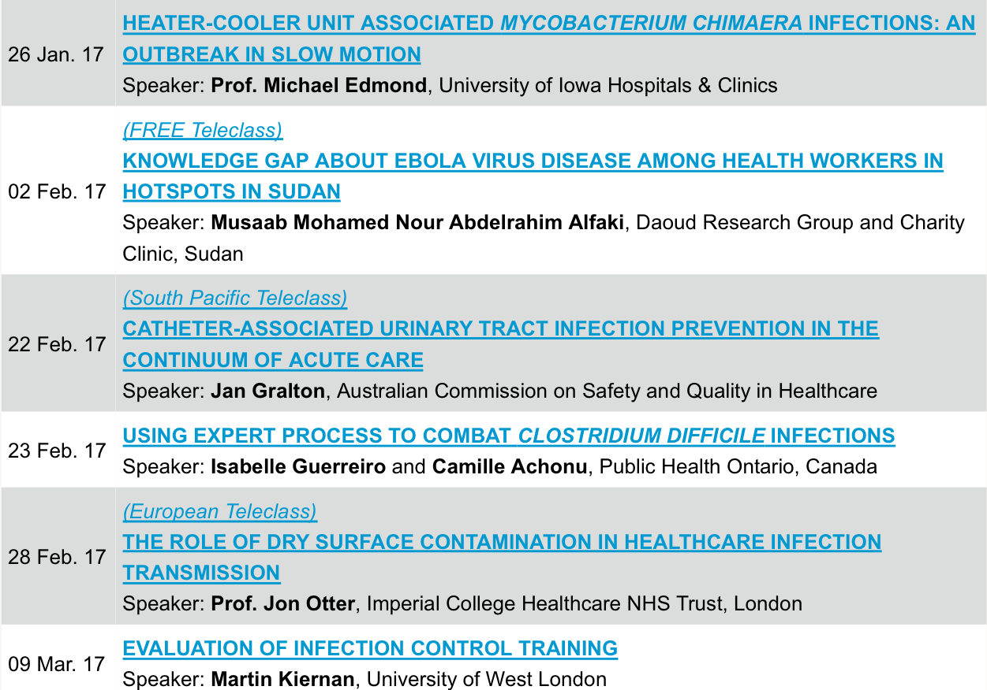

Slide 68


