Slide 1
The use of Social Media in support of global infection prevention and control
Connecting
Influencing
Engaging
Communicating
Claire Kilpatrick and Jules Storr
Directors S3 Global, Consultants to WHO,
Social Media Team #CleanHands 10; @HIFA_Org
Hosted by Dr Bassim Zayed Medical Officer, WHO HQ
www.webbertraining.com
October 14, 2015

Slide 2
A hard day at the office

Slide 3
Circa May 1965
3

Slide 4
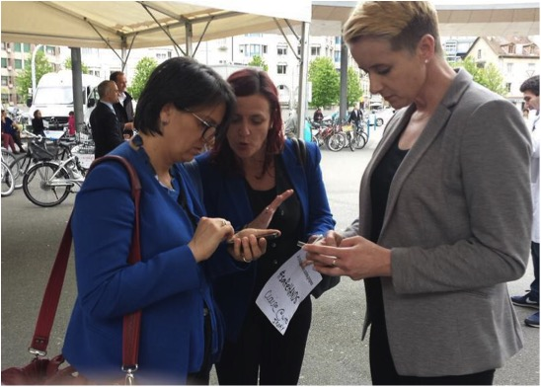
WHO 5 May 2015 @allegranzib @claireekt @julesstorr
4

Slide 5
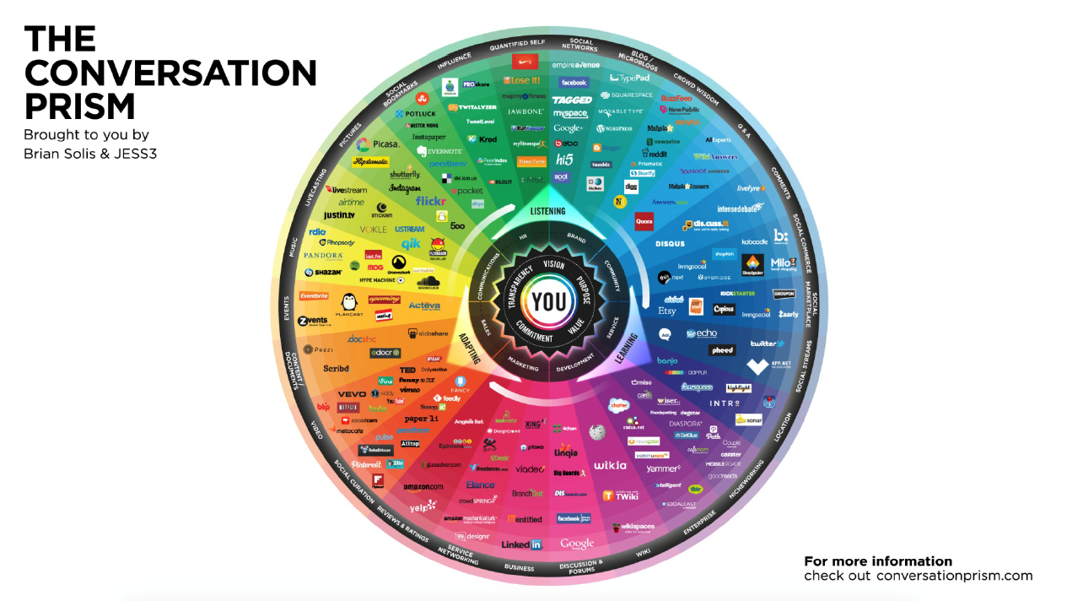
Social media has many faces
University of Utrecht 2015
5

Slide 6
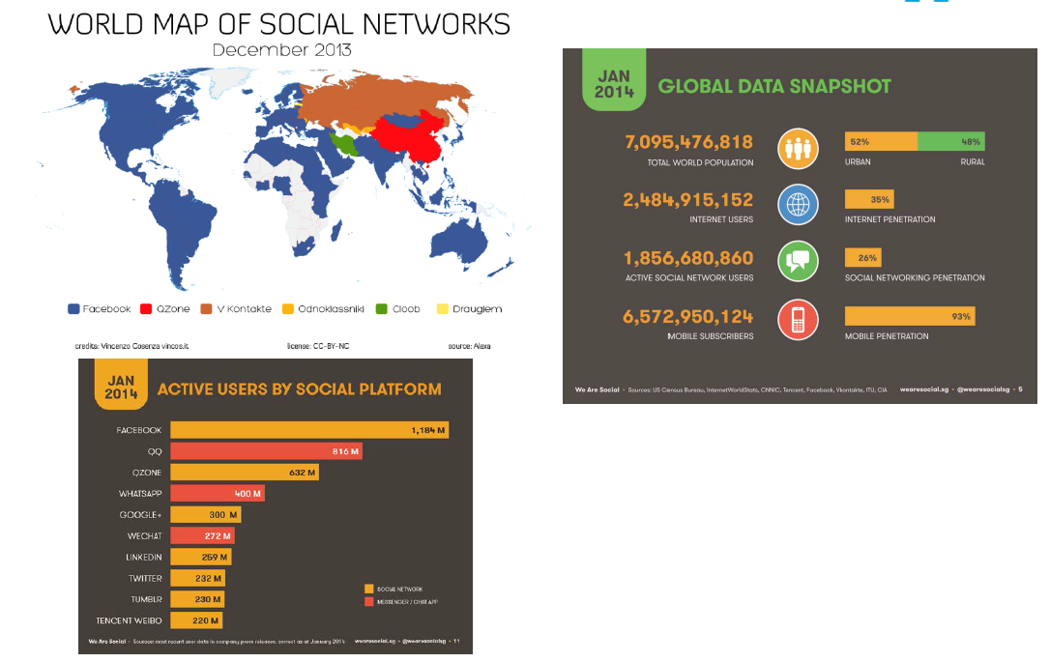
Some facts and figures
University of Utrecht 2015
6

Slide 7
Relevance to developing countries:
A recent report by the Pew Research Center highlights the growing use of SoMe in developing countries.
In the U.S., 73% of Internet users use social networks.
The report found that in 17 developing countries usage is as high as 88%, mainly Facebook, Twitter, Instagram and LinkedIn.
Leveraging social media as part of an overall m and e-technology approach offers a mechanism for information to reach and influence healthcare in many marginalized and distant communities.
In addition, at the policy level, increasing numbers of ministries of health across all nations are using Twitter and Facebook as a means of communicating.
Pew Research Center Report: Emerging Nations Embrace Internet http://www.pewglobal.org/files/2014/02/Pew-Research-Center-Global-Attitudes-Project-Technology-Report-FINAL-February-13-20146.pdf
7

Slide 8
A bit like “love” - Social Media (SoMe) is all around
But:
Does it actually add value to what we do in IPC?
Are we maximising its potential?
8

Slide 9
Characteristics of SoMe:
Openness
Participation
Connectedness
Community
Websites & internet
Mobile technology
Blogs & vLogs
Social networking channels
9

Slide 10
Websites & internet
Mobile technology
Today we will focus on:
Blogs & vLogs
Social networking channels
10

Slide 11
A few questions:
How many are on social media – what?
How many tweet/retweet at least once a day?
How many have posteded a video on YouTube?
How many subscribe to YouTube channels?
How many organizations/professional societies engage through social media?
If yes to any of the above – is impact evaluated?

Slide 12
Disclaimer
Everything we say is completely influenced by our bias towards the power of social media in [global] health and IPC as a force for good (as part of an integrated communications strategy)

Slide 13
Rapid overview of Social Media & its potential and actual applications in IPC

Slide 14
Lets start with Facebook...... The “face” of popular social media
1. Facebook
14

Slide 15
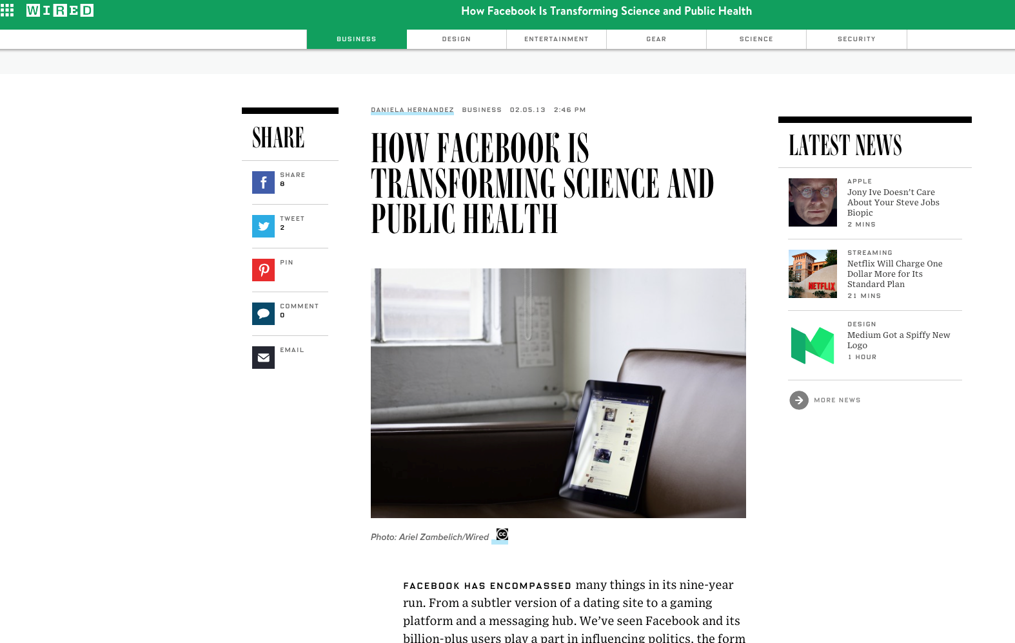
15

Slide 16
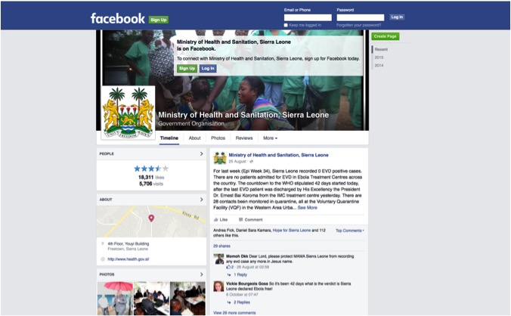
16

Slide 17
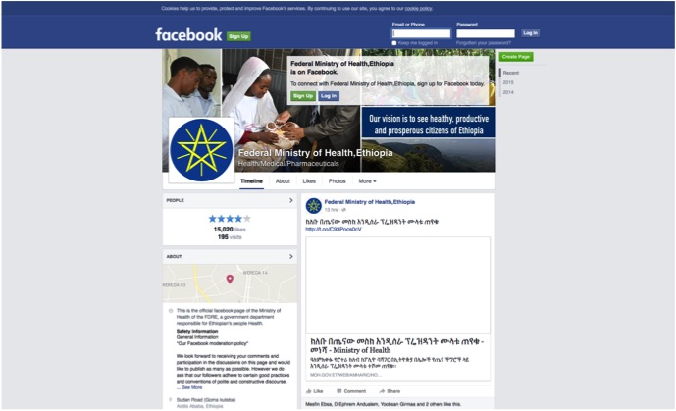
17

Slide 18
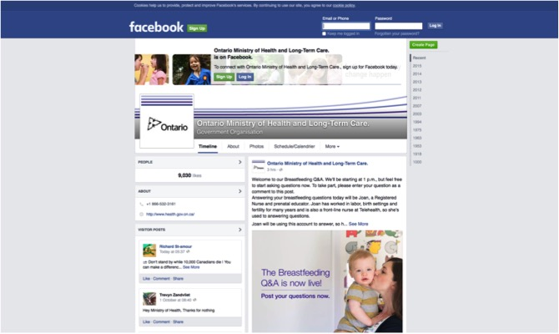
18

Slide 19
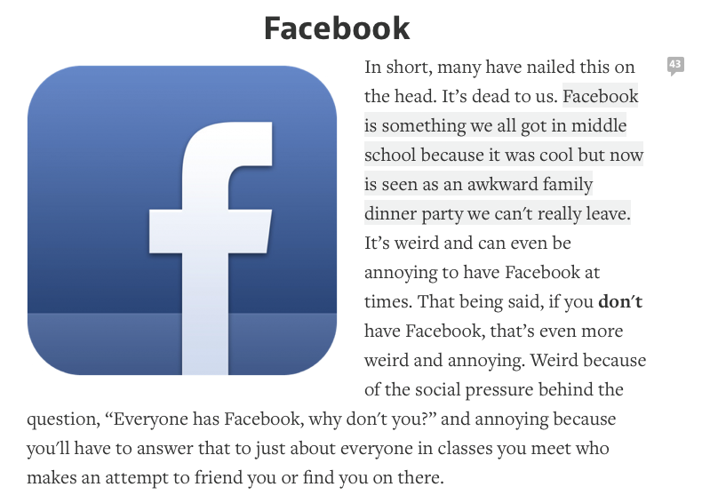
But....a young person’s view?
19

Slide 20
“Knowledge” at your fingertips
2. Twitter
20

Slide 21
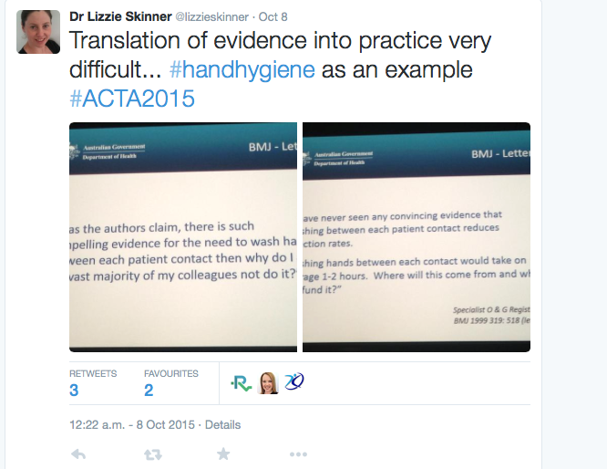
21

Slide 22
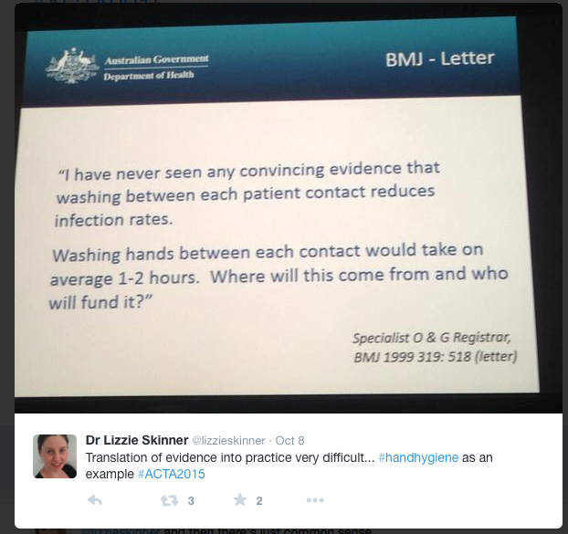
22

Slide 23
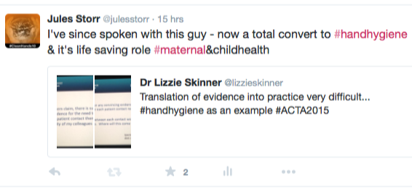
Amazing opportunity to strike up a conversation, engage [and influence] with people on the other side of the world
23

Slide 24
But important to know your audience & be “culture-aware”

Slide 25
25

Slide 26
26

Slide 27
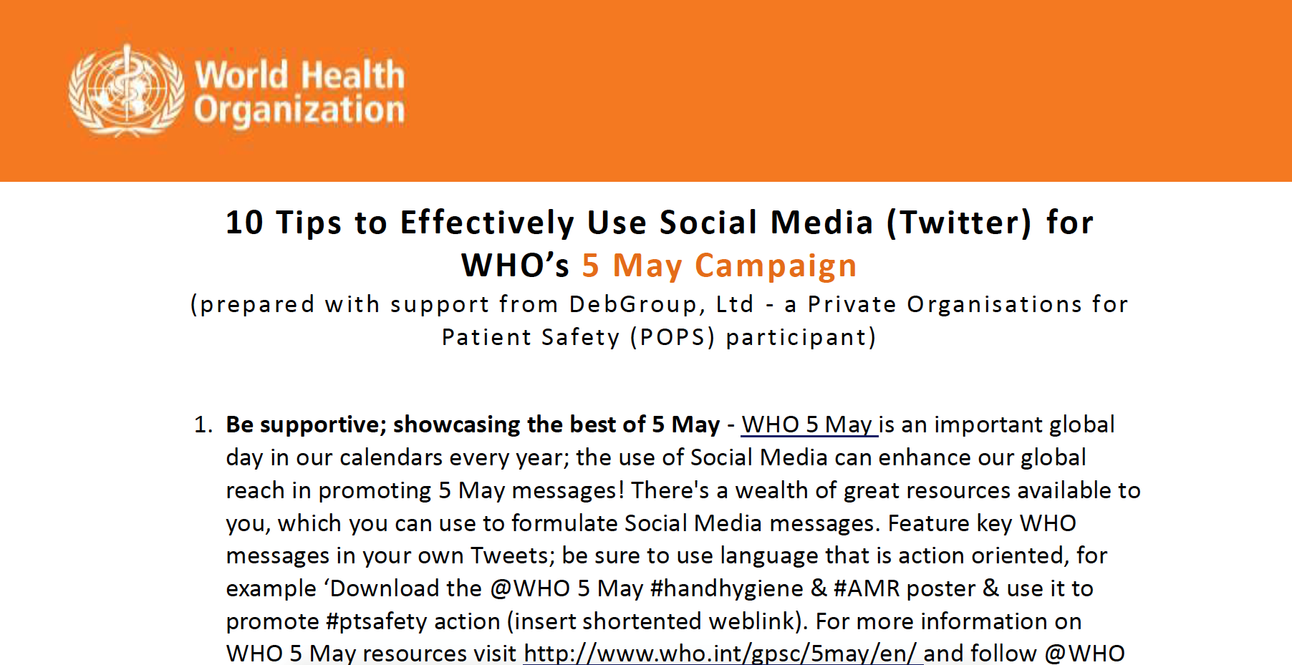
27

Slide 28
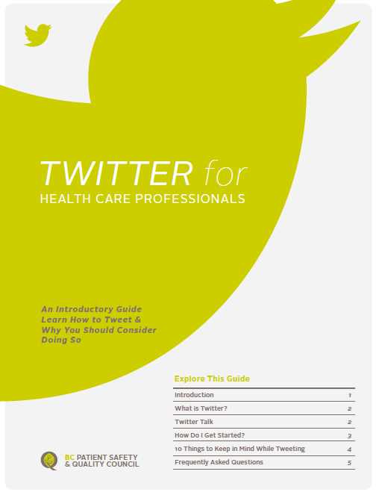
Twitter for good?
‘She knows, she’s on Twitter’
28

Slide 29
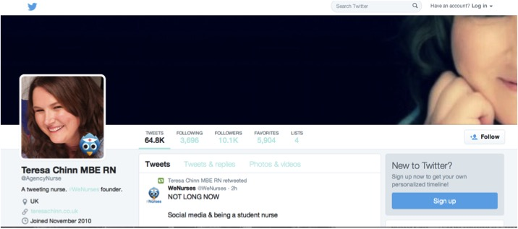
Teresa Chinn MBE RN, UK
29

Slide 30
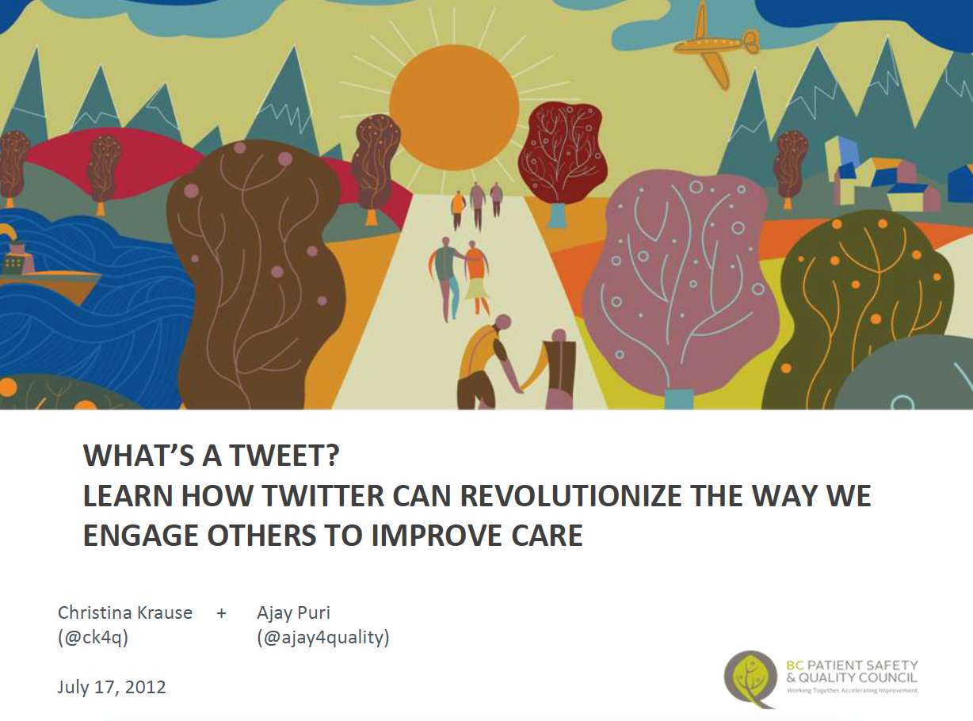
30

Slide 31
Why Twitter?
‘Twitter for HCPs is unique as it is the only platform that allows one to connect, engage, learn, and educate oneself and others in real time on a global scale. For the ID HCP, Twitter may help them teach global responsible use of antimicrobials in a world of escalating antimicrobial resistance.’
Goff et al 2015
Connect
Learn
Educate
Self
Others
Real-time
Global
Engage
31

Slide 32
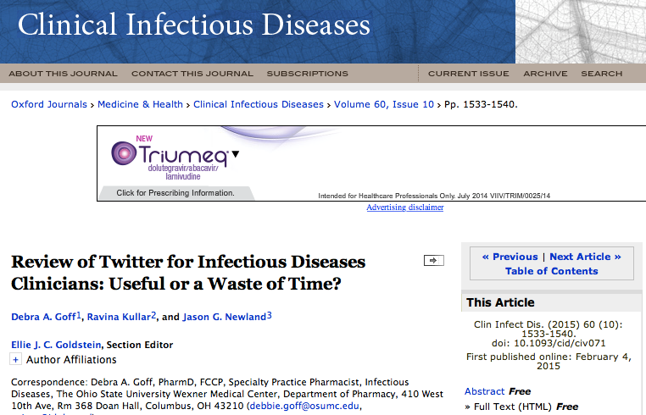
32

Slide 33
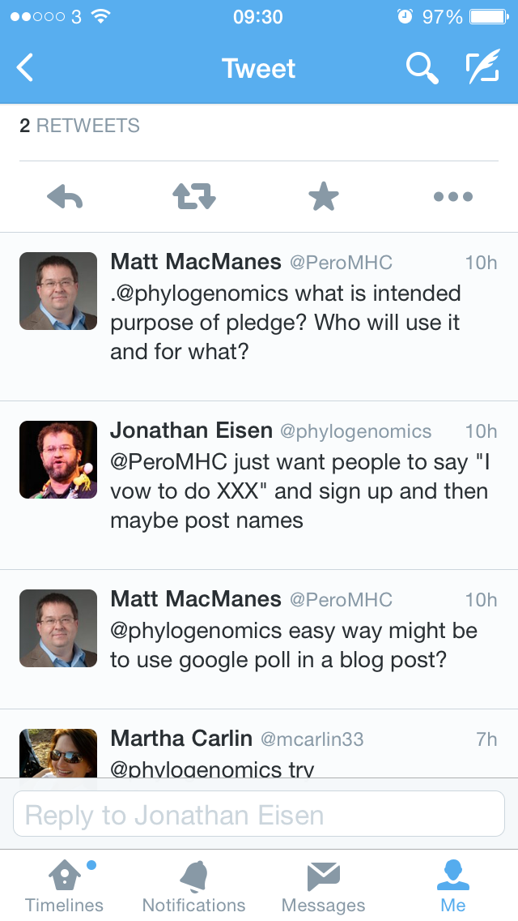
Talk to the experts?
33

Slide 34
Snapshot of one of the largest IPC conferences 2015
14% of the speakers and faculty were on Twitter
7% were active
Is this important?
34

Slide 35
More than just a video sharing site – youtube channels, video blogs (vlogs), educational videos etc
3. YouTube
35

Slide 36
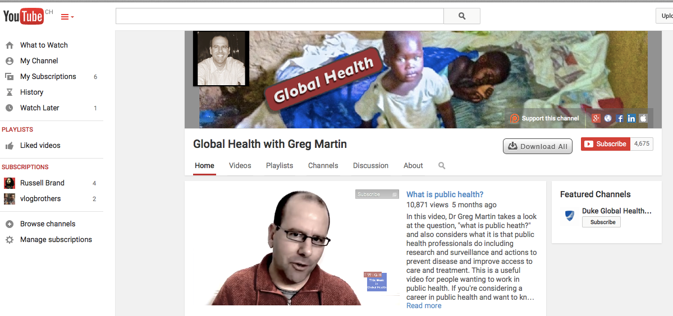
The week in global health (TWIGH)
https://www.youtube.com/user/drgregmartin
36

Slide 37
Is there a place for TWiIPC?
https://www.youtube.com/watch?v=8kMqJWED8YA
37

Slide 38
However – need to be aware of how best to grab peoples attention

Slide 39
8 SECOND COUNTDOWN

Slide 40
e.g. Twitter & YouTube
Campaigns & advocacy
40

Slide 41
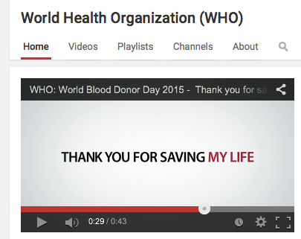
The 8 second filter matters
The length of healthcare campaign videos on YouTube currently ranges from 50 seconds - 8 minutes
41

Slide 42
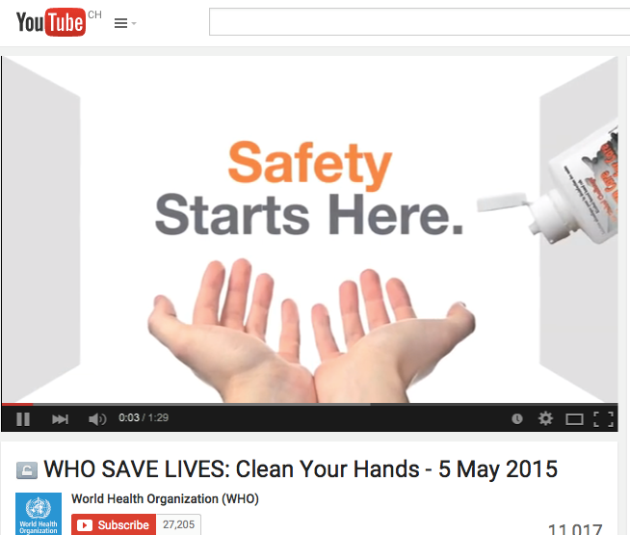
1.29 secs
WHO #safeHANDS campaign
5 May 2015
42

Slide 43
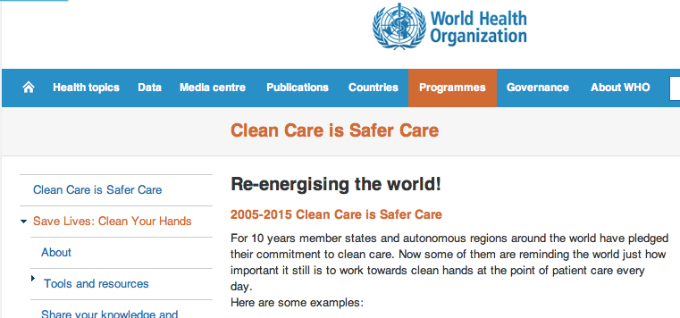
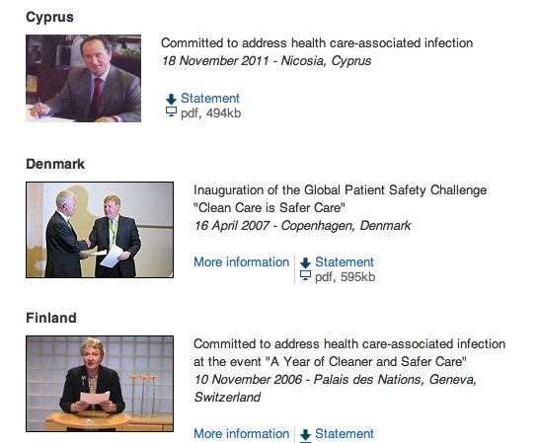
WHO 5 May 2015
Previously:
43

Slide 44
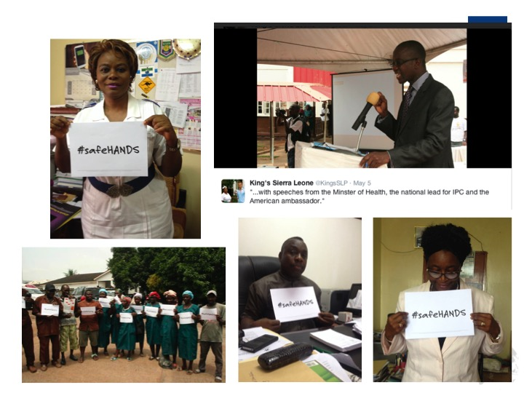

Slide 45
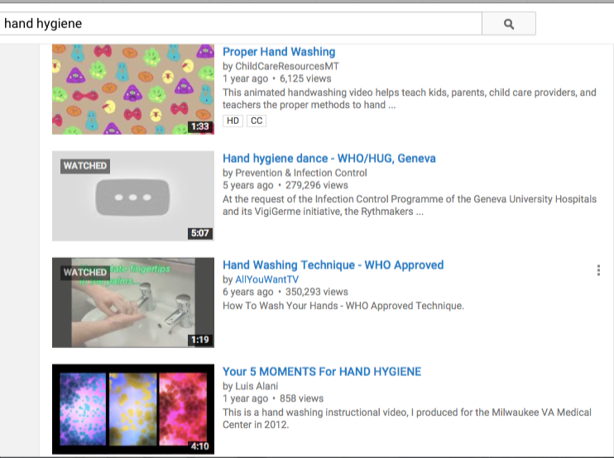
Hand hygiene videos on YouTube
About 65 000 results!
Instructional
Awareness raising
Entertainment!
Academic publication - NEJM
Range from 1 minute to 15 minutes
45

Slide 46
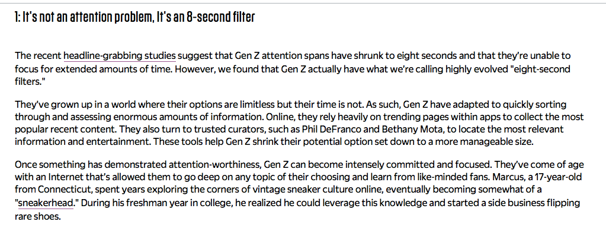
46

Slide 47
An online photo sharing and video sharing platform.
4. Instagram
47

Slide 48
Live video streaming app. Conceived in 2013 in Turkey – the guys who conceived it wanted more than to “tweet” about the [then] troubles – they wanted to SEE what was happening.
5. Periscope
48

Slide 49
Yikyak - Allows people to anonymously create and view “yaks” within a 5-mile radius i.e. share content with people near the user making it “intimate” and allows people to vote up or vote down (like or dislike) yaks! – in summary, sort of a combination of GPS and instant messaging.
6. Snapchat
7. Tumbler
8. Yikyak
49

Slide 50
Some ideas about how to leverage all of this for IPC

Slide 51
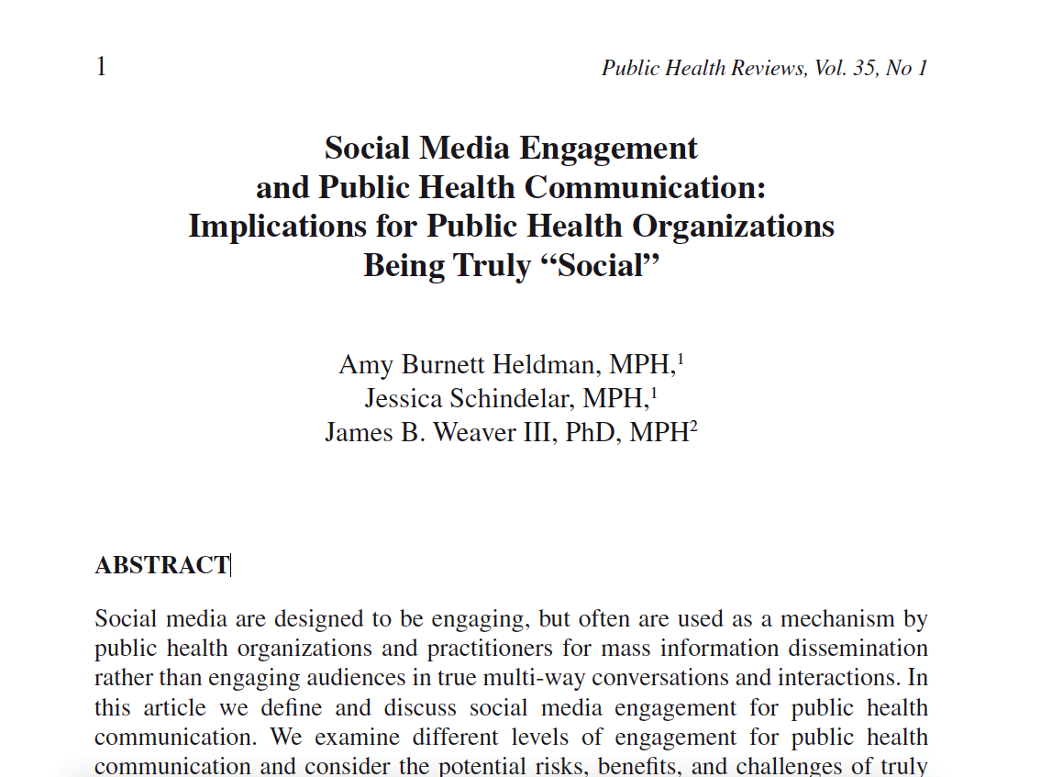
Heldman A, Schindelar, Weaver JB (2013) Social Media Engagement and Public Health Communication: Implications for Public Health Organization Being Truly “Social” Public Health Reviews, Vol. 35, No 1
51

Slide 52
Summary points
Application of SoMe in IPC is under researched
BUT, we do know that there is “a need to harness the participatory nature of social media”
Its not about “preaching” rather “engaging”
“One defining characteristic of all social media is their potential to facilitate engagement – the interactive, synchronous communication and collaboration among numerous participants via technology” – at the same time but in different places!
Allows us to move from basic information dissemination to fully interactive information sharing dialogue.
52

Slide 53
An example on which to base our strategies: POSTE

Slide 54
P
People
E
Evaluation
O
S
T
Assess your stakeholder’s social activities
Objectives
Decide what you want to accomplish
Strategy
Plan for how relationships with your stakeholders will change
Technology
Decide which social technology to use
Determine how to measure success
54

Slide 55
Ideas on how might IPC use this
Campaigning
Advocacy
Live feeds & updates
Community engagement
Disseminate articles
Engage partners & collaborate
Crowd sourcing
Data collection
Brainstorming
Motivate
Sustain
Segment (Generation Y)
Hand hygiene
AMR
Obks of highly transmissible infection
Patient & consumer engagement
Engagement, education & training
Personal development
?
55

Slide 56
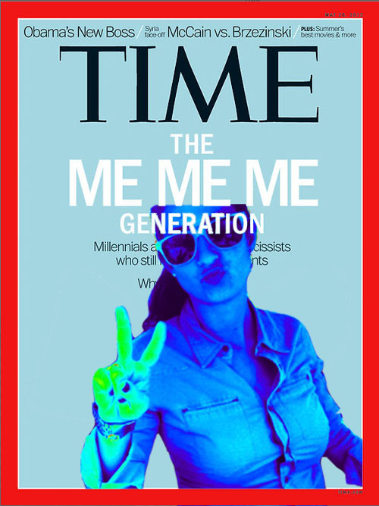
Remember - demographic matters
“Generation Y - the Millennials (born 1980-2000) - has arrived. They have emerged as a powerful political and social force. Their huge numbers and progressive attitudes are already changing….. the world”
56

Slide 57
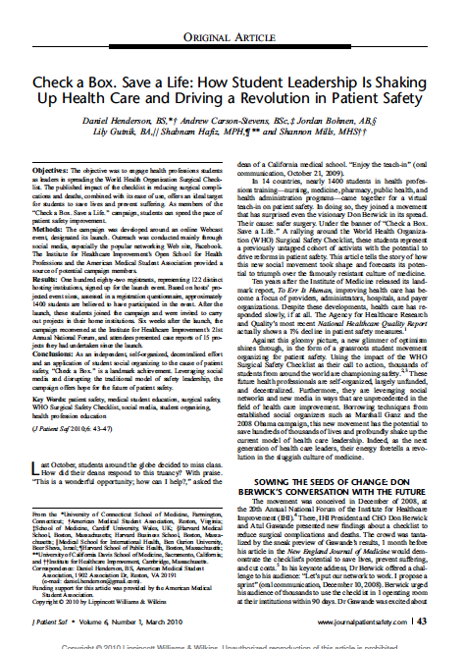
A take-away
QUESTIONS;
Using this article as a source of stimulation:
Are we engaging and inspiring our stakeholders enough?
What can student leaders do for IPC on social media?
What do you consider the top 5 things that need to be in place if IPC were to mirror the approach described in this paper?
57

Slide 58
In summary: Engagement. Engagement. Engagement.
Narrative versus conversation

