Slide 1
Topical Antibiotics to Prevent Post-Operative Surgical Infection.
Is the Paradigm Changing?
Hilary Humphreys
Department of Clinical Microbiology
Royal College of Surgeons in Ireland (RCSI) & Beaumont Hospital Dublin, Ireland
Hosted by Paul Webber
paul@webbertraining.com
www.webbertraining.com
April 19, 2018

Slide 2
Declaration
The views expressed are of a professional but personal nature & are not necessarily those of the RCSI & Beaumont Hospital, Dublin.
I have recently received research funding from Pfizer & Astellas. I have also provided professional advice or education for Pfizer.

Slide 3
Outline
Measures to reduce surgical site infection (SSI) & involving antibiotics
Lack of & or poor quality of evidence for topical or local antibiotics
Unintended consequences
Conclusions

Slide 4
Measures to Reduce SSI
&
Involving Systemic Antibiotics

Slide 5
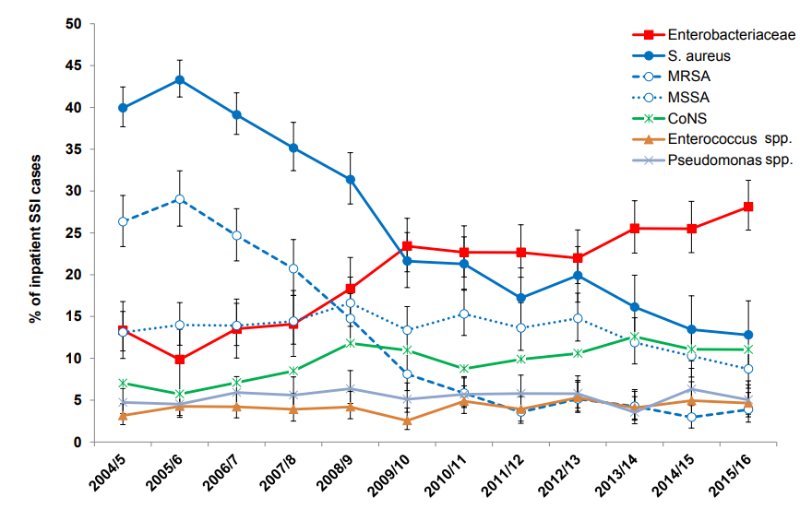
Surveillance of Surgical Site Infections in NHS hospitals in England 2015/16
5

Slide 6
IV surgical prophylaxis: why do we use it?
To prevent surgical infection
Evidence based. Really? What quality of evidence?
Prior to incision
Need rapid tissue levels
Choice of antibiotic depends on likely contaminating microbes
Single dose currently in vogue
M Dryden, UK

Slide 7
Timing of Prophylactic Antibiotics & Risk of SSI
Elective surgery in Salt Lake City
~ 3,000 patients, 55% of total eligible
100%, for 24h & 80% for ≥ 48h
New Eng J Med 1992; 326: 281-6

Slide 8
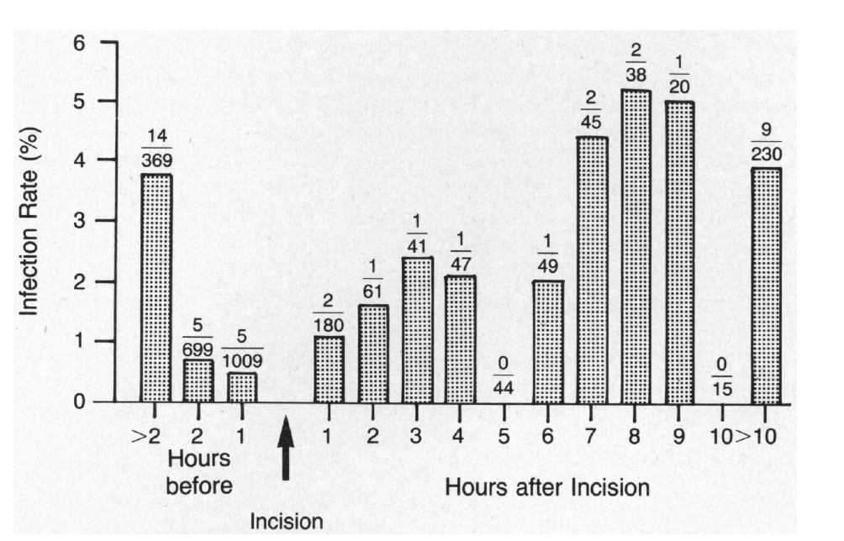
Timing of Prophylaxis & Risk of SSI
Age, gender, surgeon & postsurgical procedures were not significant
New Eng J Med 1992, 326: 281-6

Slide 9
A Review of 28 Studies of Antibiotic Prophylaxis & Quality Indicators
Indication, timing, choice & duration
Compliance – 9-80%, but up to 100% after
interventions overall
– 19-91%, with indication
– 30-95%, for timing
Interventions – education, MDT, computer-based ordering, etc.
Epidemiol Prev 2015; 39: Suppl 1, 27-32

Slide 10
Measures to Reduce SSI
&
Involving Topical Antibiotics

Slide 11
Definition
“Antibiotic agents applied directly to the surgical site intra-operatively or post-operatively via powders, sponges, irrigation solutions, sealents or dressings”
Antiseptic agents excluded

Slide 12
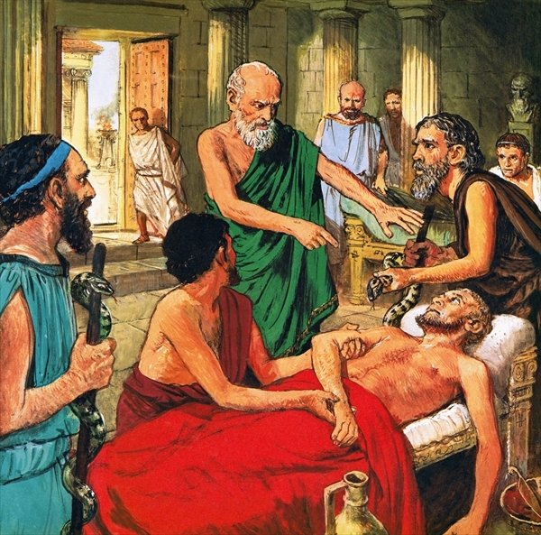
Topical Antibiotic Use
Orthopaedic
General surgery
Plastics
ENT
Ophthalmology
Dermatology
Interventional cardiology
Emergency department
General practitioners
Widely used
Geographical & specialty variation in use
M Dryden, UK
12

Slide 13
The selective use of topical antibiotics as surgical prophylaxis is justified for specific procedures, such as joint arthroplasty, cataract surgery and, possibly, breast augmentation.
“Selective” might include obese patients

Slide 14



The use of topical antibiotics to prevent surgical site infection; a survey of practice and opinion
Charlotte Cooper¹, Gavin Barlow², Niels Fibæk Bertel³, Tracey Guise⁴, Carolyne
Horner⁴, Hilary Humphreys⁵
¹School of Biosciences, University of Birmingham, UK ² Hull and East Yorkshire NHS Trust, Hull, UK ³European
Wound Management Association, Frederiksberg, Denmark ⁴British Society of Antimicrobial Chemotherapy, Birmingham, UK ⁵Royal College of Surgeons in Ireland and Beaumont Hospital, Dublin, Ireland

Slide 15
Clinical Practice: Agent & Application
n=108 responses

Slide 16
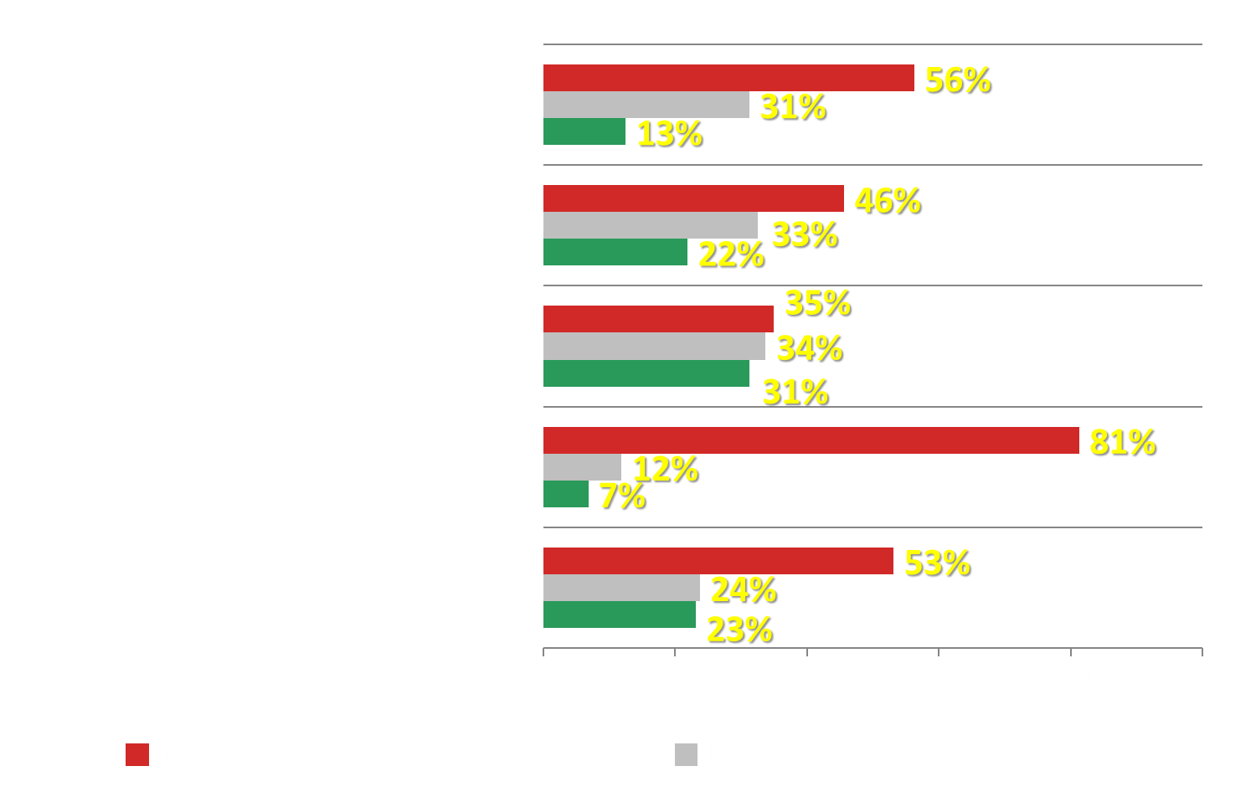
Opinion: Topical Antibiotics to Prevent SSI
There is a significant body of evidence in favour of use
Are cost effective
Rarely result in detrimental side effects for the patient
Don’t contribute to antibiotic resistance
Confer additional benefits to other forms of prophylaxis
n=160 responses

Slide 17
British Society of Antimicrobial Chemotherapy (BSAC) Literature Review
June 2010 to June 2017 focussing on orthopaedic (21), cardiac surgery (11) & abdominal studies (7)
“Conflicting results within & between studies depending on the type of surgical site infection (SSI); total, deep, superficial & organ space. Studies are largely underpowered, not controlled and with little standardisation meaning results can only be treated as trends rather than confirmed effects”

Slide 18
Topical antibiotics: why not?
Pros
  High sustained local concentration
  No disruption of microbiome
  Active at the site of entry of infection
  No systemic toxicity
  No C.difficile
  May be particular benefit for high risk e.g. diabetes mellitus, smokers, ischaemic etc.
Cons
  contact dermatitis
  interference with wound healing
  the potential for increased antibiotic resistance
  cytotoxicity
M Dryden, UK
18

Slide 19

Short-Term Antibiotic Treatment Has Differing Long-Term Impacts on the Human Throat and Gut Microbiome
Jakobsson HE et al., , March 24, 2010
Systemic antibiotic use is like napalm – it destroys all with long-term consequences. It is ecological vandalism.
Four years after treatment high levels of the macrolide resistance gene erm(B) were found, indicating that antibiotic resistance, once selected for, can persist for longer periods of time than previously recognized.
This highlights the importance of a restrictive antibiotic usage in order to prevent subsequent treatment failure and potential spread of antibiotic resistance.
M Dryden, UK
19

Slide 20
Some Studies on Topical or Local Antibiotics

Slide 21
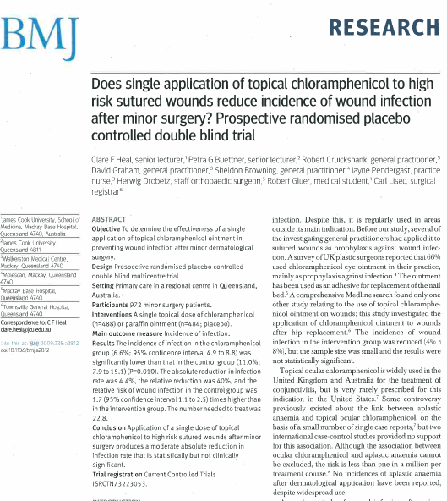
Chloramphenicol
Ophthalmology
ENT minor surgery
Dermatology
Plastic surgery
M Dryden, UK

Slide 22
Topical Bacitracin to Prevent Sternal Wound Infections After Cardiac Surgery
Annals of Thoracic Surgery; 2017; 104: 1496-1500
9 year experience of peri-operative sternal wound bacitracin
0% deep infection rate versus expected rate of 0.29%
4 superficial infections
Well tolerated. No serious adverse effects
Readily available & inexpensive therapy
M. Dryden, UK

Slide 23
Intra-Wound Antibiotics (IWA), Infection & Spinal Fusion Surgery
9,823 patients in 20 Washington State Hospitals, 55% receiving IWA
111 (1.1%) with SSI; 0.8% (IWA)* vs 1.5% (no IWA)
After adjustment, no difference
Surg Infect 2016; 17: 177-186

Slide 24
Local Gentamicin to Wound for Abdominoperineal Resection
582 articles from search (1988-2012) but only 8 suitable
  4 RCTS
  3 consecutive studies
  1 cohort (no controls)
Sponges (3), beads (4), injection (1)
Substantial heterogeneity in studies
Evidence does not support perineal application of gentamicin
World J Surg 2015; 39: 2786-2794

Slide 25
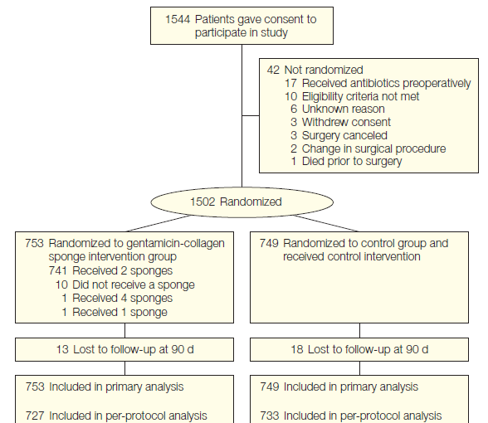
Gentamicin Collagen Sponges (GCS), Sternal SSI after Cardiac Surgery
Phase 3, single blind, RCT of 1502 patients at high risk (DM or BMI> 30)
JAMA 2010; 304: 755-762

Slide 26
GCS & Sternal SSI after Cardiac Surgery
Per Protocol Analysis | GCS (727) | Control (749)
Any SSI | 8.4% | 8.6%
Surgically treated SSI | 3.2% | 4.9%
Superficial SSI | 6.6% | 6.1%
Deep SSI | 1.8% | 2.5%
Re- hospitalisation for SSI | 3.0% | 3.3%
Post-operative length of stay | 6.0 d | 6.0 d
JAMA 2010; 304: 755-762

Slide 27
GCS & Colorectal Surgery
2 sponges (260 gentamicin) to patients in 39 US sites
From 674 enrolled, 602 randomised (GCS 300, control 302)
Adjusted SSI of 29% in GCS group & 21% in control (p=0.03)
GCS patients more likely to visit ED or surgeon’s office (19.7% v 11%, p = 0.004)
15 gentamicin resistant isolates, 13 in GCS group
N Engl J Med 2010; 363: 1038-49

Slide 28
GCS & Colorectal Surgery
Initial effect but not sustained due to a lack of sustained antibiotic levels
Collagen sponge may be a mechanical barrier to rapid & effective closure of wound
N Engl J Med 2010; 363: 1038-49

Slide 29
NICE - SSI Prevention & Treatment, 2017
Pre-operative
e.g. antibiotic prophylaxis
Intra-operative
Do not use wound irrigation to reduce the risk of SSI
Do not use intra-cavity lavage to reduce the risk of SSI
Do not use intra-operative skin re-disinfection or topical cefotaxime in abdominal surgery to reduce the risk of SSI
Post-operative
Do not use topical antimicrobial agents for surgical wounds that are healing by primary intention to reduce the risk of SSI

Slide 30
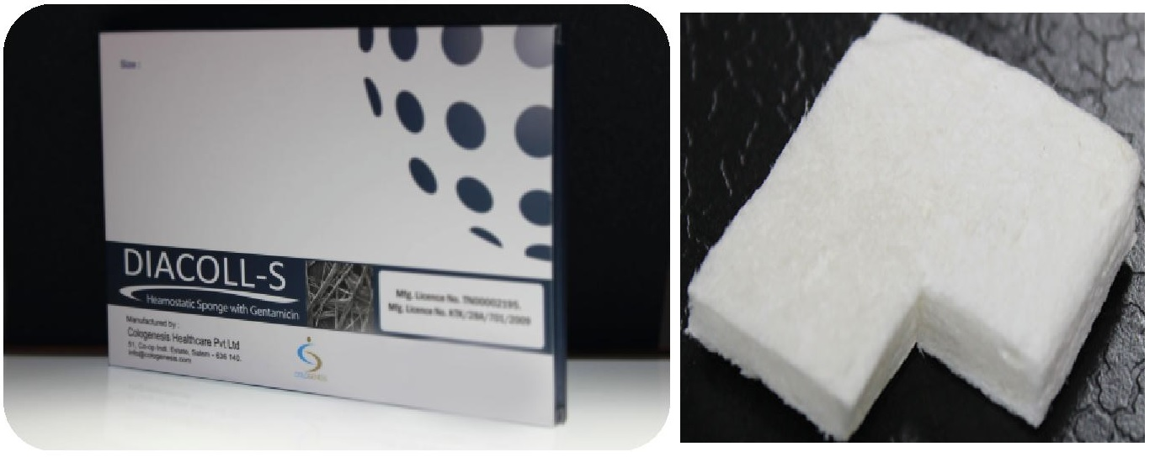
Preventing SSI in Acute Care Hospitals, 2014
SHEA, IDSA, AHA & APIC
Gentamicin collagen sponges (GCS)
Colorectal surgery, SSI higher with GCS
Cardio-thoracic, mixed evidence
GCS not approved by FDA in USA
Infect Control Hosp Epid 2014; 35: 566-588

Slide 31
WHO Recommendations 2016
“…. antibiotic incisional wound irrigation before closure should not be done”
Conditional Recommendation
Low quality of evidence
Lancet Infect Dis 2016; 16: e288-303

Slide 32
Unintended
Consequences

Slide 33
Impact of Topical Vancomycin in Spinal Surgery
Retrospective review of 981 patients receiving 1-2 gr vancomycin, 2011-13
6.7% SSI – 5.2% had + ve cultures; 44/51 (86%) Gram + ve, & 31 (61%) Gram negative
Historical controls had Gram-ves in 21% (p=0.0001)
Use of topical vancomycin for prophylaxis shifts causes to Gram negative
Spine 2014: 39: 530-555

Slide 34
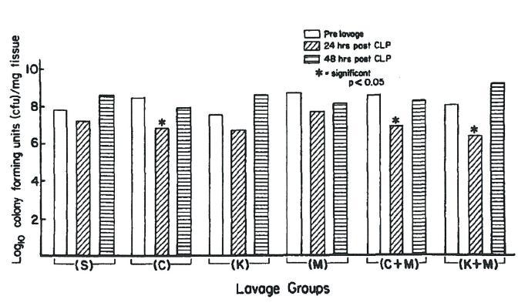
Impact of Topical Antibiotics on Flora
Animal studies on rats & impact of antibiotics on flora, i.e. cephazolin, kanamycin, metronidazole & combinations
Saline lavage does not alter anaerobic flora
Antibiotics had transitory impact on flora, re-colonisation at 4h
World J Surg 1990; 14: 176-183

Slide 35
Antibiotics & Intra-Abdominal Adhesions
Group 1 16 rats + saline
Group 2 8 rats + cefazolin
Group 3 8 rats + tetracycline
More adhesions after 2/52 in groups 2 & 3 compared to group 1
Mesothelial thickening & extensive collagen deposition, especially in Group 3
Am J Surg 1989; 158: 435-437

Slide 36
GCS, Sternal SSI after Cardiac Surgery
Impact of Gentamicin
Levels taken 2h before & 2,4,8,12 & 24h after closure of wound
No difference in adverse events
JAMA 2010; 304: 755-762

Slide 37
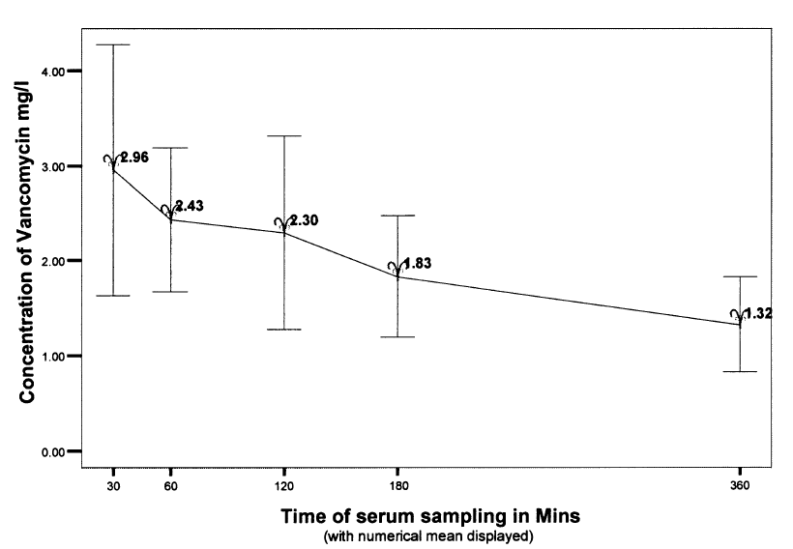
Vancomycin Levels & Sternotomy Wounds
500 mg vancomycin power or dissolved in saline
Levels taken 30 min – 720 min
Mean concentration in urine was 24.4 at day 1
Eur J Cardio-Thoracic Surg 2003; 23:765-770

Slide 38
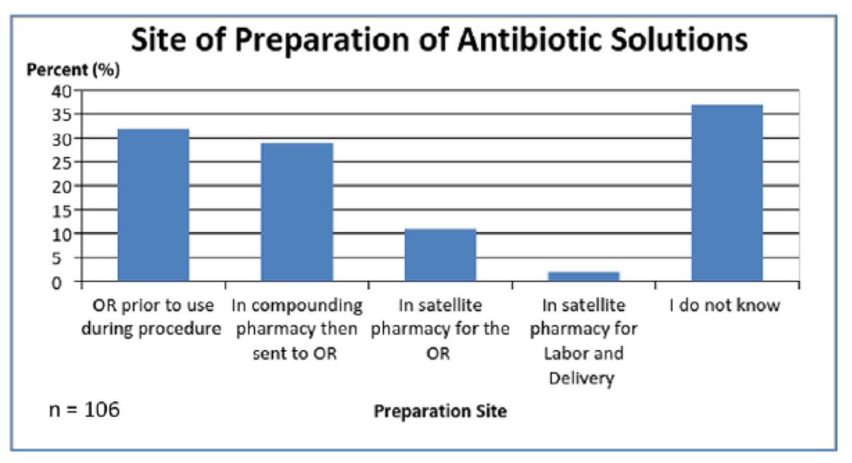
Safety Quality of Antibiotic Preparation
Am J Infect Control 2017; 45: 1259-1266

Slide 39
Conclusions
&
Final Thoughts

Slide 40
Almost all of the studies showing a benefit for topical antibiotics are flawed
RCTs suggest no impact & or even possibly increased SSI
Risks include increased resistance, altered flora & adhesions
Benefits include less reliance on systemic antibiotics & possibly reduced infection rates
Potential advantages for selected patients after specific procedures

Slide 41
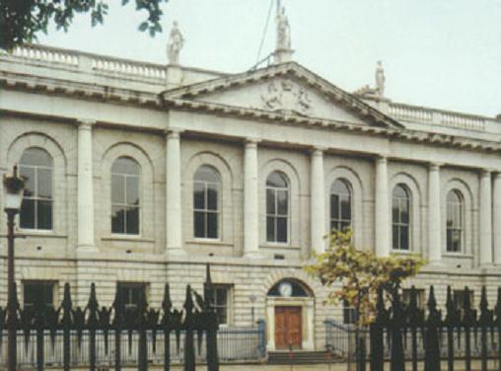
Thank you

Slide 42

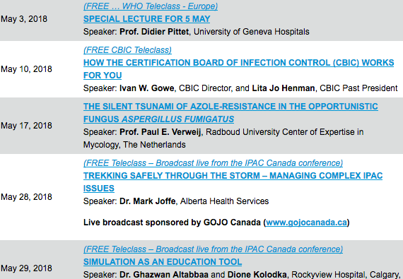

Slide 43


