Slide 1
Using Expert Process to Combat Clostridium difficile Infections (CDI)
Isabelle Guerreiro, Program IPAC Specialist, Public Health Ontario
Camille Achonu, Epidemiologist Lead, Public Health Ontario
Hosted by David Ryding
Public Health Ontario
www.webbertraining.com
February 23, 2017

Slide 2


Acknowledgements
PHO’s Infection Prevention and Control (IPAC) Department

Slide 3
Objectives
At the end of the session, attendees will be able to:
  Describe the Infection Control Resource Team (ICRT) process.
  Discuss the collaborative role between all those involved in ICRT visit activities.
  Summarize key areas of practice improvement that were most frequently identified by ICRT visits.

Slide 4

Image credit: Microsoft Clipart

Slide 5
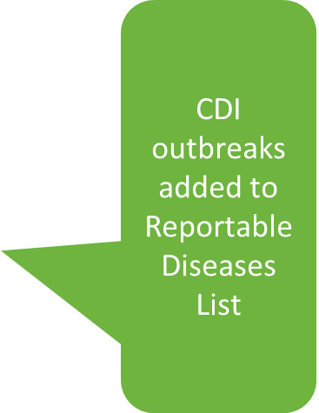
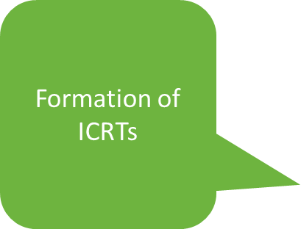

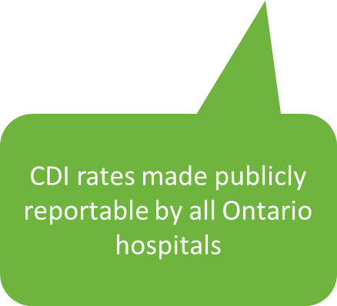

Slide 6

Goals of the ICRT visits
ICRT visits provide:
  Expert scientific advice
  A ‘second set of eyes’
  Supportive approach
  Referenced recommendations.

Slide 7
The ICRT… back then
Two teams supporting different areas of the province.
First point of contact.
Independently coordinated the ICRT visit process and managed CDI outbreaks.
Teams included an infectious diseases (ID) physician, infection control professionals (ICPs) and others such as epidemiologist and other PHO staff.

Slide 8

The ICRT… Now
ICRT visit may be requested in a number of ways.
Information gathering by IPAC Specialist.
PHO determines the level of support needed.

Slide 9
ICRT Members
Drawn from PHO’s Infection Prevention and Control Team.
At a minimum:
  One PHO IPAC physician
  One Program IPAC Specialist
  One IPAC Manager
  Representative(s) of Regional Support Unit
Additional PHO members.

Slide 10
Expectations
PHO ICRT Members:
  Refer to best practices
  Prepared and ready to support facility before, during and after visit.
Requesting Facility:
  Available and transparent
  Senior Management Team Involvement.

Slide 11

ICRT Visit – The Overview and Interviews
Overview Meeting.
Interviews with relevant staff and/or teams.

Slide 12

ICRT Visit – The Tour
Opportunity to:
See practices in action and validate what we heard and read.
Speak with staff, ask questions, clarify our understanding of issue(s).
Identify gaps in facility design; patient flow; equipment and supplies management, etc.

Slide 13

ICRT Visit – The Debrief
Held at the end of the visit.
Provide preliminary recommendations.

Slide 14

ICRT Visit Report
Final approved PDF report provided soon after.
Facility is encouraged to share the report (e.g., local PHU).
PHO will provide ongoing support through the Regional Support Unit as the facility implements the recommendations.

Slide 15

Regional Support Unit
Core Function: Provide scientific and technical support.
Have pre-existing relationship.
Work with local PHU to support facility’s outbreak management issue(s).

Slide 16

Regional Support Role Before Visit
Review results of pre-ICRT visit to discuss identified barriers with the team.
Assist in identifying key issues to ensure appropriate review during the visit.

Slide 17

Regional Role During Visit
Review of information.
Participation during interviews.
Gather and share information during the visit.

Slide 18

Regional Role Following the Visit
Provide ongoing support.
May assist in developing a plan to address recommendations.
Ongoing follow-up support with facility and local PHU.

Slide 19
Role of Public Health Unit During an ICRT
Provide PHO outbreak information prior to the visit where applicable.
Participate during the ICRT visit
  Overview and debrief meetings
  Interviews.
Support Facility
  Hence importance of sharing report with PHU if not part of the request.

Slide 20

Lessons Learned

Slide 21

Methods
Reviewed PIDAC best practices documents and identified 49 high impact recommendations in 14 general categories
Selected all CDI-related ICRT reports from 2008 to 2012
For each recommendation, reviewed ICRT reports to identify if hospital did not meet or needed to improve
Ranked categories in order of most frequently identified

Slide 22

What We Saw From 2008 to 2012…
Between 2008 and 2012, 22 CDI-related ICRT visits to 19 facilities.
3 facilities had two ICRT visits over the five-year period.
The majority (59%) of ICRT visits were at large community hospitals; the remainder were at acute teaching hospitals (27%) and small community hospitals (14%).

Slide 23
14 Areas of Concern
1. Environmental services (82%)
2. Antibiotic stewardship (73%)
3. Program staffing and medical leadership (73%)
4. Identification and isolation of CDI cases (73%)
5. Hand hygiene (68%)
6. Human waste management (64%)
7. IPAC education and training on Routine Practices/Additional Precautions (55%)
8. Audits of IPAC-related practices (55%)
9. Senior leadership support (32%)
10. Facility design (32%)
11. CDI outbreak management (32%)
12. Communication and partnerships (27%)
13. Access to appropriate and timely laboratory testing (23%)
14. Environmental cleaning services, policies and procedures for CDI (23%)

Slide 24
Top 5 Areas of Improvement
Environmental services
Antibiotic Stewardship
Program staffing and medical leadership
Identification and isolation of CDI cases
Hand hygiene

Slide 25

Environmental Services
Most frequently identified IPAC issues were:
  Clear processes for cleaning and disinfection of shared patient care equipment
  Clear identification of clean versus dirty shared patient care equipment
  Adequate environmental services resources – staffing.

Slide 26
IPAC Program Staffing and Medical Leadership
Difficulty staffing IPAC programs with ICPs as per minimum requirements.
Lack of dedicated manager or identification of combined management role.
Insufficient medical support.
IPAC program responsible for roles outside their scope.

Slide 27
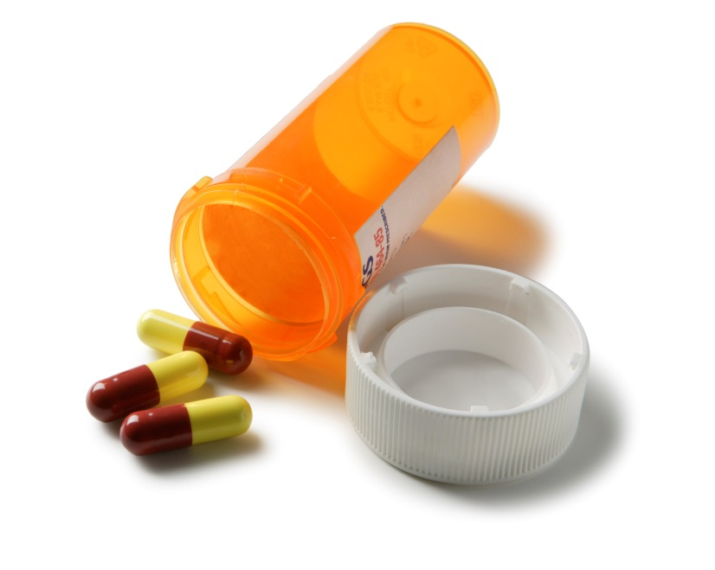
Antibiotic Stewardship or ASP
Lack of ASPs with dedicated resources
  Most in early stage of implementation
  No dedicated pharmacist and/or physician.
ASP activities are not sustainable due to limited resources.
Inclusion of an ASP recommendation added to Annex C of PIDAC’s RPAP document in 2012.

Slide 28
Identification and Isolation of CDI Cases
Lack of immediate implementation of Contact Precautions when diarrhea was identified.
Unnecessary movements/transfers of patients
  Impacted cleaning and disinfection
  Created challenges for multiple departments
  Made containment of CDI difficult.
Poor communication between units.

Slide 29
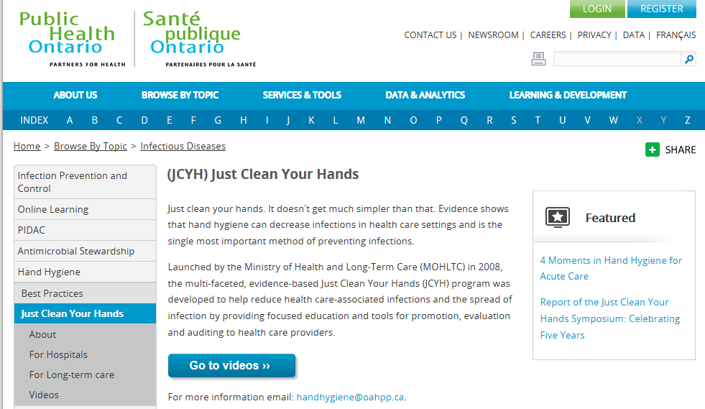
Hand Hygiene
Various stages of hand hygiene programs.
Inadequate location of ABHR dispensers.
Poor compliance with hand hygiene
  Reluctance to provide individual feedback
  Inconsistent awareness of audit results.
Image credit: PHO 2016

Slide 30
What Have We Learned?
Identified key common issues where stakeholders require support
Refer to 49 high-impact recommendations when carrying out ICRT visits
Informed development of IPAC resources
Continue evaluation of recommendation up-take to inform impact of ICRT visits

Slide 31

Overall…
We have learned as much from those facilities experiencing outbreak management issues as they have learned from us
Teamwork and collaboration has enabled PHO to improve ICRT visit process

Slide 32
Did You Know…
A summary of the ICRT findings has been published in the American Journal of
Infection Control (AJIC) and can be found at
http://www.ncbi.nlm.nih.gov/pubmed/27451312

Slide 33
For further information: isabelle.guerreiro@oahpp.ca camille.achonu@oahpp.ca
www.oahpp.ca

Slide 34

Thank you…

Slide 35

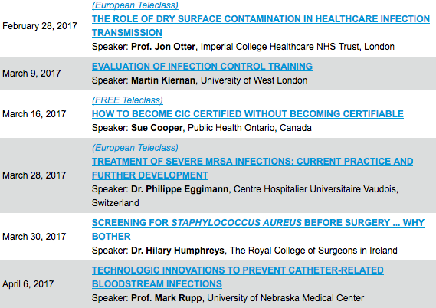

Slide 36


