Slide 1


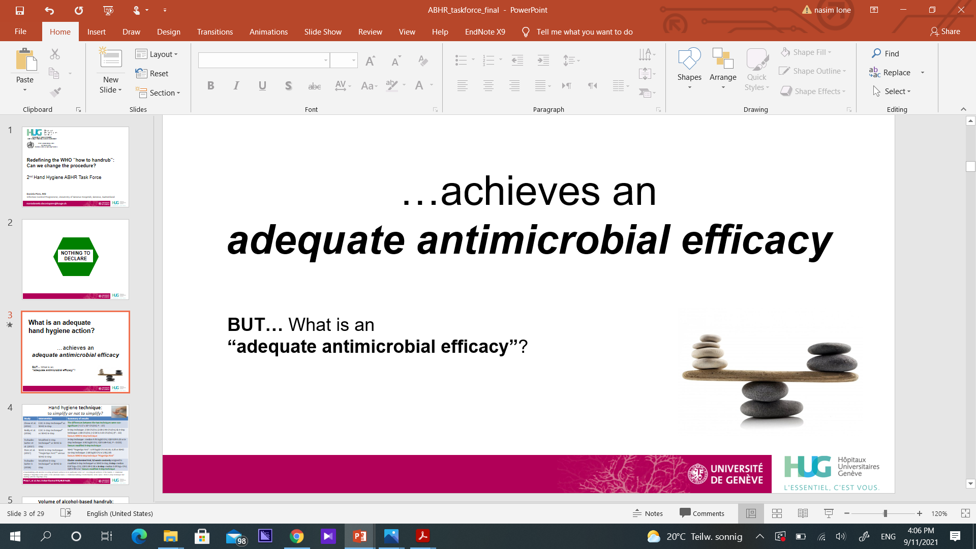
Using humor in infection prevention
Professor Didier Pittet, MD, MS, CBE
Faculty of Medicine Geneva,
Switzerland
Chair, Clean Hospitals
www.webbertraining.com
January 12, 2023

Slide 2

Plan
- Humor in hand hygiene (early 1990’s)
Effects of humor in advertising
Humor in health care
How to use humor in infection prevention (IPC) ?
Humor in scientific publications
Humor in media
Humor in the community

Slide 3
Plan
- Humor in hand hygiene (early 1990’s)
Effects of humor in advertising
Humor in health care
How to use humor in infection prevention (IPC) ?
Humor in scientific publications
Humor in media
Humor in the community

Slide 4
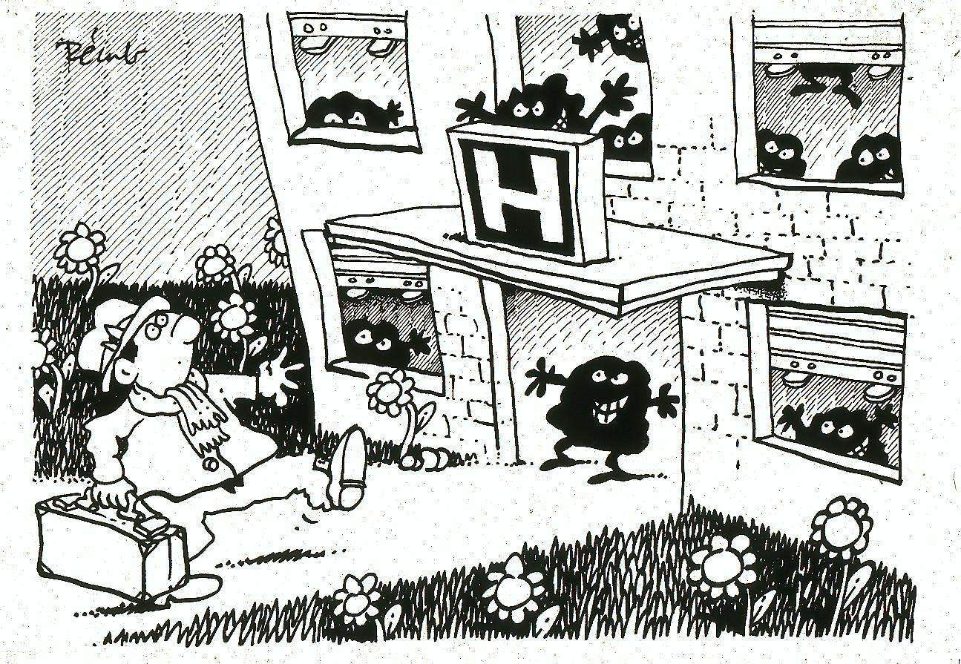

Slide 5
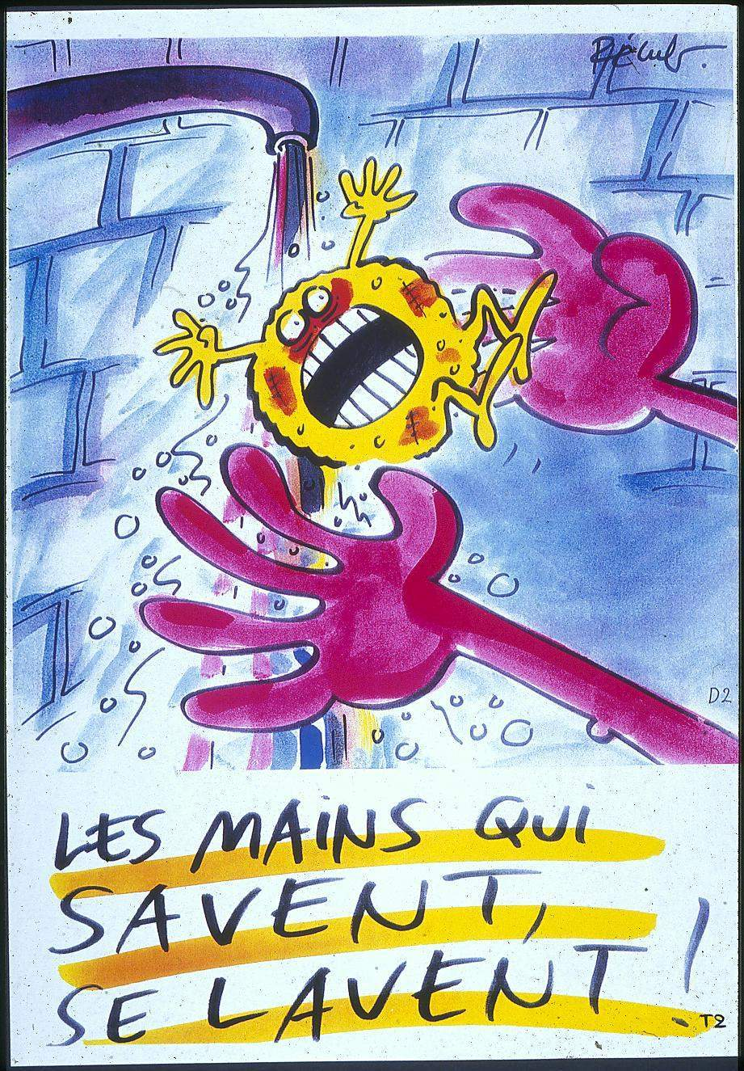

Slide 6
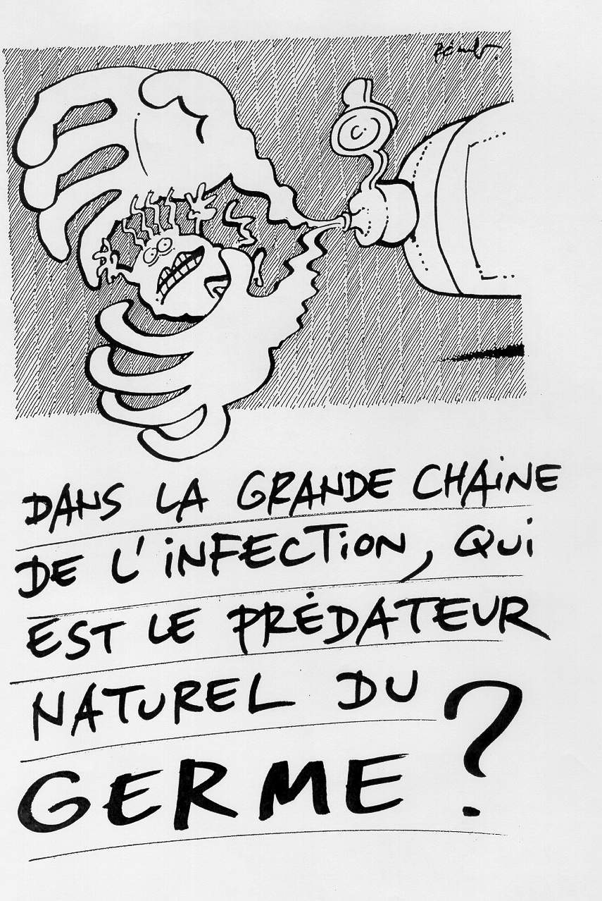
Handwashing…
An action of the past
(except when hands are visibly soiled)
System change
Alcohol-based handrubbing…
The new standard of care
The « hand hygiene revolution »

Slide 7
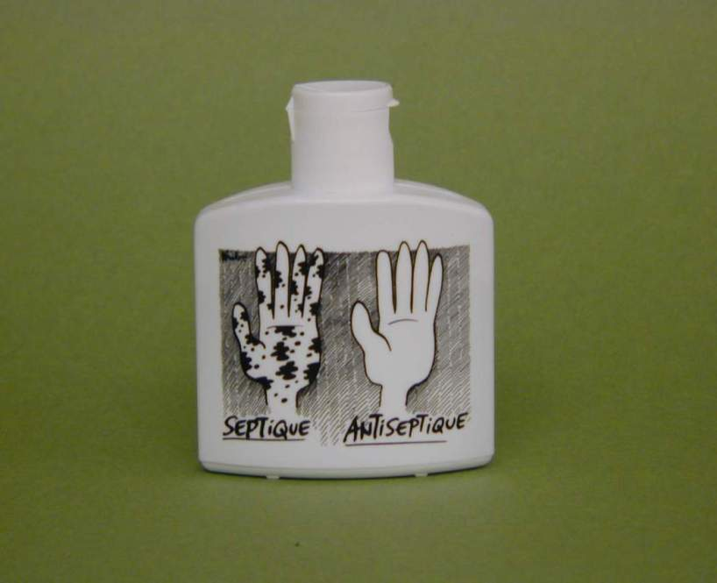
Alcohol-based hand rub at the point of care
The University
of Geneva
Hospitals, 1995
Before and after any patient contact
After glove use
In between different body site care

Slide 8
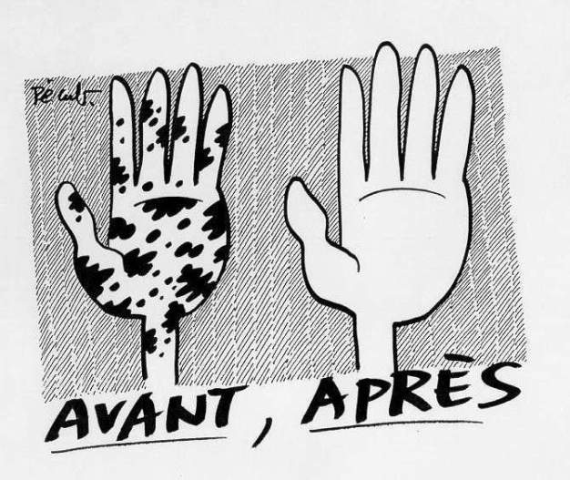
The University of Geneva Hospitals (HUG), 1995
Education
AFTER
BEFORE

Slide 9
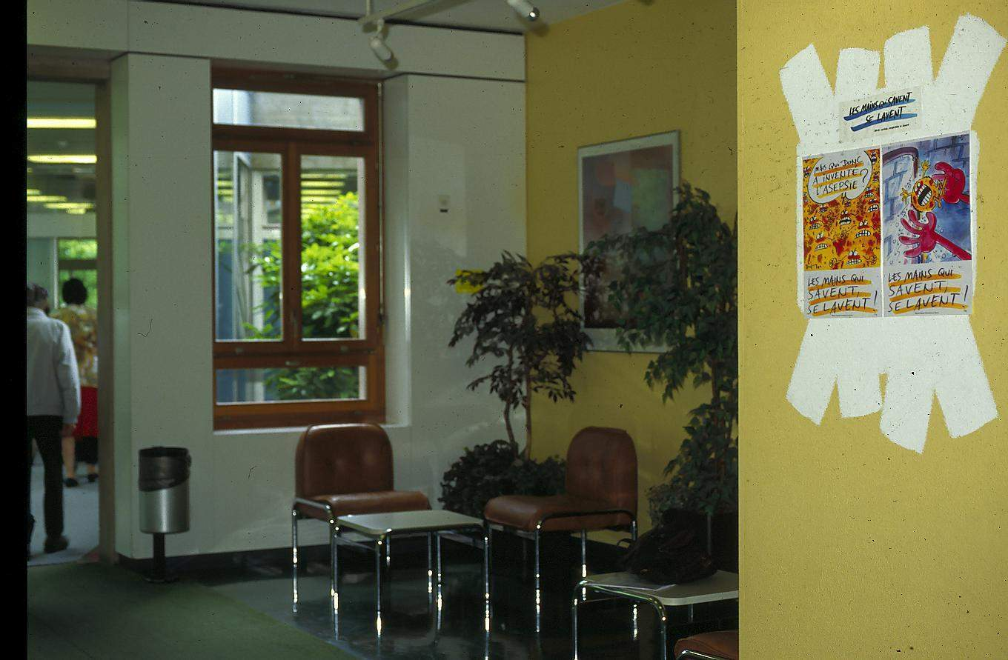
« Talking walls »
The University of Geneva Hospitals (HUG), 1995 - 1998

Slide 11

Handrub is the natural killer of cross transmission

Slide 12
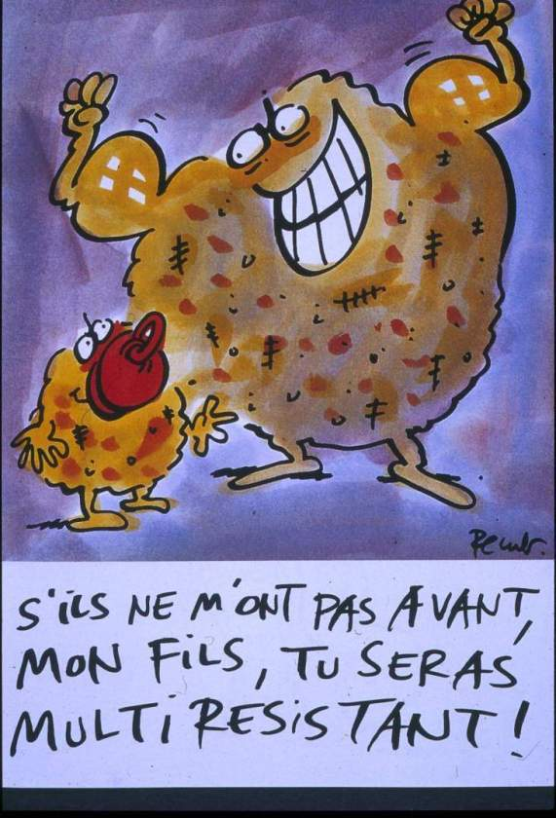
My son,
if they don’t get me,
you will become
multiresistant

Slide 13
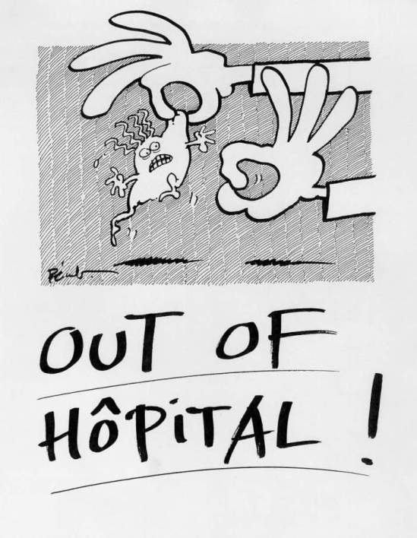
Dirty Staph
…out
of
hospital

Slide 14
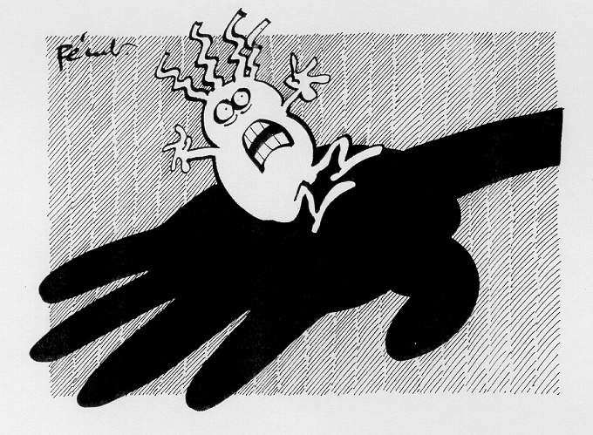
Workplace
reminders
The University of Geneva Hospitals (HUG), 1995 - 1998

Slide 15
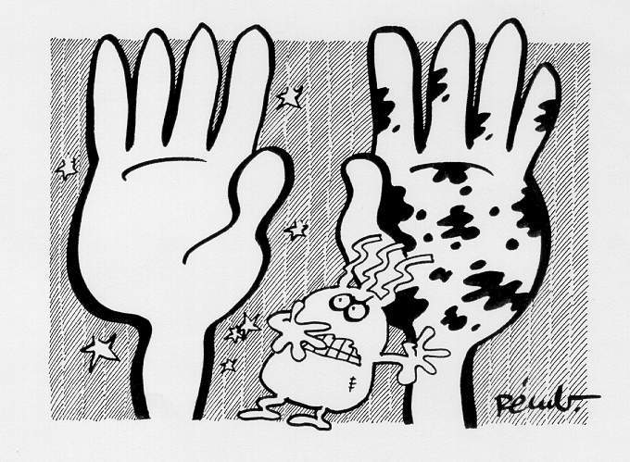
The University of Geneva Hospitals (HUG), 1995 - 1998

Slide 16
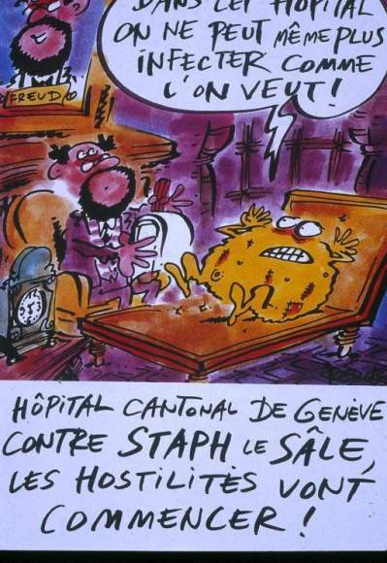
Doctor Freud,
in this hospital,
it’s become impossible
to cause infections
any more !
Safety culture
Geneva’s University
Hospitals against Dirty Staph :
war has been declared

Slide 17
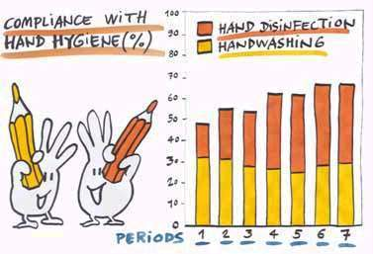
Results
Alcohol-based handrubbing
Handwashing (soap + water)
Monitoring
+
Performance feedback
12/94
12/95
12/96
12/97
www.hopisafe.ch
Pittet D et al, Lancet 2000; 356: 1307-1312

Slide 18
System change
Education
Monitoring
+
Performance feedback
multimodal
behavior
change
strategy
Workplace
reminders
Safety culture

Slide 19
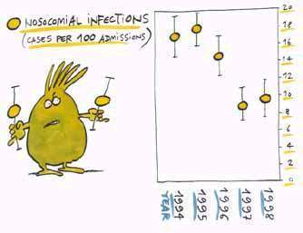
Hospital-wide nosocomial infections; trends 1994-1998
50%
www.hopisafe.ch
Pittet D et al, Lancet 2000; 356: 1307-1312

Slide 20
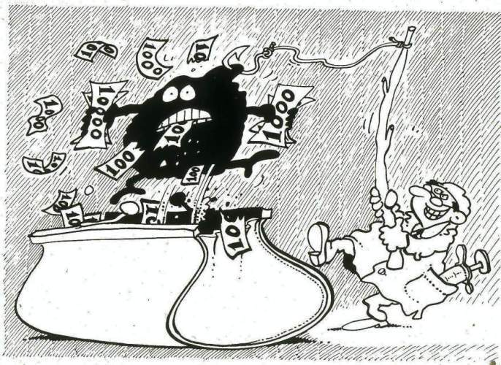
The University of Geneva Hospitals (HUG), 8 years follow-up
Rub
hands…
it saves
money
Pittet D et al, Inf Control Hosp Epidemiol 2004; 25:264

Slide 21
THE LANCET Vol 256 – October 14, 2000
« Geneva model » of hand hygiene promotion,
Reproduced with success (2002-2005)
in single hospitals in France, Belgium, USA, Australia …
in multiple hospitals in Hong Kong, Australia, Belgium, …
in national promotion campaigns: Belgium, the UK, Switzerland

Slide 22
Plan
- Humor in hand hygiene (early 1990’s)
Effects of humor in advertising
Humor in health care
How to use humor in infection prevention (IPC) ?
Humor in scientific publications
Humor in media
Humor in the community

Slide 23
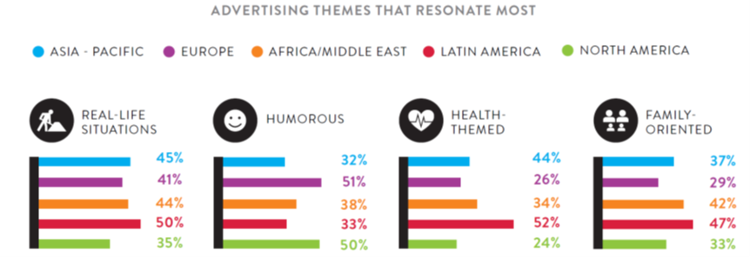

Effects of humor in advertising
In advertising, it is demonstrated that:
Humor is an effective method to attract attention
Using humorous and positive messages encourage/promote behaviour change and knowledge acquisition
Humor strength (humor’s attention gaining mechanisms) and humor–message relatedness have a positive impact on memorizing the message
Nielsen Global Survey of Trust in Advertising 2015
Cline TW., Kellaris JJ. Journal of Advertising, 2007; 36: 55–67
Notes:
Although Effect of humor in advertising varies according to the generations and development level of the country, it is in the top 3 theme that resonate most
https://www.nielsen.com/wp-content/uploads/sites/3/2019/04/global-trust-in-advertising-report-sept-2015-1.pdf

Slide 24
Plan
- Humor in hand hygiene (early 1990’s)
Effects of humor in advertising
Humor in health care
How to use humor in infection prevention (IPC) ?
Humor in scientific publications
Humor in media
Humor in the community

Slide 25
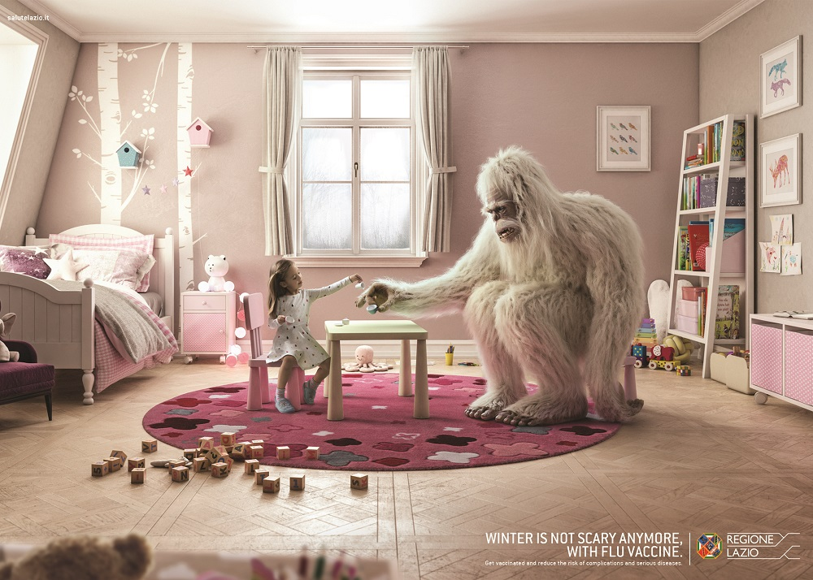
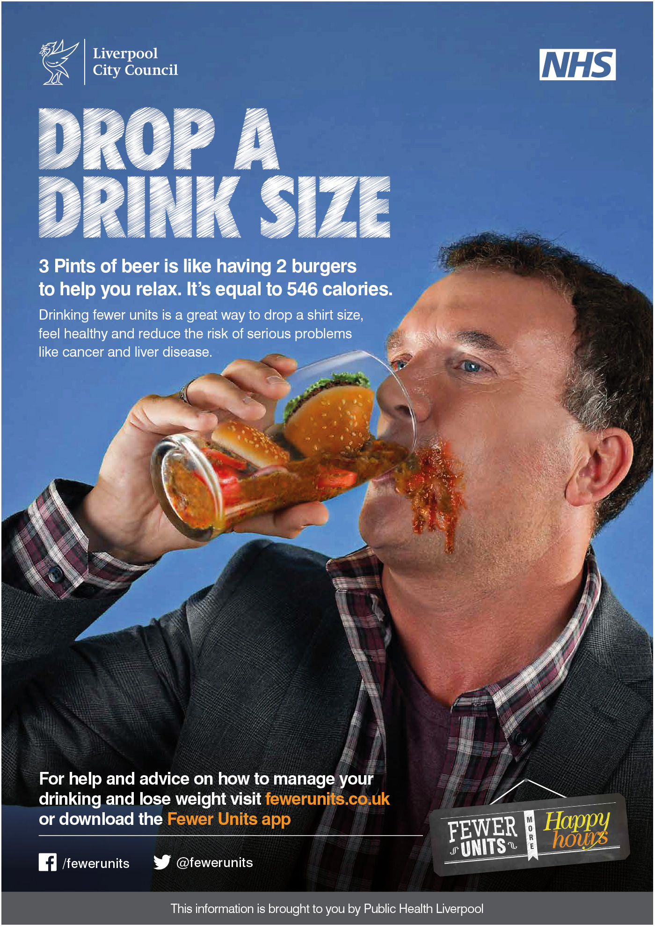
Humor in health care
Preventive health campaigns
Humor-based materials are used effectively in preventive campaigns to prevent alcohol and tobacco consumption, obesity, and cancer:
to draw attention
to reduce negative emotional responses, such as fear, anxiety, and embarrassment to disturbing health topics
to increase acceptance of health messages and behavior change
Miller E et al. Aust N Z J Public Health. 2021;45:568-577
Blanc N, Brigaud E. Health Commun. 2014;29:669-77
Notes:
Blanc: Humour in preventative print advertisements targeting alcohol, tobacco and obesity was examined in one study. Participants who watched humorous ads exhibited prolonged attention, judged the ad as more convincing and the message was better recognised compared to non-humorous ads, supporting the hypothesis that attention is attracted by humour.
.

Slide 26
Plan
- Humor in hand hygiene (early 1990’s)
Effects of humor in advertising
Humor in health care
How to use humor in infection prevention (IPC) ?
Humor in scientific publications
Humor in media
Humor in the community

Slide 27

How humor can be used in infection prevention and control (IPC)?
Training
IPC training by the use of the same messages and teaching materials may result in HCWs feeling bored and over-messaged
Traditional training may also cause less comprehension of the key messages
Educational games and creative hands-on activities can be used in IPC training to stimulate sustainable learning and team spirit
Koo E, et al. Am J Infect Control. 2016;44:1241-6
Richard Siderits et al. AORN J 2006; 84:1053-8
Notes:
he PICNet team set out to create an infection control educational game that would be fun, memorable, and involve hands-on activities to would encourage team-building and learning by doing.

Slide 28
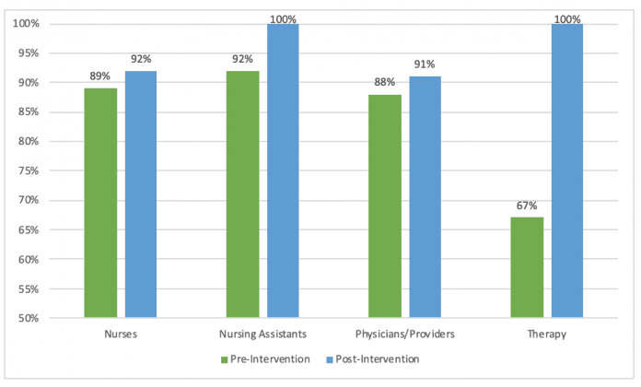
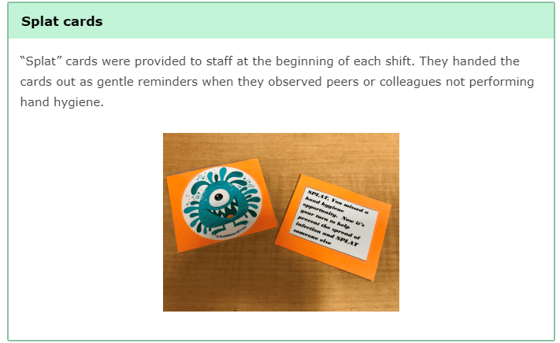
Some examples …
An interactive audit and feedback strategy for hand hygiene was implemented using a card game in a large academic center
“Splat” game – hand hygiene
Nurses Nursing Ass Physicians Therapists
After implementing the game:
Hand hygiene adherence increased from 87% in 2017 to 90% in 2018 and it continued to improve
C. difficile infection rate decreased from 17% (6 months before the intervention) to 3.7% (6 months after the intervention)
The first person on each shift to give all their cards away and not obtain any card in return was offered coffee gift cards donated by the medical director
www.myamericannurse.com/how-an-interactive-game-improved-hand-hygiene-adherence/
Notes:
Splat This campaign helped improve peer-to-peer accountability and adherence to hand hygiene in a fun, nonthreatening way. At our hospital, hand hygiene adherence is measured through observation audits completed by two dedicated hand hygiene auditors. After implementing the game, overall hand hygiene adherence on the unit increased from 87.2% in fiscal year 2017 to 90.4% in fiscal year 2018. Compliance has continued to improve since then and is currently 96.4% year to date. In addition, when hand hygiene compliance increased, the unit Clostridium difficile infection rate decreased from 16.87% (6 months before the intervention) to 3.72% (6 months after the intervention).

Slide 29
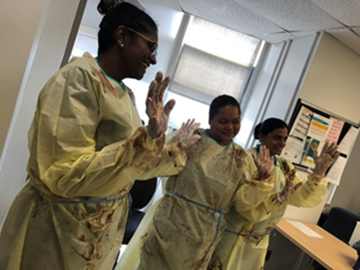
Some examples …
As part of an education session at St.Joseph’s Health Centre, staff had to remove their gown and gloves without getting any of the pudding on their skin or clothes underneath
The game was meant to mimic the potential for transmission of bacteria by health-care providers
The « PPE Pudding game »
https://hospitalnews.com/making-infection-prevention-fun-introducing-the-ipac-olympics/

Slide 30
Some examples …
The University of Geneva Hospitals created “Escape COVID-19”, a serious game to promote safe IPC practices among HCWs and other hospital employees during the COVID-19 pandemic
Suppan M, et al. JMIR Serious Games 2020;8(4):e24986

Slide 31
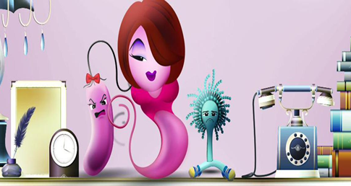
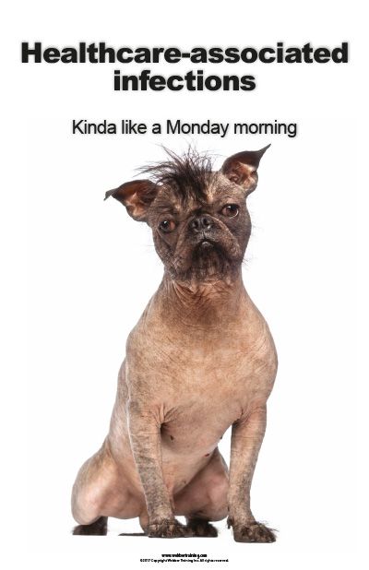

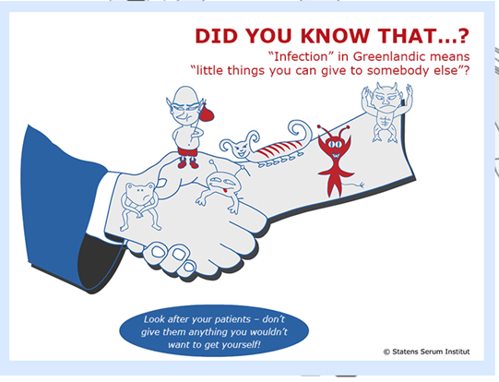
How humor can be used in IPC?
Awareness raising campaigns
Humorous materials (e.g. posters, reminders, screen savers) may help to capture HCWs attention
Soh, Antimicrobial Resistance & Infection Control 2015; 4(Suppl 1):I12

Slide 32
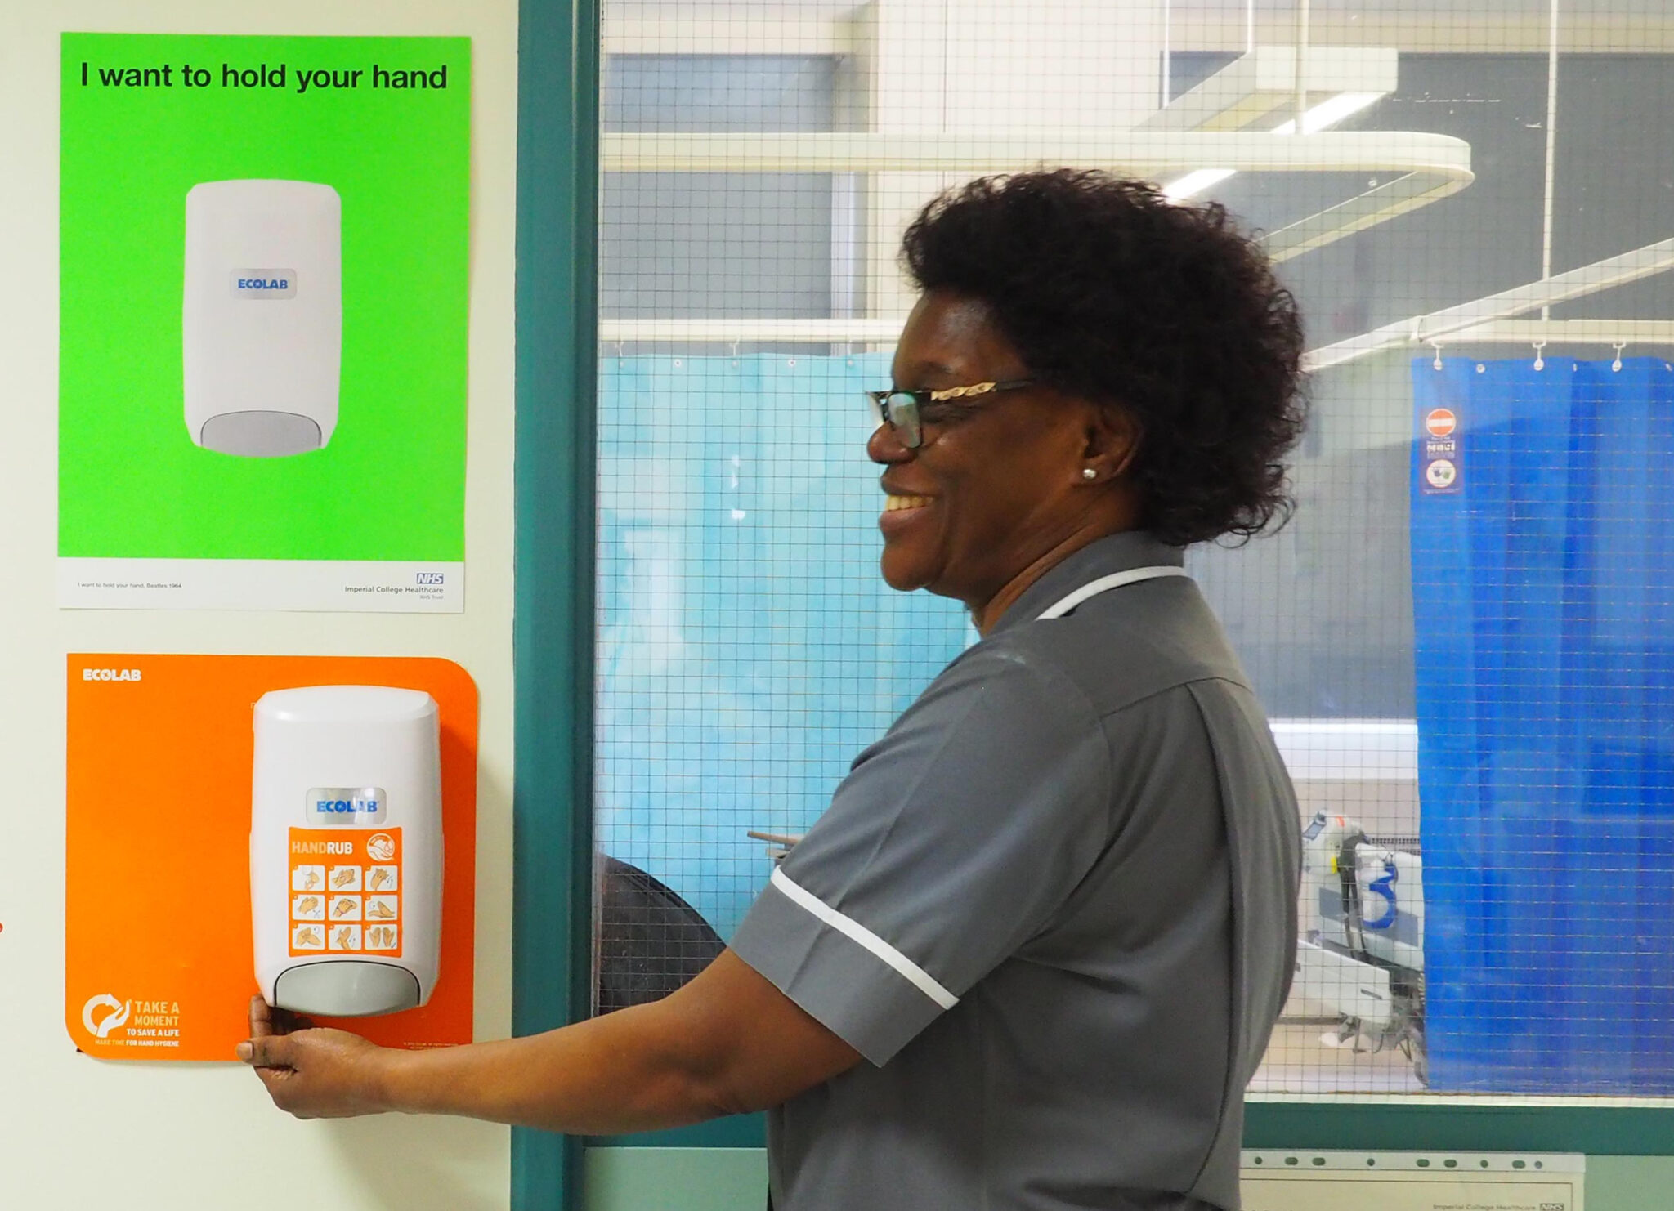
Some examples …
‘Nudge’ reminders based on well-known song lyrics have been developed
Hand hygiene compliance significantly improved from 31% to 68% in 10 wards with the new reminders and multi-modal hand hygiene promotion strategy
Mookerjee S, et al. J Infect Prevention 2019;20(1S):P131
Notes:
https://design-science.org.uk/icht-nhs-hand-hygiene-2/

Slide 33
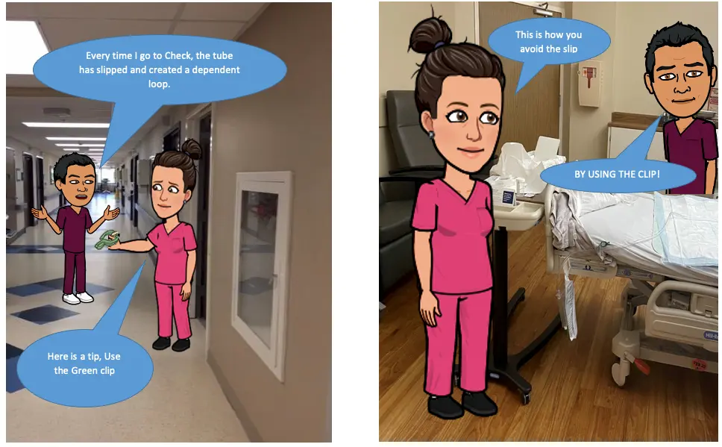
Some examples …
Emojitoons are created by using avatars of employees to remind the key IPC practices to the HCWs
They are designed to give a brief information at a short time to make easy to remember the topic
Results:
50% increase in compliance detected
on key IPC practices
www.infectioncontroltoday.com/view/emojitoons-selling-infection-prevention-compliance-avatars
Notes:
https://www.infectioncontroltoday.com/view/emojitoons-selling-infection-prevention-compliance-avatars Our emojitoons are just a fan favorite,” Scott said. “[They] make it a lot easier for [the topic] to sink in. By only giving [the HCW] a little bit to remember a week, it helps them retain it a lot more than if you throw a lot of information at them at once.”
https://www.infectioncontroltoday.com/view/film-festival-uses-humor-and-education-promote-infection-prevention Other submissions to the Film Festival looked at various infection prevention practices. For example, one took a humorous look at the importance of hand hygiene with a reality-style show called Mr. Bachelor Sparkle digits, where contestants Wendy Wet-Yur-Hands, Lucy Lather, Sally Scrub, Rhonda Rinse, and Delores Dry-Em-Good teach viewers about good hand hygiene practices.

Slide 34
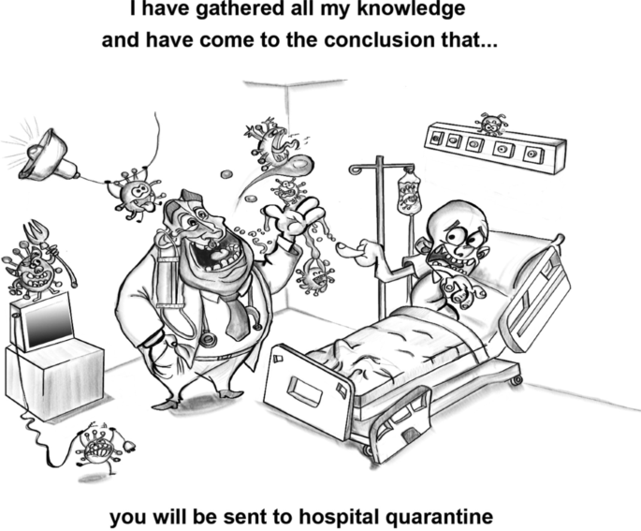
Environmental hygiene
Patient area environmental surfaces play an important role in the transmission of all health care–associated pathogens
Although both hand hygiene and environmental hygiene represent basic horizontal interventions to prevent cross-transmission, there is a need for both interventions to be recognized as interdependent
Several technologic interventions to augment environmental hygiene have been recently developed but remain to be objectively evaluated in well-designed clinical studies
Carling PC. Optimizing Health Care Environmental Hygiene. Infect Dis Clin North Am. 2016

Slide 35
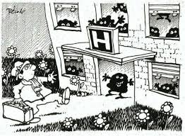
Environmental hygiene
According to a 2022 systematic review, improving healthcare environmental hygiene helps keep patients safe
Most studies demonstrated that interventions in the hospital environment were assoicated with lower HAI and/or patient colonization
Peters et al. “Impact of environmental hygiene interventions on healthcare-associated infections and patient colonization: a systematic review.” Antimicrobial resistance and infection control. 2022

Slide 36
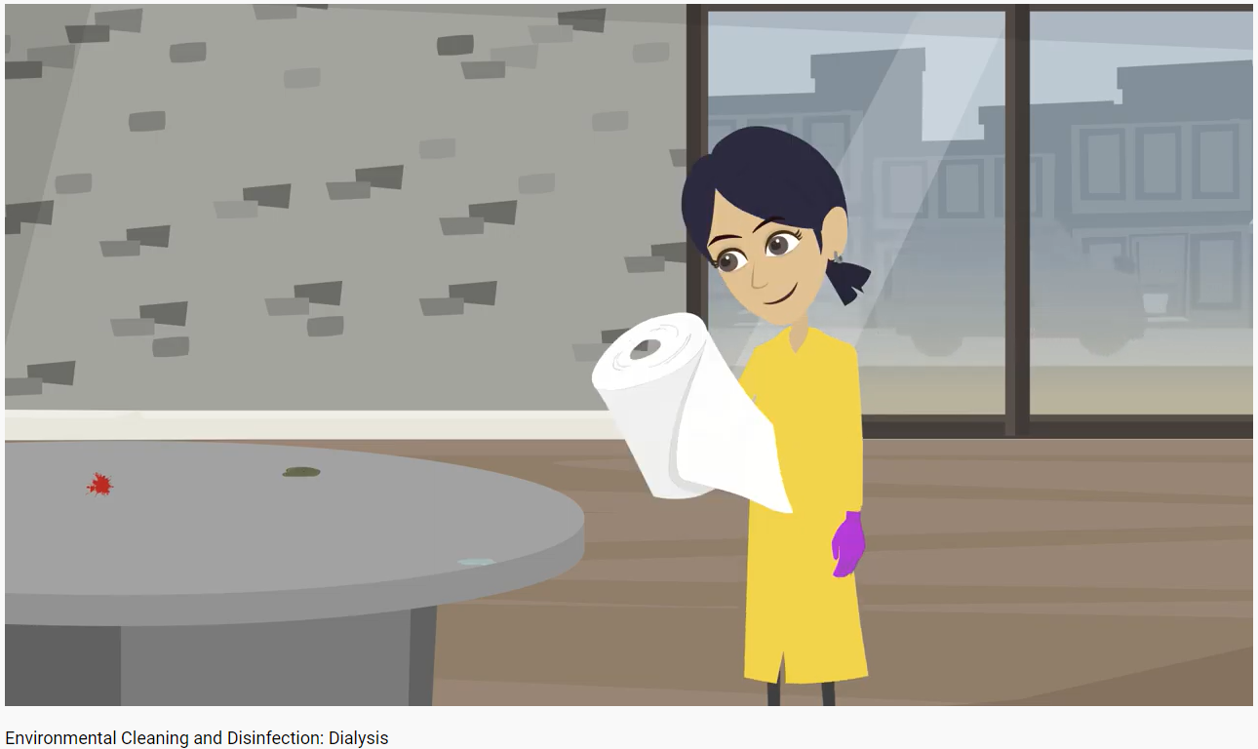
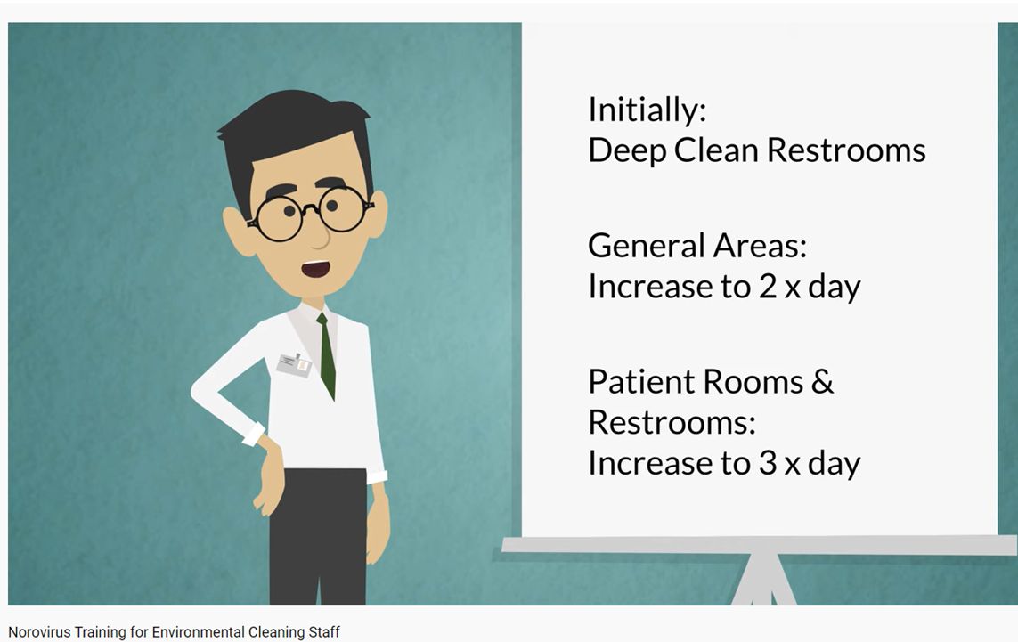

Oregon Patient Safety Commission
Training for EVS
Notes:
https://www.youtube.com/watch?v=NWWa1ZlqneQ&ab_channel=OregonPatientSafetyCommission
Oregon Patient Safety Commission

Slide 37
Centre for Diseases Control and Prevention, (CDC) USA
EVS and the Battle Against Infection Graphic Novel
https://www.cdc.gov/infectioncontrol/training/evs-battle-infection.html

Slide 38
CDC
EVS and the Battle Against Infection Graphic Novel

Slide 39
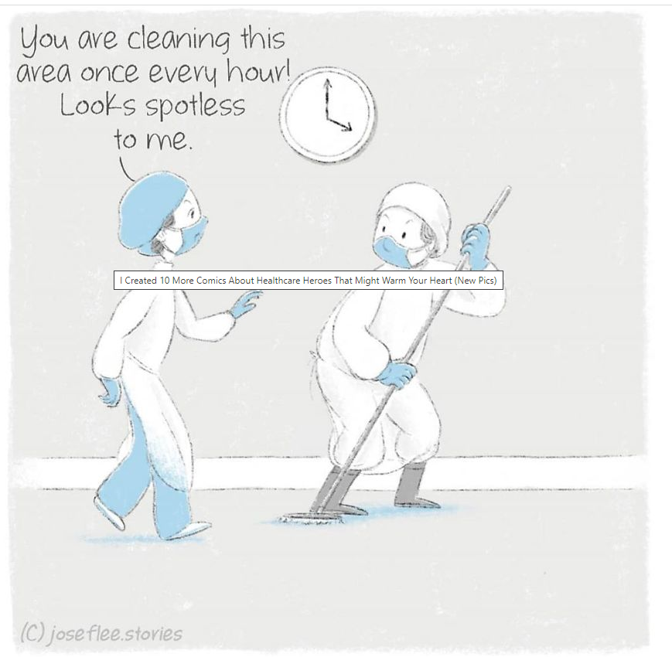
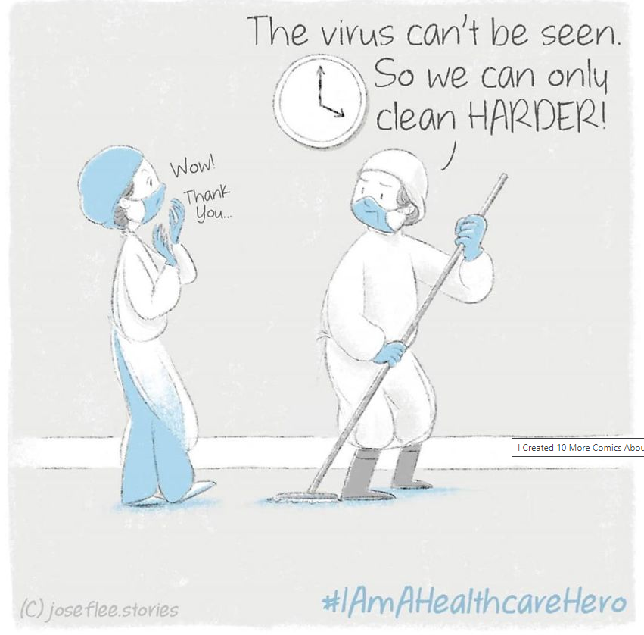
Environmental cleaning during Covid-19
#IAmAHealthcareHero
Notes:
Web page: https://www.boredpanda.com/heartwarming-comics-healthcare-heroes-joseflee-stories-part-3/?utm_source=google&utm_medium=organic&utm_campaign=organic

Slide 40
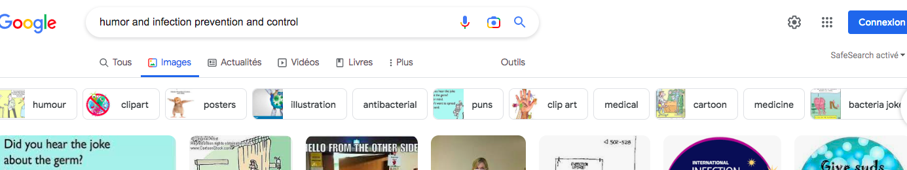
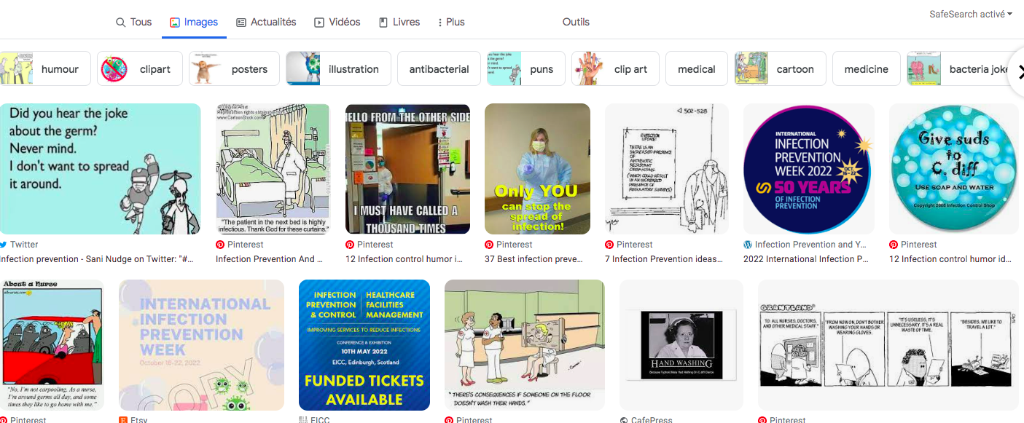
Other examples … from multiple sources

Slide 41
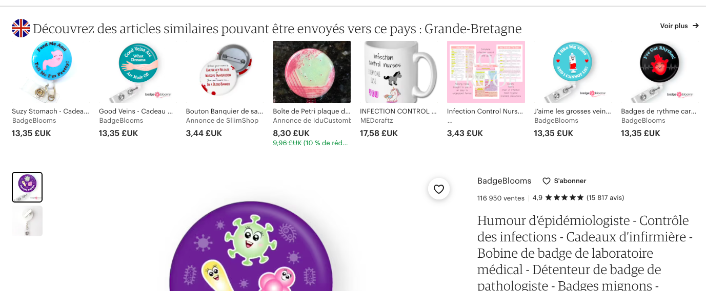
Other examples … looking for gagets and tools..

Slide 42
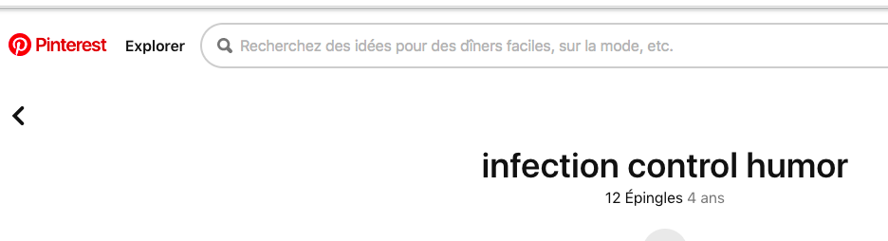
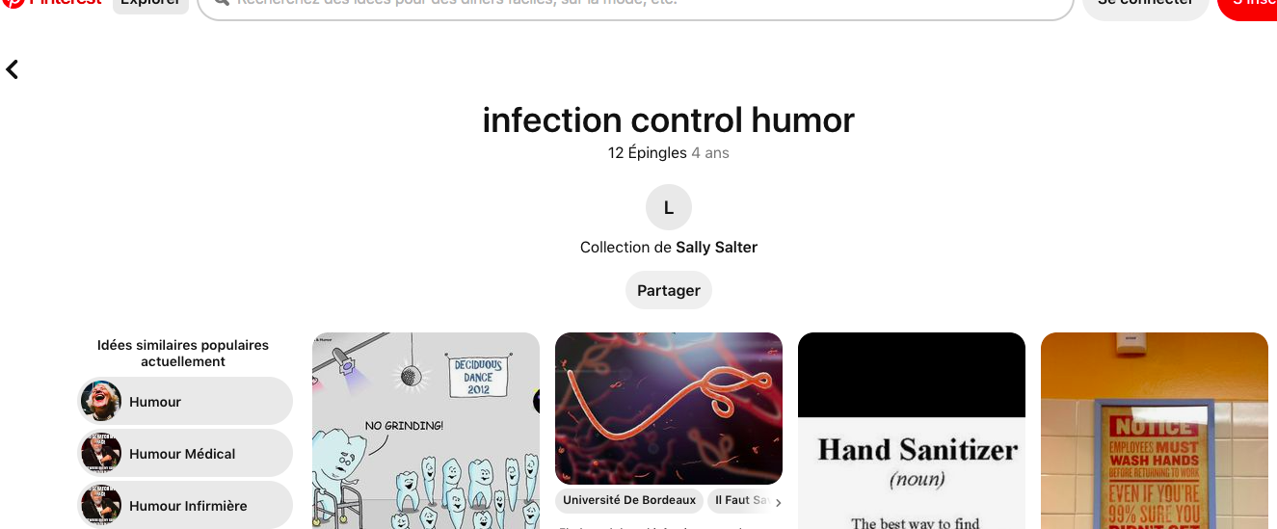
Ointerest
A Pinterest side…. To get ideas and materials

Slide 43

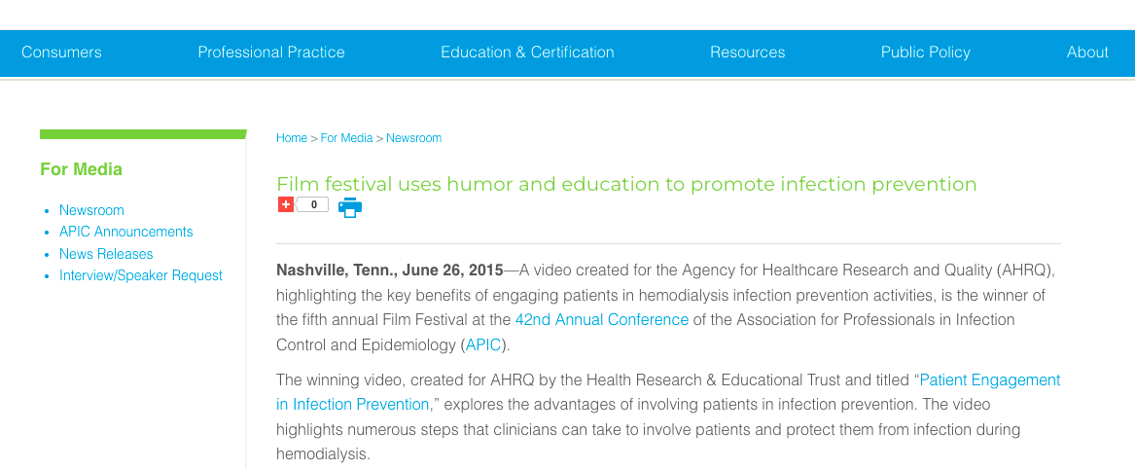
Film festival promoted by APIC…

Slide 44
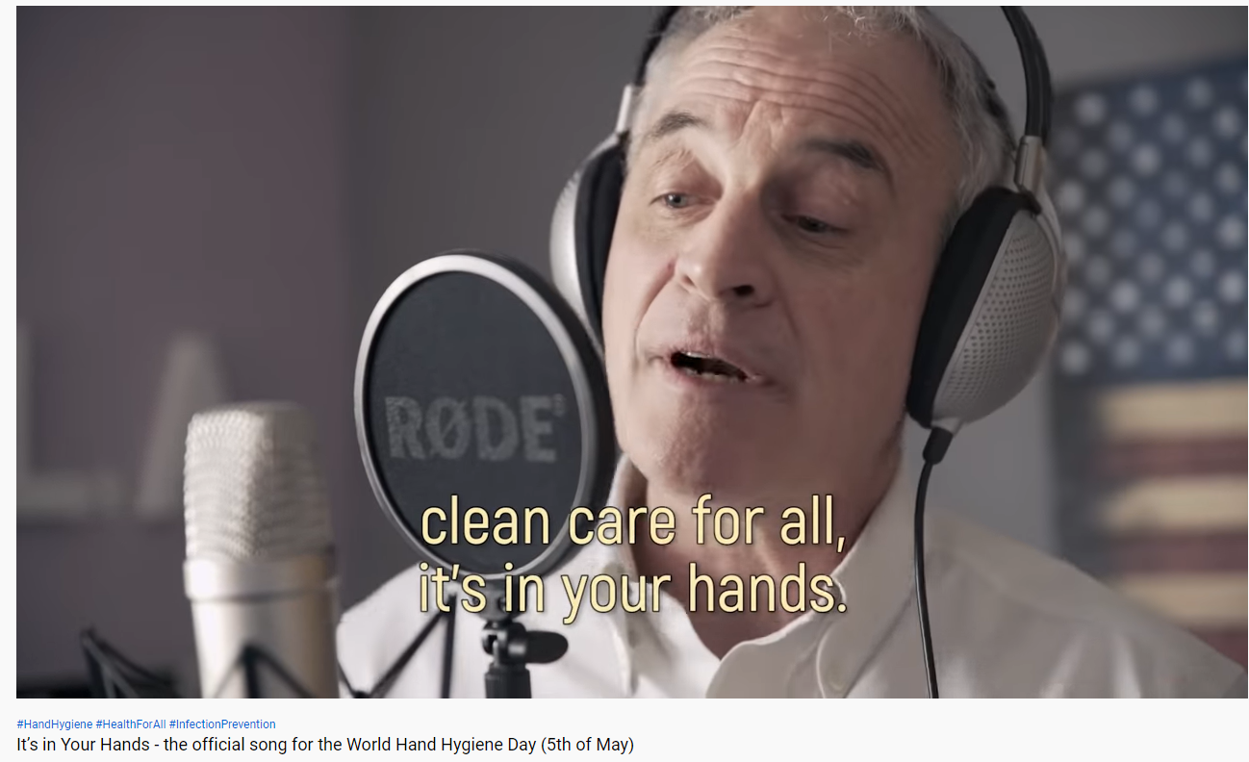
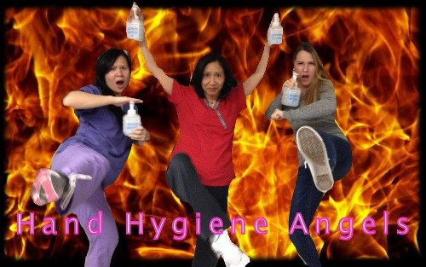
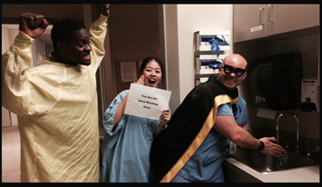
How humor can be used in IPC?
Contests (poster, photo, song, video,..)
Contests for IPC activities motivate front line staff to show their enthusiasm, creativity, and team spirit
Canadian “Clean Shots” photo contest
https://hospitalnews.com/infection-control-educate-motivate/
Notes:
https://hospitalnews.com/infection-control-educate-motivate/

Slide 45
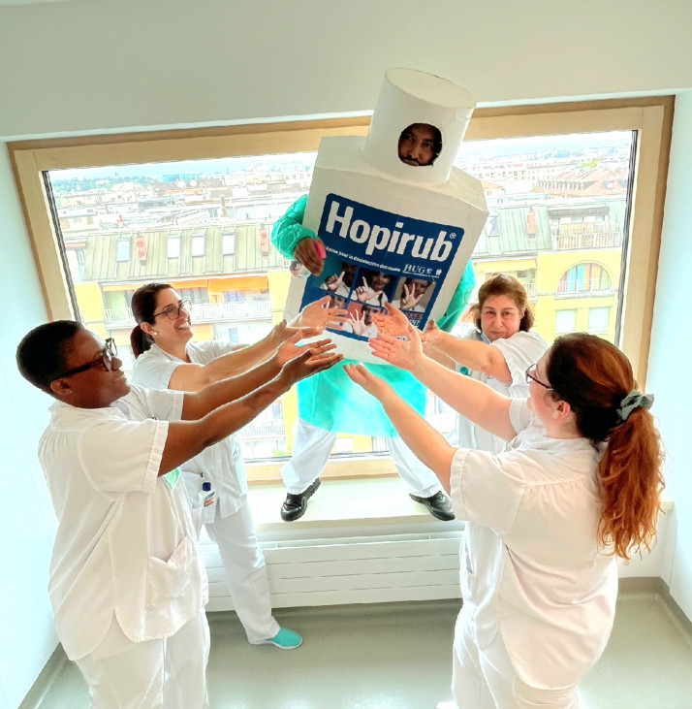
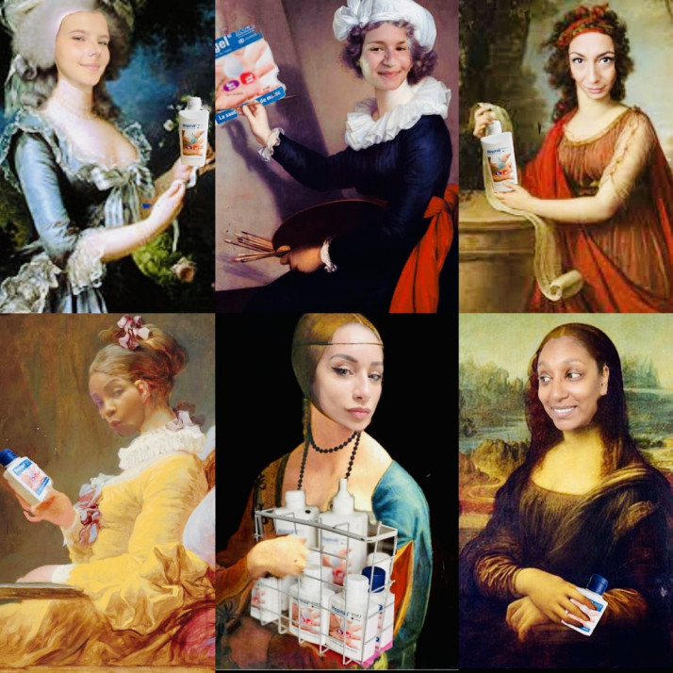
Photo Contest, 5 May 2022, Geneva Hospitals

Slide 46
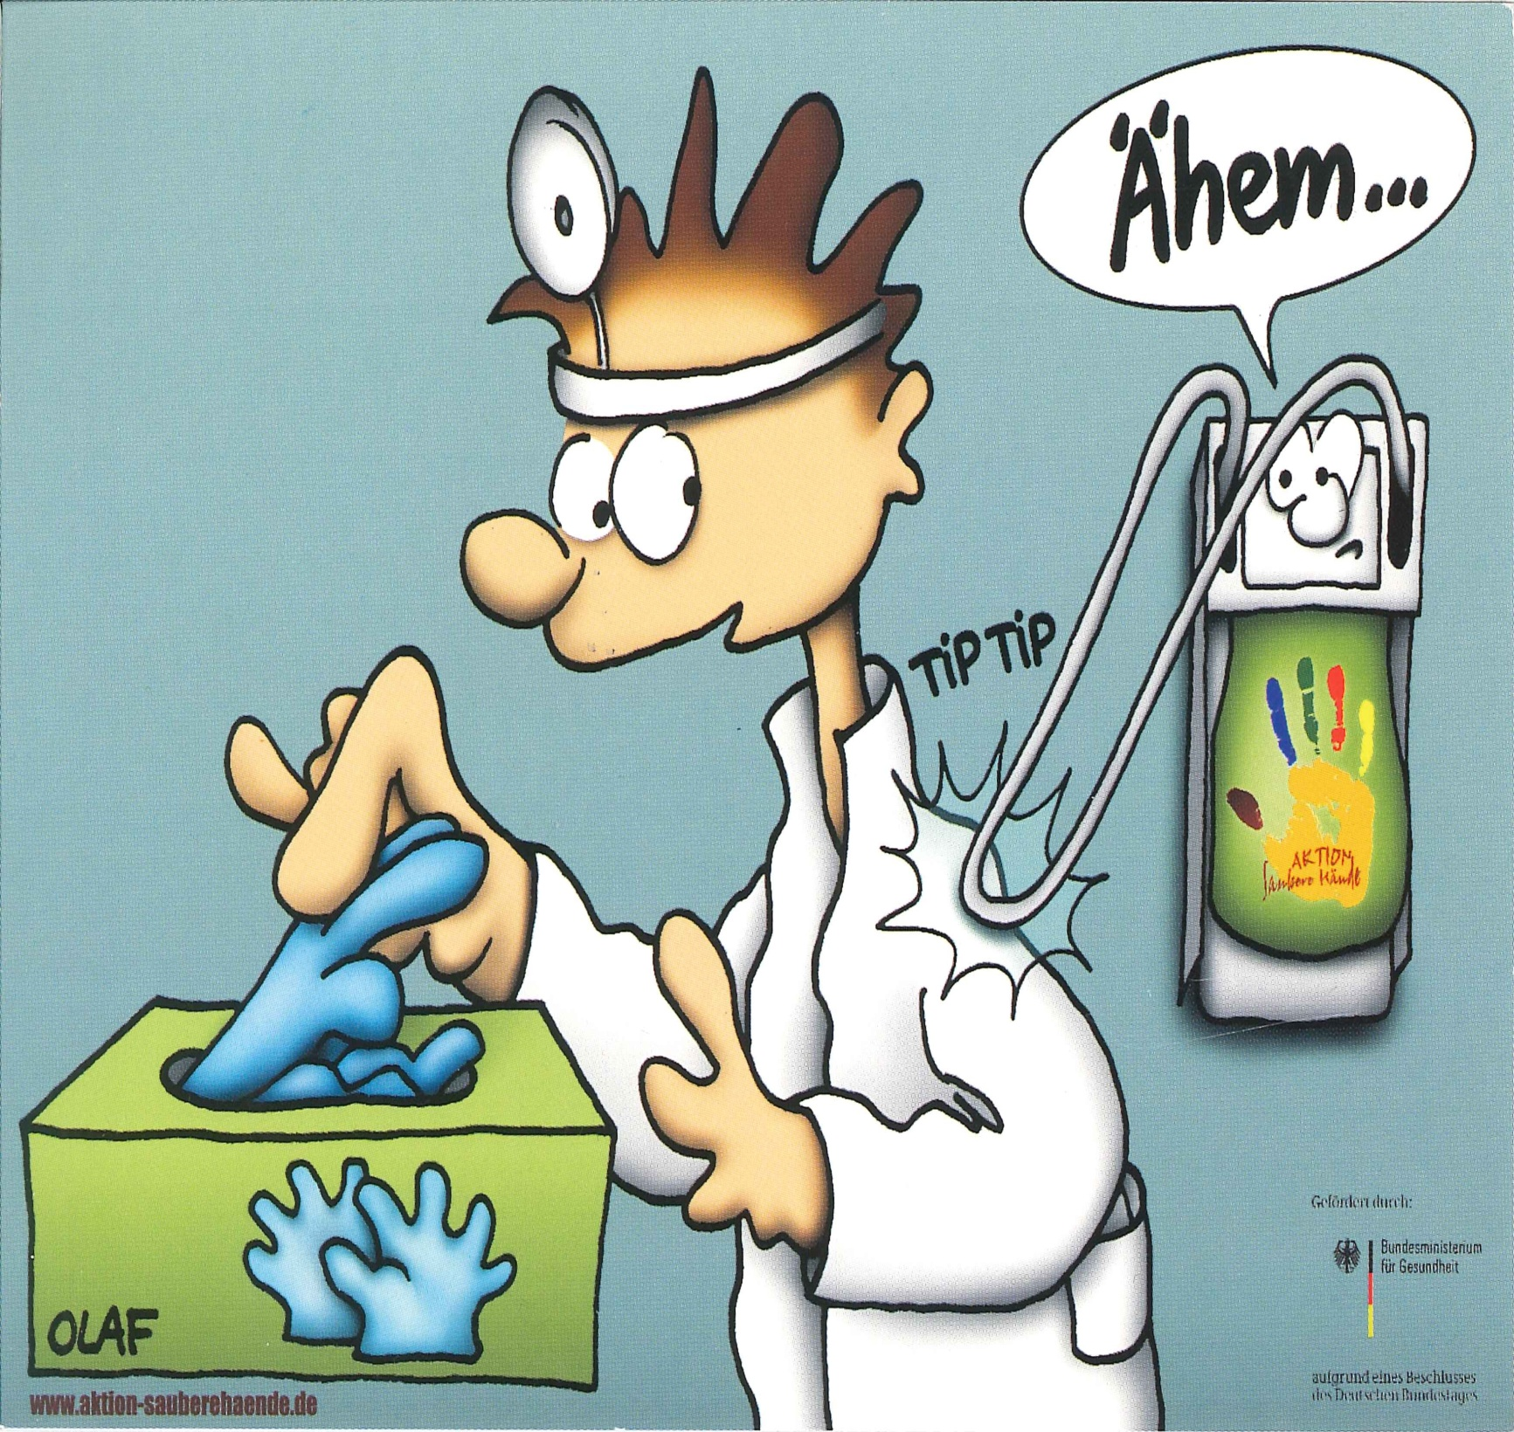
Germany

Slide 47
Plan
- Humor in hand hygiene (early 1990’s)
Effects of humor in advertising
Humor in health care
How to use humor in infection prevention (IPC) ?
Humor in scientific publications
Humor in media
Humor in the community

Slide 48
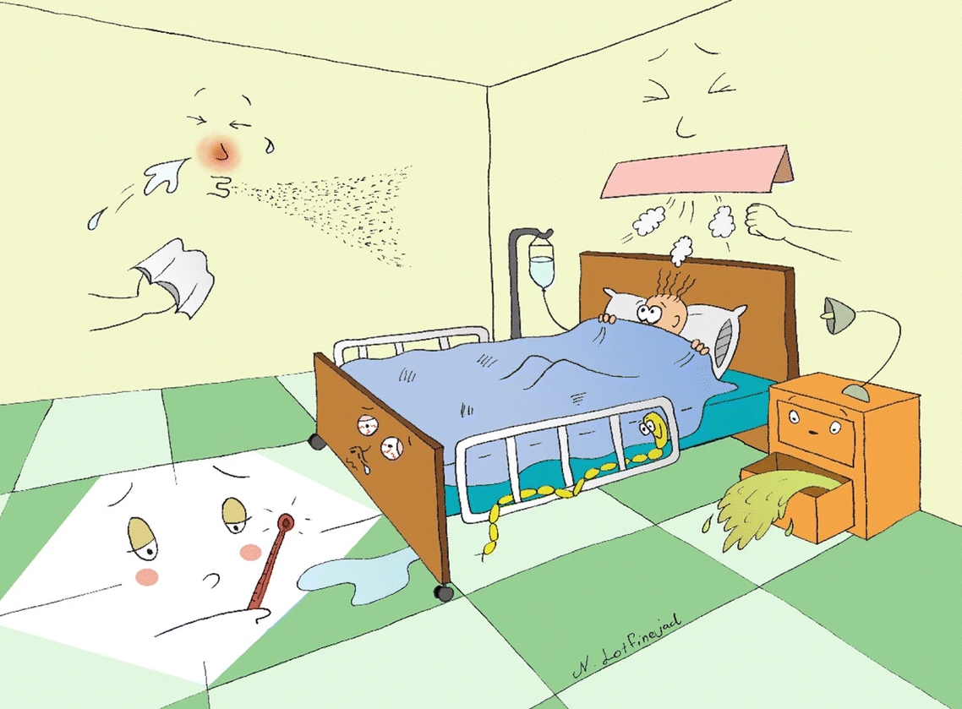
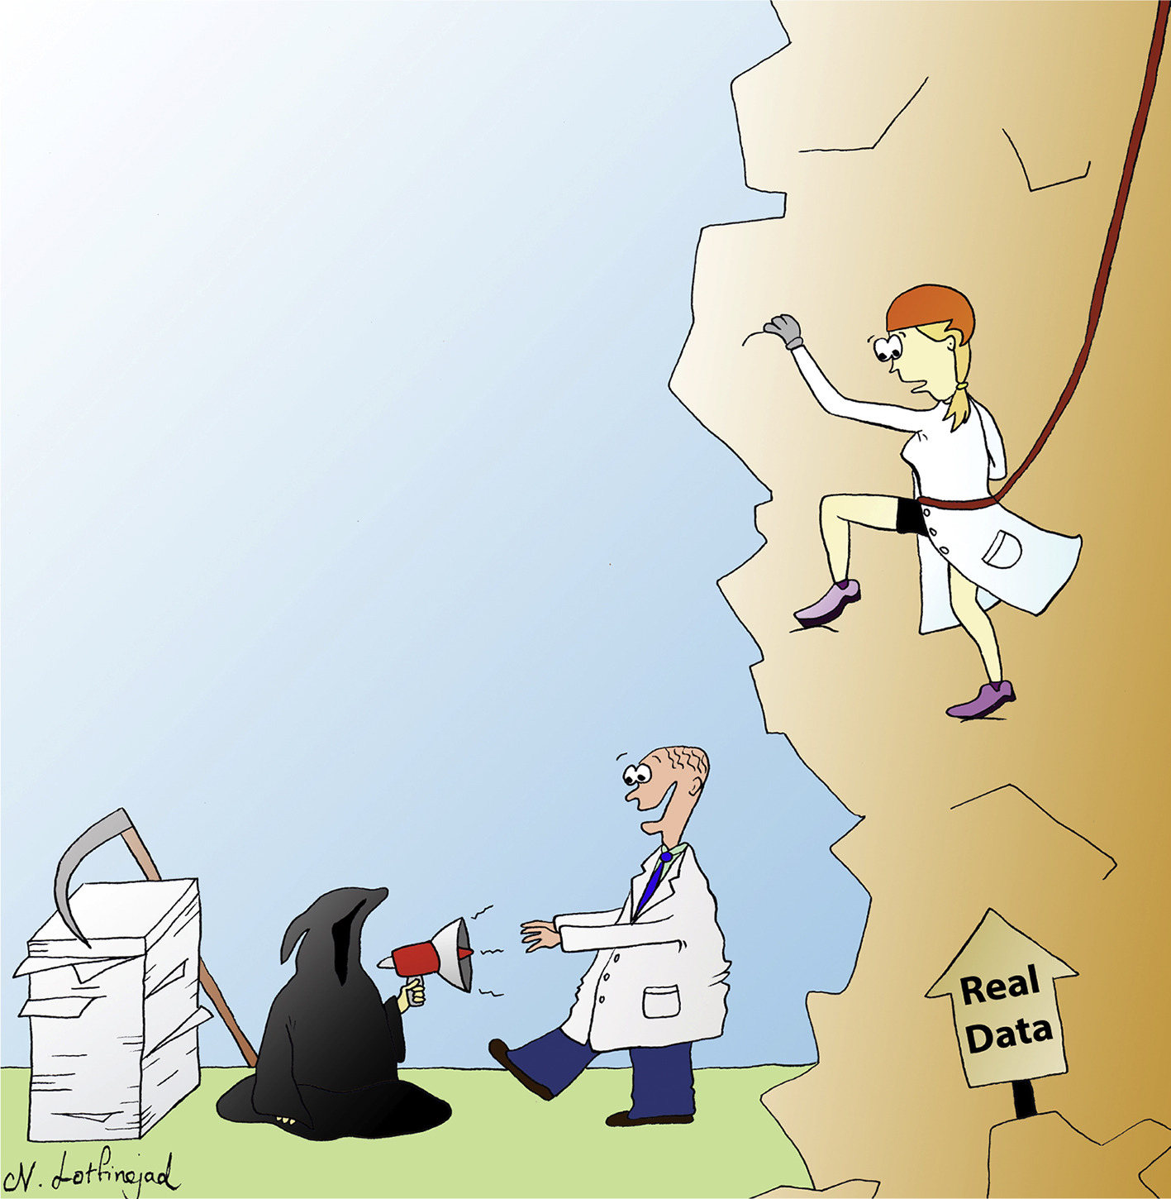
Humour in scientific publications
Keeping hospitals clean is a crucial patient safety issue
Bad science impacts public health
Peters et al., Antimicrob Resist Infect Control 7, 132 (2018)
Peters, A. et al. Journal of Hospital Infection, Volume 100, Issue 4, 365 - 370

Slide 49
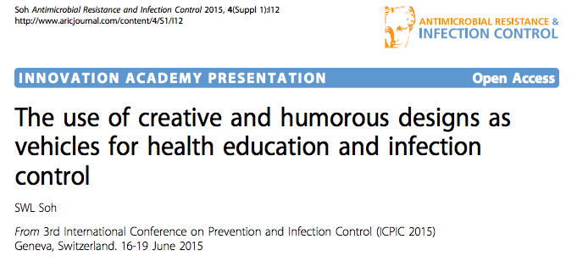
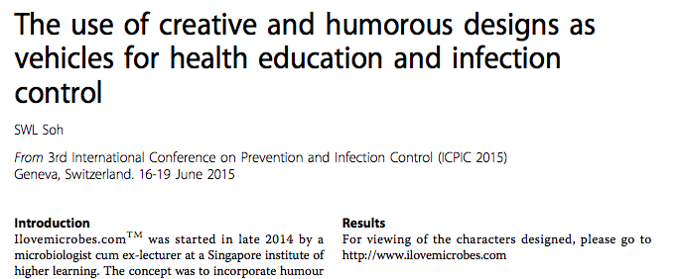

Slide 50
Plan
- Humor in hand hygiene (early 1990’s)
Effects of humor in advertising
Humor in health care
How to use humor in infection prevention (IPC) ?
Humor in scientific publications
Humor in media
Humor in the community

Slide 51
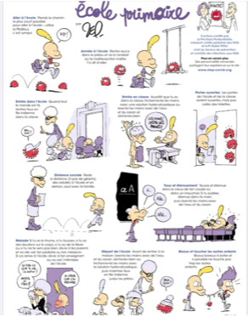
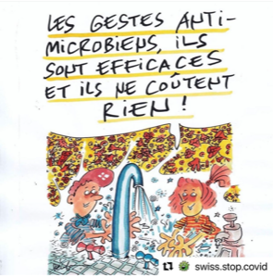

Humor in media
‘Standard precautions are efficacious and cost-effective’
www.Swiss.Stop.Covid

Slide 52


Humor in media
About Covid certificate:
« For sure,
the copy of a Didier Pittet »

Slide 53

SARS , 2002

Slide 54
Plan
- Humor in hand hygiene (early 1990’s)
Effects of humor in advertising
Humor in health care
How to use humor in infection prevention (IPC) ?
Humor in scientific publications
Humor in media
Humor in the community

Slide 55

Humor (?) in the community
SARS , 2002
SARS « time »

Slide 56

First case of H1N1-2009 in Paris area
Humor
in the community
H1N1 , 2009

Slide 57
First case of H1N1-2009 in Paris area

Slide 58
Conclusions
In advertising, it is demonstrated that:
Notes:
Although Effect of humor in advertising varies according to the generations and development level of the country, it is in the top 3 theme that resonate most
https://www.nielsen.com/wp-content/uploads/sites/3/2019/04/global-trust-in-advertising-report-sept-2015-1.pdf

Slide 59
Conclusions
In advertising, it is demonstrated that:
Humor is an effective method to attract attention
Notes:
Although Effect of humor in advertising varies according to the generations and development level of the country, it is in the top 3 theme that resonate most
https://www.nielsen.com/wp-content/uploads/sites/3/2019/04/global-trust-in-advertising-report-sept-2015-1.pdf

Slide 60
Conclusions
In advertising, it is demonstrated that:
Humor is an effective method to attract attention
Using humorous and positive messages encourage/promote behaviour change and knowledge acquisition
Notes:
Although Effect of humor in advertising varies according to the generations and development level of the country, it is in the top 3 theme that resonate most
https://www.nielsen.com/wp-content/uploads/sites/3/2019/04/global-trust-in-advertising-report-sept-2015-1.pdf

Slide 61
Conclusions
In advertising, it is demonstrated that:
Humor is an effective method to attract attention
Using humorous and positive messages encourage/promote behaviour change and knowledge acquisition
Humor strength and humor–message relatedness have a positive impact on memorizing the message
Notes:
Although Effect of humor in advertising varies according to the generations and development level of the country, it is in the top 3 theme that resonate most
https://www.nielsen.com/wp-content/uploads/sites/3/2019/04/global-trust-in-advertising-report-sept-2015-1.pdf

Slide 62
Conclusions
In advertising, it is demonstrated that:
Humor is an effective method to attract attention
Using humorous and positive messages encourage/promote behaviour change and knowledge acquisition
Humor strength and humor–message relatedness have a positive impact on memorizing the message
The impact of humor on compliance with optimal IPC practices deserves more research
Notes:
Although Effect of humor in advertising varies according to the generations and development level of the country, it is in the top 3 theme that resonate most
https://www.nielsen.com/wp-content/uploads/sites/3/2019/04/global-trust-in-advertising-report-sept-2015-1.pdf

Slide 63
Conclusions
In advertising, it is demonstrated that:
Humor is an effective method to attract attention
Using humorous and positive messages encourage/promote behaviour change and knowledge acquisition
Humor strength and humor–message relatedness have a positive impact on memorizing the message
The impact of humor on compliance with optimal IPC practices deserves more research
However, humor can be used as a powerful tool
for delivering key infection control messages
in a memorable and engaging way
and engaging way
Notes:
Although Effect of humor in advertising varies according to the generations and development level of the country, it is in the top 3 theme that resonate most
https://www.nielsen.com/wp-content/uploads/sites/3/2019/04/global-trust-in-advertising-report-sept-2015-1.pdf

Slide 64

Notes:
The saying “laughter is the best medicine” is believed to have originated — albeit now in a snappier form —from Proverbs 17.22 of the King James Bible.

Slide 65



2023
Save the Date:
7th ICPIC, 12-15 Sept 2023,
Geneva, Switzerland
Semmelweis at ICPIC
www.icpic.com

Slide 66










Follow and like
@didierpittet
@Clean_Hands
@Clean_Hospitals
www.who.int/gpsc/5may
www.CleanHandsSavesLives.org
#HandHygiene
#CleanHospitals
#CleanHands

Slide 67
Thank you for your attention!
Notes:
The saying “laughter is the best medicine” is believed to have originated — albeit now in a snappier form —from Proverbs 17.22 of the King James Bible.

