Slide 1




Using Infection Prevention Resources Wisely – Examples From Ebola
Broadcast live from IPAC Canada 2015 Conference
Prof Shaheen Mehtar
Chair ICAN
UIPC, SUN, Cape Town S Africa
www.webbertraining.com
June 16, 2015

Slide 2
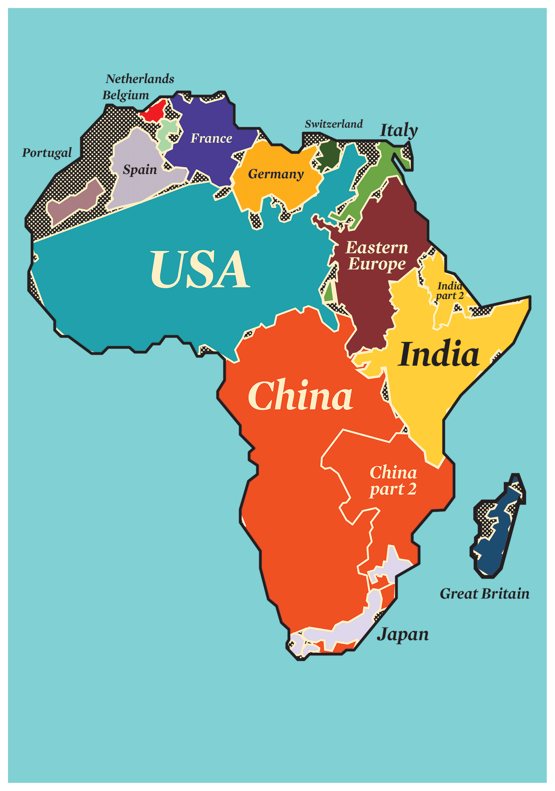
The True Size of Africa
It is a large continent
The land mass covers most of the other continents except
  Canada
  South America
  Australia
Unlike the above, the population, tradition and culture is diverse and heterogenous

Slide 3
Impact of poorly used resources
Increase in mortality can be up to 15 times higher due to
Lack of infrastructure- water, electricity
Lack of administrative controls- no policies
Lack of knowledge- surrounded by myth and superstition- no evidence
Impact of HCW fear on patient care during EVD outbreak
  Same gloves between patients
  No drips put up on EVD cases
  Deliveries not assisted- 100% mortality for mother and child
Lack of preparedness!

Slide 4
Health profile of EVD affected countries
2012 | Guinea | Liberia | Nigeria | Sierra Leone
Total population (millions) | 11.45 | 4.19 | 169 | 6
< 5y mort / 1 000 live births | 101 | 75 | 124 | 182
Mort 15 & 60 yr m/f (/1000 pop) | 306/277 71% (ID) | 282/246 | 371/346 | 444/426
Total expenditure on health per capita ($) % of GDP | 67 (6.3) | 102 (15.5) | 161 (6.1) | 205 (15.1)
Doctors /10 000 pop (regional average 4.6) | 0.03 | 0.1 | 4.1 | 0.2
Nurses- /10 000 pop (regional average 12.6) | 0.04 | 2.7 | 16.1 | 1.7

Slide 5
Ebola outbreak- 2013
Medical teams, epidemiologists, veternary teams work in Africa
Several NGOs work in Africa
Most teams work in silos and communication with each other
Why is it important to communicate with each other?

Slide 6
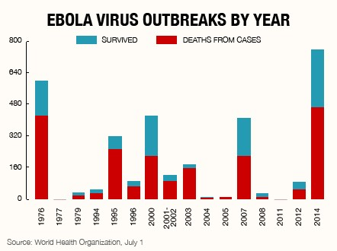
WHO- epidemic curve

Slide 7
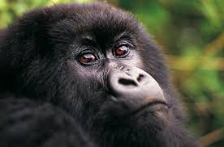
What happened in 2013?
In 2012 and 2013 there was an outbreak of Ebola amongst the great apes in the DRC and surrounding areas which largely went unnoticed by the medical faternity ( over 5000 apes died)
That was the epicentre of the current outbreak

Slide 8
Ebola subspecies in humans and Non human primate outbreaks
Year | Country | Ebola sp | Cases | Deaths | Case fatality | NH primates | Subspecies | country
2008 | DRC | Zaire | 32 | 14 | 44% | No published report
2007 | DRC | Zaire | 264 | 187 | 71% | No published report
2005 | DRC | Zaire | 12 | 10 | 83% | Gorillas | Zaire | Congo
2003 (Nov-Dec) | DRC | Zaire | 35 | 29 | 83% | Gorillas | Zaire | Congo
2003 (Jan-Apr) | DRC | Zaire | 143 | 128 | 90% | Gorillas | Zaire | Congo
2001-2002 | DRC | Zaire | 59 | 44 | 75% | Gorillas | Zaire | Gabon
2001-2002 | Gabon | Zaire | 65 | 53 | 82% | Gorillas | Zaire | Gabon
1996 (Jul-Dec) | Gabon | Zaire | 60 | 45 | 75% | Chimpanzees | Zaire | Gabon
1996 (Jan-Apr) | Gabon | Zaire | 31 | 21 | 68% | Chimpanzees | Zaire | Gabon
1995 | DRC | Zaire | 315 | 254 | 81% | No published report
1994 | Gabon | Zaire | 52 | 31 | 60% | No published report
1977 | DRC | Zaire | 1 | 1 | 100% | No published report
1976 | DRC | Zaire | 318 | 280 | 88% | No published report

Slide 9
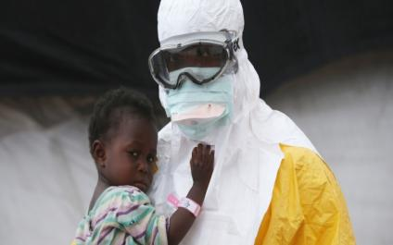
The EVD spread to humans
On 13 Dec 2013, a 2 year old child was diagnosed with Ebola in Guinea - the first human case in the current outbreak.
Why a toddler?
Not investigated further
From Guinea, it spread to Liberia and Sierra Leone

Slide 10
Bats and humans
Bats found to be carriers of Ebola
The eat high hanging fruit in the forest
Children and non human primates eat these fruit (foraging in the forest)
Young adults hunt bats, small animals and non human primates for food
“Bush meat” also consists of carcasses of dead animals.

Slide 11
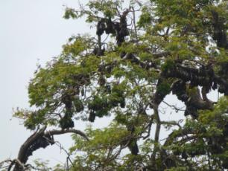
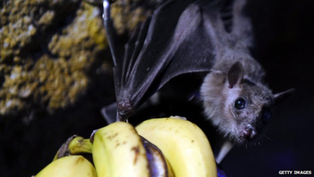
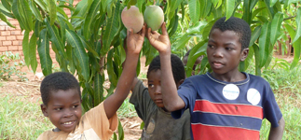
Bats and human- toddlers

Slide 12
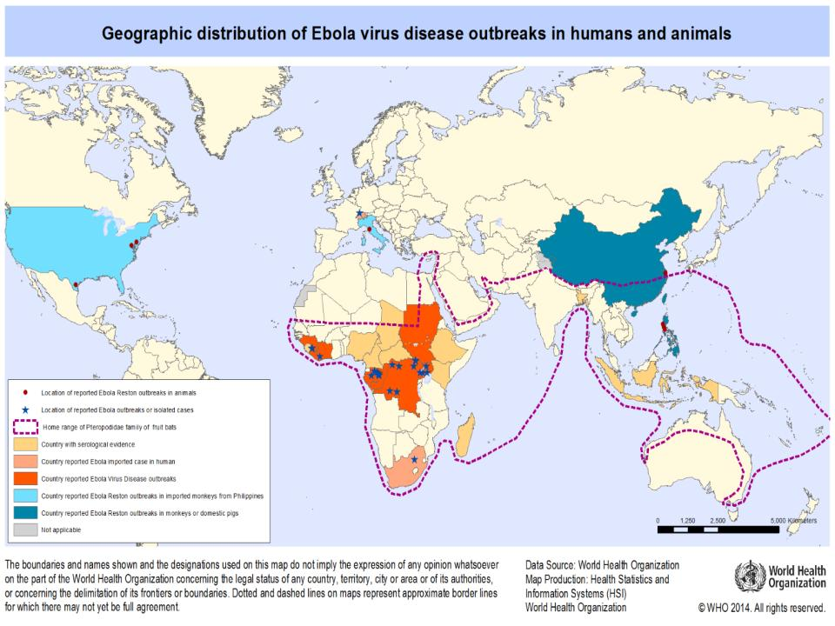
Areas vulnerable to EVD from bat migration

Slide 13
Why was the spread amplified?
Deforestation in Liberia and parts of Guinea
The non human and human primate populations moved closer together
Foraging for food in the same area
Humans encroaching on ape territory and their resources.
Climate change increased bat migration and roosting to residential areas (DRC & Guinea)

Slide 14
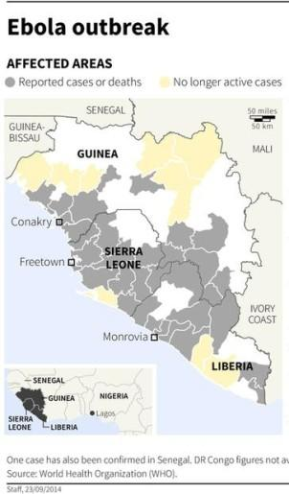
In Africa from Dec 2013
DRC- separate outbreak

Slide 15
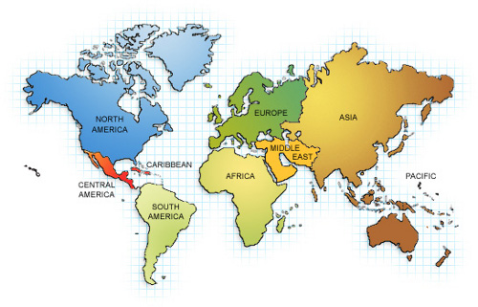
30 Sept, first case outside Africa!

Slide 16
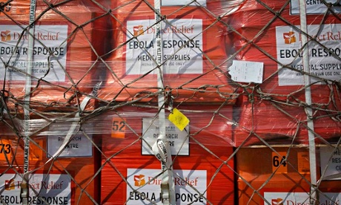
And funding started coming!
NOW IS A POLITICAL ISSUE
American lives are at stake!
  Money- coming in!
  Deployment of troops
  Healthcare workers
  Mobile laboratories
  Mobilizing global resources
Contain Ebola in West Africa to stop it spreading to USA & Europe!!
Need 5000 more HCWs!

Slide 17
International Support since April 2014
Not very clearly documented
  Chinese CDC = 7500 HCW- laboratories, IPC
  Cuba = 600 approximately
  African HCW= 8000 sent by AU
  UK = 750 HCW, laboratory staff, plus research team
  USA via CDC= 1000 trainers, mentors, and researchers
  NGOs= 2000

Slide 18
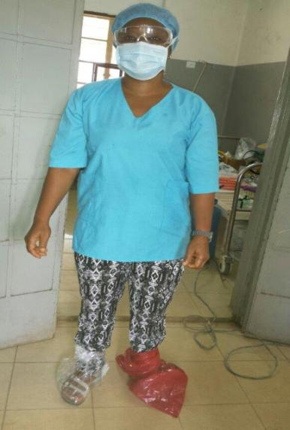
Use what ever is available!
Healthcare workers in the field since May 2014
Support arrived after late August when the first US citizen contracted Ebola!
Working with limited resources

Slide 19
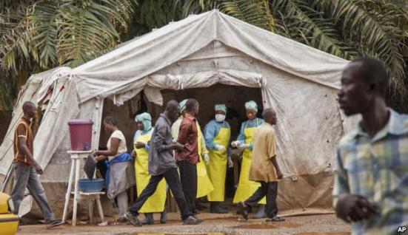
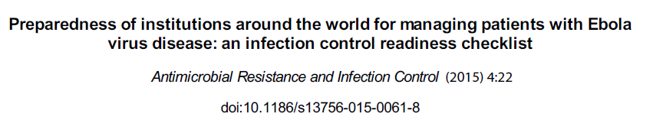
Ebola Preparedness
Survey conducted between October to Dec 2014
Number of replies ............. 192
Number of countries ......... 45

Slide 20
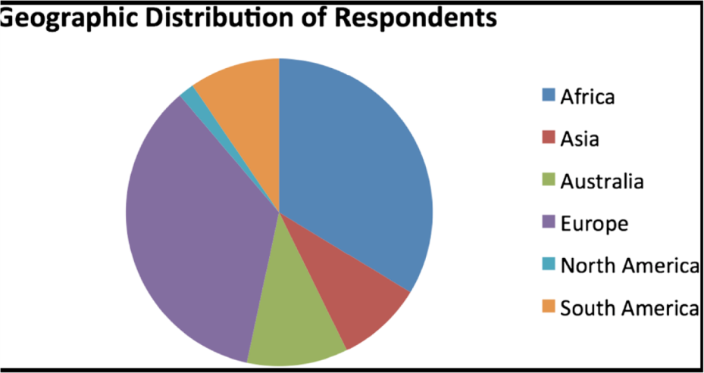
Participating countries

Slide 21
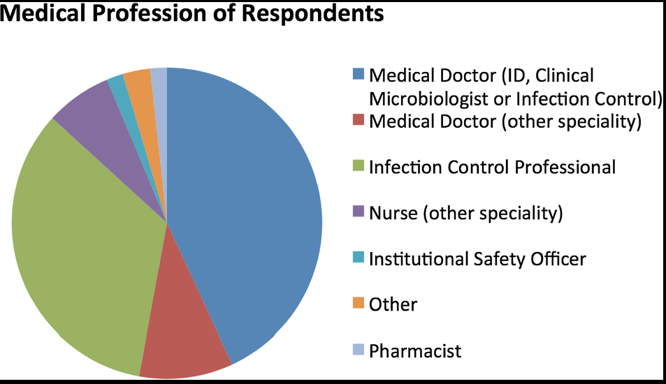
Participating healthcare professionals

Slide 22
General Administration
Administration | EVD receiving |  | Non EVD receiving
 | Yes | % | Yes | %
IPC represented on Hosp Team EVD | 57 | 69.5 | 46 | 69.3
Alert system in place | 61 | 73.5 | 51 | 70.8
Frontline staff aware of surveillance | 56 | 68.3 | 43 | 60
IPC policy in place | 57 | 70.4 | 48 | 66.7
Monitoring of clusters of infection | 27 | 33.3 | 19 | 26.8
Alert systems in place but monitoring for clusters of infection inadequate
Notes:
9

Slide 23
Communication
Communication | EVD receiving |  | Non EVD receiving
Information disseminated widely to all HCW | 45 | 59.2 | 33 | 46.5
Teaching material available | 29 | 38.2 | 28 | 39.4
Public messaging systems in place | 28 | 36.8 | 9 | 12.7
Draft press release ready | 19 | 25.3 | 10 | 14
Internal communication in place | 42 | 55.3 | 37 | 52
Information available but poorly disseminated and inadequate teaching material circulated

Slide 24
Supplies
Supplies and monitoring | EVD receiving |  | Non EVD receiving
 | Yes | % | Yes | %
Adequate amount of PPE available | 55 | 80.9 | 42 | 68.9
Adequate stocks of essential drugs & PPE | 36 | 52.2 | 22 | 36.7
Checking systems for supplies in place | 37 | 53.6 | 33 | 54.1
Reasonable supplies but monitoring stores and supply chain needed improvement- responsibility for ordering!!

Slide 25
Education
Item | EVD receiving |  | Non EVD receiving
 | Yes | % | Yes | %
Evidence of training in SP & TBP | 52 | 71.2 | 37 | 56.1
Training teams to train others | 46 | 63 | 35 | 53
Audit of training teams independently | 24 | 33.8 | 16 | 25
Training given but audit of the competency of the training teams not audited

Slide 26
Facilities to deal with EVD
Item | EVD receiving | Non EVD receiving
 | N | % | N | %
Designated team for high risk clinical care | 27 | 38.6 | 11 | 17.7
Completed fit testing for N95 respirator | 21 | 30 | 11 | 17.7
Ventilation – negative pressure | 38 | 56.7 | 20 | 34.5
Surgical masks are available and used | 53 | 80.3 | 36.6 | 67
N95 respirators | 37 | 55.2 | 24 | 41.3
PAPR | 25 | 37.9 | 9 | 15.5
Contributing to mixed messages- indicating airborne rather than droplet transmission based precautions

Slide 27
IPC practices in place- good!
Item | EVD receiving |  | Non EVD receiving
 | Yes | % | Yes | %
IPC to produce evidence based GL | 43 | 65.2 | 40 | 68.9
Isolation area for clinical evaluation | 46 | 68.7 | 40 | 68.9
Safe movement of patients | 47 | 70.1 | 32 | 56.1
Isolation facilities for patients | 50 | 74.6 | 34 | 58.6
Environmental cleaning & disinfection | 33 | 48.5 | 17 | 29.3
HCW management satisfactory | 51 | 75 | 37 | 63.8
Trained cleaning staff | 33 | 48.5 | 24 | 42
Safe disposal of human waste | 44 | 65.7 | 27 | 47.4

Slide 28
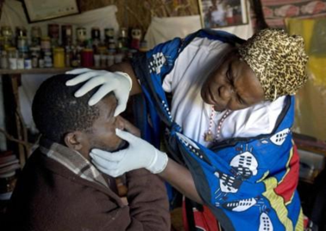
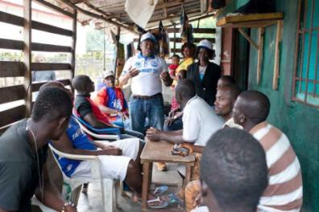
Community involvement
TALK TO THE TRADITIONAL LEADERS FIRST!
Pivotal for containing outbreaks
There is
  Fear
  Stigma
  Concern around witchcraft
  Insecurity and suspicion
If the traditional heads of tribes or communities are aware of the risks, they can become great allies!
It enhances their power and presence in the community

Slide 29
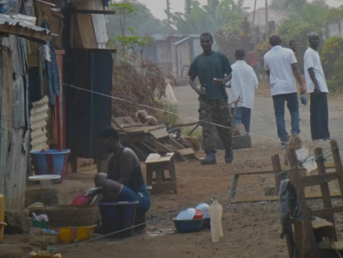
Transmission- household
EVD cases become more infectious as they move from the “dry” to the “wet” stage of the disease.
Direct contact within families
  Only those who were looking after a confirmed case of EVD actually developed EVD
  Possibly due to lack of hand hygiene and contact with body fluids and excrement
Houses are quarantined for 21 days but some escaped

Slide 30
Transmission within social circles
Transmission has occurred when EVD survivors returned home and, despite warning, had unprotected sex- protection required for 3 months- 5 households; 14 cases
Transmission also occurred from female EVD survivors- 1 household, 4 cases
One child infected from a wet nurse (anecdotal)
Infections from several infected traditional healer- 137 cases in SL alone! Still continues today!

Slide 31
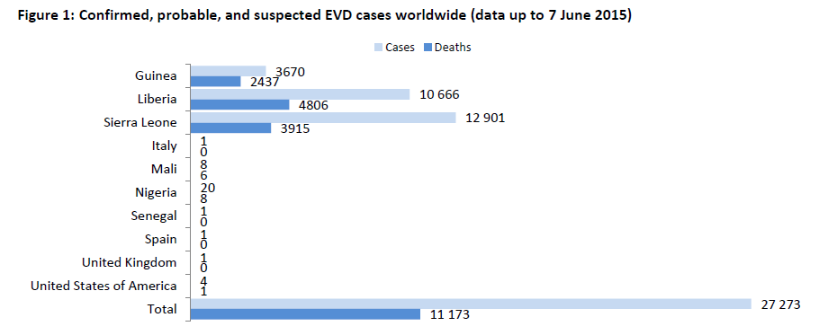
WHO Weekly Rep, 10th June ’15
http://apps.who.int/iris/bitstream/10665/174709/1/roadmapsitrep
66.5%
45%
30%
41 %

Slide 32
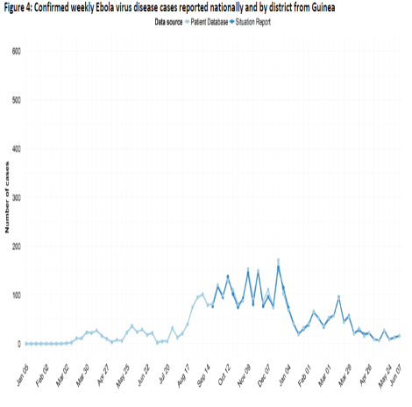
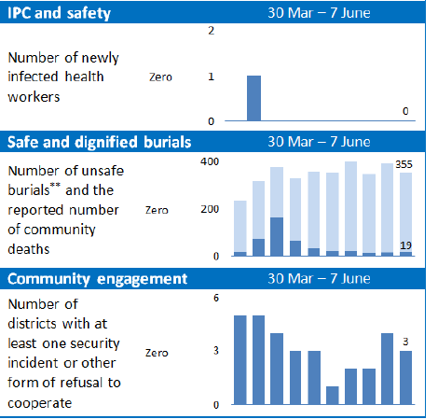
Guinea- 10th June ‘15

Slide 33
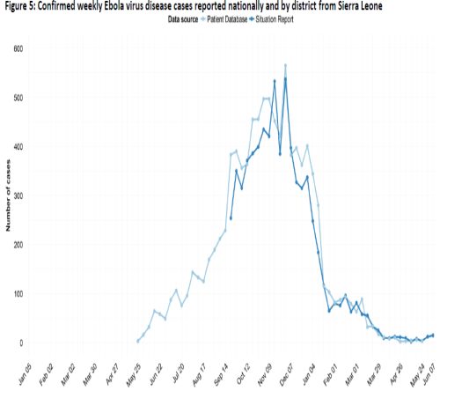
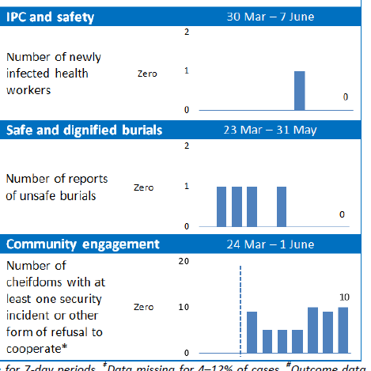
Current-Sierra Leone 10th June ‘15

Slide 34
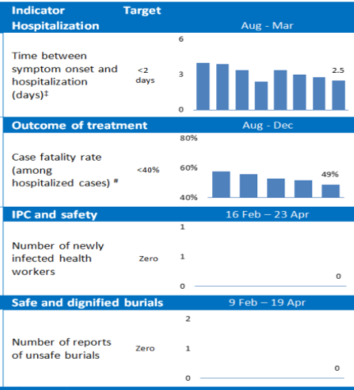
Current -Liberia 29th April ‘15
LIBERIA IS DECLARED EBOLA FREE!

Slide 35
Transmission: Clinical areas
Not in Ebola Treatment Centres but in general clinical areas- not aware of EVD
Poor IPC
  Lack of equipment and PPE
  Lack of segregation
  Poor healthcare waste management
Most HCW working in Ebola Treatment Centres so routine HCF closed down.
Few untrained staff left behind to look after non EVD emergencies

Slide 36
EVD exposure risk in HCW
Contact areas in the workplace | Number | %
Total number interviewed | 279
In patient room | 233 | 84
Feeding & talking | 145 | 52
Examining patient | 43 | 15
Lab handling blood | 17 | 6
Taking blood | 31 | 13
Washed patient | 10 | 4
Washed patient clothes | 7 | 3
Washed cadaver | 20 | 7
Contact at home & HCF | 30
Contact at home only | 3
JID 1999;179 (Suppl 1) Ebola Serologic Survey of Health Workers

Slide 37
HCW contact with EVD
Category | Number | %age
Attack rate | 37/ 429 | 9%
Physicians | 4/13 | 31%
Nurses | 22/212 | 10%
Technicians | 7/62 | 11%
Others | 4/111 | 4%
Type of contact | Number | %age
Direct | 204 | 73%
Indirect | 3 | 33%
Unlikely | 63 | 64%
Unknown | 9 | 56%

Slide 38
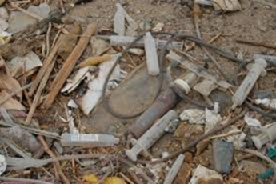
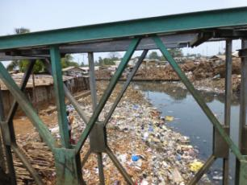
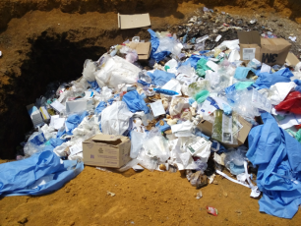
Poorly managed HC Waste
Pit burning, dumping and too much PPE to handle!!
30/kg/bed/ day is generated by an EVD case

Slide 39
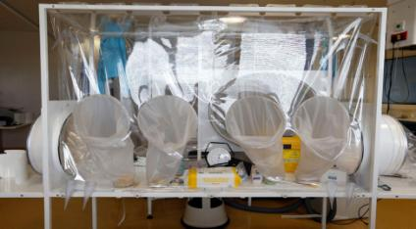
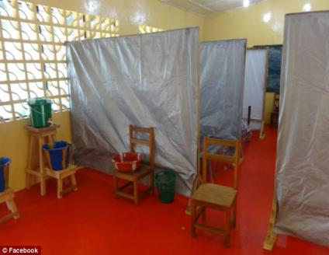
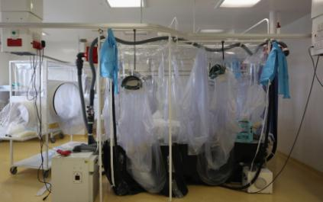
Difference in isolation facilities- 2014
Isolator used to treat VHF at the RFH
Rudimentary: Plastic buckets for disinfectant or even possibly vomit from patients stand in front of simple partitions put up to make cubicles for the ever-increasing number of patients

Slide 40
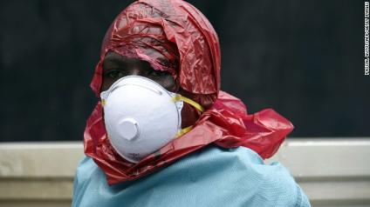
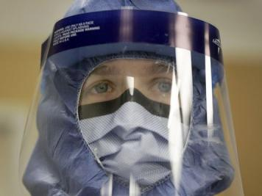
Differences in PPE –both effective?
First, protect yourself.

Slide 41
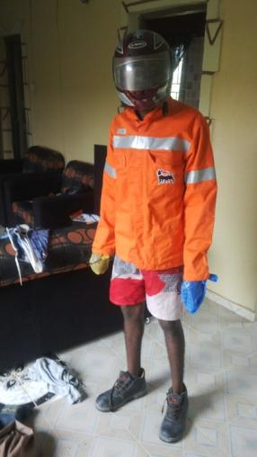
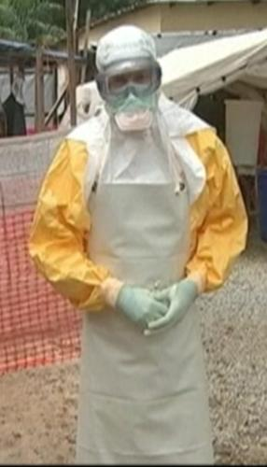
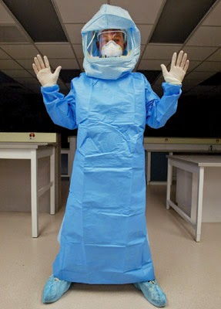
Dressing up for Ebola

Slide 42
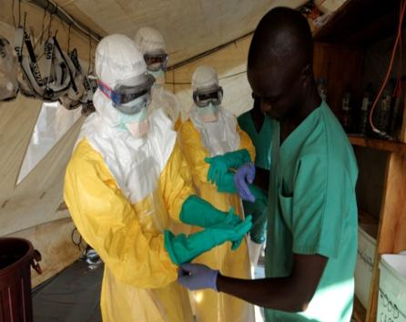
Confusion about taking off PPE
“First-on-last off” principle ?
Do the outer gloves come off first? (CDC)
Does the apron come off first? (WHO)
Evidence for exposure occurs while removing PPE?

Slide 43
Has the training been effective?
Now extensive training, mentorship programmes and support in the field has been provided
173 healthcare workers trained in IPC
Fewer cases of transmission amongst the national HCW
Only cases occurred in international groups
NGO mentors found to be less knowledgeable than the nationals
Many African HCW have been dealing with VHF in Africa for years- and have survived

Slide 44
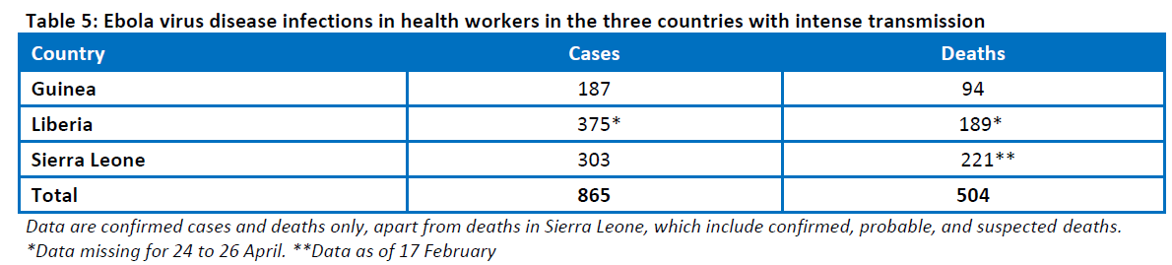
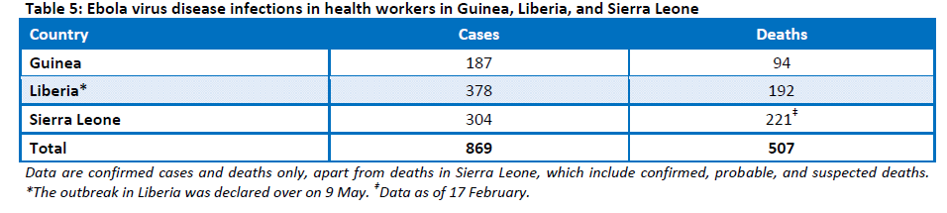
WHO report on HCW infection
26th April, ‘15
10th June ‘15

Slide 45
Structures SL- UIPC at national level
A national IPC coordinator appointed
An IPC training coordinator appointed
National offices being set up
Massive IPC training programmes funded by the WHO & CDC and delivered by ICAN
Getting there– slowly!

Slide 46
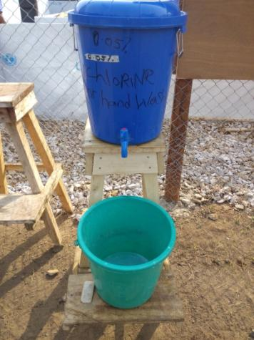
Hand washing stations everywhere!
Hand hygiene stations with 0.05% chlorine where everyone has to rub ones hands and allow to air dry
Many HCW have had skin reactions

Slide 47
The indiscriminate use of chlorine!

Slide 48
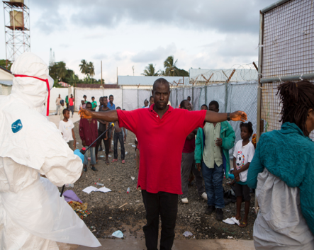
Fears and Healthcare
Many people will not go to ordinary HCF because of fear of exposure to EVD but mainly to chlorine.
Several people died because of a lack of healthcare
Not much staff available outside ETUs
No protection for the person being sprayed

Slide 49
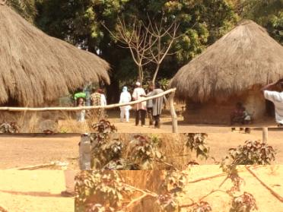
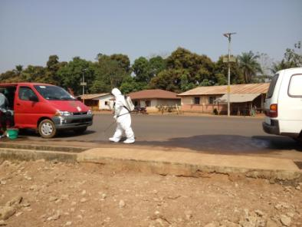
Community triage
When a case is identified in the community
A team of investigators and sprayers are dispatched
The household is interrogated and the suspected case or cases are taken to the nearest ETU

Slide 50
About chlorine
Highly toxic and dangerous!
Usually accidental exposure
  Train derailment
  Wrong dilutions of concentrated chlorine powder or liquid
WHO proposes ambient level of chlorine is
  0.034 ppm (0.1mg/m⁻³ to protect the general population from sensory irritation and significant reduction in ventilatory capacity.
Fatality- 400 ppm in 30 min and 1000 ppm in few minutes.
Spraying has been in higher concentrations than the recommended dose

Slide 51
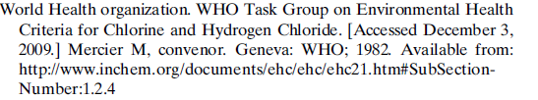
Workplace exposure
Workplace exposure limits include
Short-term exposure of up to 15 min not to exceed 1 ppm (2.9 mg/⁻³ )
Long term exposure not to exceed 0.5 ppm (1.5 mg/⁻³ )

Slide 52
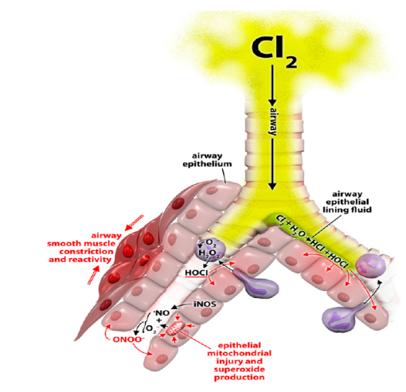

Injury to the respiratory tract
Converts from chlorine to hydrochloric acid and other toxic substances which destroy the lining of the respiratory tract and cause wheezing!

Slide 53
Chlorine effect on Eyes
10 volunteers’ eyes were irrigated with
  250 mL (50 seconds) of physiological salt solution (PSS), pH 6.4
  distilled water (DW), pH 6.8
  tap water, pH 6.8
  or PSS with chlorine (0.5 mg/L) pH 6.4.
Vital staining, fluorophotometric assessment, and confocal microscopy were performed before and after irrigation with each fluid
Chlorine showed corneal irritation, ulceration and increase uptake of fluorescein

Slide 54
Chlorine study- SL preliminary data
S Mehtar, A Bulabula- SUN
H Nyandemoh, S Jambawai- SL

Slide 55
Methodology
Data on chlorine exposure collected retrospectively between March – May 2015
HCW and Ebola survivors were interviewed using a questionnaire
The number of exposure to chlorine spraying
Adverse effects of chlorine recorded
  Eyes
  Respiratory
  Skin

Slide 56
HCW exposure to Chlorine
Item | N = 400 | % | 95 % CI
Males | 213 | 53 | 48.2 - 58.2
19-35 y of age | 301 | 75 | 70.7 - 79.3
Working in ETU 4-6 months | 278 | 69.5 | 64.7 - 73.9
Hygienist | 188 | 47 | 42.0 – 52.0
Nurses | 184 | 46 | 41.1 – 51.0
Dr | 5 | 1.3 | 0.5 - 3.1
Chlorine Exposure | 391 | 97.8 | 95.6 - 98.9
Wearing eye protection | 325 | 81.5 | 77.2 - 85.1
Wearing skin protection | 358 | 89.7 | 86.3 - 92.5

Slide 57
Exposure to chlorine amongst HCW
Item n=400 | n | % | 95% CI
Previous eye problems | 39 | 9.8 | 7.1- 13.2
Eye problems after exposure to chlorine | 179 | 44.8 | 39.8- 49.8
Overall eye problems | 192 | 48.0 | 43- 53
Overall respiratory symptoms | 253 | 63.3 | 58.3-67.9
Skin irritation | 152 | 38.0 | 33.3- 43

Slide 58
Multiple chlorine exposure
Condition | Multiple Chlorine Exposure | Single Chlorine Exposure | P value | OR (95% CI)
Eye | 56.8% (109/192) | 43.2% (83/192) | <0.001 | 3.3 (2.18 – 5.02)
Chest | 51.8% (131/253) | 48.2% (122/253) | <0.001 | 3.2 (2.04 – 4.99)
Skin | 55.3% (84/152) | 44.7% (68/152) | <0.001 | 2.4 (1.59 -3.64)

Slide 59
Comparison between HCW and Ebola Survivors
Condition | HCW | Ebola Survivors | P value
Eye | 45.0% | 55.0% | <0.01
Chest | 66.4% | 33.6% | <0.01

Slide 60
Chlorine
There is no published evidence that chlorine spraying will reduce transmission of EVD.
It is a HCW ritual based on fear of healthcare workers.
It is messy and drips and spreads the virus!
It is toxic particularly when burning used PPE soaked in chlorine!

Slide 61
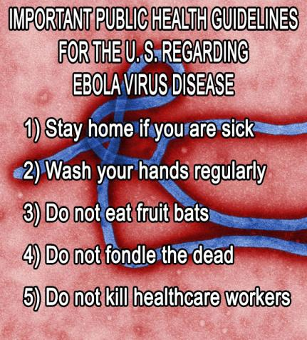
Summary
Do not forget the basic IPC principles
Good IPC is of the essence- safe, and sensible!
Keep the environment clean and dry!
Vaccines are coming!

Slide 62

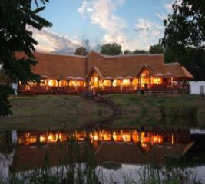

Save The Date
23 – 28 September, 2016
6th Infection Control Africa
Network Congress 2016
23 – 28 September, 2016
Indaba Hotel, Fourways, Johannesburg, South Africa
www.icanetwork.co.za

Slide 63

www.ipac-canada.org

