Slide 1
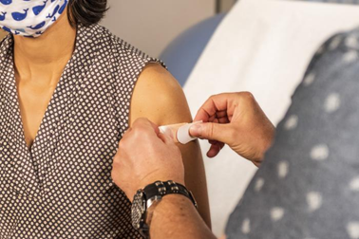
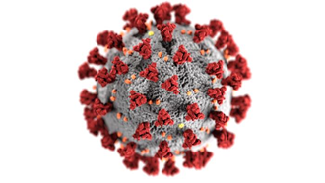
Vaccine Hesitancy- What’s Happening
Prof. Rodney E. Rohde
Hosted by Martin Kiernan
www.webbertraining.com
February 24, 2022

Slide 2
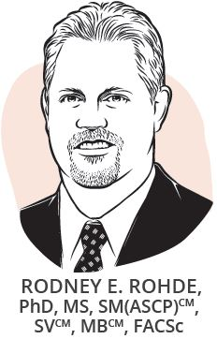
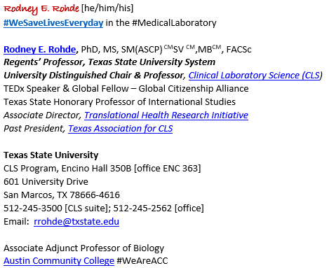
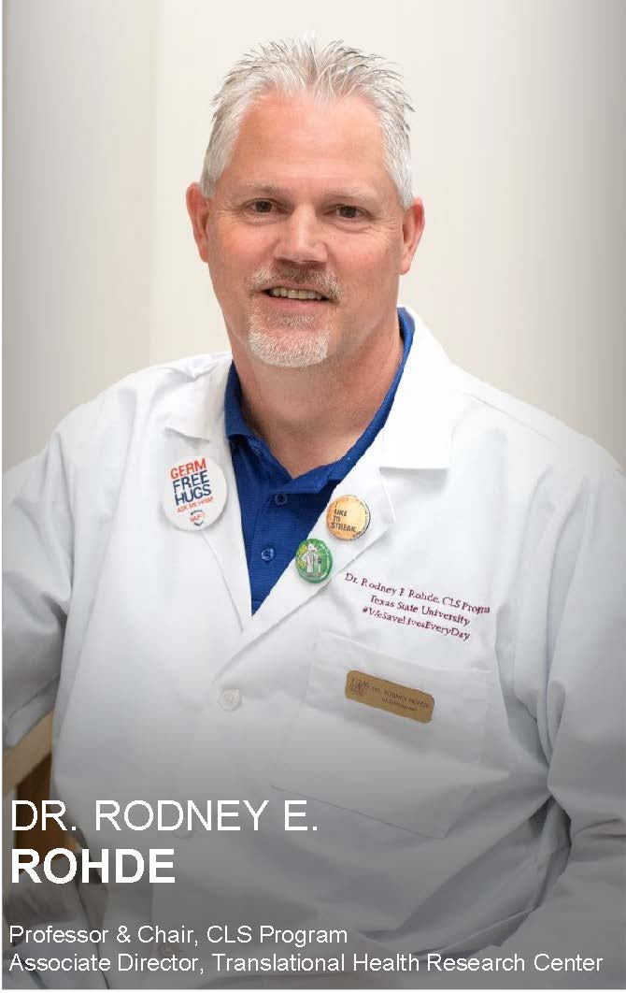
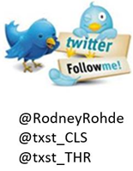
Speaker Bio
2

Slide 3
“The impact of vaccination on the health
of the world’s peoples is hard to exaggerate. Apart from safe water, no other modality has had such a major effect on mortality reduction and population growth.”
Susan and Stanley Plotkin, A Short History of Vaccination, in Vaccines 1st Edition, 1988

Slide 4
Overview
A brief historical view
Vaccine hesitancy
Elements of vaccine confidence
Strategies for building vaccine confidence
Strategies for talking about vaccines, including COVID-19
Communication resources
CDC PHIL 24150

Slide 5
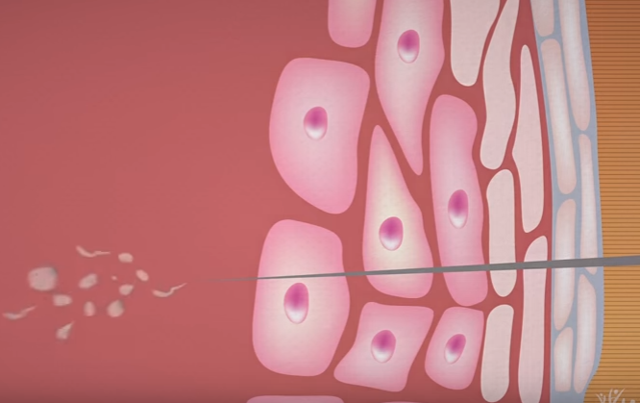
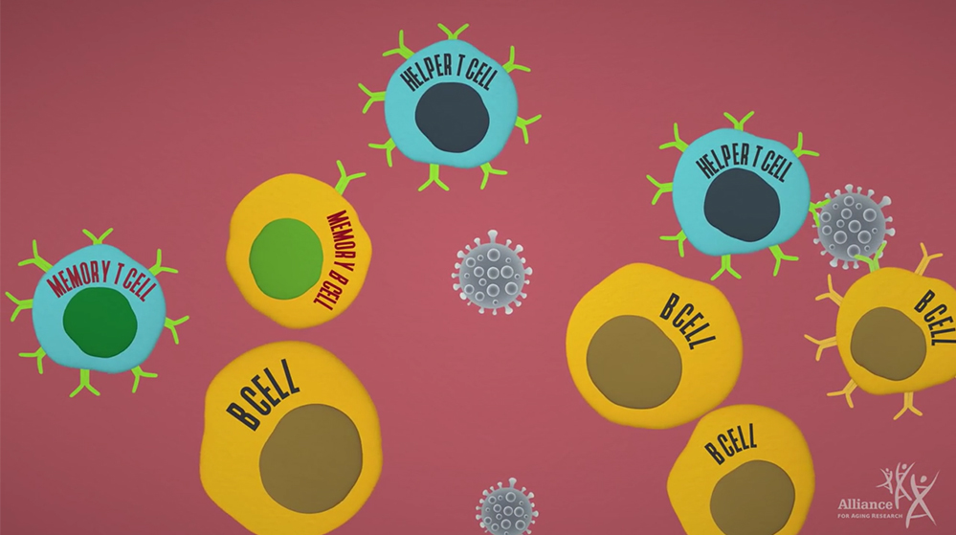
How Vaccines Work
Vaccines help us develop immunity by imitating an infection and triggering antibodies to develop Those antibodies will be available to fight the next time you are exposed to that microbe – virus, bacterium, fungus, protozoan, or allergen.
Source: The Alliance for Aging Research
5

Slide 6
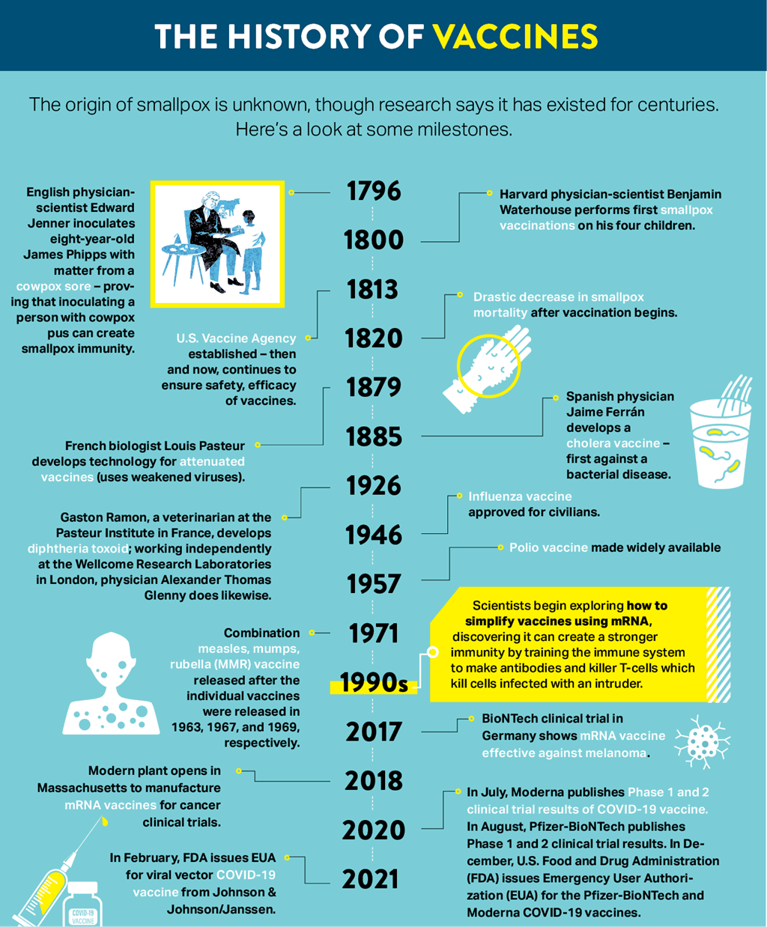
Historical View
Source: Northwestern Medicine - https://www.nm.org/healthbeat/covid-19/ believe-in-the-vaccine/history-of-vaccines
EDWARD JENNER ILLUSTRATION: Mario Breda | ADOBE STOCK | ALL OTHER ICONS: ADOBE STOCK AND ISTOCKPHOTO.COM

Slide 7
Vaccines for Children and Adolescents
Now Routinely Given in Different Parts of the World
Diphtheria | Measles
Tetanus | Mumps
Pertussis | Rubella
Polio | Varicella
Hepatitis B | Pneumococcus
Hemophilus influenzae | Human Papillomavirus
Rotavirus | Meningococcus A, C, W, Y
Hepatitis A | Influenza
Japanese Encephalitis | Tick-Borne Encephalitis

Slide 8
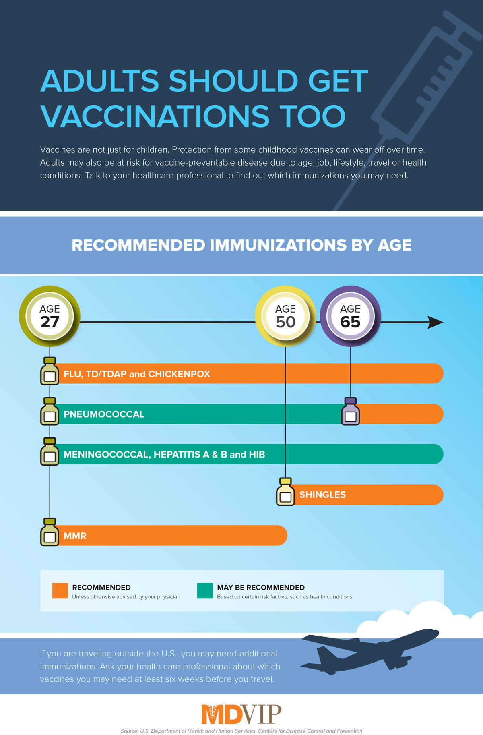
Adults
too!
Traveling?

Slide 9
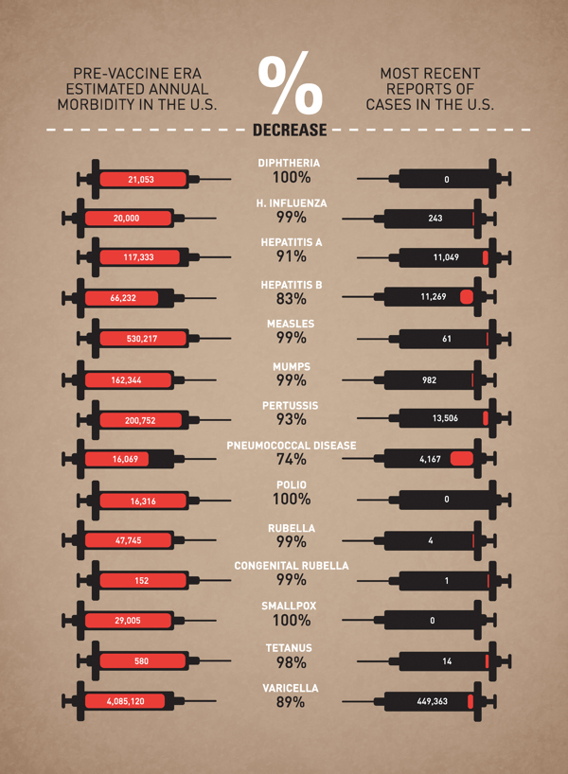
Vaccine Effectiveness
Graphic created by Leon Farrant based on CDC data

Slide 10
Definitions
Vaccine hesitancy
Delay in acceptance or refusal of vaccination despite availability
Complex and context specific (varies across place, time, and vaccine)
Vaccine acceptance
Timely receipt of all childhood vaccines as recommended by ACIP when available
Vaccine confidence
Trust that parents or providers have in the recommended immunization, the providers who administer the vaccine, and the process of licensure and vaccination schedule
Source: McDonald NE, et al. Vaccine, 2015; 33
Orenstein WA, et al. Pub Health Rep, 2015; 130

Slide 11
Decline in Vaccination Rates
Whole cell pertussis vaccine associated with encephalopathy
In 1974, vaccination rate decreased in UK followed by an epidemic of more than 100,000 cases of pertussis and 36 deaths by 1978
In Sweden, the annual incidence rate of pertussis per 100,000 children of 0-6 years of age increased from 700 cases in 1981 to 3,200 in 1985
In Japan, after vaccination rates plummeted from 70 percent to 20-40 percent, a jump of over 3,000 percent in pertussis cases was observed between 1974 and 1979
MMR linked with autism in 1990’s
Decline in vaccination in U.S. and UK followed by outbreaks of measles
5% decline in MMR coverage results in 3-fold increase in cases/yr
Source: Marshall G. The Vaccine Handbook, 9E, 2020
https://www.who.int/vaccine_safety/initiative/detection/immunization_misconceptions/en/index2.html

Slide 12
Vaccines and Autism – Wakefield.
In 1998, Andrew Wakefield and colleagues published a paper in the journal Lancet. Wakefield's hypothesis was that the measles, mumps and rubella (MMR) vaccine caused a series of events that include intestinal inflammation, entrance into the bloodstream of proteins harmful to the brain, and consequent development of autism. In support of his hypothesis, Dr. Wakefield described 12 children with developmental delay — eight had autism. All of these children had intestinal complaints and developed autism within one month of receiving MMR. Thus, MMR linked with autism began in 1990’s
The Wakefield paper published in 1998 was flawed for two reasons:
Source: https://www.chop.edu/centers-programs/vaccine-education-center/vaccines-and-other-conditions/vaccines-autism

Slide 13
Vaccines and Autism – Wakefield.
About 90% of children in England received MMR at the time this paper was written. Because MMR is administered at a time when many children are diagnosed with autism, it would be expected that most children with autism would have received an MMR vaccine, and that many would have received the vaccine recently. The observation that some children with autism recently received MMR is, therefore, expected. However, determination of whether MMR causes autism is best made by studying the incidence of autism in both vaccinated and unvaccinated children. This wasn't done.
Although the authors claim that autism is a consequence of intestinal inflammation, intestinal symptoms were observed after, not before, symptoms of autism in all eight cases.
Paper retracted and Wakefield eventually loses medical license after a 2nd flawed 2002 study. For complete review, see SOURCE.
Source: https://www.chop.edu/centers-programs/vaccine-education-center/vaccines-and-other-conditions/vaccines-autism

Slide 14
Vaccine Hesitancy
Vaccine hesitancy is a behavior influenced by several factors including issues of confidence, complacency, and convenience. Vaccine-hesitant individuals are a heterogeneous group who hold varying degrees of indecision about specific vaccines or vaccination in general.
Vaccine hesitant individuals may accept all vaccines but remain concerned about vaccines; some may refuse or delay some vaccines but accept others; some individuals may refuse all vaccines.

Slide 15
Vaccine Refusal
Majority of physicians report >1 vaccine refusal / month
13% children under-vaccinated due to parental choice
Growing number of pediatricians accept requests for delay
(13 → 37%)
Glanz JM JAMA Pediatr. 2013;167(3):274-281; Gowda, etal. Hum Vac Imm, 2013.

Slide 16
Vaccine Hesitancy: A consequence of success and changing times
Distrust and scientific denialism
Rapid dissemination of misinformation
Naturalism
Distortion of risk
Changes in Decision-making

Slide 17
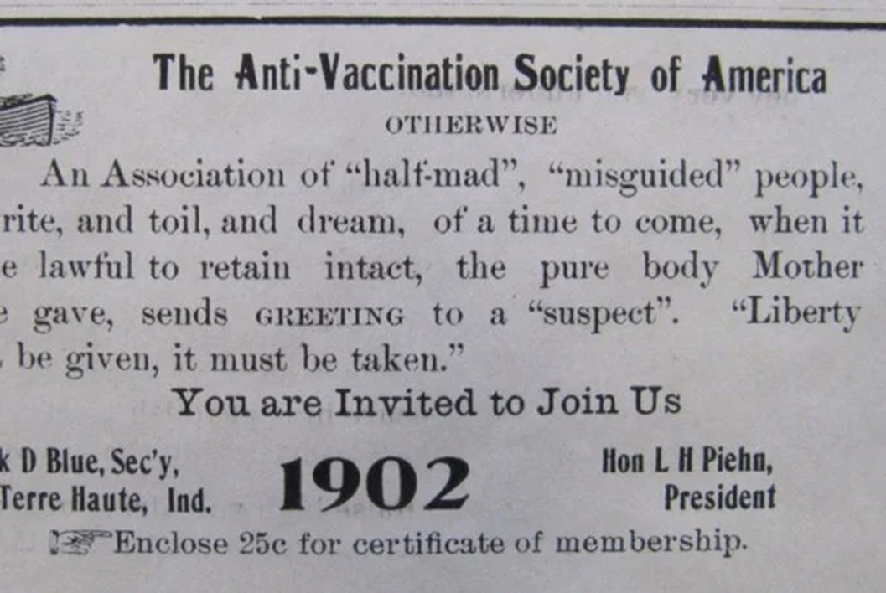
But it is not NEW to our society…
Source: Scientific American Blog

Slide 18
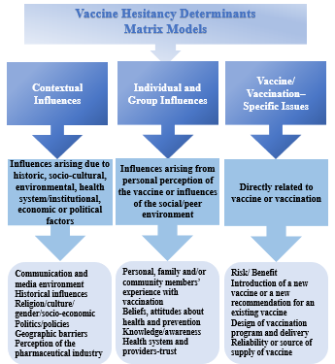
Vaccine Hesitancy As A Global Issue
Sukainah Al Subia
University of Northern Iowa

Slide 19
Defining Vaccine Confidence
Vaccine confidence is the trust that patients, parents, or healthcare professionals have in:
recommended vaccines;
professionals who administer vaccines; and
processes and policies that lead to vaccine development, licensure, manufacturing, and recommendations for use.

Slide 20
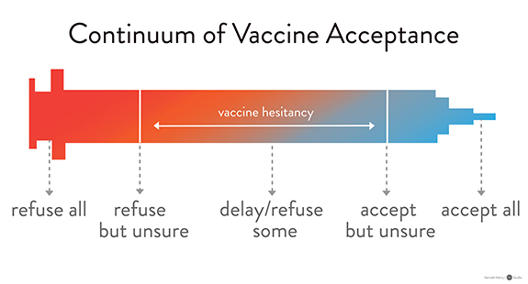
Elements of Vaccine Confidence
Delay in acceptance or refusal of vaccination despite availability of vaccine services

Slide 21
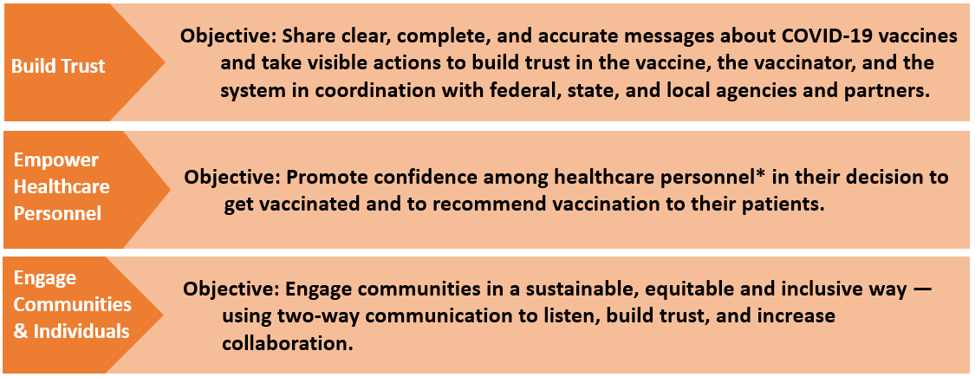
A National Strategy to Reinforce Confidence in COVID-19 Vaccines
*Personnel = All staff working in healthcare settings, including physicians, physician assistants/nurse practitioners, nurses, allied health professionals, pharmacists, support staff, and community health workers
https://www.cdc.gov/vaccines/covid-19/vaccinate-with-confidence.html

Slide 22
A component of the National Strategy to Reinforce Confidence in COVID-19 vaccines
Tactics
Engage local and national professional associations, health systems, and healthcare personnel
Ensure healthcare systems and medical practices are equipped to create a culture that builds confidence in COVID-19 vaccination.
Strengthen the capacity of healthcare professionals to have empathetic vaccine conversations using motivational interviewing techniques.

Slide 23
Keys to Building Demand for Vaccines
Make vaccines:
Accessible (easy to get)
Beneficial (health benefits outweigh perceived or real risk of getting COVID-19 or perceived or real side effects from vaccination)
Convenient (reduce out of pocket, social, and opportunity costs)
Desirable (appealing)
Normative (presented as a social default)
Necessary (indispensable for accessing things they want to get back to doing)

Slide 24
Strategies to Build COVID-19 Vaccine Confidence Among Healthcare Professionals
Host discussions where personnel at different levels can ask questions and share concerns in a safe space.
Share key messages with staff through emails, breakroom posters, and other channels.
Highlight the experiences of employees who were initially hesitant to get vaccinated, but who later made the decision to get the vaccine.
Encourage senior leaders to be vaccine champions.

Slide 25
The Role of Healthcare Professionals
Healthcare professionals are patients’ and parents’ most trusted source of information on vaccines.
Your answers to their questions matter and will help them make an informed decision about getting a COVID-19 vaccination for themselves or their children.
Your strong vaccine recommendation is the most important part of the conversation.
www.cdc.gov/vaccines/covid-19/hcp/engaging-patients.html

Slide 26
Lead with Listening
Do not make assumptions about whether your patients will choose to get vaccinated or the reasons for their decisions.
Instead, begin with an open-ended question, such as “What are your thoughts on getting a COVID-19 vaccination today?”
Actively listen and seek to understand the patient’s point of view.
Recognize that these conversations can take time and may continue over the course of multiple encounters.

Slide 27
Use Patient-Centered Communication Techniques
Use open-ended questions to promote dialogue. Ask about readiness to vaccinate and what questions or concerns they may have.
Paraphrase any information shared to show that you have heard and understood it.
Praise measures already taken to protect themselves or their children from COVID-19, like mask wearing and physical distancing. Then frame vaccination as a safe and effective way to help protect them and their loved ones from getting COVID-19.
Ask for permission to share more information on COVID-19 vaccines. This will foster openness and connection.

Slide 28
Respond to Questions and Concerns with Empathy
Respond to questions and concerns in a non-judgmental, respectful, and empathic way.
Provide accurate answers using clear, simple language. Explore questions patients ask most often about vaccines (see URLs below).
Some concerns may stem from mistrust in the medical establishment or the government as result of collective or individual mistreatment and traumas. Acknowledging past traumas may promote patients’ trust in you and your message.
Acknowledge uncertainty about what we don’t yet know about COVID-19 vaccines. This can help build trust.
www.cdc.gov/vaccines/covid-19/hcp/answering-questions.html
www.cdc.gov/coronavirus/2019-ncov/vaccines/faq.html

Slide 29
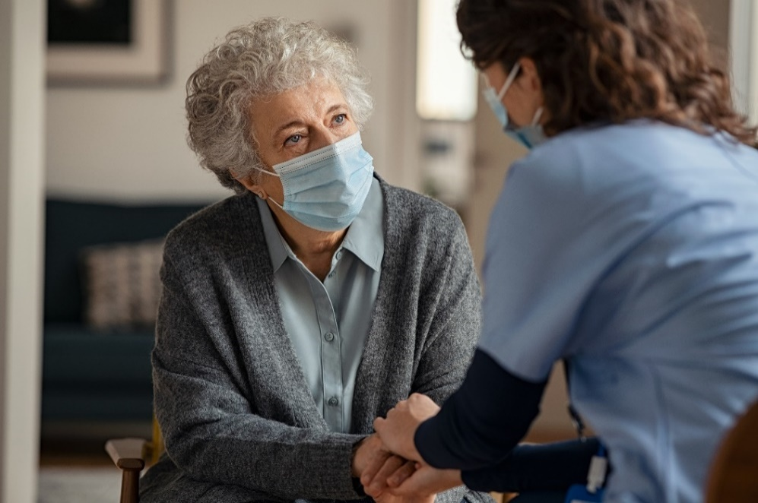
Give Your Strong Recommendation
Let your patients know that you recommend COVID-19 vaccination for them. Your strong recommendation is critical for vaccine acceptance.
Tailor your recommendation to include any relevant reasons why COVID-19 vaccination might be important for this particular patient.

Slide 30
Give Your Strong Recommendation
Talk about your personal decision and experience in getting a COVID-19 vaccine and your experience treating COVID-19 patients.
Share the benefits of getting vaccinated, including:
Protecting themselves and others who may be more vulnerable, and
Enabling them to get back to activities they have missed.
Explain what they can do when they’ve been fully vaccinated.

Slide 31
Examples
“I strongly recommend you get a COVID-19 vaccine…”
“…This shot is especially important for you because of your [job/underlying health condition/vulnerable family member].”
“…I believe in this vaccine so strongly that I got vaccinated as soon as it was available to me, and I recommended that everyone in my family do the same.”
“I have seen what COVID-19 can do to patients and their families. I want to protect you as best I can from COVID-19 infection and complications.”

Slide 32
Key Messages About COVID-19 Vaccination
You can help stop the COVID-19 pandemic by getting a COVID-19 vaccine.
COVID-19 vaccines are safe and effective.
COVID-19 vaccines are free.
After COVID-19 vaccination, you might have some temporary side effects. These are normal signs that your body is building protection.
Once you are fully vaccinated, you can resume most activities that you stopped doing because of the COVID-19 pandemic, such as gathering indoors with family and friends, without wearing a mask.

Slide 33
Address Misinformation About COVID-19 Vaccination by Sharing Key Facts
COVID-19 vaccines cannot give you COVID-19.
People who have already gotten sick with COVID-19 may still benefit from getting vaccinated.
There is currently no evidence that COVID-19 vaccination causes any problems with pregnancy or fertility.
COVID-19 vaccines do not change your DNA in any way.
https://www.cdc.gov/coronavirus/2019-ncov/vaccines/facts.html

Slide 34
Help Individuals Find Their Motivation for Getting Vaccinated
Steer the conversation away from “why not?” and toward the important reasons that matter to them—their “why.”
The reasons that someone may choose to get vaccinated will always be those that are most compelling to them personally.
You may choose to share your reasons for getting vaccinated or discuss common goals you may have, like visiting with family safely.

Slide 35
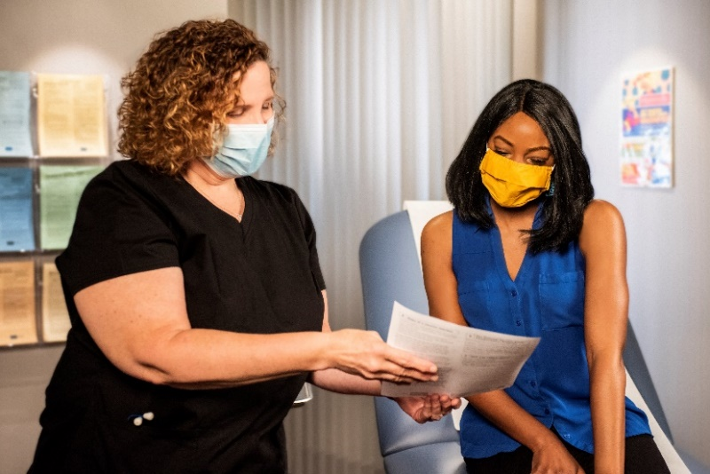
Wrap Up the Conversation
Encourage patients or parents to take at least one action, such as:
Scheduling a vaccination appointment with your office, a pharmacy, or another vaccination site, or
Reading any handouts that you provide to them.
If they decline vaccination, acknowledge that this is their decision, and keep the door open to revisiting the topic during future visits.

Slide 36
It Will Take More Than One Conversation to Change Minds
Vaccine hesitancy, especially when rooted in lack of trust rather than lack of information, is best addressed through trusted messengers in trusted spaces.
Encourage two-way dialogue and allow space for people to ask questions.

Slide 37
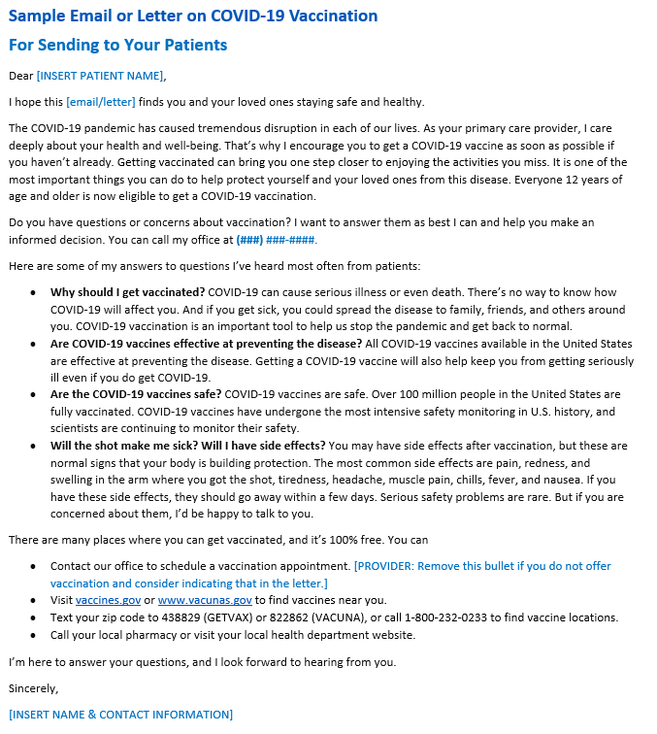
Resources: Sample Email or Letter on COVID-19 Vaccination To Send to Your Patients
https://www.cdc.gov/vaccines/covid-19/downloads/Sample-Physician-Letter-COVID-19-Vaccine.docx

Slide 38
Resources for Talking with Patients about COVID-19 Vaccination
COVID-19 data and vaccination tracker: https://covid.cdc.gov/covid-data-tracker/#datatracker-home
Vaccines for COVID-19 – information for patients: https://www.cdc.gov/coronavirus/2019-ncov/vaccines/index.html
Where to find a COVID-19 vaccine: https://www.vaccines.gov/
Preparing to provide COVID-19 vaccines: https://www.cdc.gov/vaccines/covid-19/training.html
Talking with patients about COVID-19 vaccines: www.cdc.gov/vaccines/hcp/covid-conversations
Frequently asked questions about COVID-19 vaccination: https://www.cdc.gov/coronavirus/2019-ncov/vaccines/faq.html
COVID-19 Vaccines for Children and Teens: https://www.cdc.gov/coronavirus/2019-ncov/downloads/vaccines/toolkits/COVID-19-Vaccine-for-Preteens_Teens-508.pdf
Clinician Outreach and Communication (COCA) Call – What every clinician should know about COVID-19 vaccine safety and effectiveness and how to address patient questions and concerns: https://emergency.cdc.gov/coca/calls/2021/callinfo_030921.asp

Slide 39
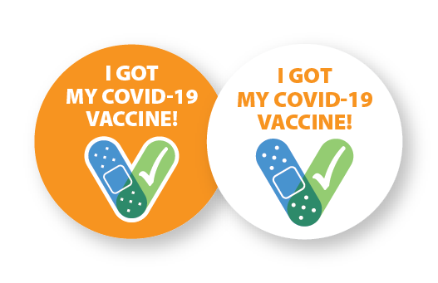
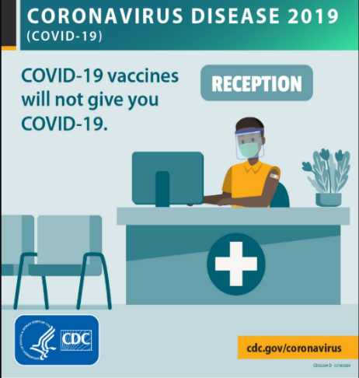
COVID-19 Vaccination Communication Toolkit for Medical Centers, Clinics, and Clinicians
Stickers
Social media
Slides
Fact sheets & FAQs
Posters
www.cdc.gov/vaccines/covid-19/health-systems-communication-toolkit.html

Slide 40
Vaccine Safety Monitoring Systems
Existing systems and data sources are used to monitor safety of vaccines post-authorization and post-licensure, such as:
Vaccine Adverse Event Reporting System (VAERS)
Vaccine Safety Datalink (VSD)
Clinical Immunization Safety Assessment (CISA)
Biologics Effectiveness and Safety System (BEST)
New systems have been developed to monitor COVID-19
vaccine safety, such as v-safe:
Active surveillance that uses text messaging to initiate web-based survey monitoring.
Provides telephone follow up to anyone who reports medically significant adverse events.

Slide 41
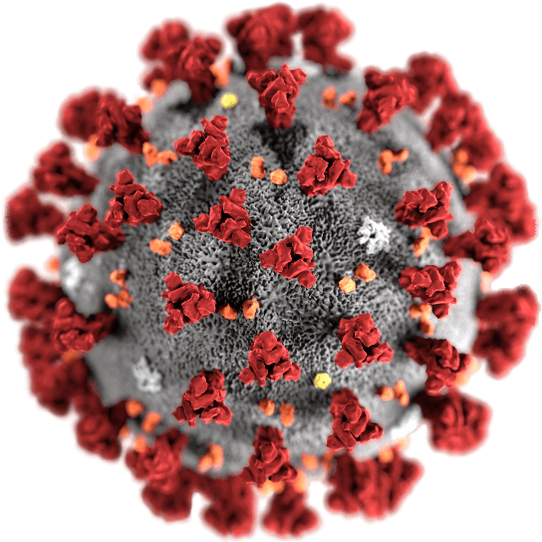
“EVERYTHING WE DO BEFORE A PANDEMIC WILL SEEM ALARMIST. EVERYTHING WE DO AFTER WILL SEEM INADEQUATE”
~ Michael Leavitt

Slide 42
References and Resources
Addressing Parental Vaccination Concerns and Maintaining Immunization Rates in the Midst of COVID-19 Presentation. Nevada Immunization Learning Exchange (NILE). www.ImmunizeNevada.org/webinars
Emily K. Brunson, Rodney E. Rohde & Lawrence V. Fulton (2021) College students’ willingness to accept COVID-19 vaccines, Journal of American College Health, DOI: 10.1080/07448481.2021.1996375
Centers for Disease Control and Prevention. Accessed from https://www.cdc.gov/vaccines/covid-19/vaccination-resources.html February 8, 2022.
Rohde, R.E. Personal webpage and resources. January 25, 2022. https://rodneyerohde.wp.txstate.edu/
The Alliance for Aging Research and Vaccination presentation.
Vaccine hesitancy presentation. Stanley A. Plotkin

Slide 43
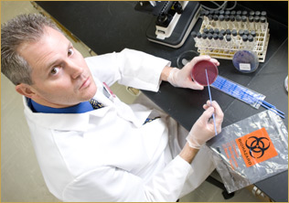
Thanks / Questions

