Slide 1

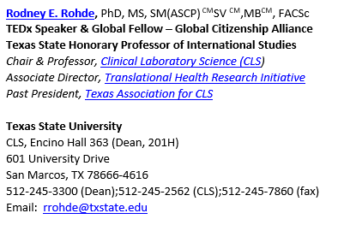
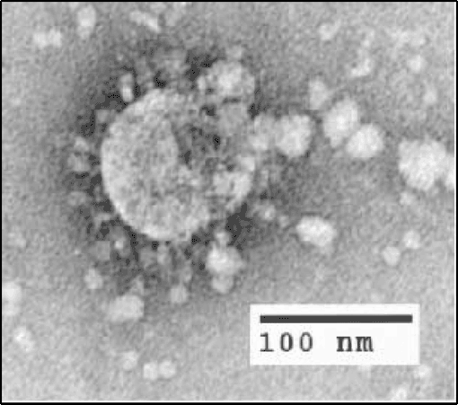


Emerging Pathogens:
Have We Learned Any Lessons?
Hosted by Martin Kiernan
martin@webbertraining.com
www.webbertraining.com
May 27, 2021

Slide 2
Emerging Pathogens: Have We Learned Any Lessons?
Abstract
Emerging and reemerging pathogens leading to a global pandemic is a complex issue driven by globalization and neglect for preparedness in health security. Obviously, we have reached a dangerous tipping point.
The nature of this critical public health and healthcare problem has two primary components: 1) the emergence of diverse and novel pathogens, and 2) the alarming ability of these pathogens to be translocated and transmitted in a wide array of geographic and densely populated regions.

Slide 3
Objectives
1. Provide a BRIEF update on the current SARSCoV2 (COVID-19) pandemic.
2. Discuss the factors associated with the globalization of infectious diseases, including historical and current examples of how select pathogens can evade antimicrobial treatments, and how this confers an evolutionary advantage to that pathogen.
3. List and describe the effects of globalization in the spread of pathogens, particularly international travel and urbanization.
4. Describe how proper public policy, medical intervention strategies, and development of novel therapies can be used to curtail the emergence of pathogens.
5. Correlate the local and global issue of these pathogens through the lenses of globalization and public health.

Slide 4
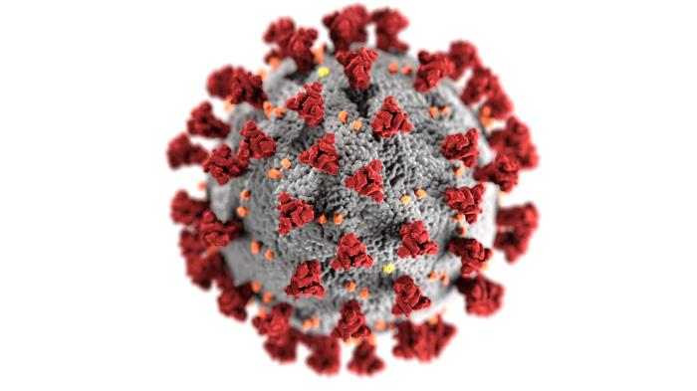
Virus spikes =
“corona”
History and background
On February 11, 2020 the World Health Organization announced an official name for the disease that is causing the 2019 novel coronavirus outbreak, first identified in Wuhan China. The new name of this virus is SARSCoV2 and the disease is coronavirus disease 2019, abbreviated as COVID-19. In COVID-19, ‘CO’ stands for ‘corona,’ ‘VI’ for ‘virus,’ and ‘D’ for disease. Formerly, this disease was referred to as “2019 novel coronavirus” or “2019-nCoV”.
Image source: #23312 CDC/ Alissa Eckert, MSMI; Dan Higgins, MAMS

Slide 5
SARS-CoV-2 / COVID-19 Update
Coronaviruses are everywhere. They are the second leading cause of the common cold (after rhinoviruses).
Airborne transmission and are responsible for about 10-30 percent of colds worldwide.
Seven human coronaviruses (HCoVs) have now been identified: HCoV-229E, HCoV-OC43, HCoV-NL63, HCoV-HKU1, SARS-CoV (which causes severe acute respiratory syndrome), MERS-CoV (Middle East respiratory syndrome), and now SARS-CoV-2.

Slide 6

SARS-CoV-2 / COVID-19 Update
Zoonotic infection meaning they can be transmitted between animals and people, but most infect only their specific animal host.
Rarely, animal coronaviruses can evolve to infect and spread among people. This was the case with Severe Acute Respiratory Syndrome Coronavirus (SARS-CoV) and Middle East Respiratory Syndrome Coronavirus (MERS-CoV).
Coronaviruses are named for the crown-like spikes on their surface. There are four main sub-groupings of coronaviruses, known as alpha, beta, gamma, and delta.
DIN Image source: R. Rohde / https://onehealthplatform.com/content/james-steele-conference-diseases-nature-transmissible-man-din

Slide 7
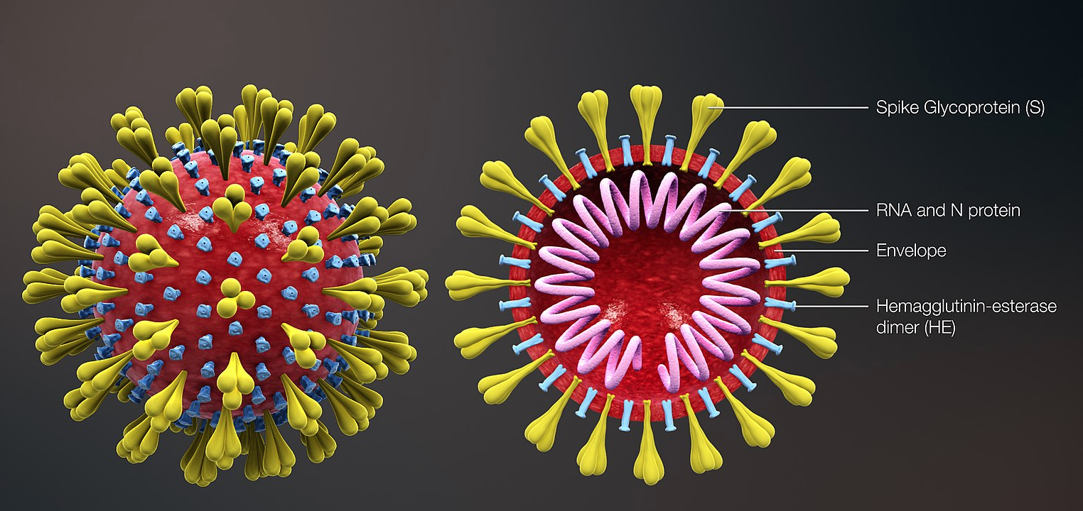
Diagram of coronavirus virion structure showing spikes that form a "crown" like the solar corona, hence the name. Source: https://commons.wikimedia.org/wiki/File:3D_medical_animation_corona_virus.jpg

Slide 8
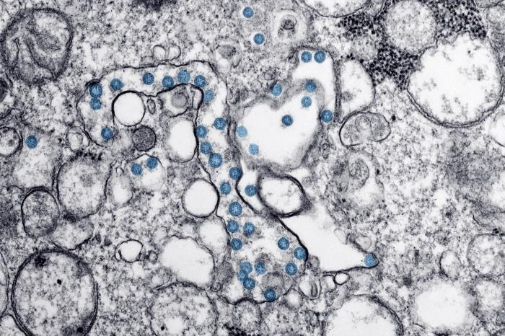
Transmission electron microscopic image of an isolate from the first U.S. case of COVID-19, formerly known as 2019-nCoV. The spherical viral particles, colorized blue, contain cross-sections through the viral genome, seen as black dots. Photo ID 23354
This image is in the public domain and thus free of any copyright restrictions. As a matter of courtesy we request that the content provider be credited and notified in any public or private usage of this image. CDC/ Hannah A Bullock; Azaibi Tamin

Slide 9
SARS-CoV-2 / COVID-19 Update
SARS-CoV (the beta coronavirus that causes severe acute respiratory syndrome, or SARS)
  SARS (2003) killed nearly 10% of the 8,096 people who fell ill in 29 countries (774 deaths).
MERS-CoV (the beta coronavirus that causes Middle East Respiratory Syndrome, or MERS)
  Since 2012, MERS has caused 2,494 confirmed cases in 27 countries and killed over 30% (858 deaths).
SARS-CoV-2 (the novel coronavirus that causes coronavirus disease 2019, or COVID-19)
  Provide current update for cases, mortality and geographic spread
  Ongoing expansion

Slide 10

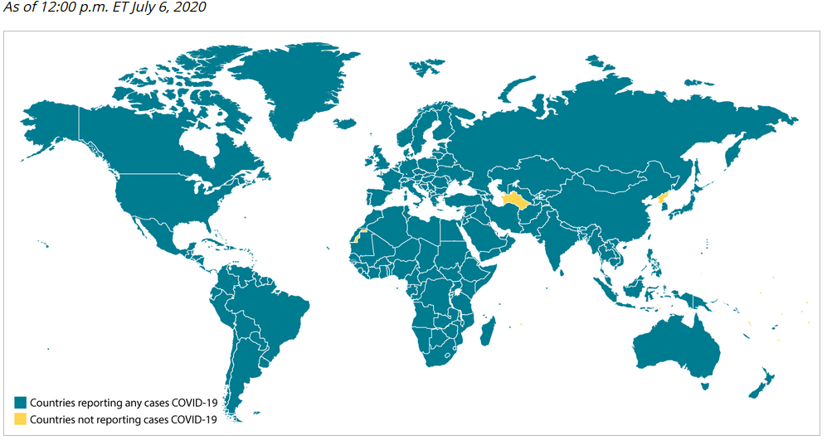

SARS-CoV-2 / COVID-19 Update
219 Countries and Territories around the world have reported a total of 142,329,811 confirmed cases of the coronavirus COVID-19 that originated from Wuhan, China, and a death toll of 3,036,631 deaths. April 19, 2021. https://www.worldometers.info/coronavirus/countries-where-coronavirus-has-spread/

Slide 11
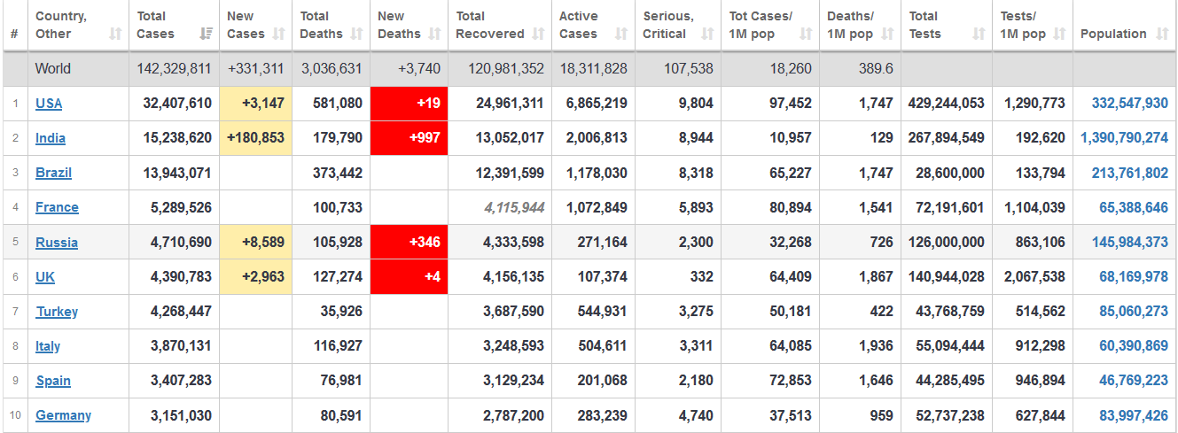
SARS-CoV-2 / COVID-19 Update
Top 10 Countries – April 19, 2021.
https://www.worldometers.info/coronavirus/#countries

Slide 12
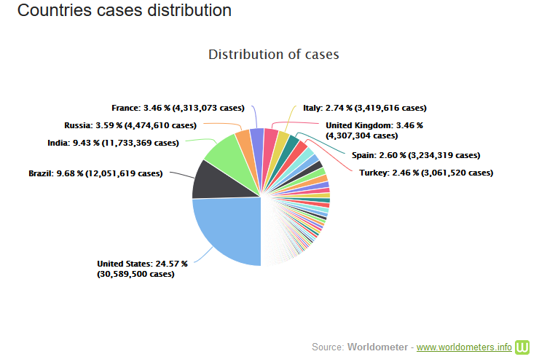
SARS-CoV-2 / COVID-19 Update
U.S. has 5% of global population but 25% of cases!

Slide 13
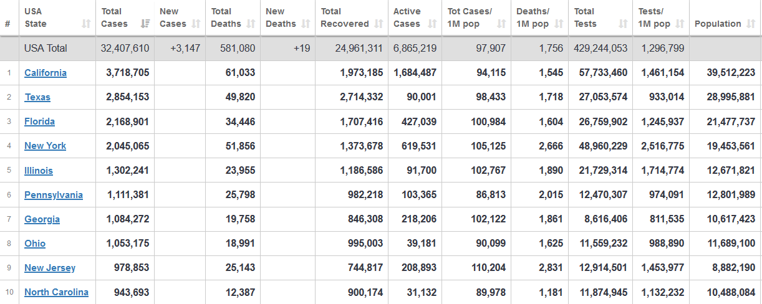
SARS-CoV-2 / COVID-19 Update
Top 10 U.S. States – April 19, 2021.
https://www.worldometers.info/coronavirus/country/us/

Slide 14
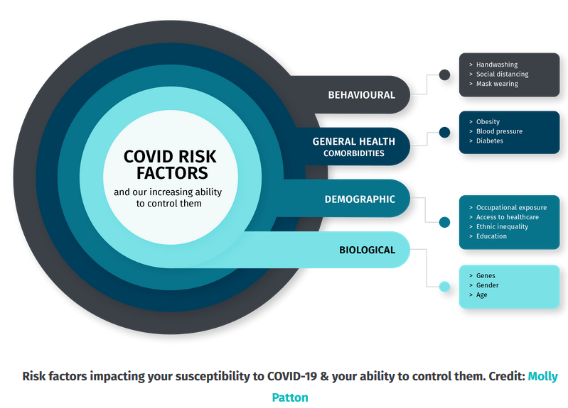

Slide 15
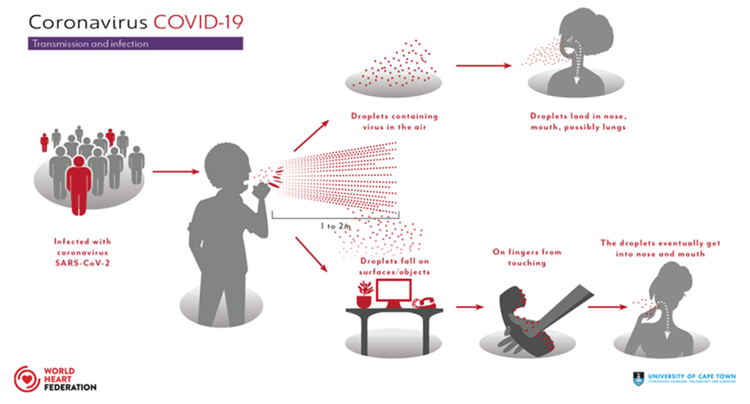
SARS-CoV-2 / COVID-19 Update

Slide 16
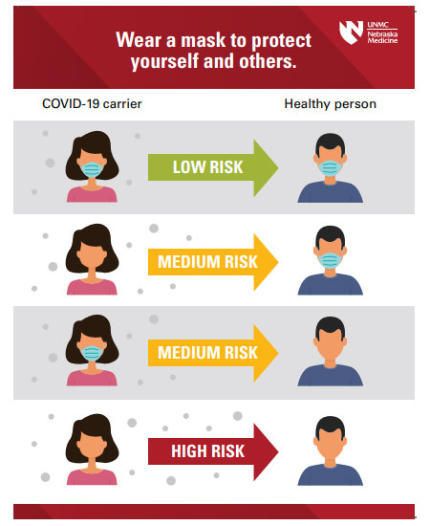
SARS-CoV-2 / COVID-19 Update
Masks – research and evidence show they work!
N95 Masks
Surgical (procedural masks)
Cloth Masks
Face shields
Image source: https://www.nebraskamed.com/COVID/coronavirus-is-not-canceled-wear-your-mask
https://www.youtube.com/channel/UCtWrOlPkjfLm2_i1G3ZVWBg

Slide 17


SARS-CoV-2 / COVID-19 Update
Masks – research and evidence show they work!
#TXSTrespect
https://www.youtube.com/channel/UCtWrOlPkjfLm2_i1G3ZVWBg

Slide 18
Your risk of COVID19
Those Who Need Extra Precautions
Racial & Ethnic Minority Groups
People with Disabilities
People with Developmental & Behavioral Disorders
Pregnant People
People Experiencing Homelessness
Take home message – IMMUNOCOMPROMISED (generally at more risk)
#Superspreader events are REAL!
  Church/choir, bars, large gatherings (rallies, etc.) where precautions are not used
https://www.cdc.gov/coronavirus/2019-ncov/need-extra-precautions/other-at-risk-populations.html

Slide 19
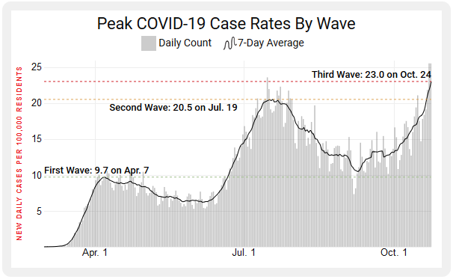


SARS-CoV-2 / COVID-19 Update
Just days before a momentous and unpredictable Presidential election, the United States has reached a new record high in the number of daily COVID-19 infections, surpassing the peak in mid-July during the second surge of the coronavirus pandemic’s domestic toll.
As of Oct. 24, there was a weekly average of 23.0 infections per 100,000 residents, up from 20.5 on July 19 and ticking rapidly upward.
The country also set a new single-day record on Oct. 23 with 83,757 new cases.
Thursday, Feb 4 2021: US records more than 5,000 Covid deaths in single day after data audit [5,077 deaths]
Surge
https://time.com/5903673/record-daily-coronavirus-cases/

Slide 20
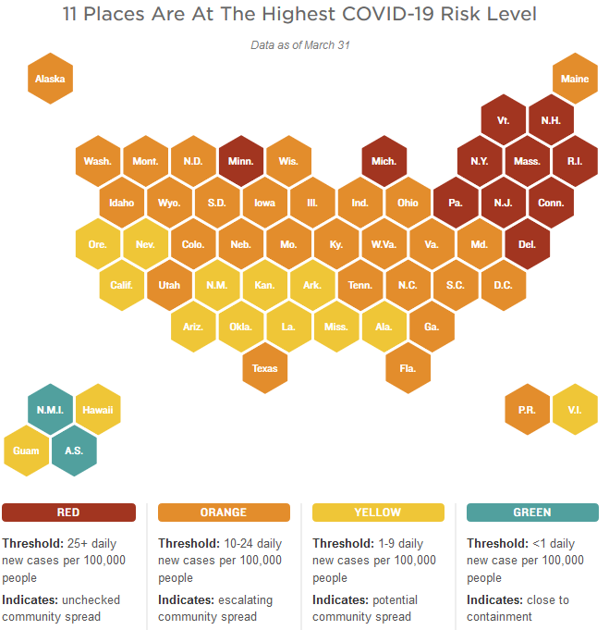
SARS-CoV-2 / COVID-19 Update
Source:
https://www.npr.org/sections/health-shots/2020/09/01/816707182/map-tracking-the-spread-of-the-coronavirus-in-the-u-s

Slide 21
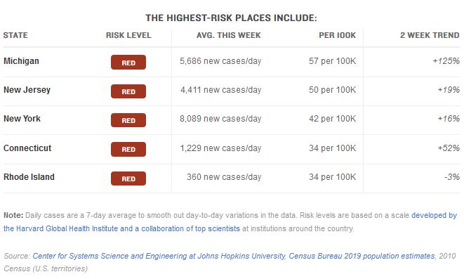
SARS-CoV-2 / COVID-19 Update
Source:
https://www.npr.org/sections/health-shots/2020/09/01/816707182/map-tracking-the-spread-of-the-coronavirus-in-the-u-s
The map above shows the risk of infection in each state based on new daily cases per capita. The consortium of researchers and public health experts who developed these risk levels advises states in the red category to issue stay-home orders. They advise orange states to consider stay-home orders, along with increased testing and contact tracing. Yellow states need to keep up social distancing and mask usage, and all states should continue testing and contact tracing.

Slide 22

SARS-CoV-2 / COVID-19 Update
The best way to prevent illness is to avoid being exposed to this virus (avoid high case areas).
  Hand hygiene / avoid high touch surfaces
  Physically distance (at least 6 feet / avoid enclosed areas)
  Use a mask [don’t let the perfect be the enemy of the good]
  Ventilation matters
  Clean and disinfect (EPA N list)
  Monitor your health and those around you

Slide 23
SARS-CoV-2 / COVID-19 Update
Treatment / therapy options
  Remdesivir (antiviral)
  Convalescent plasma
  Monoclonal antibodies [REGN-COV2 (2 MABs) cocktail & Eli Lilly]; others in development
  Steroids [dexamethasone]
  Patient position [on tummy if severe illness]

Slide 24
Virus mutation
Coronaviruses do not have segmented genomes [like flu] and cannot reassort. Instead, the coronavirus genome is made of a single, very long piece of RNA. However, when two coronaviruses infect the same cell, they can recombine, which is different than reassortment.
In recombination, a new single RNA genome is stitched together from pieces of the two “parental” coronaviruses genomes. It’s not as efficient as reassortment, but scientists believe that coronaviruses have recombined in nature.
When this happens, scientists identify the resulting virus as a “novel coronavirus.” The generation of a novel coronavirus, although occurring by a different mechanism than antigenic shift in influenza viruses, can have a similar consequence, with pandemic spread.

Slide 25
SARS-CoV-2 Variant Classifications and Definitions
Genetic variants of SARS-CoV-2 have been emerging and circulating around the world throughout the COVID-19 pandemic.
Viral mutations and variants in the United States are routinely monitored through sequence-based surveillance, laboratory studies, and epidemiological investigations.
A US government interagency group developed a Variant Classification scheme that defines three classes of SARS-CoV-2 variants:
  Variant of Interest – low level
  Variant of Concern – moderate level
  Variant of High Consequence – high level
The B.1.1.7, B.1.351, P.1, B.1.427, and B.1.429 variants circulating in the United States are classified as variants of concern

Slide 26
SARS-CoV-2 Variant of Concern
A variant for which there is evidence of an increase in transmissibility, more severe disease (increased hospitalizations or deaths), significant reduction in neutralization by antibodies generated during previous infection or vaccination, reduced effectiveness of treatments or vaccines, or diagnostic detection failures.
Possible attributes of a variant of concern (in addition to the possible attributes of a VOI):
  Evidence of impact on diagnostics, treatments, and vaccines
  Widespread interference with diagnostic test targets
  Evidence of substantially increased resistance to one or more class of therapies
  Evidence of significant decreased neutralization by antibodies generated during previous infection or vaccination
  Evidence of reduced vaccine-induced protection from severe disease
  Evidence of increased transmissibility
  Evidence of increased disease severity

Slide 27
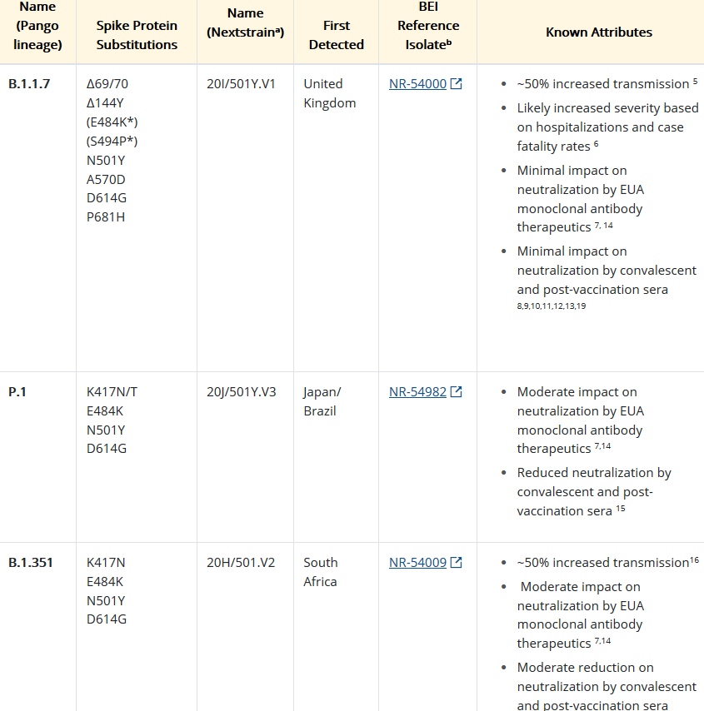

Slide 28
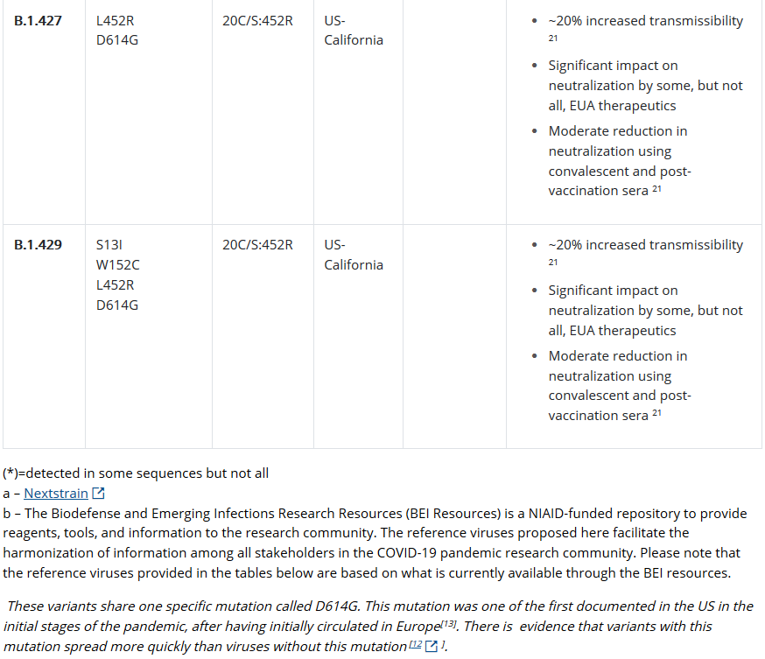

Slide 29
SARS-CoV-2 Variant of High Consequence
A variant of high consequence has clear evidence that prevention measures or medical countermeasures (MCMs) have significantly reduced effectiveness relative to previously circulating variants.
Possible attributes of a variant of high consequence (in addition to the possible attributes of a VOC):
Impact on Medical Countermeasures (MCM)
  Demonstrated failure of diagnostics
  Evidence to suggest a significant reduction in vaccine effectiveness, a disproportionately high number of vaccine breakthrough cases, or very low vaccine-induced protection against severe disease
  Significantly reduced susceptibility to multiple Emergency Use Authorization (EUA) or approved therapeutics
  More severe clinical disease and increased hospitalizations

Slide 30
SARS-CoV-2 Variant of High Consequence
A variant of high consequence would require public health officials declare a **PHEIC (if not already declared), reporting to CDC, an announcement of strategies to prevent or contain transmission, and recommendations to update treatments and vaccines.
Currently there are no SARS-CoV-2 variants that rise to the level of high consequence.
**Public Health Emergency of International Concern

Slide 31
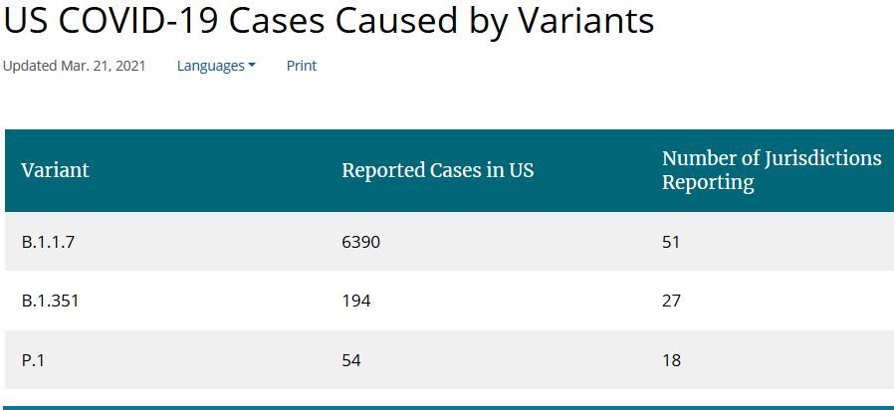
SARS-CoV-2 Variant Epidemiology

Slide 32
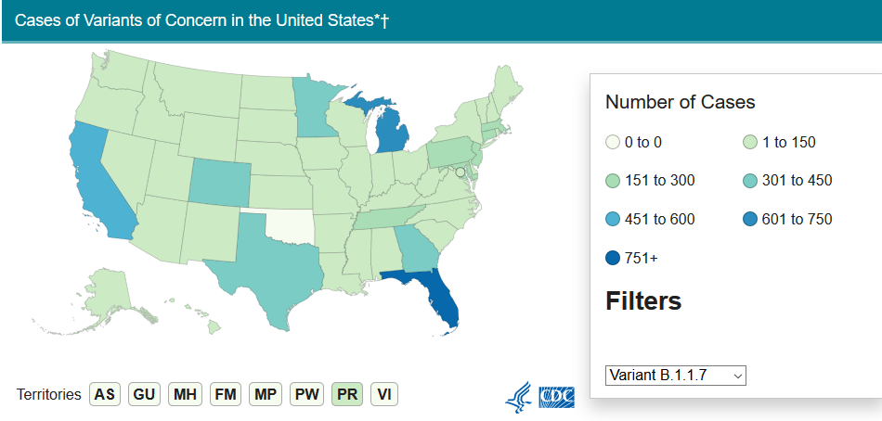
SARS-CoV-2 Variant Epidemiology

Slide 33
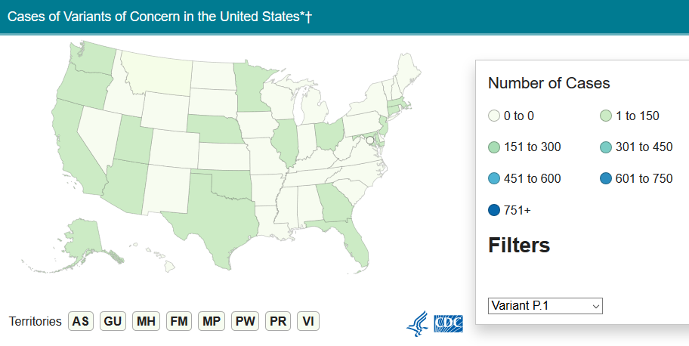

SARS-CoV-2 Variant Epidemiology

Slide 34
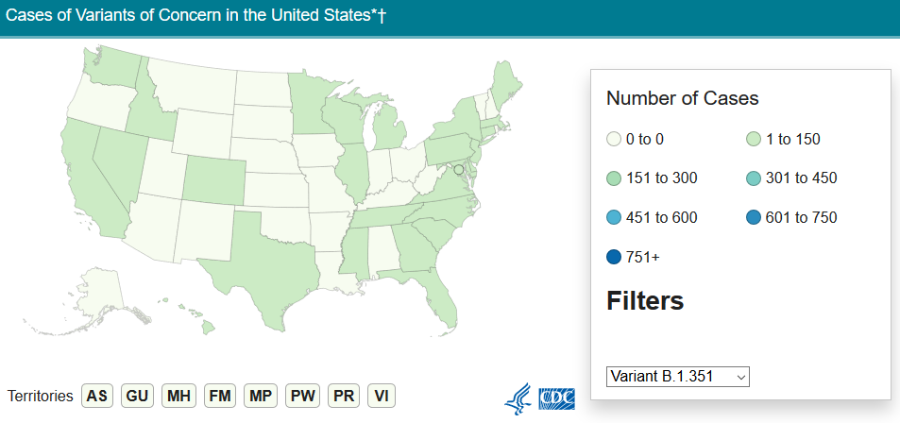
SARS-CoV-2 Variant Epidemiology

Slide 35
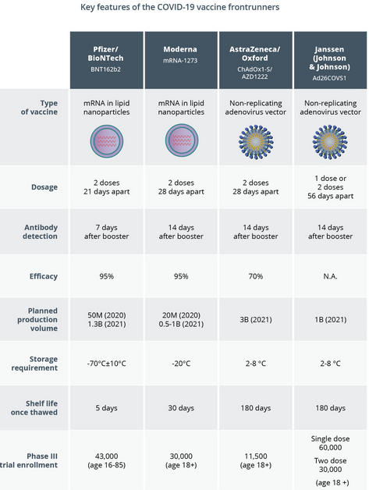
Vaccines
~80%

Slide 36
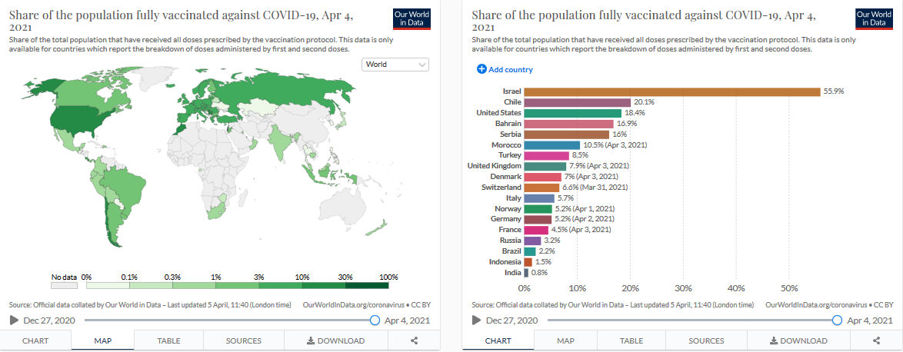
https://ourworldindata.org/covid-vaccinations

Slide 37
Emerging Pathogens: Have We Learned Any Lessons?
Globalization & Infectious Diseases
Several human activities that characterize the Anthropocene account for the increases in NTDs.
See figure to facilitate the emergence of two of the most devastating NTDs in 2014 and 2015—Ebola and Zika virus infections, respectively.
AND, the return of vaccine-preventable diseases – measles, polio, pertussis, etc.
Figure: The major forces arising out of the Anthropocene now promoting the emergence of catastrophic neglected tropical diseases (NTDs). doi:10.1371/journal.pntd.0004648.g002 (Hotez, 2016)

Slide 38
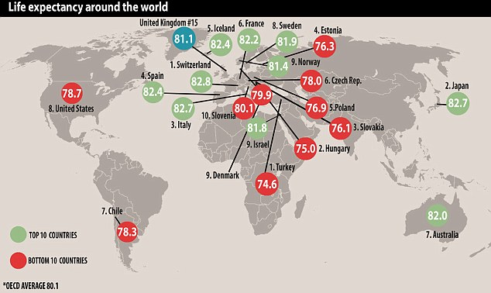
Globalization & Infectious Diseases
Global Health Revolution
  Global life expectancy
    1948 – 46 years
    1999 – 65 years
    2015 – 71 years
Global health revolution
    Health care and prevention, communications, agricultural productivity, trade
    While life expectancy around the world has risen by an average of 10 years in rich nations, the US is lagging behind. It is among the bottom 10 countries….

Slide 39

Science and the “Conquest” of Infectious Disease
Scientific triumphs: Antibiotics, Vaccines, Sanitation
Led scientists 60 years ago to proclaim that “we” would conquer infectious disease by turn of 21st century (1977: Smallpox Zero)
Other “conquests” in public health or medicine?

Slide 40

But….hold up!
Optimism based on false assumptions:
  Diseases could be geographically isolated / “systematically controlled”
  Microbes didn’t change / “We’re smarter”

Slide 41
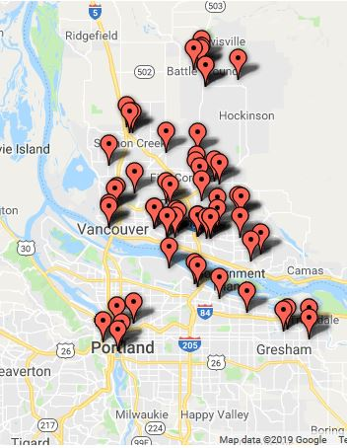
Microbes don’t read the books or play by the rules!
Since 1973:
~31 Emerging Infectious Diseases (EIDs)
  HIV/AIDS, Hepatitis C; Lyme Disease, Ebola, Hantavirus, SARS, Zika, etc.
~20 Reemerging Diseases
  MEASLES, TB, diphtheria, malaria, cholera, yellow fever, etc.
Clark County Public Health has confirmed 64 measles cases in its ongoing outbreak investigation.

Slide 42

Interdependence:
The Shrinking World
1 billion people cross international borders each year or 25/second
  unprecedented vulnerability
  Threats spread faster, further, and non-linear
Increased threats of global pandemics
  Significant risk in resource-poor countries with under funded public and animal health systems
Source: Professor William Powderly, J. William Campbell Professor of Medicine, Director, Institute for Public Health, Health Challenges :
The Need for Transdisciplinary Science

Slide 43
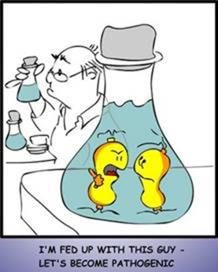
Factors Leading to Emergence and Reemergence of Infectious Disease
I. Microbial Adaptation
Genetic mutation and evolution
Resistance to antibiotics
Resistance to pesticides / disinfectants (e.g. malaria, HAIs)

Slide 44
Factors Leading to Emergence and Reemergence of Infectious Disease
II. Human Activity
C. Global Commerce and Travel
Air Travel since the 1970s (^ transmission)
Movement of People (tourists, migrants, military personnel) spread pathogens to new populations
  Sometimes naïve populations (low immunity)
Commerce spreads contaminants across borders via food, plants
Hitchhiking insects (e.g. Foot and Mouth Disease)

Slide 45
Factors Leading to Emergence and Reemergence of Infectious Disease
II. Human Activity
D. Globalization of Food Supplies
Free trade and comparative advantage
Limited regulation of food production, preparation, handling and outdated laws
Cheap animal feed (Mad Cow Disease and new variant -- Creutzfeldt-Jakob)
    (e.g. human food lobby, animal industry & McDonalds)

Slide 46
Factors Leading to Emergence and Reemergence of Infectious Disease
II. Human Activity
E. Economic Development & Environmental Degradation
Changes in land use > reforestation; encroachment on tropical forests; conversion of grasslands to farms; clearance of rainforests
Zoonotic diseases (animal > human)
  e.g. Flu, SARS

Slide 47
Factors Leading to Emergence and Reemergence of Infectious Disease
II. Human Activity
E. Economic Development & Environmental Degradation
Changes in water management (dam building) spreads water-breeding vectors (mosquitoes, snails)
  malaria in Nile valley
Undermines local livelihoods forcing migration

Slide 48
Factors Leading to Emergence and Reemergence of Infectious Disease
II. Human Activity
F. Climate Change
Climate change / global warming favors mosquitoes, rodents, other insects > spread of malaria in highland areas; spread of subtropical diseases into US
Ocean algae blooms
Weather patterns (impact of floods, droughts)

Slide 49
Factors Leading to Emergence and Reemergence of Infectious Disease
II. Human Activity
G. Breakdown of Public Health & Medical Laboratory
Complacency > faith in antibiotics and vaccines undermined spending
Failure to keep up with new technologies
National disasters and economic collapses (impact of structural adjustment programs)
Hidden professions / recognition / understanding

Slide 50
Do we know what’s coming next?
Emerging Pathogens
On 24-25 January 2017, the WHO held an informal consultation in Geneva, Switzerland, to review the list of priority diseases for the WHO R&D Blueprint.
The R&D Blueprint focuses on severe emerging diseases with potential to generate a public health emergency, and for which insufficient or no preventive and curative solutions exist.
The original list of diseases that most readily meet these criteria and for which additional research and development is urgently required was agreed at an international consultation held in November 2015

Slide 51
Do we know what’s coming next?
The 2017 annual review determined there was an urgent need for research and development for:
  Arenaviral hemorrhagic fevers (including Lassa Fever)
  Crimean Congo Haemorrhagic Fever (CCHF)
  Filoviral diseases (including Ebola and Marburg)
  Middle East Respiratory Syndrome Coronavirus (MERS-CoV)
  Other highly pathogenic coronaviral diseases (such as Severe Acute Respiratory Syndrome, SARS)
  Nipah and related henipaviral diseases
  Rift Valley Fever (RVF)
  Severe Fever with Thrombocytopenia Syndrome (SFTS)
  Zika
  **Chikungunya was designated as 'serious', requiring action by WHO to promote R&D as soon as possible

Slide 52
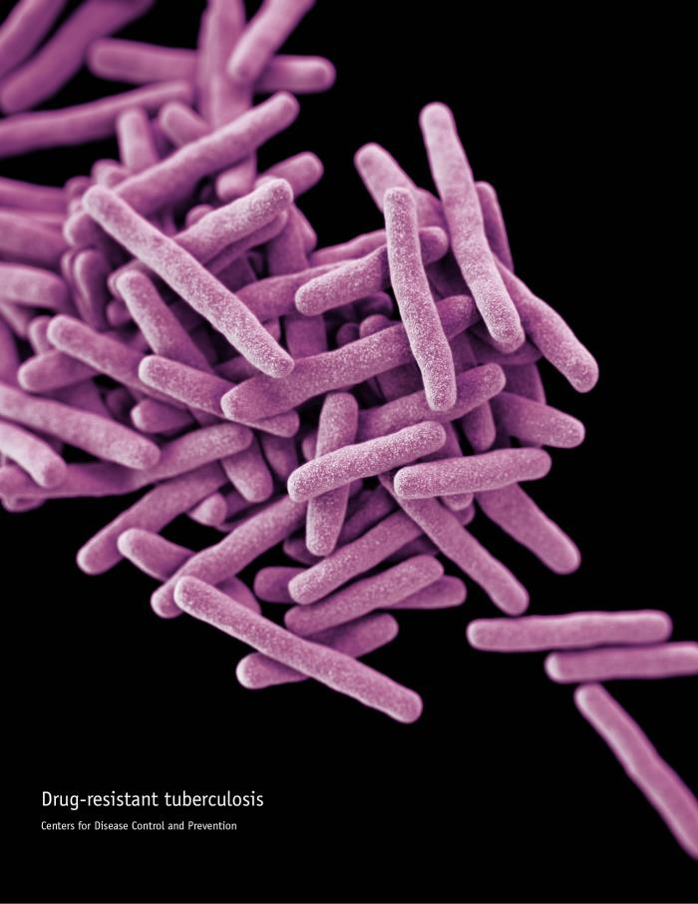
Do we know what’s coming next?
Other diseases with epidemic potential?
For example, HIV/AIDS, Tuberculosis, Malaria, Avian influenza and Dengue
  Not included because there are major disease control and research networks for these infections, and an existing pipeline for improved interventions.

Slide 53
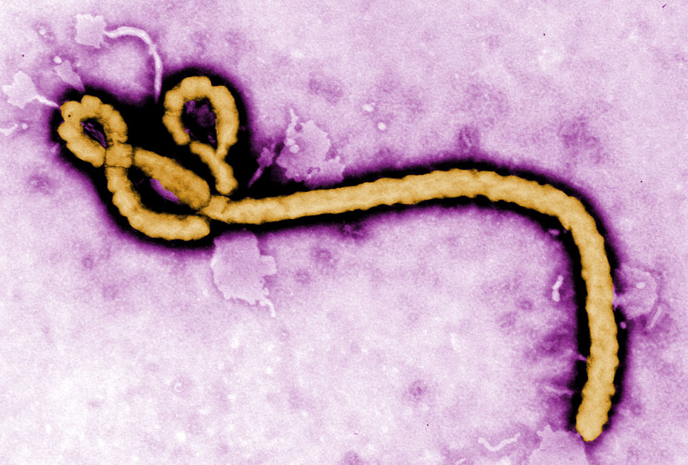
Do we know what’s coming next?
Ebola virus disease (EVD)
Ebola virus disease (EVD) is a deadly disease with occasional outbreaks that occur primarily on the African continent.
It is caused by an infection with a group of viruses within the genus Ebolavirus:
  Ebola virus (species Zaire ebolavirus)
  Sudan virus (species Sudan ebolavirus)
  Taï Forest virus (species Taï Forest ebolavirus, formerly Côte d’Ivoire ebolavirus)
  Bundibugyo virus (species Bundibugyo ebolavirus)
  Reston virus (species Reston ebolavirus)
  Bombali virus (species Bombali ebolavirus)
http://www.cdc.gov/ncidod/dvrd/spb/mnpages/dispages/ebola/qa.htm CDC - Nat. Center for Infectious Diseases; Special Pathogens Branch
Information extracted from IPTC Photo Metadata.

Slide 54
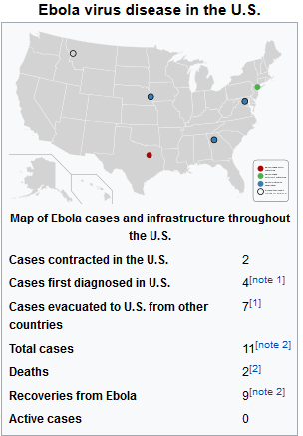
Ebola virus disease (EVD)
Who died of Ebola in the US?
Two died – a Liberian visiting the United States and a doctor who had treated Ebola patients in Sierra Leone. Two American nurses contracted the disease while treating the Liberian patient, but both recovered. In other words, only two people have ever been infected with Ebola while on American soil and neither died.

Slide 55
Do we know what’s coming next?
Concerns closer to home …
National Institute of Allergy and Infectious Diseases (NIAID’s) pathogen priority list is periodically reviewed and is subject to revision
Category A pathogens are those organisms/biological agents that pose the highest risk to national security and public health because they
Can be easily disseminated or transmitted from person to person
Result in high mortality rates and have the potential for major public health impact
Might cause public panic and social disruption
Require special action for public health preparedness

Slide 56
Do we know what’s coming next?
Concerns closer to home …
Continued…
Category B pathogens are the second highest priority organisms/biological agents. They
Are moderately easy to disseminate
Result in moderate morbidity rates and low mortality rates
Require specific enhancements for diagnostic capacity and enhanced disease surveillance

Slide 57
Do we know what’s coming next?
Concerns closer to home …
Continued…
Category C pathogens are the third highest priority and include emerging pathogens that could be engineered for mass dissemination in the future because of
Availability
Ease of production and dissemination
Potential for high morbidity and mortality rates and major health impact

Slide 58
Do we know what’s coming next?
Concerns closer to home …
Category A pathogens
  Examples – anthrax, botulism, plague, smallpox, tularemia, Arenaviruses (Lassa fever, etc.), Bunyaviruses (hantaviruses, etc.), Flaviviruses (dengue), and Filoviruses (Ebola and Marburg)
Category B pathogens
  Examples – Burkholderia pseudomallei (melioidosis), Coxiella burnetii (Q fever), Brucella species (brucellosis), Burkholderia mallei (glanders), Chlamydia psittaci (Psittacosis), Typhus fever (Rickettsia prowazekii), Food- and waterborne pathogens (e.g. Listeria monocytogenes, Campylobacter jejuni; Mosquito-borne viruses (Zika, EEE, WEE, VEE, WNV, JE, etc.).
Category C pathogens
  Examples – Antimicrobial resistance, excluding research on sexually transmitted organisms, unless the resistance is newly emerging*, Nipah and Hendra viruses, Tick-borne hemorrhagic fever viruses, Tickborne encephalitis flaviviruses (e.g. Powassan/Deer Tick virus), Tb, influenza, rabies

Slide 59
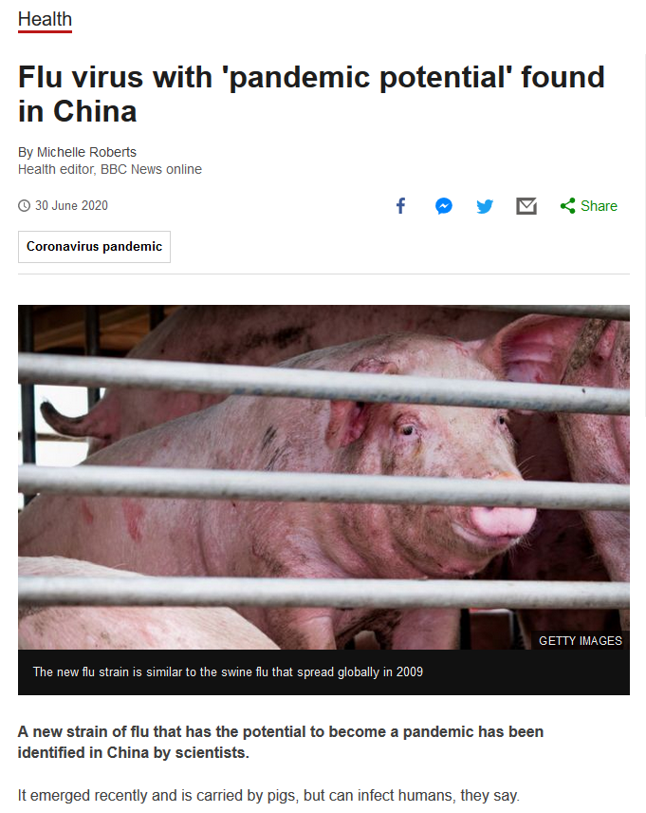
Do we know what’s coming next?
ALWAYS a concern!
https://www.bbc.com/news/health-53218704

Slide 60
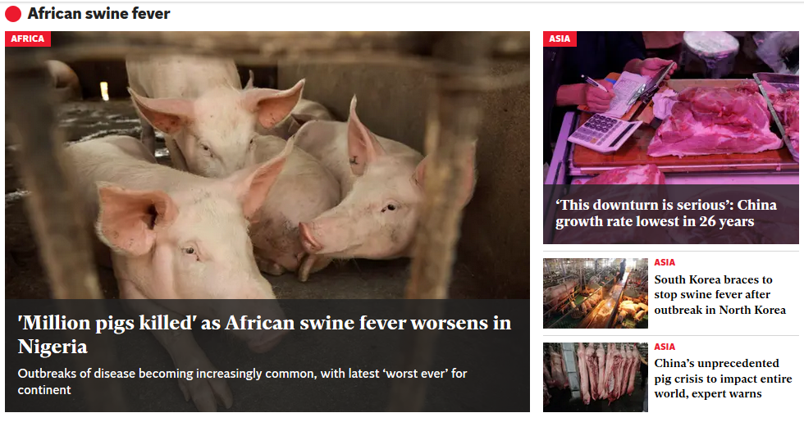
Do we know what’s coming next?
https://www.independent.co.uk/topic/african-swine-fever

Slide 61
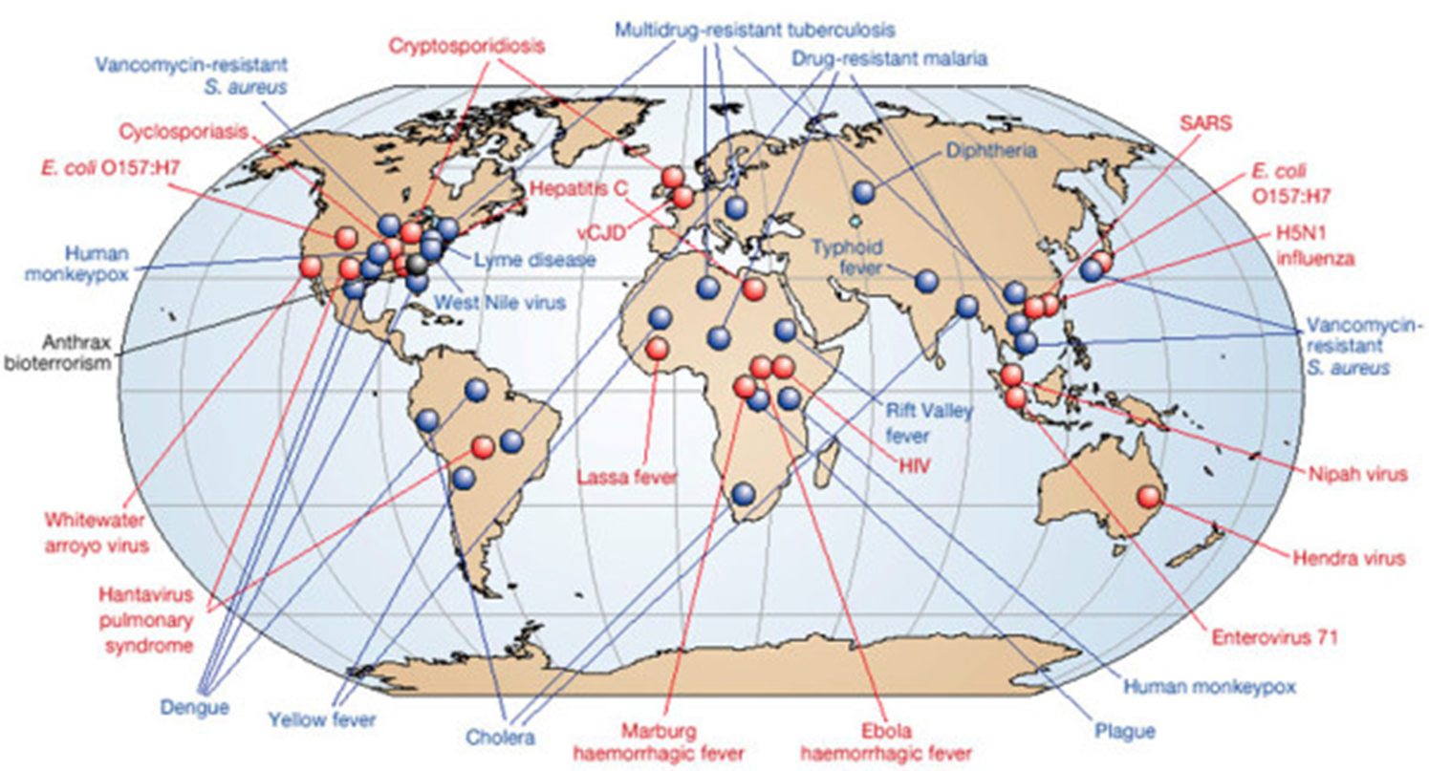
Globalization of infectious diseases
Source: https://publichealthwatch.wordpress.com/2014/11/24/study-global-outbreaks-emerging-infectious-diseases-on-the-rise/

Slide 62
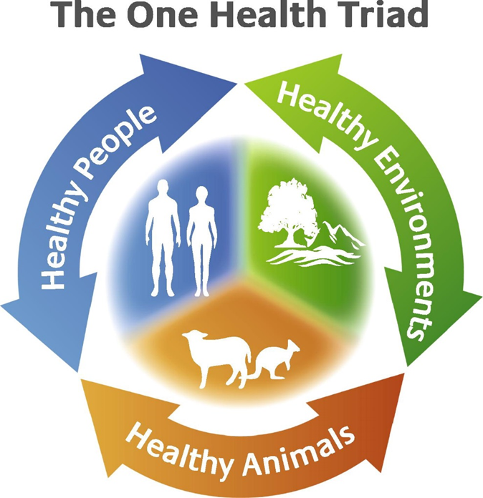
Globalization & One Health
And….yet, there is still an elephant in the room that I believe is a “hidden pandemic” and maybe our biggest worry globally….

Slide 63
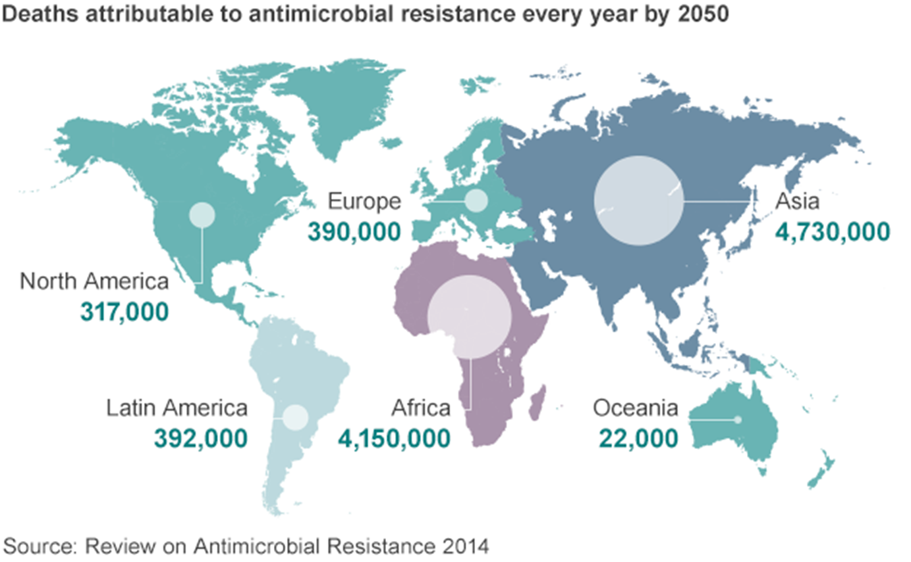
Antimicrobial resistance / HAIs

Slide 64
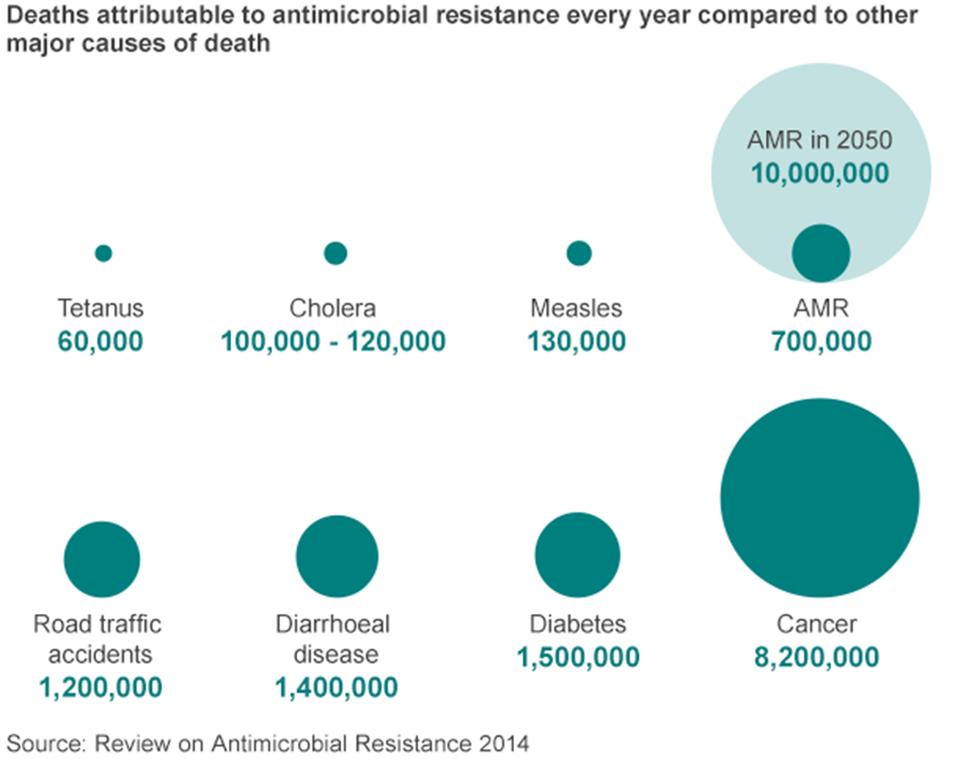
Antimicrobial resistance / HAIs
WHO (by 2050)
$100 trillion
10 million
1 new AMR / 3 sec
Healthcare Associated Infections (HAIs)
1 in 25

Slide 65
Global Challenges
Challenges are interdependent: an improvement in one makes it easier to address others; deterioration in one makes it harder to address others.
Challenges are transnational in nature and trans- institutional in solution.
  Cannot be addressed by any government or institution acting alone.
  Need collaborative action among governments, international organizations, corporations, universities, NGOs, and creative individuals.

Slide 66
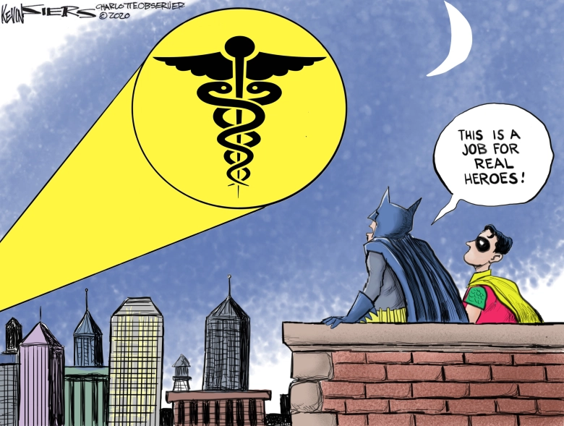
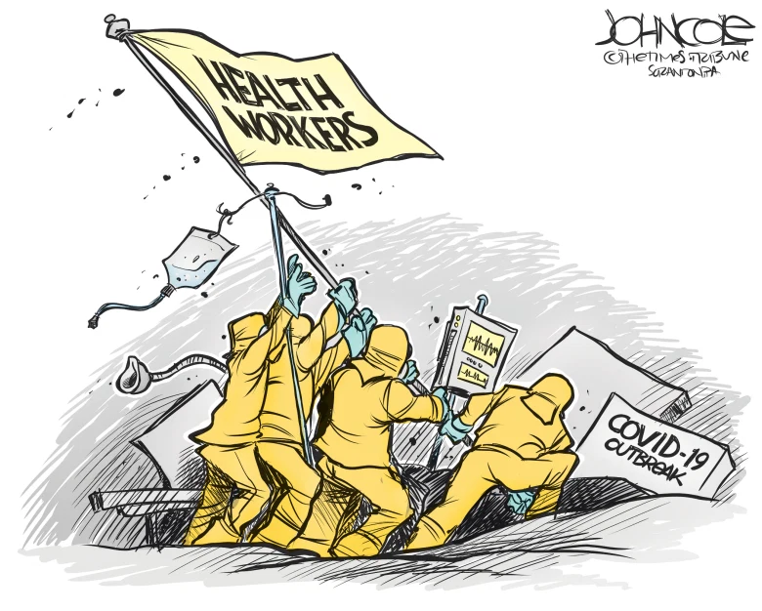

Have we Learned any Lessons?
Let’s talk…
National / Global strategy for prevention / preparation?
  Policy
  Funding
  Operationalization – boots on the ground!
National / Global strategy for TESTING?
Treatment [for COVID19 but also the NEXT agent]
  Therapeutics
  Vaccines
  Other?
Experts
  Medical Laboratory
  Public Health
  Healthcare
  Science / Research
https://www.whittierdailynews.com/2020/03/24/pandemic-a-time-for-heroes-political-cartoons/

Slide 67


References and Resources
Centers for Disease Control and Prevention (CDC). Coronavirus (COVID-19). Accessed March 1, 2021 from https://www.cdc.gov/coronavirus/2019-nCoV/index.html
Centers for Disease Control and Prevention (CDC). Ebola (Ebola Virus Disease). Accessed March 1, 2021 from https://www.cdc.gov/vhf/ebola/about.html
Centers for Disease Control and Prevention (CDC). Zika in the US. Accessed March 1, 2021 from https://www.cdc.gov/zika/geo/index.html
Esri Mapping the Novel Coronavirus Pandemic. Accessed March 1, 2021 from https://storymaps.arcgis.com/stories/4fdc0d03d3a34aa485de1fb0d2650ee0
Fox, Maggie. These coronavirus variants are keeping scientists awake at night. Accessed March 2, 2021 from https://www.cnn.com/2021/01/19/health/coronavirus-variants-what-we-know/index.html
NIAID Emerging Infectious Diseases/ Pathogens. Accessed March 1, 2021 from https://www.niaid.nih.gov/research/emerging-infectious-diseases-pathogens
Rohde, R.E. #SARSCoV2 / #COVID19 Resources. Accessed March 1, 2021 from https://rodneyerohde.wp.txstate.edu/sarscov2-covid19-resources/
Rohde, R.E. Dr. Rodney E. Rohde lends expertise to national news coverage of COVID-19 – Featured Faculty. Accessed March 1, 2021 from https://news.txstate.edu/featured-faculty/2020/dr-rodney-e-rohde-lends-expertise-to-national-news-coverage-of-cov-19.html
Rohde, R.E. ACC Globalization & Diseases #WeSaveLivesEveryday. Accessed March 1, 2021 from https://www.youtube.com/watch?v=JLKh_WzKwiU
World Health Organization (WHO). WHO publishes list of top emerging diseases likely to cause major epidemics. Accessed March 1, 2021 from https://www.who.int/medicines/ebola-treatment/WHO-list-of-top-emerging-diseases/en/
Worldometer. COVID-19 Coronavirus Pandemic cases. Accessed March 1, 2021 from https://www.worldometers.info/coronavirus/

Slide 68
References and Resources
Breakthroughs at the Intersection of Health and Science. How Do Viruses Mutate and What it Means for a Vaccine? Accessed on March 23, 2021 from https://www.breakthroughs.com/advancing-medical-research/how-do-viruses-mutate-and-what-it-means-vaccine
Centers for Disease Control and Prevention (CDC). Coronavirus (COVID-19). Accessed March 22, 2021 from https://www.cdc.gov/coronavirus/2019-nCoV/index.html
Centers for Disease Control and Prevention (CDC). Coronavirus (COVID-19). SARS-CoV-2 Variant Classifications and Definitions. Accessed March 23, 2021 from https://www.cdc.gov/coronavirus/2019-ncov/cases-updates/variant-surveillance/variant-info.html
Rohde, R.E. #SARSCoV2 / #COVID19 Resources. Accessed March 22, 2021 from https://rodneyerohde.wp.txstate.edu/sarscov2-covid19-resources/
Worldometer. COVID-19 Coronavirus Pandemic cases. Accessed March 22, 2021 from https://www.worldometers.info/coronavirus/

Slide 69

Thanks / Questions
#Labucate
#Labvocate
#IamASCLS
#Lab4Life
@TACLS1
#WeSaveLivesEveryday -> #TellYourStory / #TellOurStory about the #MedicalLaboratory!

Slide 70

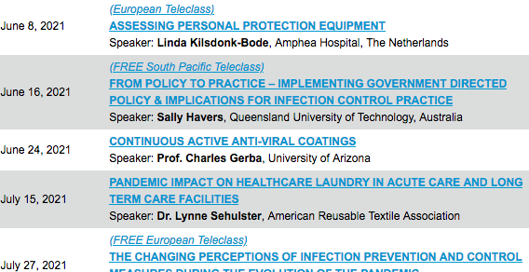

Slide 71


