Slide 1

Common Features of Waterborne Pathogens in Hospitals:
Why Are They So Challenging?
Joseph O. Falkinham, III jofiii@vt.edu
Hosted by Paul Webber
paul@webbertraining.com
www.webbertraining.com
October 14, 2021

Slide 2
Waterborne Pathogens in Hospitals
Mycobacterium avium complex (MAC)
Mycobacterium abscessus complex
Pseudomonas aeruginosa
Stenotrophomonas maltophilia
Acinetobacter baumannii
Sphingomonas paucimobilis
Legionella pneumophila

Slide 3
Hospital Acquired Infections
Life-threatening pneumonia
Dermal infections post surgery
Life-threatening bacteremia post cardiac surgery (M. chimaera in heater-coolers)

Slide 4
Risk Factors Hospital Infection
Patients: Immunosuppression, cancer, cystic fibrosis, neonates
Hospital Environment: Surgery, intensive care, cardiac surgery, shower exposure, ice exposure, prolonged residence in hospitals

Slide 5
Shared Characteristics of Waterborne Pathogens
Disinfectant-Resistance
Adherence and Biofilm Formation
Grow at Low Organic Carbon
Desiccation-Tolerant
Grow at Low Oxygen (stagnation)
Concentrated in Aerosols
Grow in Amoebae

Slide 6
Consequences of Impermeable Membrane
Hydrophobic cells = Adherence
Reduced uptake of nutrients
Resistance to disinfectants
Resistance to antibiotics
Reduced rate of growth

Slide 7
Consequences of Adherence
Biofilm-formation
Protective Extracellular Matrix
Residence and Persistence
Resistance to Disinfection
Re-appearance Following Disinfection

Slide 8
Waterborne Pathogen Sources
Fountains, Drinking Water, Ice
Showers, Therapy Baths, Drains
Medical Equipment:
Bronchoscopes, Heater-Coolers
Disinfectant Solutions

Slide 9
Routes of Transmission
Swallowing water or ice
Aerosols: Showers, Therapy Baths, Humidifiers, Drains, Medical Equipment
Sterilizing Solutions
Inoculation from Bronchoscopes
Construction Activities

Slide 10
Monitoring Challenges
Numbers Don’t Correlate with E. coli, HPC, nor Other Measures
Enumeration Requires Special Media and Long Incubation
Enumeration by PCR
No Infectious Dose Identified
Where and When to Monitor

Slide 11
Emergency Remediation
Actions:
Circulate Very Hot Water: 70°C
Circulate High Chlorine: 5 ppm
Problem:
How to Remove Biofilm?
Never Get Rid of OPPPs

Slide 12
Regular Remediation
Drain Water Heater Monthly
Raise Water Heater to 70°C
Reduce Stagnant Portions: Flush
Remove All Dead Ends
Point-of-Use Filters and Shower Heads
Remove Aerosol-Generators

Slide 13
Green Buildings Enrich
NTM Numbers
Lower Water Heater Temperatures
Longer Water Residence Time
Reduced Flow, Misting Shower Heads
Biofilm Build-Up

Slide 14
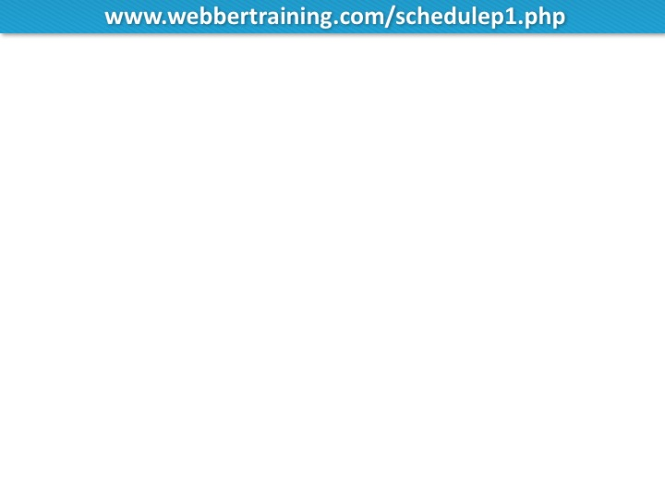
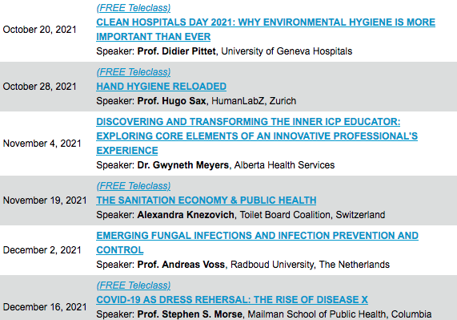

Slide 15


