Slide 1
Emerging fungal infections in hospitals … and control
Andreas Voss MD, PhD
Consultant Medical Microbiology, CWZ
Professor of Infection Control Radboudumc
Nijmegen, The Netherlands
Hosted by Paul Webber paul@webbertraining.com
www.webbertraining.com
December 2, 2021

Slide 14
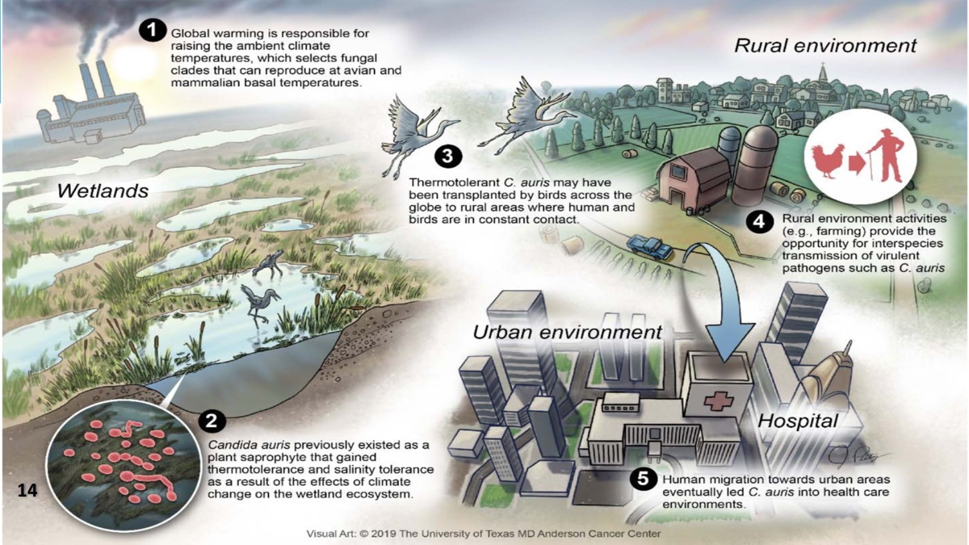

Slide 16
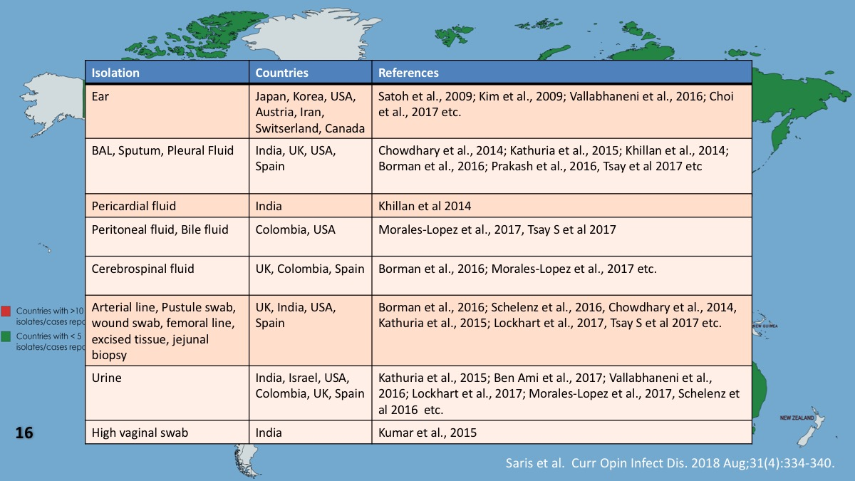

Slide 20
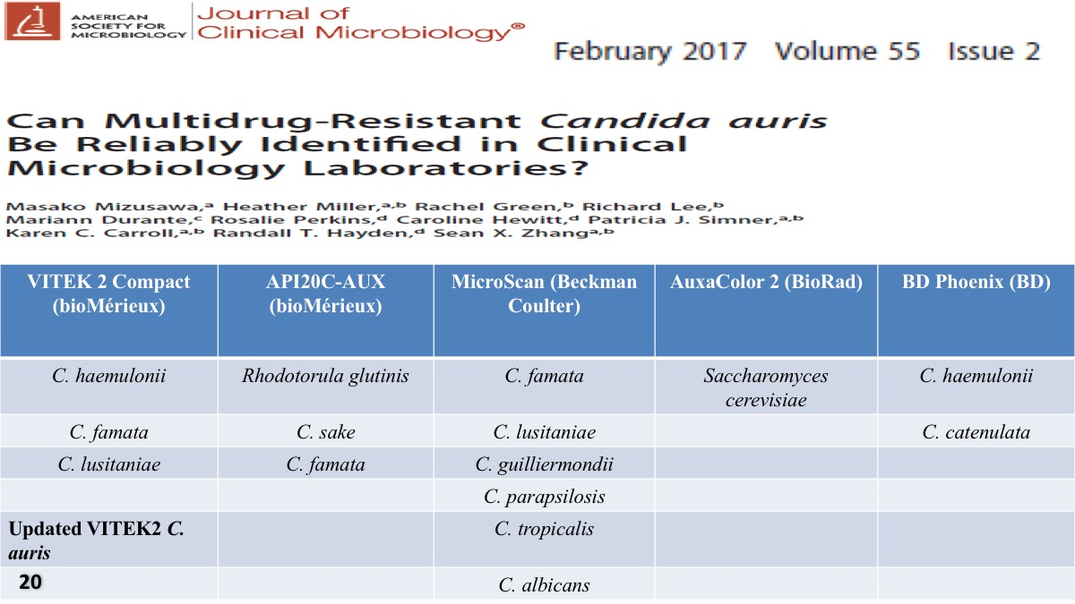

Slide 23
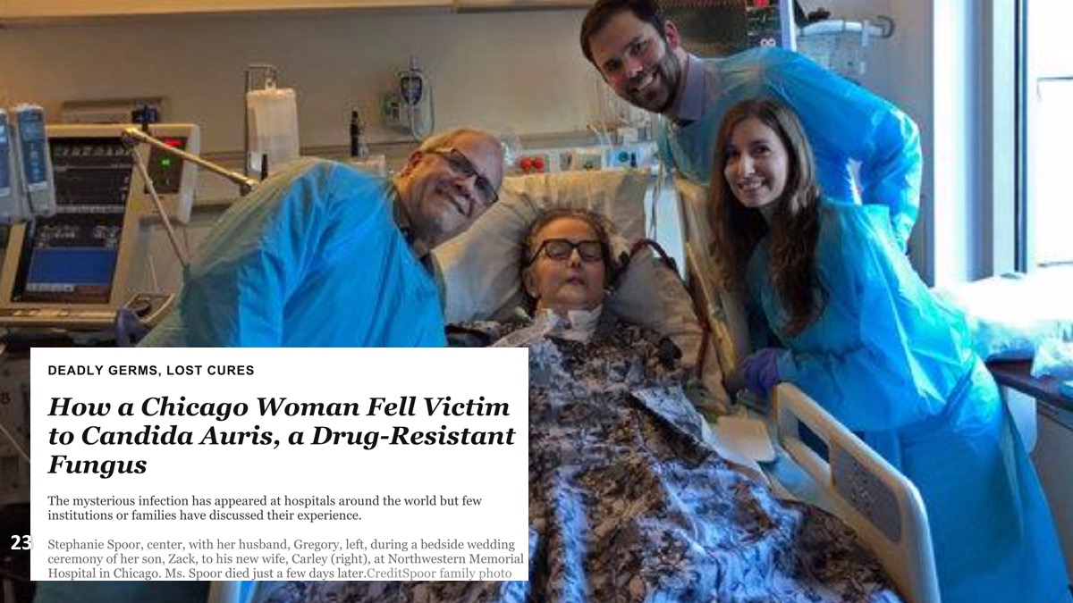

Slide 29
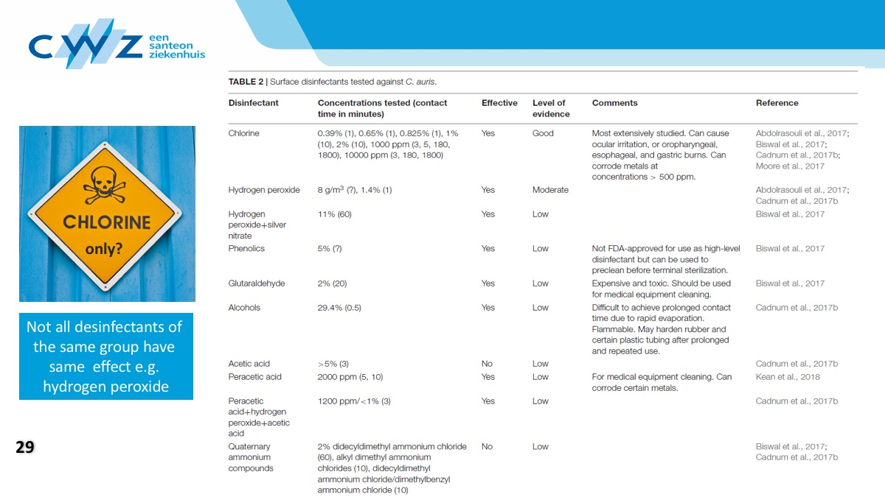

Slide 32
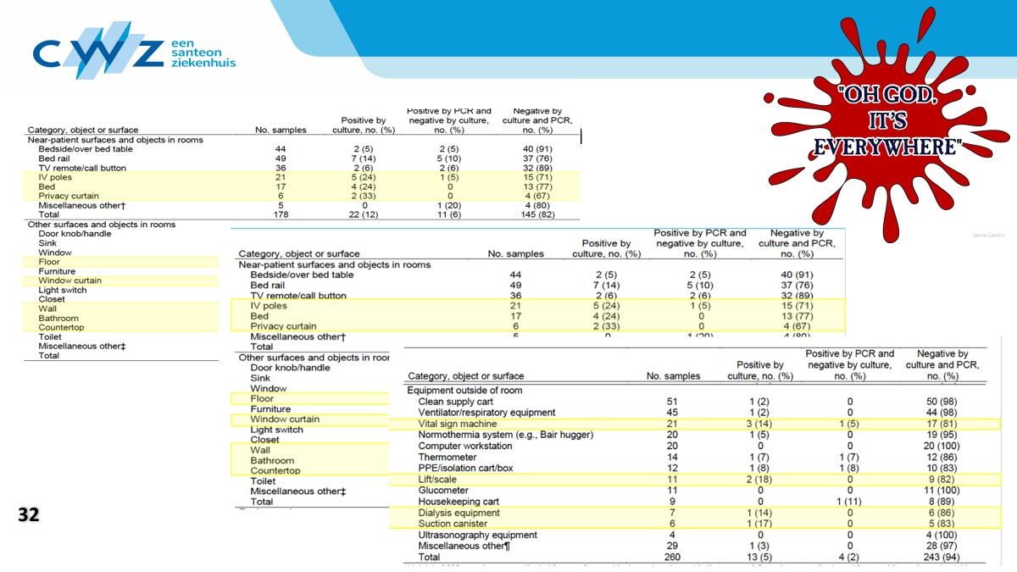

Slide 38
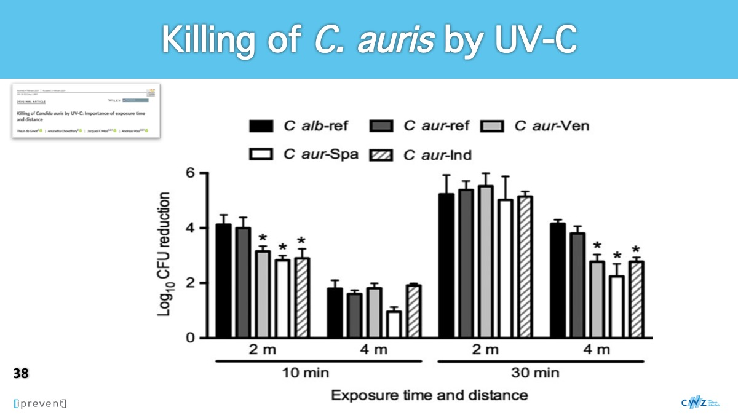

Slide 43
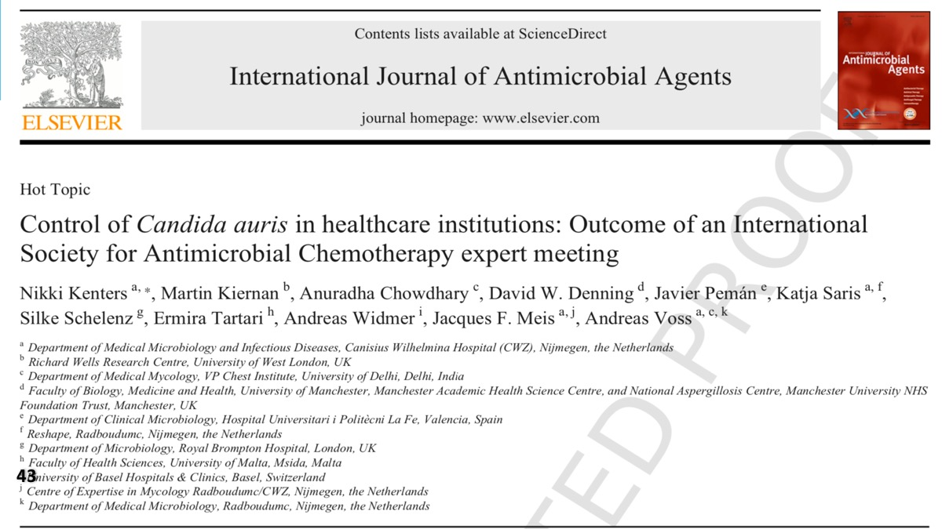

Slide 46
