Slide 1

THE COST-EFFECTIVENESS OF TEMPORARY SINGLE-PATIENT ROOMS TO REDUCE THE RISK OF HAI
Nicholas Graves, PhD
Hosted by Jane Barnett
jane@webbertraining.com
www.webbertraining.com
September 14, 2022

Slide 2
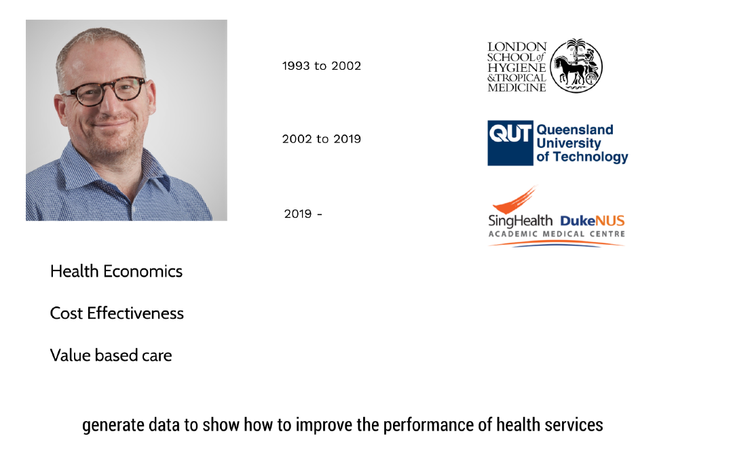

Slide 3
Objectives: - Introduce the principles of cost effectiveness as applied to infection prevention initiatives - Review some key papers on the topic - Present findings of recent studies on the cost-effectiveness of using temporary single-patient rooms in UK, Australia & Singapore

Slide 4
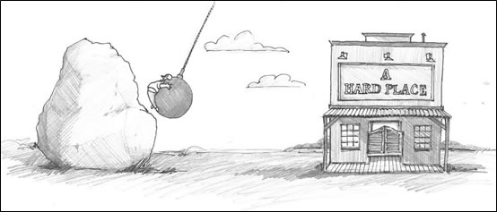
Why do we need cost-effectiveness research?
New demand & New Supply
Non increasing budgets

Slide 5
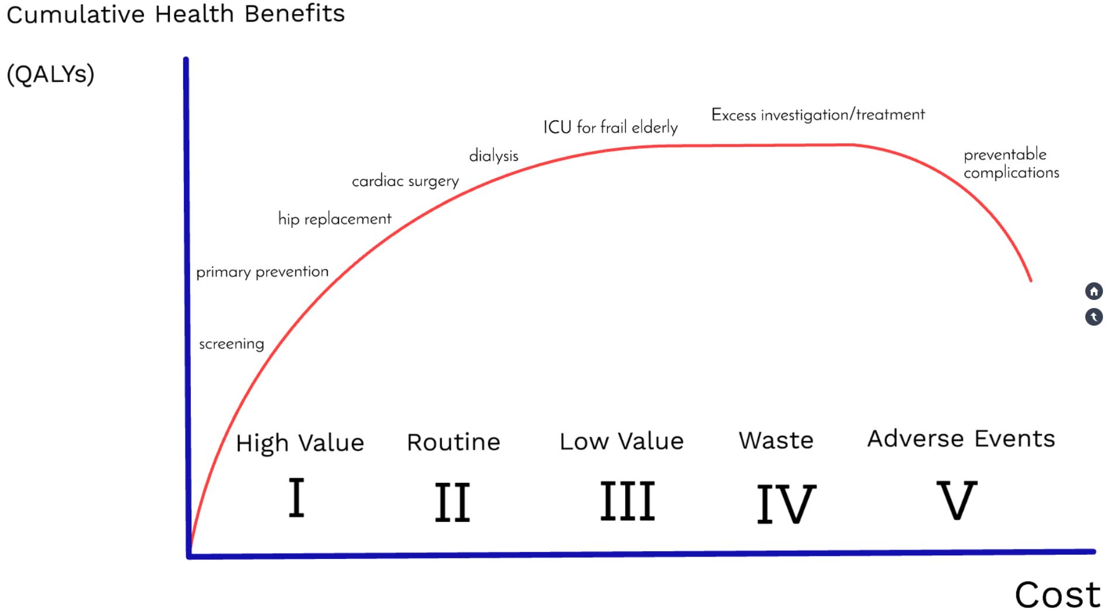


Slide 6

We need to systematically evaluate change to costs and health benefits from competing uses of scarce resources
Expanding cardiac surgery
Primary Prevention T2D
New neo natal ICU
Screening for cancers
Robotic surgery
Adolescent mental health interventions
New drugs for Parkinson’s disease

Slide 7
We need to systematically evaluate change to costs and health benefits from competing uses of scarce resources
Asepsis technique/bundles
Antimicrobial stewardship
Screening and decolonisation
Prophylaxis with antibiotics
Improving hand hygiene
Environmental cleaning
Enhanced Surveillance

Slide 8
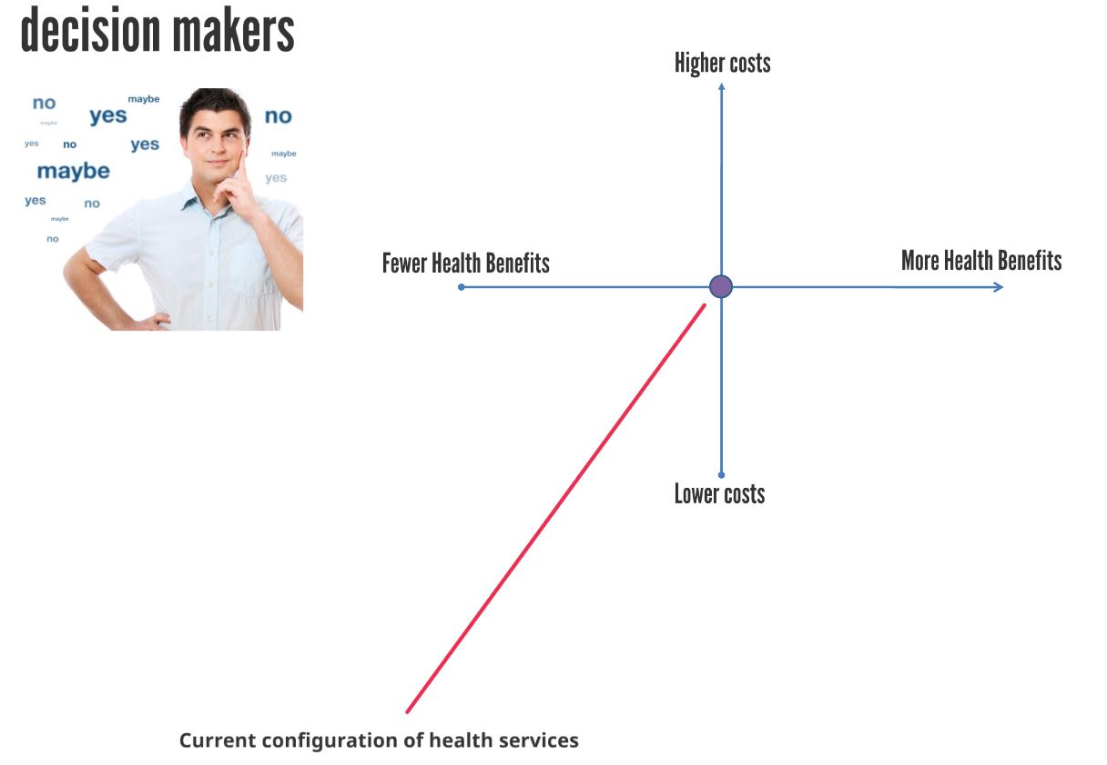
We need to systematically evaluate change to costs and health benefits from competing uses of scarce resources

Slide 9
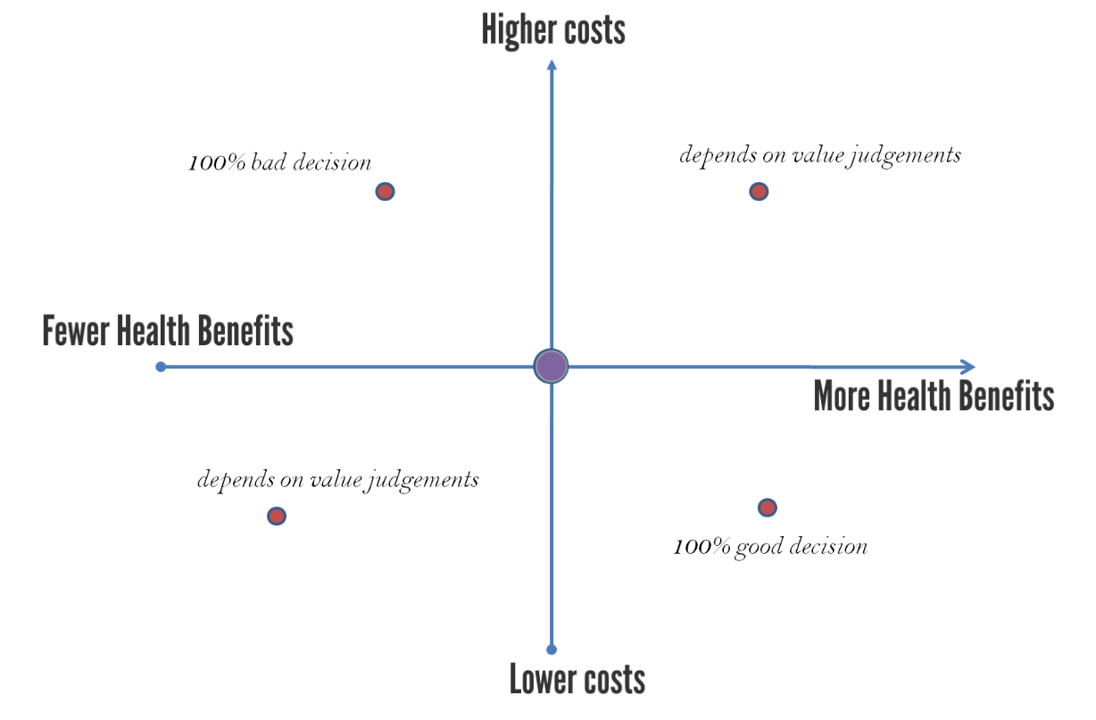
We need to systematically evaluate change to costs and health benefits from competing uses of scarce resources

Slide 10
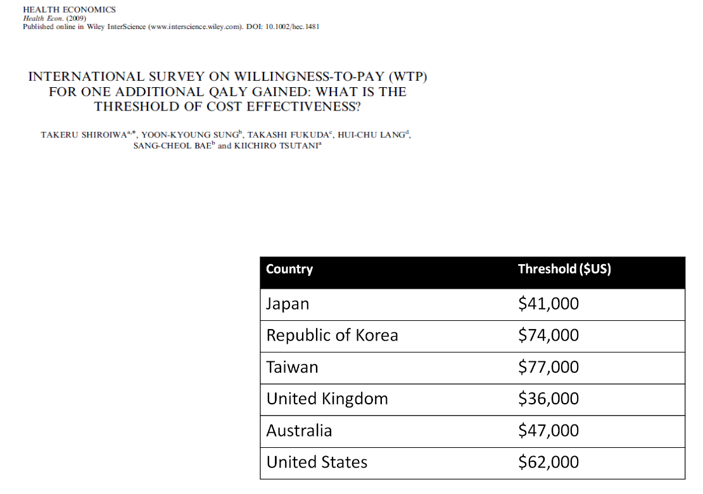
We need to systematically evaluate change to costs and health benefits from competing uses of scarce resources

Slide 11
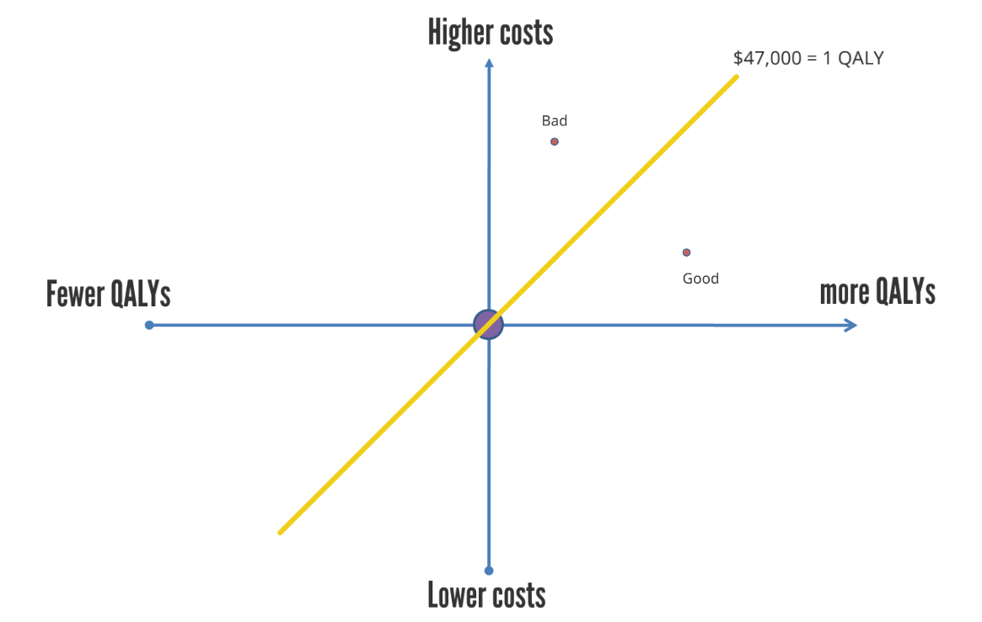
We need to systematically evaluate change to costs and health benefits from competing uses of scarce resources

Slide 12

We need to systematically evaluate change to costs and health benefits from competing uses of scarce resources
Improving hand hygiene
Environmental cleaning
Screening and decolonisation

Slide 13
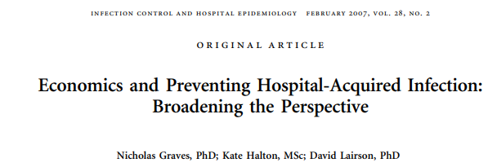

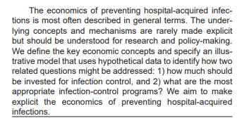
Objectives: - Introduce the principles of cost effectiveness as applied to infection prevention initiatives - Review some key papers on the topic - Present findings of recent studies on the cost-effectiveness of using temporary single-patient rooms in UK, Australia & Singapore
We demonstrate that when infection control interventions reduce economic costs and increase health benefits, they should be adopted without further question. If, however, interventions increase economic costs and increase health benefits, then the trade-off between costs and benefits should be examined. Decision-makers should assess the cost per unit of health benefit from infection control programs, consider the impact on health budgets, and compare infection control with alternative uses of scarce healthcare resources.

Slide 14
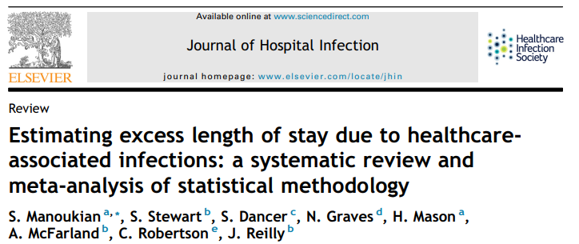
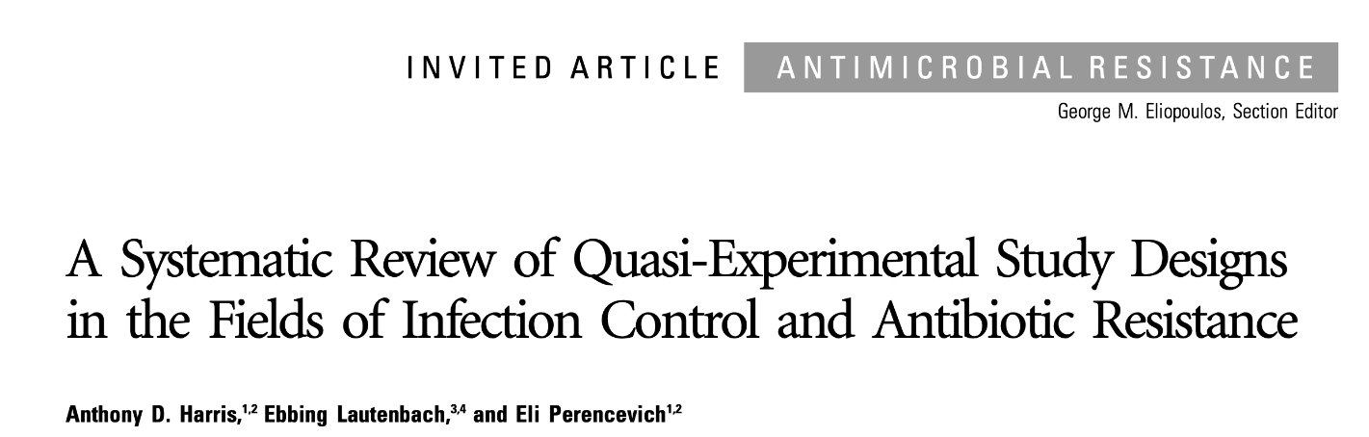
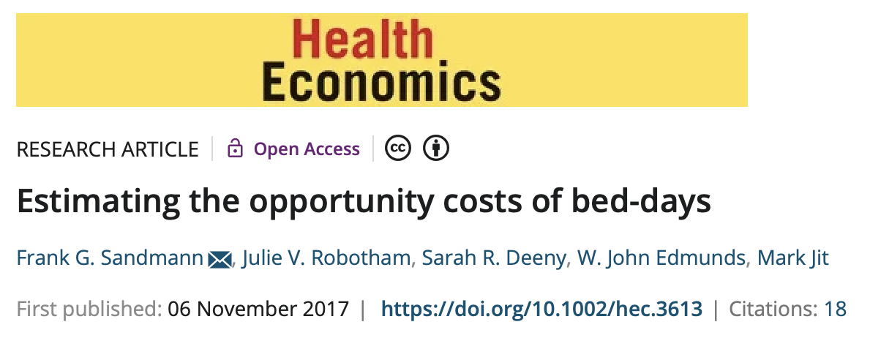
Objectives: - Introduce the principles of cost effectiveness as applied to infection prevention initiatives - Review some key papers on the topic - Present findings of recent studies on the cost-effectiveness of using temporary single-patient rooms in UK, Australia & Singapore

Slide 15
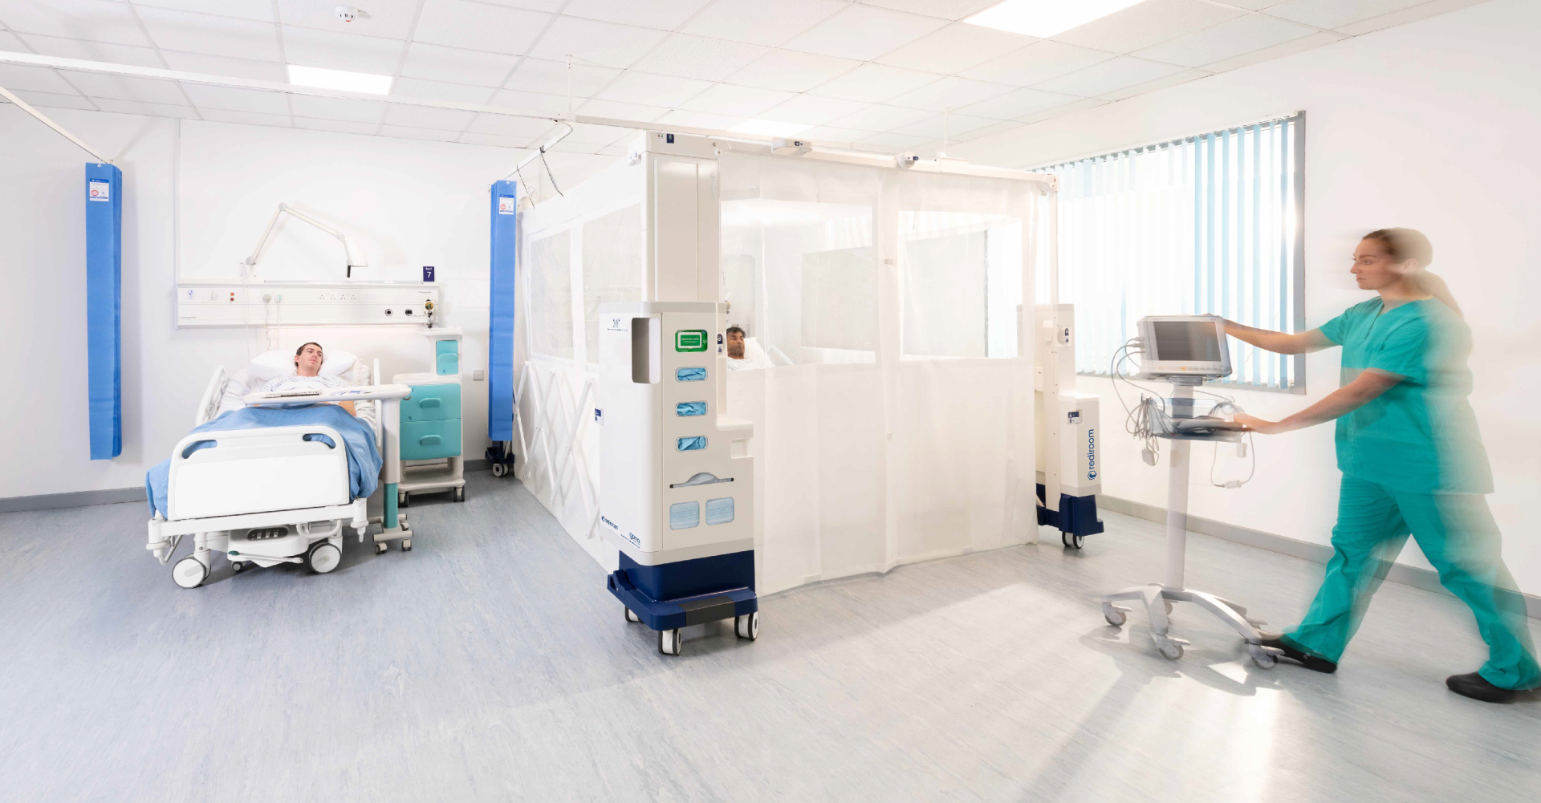
Objectives: - Introduce the principles of cost effectiveness as applied to infection prevention initiatives - Review some key papers on the topic - Present findings of recent studies on the cost-effectiveness of using temporary single-patient rooms in UK, Australia & Singapore
Single-patient, isolation room that can be deployed in a patient care area or ward.
Air-filtered isolation room with hands-free entry and an integrated PPE station.
Deployed by a single person in less than 5 min.
Canopy is single use and is disposed of.

Slide 16
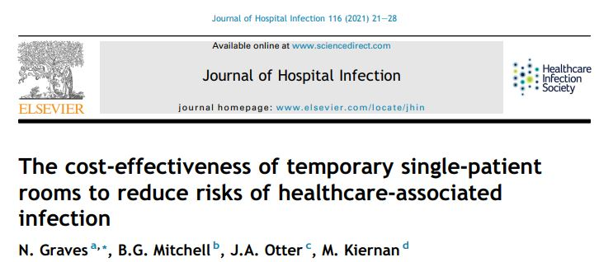
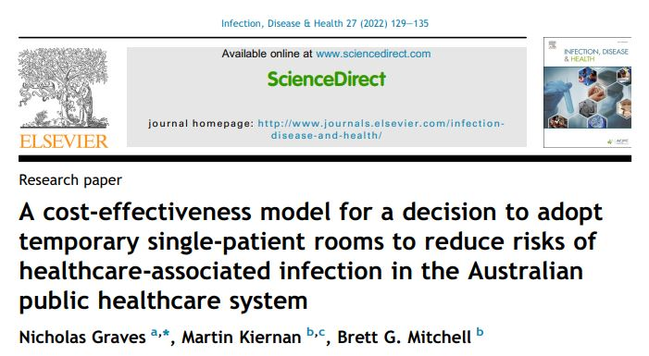
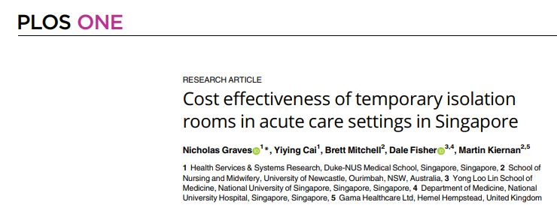
Objectives: - Introduce the principles of cost effectiveness as applied to infection prevention initiatives - Review some key papers on the topic - Present findings of recent studies on the cost-effectiveness of using temporary single-patient rooms in UK, Australia & Singapore

Slide 17
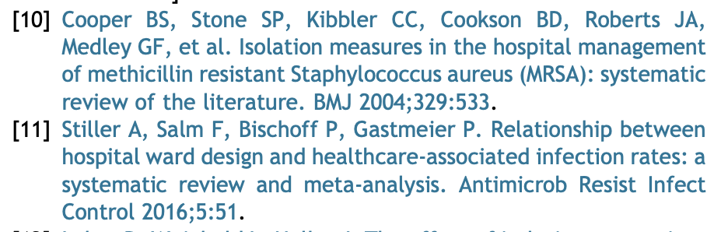
RATIONALE
Clinical guidelines recommend single-room isolation for patients with multidrug-resistant pathogens.
Plausible mechanisms for benefit.
Research evidence is patchy and the marginal effects of isolation are difficult to disentangle from a bundled strategy.
It is challenging to establish by experiment the role of single-room isolation on risks of HAI.
Two systematic reviews provide some evidence that isolation rooms are effective at reducing risks of HAI.
Research exists on the adverse effects of isolation showing that the mental well-being of patients is affected.
The aim is to model the cost-effectiveness of adding ‘Rediroom’ into UK National Health Service (NHS) hospitals.
I will also report results from Australia & Singapore

Slide 18
METHODS
Primary outcomes
‘change total costs’
‘change health benefits’ measured in ‘years of life’
from a reduced incidence of HAI from a decision to adopt a temporary isolation room into the acute care setting.
The structure of the model used was simple.
Current rates of HAI outcomes per 100,000 occupied bed-days observed in the NHS used to estimate baseline values for:
  number of patients with an HAI
  number of acute care bed-days used to manage the consequences of HAI
  monetary value of these bed-days
  deaths associated with patients with an HAI
  years of life lost to HAI.

Slide 19
METHODS
Infection types
      All HAI
      bloodstream infection
      gastrointestinal infection
      lower respiratory tract infection
      pneumonia
      surgical site infection
      urinary tract infection
      other infections

Slide 20
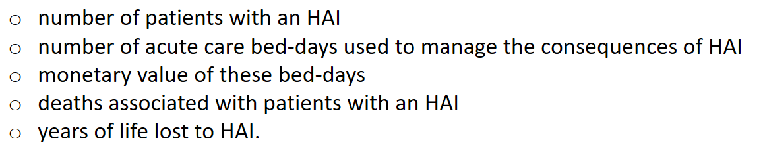
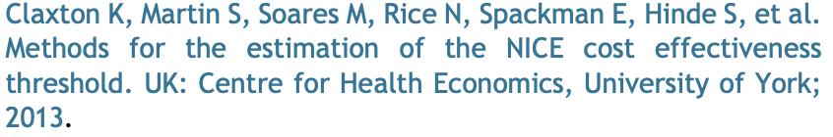
METHODS
There is no information available for effectiveness
Estimates between zero and 100% were available
If 250 cases of HAI per 100,000 occupied bed-days under baseline conditions… then inputting an effectiveness estimate of 20% would reduce the number of cases by 50.
The model was used to output new values for the outcomes based on the effectiveness scenario chosen.
The model was also programmed to include the cost of purchasing and maintaining the temporary isolation rooms.
Because the durations of HAI are relatively short use of preference utility weights to show QALYs not done
Two cost-effectiveness thresholds were used
  maximum willingness to pay of £20,000 (NICE)
  Claxton et al. suggests that an operational value adopted by the NHS is close to £13,000

Slide 21
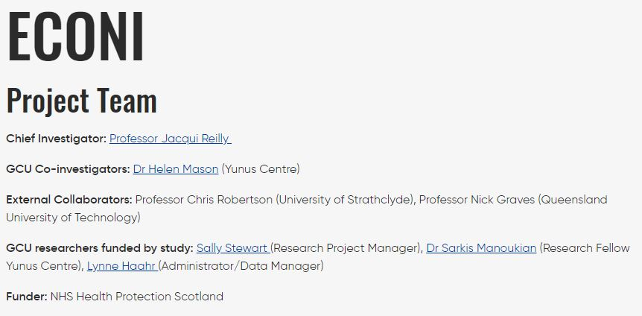
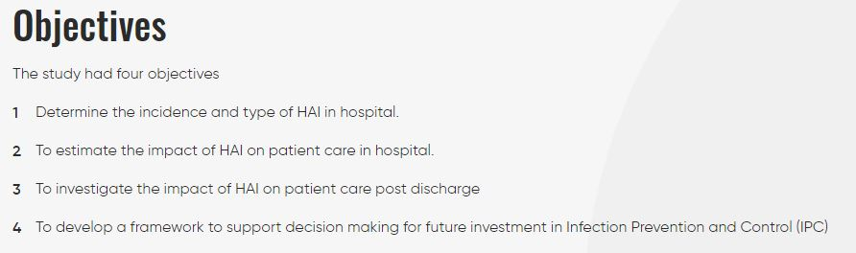
DATA

Slide 22
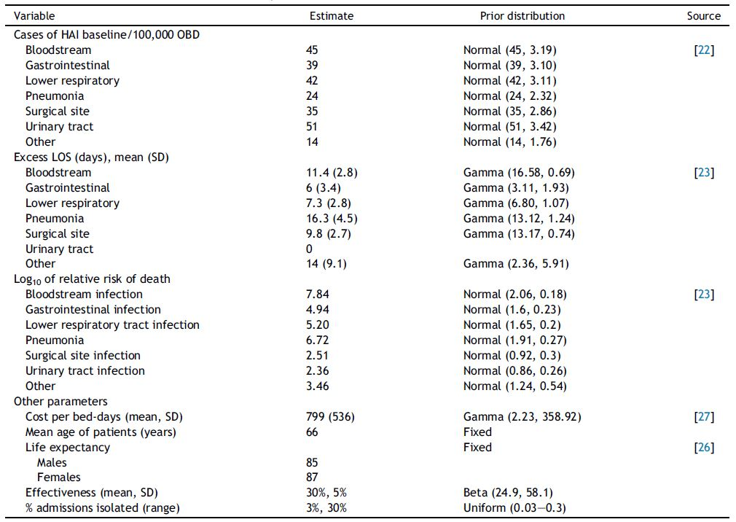
DATA

Slide 23
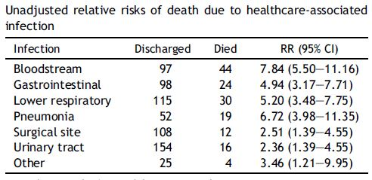
DATA
Mortality due to HAI
Costs of adoption/100,000 occupied bed-days
Capital cost of the cart is £400/month
Five-year life span
one canopy costs £300/isolated patient
Proportion of newly admitted patients who would need to be isolated
Range between 3% and 30%
Based on lit for MRSA, carbapenemase-producing Enterobacterales, extended-spectrum b-lactamase Enterobacterales, VRE.

Slide 24
EFFECTIVENESS
Evidence for the effect of single-room isolation alone on reducing HAI rates is scarce.
This study modelled potential reductions in cases at 30% on average with a standard deviation of 5%.
As guidelines across the world recommend single-room isolation for a range of multidrug-resistant pathogens and
pathogens spread via the droplet route, we assumed that there was a substantial benefit.

Slide 25
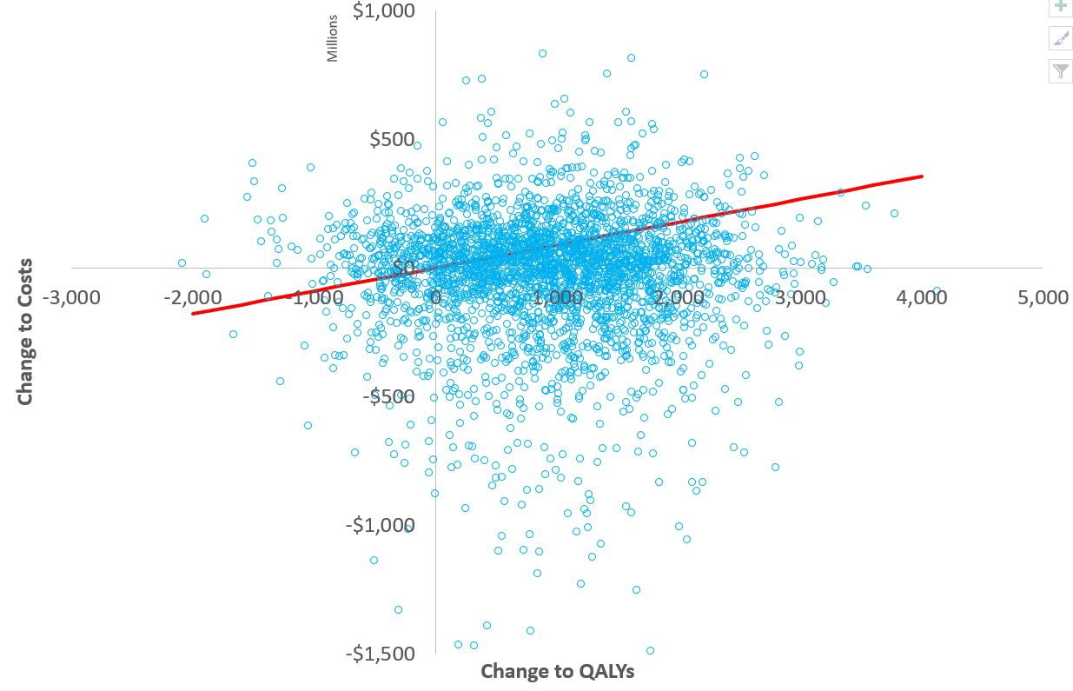
UNCERTAINTY, MODEL EVALUATION
Uncertainties in the parameters were included in the model by fitting prior statistical distributions
Subject to 3000 random samples.
Propagated forward uncertainties to output distributions of model outcomes.

Slide 26
SCENARIO ANALYSES
Halved mortality risks
Found minimum threshold hold for effectiveness at which adoption would be cost-effective

Slide 27
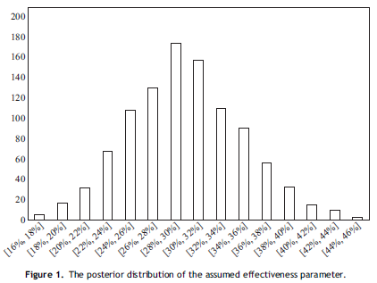
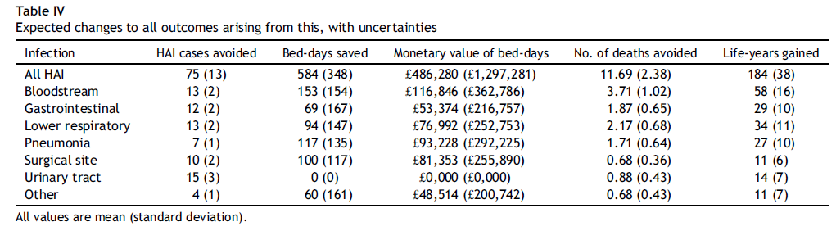
RESULTS

Slide 28
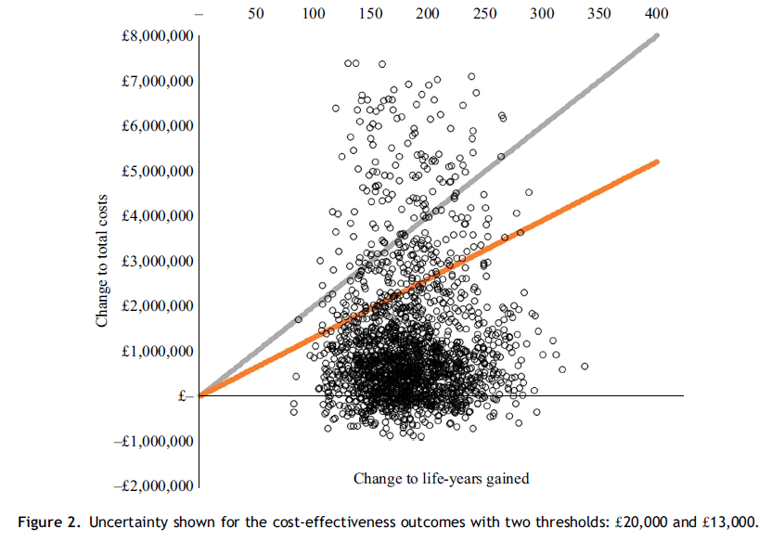
RESULTS
Per 100,000 OBD
Adoption cost = £1,545,949
Change to total cost = £1,073,645
Change to LYG is 184
Incremental cost per LYG is £5,829
Probability cost-effective
  93% @ £20,000
  87% @ £13,000
Where the risk of death with HAI is halved
Probability cost-effective
  79% @ £20,000
  67% @ £13,000
If mean value for effectiveness were reduced to 16.5%, then the probability that adoption is cost-effective >50%.

Slide 29
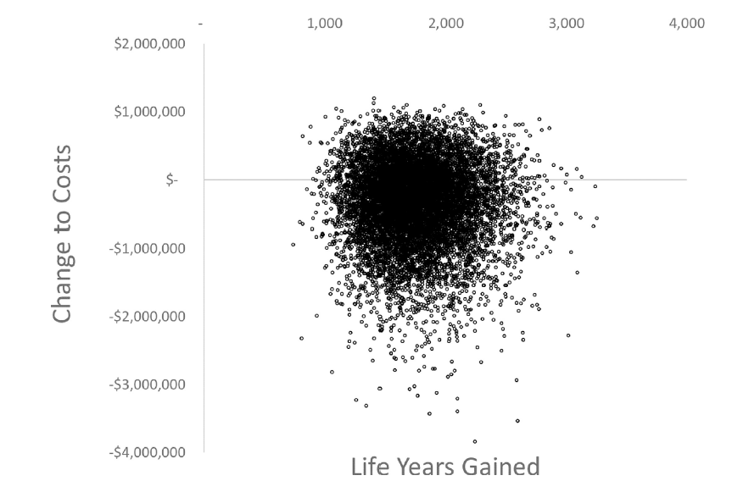
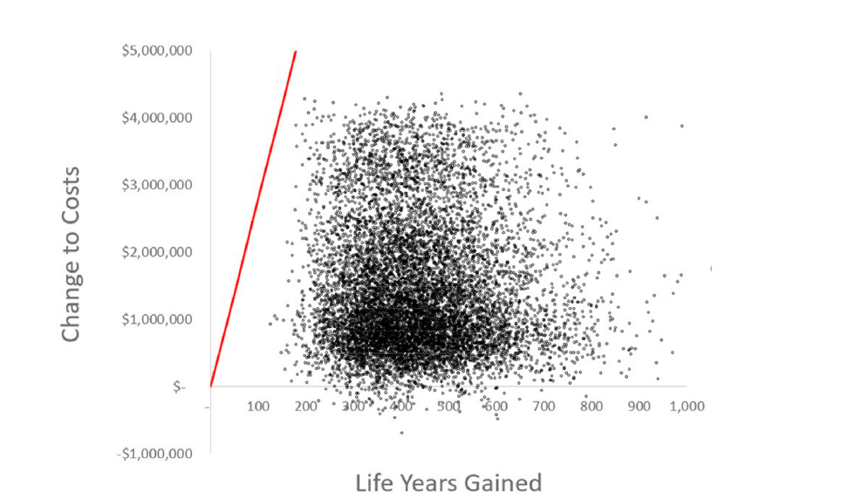
RESULTS
Australia
Singapore

Slide 30



DISCUSSION
Some evidence that the adoption of single portable isolation rooms will be a cost-effective decision.
Most data used were quite good
Mortality data were tested
Our effectiveness parameter is, however, based on expert opinion and not real data
Can a definitive study be done?
Do we even need it?
  Korean study found that strict isolation reduced VRE by 48%
  Prob of MRSA and VRE without isolation >5% to 20% in 7d.
Should we adopt now or wait for a definitive study?

Slide 31
Questions
... jane@maunco.com

Slide 32

